Slide 1
OECD CESEE SBO 25 May 2018
Public Participation in the Budget Process
Where To?
Notes:
Decisions about how public resources are raised and spent are at the heart of democratic practice and inclusive policymaking

Slide 2
OBS: What Does It Evaluate?
109 indicators used to construct the Open Budget Index assess whether governments publish online and in a timely manner eight key budget documents
18 revised questions examine formal oversight institutions
18 new questions examine opportunities for public participation in national budget decision-making and oversight

Slide 3
OBS 2017 Finding # 3: Problems Due to Lack of Transparency are Compounded by Ineffective Oversight Institutions and Weak Public Participation in Budgeting
Legislative oversight is limited, albeit stronger during budget formulation/approval than implementation/audit
The basic conditions for Supreme Audit Institutions to carry out their oversight function are generally in place, but tend to be less favorable in countries with low transparency
Global average score on Public Participation is 12/100
Not a single country, out of the 115 surveyed, offers adequate participation opportunities (score of 61 or higher)
Notes:
Legislatures exercise more oversight earlier in the budget process than during implementation, but…… Caveat: Could lead to spending not in line with the initial priorities agreed to in the original budget
Legislatures amend the budget in over half of the countries surveyed, but…… in the majority of countries, the executive can change the budget during implementation without legislative approval
In more than one-third of countries, legislatures do not examine any Audit Reports produced by Supreme Audit Institutions
For instance, where executive can remove auditor, average OBI score is 25; where executive cannot, score is 46
Only four countries have scores that indicate limited opportunities for public participation:
Australia
New Zealand
the Philippines
the United Kingdom

Slide 4
CESEE/PEMPAL Public Participation Scores
Global Average: 12

Slide 5
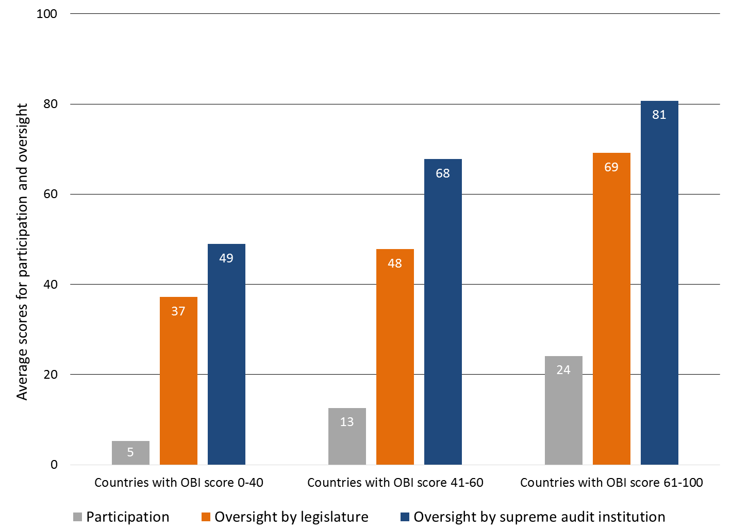
OBS Finding # 4: No country has adequate practices in all three pillars of a good budget accountability system, i.e., transparency, participation, oversight
Notes:
As transparency scores rise, so do scores on oversight and participation
No countries score 61 or higher on all three pillars of the accountability system
In 22 countries, all three areas of accountability are weak
22 countries where all three areas of accountability are weak: Algeria, Angola, Burkina Faso, Burundi, Cameroon, China, Comoros, Cote d’Ivoire, Equatorial Guinea, Lebanon, Lesotho, Madagascar, Mali, Niger, Qatar, Saudi Arabia, Somalia, Sudan, Swaziland, Tunisia, Venezuela, Yemen

Slide 6
CESEE/PEMPAL: How can we take PP further?
Examples:
Croatia: Economic and Social Council → multi-sectoral representatives give opinions on the Executive’s Budget Proposal (EBP)
Georgia: Online consultation on budget priorities + MoF coordination council
Kyrgyz Republic: MoF budget hearings on the EBP, with open invitation
Ukraine: Expert hearings → public & gov’t officials exchange views on budget
QUESTIONS FOR DISCUSSION
Can you provide further details on these mechanisms?
Are there any other examples you would like to share?
What lessons can be drawn from what works/doesn’t work?
How can these and other mechanisms be improved?
Challenges, and how can civil society and IBP/GIFT help?

Slide 7
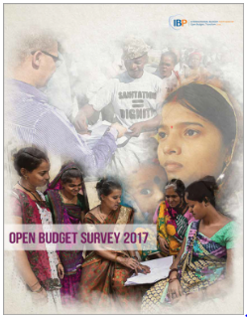
Thank you for your attention
Contact Information:
820 First Street, NE Suite 510 Washington, DC 20002
Phone: +1-202-408-1080
Fax: +1-202-408-8173
Email: info@internationalbudget.org

Slide 8
Participation Mechanisms: Examples from Around the World
Philippines Budget Partnership Agreements have strengthened the ability of individual agencies to negotiate their budget demands with the central budget agency through partnerships with citizens
South Korea Waste Reporting Center has saved the government an average of US$1 billion a year over the last 16 years
Canada For the fiscal year 2017 budget, pre-Budget Consultations resulted in more than a million interactions between citizens and their government

Slide 9
Legislative Oversight Scores
CESEE + PEMPAL countries

Slide 10
Oversight Oversight Scores
CESEE + PEMPAL countries

