Slide 1
Fiscal Transparency Code and
Fiscal Transparency Assessment
Johann Seiwald
Ljubljana, June 29, 2016

Slide 2
I. Lessons from the crisis
Implications for Fiscal Transparency Standards
Problem
Weakness in Current Standards
Recommendation
Revisions to Deficits
Infrequent fiscal reporting
Monthly operational fiscal reports
Quasi-fiscal Activity by SoEs
Exclusive focus on general government
Publication of fiscal data for public sector
Unreported Flows
Losses on asset & liability holdings not recognized
Recognition of doubtful debts in summary aggregates
Macroeconomic Shocks
Bias in macroeconomic forecasting
Alternative macro-fiscal scenario analysis
Exposure to Financial Sector
No recognition of contingent liabilities
Recognition of quantifiable contingent liabilities
Notes:
Some of the problems revealed by the crisis can be traced back to weaknesses in current fiscal transparency standards, including the IMF’s own Fiscal Transparency Code. Our Board Paper therefore made a series of recommendations about how the Code and other standards should be improved. To give you some examples:
One reason we saw large upward revisions to GG debt was because the Code and other standards only require reporting of general government data on an annual (or best quarterly) basis. But during a crisis a lot can happen in a one quarter, and most policymakers have come to appreciate the value of having fiscal updates on at least a monthly basis
Government-related enterprises (like Fannie Mae and Freddie) became attractive vehicles for QFA because these entities were excluded from standard fiscal statistics which tend to focus exclusively on GG as the relevant reporting entity. We therefore recommended that the scope of fiscal reports be expanded to encompass the entire public sector.
Even accrual-based reporting standards don’t require governments to report changes in the value of the sizeable financial assets and liabilities that many acquired during crisis. Another refinement to reporting standards proposed in the paper was the recognition of valuation changes in these holdings in summary fiscal statistics.
One reason macro shocks came as such a surprise to fiscal policy-makers was that govt’s tend to base their fiscal plans on single, often rosy, macroeconomic scenario. We therefore recommended that the Code and other standards require governments to routinely explore a range of macro-fiscal scenarios when determining the appropriate fiscal stance.
Existing fiscal reporting standards only call for recognition of contingent liabilities deemed more than 50% likely. This has made guarantees an attractive way for cash-strapped government to transfer value to private actors. Closing this loophole requires quantifiable contingent liabilities to be recognized in balance sheets at their expected value.

Slide 3
II. Fiscal Transparency Code 2014
Objectives of the Revised Code
Comprehensive consultation of code and piloting the new framework
Emphasize the quality and reliability of published information rather than clarity of reporting procedures
Update the principles and practices to reflect the lessons of the recent crisis
Align the principles and practices with relevant international standards (GFSM 2001, IPSAS, OECD Principles, PEFA)
Provide countries with a set of achievable milestones on the way towards full compliance with international standards
Notes:
To address these weaknesses revealed by the crisis, we approached the revision of the Fiscal Transparency Code with four key objectives in mind:
[Read out objectives]
This final objective was born out of a growing concern that, with each successive refinement, these international statistical and accounting standards were getting further and further out of reach of the typical low, or even middle, income country.

Slide 4
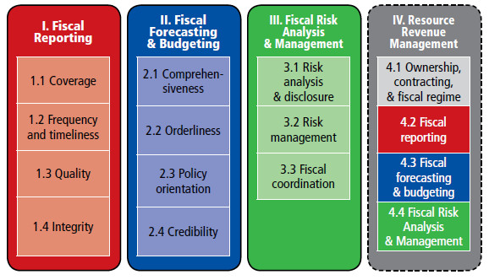
III. Fiscal Transparency Code
Architecture of the New Code
Notes:
This slides gives you an overview of the structure of the New Fiscal Transparency Code.
You can see that the new Code has a very different structure from the old Code. Rather than being organized around different phases of the reporting process, the new Code is organized around three key dimensions of fiscal disclosure:
fiscal reports in the form of fiscal statistics and accounts;
fiscal forecasting in the form of fiscal strategies and budgets; and
fiscal risk analysis in the form of fiscal risk statements and other risk management tools.
These three pillars form
the architecture for the 38 principles and 27 indicators that make up the new Code; as well as
the headings for the three main chapters of the new Fiscal Transparency Assessment

Slide 5
III. Fiscal Transparency Code
More Graduated Set of Practices
# | DIMENSION | PRINCIPLE | PRACTICES
 |  |  | BASIC | GOOD | ADVANCED
1 | FISCAL REPORTING | Fiscal reports should provide a comprehensive, relevant, timely, and reliable overview of the government’s financial position and performance
1.1 | Coverage | Fiscal reports should provide a comprehensive overview of the fiscal activities of the public sector
1.1.1 | Coverage of Institutions | Fiscal reports cover all entities engaged in public activity that are delineated according to international standards. | Fiscal reports consolidate all central government entities. | Fiscal reports consolidate all general government entities. | Fiscal reports consolidate all public sector entities.
1.1.2 | Coverage of Flows | Fiscal reports cover all government revenues, expenditures, and financing. | Fiscal reports cover all cash revenues and expenditures. | Fiscal reports cover cash flows and all accrued revenues and expenditures. | Fiscal reports cover cash flows and all accrued revenues and expenditures and other economic flows.
1.1.3 | Coverage of Stocks | Fiscal reports include a balance sheet of government assets, liabilities, and net worth. | Fiscal reports cover cash and all debt | Fiscal reports cover all financial assets and liabilities. | Fiscal reports cover all financial and non-financial assets and liabilities, and net worth.
Notes:
The new Code also differs from the old Code in that, rather simply provide a one-size-fits-all set of “best practices”, the new Code differentiates within each of its 38 principles between:
basic practice would be considered as a minimum achievable by all countries;
good practice would require more developed institutional, human, and technological capacities; and
advanced practice would entail full compliance with relevant international standards and be in line with the current “state-of-the-art.”
This slide illustrates how this more graduated rubric works for the 3 principles related to the coverage of fiscal reports.

Slide 6
IV. New Fiscal Transparency Evaluation: a. Summary Heatmap
Costa Rica: Assessment Against Fiscal Transparency Practices
Notes:
Each of the principles are then assessed against the basic, good and advanced practices.
This allows us to put the overall picture together in a easy to follow heat map – were, predictable, red are the danger spots, and green are the advanced practices.
Here is the map for Costa Rica, where you can see that the fiscal reporting and fiscal forecasting are generally in a fairly good state – and interestingly, the coverage of institutions for the public sector is an advanced practice, despite it only being a middle income country.
The area here with the biggest weaknesses relates to understanding of fiscal risks. This isn’t unusual, because the fiscal risk element is another area where the code extends the boundary of good and advanced practice.

Slide 7
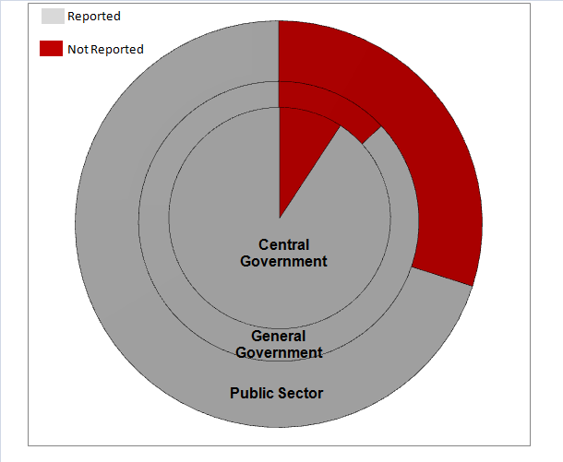
III. New Fiscal Transparency Evaluation: b. Fiscal Transparency Indicators: Fiscal Reporting
Ireland: Fiscal Transparency Indicators
Coverage of Public Sector Entities
(percent of expenditure)
Reporting of Assets and Liabilities
(percent of GDP)
Public corporations remain outside fiscal reporting
Only a quarter of public sector liabilities reported
Notes:
Another of the main innovations of the new FTA compared with the old ROSC is the use of a set of quantitative Fiscal Transparency Indicators.
The aim of these indicators is to provide countries with a sense of not only the source but also the magnitude of the gaps in their fiscal reports.
This slide illustrates the value of some of those indicators from the Irish assessment.
While the statistics cover most of the general government, in line with the ESA standards, public corporations remain outside of the report. But the coverage of the finance accounts are much narrower, with a considerable amount of extrabudgetary activity going largely unreported.
And more concerning was the very large amount of assets and liabilities that go unreported. Overall public sector asset holdings are some 317 percent of GDP, and liabilities are 386. Only a quarter of those liabilities are reported in the finance accounts, and third of the assets.

Slide 8
III. New Fiscal Transparency Evaluation: c. Fiscal Transparency Indicators: Fiscal Forecasting and Budgeting
Bolivia: Source of Budget Forecast Errors
Revenue Forecast Errors
(Percentage point Contribution)
Expenditure Forecast Errors
(Percentage point Contribution)
Means budgeted expenditure bears little relation to actual outcomes
Massive underestimation of revenue in the budget
Notes:
The fiscal forecasting and budgeting indicators attempt to get a sense of how realistic a picture the government’s budget gives of what will actually happen.
This example from Bolivia focuses on the annual budget versus outturn for the non-financial public sector.
It provides a very striking example of a budget that isn’t particularly transparent.
There is a track record of being very conservative in forecasting revenues, with an overall underestimate of 41 percent. This is spread across the various revenue heads, but a large part has to do with hydrocarbons related revenue.
Nevertheless, underestimations of 30 percent are common for tax and operating revenues, and upward of 100 percent for other revenues.
This then translates into a second round of spending through the year, as the underestimated revenues are then spent, though in the case over the previous two years, the spending has been lower than the revenue on average.

Slide 9
III. New Fiscal Transparency Evaluation: d. Targeted Recommendations: Ireland
 | Principle | Assessment | Importance | Rec.
2.1.1 | Budget Unity | Advanced: Budget is presented on a gross basis and budget documentation includes all general government entities. | Low: Own source revenue accounts for 2.6 percent of total revenue which are presented gross in an annex.
2.1.2 | Macroeconomic Forecasts | Advanced: The government publishes four comprehensive macroeconomic forecasts per year with explanations of all key variables and their composition and underlying assumptions. | Medium: Real GDP growth forecasts have an overestimating forecast error of 1.0 percent of GDP in year t+2) and an absolute volatility-adjusted forecast error of 0.45 percent of GDP.
2.1.3 | MT Budget Framework | Advanced: Budget documentation includes medium-term spending limits and revenue by ministry and economic category. | High: Spending limits cover only 80 percent of the budget, tax expenditures and extrabudgetary funds are not included. | 2.1.
2.1.4 | Investment Projects | Good: All major investment projects are subject to open and competitive tender and medium-term obligations are disclosed, but not all cost-benefit analyses are published before approval. | Medium: Public investment is relatively low at 2.6 percent of GDP. | 2.2.
2.2.1 | Fiscal Legislation | Good: The Legal Budget Framework is comprehensive, but does not include a provision restricting legislature’s power to amend the executive’s budget proposal. | Low: Upward revisions by Parliament are low with 0.3 percent of total expenditures on average.
2.2.2 | Timeliness of Budget Documents | Good: Budget proposals are released 3-4 months before the start of the financial year but approved by Parliament only in December. | Low: Budgets are routinely approved before the start of the financial year. Parliamentary amendments are limited.
2.3.1 | Fiscal Policy Objectives | Advanced: The government has several precise and time-bound national and supranational fiscal rules, some of them in place for more than 3 years, NAO and not MoF reports on compliance. | High: Not all national fiscal policy objectives are consistently observed. CG gross debt is not on a declining path but will grow from 41 percent in 2010 to 49 percent in 2015. | 2.1.
Notes:
One comment we have had throughout this process is that the basic/good/advanced approach is a bit arbitrary. Some principles are far more important than other – for instance coverage of institutions
Other principles might be meaningless in some countries, but a big deal in others. For instance, financial derivatives is my home country are not used, so a poor rating would not be important, whereas in, say Italy where they have been a source of strife, it would be important.
For that reason, we have made an effort to combine the results of the assessment of practices with the fiscal vulnerability indicators.
This allows us to triangulate on the areas of major concern. Thus even if a country is meeting good practice – as Ireland is in coverage, if the gaps are sufficiently large, this warrants concern, and will be the focus of one of our limited number of recommendations.
Similarly, if the practice was not met, if the importance of the gap was low, the report would not be too concerned.
This is another major step up from the old ROSCs, that tended to provide a long, unprioritized list of recommendations.

Slide 10
III. New Fiscal Transparency Evaluation: e. Sequenced Action Plan
Ireland Fiscal Transparency Action Plan
Action | 2013 | 2014 | 2015 | 2016 | 2017
1. Expand Institutional Coverage of Budgets, Statistics, and Accounts
a. Present all gross revenues and expenditures of central government entities in budget documentation |  | Incorporate NPRF into budget documentation | Incorporate Non-Commercial Semi-State Bodies into budget documentation | Incorporate all central government entities in budget documentation | Integrate non-commercial semi-state bodies into departmental votes
b. Combine Finance and Appropriation Accounts into a consolidated Central Government Financial Statement | Combine the information in the notes to the Appropriation Accounts to produce a summary report | Combine Finance and Appropriation Accounts into a partial Central Government Financial Statement based on existing accounting policies | Incorporate SIF and NPRF into partial Central Government Financial Statement | Incorporate Non-Commercial Semi-State Bodies into consolidated provisional Central Government Financial Statement | Prepare comprehensive consolidated Central Government Financial Statement for audit by C&AG
c. Provide an overview of the gross revenues and expenditures of the general government and its subsectors | Reconcile gross revenues and expenditures of Exchequer and general government in budget | Provide summary of gross revenues and expenditures of central government in budget | Provide summary of gross revenues and expenditures of central, local, and general government in budget | Publish quarterly statistics on gross revenues and expenditures of central, local, and general government sectors | Publish monthly statistics on gross revenues and expenditures of central, local, and general government sectors
Notes:
A final shortcoming of existing fiscal ROSC reports was that made recommendations about what countries what they needed to do, but didn’t tell them how to go about doing it.
To address this, the new FTA concludes with a fiscal transparency action plan which sets out the specific steps that a country needs to take to address the most important fiscal transparency problems identified in the analytical chapters of the assessment.
This slide shows a sample of such an action plan for Ireland and shows the sequence of parallel actions that need to be taken to expand the institutional coverage of fiscal reports from budgetary central government to public sector over a 5 year period.
These action plans can then provide the basis for coordination and monitoring of the implementation of transparency-related reforms over the medium-term.

Slide 11
IV. Fiscal Transparency Evaluation:
Potential benefits for users
Country Authorities
  A clearer picture of where they stand relative to international standards
  A better prioritized and sequenced action plan for addressing reporting gaps
  A wealth of data to use in starting to address those gaps
Citizens, Markets, and the International Community
  A stronger evidence-base for the need for action to improve transparency
  Facilitates cross-country comparisons of fiscal transparency practices
  Identifying unknown unknowns provides a stronger basis for risk assessment

