Slide 1
PEFA and fiscal transparency
Lewis Hawke
PEFA Secretariat
OECD CESEE SBO
Ljubljana, Slovenia
July 8, 2016

Slide 2







What is the PEFA program?
PEFA:
  Public Expenditure and Financial Accountability
Partnership founded in 2001
Mission:
  Improving public financial management
  Supporting sustainable development

Slide 3

PEFA in a nutshell
Standardized methodology with two components
  A standard set of high level indicators to assess PFM performance
  A concise, integrated performance report
Its purpose is to:
  Provide a thorough, consistent and evidence-based analysis of PFM performance at a specific point in time
  Assess how PFM impacts on the key budget outcomes - fiscal discipline, efficient resource allocation, efficient service delivery
  Establish the basis for developing and implementing improvements in PFM
PEFA does not:
  Assess causes for good or poor performance
  Assess government policies

Slide 4
How many PEFA assessments prepared?
506 assessments prepared in 149 countries (as at April 1, 2016)
Type of assessment | Baseline assessments | Successive assessments | Total
National level | 146 | 166 | 312
Sub-national level | 165 | 29 | 194
Total | 311 | 195 | 506

Slide 5
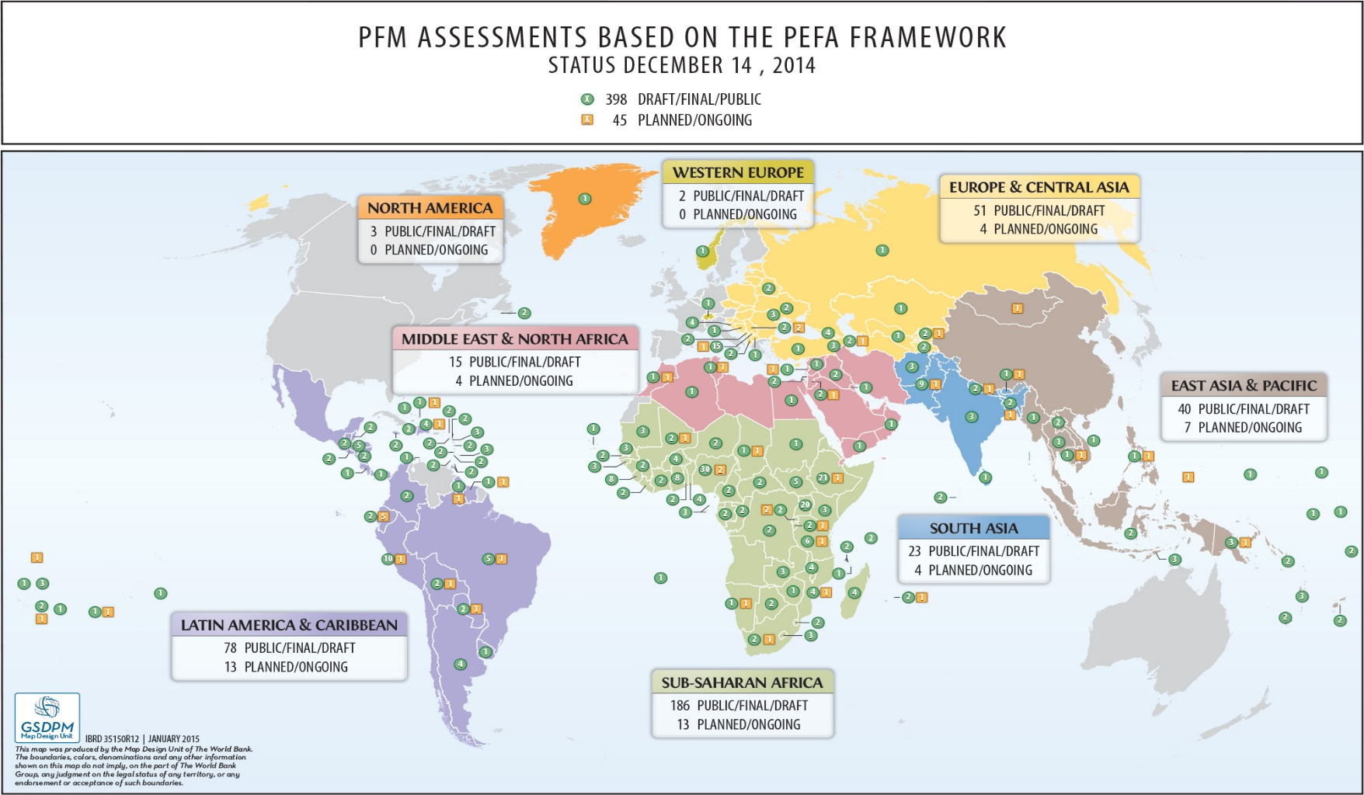
PEFA assessments by region

Slide 6
PEFA 2016 FRAMEWORK
7 | 31 | 94
Pillars | Indicators | Dimensions

Slide 7
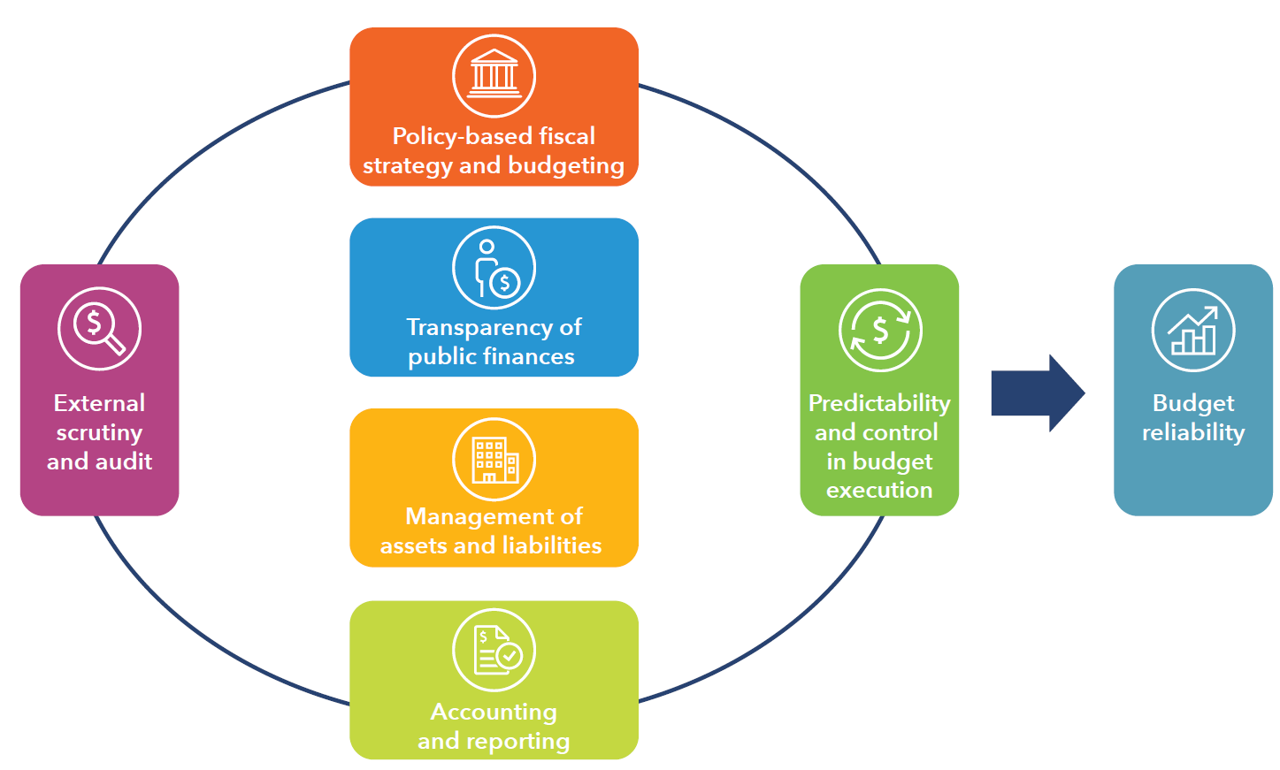
PEFA 2016 and the budget cycle

Slide 8
Performance indicators
I. Budget reliability:
1. Aggregate expenditure outturn
2. Expenditure composition outturn
3. Revenue outturn
IV. Policy-based fiscal strategy and budgeting:
14. Macroeconomic and fiscal forecasting
15. Fiscal strategy
16. Medium term perspective in expenditure budgeting
17. Budget preparation process
18. Legislative scrutiny of budgets
V. Predictability and control in budget execution:
19. Revenue administration
20. Accounting for revenue
21. Predictability of in-year resource allocation
22. Expenditure arrears
23. Payroll controls
24. Procurement management
25. Internal control on nonsalary expenditure
26. Internal audit
II. Transparency of public finances:
4. Budget classification
5. Budget documents
6. Central government operations outside financial reports
7. Transfers to subnational governments
8. Performance information for service delivery
9. Public access to fiscal information
VI. Accounting and reporting:
27. Financial data integrity
27. In-year budget reports
28. Annual financial reports
III. Management of assets and liabilities:
10. Fiscal risk reporting
11. Public investment management
12. Public asset management
13. Debt management
VII. External scrutiny and audit:
30. External audit
31. Legislative scrutiny of audit reports

Slide 9
Performance indicators
17/31 contain specific requirements on transparency of information
I. Budget reliability:
1. Aggregate expenditure outturn
2. Expenditure composition outturn
3. Revenue outturn
IV. Policy-based fiscal strategy and budgeting:
14. Macroeconomic and fiscal forecasting
15. Fiscal strategy
16. Medium term perspective in expenditure budgeting
17. Budget preparation process
18. Legislative scrutiny of budgets
V. Predictability and control in budget execution:
19. Revenue administration
20. Accounting for revenue
21. Predictability of in-year resource allocation
22. Expenditure arrears
23. Payroll controls
24. Procurement management
25. Internal control on nonsalary expenditure
26. Internal audit
II. Transparency of public finances:
4. Budget classification
5. Budget documents
6. Central government operations outside financial reports
7. Transfers to subnational governments
8. Performance information for service delivery
9. Public access to fiscal information
VI. Accounting and reporting:
27. Financial data integrity
27. In-year budget reports
28. Annual financial reports
III. Management of assets and liabilities:
10. Fiscal risk reporting
11. Public investment management
12. Public asset management
13. Debt management
VII. External scrutiny and audit:
30. External audit
31. Legislative scrutiny of audit reports

Slide 10
DESIRABLE FISCAL AND BUDGETARY OUTCOMES
Aggregate fiscal discipline
Strategic allocation of resources
Efficient service delivery

