Slide 1
Fiscal risk analysis in the United Kingdom
Robert Chote
Chairman
5 July 2019
Minsk, Belarus

Slide 2
Background to the OBR
The OBR is the UK’s official fiscal watchdog
Public body but independent of government
3-person committee plus 30 staff
Legal right to information from within government
Responsibilities
Produce five-year fiscal forecasts twice a year
Monitor government performance against fiscal targets
Assess public sector balance sheet and long-term outlook
But we do not give policy advice or recommendations

Slide 3
Fiscal risk monitoring in the UK
The IMF’s 2016 UK Fiscal Transparency Evaluation said that
“In many cases, the government’s control of risks falls short of the Code’s standards of good or advanced practice. The absence of summary reporting of specific risks is a weakness that should be addressed”
OBR is required by law to:
“produce a fiscal risks report … once every 2 years. The government will formally respond to this report”
Other countries publish risk reports - by finance ministries or prime ministers’ offices. The UK is unusual in having an independent one
Our first FRR was published in July 2017 and the Treasury responded a year later with its ‘Managing Fiscal Risks’ paper. Our next FRR will be published later this month (www.obr.uk)

Slide 4
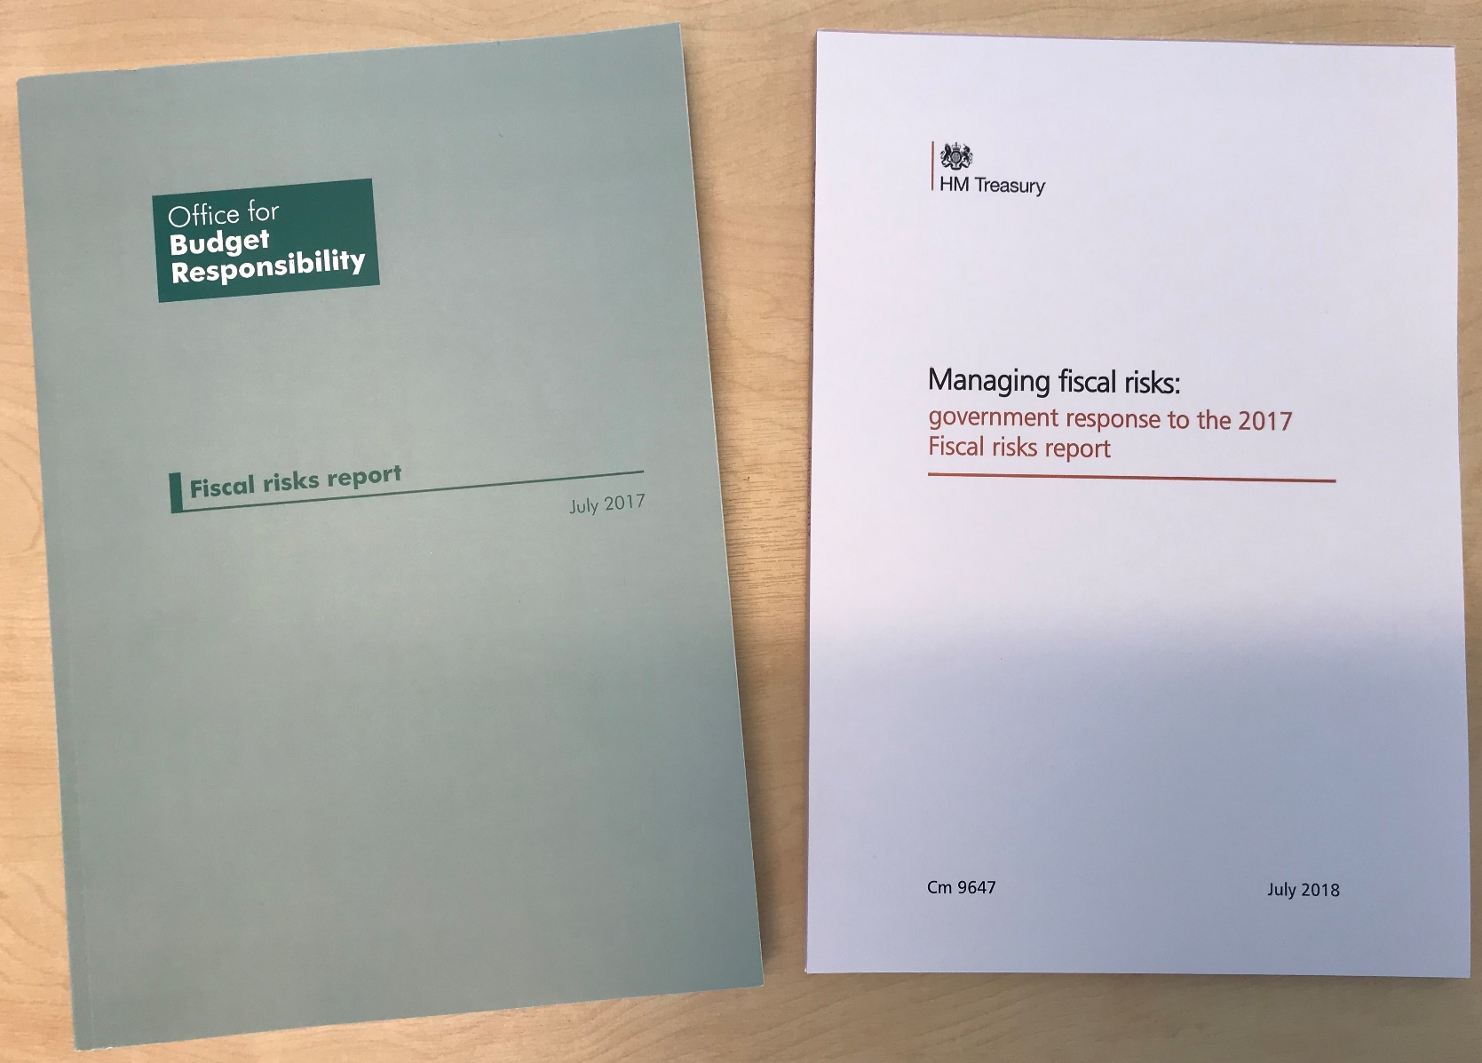
Fiscal risk monitoring in the UK

Slide 5
Our approach
The IMF defines fiscal risks as
“the possibility of deviations of fiscal outcomes from what was expected at the time of the Budget or other forecast”
We focus on risks
To our latest forecast over the medium term
To fiscal sustainability over the longer term
With greater attention to downside risks in both cases
But we note that assuming risk is a key function of government
We are interested in
The probability and potential impact of particular risks
Whether they are correlated with other risks
What the government is doing about them and why
Are attempts to transfer risks out of the public sector genuine?

Slide 6
Types of fiscal risk
Increases in spending (one-off or persistent)
Losses of revenue (one-off or persistent)
‘Stock-flow adjustments’
Balance sheet transactions (lending or issue debt to buy assets)
Balance sheet transfers (real-world or statistical classification)
Balance sheet valuation changes

Slide 7
Structure and special themes
Introduction: analytical framework
Policy risks: evidence of deficit bias
Macroeconomic risks: potential, cycles and composition
Financial sector risks: shadow banks
Revenue risks: digital economy and tax expenditures
Primary spending risks: health and social care
Balance sheet risks: intangible assets
Debt interest risks: r-g
A fiscal stress test: IMF’s disruptive Brexit scenario
Climate change: introduction and work by central banks

Slide 8
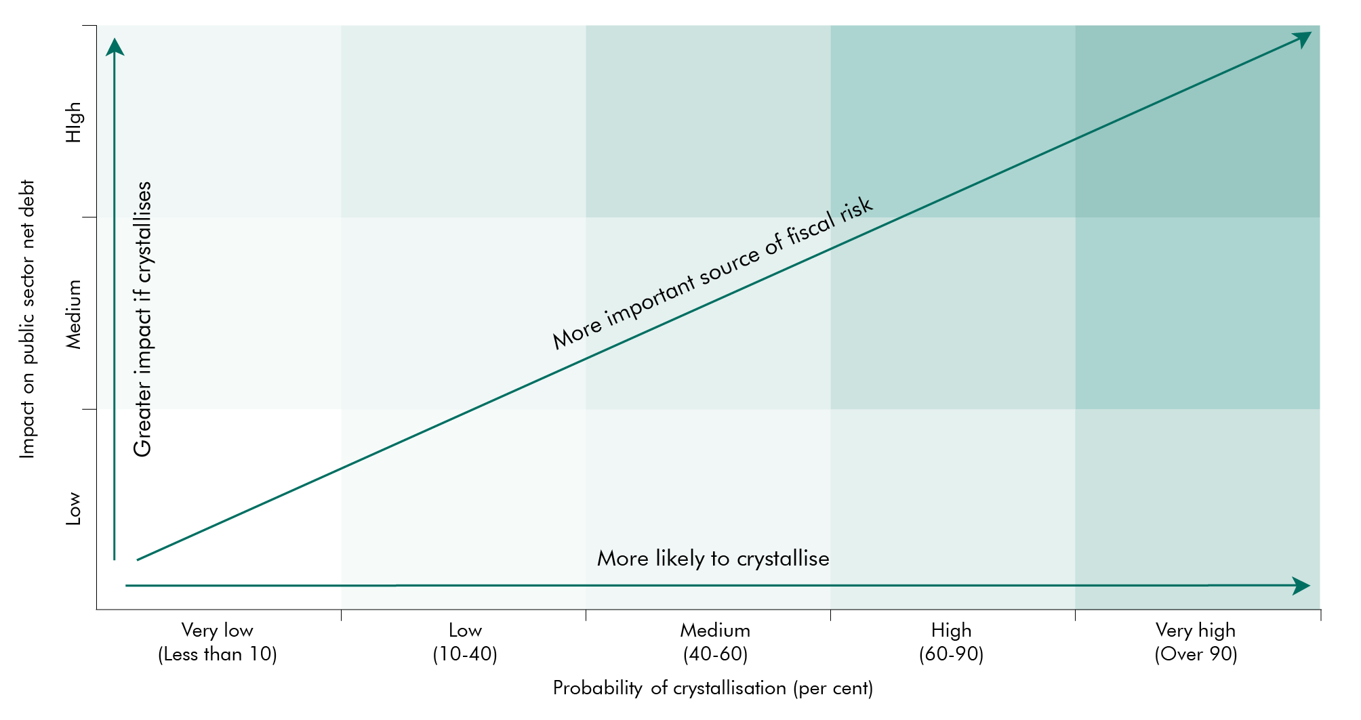
Summarising risk characteristics

Slide 9
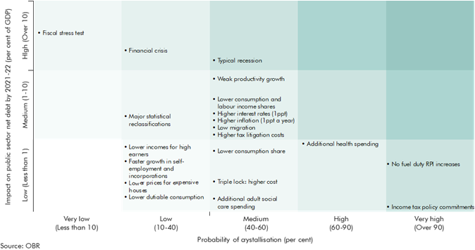
Summarising risk characteristics

Slide 10
‘Challenge and respond’
2017 FRR report highlighted 57 issues to respond to
Government response was substantive, but more often highlighted current actions rather than signalling new ones
Not much to say about ‘risk appetite’, other than to commit to existing fiscal targets and belief that debt/GDP ratio too high
But Treasury is continuing to improve risk management processes
More transparency (balance sheet, GFSM, asset sales)
Balance sheet review (identify and dispose, controls on contingent liabilities, key liabilities inc clinical negligence)
Updated risk management manual
Finance ministry more focused on this than some other ministries

Slide 11
Potential conclusions
Main medium-term risks
Economy: recession, weak productivity (Brexit + other)
Spending: debt interest, health, services
Policy: giveaways, adopting looser fiscal targets
Main long-term risks
Economy: recessions and financial crisis
Spending: Ageing and health costs
Revenues: fuel, tobacco and work patterns
Climate change: focus for 2021 report
Policy approach
Keep risks Government chooses under review
Prepare for nasty surprises – you cannot prevent them all
Take action on long-term pressures before they build up too much

