Slide 1

Budget Transparency in
PEMPAL Countries
PEMPAL Budget Community of Practice
Budget Literacy and Transparency Working Group
Anna Belenchuk, MoF Russian Federation
29 June 2016

Slide 2

Enhancing Fiscal Transparency is on the Top of PEMPAL Budget COP Agenda
  PEMPAL met in 2014 to discuss fiscal transparency and accountability – 200 participants from 18 member countries met from the three Communities of Practice (Budget, Treasury and Internal Audit) with experts from World Bank, IMF, OECD, IBP and GIFT.
  17 of the 23 PEMPAL members participated in the 2015 Open Budget Index, but information on budget documentation accessibility for several countries, not covered by OBI, is available from PEMPAL surveys.
  A special Working Group on Budget Transparency and Literacy has been functioning under Budget COP since May 2014 with 15 PEMPAL member countries participating.
  Focus of PEMPAL Working Group work has been on improving budget literacy and citizens budgets in light of OBI and PEMPAL survey results and feedback from member countries.

Slide 3
What are the Key Challenges for PEMPAL countries?

Slide 4

ACCESSIBILITY OF KEY BUDGET DOCUMENTATION TO CITIZENS

Slide 5
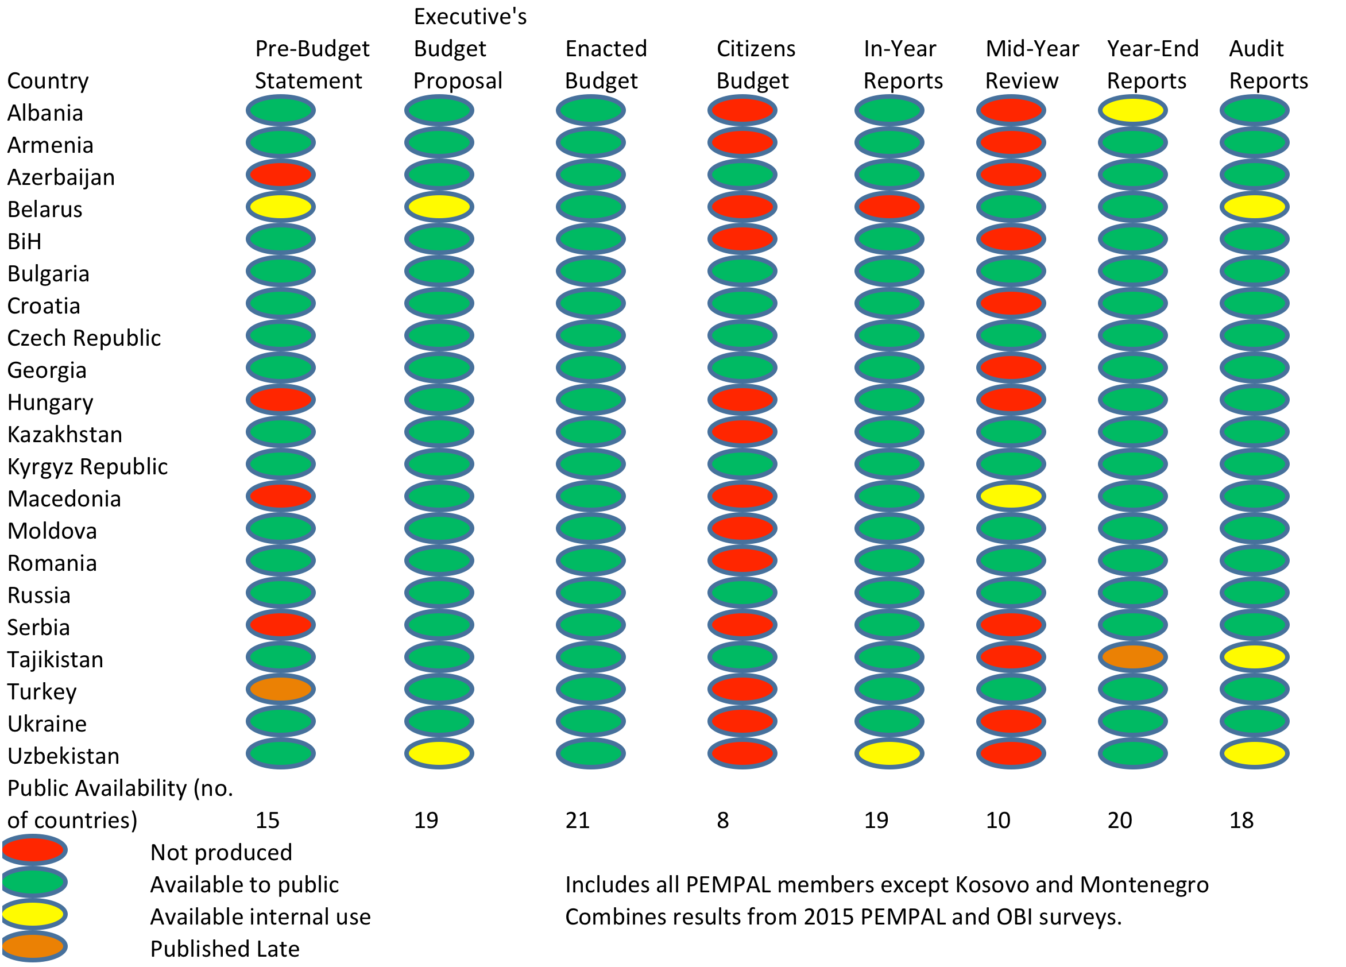
Public Availability of Budget Documents (1)

Slide 6
Public Availability of Budget Documents (2)
Of the PEMPAL member countries who participated in either the 2015 OBI or PEMPAL surveys, only Bulgaria, Kyrgyz Republic and Russian Federation make all their budget documentation accessible to the public.
The worst category still remains citizens budget, which only 8 countries have.
Countries with citizens budgets include:
  Azerbaijan
  Bulgaria
  Croatia
  Czech Republic
  Georgia
  Kyrgyz Republic
  Russian Federation
  Tajikistan.

Slide 7
OPEN BUDGET INDEX RESULTS

Slide 9
2015 Open Budget Index Results
The following results were achieved by PEMPAL members:
      PEMPAL average OBI score 52/100 – higher than international average of 45.
  Substantial information provided (61-80/100) by 5 countries: Romania, Russian Federation, Czech Republic, Georgia, and Bulgaria
  Limited information provided (41-60) by 9 countries: Kyrgyz Republic, Croatia, Kazakhstan, Azerbaijan, Hungary, Serbia, Ukraine, Turkey and Bosnia and Herzegovina
  Minimal information provided (21-40) by 3 countries: Albania, Macedonia and Tajikistan
Extensive information provided by only 5 countries: New Zealand (88), Sweden (87), South Africa (86), Norway (84), United States (81).

Slide 10
Open Budget Index Results: What Changed?
  PEMPAL scores between 2012 and 2015 (noting up to +/- 5 change is not seen by IBP as significant change in results):
    6 countries experienced decreased scores: Albania (-9), BiH (-7), Croatia (-8), Czech Republic (-6), Turkey (-6), Ukraine (-8)
    3 countries remained on same score: Bulgaria, Macedonia, Russian Federation
    7 countries improved their score: Azerbaijan (+9), Georgia(+11), Kazakhstan (+3), Kyrgyz Republic (+34), Romania (+28), Serbia (+8), Tajikistan (+8).
    1 new PEMPAL country joined survey: Hungary (Internal Audit COP member)
    Most improved PEMPAL country is Kyrgyz Republic who increased score from 20 in 2012 to 54 in 2015. Romania also achieved significant progress rising form 47 to 75.
    For relatively new assessment of public participation, PEMPAL average score was higher at 29/100 (compared to international average 25/100) but indicating lots of opportunity for reform. Kyrgyz Republic highest score among PEMPAL countries at 52/100.

Slide 11
PEMPAL Progress
Since 2014 Working Group on Budget Literacy and Transparency:
  Conducted a study visit to Croatia in 2015 to examine Citizens Budgets at state and local levels.
  Held a workshop in early 2016 in Belarus with World Bank and IBP to identify good practices in budget transparency from 2015 IBP survey from region.
  Shared practices from Russian Federation and Romania (leaders in region in Open Budget Index), and Kyrgyz Republic as most improved.
  Translated and shared guidelines on how to develop Citizens Budgets from IBP, Russian Federation, Kyrgyz Republic and Moldova. International examples of Citizens Budgets also identified and shared.
  Identified ten challenges to developing Citizens Budgets being experienced by member countries, and collated international and peer advice into a ‘knowledge product’ to provide options to address them. Currently under consultation and will be finalized September.

Slide 12
PEMPAL Future Plans
What can we do to make progress along the budget transparency spectrum?
  Engage more PEMPAL countries in OBI survey
  Help PEMPAL countries to identify and break challenges in making Budget documents open
  Continue to use the PEMPAL facilities (translation in three languages, face-to-face meetings) to share new guidelines and instruments in budget transparency between member countries
  To deepen the study of the issues of budget transparency at regional and municipal level
  Continue to promote modern instruments of budget transparency (citizen’s engagement, budget literacy) among PEMPAL countries
  Create and distribute among the governments and the MoF of PEMPAL countries our ‘knowledge products’
    “Breaking challenges in constructing Citizen’s budgets for PEMPAL countries”
    “Ten steps to inclusive budget process in PEMPAL countries”
    “Budget literacy practices in PEMPAL countries”

Slide 13
Conclusions
Maintaining good performance in budget transparency requires ongoing focus and attention.
Good practice is still evolving in some areas ie public consultation and participation in the budget process.
  The ongoing work of IBP and GIFT is important here.
Survey instruments such as OBI has provided incentives and motivated many countries to improve performance.
Sharing of information in networks such as PEMPAL and OECD SBO also very valuable. Power of peer-to-peer benchmarking, sharing and solving common problems.
The new OECD toolkit will be a very useful tool as it allows self-assessment and it collates available advice and good practice.

Slide 14

Thank you for your attention!

