Slide 1

A Toolkit on Budget Transparency: for integrity, openness and sound budgeting
Ruben Werchan
Joint meeting of CESEE SBO / OGP Fiscal Openness Working Group
Ljubljana, June 28-29 2016

Slide 2
Overview
Background - Why a toolkit?
The content and the structure of the toolkit
Further steps

Slide 3
The G20 Context
Background of G20 Anti-corruption Working Group (ACWG):
Implementation Plan 2015-16
“Promoting greater budget transparency and fiscal openness plays an important role in anti-corruption efforts, including by deterring illicit diversions of public money by corrupt officials and promoting good governance”
“Promoting greater budget transparency and fiscal openness has important links to the G20 resilience agenda, including by fostering greater public confidence in the stability and soundness of public finances.”
“develop a G20 practical toolkit on budget transparency”

Slide 4









Do we need more rules for budget transparency?

Slide 5

3 useful roles for a “toolkit”
Help to self-assess level of budget transparency, and to plan and implement transparency-focused reforms
Reinforce key messages by bringing together the insights of the international community of budget transparency
Provide a gateway to resources that are already available across the international community

Slide 6
So, what does it look like?
?

Slide 7







Structured in five institutional spheres
C
Benefiting from parliamentary engagement and scrutiny
D
Supporting parliamentary capacity
Parliamentary
Involvement
E
Monitoring and control of budget execution
A
Providing useful budget reports
during the annual cycle
F
Supporting the role of the Supreme Audit Institution
B
Including the right financial information in budget reports
Government
Reporting
Independent
Oversight
G
Designing effective Independent Fiscal Institutions
Budget Transparency
Toolkit
H
Making the budget accessible to the public
I
Using open data to support budget transparency
K
Opening up public contracting and procurement
Openness and
Civic Engagement
Interaction with the
Private Sector
J
Making the budget more inclusive and participative
L
Revenues and expenditures in resource endowments

Slide 8
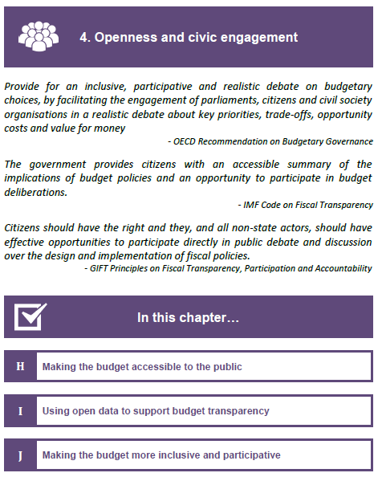
Structure of the Chapters
Colours and icons for easy navigation within the document.
Quotes from publications of leading institutions in the area to highlight the relevance of the topic
Overview of the chapters content

Slide 9

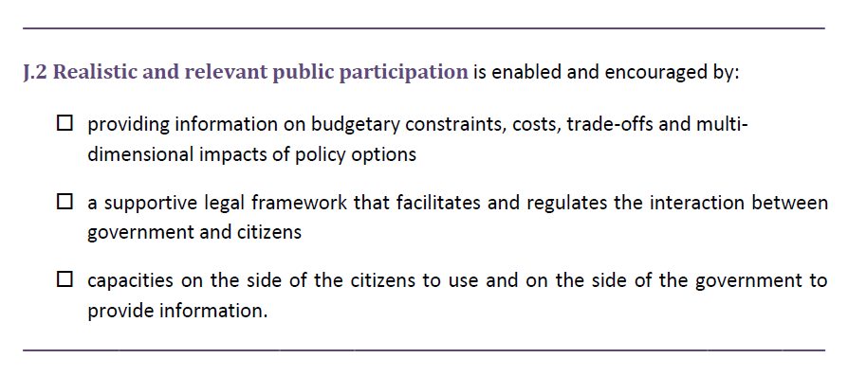
Chapters and sections
4. Openness and Civic Engagement
J
Making the budget more inclusive and participative
What opportunities do different institutions have to foster participation?
How can realistic and relevant public participation be enabled and encouraged?
How to design a participation process that is best suited to deliver meaningful, substantive contribution?

Slide 10
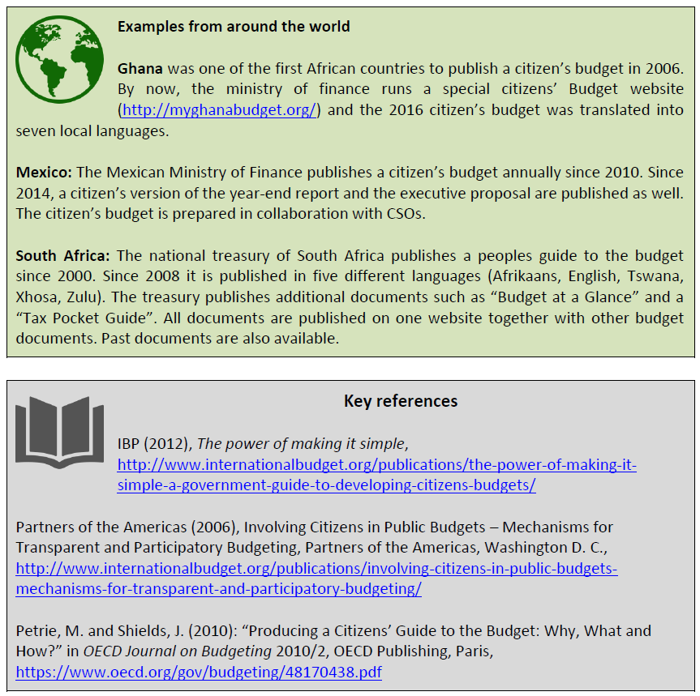
Country Examples and Key References
Examples of how different countries have implemented a certain policy.
A list of key references to direct the reader towards more
in-depth documents.

Slide 11
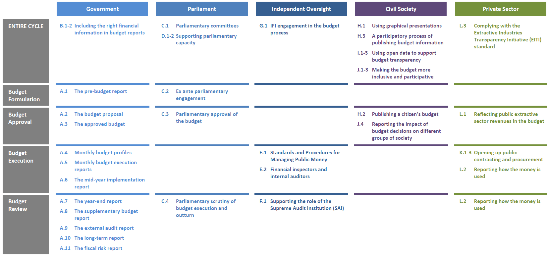
Link to the Budget Cycle

Slide 12
Why did we chose this approach?
Over-riding principle: short and sweet
broaden concept of budget transparency
  Traditionally: making budget by government
  Toolkit: Roles by diverse player:
  budget execution + open government + anti-corruption
Country examples – teasers

Slide 13
Further steps
Have received a lot of feedback over the past weeks
  review the toolkit in light of this feedback
  Incorporate the feedback where appropriate
Will further improve the existing document
Ideal scenario: a toolkit that is genuinely useful, and that is developed and maintained on collaborative principles

Slide 14
Thank you for your attention!
Contact:
Jaehyuk Choi
Jaehyuk.CHOI@oecd.org

