Slide 1
Budget Community of Practice (BCOP)
Update on BCOP Activities
Kanat Asangulov, BCOP Executive Committee
Ministry of Finance, Kyrgyz Republic
March 14, 2018
The 2018 BCOP Plenary Meeting, Vienna

Slide 2
BCOP MEMBERSHIP
21 countries are BCOP members.
71 members from the Ministries of Finance from 19 different countries attended at least one BCOP event out of 9 events in the last year.
Two working groups:
Budget Literacy and Transparency Working Group (BLTWG) – 16 member countries
Program and Performance Budgeting Working Group (PPBWG) – 15 member countries

Slide 3
BCOP Strategy
BCOP aims to strengthen budget methodology, planning and transparency in PEMPAL member countries through:
1. Sharpening tools for effective fiscal management - a broad topic that includes the topics of Program and Performance Budgeting Working Group discussed continuously (including monitoring and evaluation tools), as well as other tools, discussed periodically, such as wage bill management, fiscal risks etc.
2. Strengthening fiscal transparency and accountability with a focus on budget literacy, citizens’ budgets, and public participation initiatives.

Slide 4
BCOP Strategy (cont.)
BCOP aims to strengthen budget methodology, planning and transparency in PEMPAL member countries through:
3. Facilitating knowledge exchange between:
budget related Departments of our 21 member country MoFs in Europe and Central Asia region.
OECD member and accession countries at annual Senior Budget Officers’ (SBO) meetings.
other COPs, through sharing progress at annual cross-COP meetings of all COP Executive Committees, and quarterly PEMPAL Steering Committee meetings.
4. Expanding internationally available data on PEMPAL countries through benchmarking using pre-meeting thematic surveys and more formal surveys (e.g. PEMPAL surveys, International Budget Partnership and OECD surveys).

Slide 5
BCOP LEADERSHIP AND MANGEMENT
BCOP Executive Committee

Slide 6
BCOP ACTIVITIES
In 2017, there were 9 BCoP events:
Plenary meeting of all members on tools for fiscal management - Bishkek, April 2017
RESULTS: i) increased understanding of fiscal risk management through the sharing of good practices by international organizations and country cases; ii) shared international trends on budget transparency and public participation with country cases, which assisted the BLTWG to finalize its knowledge product on citizens’ budgets; and iii) shared preliminary survey findings for PEMPAL countries participating in the OECD Performance Budgeting survey, which allows for benchmarking among PEMPAL countries and with the OECD countries.
BLTWG workshop and participation in the World Bank Conference of the Russian Budget Literacy Project- Moscow, June 2017
RESULTS: i) learned from the Russian experience in implementing budget literacy curriculum in schools ii) contributed to the Russian Budget Literacy Project Conference by presenting the experiences of the Kyrgyz R. and Croatia; iii) examined the preliminary results of the International Budget Partnership’s 2017 Open Budget Survey which enable benchmarking; iv) familiarization with the OECD Toolkit on Budget Transparency, on which PEMPAL countries provide input.

Slide 7
BCOP ACTIVITIES (continued)
OECD Senior Budget Officials’ Network for Central, Eastern, and South-Eastern Europe (SBO CESEE) – Paris, July 2017
RESULTS: i) shared results of PEMPAL countries on the Survey on Performance Budgeting with the OECD countries, as well as BCOP knowledge product on citizens’ budgets ii) reviewed the recent budgeting and spending review developments in several OECD countries, iii) participated in the OECD’s consultations with the participants on the OECD’s forthcomiтg Gender Budgeting Toolkit.
PBWG workshop on performance indicators – Videoconference, September 2017
RESULTS: i) shared and discussed examples or whole sets of performance indicators collected from nine BCOP countries and each member country presented on criteria (predefined by PPBWG Leader and the Resource Team) for assessing the performance indicators, ii) decided on the PPBWG assessment that will be presented in the OECD Performance and Results meeting in November 2017, iii) decided next steps for the PPBWG work.
BLTWG workshop on public participation– Videoconference, October 2017
RESULTS: i) familiarization with the background paper developed to support discussions of the BLTWG to conceptualize a knowledge product to assist in future reforms in public participation; ii) shared information on new interesting international country cases was also been provided by IBP from preliminary results of the latest Open Budget Survey currently underway and from GIFT, which will be used to identify potential host country for a SV.

Slide 8
BCOP ACTIVITIES (continued)
BCOP participation at the OECD Senior Budget Officials’ Performance and Results Network meeting, Paris, November 2017
RESULTS: i) familiarization with newest trends in performance budgeting in OECD countries; ii) BCOP's contribution in discussing and providing suggestions for improvement of OECD’s Draft Best Practices in Performance Budgeting; as well as dissemination of BCOP's work on knowledge product on performance indicators in PEMPAL countries, and delivering a detailed presentation of Russian country case in performance budgeting.
Three meetings of the Executive Committee (April, July, and December 2017). Minutes available https://www.pempal.org/about/governance/ex-com-bcop
PEMPAL Steering Committee met 4 times (February, June, and November 2017 and February 2018). Minutes available https://www.pempal.org/event/steering-committee-meetings

Slide 9
BCOP KNOWLEDGE RESOURCES PREPARED BY BCOP OR COLLECTED/TRANSLATED FOR BCOP
List and links of all materials shared since 2011 listed in a document provided in your background materials.
Examples from past year:
Sets of examples of programs and performance indicators from 10 PEMPAL countries and additional sets of performance indicators in health and education countries from 11 countries
Performance budgeting and indicators in Austria
Presentations from the Russia Budget Literacy Conference
Materials from the session on promoting fiscal transparency (including the final OECD Toolkit in Budget Transparency) and from the session on gender budgeting from the 2017 OECD CESEE Senior Budget Official’s Network meeting
Materials from the November 2017 OECD meeting of the Performance and Results Network
Public Participation Background Paper
For this meeting:
BCOP PPBWG Knowledge Product on Performance Indicators in PEMPAL Countries
BCOP BLTWG Draft OECD Best Practices for Performance Budgeting

Slide 10
FUTURE ACTIVITIES
Remaining events in FY2018 (up to end June 2018) after the March 2018 Vienna events:
Study visit on public participation in April or May 2018 – may be moved to FY2019.
Participation in the 14th OECD CESEE SBO meeting in Croatia in late May 2018.
Action Plan for FY2019 (July 2018 – June 2019)
Your feedback is used by the Executive Committee to develop the draft BCOP Action Plans. The Executive Committee will specify the events for 2018-2019 and send it to the PEMPAL Steering Committee by mid 2018, taking into account the feedback gathered from member countries prior to this plenary meeting and on the discussions and Executive Committee meeting decisions.
Initial resources currently allocated for each COP for FY2019 are 180,000 USD and any savings we have from this year. It is expected that the Steering Committee will revisit FY2019 budgets in mid-2018, after which the Executive Committee will finalize the Action Plan for FY2019.

Slide 11
FUTURE ACTIVITIES (continued)
Your feedback for BCOP Action Plan from the survey conducted prior to this plenary meeting
Priority themes
1. Program and performance budgeting - 10 out of 17 countries
i. programs,
ii. performance indicators, and
iii. monitoring and evaluations of expenditure including spending reviews)
Out of the three subtopics, monitoring and evaluation is the most frequently selected sub-topic.
2. Budget literacy and transparency – 9 out of 17 countries
i. citizens’ budgets,
ii. budget literacy, and
iii. public participation
Out of the three subtopics, citizens’ budgets is the most frequently selected sub-topic, however the group worked with this topic in the past and will need to explore further how to address members interests in its activities.
3. Integrating capital budgeting/public investment in budget planning (assessing its effectiveness, prioritizing) – 6 countries

Slide 12
FUTURE ACTIVITIES (continued)
Annual Plenary Meeting 2019
Approach:
Based on collected country priorities, the Executive Committee will consider applying the same approach we applied to the 2017 and 2018 plenary meetings to the 2019 plenary meeting:
- One day of the plenary meeting to each of the Working Groups, while introducing a new topic or exploring further previously discussed topic which is outside of the scope of Working Groups’ topics in the first day of the plenary meeting.
It is expected that the BCOP 2018-2019 Action Plan plan will be finalized by the Executive Committee and adopted by the Steering Committee by mid-2018.
Location:
Uzbekistan indicated they could host the next plenary meeting and cover the costs of some dinners and/or a cultural program.
Thank you again for your feedback and proposals!

Slide 13
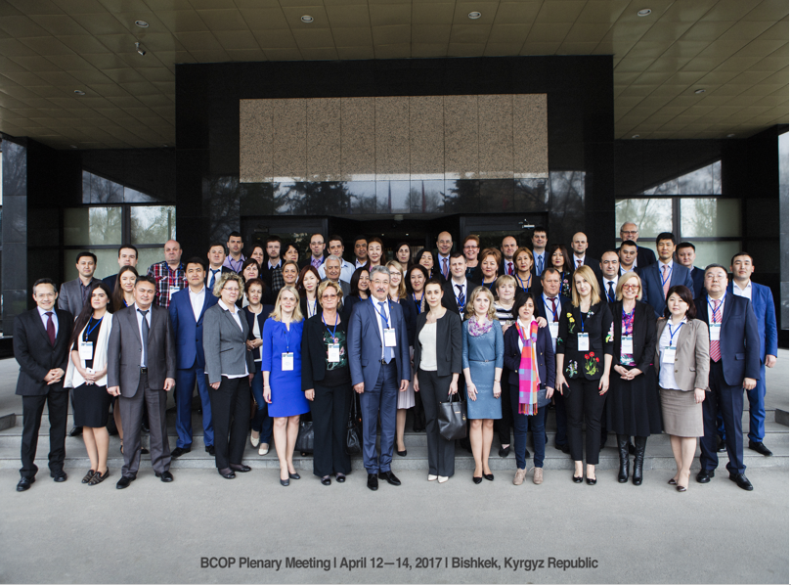

Slide 14
Thank you for your attention!

