Slide 1

Intergovernmental Fiscal Transfers: Trends and Challenges in PEMPAL Countries
This Photo by Unknown Author is licensed under CC BY-NC-SA
Iryna Shcherbyna
Public Sector Specialist, World Bank - Governance

Slide 2

CONTEXT
Introduction: Why are transfers needed?
The system of intergovernmental fiscal transfers in PEMPAL countries: What are the key trends and challenges?
Performance–Oriented transfers: How can results-based accountability be achieved?

Slide 3
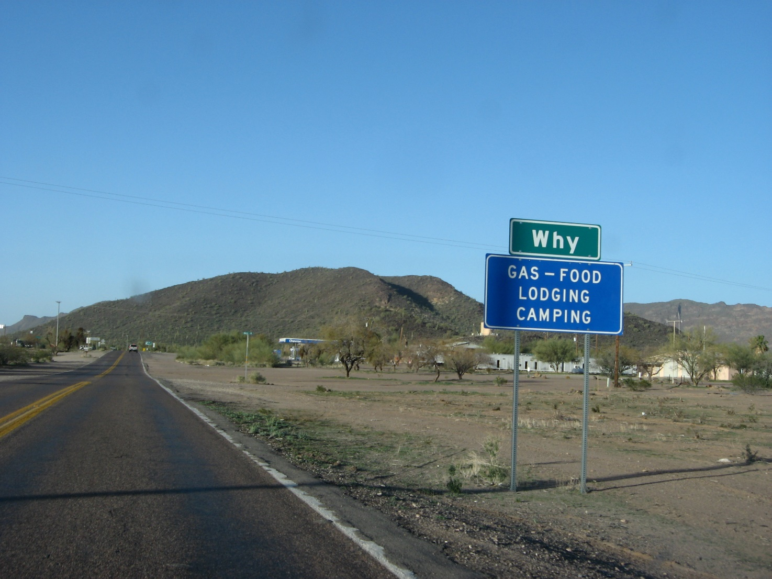
Part 1: INTRODUCTION: THE THEORY AND PRACTICE OF Intergovernmental FISCAL Relationships

Slide 4
THE ROLE OF LOCAL GOVERNMENTS IN PUBLIC FINANCES IS DIFFERENT ACROSS PEMPAL COUNTRIES
* Based on countries self-assessment

Slide 5
THE DEVIATION OF SHARE OF SUB-NATIONAL GOVERNMENTS’ TAX REVENUES IN GDP (%) in 1995 and 2014
* Eurostat data

Slide 6
TAXING POWER OF SUB-NATIONAL GOVERNMENTS
Share of local budget tax revenues in GDP (%) in 2014

Slide 7
EXPENDITURE NEEDS EXCEED REVENUES IN ALMOST ALL PEMPAL COUNTRIES
* Based on countries self-assessment

Slide 8

Intergovernmental fiscal transfers finance about 60 percent of subnational expenditures in developing countries and transition economies
Beyond the expenditures they finance, these transfers create incentives and accountability mechanisms that affect the fiscal management, efficiency, and equity of public service provision and government accountability to citizens.

Slide 9
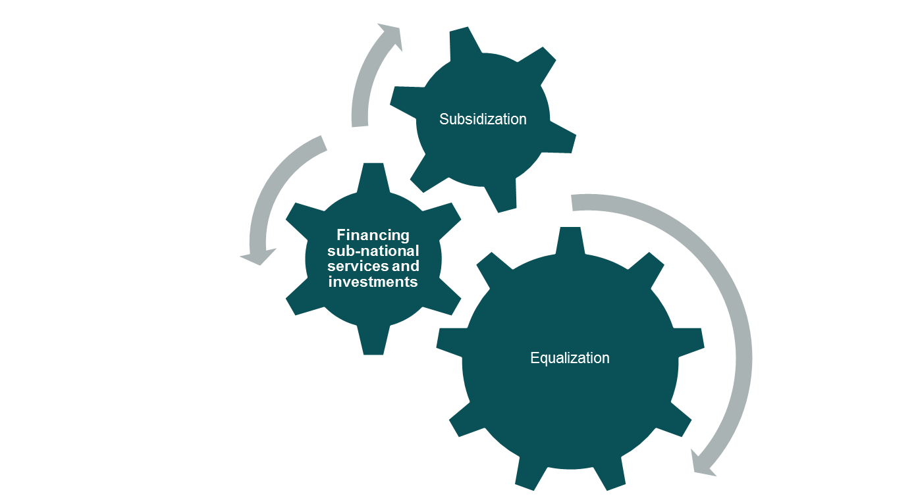
Key objectives of intergovernmental FISCAL transfers

Slide 10
TYPES OF INTER-BUDGETRAY TRANSFERS (grants)
Grants
Non-earmarked
Mandatory
General purpose grant
Block grant
Discretionary
Earmarked
Mandatory
Non-matching grant
Matching grant
Discretionary
Source: OECD, INTERGOVERNMENTAL TRANSFERS AND DECENTRALISED PUBLIC SPENDING, Working Paper N 3, 2006

Slide 11

definitions
Earmarked grants An earmarked grant is a grant that is given under the condition that it can only be used for a specific purpose.
Non-earmarked grants Non-earmarked grants can be spent as if they were the receiving sub-national government’s own (non-earmarked) tax revenues.
Mandatory grants Mandatory grants (entitlements) are legal, rules-based obligations for the government that issues the grant. This requires that both the size of the grant and the conditions under which it is given are laid down in a statute or an executive decree and that these conditions are both necessary and sufficient.
Discretionary grants Discretionary grants, and the conditions under which they are given, are not determined by rules but decided on an ad hoc, discretionary basis. Discretionary grants are often temporary in nature and include, for example, grants for specific infrastructural projects or emergency aid to a disaster area.
Matching grants Matching grants are grants designed to complement sub-national contributions. Matching grants are dependent on normative or actual spending for services for which the grants are earmarked or on local revenue collection related to these services.
Non-matching grants Non-matching grants are grants not directly linked to any sub-national contribution.
Current grants Current grants are grants assumed to be spent on either current or capital expenditures.
Capital grants Capital grants are grants assumed to be spent only on capital expenditures.
Sources: OECD, INTERGOVERNMENTAL TRANSFERS AND DECENTRALISED PUBLIC SPENDING, Working Paper N 3, 2006;
WB, INTERGOVERNMENTAL FISCAL TRANSFERS.PRINCIPLES AND PRACTICE, 2007

Slide 12

Part 2: THE SYSTEM OF INTERGOVERNMENTAL FISCAL TRANSFERS IN PEMPAL COUNTRIES

Slide 13
THE LOWER THE SHARE OF SUB-NATIONAL BUDGET REVENUES IN GGP, THE HIGHER THE IMPACT OF CENTRAL BUDGET TRANSFERS
* Based on countries self-assessment

Slide 14
THE STRUCTURE OF LOCAL BUDGET REVENUES IN 2016
PEMPAL Survey Data*
* Based on countries self-assessment

Slide 15
LOCAL BUDGET EXPENDITURES BY FUNCTIONS (%) IN 2016
PEMPAL Survey Data*
* Based on countries self-assessment

Slide 16

SOME Key decisions TO BE TAKEN FOR the design of transfers
Non-earmarked grants versus earmarked grants;
Mandatory grants versus discretionary grants;
List of basic service packages and distribution formulas for non-earmarked grants;
Equalization approach, including:
Tax capacity of sub-national (local) governments;
Service capacity of sub-national (local) governments.

Slide 17
EQUALISATION VERSUS EARMARKED TRANSFERS IN PEMPAL COUNTRIES ( PEMPAL Survey Data*)
* Based on countries self-assessment

Slide 18
KEY CHALLENGES IN PLANNING AND EXECUTING OF EQUALISATION TRANSFERS
Country | Key challenges
Belarus | Absence of a fully functioning system of normative budgetary financing of social sectors.
Bulgaria | The key challenge is achieving fairer distribution for municipalities where the indicators are such that the equalization subsidy/transfer formula is distorted - a need to introduce a fairer model of the equalizing subsidy.
Croatia | Since these are equalization transfers (subsidies) for units with below average fiscal capacity, the challenge lies in the calculation of the fiscal capacity of units of local and regional self-governments.
Kazakhstan | 12 subvention regions for under delivery by income, 4 regions - withdrawals to the republican budget for an amount of excess for incomes.
Kyrgyz Republic | Forecasted revenue indicators are overstated (deviation from actual forecasts), which negatively affects the volumes of equalization transfers.
Montenegro | The main challenge is how to determine the criteria for the allocation of equalization fund resources.
Romania | Finding keys for equal treatment of territorial administrative units
Serbia | Establishing formulas which ensure fairness in transfer allocations.

Slide 19
KEY CHALLENGES IN PLANING AND EXECUTING EARMARKED TRANSFERS
Main types of earmarked transfers | Key challenges in planning and executing earmarked transfers
 | Identifying distribution criteria for subventions; Using mechanisms and formulas to reflect each municipality’s specifics; Quality and neutrality of the determination of transfer amounts; Excessive quantity and a "single-point" nature of earmarked transfers; High impact of non-economic criteria for the allocation of earmarked transfers; Introducing a fairer model of allocating the transfers and linking them to the quality of services provided and achieving solidarity.

Slide 20


Part 3: Achieving Results–Based Accountability through Performance–Oriented transfers

Slide 21
KEY PRINCIPLES (1)
Clarity in grant objectives.( Grant objectives should be clearly and precisely specified to guide the grant design)
Autonomy ( Subnational governments should have independence and flexibility in setting priorities. They should not be constrained by uncertainty associated with decision making at the center. Tax-base sharing – allowing SG to introduce their own tax rates on central bases, formula-based revenue sharing, or block grants - is consistent with these objectives).
Revenue adequacy (adequate resources for designated responsibilities)
Responsiveness ( having enough flexibility to accommodate unforeseen changes in the fiscal situation of the recipience )
Equity ( Allocated funds should vary directly with fiscal need factors and inversely with tax capacity of each jurisdiction)
Predictability ( Publishing mid-term projections ( 5 year) of funding availability. The grant formula should specify ceilings and floors for yearly fluctuations. Any major changes in the formula should be accompanied by hold-harmless provisions.

Slide 22
KEY PRINCIPLES (2)
Transparency ( Both the formula and the allocations should be disseminated widely);
Efficiency ( the grant design should be neutral with respect to subnational government’s choices of resource allocation to different sectors or types of activities);
Simplicity (The formula should be easy to understand);
Incentive ( the design should provide incentives for efficient fiscal management );
Accountability for results (the grantor is accountable for the design and operation. The recipient is accountable to the grantor and citizens for financial integrity and results).
Source: WB, INTERGOVERNMENTAL FISCAL TRANSFERS.PRINCIPLES AND PRACTICE, 2007

Slide 23
Features of Traditional and Output-based Conditional Grants
Feature | Traditional grant | Output-based grant
Grant objectives | Spending level | Quality and access to public services
Grant design and administration | Complex | Simple and transparent
Conditions | Expenditures on authorized functions and objects | Output-service delivery results
Compliance verifications | Higher level inspections and audits | Client feedback and redress, comparison of baseline and post-grant data
Managerial flexibility | Little or none. No tolerance to risk and no accountability for failure | Absolute. Rewards for risks but penalties for persistent failure.
Local government autonomy, budget flexibility and transparency | little | Absolute

Slide 24
Features of Traditional and Output-based Conditional Grants (2)
Feature | Traditional grant | Output-based grant
Focus | Internal | External, competition, innovation, benchmarking
Accountability | Hierarchical to higher-level government, controls on inputs and process with little or no concern for results | Results-based, bottom-up, Client-driven
Source: WB, INTERGOVERNMENTAL FISCAL TRANSFERS.PRINCIPLES AND PRACTICE, 2007

Slide 25

important
Achieving citizens’ satisfaction with services delivered by subnational governments requires general efficiency of intergovernmental fiscal relations, equitability, and sustainability of inter-budgetary transfers.

Slide 26
Thank you
Questions?
Please refer to:
Iryna Shcherbyna (WB, Governance)
ishcherbyna@worldbank.org
Maya Gusarova (WB, Governance)
mgusarova@worldbank.org

