Slide 1

Messages from the OECD’s Fiscal Network
PEMPAL Meeting
14 March 2018
Vienna, Austria
Sean M. Dougherty
Senior Advisor

Slide 2
The OECD’s Fiscal Network
Shares experiences on all aspects of fiscal federalism and sub-national public finance, on both the revenue and spending sides of the budget
Annual Network meetings, as well as workshops and expert seminars
Unique policy analysis, database and reports
Membership-based: most Federal OECD countries, unitary countries that are more decentralised; non-OECD members are welcome
Collaborates with multiple directorates at the OECD

Slide 3
Wealthier countries tend to be more decentralised…

Slide 4
Part of these arrangements are constitutional
Index

Slide 5
OECD countries follow various models

Slide 6
Some key questions
How has fiscal decentralisation and autonomy changed over time?
What difference does it make?
What are “good” policies more broadly?
How to promote greater autonomy?

Slide 7
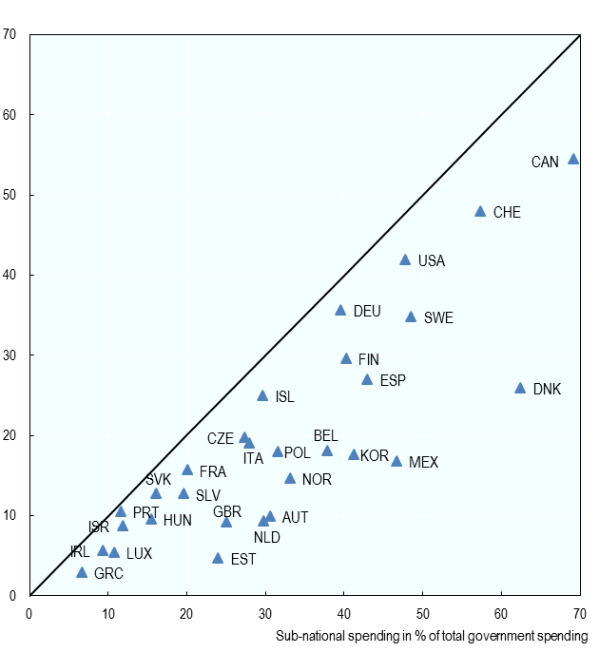
Most countries decentralise spending more than revenues
Sub-national revenues
Sub-national spending

Slide 8
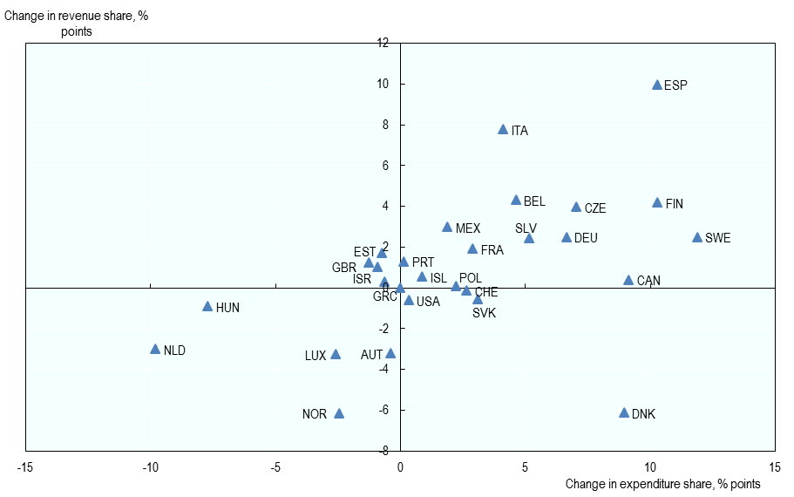
Broad trend towards decentralisation over the last decade
Change in sub-national revenues
Change in sub-national spending

Slide 9
Policy areas more decentralised than others: education, social protection, health, public transport, housing
Breakdown of SNG expenditure by economic function

Slide 10
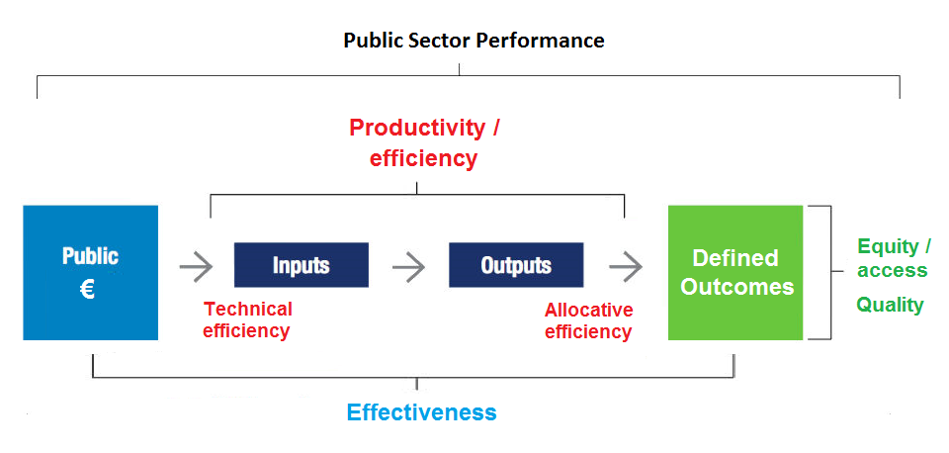
Why decentralise? To promote sub-national government performance
Central governments can help sub-nationals to enhance public sector productivity

Slide 11
Approaches to measuring performance
Composite indicators
Composite indicators are easy to interpret, however they should be accompanied by the more detailed information, sensitivity analysis and the techniques used
External inspections and self-assessments are useful, especially when used together – the results are more likely to be ‘owned’ by the provider but can also provide distance and challenge assumptions
Performance measurement mechanisms
Quality assurance systems
Surveys can help broadly identify the quality of services. Better consumer satisfaction is also linked to better consumer outcomes (health especially)
Consumer experience and satisfaction surveys

Slide 12
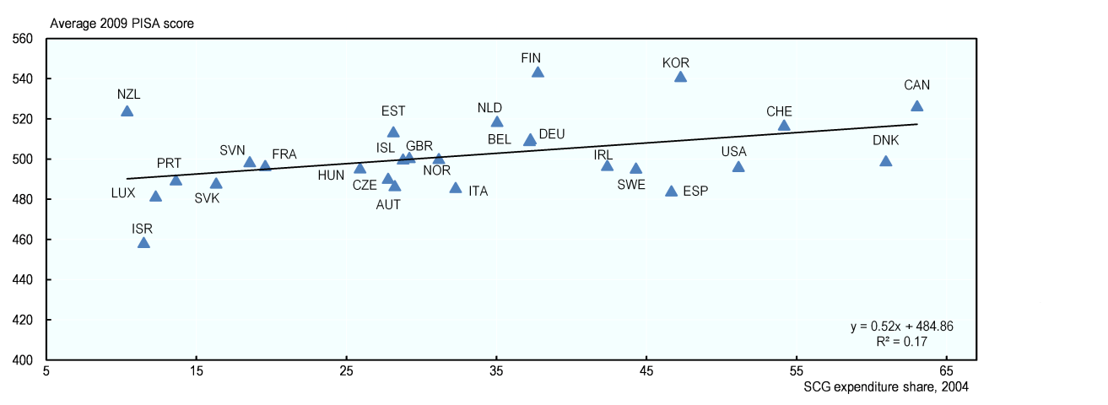
Decentralisation can improve incentives
Better educational outcomes associated with more SNG spending

Slide 13
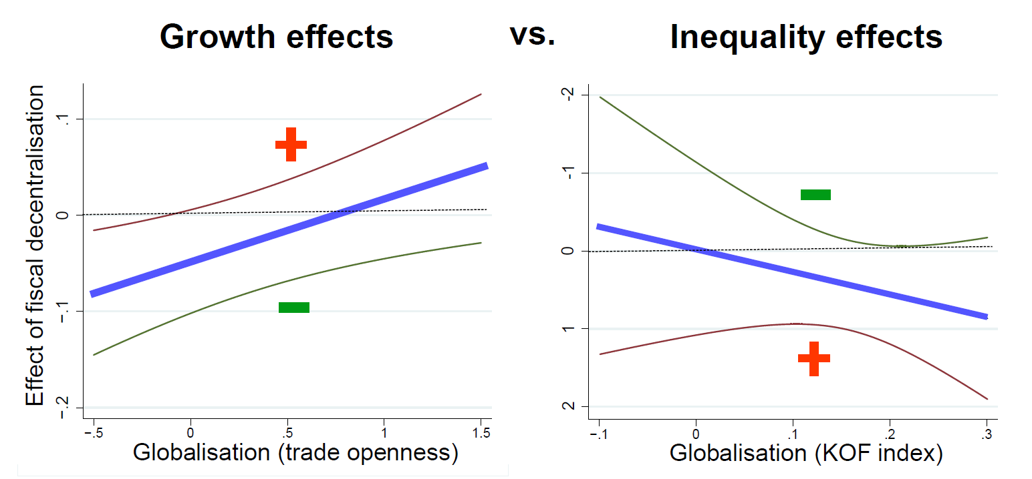
And boost economic growth, reduce inequality – harder if globalised
Effect of increasing centralisation or decentralisation
Index of globalisation
Index of globalisation

Slide 14
Key lessons from our work
Based on a recent synthesis of reviews:
    better align sub-central spending with own-source revenue;
    delineate responsibilities and functions clearly;
    raise sub-central spending power, tax autonomy and reduce the scope of earmarked grants;
    maintain and strengthen internal markets;
    devolve some responsibilities to private-sector service providers;
    strengthen intergovernmental information and co-ordination systems.

Slide 15
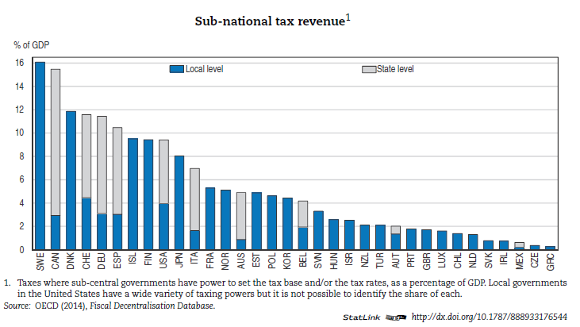
Sub-national revenue bases vary widely

Slide 16
Strategies to generate and optimize subnational revenue:
  Why is it important to achieve greater subnational fiscal autonomy?
    Better outcomes, promote efficiency
        Balance heterogeneity and economies of scale/scope
  What lessons can we draw from international experiences on subnational fiscal autonomy strengthening?
    Mixed experiences in OECD countries
        Need to get incentives right, boost capacity

Slide 17
Tax autonomy of state/regional governments in OECD countries, average
*preliminary data

Slide 18
What about fiscal equalisation?
“Natural” companion of decentralisation, seeking to correct disparities from sub-national autonomy
Widely used: across the OECD, fiscal equalisation amounts to 2.5% of GDP; 5% of government spending, and 50% of inter-governmental grants
While it can correct regional disparities, it does not correct household-level ones, thus caution is appropriate

Slide 19
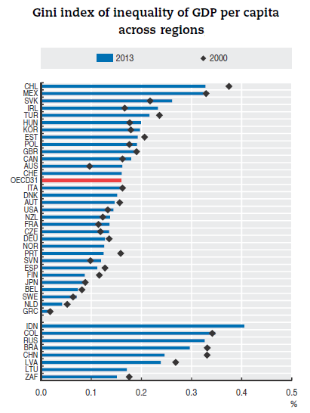
Inequality across regions is one motivation

Slide 20
Recent Policy Analysis
Decentralisation and inequality: Do decentralised countries grow more or less equal? And are regional disparities larger?
The taxation of immovable property: What is a “good” property tax, and how can property tax reform be successfully implemented?
Debt monitoring and management: Should central government monitor sub-national debt, and if so, what are the preferred instruments?
Fiscal constitutions: Do constitutional frameworks affect fiscal policy? How conducive are they to long-term growth?
Decentralization, education, and growth: Do decentralised countries invest more and grow faster? And do their students perform better?
Sub-central fiscal rules: How to design sub-central fiscal rules that foster stable and sustainable public finances and inclusive growth?
Website: http://oe.cd/fiscalnetwork
Email: Sean.Dougherty@oecd.org

Slide 21

Twitter @econecho

