Slide 1
PEMPAL BCOP plenary meeting
Intergovernmental Fiscal Relations
The Austrian Experience
March 14th 2018
Gerlinde Zimmer, Philipp Paecklar
Ger.Zimmer@bmf.gv.at, Philipp.Paecklar@bmf.gv.at

Slide 2

Intergovernmental Fiscal Relations:
The Austrian Experience
Austria – Facts & Figures
Fiscal Federalism in Austria
Fiscal Equalization
  Taxes, collection, sharing
  and transfers & IFRA 2017
  Budget Coordination
  Experiences
Austrian Internal Stability Pact
Innsbruck, Tyrol

Slide 3

Austria: Facts and Figures
Area: ~ 84,000 km²
Inhabitants: ~ 8.6 million
Capital: Vienna,
~ 1.7 million
2016
GDP: € 349.49 bn
Deficit -1.6 % of GDP
Debt 84.6 % of GDP
Inflation 1.0 % of GDP
GDP/capita 2016
  Austria: € 36,300
  Germany: € 34,600
  EU 28 € 27,000

Slide 4
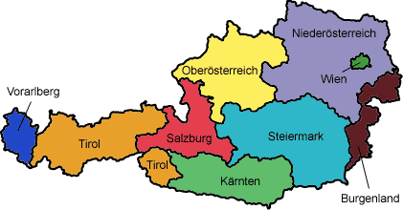
Fiscal Federalism in Austria
Cooperative federalism, closely interlinked
Federation: 3 levels of Government
  Federal Government
  9 State Governments (Länder)
  2.098 Local Gov. = Municipalities
  additional: Social Security Authorities
All Governments:
  Budgetary Autonomy
  Supervision of Municipalities by Länder Governments
Competences:
  Legal framework: Federal Constitution of Austria

Slide 5
Austria – Distribution of Powers
-> Expenditure Responsibilities
Federation:
  external affairs, customs, immigration,
  federal finances and taxes
  monetary, banking system,
  civil law affairs, police, army
  trade, industry, traffic, mining
  public health, education, universities
States
  hospitals, elderly care, regional roads, municipal laws, sports, primary schools,
  administration of most federal laws, state finances and administration, public housing subsidies
Local governments:
  local gov finances and administration,
  providing local services: water, sewage, waste disposal, local public transport, construction permits, fire brigades
What are the core responsibilities of each tier of Government?

Slide 6
Public expenditure 2015

Slide 7
Fiscal Federalism – Legal Framework
Fiscal Constitutional Law (Finanz-Verfassungsgesetz 1948) - constitutional framework
Federal Intergovernmental Fiscal Relations Act – IFRA (Finanzausgleichsgesetz - FAG)
  tax sharing
  intragovernmental transfers
  cost bearing
  → Main goal: fiscal equity

Slide 8
Constitutional setting (I)
Constitutional charter:
  Outlines the competencies of federal, state and local governments
  to act as legal entities
  to budget autonomously
  to own assets and
  to conclude public treaties
  For more special rules →
Fiscal Constitutional Law 1948
  Constitutional framework: basic rules for fiscal competences of the federal level, the Laender (states) and municipalities, most important:
  Taxing
  Tax sharing
  Cost bearing and
  Transfer rules

Slide 9
Constitutional setting (II)
Intergovernmental Fiscal Relations Act (IFRA)
  details on intergov. relations
  tax sharing
  intragovernmental transfers
  cost bearing
  single majority law of the federal government (no veto power of the Länder-chamber in parliament)
→ Main goal: fiscal equity

Slide 10
IFRA – political issues
Intergovernmental Fiscal Relations:
negotiations between
federal, state and local governments
4 -6 years, based on unanimous agreement between governments
(current IFRA: 2017-2021)
objective: equal living conditions all over Austria
high value of co-operation and consensus across government levels

Slide 11

Institutional players on Fiscal Relations
central gov.
states
local govs.
2 Assossiations

Slide 12

Important Revenues
Shared Taxes
Most important taxes: VAT, corporation tax, income tax, …
Exclusive Local Taxes: - municipal payroll tax, property tax
    equally important:
    local (highly autonomous) defined charges and fees
Tax autonomy of Länder: subordinate importance (tourism charges etc.)
Cross country, Vorarlberg, Austria

Slide 13
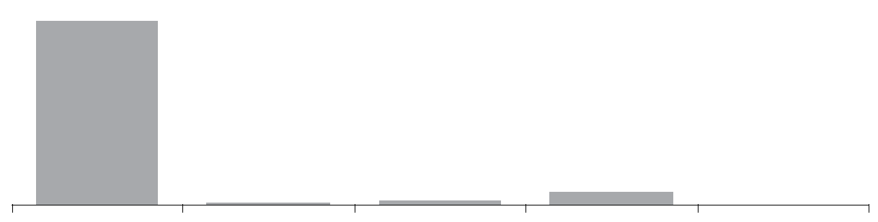
Taxes: collection, sharing and transfers
2016: € 93.211 bn
1st Step – Tax Collection
FED.g.
States
WITHOUT vIENNA
Vienna
Loc.G
EU
€ bn 88.118 357 1.326 3.410 0
Percent 94.57% 0.38% 1.42% 3.66% 0.00%

Slide 14
Shared taxes – allocation formulas – vertical allocation
 | federal gov. | states | local govs.
Shared taxes – standard formula | 67,934 | 20,217 | 11,849
Shared taxes – special formulas:
Advertising Tax | 4,000 | 9,083 | 86,917
Real Estate Tax | 4,000 | - | 96,000

Slide 15
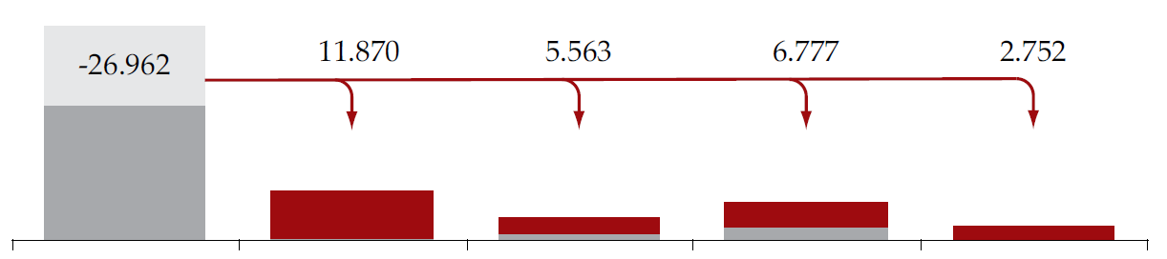
Taxes: collection, sharing and transfers
2nd Step – Tax Sharing
-27.553
12.150 5.813 7.032
2.557
Fed. G
States
WITHOUT vIENNA
VIENNA
Loc. G
EU
€ bn 60.565 12.507 7.140 10.442 2.557
Percent 64.98% 13.42% 7.66% 11.20% 2.74%

Slide 16
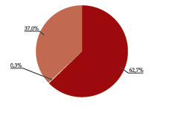

Tax Sharing – States
(2017)
32.6 %
0.1 %
67.3 %
Fed.
Gov
32.6 % Fixed Key
67.3 % Population
0.1% Local Revenues

Slide 17
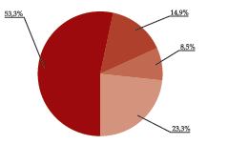
Tax Sharing - Municipalities
Step 1 – „9 groups-statewise“
52.0%
15.7%
11.1%
21.2%
52.0% WPI
11.1% Local Revenues
15.7 % Population
21.2% Fixed Key
WPI = Weighted Population Index

Slide 18


The Weighted Population Index (WPI)
WPI ➔
Larger loc govs get more per head!
One inhabitant counts in municipalities
till 10.000 inhabitants
1 41/67
10.001 to 20.000
1 2/3
20.001 to 50.000
2
above 50.000
2 1/3
Max | 1.793.212
Min | 47
avg | 4.084

Slide 19
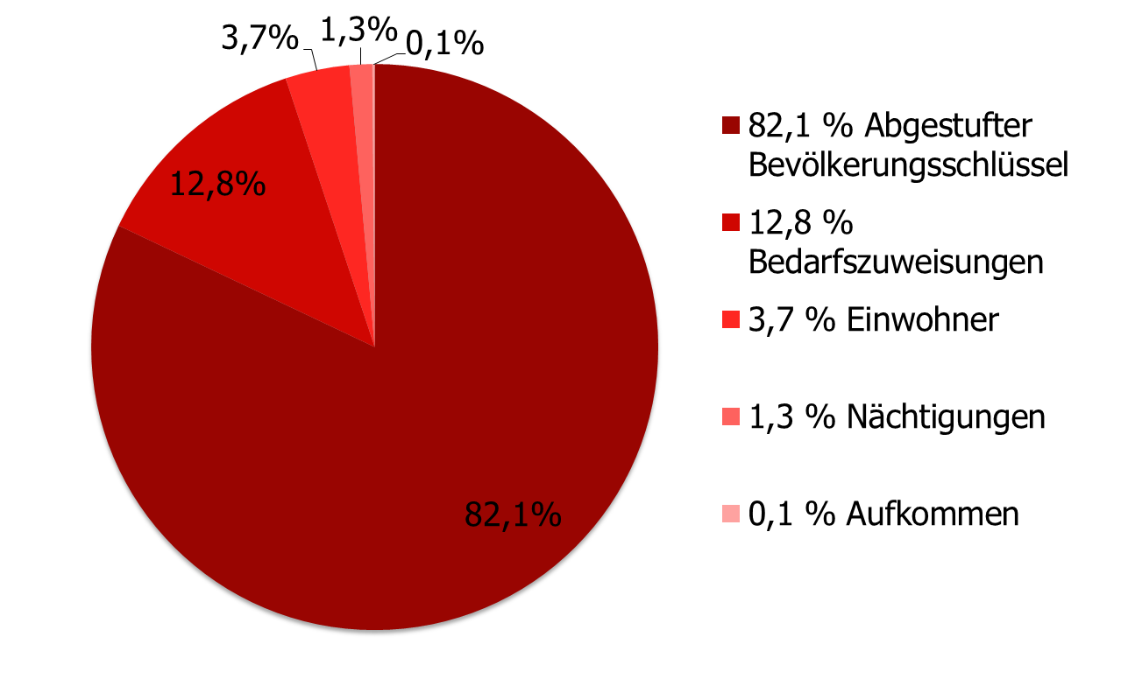
Tax Sharing – Municipalities
(2017)
Step 2 – individual municipalities
WPI
„Fiscal Needs Transfer“
Inhabitants
„Nächtigungen“
local revenues

Slide 20
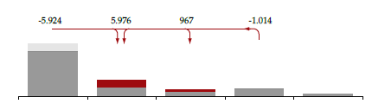
Taxes: collection, sharing and transfers
(2016) in € bn
3rd Step – Transfers and Cost Bearing
-8.008 8.230 1.411 -1.642
Outcome Fiscal Equalization
Fed. G
States
WITHOUT vIENNA
Vienna
Loc. g
EU
€ bn 52.557 20.737 8.551 8.800 2.557
Percent 56.39% 22.25% 9.17% 9.44% 2.74%

Slide 21
IFRA 2017 (I)
2010: independent studies on possible IFRA-reform
https://www.bmf.gv.at/budget/finanzbeziehungen-zu-laendern-und-gemeinden/studien-zur-reform-des-finanzausgleichs.html
04/2015-11/2016: intensive negotiations
7th Nov. 2016: memorandum of understanding
15th Nov. 2016: government bill
21th Dec. 2016: Act of parliament
1st Jan. 2017: IFRA 2017 enters into force

Slide 22
IFRA 2017 (II)
IFRA 2017
beginning of change to more…
Tax autonomy of states
Task orientation
new instruments to support administrative reforms
(system of benchmarks and spending reviews)
Maximum Ceiling for public guarantees for all levels of gov.

Slide 23


Budget Coordination – Fiscal Governance in Austria
What is Fiscal Governance?
Why is Fiscal Governance important?
What is the objective of Fiscal Governance?
Sustainable Budgets - the Austrian Way

Slide 24


Sustainable Budgets - the Austrian Way
Sixpack
substantial
budget. autonomy CG +SNG
Fiscal Compact
Twopack
ASP 2012
Partners:
- Federal Minister of Finance
- 9 state finance ministers
- political representatives of rural &
urban municipalities

Slide 25
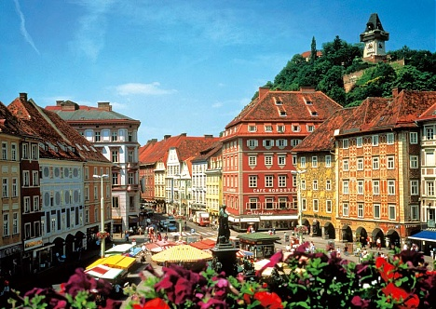
The Internal Stability-Pact
Open-ended treaty (prev. pacts: 4-6 years)
Budget coordination
Medium-term orientation of budget policy
Nationwide - Fiscal Council,
high level political committee
System of Multiple Fiscal Rules
Sanctions
Graz, Styria, Austria

Slide 26
The Internal Stability Pact
Multiple Fiscal Rules - Key-Elements
Ambitious deficit targets
converging towards a balanced Maastricht-budgetary position of general government in 2016.
Structural balance rules
for all levels of government, from 2017 on
limit of general government structural deficit of - 0.45% of GDP in line with the medium-term objective (MTO)
(-0.35%: central government;- 0.1% states & municipalities)
Expenditure Rule
annual expenditure growth of all governments must not exceed a rate below a reference medium-term rate of potential GDP growth
Debt Criterion
debt dynamics reversed (the 1/20 rule for all levels of gov.)

Slide 27

Thank you and enjoy Vienna´s cafes!

