Slide 1
REPUBLIC OF TURKEY
MINISTRY OF DEVELOPMENT
INVESTMENT PROGRAM MANAGEMENT IN TURKEY
Directorate General of Investment Programming, Monitoring and Evaluation
November 2013
Ankara

Slide 2
TURKEY’S KEY INDICATORS
INDICATOR / YEARS | 2009 | 2010 | 2011 | 2012 | 2013 (Provision) | 2014 (Program)
GDP (in current prices, USD billion) | 617 | 735 | 774 | 786 | 823 | 867
Population (midyear, million) | 72 | 73 | 74 | 75 | 76 | 77
GDP per Capita: - in current prices, USD billion - Purchasing Power Parity, USD | 8,559 14,415 | 10,022 15,775 | 10,466 17,034 | 10,497 18,125 | 10,818 18,735 | 11,277 19,583
GDP Growth (%) | -4.8 | 9.2 | 8.8 | 2.2 | 3.6 | 4.0
Public Expenditure / GDP (%) (Total per Country) | 40.1 | 38.3 | 36.8 | 38.9 | 40.8 | 39.6

Slide 3
NEW PUBLIC FINANCIAL MANAGEMENT AND CONTROL SYSTEM
Law on Financial Management and Control No.5018 (Framework Law)
New Tools:
Mid-Term Program and Financial Plan
Multi-annual Analytical Budgeting
Corporate Strategic Planning
Performance-Based Budgeting
Internal Control and Audit

Slide 4
NEW PUBLIC FINANCIAL MANAGEMENT AND CONTROL SYSTEM
Principles:
Transparency
Accountability
Efficiency
Effectiveness

Slide 5
KEY POLICY DOCUMENTS IN TURKEY
(Plan, Program and Budget Correlation)
LONG-TERM STRATEGY
DEVELOPMENT PLAN
Mid-Term Financial Plan
Mid-Term Program
Sectoral and Thematic Strategies
Regional Development Plans
Annual Program
Budget
Corporate Strategic Plans
Public Investment Program

Slide 6
3. Bölüm
KEY POLICY DOCUMENTS IN TURKEY
KEY POLICY DOCUMENTS IN TURKEY
Long-Term Strategy (2001-2023): A document stipulating the core long-term macro-economic and sectoral goals and policies, as well as frameworks of economic development plans.
Development Plan: A document developed under the guidance of the Ministry of Development and enacted by the decision of the Turkish Grand National Assembly (TGNA) in compliance with long-term strategies for a 5-year period (IXth Plan for 7 years), which determines development goals and objectives, as well as political priorities of economic development.
Mid-Term Program (MTP): A document developed under the guidance of the Ministry of Development and enacted by the decision of the Council of Ministers in compliance with economic development plans for a 3-year period, which determines priority economic development goals, objectives and policies.
Mid-Term Financial Plan (MTFP): A document developed under the guidance of the Ministry of Development and made public by the decision of the Supreme Council of Planning in compliance with mid-term programs for a 3-year period, which determines financial policies, the size of the central administrative office budget and the ceilings for appropriation proposals for institutions.

Slide 7
3. Bölüm
KEY POLICY DOCUMENTS IN TURKEY
KEY POLICY DOCUMENTS IN TURKEY
Annual Program: A document determining specific policies and measures on economic, financial, social and cultural issues and foreign economic relations for one-year period in compliance with the mid-term program. The document is published in the Official Gazette as an annex to the Decision of the Council of Ministers.
Centralized Administration Budget: Is drawn up within the framework of the Mid-Term Financial Plan and enacted after adoption by the TGNA. The document includes revenue and expenditure provisions for the current year, as well as expenditure plans as indicators for the following two years.
Investment Program: A document developed annually under the guidance of the Ministry of Economic Development including such elements as distribution of public investment projects by sectors and institutions, titles, place, subject, amount, total expenditure, appropriations and having the nature of an Annual Program. The document is published in the Official Gazette as an annex to the Decision of the Council of Ministers.
Sectoral and Thematic Strategic Documents: Strategy and policy documents developed by various sectors and thematic areas and usually approved by the Supreme Council of Planning (agriculture, small and medium enterprises, industry, energy, tourism, information society, transport strategy, etc.).

Slide 8
3. Bölüm
KEY POLICY DOCUMENTS IN TURKEY
KEY POLICY DOCUMENTS IN TURKEY
Sectoral strategic documents and strategies: Strategy and policy documents developed by various sectors and thematic areas and usually approved by the Supreme Council of Planning (agriculture, small and medium enterprises, industry, energy, tourism, information society, transport strategy, etc.).
Regional Plans and Programs: Documents drawn up to develop specific regions: Southeastern Anatolia Project Master Plan, Eastern Anatolia Project Master Plan, Eastern Black Sea Regional Development Plan, Zonguldak-Bartın-Karabük Regional Development Plan, Yeşilırmak River Basin Development Project.
Strategic Plans of institutions: According to the Law No.5018 on Public Financial Management and Control, strategic plans must be developed based on development plans, mid-term programs and other relevant domestic, regional and sectoral plans and programs.

Slide 9
STRUCTURE OF THE TENTH DEVELOPMENT PLAN
TENTH DEVELOPMENT PLAN (2014-2018)
Innovative production, stable high economic growth
Suitable premises, sustainable environment
International cooperation for economic development
Qualified people, powerful society
Priority transformation programs
Realization, monitoring, evaluation

Slide 10
PRIORITY TENTH PLAN REFORM PROGRAMS
25 distinct programs
In priority areas
Meant to solve major structural problems
Capable of facilitating the transformation process
Requiring inter-agency coordination and responsibility
Applying sectoral and cross-sectoral approaches
Covering several areas at the same time
With specific goals
After plan adoption, implemented in practice by the decision of the Supreme Council of Planning (SCP), including financial measurements and measures.

Slide 11
ANNUAL BUDGET AND INVESTMENT PROGRAM PROCESS
3. Bölüm
Yıllık kamu Investment Program
MTP (Ministry of Economic Development) (By End First Week of September),
MTFP (Ministry of Finance) (15 September)
Final formulation of draft public budget macroeconomic indicators
(By End September)
Budget Call (Ministry of Finance)
(15 September)
Submission of drafts to the SCP and discussion in the SCP
(First Week of October)
Budget Development Guide (Ministry of Finance)
(15 September)
Submission of the draft budget to the TGNA
(17 October)
Investment Program Development Guide (Ministry of Economic Development)
(15 September)
Publication of the Decision about the program and the Program for the next year in the Official Gazette
(October)
Proposals on budget and investment programs
(End September)
Budget adoption by the TGNA and publication in the Official Gazette
(By Beginning of Financial Year)
Discussion of budget and investments
(Ministry of Economic Development, Ministry of Finance, institutions)
(September)
Publication of the Investment Program in the Official Gazette
(Within 15 days after the budget enactment)

Slide 12
SCOPE OF THE PUBLIC INVESTMENT PROGRAM
STATE
Public
Economic
Institutions
SOCIAL WELFARE
INSTITUTIONS AND CIRCULATING
FUNDS
CENTRAL
ADMINISTRATION
BANK OF PROVINCES AND LOCAL PUBLIC ADMINISTRATION
(Projects implemented through
external credits)
FRAMEWORK BUDGET
DEPARTMENTS
SPECIAL BUDGET
DEPARTMENTS
REGULATORY AND CONTROL
INSTITUTIONS

Slide 13
KEY SECTORS OF THE ANNUAL PUBLIC INVESTMENT PROGRAM
Agriculture
Mining Industry
Production
Energy
Transport and Communications
Tourism
Housing Construction
Education
Health Care
K. Other Services

Slide 14
KEY INVESTMENTS IN THE STRUCTURE OF ONGOING PUBLIC INVESTMENTS
Agriculture | Storage facilities (dams, water basins etc.), melioration facilities (water supply, drainage etc.), protective facilities /anti-floods/ (dikes, floodwater retarding dams etc.), fishing ponds, forest facilities
Energy | HPPs, TPPs, gas power plants, transmission lines
Transport | Motorways: lane line motorways, expressways, district roads, motorway infrastructure and superstructure, road works (bridges, overpasses etc.). Railways : Infrastructure and superstructure, trains Sea transport : ports, breakwater harbors, quays, dockyards Air transport : airports, terminals City transport : metro and fixed rail systems Pipelines : delivery and distribution mains, tanks, compressor plants
Tourism | Infrastructure of tourist districts (water supply, sanitation, tourist paths)
Education/Culture/Sports | Schools of all levels, classrooms, campus infrastructure, departments, equipment and endowment, cultural centers, libraries, sports facilities
Health Care | Hospitals, health resorts, health units, clinics
OTHER PUBLIC SERVICES | Buildings of the security agency, police, public institutions, courts, penal colonies, administrative services, residence halls, potable water and sanitation networks, water treatment plants, waste storage, creation of organized industrial zones and small industrial parks, technological research

Slide 15
INVESTMENT SHARE IN GDP (2002-2014) (*)
4. Bölüm
Türkiye’de kamu yatırımlarında gelişmeler
Total Investments
Private Investments
Total Public Investments
Percentage
(*) Including investments of local administration authorities.
Notes:
15
15
Sabit sermaye yatırımlarının seyri incelendiğinde ВСЕГО yatırımlar üzerinde kamu yatırımlarından ziyade, kriz dönemlerinde önemli dalgalanmalar gösteren özel yatırımların belirleyici olduğu görülmektedir. 1998-2011 döneminde kamu yatırımlarının ВВП içindeki payı %4 civarında istikrarlı bir seyir izlemiştir.
Yıllar itibarıyla, ВСЕГО yatırımların %75-80’lik kısmını özel sektör yatırımları oluşturmaktayken, kamu yatırımlarının payı %20-25 seviyelerinde seyretmektedir.
Yatırımların tutarları kadar kalitesi de büyük önem arz etmektedir. Rasyonelleştirme çalışmaları sayesinde son dönemlerde kamu yatırımlarının büyümeye katkı anlamında kalitesinde artış gözlemlenmektedir.

Slide 16
FIXED PUBLIC CAPITAL INVESTMENT PLAN (Xth Plan)
4. Bölüm
Türkiye’de kamu yatırımlarında gelişmeler
Fixed Public Capital Investment Development and Goals
In 2013 prices
SECTORS | IXth Planning Period (implemented) (2007-2013)¹ |  | Хth Planning Period (2014-2018)
 | TL, million | Share, % | TL, million | Share, %
Agriculture | 39,947 | 10.2 | 50,087 | 12.0
Mining Industry | 8,483 | 2.2 | 12,522 | 3.0
Production | 3,809 | 1.0 | 3,757 | 0.9
Energy | 28,655 | 7.3 | 15,026 | 3.6
Transport | 146,123 | 37.4 | 141,914 | 34.0
Tourism | 2,087 | 0.5 | 2,504 | 0.6
Housing Construction | 6,409 | 1.6 | 4,174 | 1.0
Education | 47,886 | 12.3 | 66,783 | 16.0
Health Care | 21,887 | 5.6 | 21,287 | 5.1
Justice | 5,072 | 1.3 | 6,261 | 1.5
Security | 3,894 | 1.0 | 4,591 | 1.1
Potable Water | 25,847 | 6.6 | 29,218 | 7.0
Sanitation | 21,746 | 5.6 | 24,209 | 5.8
Technological Study | 6,889 | 1.8 | 10,435 | 2.5
Other | 21,951 | 5.6 | 24,626 | 5.9
TOTAL: | 390,684 | 100.0 | 417,393 | 100.0
Source: Xth Development Plan

Slide 17
SCOPE OF THE PUBLIC INVESTMENT PROGRAM
(in current prices, USD, billion)
 | 2014
Total Fixed Public Capital Investments | 35.7
Public Investment Program (*) | 24.0
Public Investment Program Share (%) | 67.1%
(*) Apart from local and labor authorities in investments

Slide 18
PUBLIC INVESTMENT VOLUME IN 2013
(in current prices, USD billion)
 | 2013
Number of Projects | 2,737
Total Project Cost | 222
Total Expenditure Until End 2012 | 102
Remaining Reserves | 120
Program Appropriations | 25
Mid-Term Project Completion Date (year) | ~ 4

Slide 19
PUBLIC INVESTMENT VOLUME IN 2013
4. Bölüm
Türkiye’de kamu yatırımlarında gelişmeler

Slide 20
PUBLIC INVESTMENT PROGRAM STRUCTURE
SECTOR:
INSTITUTION: |  |  |  |  |  |  |  |  |  |  |  | In 2013 prices, TL thousand
PROJECT NO. | PROJECT TITLE | PLACE PROVINCE DISTRICT | CHARACTERISTICS | WORK BEGINNING AND COMPLETION DATE | PROJECT COST |  |  | TOTAL EXPENDITURE BY END 2012 |  |  |  | 2013 INVESTMENTS
 |  |  |  |  | EXTERNAL |  | TOTAL | EXTERNAL |  |  | TOTAL | EXTERNAL |  | TOTAL
 |  |  |  |  | CREDIT | CAPITAL |  | CREDIT | CAPITAL |  |  | CREDIT | CAPITAL
(INSTITUTION) TOTAL
A. PROJECT WORKS - TOTAL
a) Completed in 2013
b) Will be completed after 2013
B. CONTINUED PROJECTS - TOTAL
a) Completed in 2013
b) Will be completed after 2013
C. NEW PROJECTS - TOTAL TOTAL
a) Completed in 2013
b) Will be completed after 2013

Slide 21
PUBLIC INVESTMENT PROGRAM STRUCTURE - Project Samples
PUBLIC INVESTMENT PROGRAM STRUCTURE
SECTOR : Agriculture
PROJECT OWNER: STATE HYDRAULIC WORKS
 |  |  |  |  |  |  |  |  |  |  |  | (TL, thousand)
 |  |  |  |  |  |  | BY END 2012
 |  |  |  |  | PROJECT COST |  | ESTIMATED EXPENDITURE |  |  |  | 2013 INVESTMENT
 |  |  |  | DATE OF
 |  |  |  | BEGINNING AND
 |  | PLACE |  | COMPLETION | EXTERNAL | TOTAL | EXTERNAL |  | TOTAL | EXTERNAL |  | TOTAL
PROJECT NO. | PROJECT TITLE | DISTRICT, PROVINCE | TYPE | OF WORKS |  |  | CREDIT | CAPITAL |  | CREDIT | CAPITAL
 | STATE HYDRAULIC WORKS - TOTAL |  |  |  | 4,106,581 | 72,633,354 | 2,597,127 | - | 26,608,690 | 46,030 | - | 3,351,800
A) PROJECT WORKS TOTAL |  |  |  |  | 16,783 | 1,171,246 | 16,783 | - | 310,246 | - | - | 150,000
 | a) Completed in 2011 |  |  |  | - | 15,000 | - | - | - | - | - | 15,000
2011A010010 | Various studies | Various | Studies-Projects | 2011-2011 | - | 15,000 | - | - | - | - | - | 15,000
2000A010300 | Water Supply to Anamur (TRNC) from Dragon River by Water Pipeline |  | Studies-Projects | 2000-2011 | (14,781) | (17,442) | (13,535) |  | (15,972) | (1,246) |  | (1,470)
 | (1)
 | b) Remaining from the period after 2011 |  |  |  | 16,783 | 1,156,246 | 16,783 | - | 310,246 | - | - | 135,000
1985A010020 | Various studies | Various | Studies-Projects | 1985-2016 | 16,783 | 1,156,246 | 16,783 | - | 310,246 | - | - | 135,000
 | (GAP) |  |  |  |  |  |  |  |  |  |  | (35,000)
 | (DAP) |  |  |  |  |  |  |  |  |  |  | (20,000)
 | (KOP) |  |  |  |  |  |  |  |  |  |  | (5,000)
B. CONTINUED PROJECTS - TOTAL |  |  |  |  | 4,088,620 | 67,871,626 | 2,580,344 | - | 26,298,444 | 46,029 | - | 3,136,056
 | a) Completed in 2011 |  |  |  | 182,042 | 1,969,632 | 182,042 | - | 1,897,972 | - | - | 71,660
1999A010010 | Filyos-Köprübaşı (DA) (ZBK) | Zonguldak,Bolu | Fencing : 2 districts | 1999-2011 | - | 15,447 | - | - | 14,147 | - | - | 1,300
1986A010180 | Mersin-Mut | Mersin | Irrigation: 4,163 ha | 1986-2011 | - | 124,375 | - | - | 121,375 | - | - | 3,000
1964A010800 | Erzincan, Stage II (DAP) | Erzincan | Storage: 178 hm3 | 1964-2011 | 31,118 | 430,111 | 31,118 | - | 429,111 | - | - | 1,000
 |  |  | Irrigation : 32,321 ha
 |  |  | Renovation: 5,700 ha
 | b) Remaining from the period after 2011 |  |  |  | 3,906,578 | 65,901,994 | 2,398,302 | - | 24,400,472 | 46,029 | - | 3,064,396
1991A010070 | Bursa-Yenişehir, Stage I | Bursa | Storage: 65 hm3 | 1991-2014 | - | 348,562 | - | - | 108,384 | - | - | 7,500
 |  |  | Irrigation : 16,665 ha
 |  |  | Fencing : 1 district
1991A010130 | Karaman, Stage II (KOP) | Karaman | Storage: 134 hm3 | 1991-2015 | - | 165,765 | - | - | 69,267 | - | - | 10,000
 |  |  | Irrigation : 8,700 ha
C) NEW PROJECTS - TOTAL |  |  |  |  | 1,178 | 3,590,482 | - | - | - | 1 | - | 65,744
 | a) Completed in 2011 |  |  |  | - | 56,142 | - | - | - | - | - | 56,142
2011A010030 | Tree planting Parks and nurseries | Various | Various | 2011-2011 | - | 4,000 | - | - | - | - | - | 4,000
 | b) Remaining from the period after 2011 |  |  |  | 1,178 | 3,534,340 | - | - | - | 1 | - | 9,602
2011A010160 | Samsun-19 May (YHGP) (4) | Samsun | Storage: 43.4 hm3 | 2011-2015 | - | 51,000 | - | - | - | - | - | 100
 |  |  | Irrigation : 1,654 ha

Slide 22
SETTING PRIORITIES OF PUBLIC INVESTMENTS
For public investments:
Sectoral
Regional
Project
Investments are detailed in starting from the long-term strategy to the development plan, mid-term program and annual program from general to specific.

Slide 23
PUBLIC INVESTMENT STRATEGY OF TURKEY
Focus on economic and social infrastructure areas that cannot be implemented by the private sector
Implementation of local investments by local public administrations
Maximum use of cooperation between public and private sectors
Notes:
23

Slide 24
ROLES OF INSTITUTIONS IN PLANNING, BUDGETING AND PRACTICE
Turkinsh Grand National Assembly (TGNA) (Final approval of the economic development plan and budget)
Council of Ministers (Final approval of the Mid-term program, Annual Program and Investment Program)
Supreme Council of Planning (Approval of plan, program and budget documents before submission to the Council of Ministers)
Ministry of Economic Development (Project development, monitoring, evaluation and coordination of long-term plans, mid-term programs, annual program and investment programs)
Ministry of Finance (Development of mid-term financial plan, budget, general progress report, and monitoring of budget execution)
Undersecretariat of Treasury (Cash and debt management)
Public institutions and ministries (Development of departmental strategic plans, performance programs, budget proposals and investment programs, feasibility studies, progress and monitoring reports, implementation of plans, programs and budgets)
Court of Accounts (External audit)

Slide 25
MEMBERS OF THE SUPREME COUNCIL OF PLANNING
Chairperson: Prime Minister
Members:
Deputy Prime Minister (in charge of treasury and economy coordination)
Minister of Development
Minister of Finance
Minister of Environment and Urbanization
Minister of Transport, Maritime Affairs and Communications
Minister of Energy and Natural Resources
Minister of Science, Industry and Technologies
Minister of Forestry and Water Affairs

Slide 26
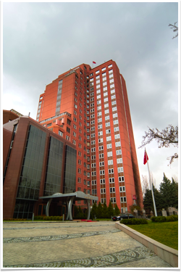
Major Objectives of the Ministry of Economic Development
To render consultancy services to the government;
To prepare long-term plans, mid-term programs and annual programs, to coordinate their implementation, to perform monitoring and evaluation;
To develop strategies for the future;
To render consultancy services to the government in finance, monetary issues, foreign trade and exchange-rate policy;
To develop general incentive policy framework;
To determine measures to accelerate the rate of development in priority regions and to make corresponding recommendations;
To inform the government on development of relations with international economic organizations and to make corresponding recommendations;
To develop sectoral and regional development plans and programs.

Slide 27
SCOPE OF THE INVESTMENT CIRCULAR AND INVESTMENT PROGRAM DEVELOPMENT GUIDE
Investment Proposal Ceilings
Sectoral, Regional and Project Priorities
Principles and Methods
Feasibility Study Formats
Indicators (foreign exchange rate, deflator etc.)

Slide 28
FEASIBILITY STUDY FORMAT
A. EXECUTIVE SUMMARY
B. GENERAL REPORT
TABLE OF CONTENTS
INTRODUCTION
PROJECT DESCRIPTION AND CONTENTS
PROJECT BACKGROUND
PROJECT RATIONALE
GOODS AND/OR SERVICES MARKETING-PRODUCTION PROGRAM
PROJECT IMPLEMENTATION PLACE/SCOPE
TECHNICAL ANALYSIS AND DESIGN
PROJECT RESOURCES
ORGANIZATIONAL STRUCTURE, MANAGEMENT AND HUMAN RESOURCES
PROJECT MANAGEMENT AND IMPLEMENTATION PROGRAM
REVENUE AND EXPENDITURE WITHIN THE EXPLOITATION PERIOD
TOTAL INVESTMENT AMOUNT AND DISTRIBUTION BY YEARS
PROJECT FINANCING
PROJECT REVIEW
APPENDICES

Slide 29
PUBLIC INVESTMENT PROJECT PROPOSAL FORM
PROJECT DESCRIPTION
PROJECT RATIONALE, GOALS AND OBJECTIVES
SOURCE OF PROJECT IDEA AND BASIS
DETAILED PROJECT INFORMATION
APPENDIX: Budget Summary
* Will be developed for projects under Article 26 of the Guide.

Slide 30
PROJECT ANALYSIS BY SPO
Project proposals are analyzed by experts of the State Planning Organization based on:
Financial
Economic
Social
Corporate
Environmental
Sectoral and regional priorities.

Slide 31
INNOVATIVE APPROACHES IN INVESTMENT PRACTICE
Enabling public institutions to establish certain criteria themselves and be flexible in implementation of large-scale projects, thus, enhancing project ownership.
Giving significant authority to institutions in current issues (appropriations, project cost, detailed projects etc.)
Creating opportunities for local public authorities to undertake expenditure by cash transfer through the practice of implementing village and municipal infrastructure projects, creating attraction centers and carrying out activities of Development Agencies
Practice of social assistance projects targeted at satisfaction of social needs
Construction of education and health institution buildings by the Housing Development Administration
Notes:
Sadece doğrudan kamu yatırımları yapmıyoruz. Hem yerel idarelere hem özel kesim ve STK’lara hibe destekler veriyoruz.
Bu kapsamda;
İŞ-KUR mesleki Образование desteği
Сельское хозяйство Bakanlığı kırsal kalkınma destekleri
Kalkınma Ajansları
Cazibe merkezleri
SODES
Ulusal Ajans
kanalıyla özel kesim ve STK’lara kaynak kullandırılmaktadır.
Ayrıca, KHGM yatırımları valiliklere devredilerek İl Özel İdareleri eliyle yürütülmektedir.
Diğer taraftan MEB gibi bazı icracı bakanlıkların yerel projeleri İl Özel İdareleri vasıtasıyla yürütülmektedir.

Slide 32
PUBLIC PRIVATE PARTNERSHIP
At central and local level:
The following models are used to streamline the opportunities of the private sector to provide public services: Build-Operate-Transfer (BOT), Build-Transfer (BT), Build-Lease-Transfer (BLT) and Transfer of Operating Rights (TOR).
In compliance with current laws, construction of airports, seaports, motorways, dams, HPPs, gas power plants takes place based on these schemes.
Within the upcoming period, construction of education and health institution buildings will take place based on the Build-Lease-Transfer scheme.

Slide 33
INVESTMENT PROGRAM IMPLEMENTATION, COORDINATION AND MONITORING
The principles, methods and rules stipulated in the decision of the Council of Ministers on Public Investment Program Implementation, Coordination and Monitoring are applied in work performance.

Slide 34
DECISION ON INVESTMENT PROGRAM IMPLEMENTATION, COORDINATION AND MONITORING
Contents:
Terms and Scope
Principles
Corporate Limits for Project Revision
Coordination
Monitoring Rep0rts and Periods

Slide 35
DECISION ON INVESTMENT PROGRAM IMPLEMENTATION, COORDINATION AND MONITORING
3. Bölüm
Yıllık kamu Investment Program
Investment Program Implementation, Coordination and Monitoring takes place based on principles, methods and rules stipulated in the corresponding Decision of the Council of Ministers. The Decision of the Council of Ministers consists of:
I. PRACTICE Description Scope - General principles - Large-scale and joint projects - Inclusion of new projects in the program and their exclusion throughout the year - Changes to be made throughout the year in project indicators (place, characteristics, terms, cost, appropriations) - Partially drawn down credits - Investments of local public authorities - Establishment of new organizations - Receiving opinions about draft laws Leasing Proposals on annual investment programs - International technical cooperation activity organization and coordination | II. COORDINATION - Cooperation and coordination - General Strategy and Master Plans Interregional cooperation - Regional Plans - Regional Development Program and Project coordination - Local coordination - Provincial Coordination Councils | III. MONITORING - State economic enterprises and subsidiaries - Regulatory and control bodies - Monitoring reports - Coordination and monitoring of external aid application activities - Need in allocation of funds to cover final report deficit - Project amendment requirements - Financial Instrument for the EU Pre-Accession - Enactment

Slide 36
DECISION ON INVESTMENT PROGRAM IMPLEMENTATION, COORDINATION AND MONITORING
3. Bölüm
Yıllık kamu Investment Program
Investment Program Monitoring
Information on the status of investment program project implementation based on the developed forms will be submitted to the Ministry of Economic Development as of:
End March,
End June,
End September and
End December
within 15 days from the last day of the first three reporting periods and by End March on the Investment Implementation Report as of End December.

Slide 37
MONITORING AND EVALUATION
Ex-ante project evaluation and appraisal by the Ministry of Economic Development
Quarterly (March, June, September, end December) financial monitoring of all project implementation
Preparation of reports by implementing institutions in the electronic form and on paper and their introduction in the data base of the Ministry of Economic Development
Based on Investment Circular, request for information on financing and processes
Within certain projects, conduction of field studies by planning specialists
Application of a different monitoring system for EU-funded projects
An impact assessment mechanism is still not in place

Slide 38
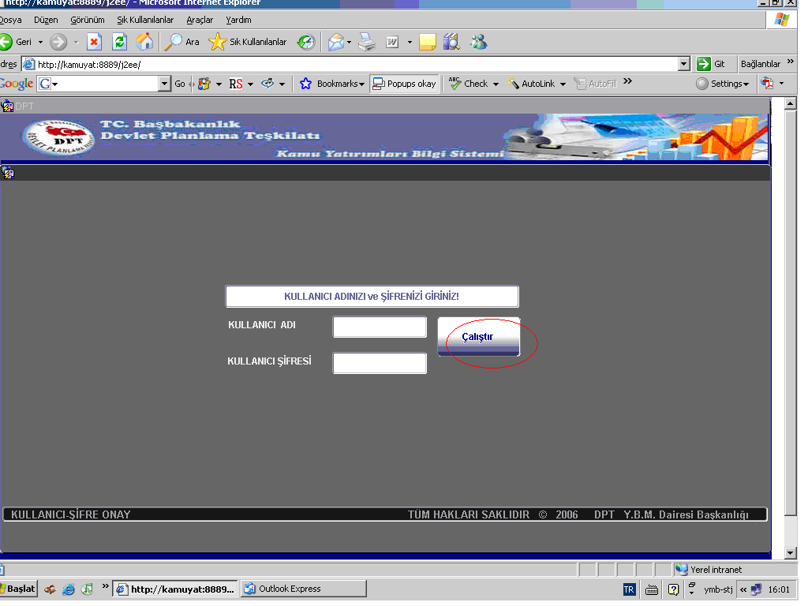
PUBLIC INVESTMENT QUARTERLY MONITORING SYSTEM
38

Slide 39
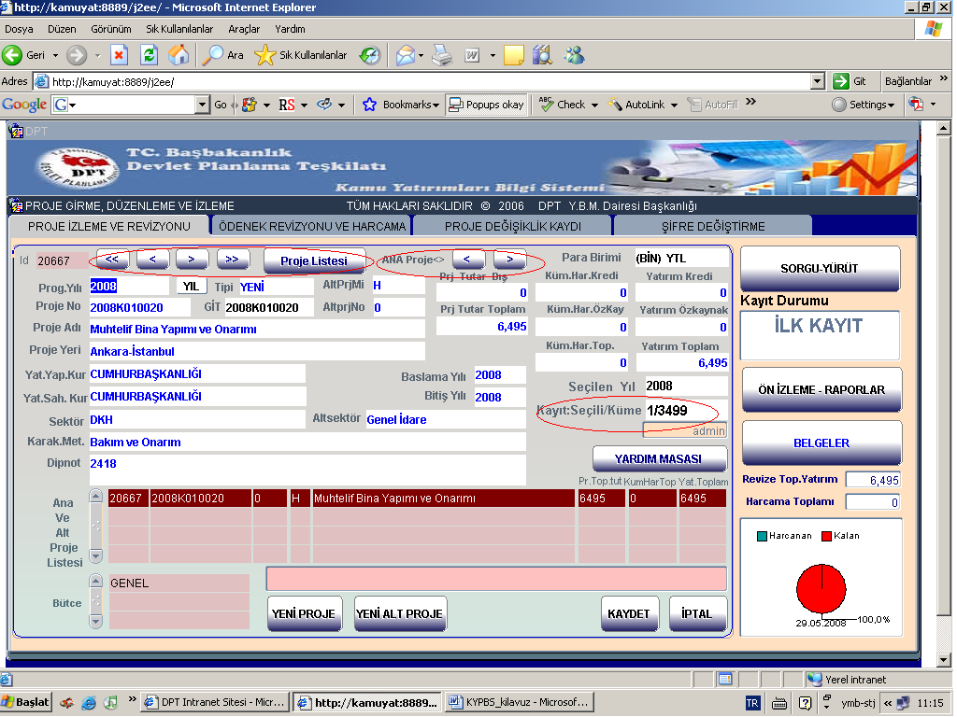
PUBLIC INVESTMENT QUARTERLY MONITORING SYSTEM
39

Slide 40
INVESTMENT PROGRAM END-YEAR MONITORING AND EVALUATION REPORT
2012 Investment Program Monitoring and Evaluation Report Form
1. Executive Summary
2. General Evaluation
Organization's Vision:
Organization's Mission:
Organization's Major Goals and Areas:
Organization's Sources of Investment Financing
Organization's Current Production Capacity (capital stock):
2012 Investment Targeted and Implemented Production Growth:
2012 Investment Practice:
- General Investment Implementation Status:
- Key challenges emerged during investment implementation
3. Project Implementation in 2012:
Continued projects:
Completed multi-annual projects (Project Completion Report) :
4. Proposals:

Slide 41
LESSONS LEARNED FROM TURKEY'S EXPERIENCE
There is a need for long-term and mid-term perspectives (strategy, long-term plan, mid-term program, multi-annual budgeting etc.)
It is important to ensure ownership of plans, programs and projects. Participatory approach should be applied at every stage of project cycle management.
Such management instruments as project cycle management and logical framework matrix can be used in planning, implementation and monitoring.
Institutions have to benefit from enough flexibility in their activities.
It is necessary to create efficient coordination and cooperation between central bodies and implementing institutions, especially to define corporate roles.

Slide 42
LESSONS LEARNED FROM TURKEY'S EXPERIENCE
It is necessary to follow such principles as transparency, accountability, participation, efficiency, effectiveness, performance, result focus.
The volume of administered investments has to correspond to resources.
Projects have to be assessed comprehensively. For instance, dams and irrigation channels have to be constructed at the same time.
The corporate capacity of state institutions is of crucial importance for development and implementation of reliable projects. Qualification of the corresponding staff has to be improved.
It is necessary to have an efficient monitoring and evaluation system in order to be able to take timely preventive and correction measures and better plan future projects.

Slide 43
LESSONS LEARNED FROM TURKEY'S EXPERIENCE
Monitoring and evaluation reports have to be drawn up correctly, reliably and timely and to be submitted to the stakeholders.
There is a need to apply a systematic comprehensive result-based approach.
Public Private Partnership (PPP) schemes can be useful in reducing the financial burden of the public sector and using the financial and managerial capacity of the private sector in providing public services.
Determination of the legal framework for program, budget and project cycle management will help to increase performance.

Slide 44
LESSONS LEARNED FROM TURKEY'S EXPERIENCE
Sufficient time and money have to be allocated to high-quality feasibility studies. It is important for projects to be relevant, feasible and sustainable.
Learning from the experience of other countries allows applying their positive achievements.
One can make use of the opportunities, technical capacity and specialization of international organizations.
The developed systems have to comply with the conditions in the country (economy, technologies, culture).

Slide 45
THANK YOU FOR YOUR ATTENTION...

