Slide 1
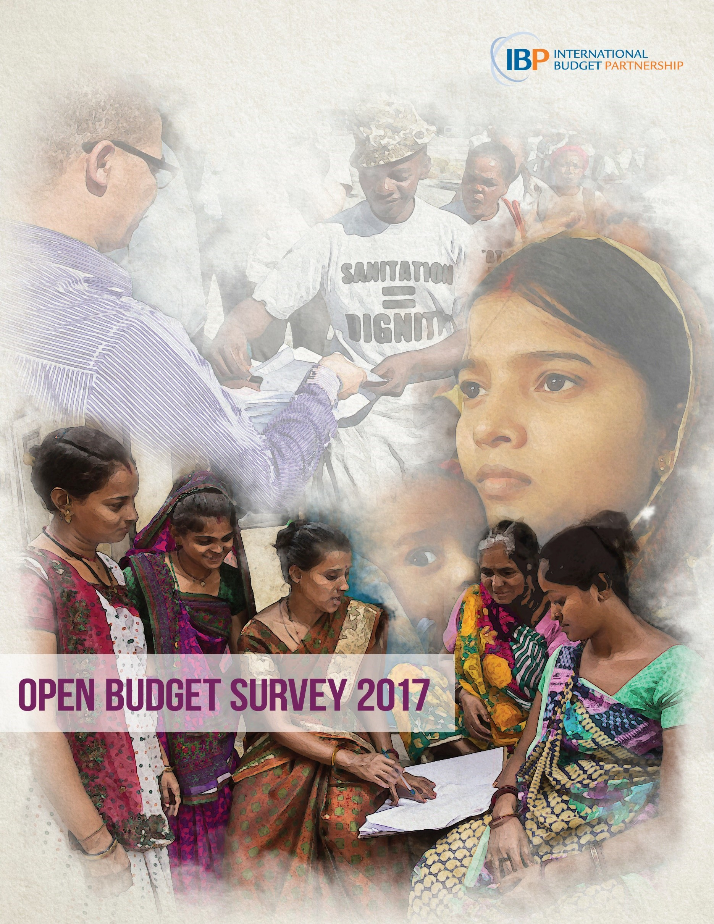
Notes:
4:24

Slide 2
The Open Budget Survey (OBS)
The OBS assesses whether the basic conditions needed for representative democracy to function are being met in the budget sphere:
  the free flow of information
  oversight practices by legislatures and auditors
  opportunities for public participation in government decision-making and oversight

Slide 3
The OBS methodology
Only independent, comparative measure of budget transparency, oversight and participation in the world
Questions based on international standards
Measures observable facts using 145 scored indicators
2017: Sixth round of the OBS covers 115 countries
The 2017 Survey covers 18 of the 23 PEMPAL countries
  Moldova was added for the 2017 Survey

Slide 4
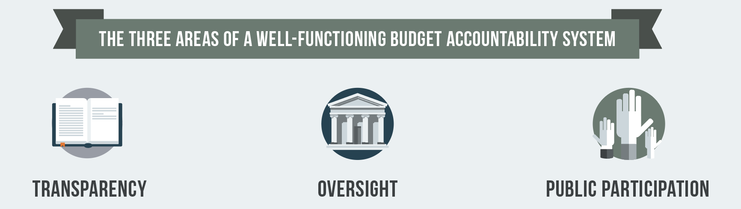
What the OBS measures
109 indicators used to construct the Open Budget Index assess whether governments publish online and in a timely manner eight key budget documents
18 revised questions examine formal oversight institutions
18 new questions examine opportunities for public participation in national budget decision-making and oversight

Slide 5
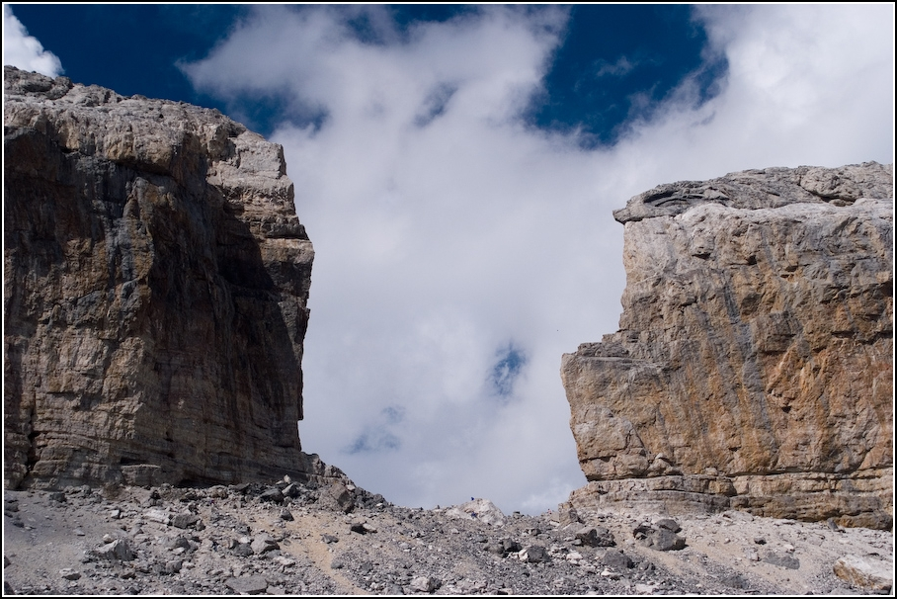
OBS 2017: Finding 1
Governments fail to make sufficient information available to the public to understand, debate and participate in budget decisions

Slide 6
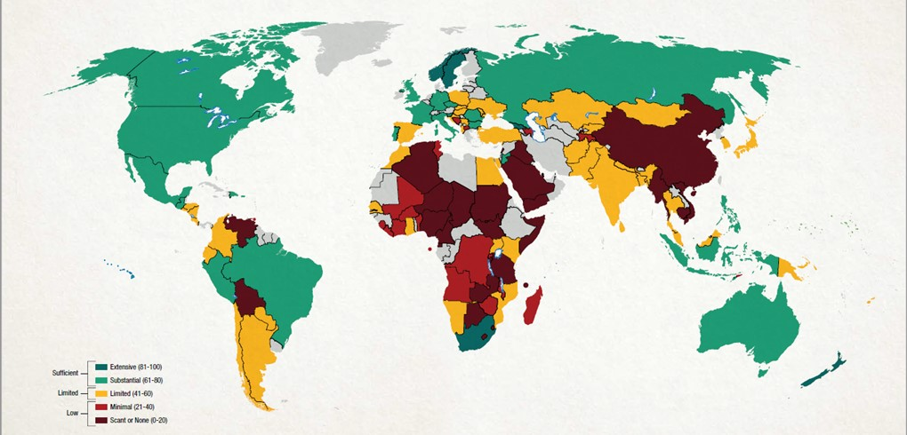
The Open Budget Index (OBI) 2017
The average OBI score of the 115 countries surveyed in 2017 is 42 out of 100, suggesting that the global state of transparency is limited

Slide 7
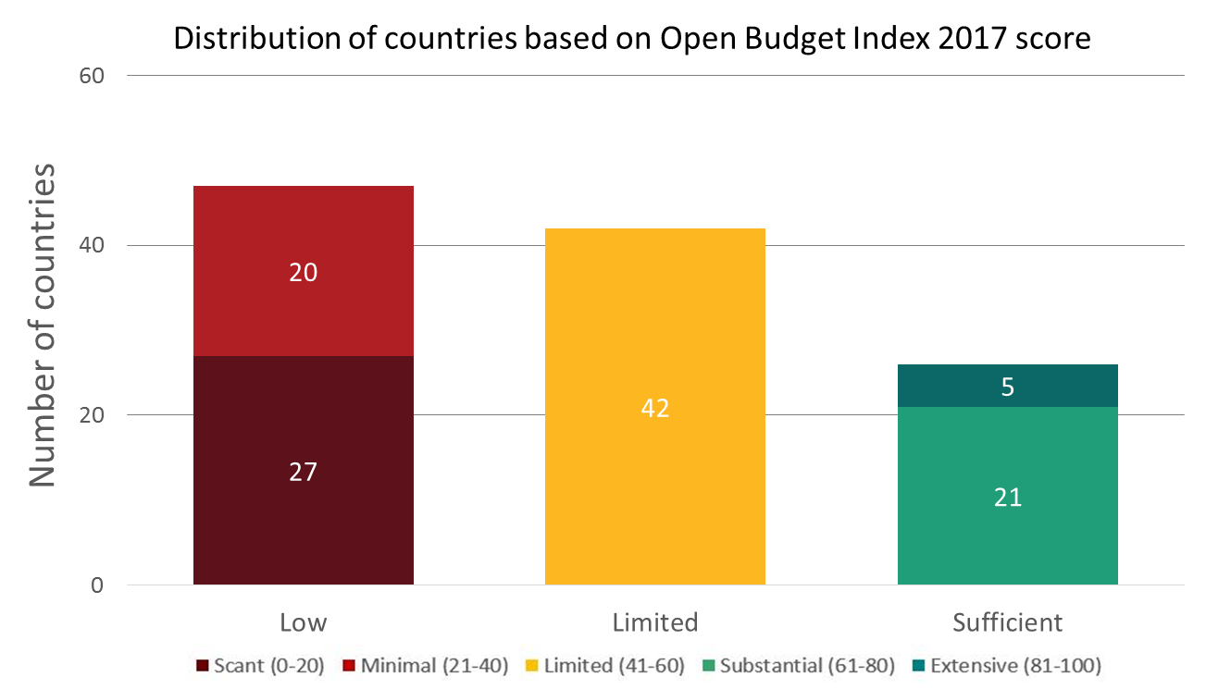
3 of every 4 countries fall short on OBI
89 of 115 countries surveyed fail to provide sufficient information to the public on their national budgets, according to Open Budget Index 2017

Slide 8
On average, PEMPAL countries provide limited budget information
18 PEMPAL countries included in OBS 2017
Average score of 54
As compared to:
  Global average of 42
  OECD average of 68
OECD
22
countries
PEMPAL
18
countries
Global
115
countries

Slide 9
Few PEMPAL countries provide sufficient information

Slide 10
When it comes to budget documents in PEMPAL…
About one in four documents that should be publicly available are not
More than half of the documents that are not published are already produced

Slide 11
Documents: PEMPAL v. Global
Percent of countries publishing key budget document in 2017

Slide 12
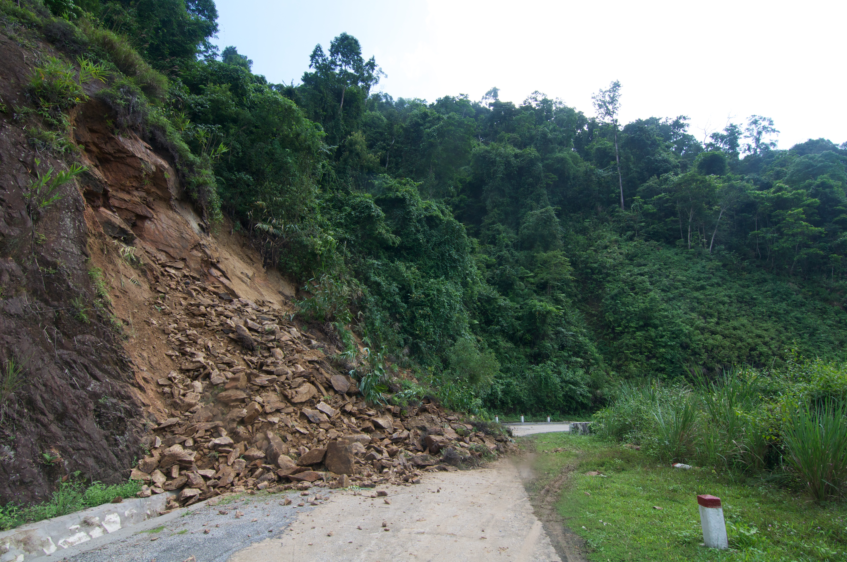
OBS 2017: Finding 2
Progress toward greater transparency has stalled for the first time since IBP began measuring it over a decade ago

Slide 13
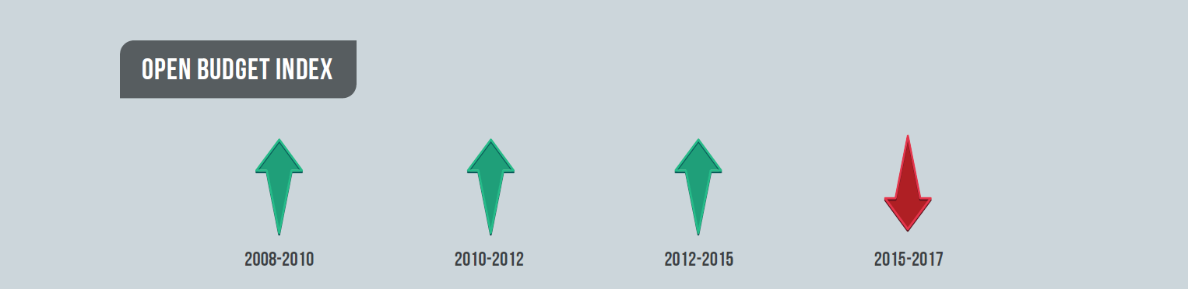
Increases in transparency halted between 2015 and 2017
The average OBI score fell from 45 in 2015 to 43 in 2017 for the 102 countries surveyed in both rounds
This was the first time this has happened since 2008
  For PEMPAL, however, the average OBI increased from 52 to 53 for the 17 comparable countries

Slide 14
OBI decline varies by regions

Slide 15
Lower global OBI score reflects decline in document publication
Net number of documents published between 2015 and 2017 Open Budget Surveys declined by 37
  First time survey found a drop in document publication
The decline was concentrated in Sub-Saharan Africa, which published 27 fewer documents
The PEMPAL countries published 4 fewer documents
  OECD: Number of documents fell by six, or about 5%.

Slide 16
Taking a Longer View: 2008 - 2017
The decline in budget transparency in 2017 did not erase all of the gains from previous rounds of the Open Budget Survey
Between 2008 and 2017, the average OBI score rose by six points for comparable countries
  In PEMPAL, the average OBI score rose by eight points for 15 comparable countries between 2008 and 2017
Available budget documents contain more information than they did in previous years, if we look at global averages
Within the region, Georgia stands out for experiencing substantial gains over the last decade

Slide 17
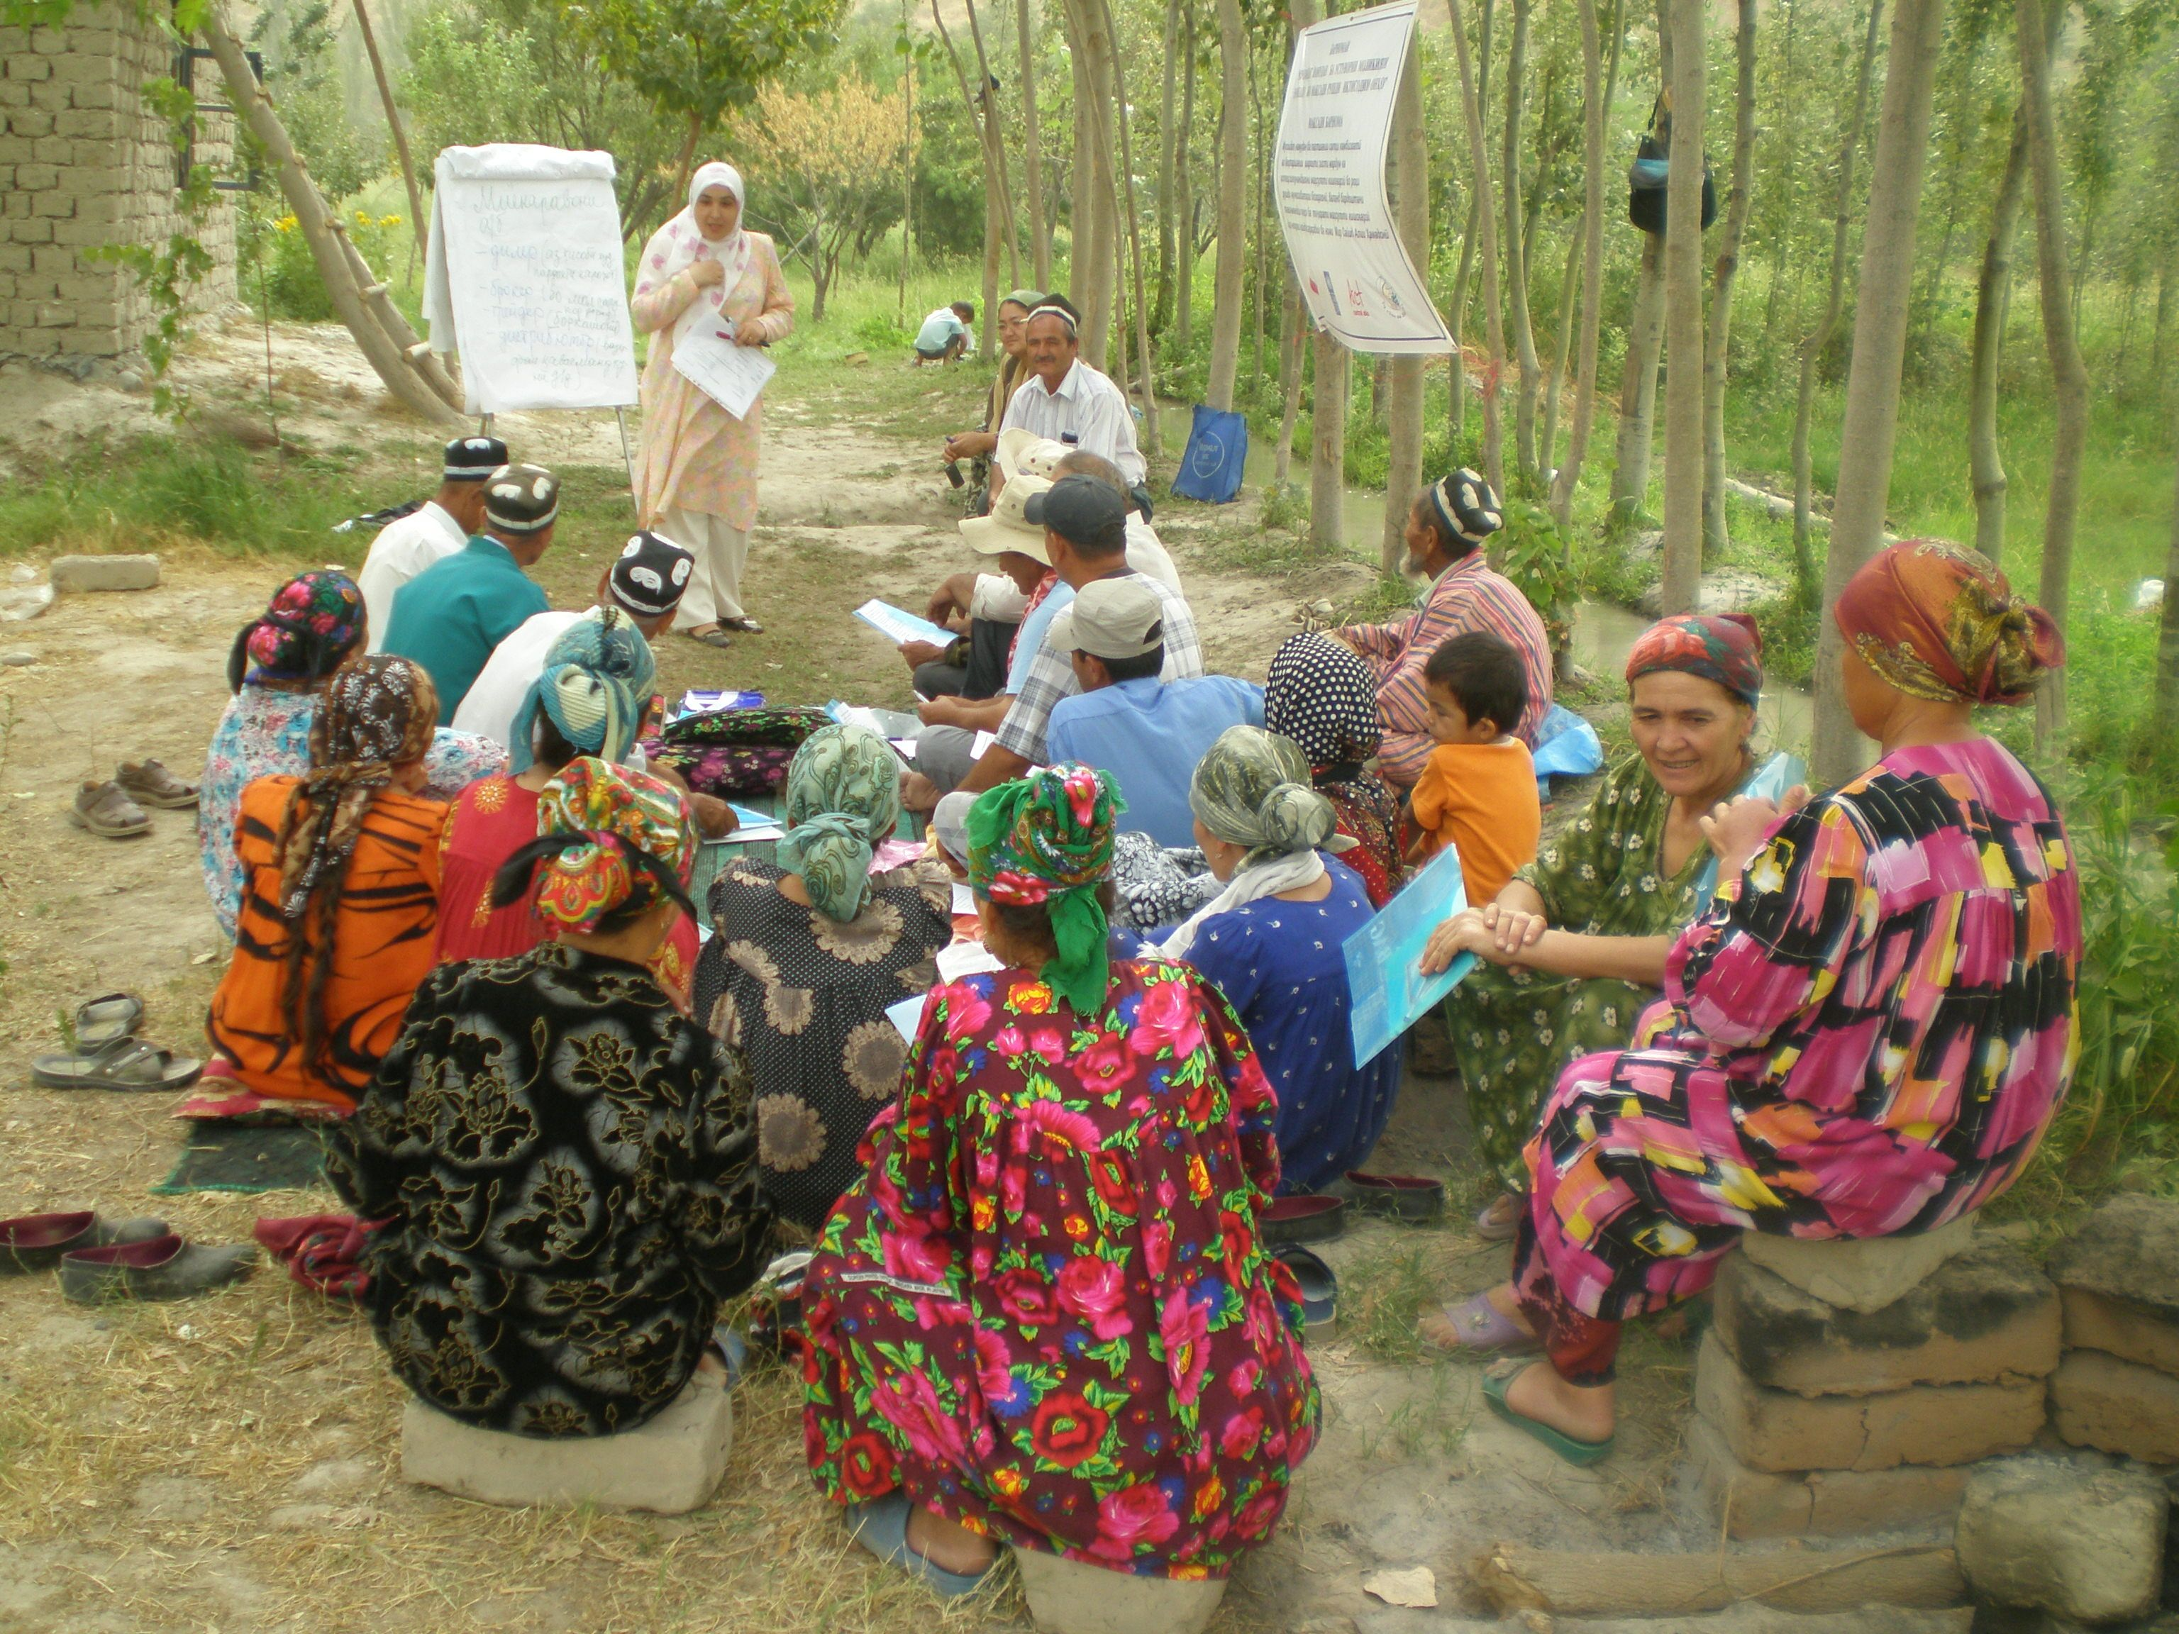
OBS 2017: Finding 3
Problems associated with a lack of budget transparency are compounded by limited oversight and few opportunities for public participation in budgeting

Slide 18
Oversight Globally
In 2017, average oversight score for global sample is 53 out of 100
Supreme audit institutions (63/100) score better than legislatures (48/100) on oversight indicators
Independent fiscal institutions (IFIs) are not prevalent: Just 28 of 115 countries had IFIs as of the end of 2016.
Combined SAI and Legislative Oversight Score

Slide 19
Across PEMPAL, oversight is scored as adequate
Average SAI and Legislative Oversight Score
In 2017, the average PEMPAL oversight score is 67 out of 100
  OECD average score is 72
Audit oversight practices are better than legislative oversight
Independent fiscal institutions (IFIs) are not prevalent: Just six of 18 PEMPAL countries have IFIs
  OECD: 14 of 22 countries have IFIs

Slide 20
Oversight by legislatures
Legislatures exercise more oversight earlier in the budget process than during implementation
Globally, legislatures do not amend the budget in nearly half of the countries surveyed…
  Higher in PEMPAL: 83% successfully amend the budget
Further, in more than half of countries, the executive is able to change the budget during implementation without legislative approval
  Half of PEMPAL executives shift funds between administrative unites without legislative approval
In more one third of countries, the legislature does not examine the Audit Report on the annual budget produced by the Supreme Audit Institution
  Legislatures in nearly all PEMPAL countries (16 of 18) examine the audit report; however only seven of 18 publish a report of findings within three months publication by the SAI

Slide 21
Oversight by Supreme Audit Institutions
The majority of countries surveyed have adequate SAI oversight scores
  Nearly all countries in PEMPAL have adequate scores (17/18)
Conditions tend to be less favorable in countries that have lower levels of budget transparency
Supreme Audit Institution Score
PEMPAL
SSA

Slide 22
OBS measures of participation
18 Questions on Public Participation in Fiscal Policy, covering:
  Executive participation mechanisms on budget formulation and monitoring
  Line ministry participation mechanisms on budget formulation or monitoring
  Legislature or legislative committee participation mechanisms on budget formulation and deliberations on the audit report
  SAI participation mechanism on determining the audit program and contributing to audit investigations
Questions reflect GIFT Principles, such as:
  Inclusive: Concrete steps to include vulnerable or underrepresented group, and open to all citizens, not just specific groups or individuals
  Timely: Participation early in the process before decisions are made
  Openness: Broad coverage of topics for discussion and purpose of participation provided to the public in advance
  Sustainability: Feedback provided to citizens on the inputs received from the public

Slide 23
Scores on participation are low
Not a single country out of the 115 surveyed offers participation opportunities that are considered adequate (a score of 61 or higher)
The average score globally is just 12 out of 100
In PEMPAL, the average score for participation is also 12
  In OECD countries, the average score is 22

Slide 24
Examples of participation mechanisms
Philippines: Budget Partnership Agreements have strengthened the ability of individual agencies to negotiate their budget demands with the central budget agency through partnerships with citizens
South Korea: Waste Reporting Center has saved the government an average of US$1 billion a year over the last 16 years

Slide 25
Examples of participation mechanisms:
PEMPAL
Ukraine:
  Expert hearings on the budget, where members of the public and government officials exchange views
Croatia:
  Economic and Social Council that includes multi-sectoral representatives that gives opinions on the budget proposal
Georgia:
  Online Consultation on Budget Priorities, and a coordination council in the Ministry of Finance that meets with stakeholders
Kyrgyz Republic:
  Budget hearings on the Executive Budget Proposal with an open invitation from the Ministry of Finance

Slide 26
Three Pillars of Accountability System
Transparency, participation, and oversight: all three pillars needed
As transparency scores rise, so do scores on oversight and participation
Globally, no countries score 61 or higher on all three pillars of the accountability system
In PEMPAL, Albania, Czech Republic, Georgia, Kyrgyz Republic, Russia, Tajikistan, and Ukraine score above 61 on transparency and both measures of oversight
The budget accountability system in PEMPAL, 2017

Slide 27
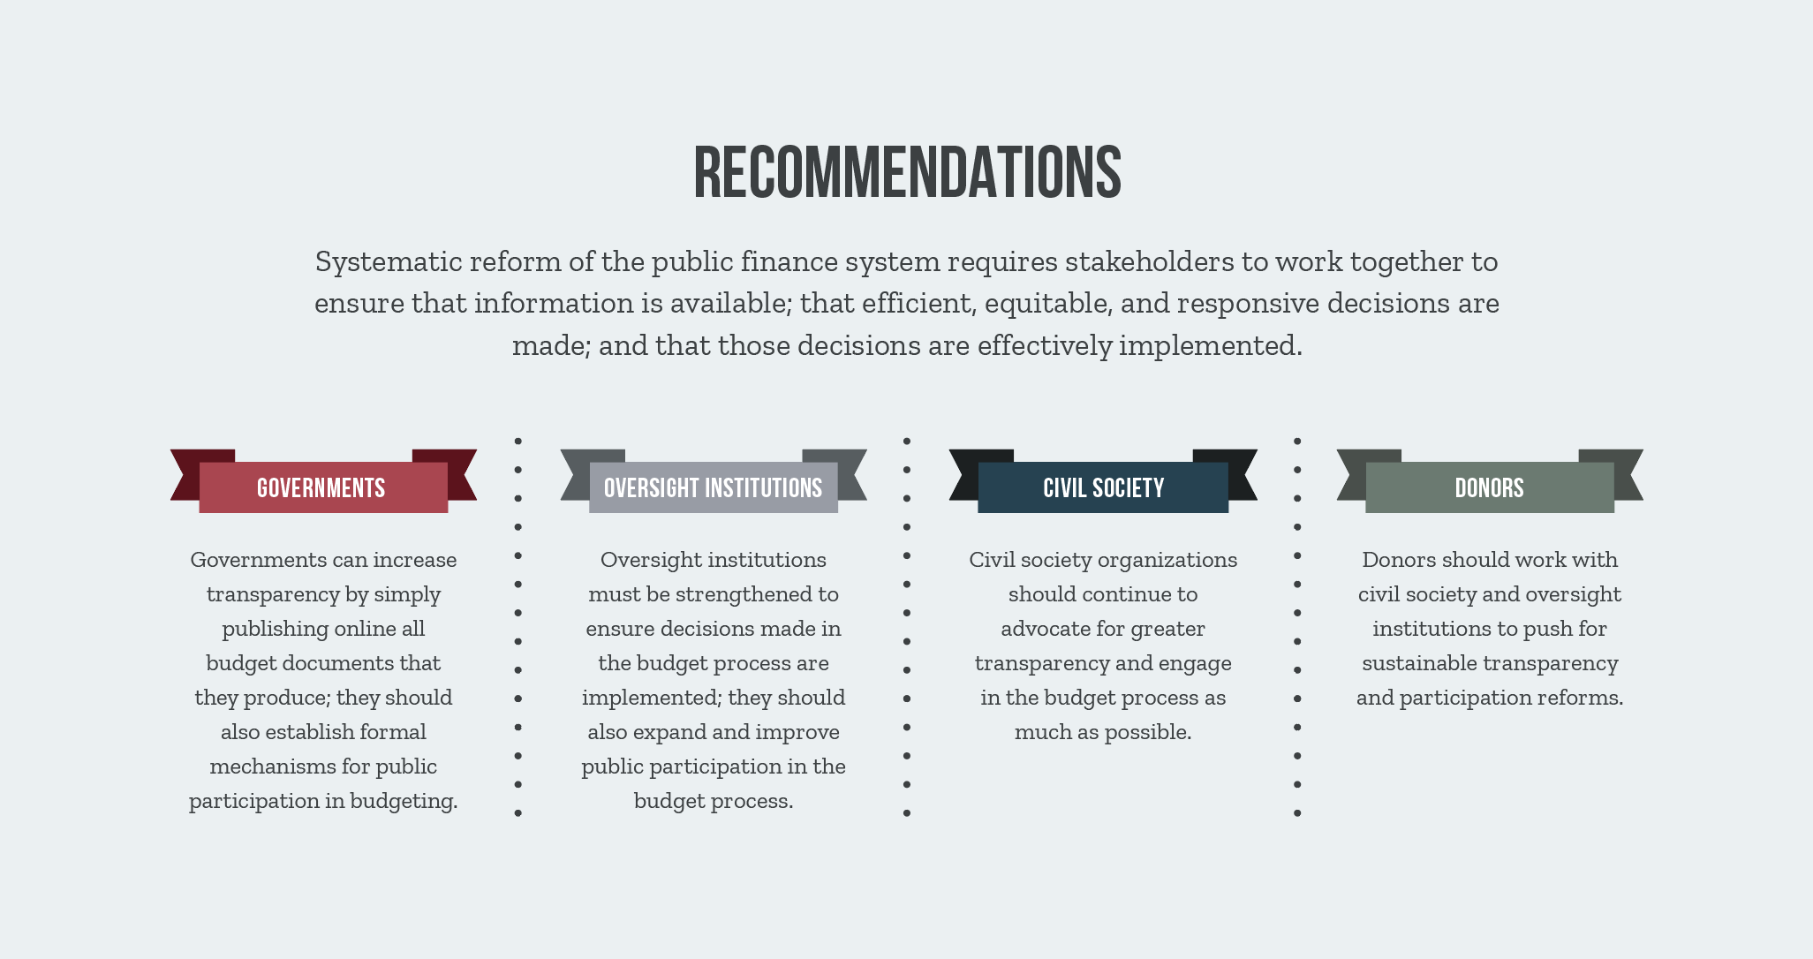

Slide 28
Contact Information
820 First Street, NE
Suite 510
Washington, DC 20002
Phone: +1-202-408-1080
Fax: +1-202-408-8173
Email: info@internationalbudget.org

