Slide 1
Public Participation in Fiscal Policies
The Open Budget Survey 2017 and
public participation: lessons and opportunities
Public Expenditure Management Peer-Assisted Learning
Working Group on Budget Literacy & Transparency
Juan Pablo Guerrero
Mars 16, 2018
#FiscalTransparency

Slide 2
Contents
Public Participation (PP) in Fiscal Transparency (FT) Codes and Standards
GIFT principles and the public participation questions of the OBP 2017
Findings, lessons and Opportunities
Where to look for examples of success?
2

Slide 3
PP in FT International Codes & Standards
2012: GIFT High-Level Principles on FTAP
2012: IBP-OBS leads the way, w/ section on PP
2014: IMF revision of Fiscal Transparency Code
2015: OECD Principles on Budgetary Governance
2015: Tax Adm. Diagnostic Assessment T.-TADAT
2015: Open Contracting Partnership
2016: Revised PEFA Indicator Program
2016: Extractive Industries Transparency Initiative 2017: New PP section in OBS-IBP
2017: OECD Budget Transparency Toolkit
2017: PEMPAL: 1st network of practitioners to engage systematically on the matter
3

Slide 4
Participation in the Budget Process –
How to establish and/or strengthen mechanisms?
PEMPAL background paper
Important lessons:
PP is mainly to benefit the people & improving impact of use of public resources
PP seeks feedback for improvements & needs to include relevant & diverse inputs (inclusiveness)
PP complements existing agencies/institutions - Key words: partnerships, alliances, collaboration, cooperation, engagements
Game changer: Information Technologies
4

Slide 5
Accessibility
Easy for all to access, understand, and to use, re-use and transform, namely in open data formats
Openness
Clarity on purpose, scope, constraints, intended outcomes, process and timelines of public participation
Inclusiveness
Proactively engage citizens and non-state actors, including excluded & vulnerable groups
Respect for self-expression
Allow articulate their interests in their own ways
Timeliness
Sufficient time in the budget and policy cycles for inputs in each phase

Slide 6
Depth
Provide information about key policy objectives, options, choices and trade-offs, potential impacts, and feedback
Proportionality
Use mechanisms proportionate to the scale and impact of the issue
Sustainability
Regular engagement, mutual trust over time; feedback for revision and institutionalize public participation
Complementarity
Complement and increase the effectiveness of existing governance and accountability systems.
Reciprocity
All state and non-state entities should be open about their mission, interests and representation

Slide 7
GIFT Principles of Public Participation in OBS-2017
Principles of Public Participation in Fiscal Policy | OBS 2017 Questions
Inclusiveness | 126, 129: Executives take concrete steps to include vulnerable or underrepresented groups 125, 128, 135: Mechanisms at budget formulation and approval stages show evidence of inclusiveness
Timeliness | 125: Mechanisms at formulation ensure early participation, before major decisions made
Openness / Depth | 127, 130, 137: Ensuring a wide scope of discussion on all key budget issues, not just a few 131: Purposes and scope of participation are clearly provided in advance
Sustainability | 132, 133, 138, 141: Executives, legislatures, and supreme audit institutions provide feedback on inputs received from the public, encouraging further engagement

Slide 8
1. Main changes from the OBS 2015 to the 2017
2015 and 2017 OBS not comparable
Only participation related directly to the NATIONAL budget is measured
Higher standards:
Highest scores for engagement between government (MoF) & citizens ≠ collection of citizen input
Reach a wide public (special attention to vulnerable groups) ≠ selecting groups or individuals for feedback
Capture more information about the scope covered in consultations (engage citizens in discussing macroeconomic issues, revenue, debt, etc,)

Slide 9
2. Implications of the changes from the OBS 2015 to 2017
Caveats:
Measures may overestimate the quality of participation processes & undervalue informal participation mechanisms
In some countries with limited national opportunities, there is robust local budget participation
Line ministries are commonly more in contact with the public (service delivery)

Slide 10
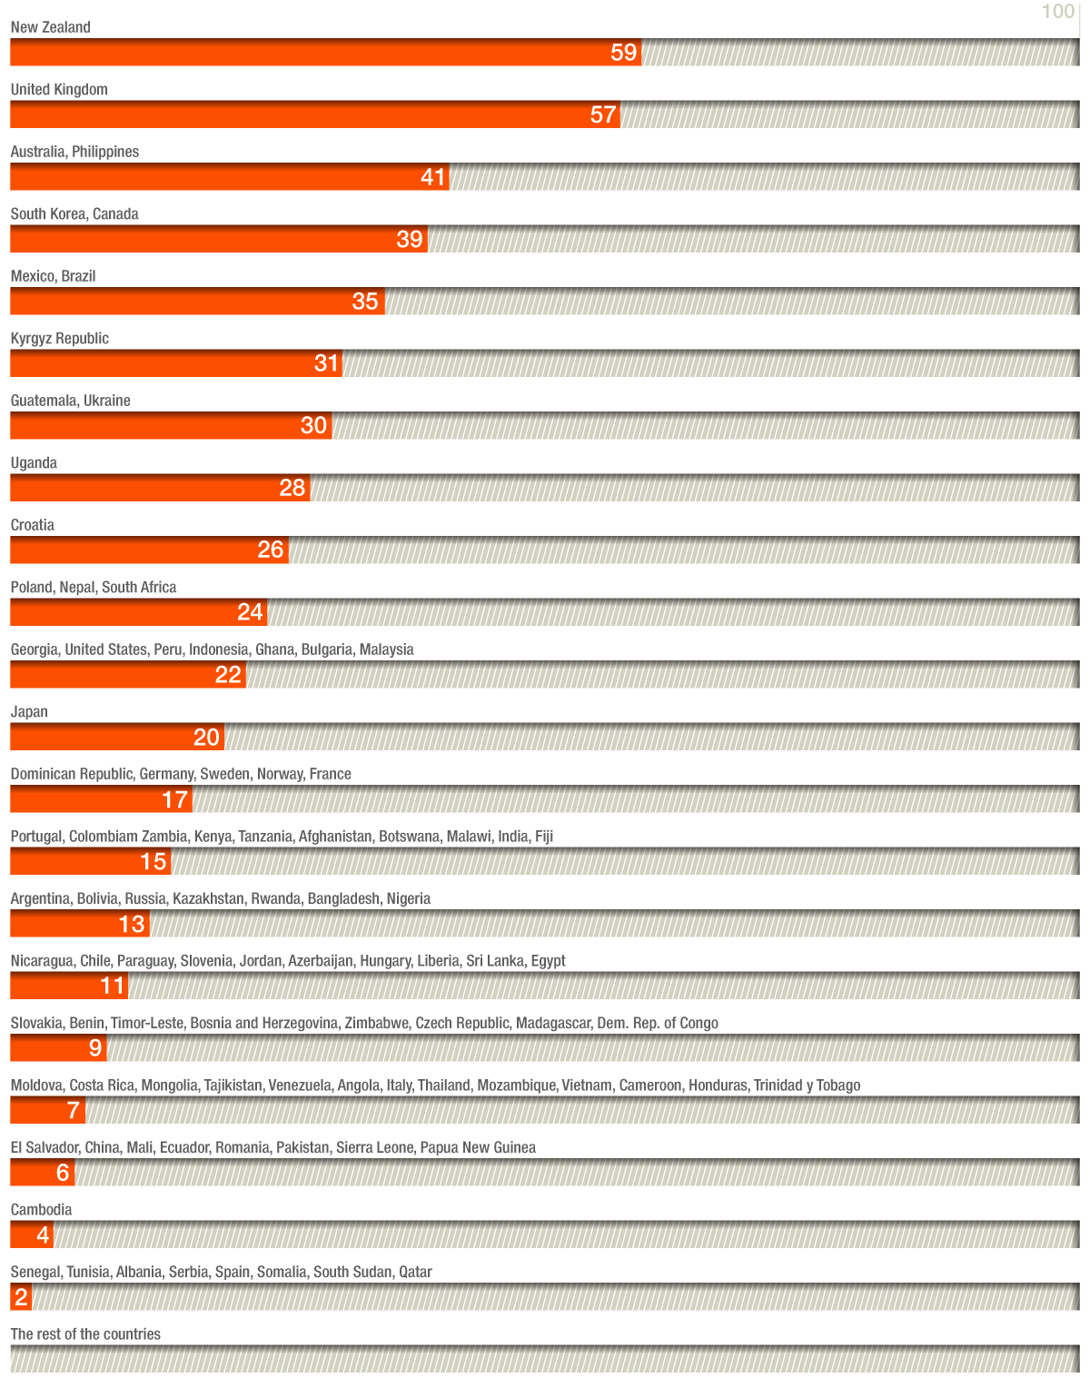
OBS 2017 results for countries on public participation in the budget cycle
10

Slide 11
1. OBS 2017: Main findings on Public Participation
Scores are low overall: global average score is 12 (out of 100)
Promising: considerable variation across countries & across stages of budget cycle
Public engagement takes place:
more during the budget preparation than during budget implementation
more when the budget is approved by the legislature than when the legislature considers the Audit Report
In significant number of countries: Supreme Audit Institution engages the public on setting its work program

Slide 12
2. OBS 2017: Main findings on Public Participation
Few countries are engaging the public across the whole budget cycle, exhibiting many innovative practices
Australia, New Zealand, the Philippines, the United Kingdom
A much more diverse group of countries perform well in aspects of public engagement by the executive branch
Afghanistan, Bangladesh, Botswana, Bulgaria, Canada, Democratic Republic of Congo, Egypt, Fiji, Ghana, Guatemala, India, Kyrgyzstan, Kenya, Madagascar, Malawi, Malaysia, Mexico, Poland, South Africa, and Ukraine
More than 80% of the countries surveyed (94 out of 115) have some form of participatory mechanism in place

Slide 13
3. OBS 2017: Main findings on Public Participation
Most countries are:
Not making effort to engage with diverse set of citizens and interests, marginalized and vulnerable communities
Not providing feedback to the public on how their inputs were considered or used
Implications: for instance, S.Korea relies more on expert-based participation => score considerably lower

Slide 14
So…..
What does the 2017 OBS also reveal?
Governments around the world are already using participation mechanisms through which the public can provide input during the annual budget cycle

Slide 15
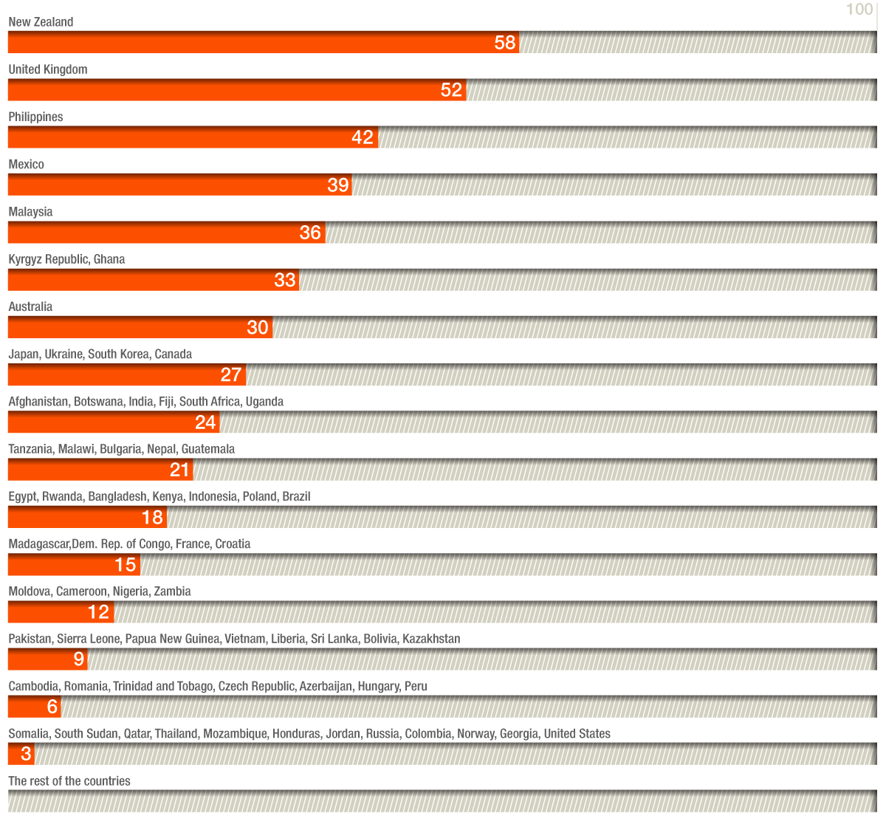
Open Budget Survey 2017 results for public participation in the Executive

Slide 16
1.Examples of PP mechanisms in OBS 2017
(Executive)
Pre-budget hearings: usually open to all unless the mechanism is ad-hoc (Kyrgyzstan, Ukraine)
Pre-budget consultations: by invitation w/ key stakeholders (Russia, Georgia)
Pre-budget submissions: MoF invites to submit proposals; can be open to all, but not always a feedback mechanism (UK, Georgia)
Public councils: elected representatives from civil society; some councils include reviewing policies and draft bills that feed into the budget, including investment projects or service delivery
16

Slide 17
2. Examples of PP mechanisms in OBS 2017
(Executive)
Policy consultations on specific issues: issues that may or may not affect the annual national budget (Moldova –tax, Croatia, Czech Republic, Bulgaria)
Sector Working groups: Convened for budget preparation; MoF + agencies & stakeholders discuss sector and cross- sector planning and prioritization (Kazakhstan, Russia)
Online reporting mechanism: websites to provide a platform for registering complaints/ provide feedback/ report waste/ respond to surveys (Georgia, Mexico)
Bottom up consultations approach: Consultations at the local level are used to inform agency budget proposals, subsequently submitted to the MoF (Philippines)
17

Slide 18
Kyrgyzstan: budget hearings + advisory councils
Open invitation by the MoF to participate in budget hearings for EBP (regulation requires all Ministries to conduct them)
Electronic documents are sent to all participants and questions and proposals are responded and recorded
A Public Advisory Councils (PACs) should be formed in every ministry and include experts and non-governmental members (NGO, expert , etc.); it usually implements a function of civic oversight
PACs also oversee implementation of anti-corruption plans, strategic documents of the line ministries, etc.
But, PAC members usually have limited capacity to look into the budget and cannot conduct thorough budget analysis of the Ministry

Slide 19
Bulgaria: open consultations on line
MoF publishes its draft documents (including documents related to budget formulation and tax amendment laws) on a dedicated page for drafts
The National Council for Tri-partite Cooperation must discuss budget policy matters, which happens before the EBP is sent to legislature
There is are Publications for consultation of the Mid-term Budget Forecast 2017-2019; publication for consultation of the Executive Budget Proposal 2017 and the updated Mid-term Budget Forecast 2017-2019
A challenges is how little time there is to provide inputs
No explanation of the process of the engagement, other than asking citizens and organizations to send their opinions and proposals

Slide 20
Croatia: economic and social council
Economic and Social Council evaluates and gives opinions on macroeconomic stability, competitiveness, balanced economic and social development, including the budget proposal
It includes multi-sectoral representatives, with government, trade unions, professional associations, private sector engaging (impact throughout the cycle of the budget)
The GIFT PP Guide describes the Commission on Fiscal Policy, an Independent Financial Institution, as another successful independent check for budget implementation.

Slide 21
Other cases: Ukraine, Moldova
Ukraine: Expert hearings on the budget are conducted by top officials of the MoF (engagement with independent experts from civil society is practiced by central executive agencies).
Members of the public and government officials exchange views on the budget & other topics as well. A CSO willing to get involved, can provide proposals and agency must publish the results of the civic expertise and the information considered during the exchange.
Moldova: working groups with the participation of CSO and expert representatives. The mechanism is informal and the topics covered are revenue forecasts, policies, and administration. Must of the exchange with civil society is related to tax administration issues.

Slide 22
Other cases: Kazakhstan, Czech Republic, Georgia
Kazakhstan : Public Council under the MoF (2016) includes representatives from civil society (National Chamber of Entrepreneurs and Association of Taxpayers, associations of auditors and accountants, i.e. mostly revenue part), and expert members from academia.
Czech R. : Council of economic and social agreement ensures a meeting on regular basis with union representatives during the formulation phase.
Georgia: online consultation on budget priorities, listing 12 Government priorities in boxes to get the input from the visitor. There is also the Public Finance Management Coordination Council in the MOF, which is chaired by the Minister
Line ministries have meetings with different stakeholders on a regular bases, which have indirect implications for the budget implementation (funding projects)

Slide 23
Russia: public participation as a target
Working with reference groups, community councils, citizens, organizations and public associations
All federal ministries and agencies have public councils which include independent members elected by business and non-governmental organizations
Russia has announced the goal to be opened to the public

Slide 24
United Kingdom: strong dialogue for budget formulation
Tax consultation framework since 2011 for tax policy decisions
Treasury publishes a response to inputs; at the end of a consultation, a summary of responses is published, including a listing of those who made submissions
Consultations shape upcoming Finance Bills, but tend to be specific and targeted
Consultations by other departments often have direct implications for future spending
Anyone - individual citizen or group - can send a budget representation ahead of the budget process
In practice, only budget representations from major institutions and stakeholders will be carefully reviewed
Consultations are widely used across ministries and many of these affect departmental expenditure

Slide 25
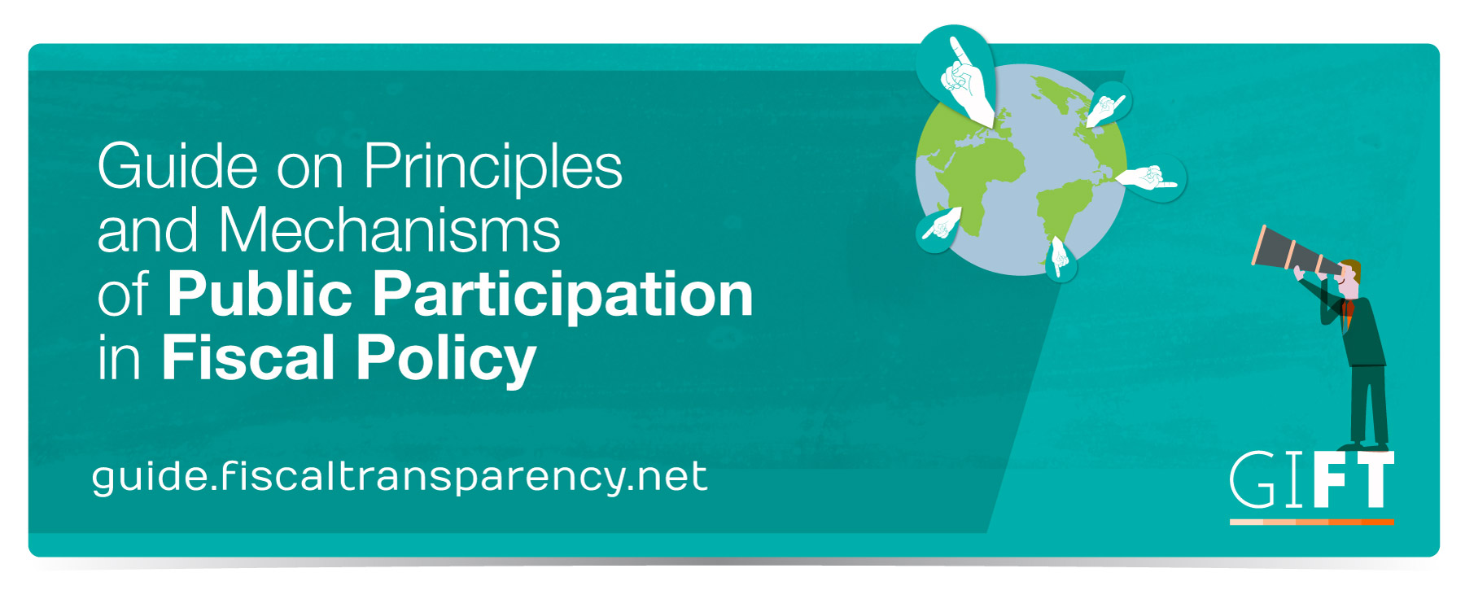

Slide 26
Guide’s Contents
19 cases
Lessons Learned identified by practitioners in charge as well as tips and the main conditions and factors associated to the success or failure of the practice
Principles of Public Participation: Which and how the mechanism aligns to the principles.
Country context: information to facilitate a general understanding of the surrounding factors and conditions in which the mechanism in question took place:
Type of government
Civic space (size of civil society, regulatory framework)
Open Budget Survey scores – OBI & scores for public participation
Score on TI Corruption Perceptions Index

Slide 27
Bottom Up Budgeting in the Philippines
Launched in 2012 with 515 communities and small budget
Primary objective: deliver basic social services to the poor, reduce the influence of local elites and empower the citizenry
Local poverty reduction action team (LPRAT) determines local priority projects
A general assembly is established: 50% members are from government and 50% from CSOs
The Assembly recommends projects to the LPRAT
Suggested projects are submitted for incorporation in the budget of the participating national agencies
CSOs can engage in the monitoring of the BuB projects
In 2016: BuB included 1,514 cities and municipalities and a budget 3 times bigger than in 2012
BASIC FACTS
Executive Branch Lead
Formulation& Implementation budget stage
Local & National level
Principles of Complementarity, Depth, Inclusiveness, Openness, Reciprocity, Respect for self-expression, Sustainability &Timeliness
27

Slide 28
Education Reform Program in Mexico
BASIC FACTS
Executive Branch Lead
Enactment & Formulation budget stage
National level
Principles of Accessibility, Complementarity, Depth, Inclusiveness, Openness, Reciprocity, Respect for self-expression, Sustainability, Timeliness
Launched in 2014-2015, aiming to improve the infrastructure and equipment of the most vulnerable basic schools throughout Mexico
Parents, teachers and directors form a committee and decide how to prioritize federal funds that have been allocated for their schools
Public engagement takes place at all stages of the process, from allocation of resources, to implementation and monitoring
Interactive website allows users to monitor project status
The program has benefited over 20,138 schools and has been renewed for 2016
28

Slide 29
Social Audit in Andhra Pradesh, India
BASIC FACTS
Non-State Lead
Audit budget stage
Regional level
Principles of Openness, Transparency, Sustainability, Inclusiveness & Respect for self-Expression
Started in 2006, the Rural Development Department of Andhra Pradesh engages non-state actors to determine whether state reported expenditures reflect the actual resources spent on the ground
After verification is complete, auditors organize a village assembly where audit findings are shared; local politicians, elected members and local officials, and field assistants participate
Discussions and debates on the state of program or policy implementation are catalyzed
Presence of civil society ensures high degree of autonomy and objectivity
State government has provided full financial and operational support
Social audit is conducted by community volunteers
More than 200,000 social auditors have been trained
On average, 130-150 social audits are conducted each month across all 22 districts, with not less than 2000 people engaged in the exercise
29

Slide 30
Public Policy Councils in Brazil
Permanent collegiate bodies creating, implementing, and monitoring public policies
Operate at all three levels of government (federal, state, municipal), in various thematic areas
Membership is based on parity (government and CSOs)
Councils must approve the budget in their policy area
In 2012 municipals councils in health, social care, and rights of children fully operational in 99% of municipalities.
75% of national council members consider they have a significant impact on policy.
Number of councils grown exponentially over the past 20 years.
BASIC FACTS
Executive Branch Lead
Formulation budget stage
Local/ Regional/National level
Principles of Complementarity, Depth, Proportionality, Reciprocity, Respect for self-expression, Sustainability &Timeliness
30

Slide 31
Top-Down Budgeting System in South Korea
Adopted in 2004 to encourage innovations in budget allocation at each ministry within sectoral ceilings
Two-step process:
Central budget agency sets sector ceilings
Line ministries allocate the budget within those ceilings
At each step, an Advisory Committee, consisting of CSO and expert members, is consulted
Budget programs are evaluated every 3 years, with the involvement of the Advisory Committee
The Committee can provide oral and written suggestions and can vote for or veto proposals
Considered to have resulted in shift to a more welfare-oriented budget
Reforms gained further legal support from the National Fiscal Act of 2006
BASIC FACTS
Executive Branch Lead
Formulation budget stage
National level
Principles of Openness, Complementarity & Depth
31

Slide 32
Budget Monitor in Georgia
Budget Monitor offers a unique analytical web-platform with comprehensive information about public finances, designed from an auditor’s perspective via different data visualization tools, such as interactive and user-friendly diagrams, info-graphics and tables
Engages the public throughout the audit cycle: citizens can send audit requests, suggestions, and proposals, inform the SAOG about the deficiencies in the PFM system, and suggest the priority spheres for future audit(s)
The SAOG uses a risk-based model to manage citizens’ requests and follows the BM’s operational manual, which discusses every step of the process in detail. Furthermore, it defines responsibilities in the SAOG, and timeframe and procedures for every step
Each request made by citizens is given a unique code that enables the requester to check whether the request is rejected or accepted, based on established criteria
The relevant audit department is responsible to further proceed with the request. During the process, the requester is able to monitor the status of the request.
The BM also gives citizens the opportunity to vote for priority spheres, the latter is also taken into consideration while planning for the next year
Finally, citizens are informed via the BM, (i) when the request-based audits are initiated and (ii) when the audits are finalized
BASIC FACTS
Supreme Audit Institution Lead
Audit budget stage
Local, regional and national levels
Principles of accessibility, openness, inclusiveness, depth, proportionality, sustainability, complementarity, reciprocity

Slide 33
THANK YOU!
Engage with us
@FiscalTrans
www.fiscaltransparency.net
guerrero@fiscaltransparency.net

