Slide 1
Ministry of Finance of Georgia
Budget Openness Index and Public Participation Arrangements
(Budget Monitoring)

Slide 2
Georgia Open Budget Index, 2006-2017
Thanks to its reforms, Georgia scored 82 points (115 countries) in the Open Budget Survey 2017 jumping to 5th notch from 33rd in the 2012 rating.

Slide 3
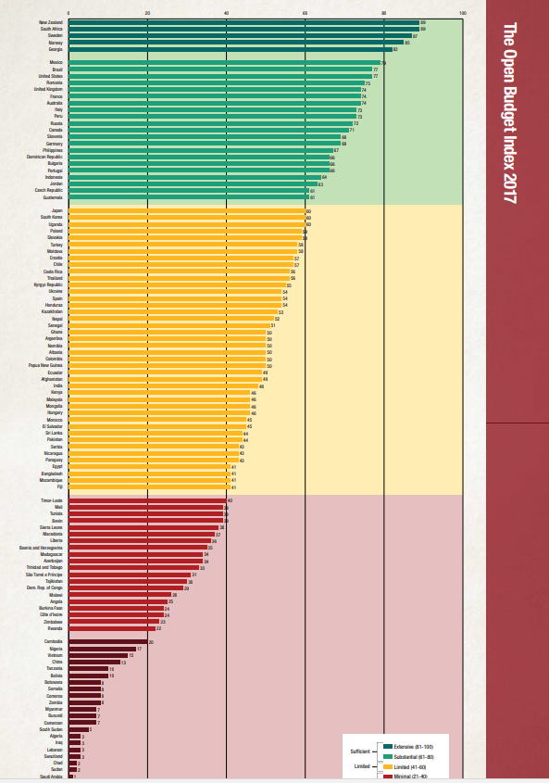
Open Budget Survey – Georgia

Slide 4
Open Budget Survey – Georgia
OBS 2015
Transparency
(Open Budget Index)
Public participation
Budget oversight
66
46
(average mean - 25)
73
100
OBS 2017
Transparency
(Open Budget Index)
Public participation
Budget oversight
82
22
(average mean - 12)
74
2017 – total average score - 42 (2015 - 45 points)

Slide 5
Key Areas Public Availability of Budget Documents
Key questions in Part I :
Design and public availability of all budget documents;
Availability of editable information on the web;
Compliance with international standards for budget legislation on medium-term planning, preparation of the annual budget, and reporting;

Slide 6
Comprehensiveness and Transparency of Budget Documents – Achievements
Recent achievements in evaluating the comprehensiveness of budget documents :
Preparation of information and analysis on public debt;
Preparation of projections and micro-scenarios: basic, best-case and worst-case scenarios;
The BBD contains information on medium-term expenditure ceilings;
Government budget is performance-based - programmatic format;
The budget process is fully consistent with international standards.
Audit report
Annual report
Semiannual report
Current reports
Citizens budget
Adopted budget
Budget proposed by the Executive
Preliminary budget statement
Average score
Azerbaijan
Tajikistan
Mongolia
Kazakhstan
Kirgizia
Turkey
Russia
Georgia
minor
minimal
limited
significant
high
high
significant
limited
minimal
minor

Slide 7
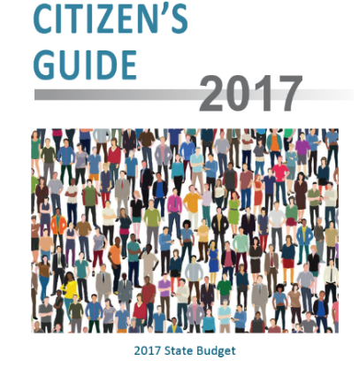
Budget Process Transparency and Accessibility of Budget Documents – Achievements
Free admission to parliamentary budget hearings (schedule is posted on the website) The hearings, including committee hearings, are broadcast live;
Work on the citizens’ budget is underway. It incudes all the required parameters (revenues and expenditures, key policy areas and current reforms, macroeconomic forecast, and contact information);
The citizens’ budget is drafted at both the preparation and adoption stages;
The citizen’s budget is fully accessible to the public: it is available on the web, in printed form and is disseminated across various public groups, discussed in meetings, and covered by television;
Turkey
Tajikistan
Mongolia
Azerbaijan
Russia
Kazakhstan
Georgia
Kirgizia
Average scope Балл
адекватные 60-1 00
ограниченные 40-60
Незначительные 0-40

Slide 8
Budget Process Transparency and Accessibility of Budget Documents – Achievements
Engagement and Communications
The PFM coordination council of the Ministry of Finance – incorporates all institutions engaged in PFM reform: Ministry of Finance (the entire agency), parliament, government audit service, budget office, procurement office, donors, and civil society;
In 2016 the coordination council hosted a (community-led) discussion of programs titled “Make in Georgia” and “Universal Healthcare”;
The Ministry of Finance arranged meetings with the public and local governments (facilities by the EU) in 4 cities. Topics discussed included fiscal rules and their compliance with EU standards, new regulations /restrictions, their values, and steps needed to improve processes;
Budget Reporting
In 2016, a semiannual budget report was drafted for the first time, along with a half-year budget review which was in full compliance with the budget transparency methodology;

Slide 9
Role and Effectiveness of Control Functions in the Budget Process – Achievements
A budget office - an independent fiscal body - reviews forecasts during budget preparation and adoption; available on the web;
An independent audit function is operating playing an important role in budget preparation and execution;
A feedback arrangement is in place to incorporate advice from the government audit service.

Slide 10
Public Participation in the Budget Process – Achievements
A PFM Coordination Council is effectively operating;
In 2017, the Ministry of Finance held regional meetings with the public and local governments to raise public awareness about fiscal management (facilitated by EU);
Budget review in the legislature is fully transparent;
Survey posted on the MOF’s webpage allows participants to prioritize expenditures;
The state audit service has designed an innovative interactive Budget Monitor web-platform (budgetmonitor.ge). The webpage targets citizens, NGOs, and the media. Users are able to compare various data, process them, and make forecasts.

Slide 11
Recommendations and Plans
Transparency:
Provide detailed financial information to the public (full information on financial and non-financial assets) and additional information in the draft budget (partnership foundation);
Provide explanations on the difference between primary macroeconomic forecasts and actual indicators;
Public Participation:
Set up a pilot arrangement to exchange information between the public and the executive branch on budget projections and monitoring;
Provide the public a chance to express their views in the course of budget discussions in parliament;
Control Effectiveness:
Prepare and share with the public parliamentary reviews of the government audit service;
Independent agencies’ oversight of the government audit process;
A concept of an electronic “open budgeting” module is in place:
A budget planning questionnaire for the public is revised (priority/program/budget organization);
Key stakeholders participate in the survey, their results captured separately;
Information on planned priorities/programs is detailed;
A feedback mechanism is introduced (a chance to argue in favor of increasing/cutting financing of a priority item;
Review of the survey results;
Financial information is placed in an open format (CSV, XML, XLSX, XLS);
Data visualization

Slide 12
Public Participation in Public Financial Oversight Budget Monitor Web Platform budgetmonitor.ge
Objective – the audit function and operations must be clear and useful to citizens and other stakeholders
Goal:
Improved accountability
Support of adequate governance
Audit transparency
Improved participation
GIFT
World Summit Awards-ის (WSA)
IDFI – for best public information availability
GITI - IT innovations

Slide 13
Budget Monitor Web Platform budgetmonitor.ge- prerequisites
Broader rights and opportunities for the public to engage in governance and hold the government accountable;
Better public awareness of the budget process and transparency of public resource management;
OGP obligation – collaboration with civil society and use of modern effective tools to raise awareness and engage the broader society.

Slide 14
Leveraging ICT to communicate with and deliver products to key stakeholders
Magnifies the audit impact and broadens opportunities for stakeholders:
Better public awareness and engagement
Better government transparency and accountability;
A chance to control public resources;
Capitalizing on audit benefits;
Designing two-way communication channels.

Slide 15
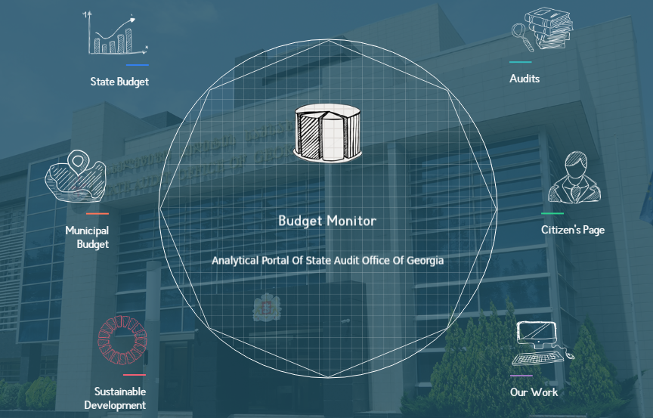
Budget Monitor Web Platform budgetmonitor.ge

Slide 16
Budget Monitor Web Platform budgetmonitor.ge
Contains up to date analytical budget information, e.g., revenues and expenditures, public debt, procurement, etc..
Contains information on identified wrongdoing and recommendations of government audit service;
All complex information is visualized;
Provides a two-way communication channel and interface enabling data input.

Slide 17
Budget Monitor Web Platform budgetmonitor.ge
100
Audit reports
1. Government budget
2. Municipal budgets.
3.Audit
76
Municipal budgets
400
Government programs
62
Fist-tier transactions

Slide 18
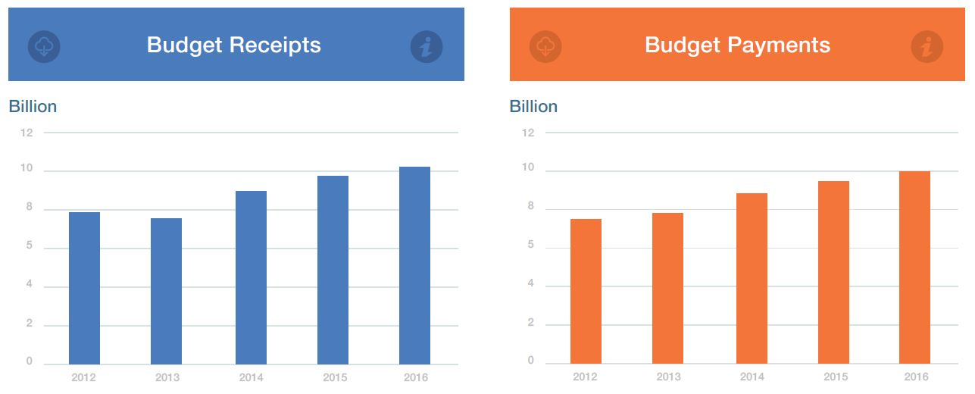
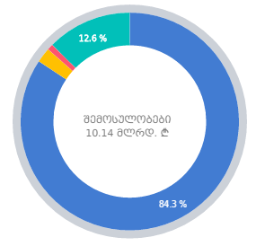
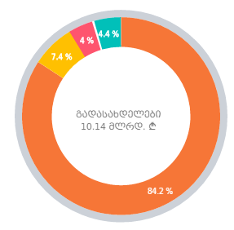
Government budget
Municipal budget
Audit
Citizens’ page
Government budget
Budget revenues and expenditures
Budget execution
Budget structure
Budget Receipts
10.5 B
Budget Payments
10.4 B

Slide 19
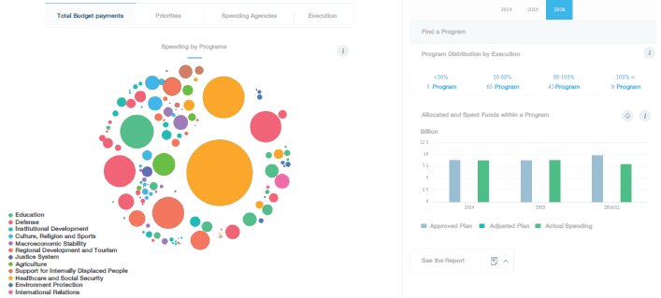
Government budget
Municipal budget
Audit
Citizens’ page
Budget expenditures
What programs are financed from the government budget?
How are public resources allocated among ministries /agencies?
How are program resources disbursed?

Slide 20
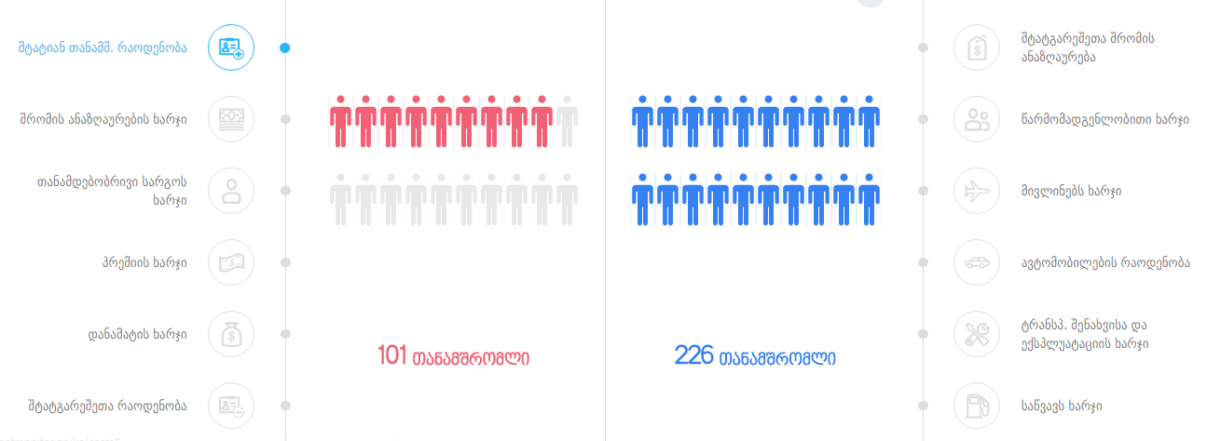
Government budget
Municipal budget
Audit
Citizens' page
Administrative expenses
Number of staff and their income
Share of bonuses relative to salaries
Structure of organization’s administrative expenses

Slide 21
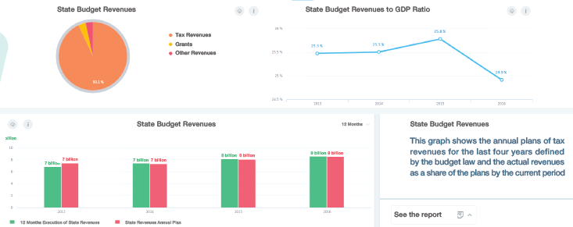
Government budget
Municipal budget
Audit
Citizens’ page
Budget revenues
Government budget revenues
Structure of tax revenues and their collection rate

Slide 22
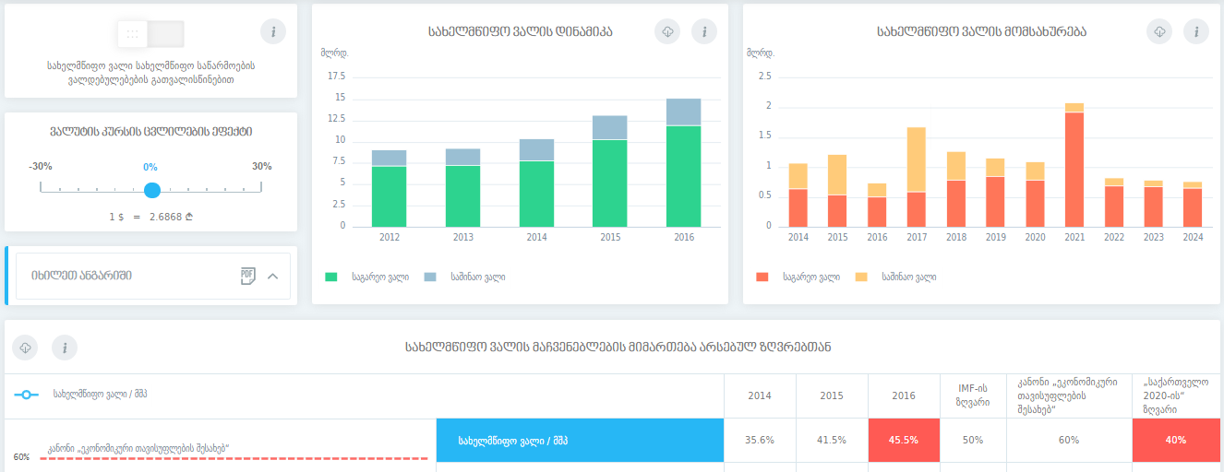
Government budget
Municipal budget
Audit
Citizens’ page
Public debt
Foreign
Domestic
Foreign
Domestic
Public debt
Impact of exchange rate on public debt
Domestic and external debt structure
Credit disbursement for investment projects

Slide 23
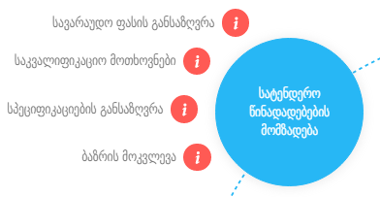
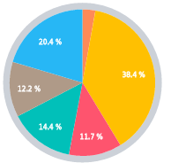
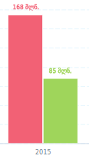
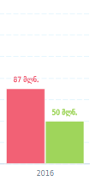
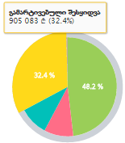
Citizens’ page
Municipal budget
Audit
Citizens’ page
Public procurement
Reserve funds
Share of procurement in government budget
Simplified procurement
Recurrent flaws in public procurement
Expenditure items
Reserve fund spending rate

Slide 24
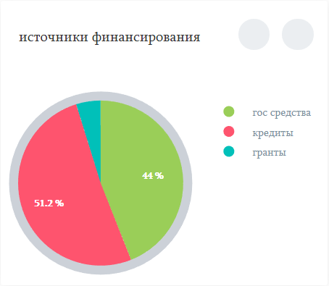
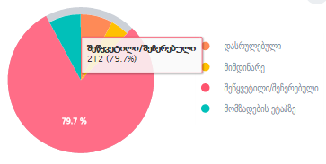
Capital projects
Government budget
Municipal budget
Audit
Citizens’ page
Share of capital projects in the budget;
Flaws identified in the course of capital project execution;
Allocation of regional fund resources among municipalities;
Implementation of capital projects at government and municipal levels;
Sources of financing
Public funds
Credits
Grants

Slide 25
Government budget
Municipal budget
Audit
Citizens’ page
National indicators
Key economic indicators
Georgia’s ranking in international ratings
Programmatic budget
Programmatic budget flaws
Actual objectives versus targets

Slide 26
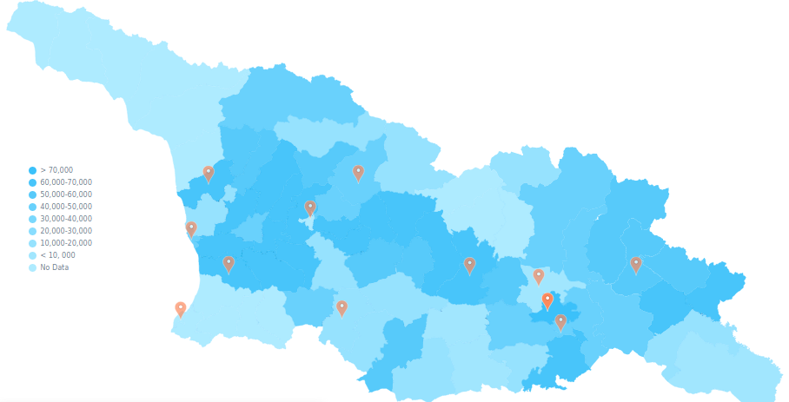
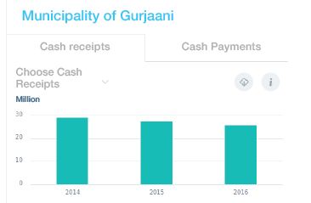
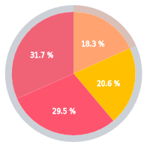
Government budget
Municipal budget
Audit
Citizens’ page
Municipal budgets
Municipal budget;
Compare budgets;
Transfers to each municipality
Municipal administrative expenditures;
Number of organizations and their financing;

Slide 27
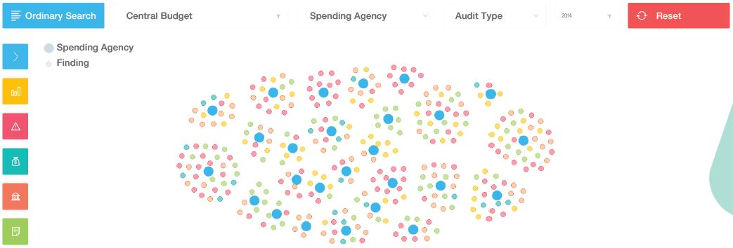
Government budget
Municipal budget
Audit
Citizens’ page
Audit
Find audit results and recommendations:
By organization
By type of violation
By name and audit type
By budget level
By year

Slide 28
Цели устойчивого развития (Sustainable Development Goals - SDGs)
Government budget
Municipal budget
Audit
Citizens’ page
No poverty
Zero hunger
Good health and wellbeing for people
Quality education
Gender equality
Clean water and sanitation
Affordable and clean energy
Decent work and economic growth
Industry, innovation and infrastructure
Reduced inequalities
Sustained cities and communicates
Responsible consumption and production
Climate action
Life below water
Life on land
Peace, justice and strong institutions
Partnership for the goals
34 – audits, 262 – concisions, 243 – recommendations

Slide 29
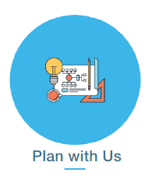
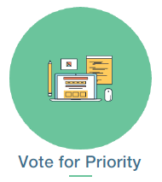
Government budget
Municipal budget
Audit
Citizens’ page
Citizens’ page
This module facilitates the PFM process;
Over 8500 unique users;
2017– 29 citizens’ petitions, 9 reviewed in 2017, 7 included in 2018 audit plan:

Slide 30
Government budget
Municipal budget
Audit
Citizens’ page
Citizens’ page
Plan with us
Objective – engage citizens during annual audit plan exercise (citizens’ petitions are taken into account when selecting topics for audits). Citizens may choose an organization from the list, state their status, describe the problem and suggest solutions, download documents, and track their application using a unique code.

Slide 31
Government budget
Municipal budget
Audit
Citizens’ page
Citizens’ page
Fight corruption
Objective – identify and prevent corruption in the public sector while engaging citizens. Citizens may select an organization/violation/problem from the list and suggest solutions, may download documents.

Slide 32
Government budget
Municipal budget
Audit
Citizens’ page
Citizens’ page
Vote for priority
Objective – take into account citizens’ interests when identifying audit priorities.
A citizen may identify 10 priorities.

Slide 33
გმადლობთ ყურადღებისათვის, спасибо за внимание, thank you

