Slide 1
FINAL REPORTING

Slide 2
  Background Legislation
  Art. 164 of the Constitution of the Republic of Turkey
  Art. 42 of Law no. 5018
  Guidelines for methods and principles of final reporting in public entities
  Circular no. 6/1 of the General Accounting Department
  General Letter of the General Accounting Department on Final Reports

Slide 3
  Scope
Public entities /departments/ under the Central Government
Public Entities supported from the General Budget
Entities supported from the private budget
Regulatory and controlling entities

Slide 4
  Function
The Great National Assembly of Turkey is guided by the Law on Final Reporting to exercise its right to “approve” the results of the Budget Law implementation.
The MPs are entitled to monitor how the executive authorities exercise their right to implement expenditures delegated to them under the Budget Law. The most convenient way to monitor this is by examining and approving the Final Report on Budget Implementation in the Parliament.

Slide 5
  Preparation
Tables and documents of final reporting are developed by the Strategy Development Department based on accounting data on budget implementation

Slide 6


  Operations by entities
payment
Spending units
Central and provincial authorities
Allocation
Expenditure
Accounting unit (say2000i)
Main Department of Accounts
harmonization

Slide 7


  Operations by entities
Spending units
Strategy Development Units
CONSOLIDATION
Final Reports of entities

Slide 8


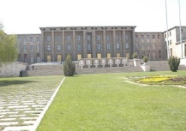

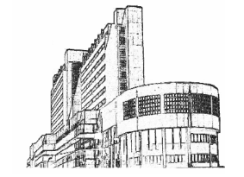
  General Operations
General and private budgets
By 15 April
(2 copies)
General Department of Accounts
DRAFT LAW ON FINAL REPORT
Agreement
By 15 May
(5 copies)
Documents and tables
say2000i
CONSOLIDATION
Public Entities
GNAT
General Department of Accounts
Draft Law on Final Report
By end June
First week of Oct.
Court of Accounts
GNAT
50 copies (uni. 25 copies)
Court of Accounts
(5 copies)

Slide 9
Thank you
Esra Aydemir
Financial Services Specialist
esra.aydemir@sgb.gov.tr

