Slide 1

Budget
Community of Practice (BCOP)
Update on BCOP Activities
Kanat Asangulov, BCOP Executive Committee
Ministry of Finance, Kyrgyz Republic
12 April 2017

Slide 2





















BCOP MEMBERSHIP
60 representatives from Ministries of Finance from 21 different countries.
Two working groups with 15 member countries:
Budget Literacy and Transparency
Program and Performance Budgeting

Slide 3
BCOP Strategy
BCOP aims to strengthen budget methodology, planning and transparency in PEMPAL member countries through:
Sharpening tools for effective fiscal management (e.g. program budgeting and other tools).
Strengthening fiscal transparency and accountability with a focus on budget literacy, citizens’ budgets, and public participation initiatives.
Facilitating knowledge exchange between:
  budget related Departments of our 21 member country MoFs in Europe and Central Asia region.
  OECD member and accession countries at annual Senior Budget Officers’ (SBO) meetings.
  other COPs, through sharing progress at annual cross-COP meetings of all COP Executive Committees, and quarterly PEMPAL Steering Committee meetings.
Expanding internationally available data on PEMPAL countries through benchmarking using pre-meeting thematic surveys and more formal surveys (eg PEMPAL surveys, International Budget Partnership and OECD surveys).

Slide 4
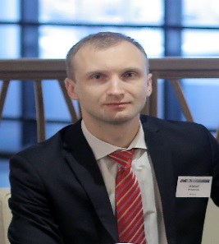
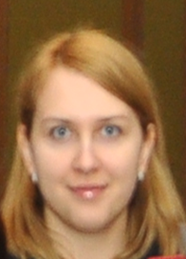
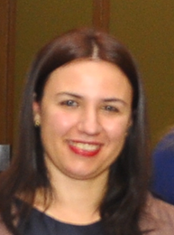
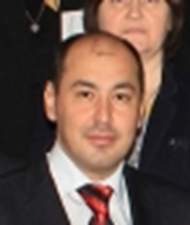
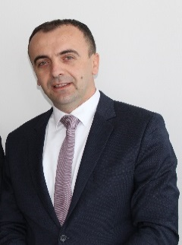
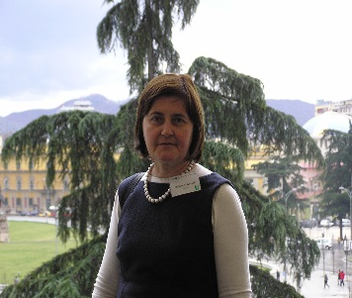
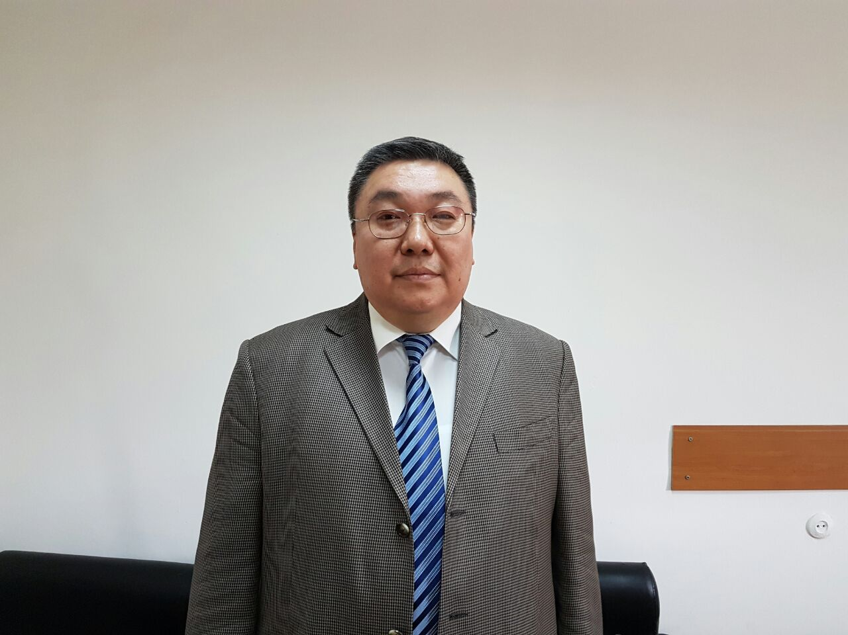
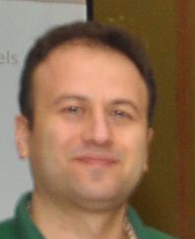
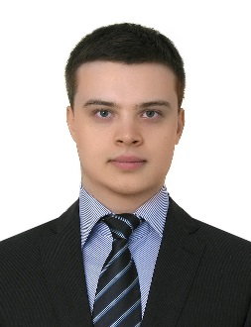
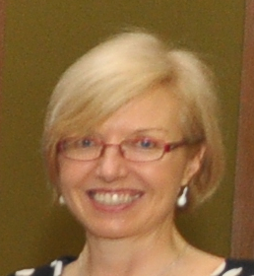
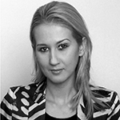

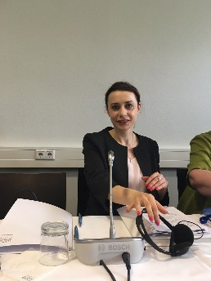

BCOP LEADERSHIP AND MANGEMENT
BCOP Executive Committee
Mikhail Prokhorik
Deputy Chair
Belarus
Anna Belenchuk
Chair
Russian Federation
Gelardina Prodani
Deputy Chair
Albania
Armen Manukyan
Armenia
Alija Aljović
Bosnia and Herzegovina
Mladenka Karačić
Croatia
Kanat Asangulov
Kyrgyz Republic
Hakan Ay
Turkey
Nikolay Begchin
Russian Federation
BCOP Resource Team
PEMPAL Secretariat (BCOP)
Maya Gusarova
World Bank
Deanna Aubrey
World bank
Naida Carsimamovic
World Bank
Ksenia Galantsova
World Bank

Slide 5
BCOP ACTIVITIES
In 2016, there were 7 BCoP events:
  Plenary meeting in Belarus of all members on fiscal rules,
    with back-to-back workshop of Budget Literacy and Transparency working group on Open Budget Index success factors.
  Study visit to Slovenia of Wage Bill Management working group on public sector pay reforms and wage bill management practice.
  Program and Performance Budgeting working group meeting on OECD Performance Budgeting survey with back-to-back participation in OECD CESEE Senior Budget Officer’s meeting in Slovenia.
    Presentation of PEMPAL trends to OECD audience.

Slide 6
BCOP ACTIVITIES
In 2016, there were 7 BCoP events (continued):
  BCOP Executive Committee meeting in Switzerland with other COP Executive Committees and PEMPAL donors to progress development of new PEMPAL strategy.
  Videoconference meeting of the Budget Literacy and Transparency working group to progress Citizens Budget knowledge product.
  Program and Performance Budgeting Working Group meeting on French performance budgeting implementation experience and key trends in spending reviews in OECD countries with back-to-back participation in the OECD Senior Budget Officer’s meeting on performance and results.
PEMPAL Steering Committee met 4 times. Minutes available https://www.pempal.org/event/steering-committee-meetings
BCOP Executive Committee met 4 times. Minutes available https://www.pempal.org/about/governance/ex-com-bcop

Slide 7
PFM RESOURCES TRANSLATED FOR BCOP
BCOP Event/Working Group materials are available on website, in PEMPAL languages (English, Russian, Bosnian-Croatian-Serbian).
Links to all materials shared since 2011 listed in a document provided in your background materials.
Examples from 2016:
Kyrgyz Republic 2014 Methodology for Development of a Citizens’ Budget
Guidelines of the Russian Federation on Citizens’ Budget (September 2015)
Recommendations on Citizens Budget (prepared for Moldova Ministry of Finance), 2013, Analytical Center “Expert Group”, Moldova
Guide to Developing Citizens Budgets by International Budget Partnership (IBP)
Slovenia public sector salary system act; decree on promotion to salary grades; and collective agreement
OECD Toolkit on Budget Transparency
For this meeting:
Principles of Public Participation in Fiscal Policy (Global Initiative for Fiscal Transparency – GIFT)
BCOP Draft Knowledge Product on Breaking Challenges to Developing Citizens’ Budgets

Slide 8
NEW PEMPAL Strategy
The PEMPAL Executive agreed that the goal/impact of the new strategy is that:
Governments of PEMPAL member countries from Europe and Central Asia more efficiently and effectively use public resources resulting from applying good and improved PFM practices developed, promoted or shared with PEMPAL contribution.
The Outcome of the PEMPAL Strategy 2017-22 is:
A well functioning professional peer learning platform through which public finance practitioners from the member countries are networked to strengthen their capacities and to enable them to create and share knowledge and benchmarking.
The new strategic framework has three results areas to ensure PEMPAL meets its goal and outcome objectives.
DEPTH AND RELEVANCE
QUALITY
IMPACT
Result 1: PFM reform priorities of member countries in the functional areas of budget, treasury and internal audit/internal control, including cross-functional priorities, are addressed by the network platform.
Result 3: PEMPAL is a viable network which is supported by committed PFM professionals, member countries, and a range of development partners, who see the value and benefit in the network as a tool to improve member country PFM performance.
Result 2: High quality and relevant network services and resources are developed and delivered to support the PFM practices and reform needs of members.

Slide 9
STRATEGY MONITORING AND REPORTING
Strategy will be measured by 12 performance indicators in strategy’s results framework. Strategy will be implemented through 15 implementation activities.
Strategy Cost: 12 million USD over five years, partially funded by donors – SECO provided funds (as part of exit phase) and MoF Russia Federation to provide funds. We are seeking other donors and will also implement and pilot initiatives to strengthen sustainability (eg go green initiative, member contribution initiatives).
To demonstrate PEMPAL’s impact to potential donors, success stories have been developed: see https://www.pempal.org/success_stories and we are collecting information from you to get baseline data to measure impact of strategy over next 5 years:
Thank you for filling out the pre-meeting survey……….

Slide 10
IMPACT OF BCOP (Overall)
Here is where we are starting from……we will redo this survey at the mid-term of the strategy (after December 2019) and at end (after June 2022)
Chart 1 shows 10 of the 18 countries who completed the pre-meeting survey indicated that BCOP has had a high impact (with 4 countries each indicating either significant or moderate impact and 0 low impact).

Slide 11
IMPACT OF BCOP (PFM thematic area)
Chart 2 shows that the top three areas of impact have been in program and performance budgeting (16 countries); budget literacy (14 countries); and fiscal and budget transparency (14 countries).

Slide 12
IMPACT OF BCOP (Opportunities provided)

Slide 13
DRAFT BCOP ACTION PLAN
Your feedback also helped us develop the draft BCOP Action Plan – a plan of our activities over 2017-18 and 2018-19.
This plan has been linked to the BCOP Strategy and new PEMPAL Strategy – see the draft BCOP Action Plan in your background materials and on PEMPAL website https://www.pempal.org/about/action-plans/bcop
Key highlights
PEMPAL Steering Committee allocated BCOP 330,000 USD for 2017-18, and any savings we have from this year. 2018-19 funding to be confirmed end June.
For 2017-18, 150,000 USD has been allocated for plenary meeting, 50,000 USD to each working group, and 50,000 to the Executive Committee, and 30,000 USD for a meeting of Deputy Ministers to raise profile of BCOP.
Pre-meeting survey responses on future plenary meeting topics show program budgeting remains a priority issue for most countries. This priority will continue to be met within the BCOP working group addressing these reforms.
The other priorities provided were diverse. However, the BCOP Executive Committee reviewed these yesterday to determine the most common options for future plenary meeting topics....
Only Albania and Belarus indicated they could host the next plenary meeting. Austria is also an option as several TCOP meetings have been successfully held there.
Thank you again for your feedback in the survey and we will use it to finalize the plan for submission to the Steering Committee by end June!
A report on the full survey results has been circulated in your background materials.

Slide 14
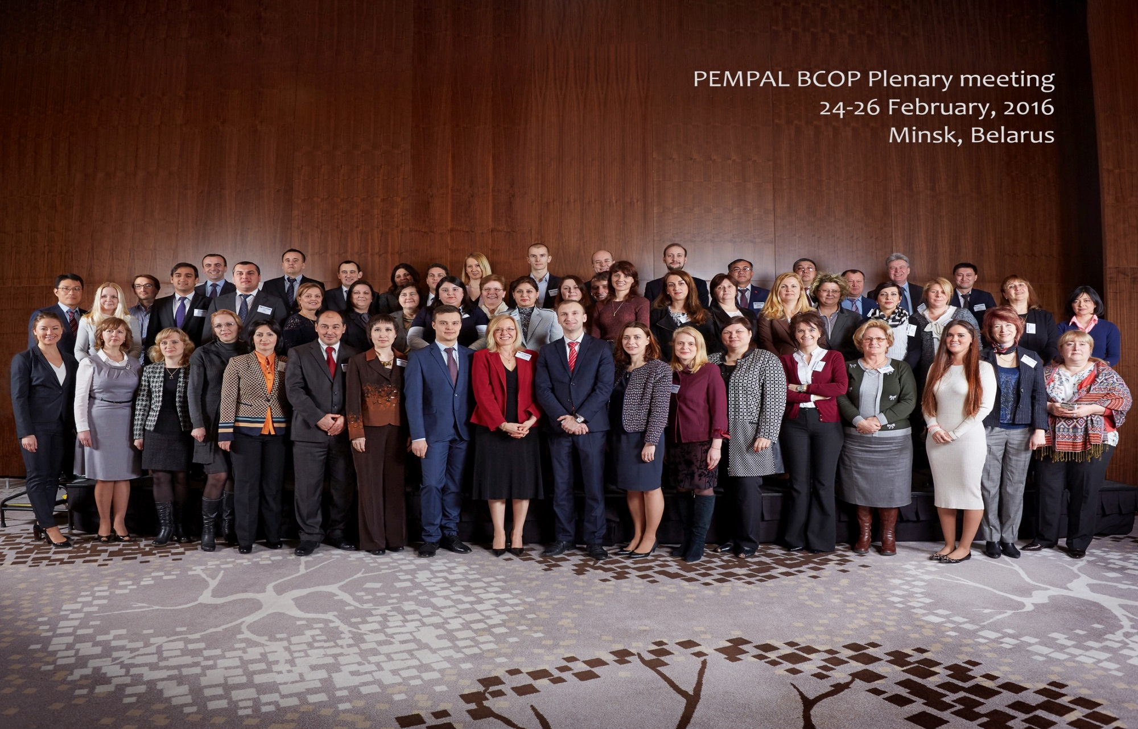

Slide 15
Thank you for your attention!

