Slide 1
Strengthening Fiscal Risk Analysis & Management
Fiscal Affairs Department
IMF
Presentation to the PEMPAL Plenary Meeting of BCOP
Bishkek, April 12, 2017

Slide 2
I. Outline of Presentation
Why Fiscal Risks Matter
Characteristics of Fiscal Risks
Understanding Fiscal Risks
Fiscal Risks Management

Slide 3
I. Sources of Fiscal Risks
Definition: The possibility of fiscal outcomes deviating from expectations (budget forecasts)
Risks arise from:
  Macroeconomic shocks (General fiscal risks)
  Realization of contingent liabilities (Specific fiscal risks)
    Explicit contingent liabilities (e.g. calls on guarantees, legal claims)
    Implicit contingent liabilities (e.g. banking crisis)
  Institutional weaknesses – that constrain the effectiveness of fiscal risk management

Slide 4
I. Sources of Fiscal Risks
Sources of Unexpected Increase in General Government Debt
(percent of GDP, 2007-2010)
 | FRA | DEU | NLD | ESP | PRT | GBR | USA | GRC | IRL | ISL | AVE*
Underlying fiscal position | 1.7 | 3.2 | -2.4 | 1.8 | 11.3 | 3.7 | 8.1 | 16.3 | 1.3 | 10.9 | 6.0
Revisions to 2007 deficit & debt | 1.7 | 1.8 | -0.9 | -0.1 | 0.1 | 1.5 | 7.1 | 2.5 | 1.6 | 4.0 | 4.7
Changes to government boundary | -0.7 | 1.4 | -0.2 | 0.6 | 9.4 | 1.9 | 0.9 | 11.2 | -0.1 | 2.5 | 1.1
Cash-accrual adjustments | 0.7 | 0.0 | -1.3 | 1.3 | 1.7 | 0.3 | 0.0 | 2.6 | -0.2 | 4.5 | 0.2
Exogenous shocks | 8.4 | 12.8 | 14.2 | 15.4 | 8.1 | 17.0 | 6.3 | 40.0 | 60.2 | 39.5 | 9.8
Macroeconomic shocks | 8.3 | 4.7 | 5.2 | 13.0 | 4.4 | 8.9 | 3.8 | 38.4 | 35.7 | -3.3 | 6.0
Financial sector interventions | 0.0 | 8.1 | 9.0 | 2.5 | 3.6 | 8.1 | 2.5 | 1.6 | 24.5 | 42.8 | 3.8
Policy changes | 2.3 | 3.8 | 1.9 | 4.9 | 4.7 | 1.1 | 6.4 | -8.0 | -9.9 | -4.3 | 4.7
Other factors | 2.1 | -0.3 | 6.5 | 1.9 | 3.7 | 6.2 | 8.3 | -6.7 | 7.5 | 21.6 | 5.9
Total Unforecast Increase in Debt | 14.4 | 19.5 | 20.2 | 24.0 | 27.8 | 28.0 | 29.1 | 41.7 | 59.1 | 67.7 | 26.4
* GDP-weighted average
Issues Revealed by the Crisis
Unreported Deficits
SoEs & PPPs
Arrears
Macroeconomic Risks
Contingent Liabilities
Stimulus / Consolidation

Slide 5
I. Fiscal costs of contingent liability realizations
Distribution of Gross Fiscal Costs of CL realizations (% of GDP)
230 episodes,174 episodes of which with identified fiscal cost
Average fiscal cost 6.1% of GDP
Source: IMF staff calculations.

Slide 6
II. Characteristics of Fiscal Risks
Fiscal risks are large (and surprisingly frequent)
Size and likelihood of fiscal shocks by type
Source: Bova et al. (2016)
4

Slide 7
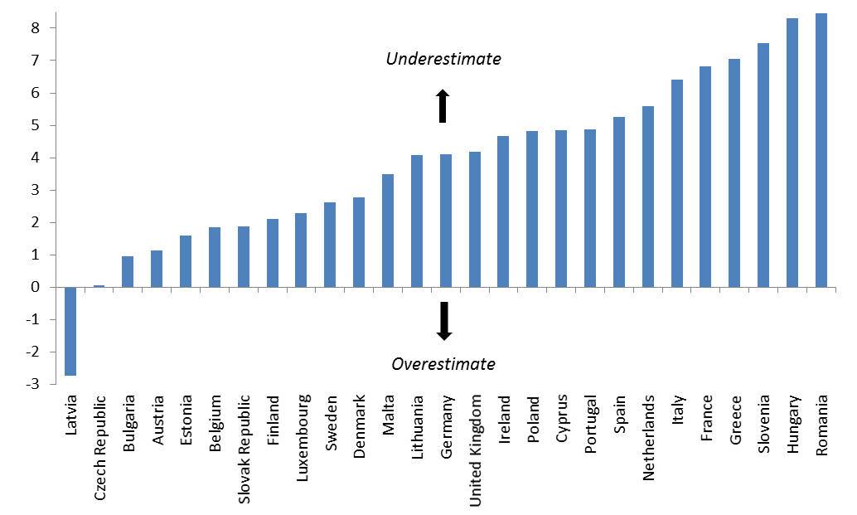
II. Characteristics of Fiscal Risks
Fiscal risks are biased toward the downside
Forecast Error for General Government Debt in Y+3
(2000-13 average as % of GDP, actual-forecast)
Source: European Commission
4

Slide 8
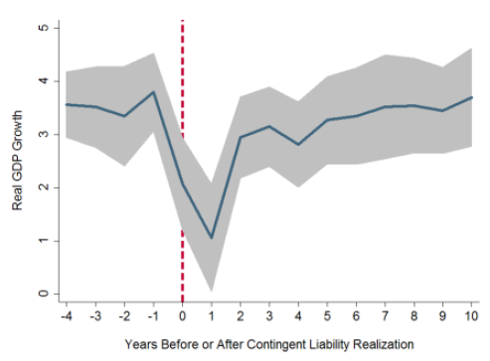
II. Characteristics of Fiscal Risks
Fiscal Risks are Highly Correlated
Contingent liability realizations are correlated with GDP shocks and with each other….
CL Realizations vs Increase in Debt
GDP and CL Realizations
Source: Bova, E., M. Ruiz-Arranz, F. Toscani, and H. E. Ture, 2016, “The Fiscal Costs of Contingent Liabilities: A
New Dataset,” IMF Working Paper 16/14 (Washington: International Monetary Fund).
5

Slide 9
III. Understanding Fiscal Risks
Fiscal Transparency Code
Risk Disclosure & Analysis
Macroeconomic Risks
Risk Management
Budgetary Contingencies
Fiscal Coordination
Sub-National Governments
Specific Fiscal Risks
Long-Term Sustainability
Asset and Liability Management
Guarantees, PPPs and Financial Sector
Natural Resources and Environmental
Public Corporations

Slide 10
III. Understanding Fiscal Risks
Risk Matrix

Slide 11
III. Understanding Fiscal Risks
Disclosure of risks remains qualitative
Contingent Liabilities
Quantitative Analysis of Risk
Qualitative Discussion of Risk
No Disclosure
Source: IMF Staff Estimates
7

Slide 12
III. Understanding Fiscal Risks
Analysis of fiscal risks is limited
Macro-fiscal Risk Analysis
(percent of countries)
Long-term Sustainability Analysis
(percent of countries)

Slide 13
III. Understanding Fiscal Risks
More Integrated Approach to Fiscal Risk Analysis
Fiscal Stress Testing can be used to test the resilience of public balance sheets
Features of stress test:
  Focus on more extreme events; rather than year-to-year volatility
  Explore a range of correlated shocks in an integrated way
  Combine macroeconomic shocks with contingent liability realization
  Analyze impact on future flows, assets and liabilities (including valuation changes)

Slide 14
III. Understanding Fiscal Risks
IMF’s fiscal stress test: fiscal balance and debt shocks
Peru Illustrative Stress Test
Fiscal Balance
(Percent of GDP)
Public Debt
(Percent of GDP)
Source: IMF (2016) “Analyzing and Managing Fiscal Risks – Best Practices,” IMF Policy Paper, June (Washington: International Monetary Fund).
9

Slide 15
III. Understanding Fiscal Risks
IMF’s fiscal stress test: liquidity and fiscal burden
Peru Illustrative Stress Test
Gross Financing
(Percent of GDP)
Fiscal Burden: Interest
(Percent of Revenue)
Source: IMF (2016) “Analyzing and Managing Fiscal Risks – Best Practices,” IMF Policy Paper, June (Washington: International Monetary Fund).
9

Slide 16
III. Understanding Fiscal Risks
IMF’s fiscal stress test: solvency
Peru Illustrative Stress Test
Long-Run Projections
(Percent of GDP)
Solvency: Net Financial Worth
(Percent of 2017 GDP)
Source: IMF (2016) “Analyzing and Managing Fiscal Risks – Best Practices,” IMF Policy Paper, June (Washington: International Monetary Fund).

Slide 17
IV. Fiscal Risk Management:
Fiscal Risk Management Toolkit
STEP 1: IDENTIFY AND QUANTIFY
STEP 1: IDENTIFY AND QUANTIFY
Identify risks
Calculate exposure and likelihood
Weigh costs and benefits of intervention
Identify risks
Calculate exposure and likelihood
Weigh costs and benefits of intervention
STEP 2: MITIGATE
STEP 2: MITIGATE
Cap Exposure
Regulate
Transfer
Cap Exposure
Regulate
Transfer
STEP 3: PROVISION
STEP 3: PROVISION
Expense
Budget contingencies
Buffer funds
Expense
Budget contingencies
Buffer funds
STEP 4: ACCOMMODATE RESIDUAL
STEP 4: ACCOMMODATE RESIDUAL
Account for in setting fiscal objectives
Account for in setting fiscal objectives
10

Slide 18
IV. Fiscal Risk Management:
Institutional frameworks need Strengthening

Slide 19
THANK YOU FOR YOUR ATTENTION!

