Slide 1
Fiscal Risks and Performance Monitoring of State Owned Enterprises (SOEs)
Andrei Busuioc, Senior Financial Management Specialist, The World Bank CFRR
April 12, 2017, Bishkek, Kyrgyz Republic
PEMPAL 2017 BCOP Plenary Meeting: TOOLS FOR FISCAL MANAGEMENT

Slide 2
Objective of the session: Governance and fiscal risks of SOEs Performance monitoring of State Owned Enterprises, with a focus on what information is needed to assess and monitor fiscal risks

Slide 3
Outline
Importance of SOEs & key elements of their good governance
Key elements of governance relevant for fiscal risks from SOEs
Fiscal risk from SOEs

Slide 4
Importance of SOEs & key elements of their good governance

Slide 5
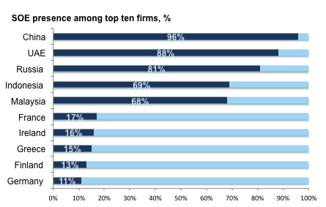
Source: World Bank Group’s Competition Policy Team elaboration based on the Note by the European Union, Roundtable on Competition Neutrality OECD, 2015.
5

Slide 6
SOEs in emerging markets
Source: Musacchio et al (2014)

Slide 7
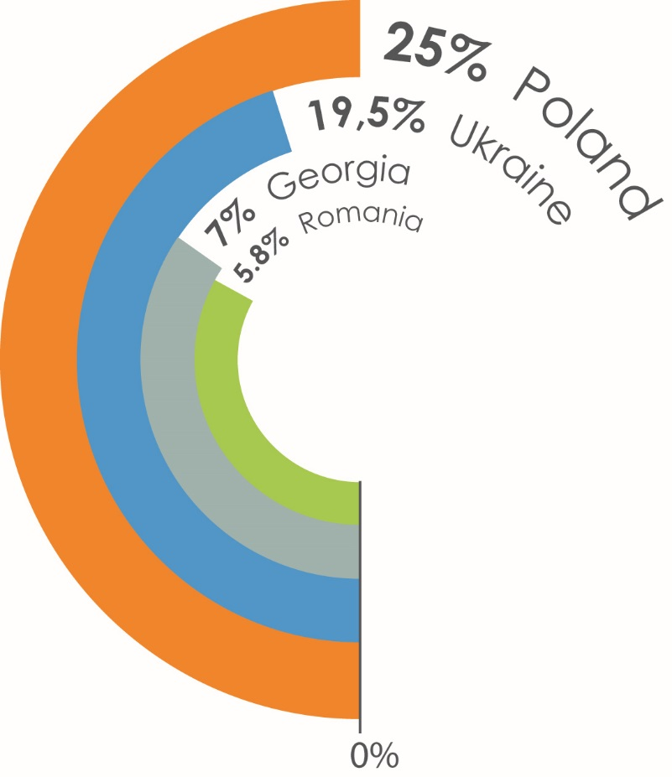
Role of SOEs in Europe and Central Asia region (1)
SOEs are significant contributors to GDP:
In the main sectors:
Energy
Transport
Telecommunications
Financial sector
General manufacturing

Slide 8
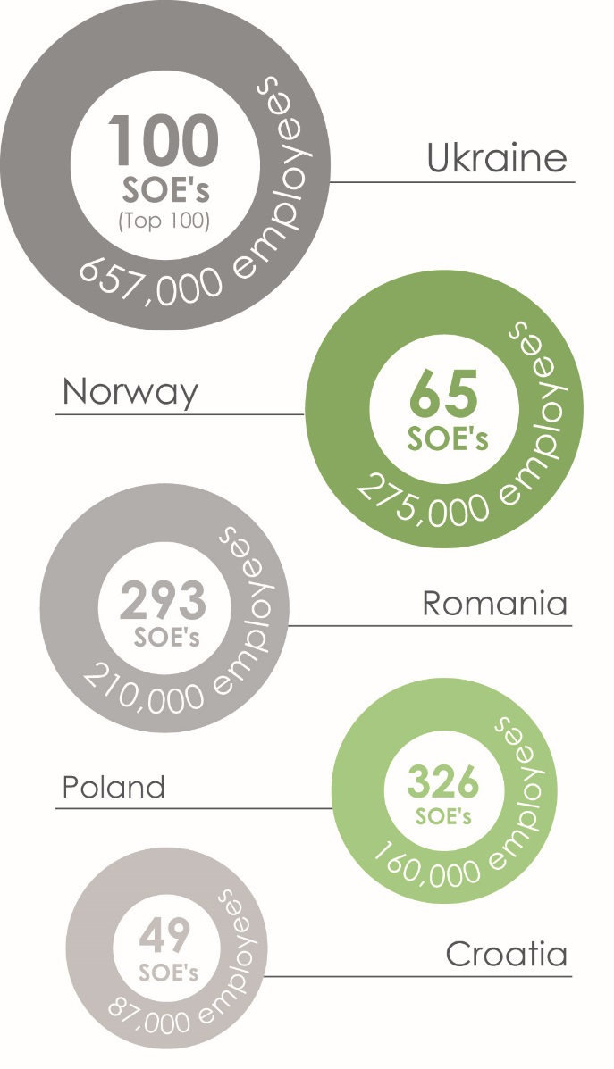
Role of SOEs in Europe and Central Asia region (2)
SOEs are among largest employers:

Slide 9
SOEs and the twin goals
CLIENT DEMAND
Performance & transparency of SOE operations
Fiscal risk management
Assessment of market distortions and resource allocation
SOFI support to fin. inclusion, SMEs and infrastructure financing
Impact on poverty of SOE operations
When and how to bring in private sector
SOE PERFORMANCE
Quality service delivery to citizens and businesses
Financial and fiscal sustainability
Level playing field and competitive neutrality
TWIN GOALS
End extreme Poverty
Promote shared prosperity
Notes:
SOFI-state owned financial institutions

Slide 10
Autonomy versus Accountability
A strong governance framework gives SOEs autonomy, while ensuring their accountability to the general public
Financial discipline
Fiscal discipline
Board independence
Identification and reimbursement for PSOs
Corporatization
Labor issues (hiring/firing, compensation)
Procurement
Managerial Autonomy
Financial Accountability
Performance monitoring
Financial reporting
Non-financial reporting
External audits
Control environment: ownership entity, board of directors, audit committee, internal audit unit; management

Slide 11
SCHEMATIC REPRESENTATION: OECD GUIDELINES - 2015
Government & Central Administration
Rationale for State Ownership (1)
Ownership Function (2)
SOEs in the marketplace (3)
(Legal and regulatory framework)
Board of Directors (7)
Transparency (6)
Publication of aggregate Reports
Publication of External Audits
SOE
Equal Treatment of Shareholders and others investors (4)
Stakeholders relations and responsible business (5)

Slide 12
Framework for SOE Governance
A strong SOE governance framework safeguards the interests of citizens, as the ultimate owners of SOEs, through appropriate mechanisms at the entity, government, and institutional levels
Levels of Reform
Legal and Regulatory framework
State’s Ownership Role
Performance Monitoring
Institutional Framework
State (government level)
SOE (entity-level)
Financial and Fiscal Discipline
Thematic
Board of Directors
Transparency, Disclosure & Controls
Equal Treatment of Shareholders

Slide 13
Key elements of governance relevant for fiscal risks from SOEs

Slide 14
Performance Monitoring
Key principles | Comments
Central role of the ownership entity(ies) | Policymaking entities and regulatory agencies also have a monitoring role
Broad scope: financial, operational and ESG aspects of performance | Holistic view/ integrated thinking
Monitoring system should be consistent with the SOEs’ own performance management
Requires well-trained staff with industry knowledge and IT infrastructure
Entails formal processes (setting goals, performance agreements, reporting, providing assurance, etc.) and informal exchanges with the SOEs | Importance to maintain balance between the two

Slide 15
Financial and Fiscal Discipline
Key principles | Comments
Reduce/phase out State’s direct and indirect financial support
Identify and cost out public policy (non-commercial) objectives and compensate the SOEs for these
Monitor and manage the fiscal burden and risk SOE impose on the State | Ex-ante controls may exacerbate moral hazard
Markets can play a disciplining role (e.g., bond issuance)
See separate discussion on fiscal risk associated with SOEs

Slide 16
Financial Accountability, Controls and Transparency (1/2)
Key principles | Comments
SOEs should observe high standards of corporate financial reporting (preferably the International Financial Reporting Standards) | IFRS designed with a focus on investors, therefore very challenging Some advocate use of public sector standards
Timeliness | SOEs often report very late
Annual and interim reporting | SOEs often only report once a year
Growing focus on non-financial reporting | No unique global standard
Strong internal controls and internal audit function reporting to the Board (or its’ Audit Committee) | State auditor can play a useful role in this area
Financial statements should be audited and non-financial information independently reviewed | State auditor in most cases not able to perform financial audit of SOEs (+ the audit should be equivalent to any private sector entity)

Slide 17
Financial Accountability, Controls and Transparency (2/2)
Key principles | Comments
Information should be easily accessible to the public (e.g., websites or central public registers of financial statements)
Audit committee plays a key role in ensuring the integrity or the reporting and audit processes, and of the internal control/risk management systems | Importance of interactions with internal and external auditors
State should report each year on the SOE sector as a whole and how it fulfilled its role as owner | Many States do not report on their ownership role
→ A key enabling dimension of governance

Slide 18
Summary – why good governance of SOEs matters
A good corporate governance system is associated with a number of benefits for all companies, whether private or state owned: » better access to external finance » larger investments and lower costs of capital » higher growth and valuation » greater employment creation and growth » improved operational performance and more efficient management » reduced risk of corporate crises and scandals
» less risk for public finances
» further reduce poverty and income inequality
Taken together, these benefits can boost the efficiency of SOEs and economy as a hole, make transactions among companies more competitive and transparent; result in more efficient allocation of resources; reduce fiscal burden and fiscal risk of SOEs; lead to greater public and private investment in critical sectors, contribute to competitiveness and growth; reduce vulnerabilities in the financial system and promote financial sector development.
Implementing many of the good practices will be a challenge for most countries in the short-term; the solutions should be sequenced in time to achieve good progress over long term

Slide 19
Fiscal risk from SOEs

Slide 20
Defining fiscal risks from SOEs
As defined by the IMF - fiscal risks are possible deviations of fiscal outcomes from what was expected at the time of the budget or other forecast
Fiscal risks are defined here as factors outside government control that can cause fiscal outturns to differ from their initial forecasts.
State-owned enterprises (SOEs) are a potentially significant and common source of fiscal risks, with government bailouts of troubled SOEs costing 3 percent of GDP on average and 15 percent of GDP in the most extreme cases. (IMF, June 2016, ANALYZING AND MANAGING FISCAL RISKS: BEST PRACTICES)

Slide 21
Indicators of fiscal risks
SOEs: one of 7 main sources of fiscal risk
Contingent liab. realization 1990 and 2014:
Contingent Liability | Number of Events | Events with Costs | Fiscal Cost
 |  |  | % of GDP | Average Maximum
Financial Sector | 91 | 82 | 9.7 | 56.8
Legal | 9 | 9 | 7.9 | 15.3
Subnational | 13 | 9 | 3.7 | 12.0
SOEs | 32 | 31 | 3.0 | 15.1
Natural Disaster | 65 | 29 | 1.6 | 6.0
Corporate | 7 | 6 | 1.7 | 4.5
PPPs | 8 | 5 | 1.2 | 2.0
Other | 5 | 3 | 1.4 | 2.5
Total | 230 | 174 | 6.1 | 56.8
Source: Bova and others (2016), cited in IMF (2016)

Slide 22
Fiscal risk and fiscal discipline
The economic performance of SOEs has a direct bearing on the government budget. Healthy companies - valuable assets, BUT loss-making or overly indebted firms - liabilities - may require interventions - capital or other assistance (reliable information is key!)
Where corporate governance and institutional oversight are weak - SOEs can generate significant fiscal risks - subsidies from the budget, generating low rates of return with lower dividends, paying less in taxes and incurring debts that the state will need to cover
Legal form of SOEs can also be a risk in itself! – sometimes quasi-fiscal activities or implementing public policy objectives can be a source of risk
Notes:
The economic performance of SOEs has a direct bearing on the government budget. While healthy companies constitute valuable assets for the state, loss-making or overly indebted companies represent liabilities which may require interventions with capital injection or other forms of assistance.
As defined by the IMF, fiscal risks represent possible deviations of fiscal outcomes from what was expected at the time of the budget or other forecast. Sources of risk include various shocks to macroeconomic variables (economic growth, commodity prices, interest rates, or exchange rates) as well as calls on several types of contingent liabilities (obligations triggered by an uncertain event: including both explicit liabilities—those defined by law or contract, e.g., debt guarantees—and implicit liabilities— moral or expected obligations for the government, based on public expectations or pressures, e.g., bailouts of banks or public sector entities).
Where SOEs corporate governance and institutional oversight are weak SOEs can generate significant fiscal risks, including requiring subsidies from the budget, generating low rates of return with commensurate lower dividend, paying less in taxes and by incurring debts. Governments can reduce their exposure to fiscal risks from SOEs by: (i) reducing overall state participation in commercial activities; (ii) limiting exposure to contingent liabilities by ensuring there is a clearly defined set of criteria that govern the operation and conduct of SOEs; (iii) strengthening governance arrangements (for example through appointing independent boards based on transparent and merit-based nomination processes); (iv) placing legal limits on bail-outs; and (v) providing transparent mechanisms in the budget to compensate SOEs where they deliver non-commercial government goals.

Slide 23
Links between state ownership in SOEs and government's budgetary position – an example from Estonia
Estonia is a Member States with a relatively high share of state participation in the capital of public and private companies, respectively 19.0% and 0.2% of GDP
The annual accounts of the state provide a good example of transparency by listing all companies with the participation of the central government, together with the state's share and companies' financial information
The companies in state ownership have predominantly been profitable; dividends received by government improved budgetary position by 0.9% of GDP on average between 2005 and 2014 - a stable source of income for the budget; The national airline Estonian Air (97% owned by state) - difficulties in recent years - government injected capital of EUR 17.9 m (0.1% of GDP) in 2010 and EUR 30 m (0.2% of GDP) in 2011 - to restore the stock capital; these transactions were considered as expenditure from the point of view of public finances
In addition, a debt cancellation towards Estonian Air was decided by the government in 2014, reducing general government's surplus in that year by EUR 37 m (0.2% of GDP). The company went into liquidation in late 2015
Source: SOEs in the EU Lessons Learnt and Ways Forward in a Post-Crisis Context. July 2016, EC.
Notes:
Estonia is a Member States with a relatively high share of state participation in the capital of public and private companies, respectively 19.0% and 0.2% of GDP. The annual accounts of the state (available in Estonian on the website of the Ministry of Finance of Estonia (1)) provide a good example of transparency by listing all companies with the participation of the central government, together with the state's share and companies' financial information. According to this list, the Estonian government was in 2014 full or majority owner of several principal infrastructure companies active in the energy sector (notably Eesti Energia and Elering), in the maritime transport sector (notably Port of Tallinn), in the railway sector (notably Estonian Railways) and in the air transportation sector (notably Estonian Air and Tallinn Airport). The companies in state ownership have predominantly been profitable, which is reflected in the fact that dividends received by general government improved budgetary position by 0.9% of GDP on average between 2005 and 2014, being a relatively stable source of income for the budget. On the other hand, the national airline Estonian Air, where the state owned 97% of shares, has experienced difficulties in recent years and the government made capital injections into the company for an amount of EUR 17.9 m (0.1% of GDP) in 2010 and EUR 30 m (0.2% of GDP) in 2011 in order to restore the stock capital of the company; these transactions were considered to have an unrequited nature, i.e. an expenditure from the point of view of public finances. In addition, a debt cancellation towards Estonian Air was decided by the government in 2014, reducing general government's surplus in that year by EUR 37 m (0.2% of GDP). The company went into liquidation in late 2015.

Slide 24
Types of fiscal risks form SOEs
Static and dynamic risk
Static - size of SOEs, financial position, current risk
Dynamic – more forward looking, trends, loosing revenues/profits/fiscal position/taxes/dividends – what can happen?
How to explore fin statements – where to get information?
Reliability of information!
Risk management – scenario analysis
Calibration – measuring risks
Contingent liabilities, provisions

Slide 25
Indicators of fiscal risks -SOEs as source of fiscal risk
“Bail out” of SOE, through fresh capital contribution, debt equity swap, loan write off, etc.
Liquidation costs
Retrenchment programs paid for by the State; transfer of SOE personnel to the State
Decline in dividend revenue
Shortfall in revenue from divestiture
Lower tax revenues
Loss of commercial revenues for the State (e.g., rental of facilities)
Etc.

Slide 26
Indicators of fiscal risks - Static View
What to look for | Source
Reduced ability to distribute dividends | Financial statements (gearing, pay out ratio, capital expenditure plans)
Deteriorating financial condition (↓equity, ↑debt) | Balance sheet and notes to F/S
Unreported financial/non-operating liabilities (e.g., decommissioning of equipment and unfavorable outcome of commercial dispute) | Notes to financial statements, management report
Large investment needs requiring a capital increase | SOE reports, discussions with ownership entity and SOE management, site visits
Retrenchment | Discussions with ownership entity and SOE management, HR analyses

Slide 27
Indicators of fiscal risks - Dynamic View
What to look for | Source
Downward revenue and/or profitability trends | Income statement, notes to the F/S, budget, three-year plan
Profits due non-competitive conditions | Bylaws, annual report, ownership reports, analysis of related-party transactions
Increased risk at SOE level due to major investments or business expansion | Annual report, financial statements, news about the SOE
Major external events (e.g., changes in prices of commodities, foreign currency fluctuations new technology, new competitor) | Annual report, industry reports, business news
Major fraud (see Petrobras)
Other (e.g., new CEO)
Notes:
Dynamic view: effect of ongoing or future events
Notes to financial statements generally do not give enough info on related-party transactions

Slide 28
IMF, June 2016, ANALYZING AND MANAGING FISCAL RISKS: BEST PRACTICES
Governments can reduce their exposure to fiscal risks from public corporations by:
Reducing overall state participation in commercial activities and reduce the size of quasi-fiscal activities
Limit exposure to contingent liabilities - clear governance for explicit government guarantees, prohibit or control guarantees by SOEs to third parties, and where appropriate, restrict the sale or use of their assets as collateral in financing transactions
Strengthening governance arrangements - e.g. appointing independent boards based on transparent and merit-based nomination processes, holding them accountable for financial performance, ensuring there is operational autonomy, and legislating high standards of financial reporting and subjecting annual accounts to external audit;
Legislating explicit no-bail out clauses to reduce exposure
Ensuring there is transparent and appropriate compensation for public corporations executing quasi-fiscal activities to achieve government goals and that subsidies for these activities are appropriately expensed in the budget
Finally - ensuring there is fiscal space to absorb retained risks through for example, a general contingency reserve to cover any calls on government guarantees to public corporations, or to cover unforeseen cost in case of their restructuring or liquidation
Notes:
Reducing overall state participation in commercial activities and reduce the size of quasi-fiscal activities
Limit exposure to contingent liabilities - clearly defined set of criteria to govern the provision of any explicit government guarantees, prohibit or control the issuance of guarantees by SOEs to third parties, and where appropriate, restrict the sale or use of their assets as collateral in financing transactions
Strengthening governance arrangements, for example through appointing independent boards based on transparent and merit-based nomination processes, holding them accountable for financial performance, ensuring there is operational autonomy, and legislating high standards of financial reporting and subjecting annual accounts to external audit;
Legislating explicit no-bail out clauses to reduce exposure
Ensuring there is transparent and appropriate compensation for public corporations executing quasi-fiscal activities to achieve government goals and that subsidies for these activities are appropriately expensed in the budget
Finally, as for other risks, ensuring there is fiscal space to absorb retained risks through for example, a general contingency reserve to cover any calls on government guarantees to public corporations, or to cover unforeseen cost in case of their restructuring or liquidation

Slide 29
Managing fiscal risks form SOEs – additional considerations
No preferred access to finance
No guarantees
Legal form of SOEs – can be a cause of risk – limited liability legal form similar to private sector
Limitation and monitoring of borrowing
Contingencies and provisions
Prohibition from bailout
Example of New Zealand - specific para in loan contracts stating that the state does not guarantee the loan - Creditors should bear the risk of lending to SOEs
See box 5.4 from toolkit

Slide 30
Estimating Fiscal Risks of SOEs - quantification
Quantification of risks – identify factors that can impact SOEs:
• Macroeconomic, including international commodity prices (oil) and exchange and interest rates
• Regulatory, including price regulations (those related to public transport and water, for example),
• Operational, including delays and cost overruns in the implementation of capital projects, factors that affect operational efficiency (such as poor decisions) and the acquisition and sales of assets
Sectoral, including sector-specific factors that drive demand, changes in market share, and the cost of production (e.g. competition and wages)
Force majeure, such as natural disasters and other uncontrollable risk factors.

Slide 31
Estimating Fiscal Risks of SOEs - impact
The impact can be assessed through the impact of risk factors on the variables:
Net contribution of the SOE to the budget - indirect taxes, corporate income tax, dividends, subsidies, net equity and debt payments, and calls on government guarantees
Financing need of the SOEs - complements the previous one - the impact of a risk factor on net contribution can be offset by taking on additional debt
Net debt - indicates total liabilities minus current assets of the SOEs - Rising net debt increases the exposure of the government to adverse shocks on the SOEs’ balance sheet and operations
Off -balance-sheet liabilities - An example is a guarantee (such as for toll road revenue) under a public-private partnership contract.
Notes:
Net contribution measures the SOE’s direct impact on fiscal revenue and spending.
But that additional risk also reduces the scope for net contributions in the future, all other things being equal. The financing need can be measured on a net basis (that is, not taking into account debt rollover) or on a gross basis (this is useful particularly when debt rollover is at risk).
Rising net debt increases the exposure of the government to adverse shocks on the SOEs’ balance sheet and operations (through the government’s need to provide financial support to the company and the likelihood of reduced net contributions to the government’s budget in the future).
Off -balance-sheet liabilities. An example is a guarantee (such as for toll road revenue) under a public-private partnership contract. Off - balance-sheet liabilities are typically of a contingent nature (if they are direct liabilities they would likely be included in liabilities on the balance sheet). This measure adds to the previous measures, because, for the government, an increase in off -balance-sheet liabilities has an impact on the SOE’s net worth similar to an increase in net debt. These measures are largely complementary, and it is not possible a priori to determine which is more important. When the government faces liquidity constraints, it may be most concerned about the net contribution to the budget. If firm debt is seen as a critical problem for the SOE sector (because of worsening payment arrears of SOEs, for example) or there is substantial borrowing by SOEs under government guarantees, then the focus may be more on financing need and net debt.

Slide 32
Good Practices for Institutional Arrangements and Reporting Mechanisms for SOE Debt
Clearly defined and legally backed institutional arrangements for SOE debt monitoring are critical
Legislation and government regulations need to define the primary data sources and specific indicators to be used for monitoring contingent liabilities originating from SOEs
Coordination mechanisms and information flows need to be transparent and streamlined to ensure efficiency and confidentiality of information, as appropriate. Care should be taken to avoid duplicate lines of reporting to reduce the overall administrative burden for SOEs and government agencies.
Laws and regulations should stipulate which government agency is responsible for primary data collection and analysis of SOE debt. Alternatively, one unit (for example, within the ministry of finance) can be responsible for data collection, consolidation, and analysis.
Financial monitoring should be seen as a proactive process (as opposed to data gathering for its own sake) and supported by appropriate financial-monitoring tools.

Slide 33
Useful resources
World Bank Group. 2014. Corporate Governance of State-Owned Enterprises : A Toolkit. Washington, DC. © World Bank. https://openknowledge.worldbank.org/handle/10986/20390
ANALYZING AND MANAGING FISCAL RISKS—BEST PRACTICES – IMF, June 2016

