Slide 1
PUBLIC PARTICIPATION IN FISCAL POLICIES
Brazilian Cases
Daniel Pitangueira de Avelino, PhD

Slide 2
1. BRAZILIAN OVERVIEW
POLITICAL SYSTEM
BUDGETARY LAWS
BUDGETARY PROCESS
RECENT EVENTS

Slide 3
BRAZIL
Political System
EXECUTIVE
LEGISLATURE
JUDICIARY
President
Ministries
National Congress
Federal Courts
FEDERAL UNION
Public Attorneys
Governor
Secretaries
State Assemblies
State
Courts
STATES
MUNICIPALITIES
Prefect
Secretaries
Municipal Chambers

Slide 4
BRAZIL
Budgetary Laws
Multi-year Plan – (4-year-long)
Budgetary Guidelines Law – LDO (annual)
Annual Budgetary Law – LOA (annual)
elections
LDO
LOA
LDO
LOA
LDO
LOA
LDO
LOA
LDO
LOA
LDO
LOA
LDO
LOA
LDO
LOA
LDO
LOA
PPA 2008-2011
PPA 2012-2015
PPA 2016-2019
FEDERAL UNION
2010
2011
2012
2013
2014
2015
2016
2017
2018
LDO
LOA
LDO
LOA
LDO
LOA
LDO
LOA
LDO
LOA
LDO
LOA
LDO
LOA
LDO
LOA
LDO
LOA
PPA 2008-2011
PPA 2012-2015
PPA 2016-2019
STATES
2010
2011
2012
2013
2014
2015
2016
2017
2018
LDO
LOA
LDO
LOA
LDO
LOA
LDO
LOA
LDO
LOA
LDO
LOA
LDO
LOA
LDO
LOA
LDO
LOA
PPA 2010-2013
PPA 2014-2017
PPA 2018-2021
MUNICIPALITIES
2010
2011
2012
2013
2014
2015
2016
2017
2018
elections

Slide 5
BRAZIL
Budgetary Process
EXECUTIVE
EXECUTIVE
LEGISLATURE
LEGISLATURE
JUDICIARY
EXECUTIVE
LEGISLATURE
EXECUTIVE
JUDICIARY
Public Attorneys
Public Attorneys
Proposals
Law Project
Approved Law
Enacted Law
Management
Monitoring
Evaluation
Accountability
LEGISLATURE
Account Control
EXECUTIVE
Court of Accounts

Slide 6
BRAZIL
Recent Events
elections
1985
indirect: TANCREDO NEVES (PMDB)
death (1985)
1989
FERNANDO COLLOR (PRN)
impeachment (1992)
1994
FERNANDO HENRIQUE (PSDB)
1998
FERNANDO HENRIQUE (PSDB)
Vice-President assumes
(PMDB)
2002
LULA (PT)
2006
LULA (PT)
2010
DILMA ROUSSEFF (PT)
2014
DILMA ROUSSEFF (PT)
impeachment (2016)
disapproval
Presidential approval
source: CNT/MDA
approval
11
12
2013
2014
2015
2016
17

Slide 7
2. PARTICIPATION OVERVIEW
UNIVERSAL DECLARATION OF HUMAN RIGHTS
BRAZILIAN CONSTITUTION
CONSTITUTION OF THE KYRGYZ REPUBLIC
CARTA IBEROAMERICANA DE PARTICIPACIÓN CIUDADANA
BRAZILIAN FISCAL RESPONSIBILITY LAW
PARTICIPATORY DEMOCRACY
STATE-SOCIETY INTERACTIONS
INTERNATIONAL INDEXES
Democracy Index
Global Open Data Index
Open Budget Index

Slide 8
Universal Declaration of Human Rights (1948)
Article 21.
(1) Everyone has the right to take part in the government of his country, directly or through freely chosen representatives. (2) Everyone has the right of equal access to public service in his country. (3) The will of the people shall be the basis of the authority of government; this will shall be expressed in periodic and genuine elections which shall be by universal and equal suffrage and shall be held by secret vote or by equivalent free voting procedures.
(SOURCE: OHCHR-UN)

Slide 9
Brazilian Constitution 1988 (Constituição da República Federativa do Brasil de 1988)
Art 1º (...)
Parágrafo único
Todo o poder emana do povo, que o exerce por meio de representantes eleitos ou diretamente, nos termos desta Constituição.
Article 1º, sole paragraph
All the power emanates from the people, who exerts it through elected representatives or directly, according to this Constitution.

Slide 10
КЫРГЫЗ РЕСПУБЛИКАСЫНЫН КОНСТИТУЦИЯСЫ – 2010 CONSTITUTION OF THE KYRGYZ REPUBLIC - 2010
2-берене.
1. Кыргызстандын эли эгемендиктин ээси жана Кыргыз Республикасындагы мамлекеттик бийликтин бирден-бир булагы болуп саналат.
2. Кыргызстандын эли өз бийлигин ушул Конституциянын жана мыйзамдардын негизинде түздөн-түз шайлоолордо жана референдумдарда, ошондой эле мамлекеттик органдардын жана жергиликтүү өз алдынча башкаруу органдарынын системасы аркылуу жүзөгө ашырат.
5. Мамлекет мыйзамда белгиленген ар кайсы социалдык топтордун мамлекеттик органдардагы жана жергиликтүү өз алдынча башкаруу органдарындагы, анын ичинде чечим чыгаруу деңгээлинде өкүлчүлүгү үчүн шарттарды түзөт.
Article 2
1. The people of Kyrgyzstan are the bearer of sovereignty and the sole source of state power in the Kyrgyz Republic.
2. The people of Kyrgyzstan shall exercise its power directly at elections and referenda, as well as through the system of state authorities and local self-governance bodies on the basis of the present Constitution and laws.
5. The state shall ensure the conditions for the representation of various social groups defined by the law in state authorities and local self-governance bodies, including at the level of decision-making.

Slide 11
Carta Iberoamericana de Participación Ciudadana en la Gestión Pública (2009)
A los efectos de la presente Carta Iberoamericana, se entende por participación ciudadana en la gestión pública el processo de construcción social de las políticas públicas que, conforme al interés general de la sociedade democrática, canaliza, da respuesta o amplía los derechos económicos, sociales, culturales, políticos e civiles de las personas, y los derechos de las organizaciones o grupos en que se integram, así como los de las comunidades y pueblos indígenas.
Así, el título de “ciudadano” y “ciudadana”en la presente Carta Iberoamericana no está referido a las personas con derechos exclusivos de ciudadanía o de nacionalidade sino a todo habitante con respecto a la gestión pública del país en donde reside, en el ejercício de los derechos que le conciernen.

Slide 12
Brazilian Fiscal Responsibility Law – LRF 2000
LEI COMPLEMENTAR Nº 101, DE 4 DE MAIO DE 2000.
Art. 48. (...)
Parágrafo único. A transparência será assegurada também mediante:
I – incentivo à participação popular e realização de audiências públicas, durante os processos de elaboração e discussão dos planos, lei de diretrizes orçamentárias e orçamentos;
Article 48 (...) sole paragraph
Transparency shall also be assured through:
I – incentives to popular participation and public hearings, during all the processes of formulation and discussing of plans, budgetary guidelines laws and budgets.

Slide 13
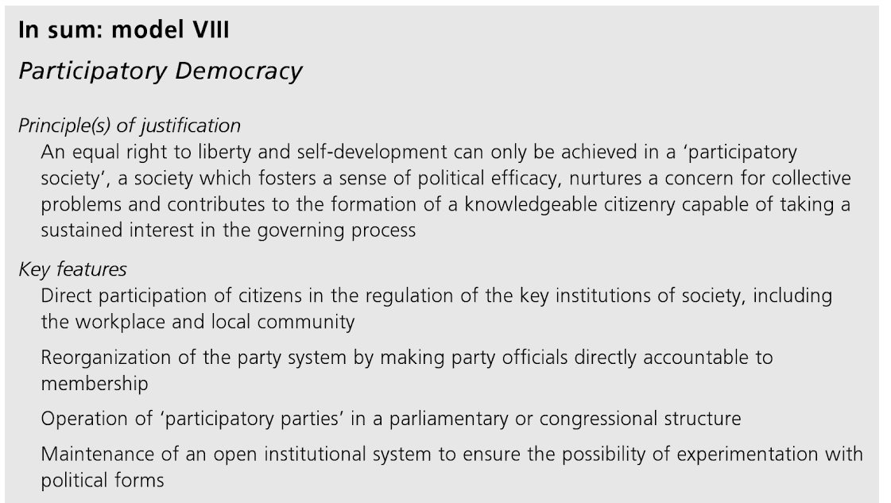
HELD, David. Models of democracy. 3rd Edition. Stanford: Stanford University Press, 2006, p.215.

Slide 14
STATE-SOCIETY INTERACTIONS
ANNUAL PERCENTAGE 2002-2010
of governmental programs and institutions displaying socio-state interactions
Source: IPEA.gov.br (2012) % programs % institutions

Slide 15
STATE-SOCIETY INTERACTIONS
SPATIAL ASSOCIATION between types of policies and types of interactions
Types of policies | Types of interaction
DE – economic development | Rgi – meeting with interest groups
PS – social protection | Dcs – councils
 | Dcf – conferences
Inf – infrastructure | CP – public consultation
 | AP – public hearing
MA – environment | OV – hearing offices
 | Ot - others
Source: IPEA.gov.br (2012)

Slide 16
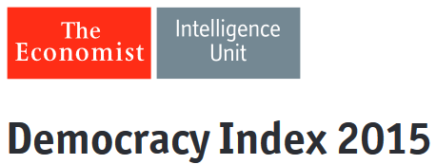
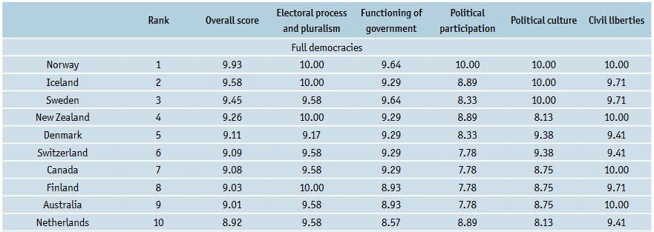

Slide 17
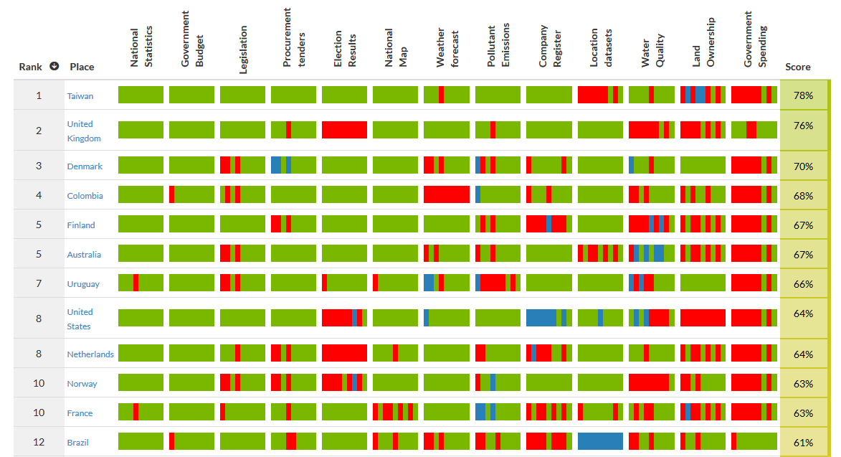

Slide 18
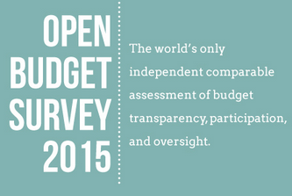

Slide 19
3. PARTICIPATION TOOLS
PARTICIPATORY BUDGETING
PUBLIC POLICY COUNCILS
INTERCOUNCIL FORUM
PUBLIC CONSULTATIONS AND HEARINGS
POPULAR LEGISLATIVE AMENDMENTS
AMONG OTHERS...
NATIONAL CONFERENCES
HEARING OFFICES (OMBUDSMAN)
DIALOGUE ROUNDTABLES
ETC

Slide 20
PARTICIPATORY BUDGETING
Previous experiences in Brazil (70s and 80s)
Experience of Porto Alegre (1989)
Selected by United Nations as one of the best urban interventions in 1995, during the Second United Nations Conference on Human Settlements (Habitat II), in Istambul;
In 1995 World Bank hosts a seminar on participatory budgeting in Porto Alegre and starts to spread the practice;
In 1999, the IDB - Inter-American Development Bank – discussed participatory budgeting during a seminar in Washington, D.C., and began to promote the practice;
Porto Alegre hosts the first edition of World Social Forum in January, 2001.

Slide 21
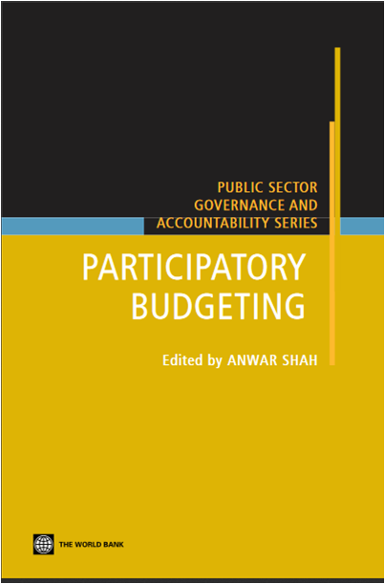
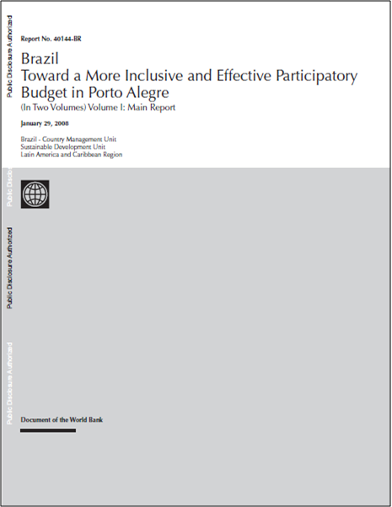

Slide 22
PARTICIPATORY BUDGETING
Number of participatory budgeting practices
Mandates (municipal/Brazil)
Source: Projeto Democracia Participativa - 2004

Slide 23
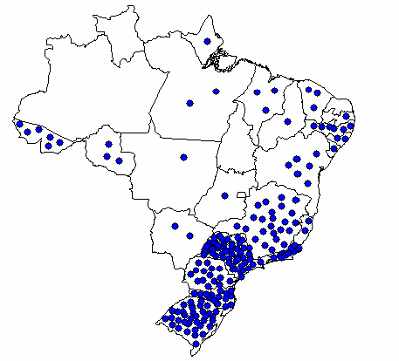
PARTICIPATORY BUDGETING
Source: PNUD/SG-PR-Brasil International Conference “Democracia, Participação Cidadã e Federalismo”, 2004.

Slide 24
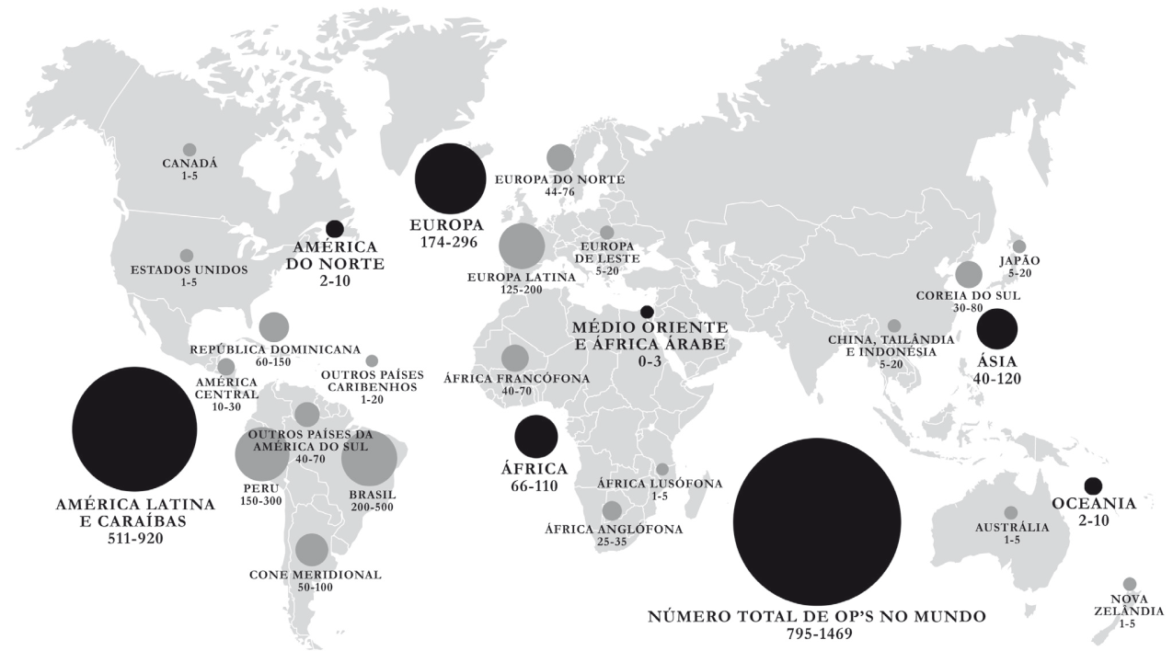
PARTICIPATORY BUDGETING IN THE WORLD
Source: Sintomer et al. (2012).

Slide 25
COUNCILS IN BRAZIL
Context
Source: ibge.gov.br (2009-2012).
COUNCIL | NUM | %
School Councils | 4243 | 76,24%
Municipal Education Councils | 4718 | 84,78%
School Fooding Councils | 5303 | 95,29%
Municipal Councils for Rights of Children and Adolescents | 5446 | 97,86%
Councils of Monitoring of FUNDEB (Educational Funding) | 5462 | 98,15%
Tutelage Councils (Protection of Children and Adolescents) | 5521 | 99,21%
Municipal Social Assistance Councils | 5527 | 99,32%
Municipal Health Councils | 5553 | 99,78%
MUNICIPALITIES TOTAL | 5565 | 100,00%

Slide 26
COUNCILS IN BRAZIL
Nacional Councils
How many?
60 National Councils
(Source: Arquitetura da Participação Social no Brasil – INESC/Polis)
35 National Councils
5 National Commissions
57 other collegiate bodies
(Source: Guia dos Conselhos Nacionais – SGPR)
62 National Councils
33 National Commissions
14 National Committees
(Source: Sistema de Informações Organizacionais – SIORG/MPOG)

Slide 27
COUNCILS IN BRAZIL
Incorporation of Councils
Councils that became public agencies, Brazil, 1933–1967
Source: Senado Federal (2012)
COUNCIL | ORIGINATED BODY | CONVERSION ACT
National Council of Coffee | National Department of Coffee | Decreto nº 22.425, de 10/02/1933
National Council of Statistics National Council of Geography | Brazilian Institute of Geography and Statistics (IBGE) | Decreto-Lei nº 218, de 26/01/1938
Federal Council of Civil Public Service | Management Department of Public Service (Dasp) | Decreto-Lei nº 579, de 30/07/1938
Council for Protection of Psychopaths | National Psychiatric Center | Decreto-Lei nº 7.055, de 18/11/1944
National Work Council | Superior Work Court | Decreto-Lei nº 9.797, de 09/09/1946
Federal Forest Council | Forest Policy Commission of the Brazilian Institute of Forest Development | Decreto-Lei nº 289, de 28/02/1967

Slide 28
COUNCILS IN BRAZIL
Incorporation of Councils
COUNCILS CONVERTED INTO FEDERAL ENTITIES:
National Council for Scientific and Technological Development - CNPq (Foundation/MCTIC)
Management Council for Economic Defense - CADE (Autarchy/MJC)
National Commission of Nuclear Energy - CNEN (Autarchy/MCTIC)
Securities and Exchange Commission of Brazil - CVM (Autarchy/MF)
Cf. DECRETO Nº 6.129, DE 20 DE JUNHO DE 2007

Slide 29
COUNCILS IN BRAZIL
Mosaic
CNCD
Conanda
Conaeti
Codefat
CDDPH
CNDI
CCFGTS
CNIG
Conatrae
Conade
CNDM
CRT
CNES
CNPCP
CNPI
CNAPO
CNRH
Conama
Conjuve
CONSEA
CONASP
CONAD
CNAS
CCEBC
CDES
CNPE
CNPCT
CNE
CNPIR
CNPS
Condraf
CNT
CNE
Concidades
CNS
CCT
CONAPE
CONDEC
CNPC
CTPCC

Slide 30
INTERCOUNCIL FORUM
Second-Level Participatory Structures
Social Movements
2nd Level
Participation
Social Movements
INTERCOUNCIL FORUM
Social Movements
Conaeti
CRT
CNES
CNIG
CNPCT
CNPE
CNCD
CDDPH
Conade
CNDI
Conanda
Conama
1st Level
Participation
CNPI
CNPCP
Conatrae
CONSEA
CNDM
CNRH
CNE
CONAD
CONASP
CDES
Conjuve
CNAS
CNT
CNPIR
CNPS
CNE
Concidades
Condraf
CONDEC
CNS
CNPC
CCT
CONAPE
CTPCC

Slide 31
INTERCOUNCIL FORUM
I Intercouncil Forum – May 2011
proposals from society for National Plan 2012-2015
II Intercouncil Forum – October 2011
governmental response
III Intercouncil Forum – November 2012
proposal of participatory monitoring – Transversal Agendas
IV Intercouncil Forum – September de 2013
first execution report of the Transversal Agendas
V Intercouncil Forum – December 2014
second execution report of the Transversal Agendas
Forum “Dialogue Brazil” – 2015 – National Plan 2016-2019

Slide 32
INTERCOUNCIL FORUM
Transversal Agendas
Racial equity, “quilombolas” and traditional communities
Women
Children and adolescents
Youth
Elderly
People with disabilities
LGBT people
Indigenous people
Street dwelling people

Slide 33
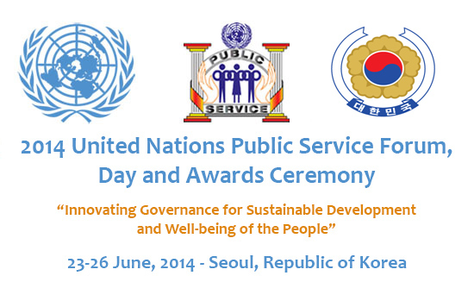
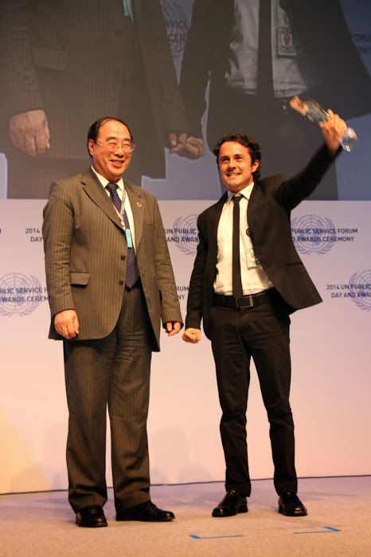
The United Nations Public Service Awards is the most prestigious international recognition of excellence in public service. It rewards the creative achievements and contributions of public service institutions that lead to a more effective and responsive public administration in countries worldwide. Through an annual competition, the UN Public Service Awards promotes the role, professionalism and visibility of public service. (UN/DESA)

Slide 34
PUBLIC CONSULTATIONS/HEARINGS
cases in fiscal management
Multiple cases – Executive or Legislature initiatives
In 2012, an Open Letter for the Democratization and Transparency of Public Budget was signed by 97 civil society organizations
Budgetary Guidelines Law (LDO) was put under public consultation in internet: 2013 – 2014 – 2015 – 2016 (national)
Annual Budget Law was put under public hearing receiving civil society proposals: 2013 – 2014 (national)

Slide 35
POPULAR AMENDMENTS
JOINT BUDGET COMMISSION (NATIONAL CONGRESS)
Parliamentarians can present amendments to federal budget – individually or by party
Amendment – inclusion of an expediture for a specific finality
(limited values)
In 2012 (discontinued), municipalities were allowed to present amendments to federal budget directly
But...
cities up to 50 thousand inhabitants;
values from 300 to 600 thousand Reais (USD 96,600 – 193,200);
specific areas of public policy;
must have realized public hearings to define priorities.

Slide 36
DIGITAL DEMOCRACY
LEGISLATURE
https://www12.senado.leg.br/ecidadania/
http://edemocracia.camara.gov.br/
https://www12.senado.leg.br/orcamento/sigabrasil

Slide 37
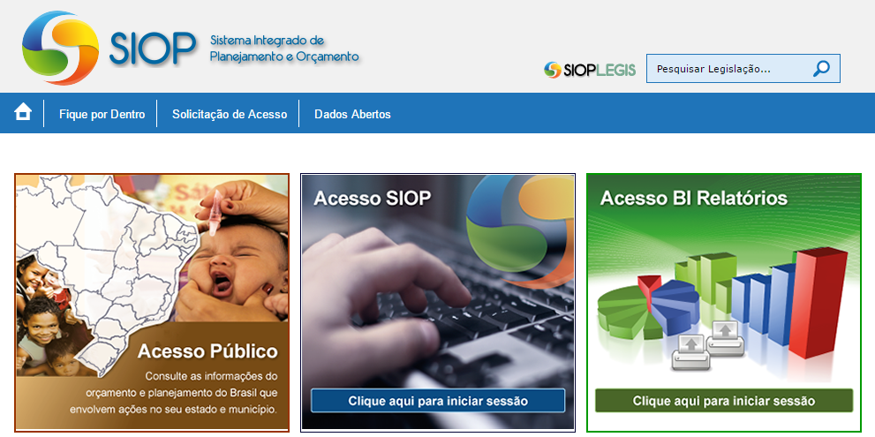
DIGITAL DEMOCRACY
EXECUTIVE
https://www.siop.planejamento.gov.br/
http://www.portaldatransparencia.gov.br/
https://ead.orcamentofederal.gov.br/

Slide 38
TRANSPARENCY
Transparency portal
http://www.portaldatransparencia.gov.br/
= USD 5,101.26

Slide 39
SOCIAL PARTICIPATION
Premises
Self-sufficiency is incompatible with dialogue. Men and women who lack humility (or have lost it) cannot come to the people, cannot be their partners in naming the world. Someone who cannot acknowledge himself to be as mortal as everyone else still has a long way to go before he can reach the point of encounter. At the point of encounter there are neither utter ignoramuses nor perfect sages; there are only people who are attempting, together, to learn more than they now know.
FREIRE, Paulo. Pedagogy of the Oppressed.

Slide 40
Чоң рахмат!
DANIEL AVELINO
daniel.avelino@ipea.gov.br
davelino@gmail.com
(+55 61) 2026-5500
(+55 61) 9 9156-5657

