Slide 1

Update on Progress of the Budget Literacy and Transparency Working Group
PEMPAL Budget Community of Practice (BCOP)
Budget Literacy and Transparency Working Group
Anna Belenchuk, MoF Russian Federation
13 April 2017

Slide 2
Working Group Factsheet
Goal: Learn from international experience with raising budget literacy among citizens and budget openness and accessibility
Objectives:
Review best international practice in transparency and budget literacy
Exchange knowledge with budget experts from the Working Group member countries with a view to designing standard approaches to implementing similar projects
Create new BCOP knowledge products based on accumulated outputs, such as recommendations on implementing similar projects in PEMPAL countries.
  Partnerships: World Bank: Budget Literacy; International Budget Partnership (IBP):Success factors for Open Budget Index; OECD/Global Initiative for Fiscal Transparency (GIFT):input to their draft ‘Budget Transparency Toolkit’; OECD SBO meeting: presented Working Group progress.
  Working Group members (15 countries): Albania, Russia, Armenia, Kosovo, Kyrgyz Republic, Croatia, Turkey, Belarus, Bosnia & Herzegovina, Romania, Tajikistan, Ukraine, Uzbekistan, Kazakhstan, and Moldova.

Slide 3
Working Group Activities Snapshot (1)
1st meeting Warsaw, Poland, May 20, 2015 - 10 countries participated.
Country cases from Canada, UK and the Russian Federation showcased various approaches to making it easier for citizens to understand government budgets by adopting Citizens Budgets, information portals, student projects, and a core curriculum for schools. Pre-meeting PEMPAL survey also conducted to determine status of budget literacy and transparency reforms.
2nd meeting via videoconference September 14, 2015 – 7 countries participated.
Review of learnings taken from international Budget Literacy Practices based on a survey of over 30 Countries conducted by World Bank.
3rd meeting, Zagreb, Croatia, December 1-4, 2015 – 10 countries participated.
Key lessons learned from Croatia: Incorporating transparency standards into the legislation is a must to enhance transparency and proper transparency standards must be put in place across all government levels. The key to successful reforms, better budget transparency and citizen engagement is close collaboration between ministries and government levels, and leveraging modern IT technologies (e-government).

Slide 4
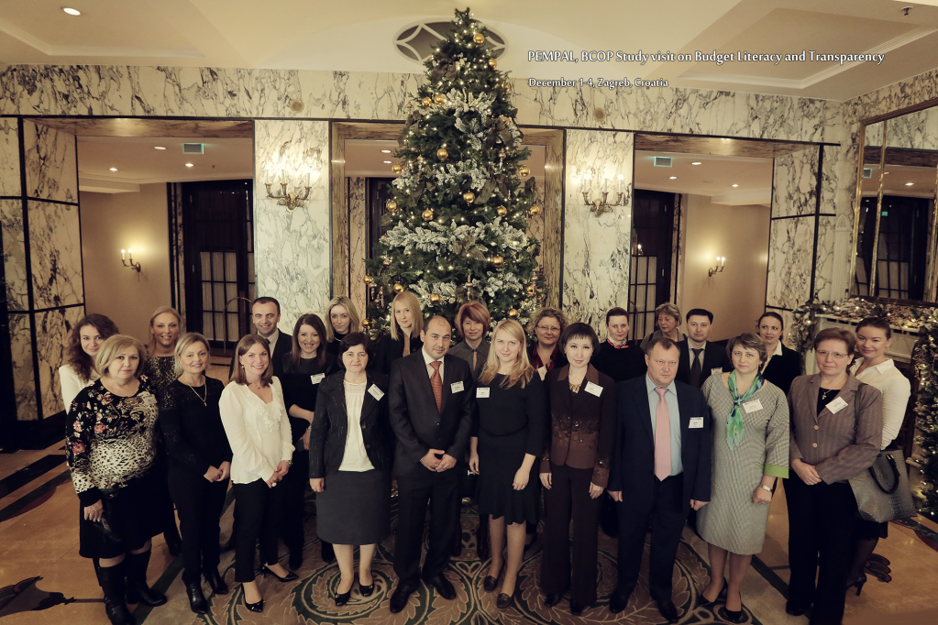
Working Group Activities Snapshot (2)
4th meeting, Minsk, Belarus, February 23, 2016– 10 countries participated
Shared success factors in budget transparency from Romania (75/100) and Russia (74/100) (both leaders in the 2015 Open Budget Index in the region), and Kyrgyz Republic (from 20/100 to 54/100) as most improved.
Translated and shared guidelines on how to develop Citizens Budgets from International Budget Partnership, Russia, Kyrgyz Republic and Moldova. International examples on Citizens Budgets also identified and shared.
5th meeting via videoconference, September 22, 2016 – 6 countries participated
To progress discussions on the Working Groups Knowledge Product on how to address the 10 Challenges to developing Citizens Budgets being experienced by member countries.
Focus has been on Citizens Budgets because they are not common in the region….

Slide 5
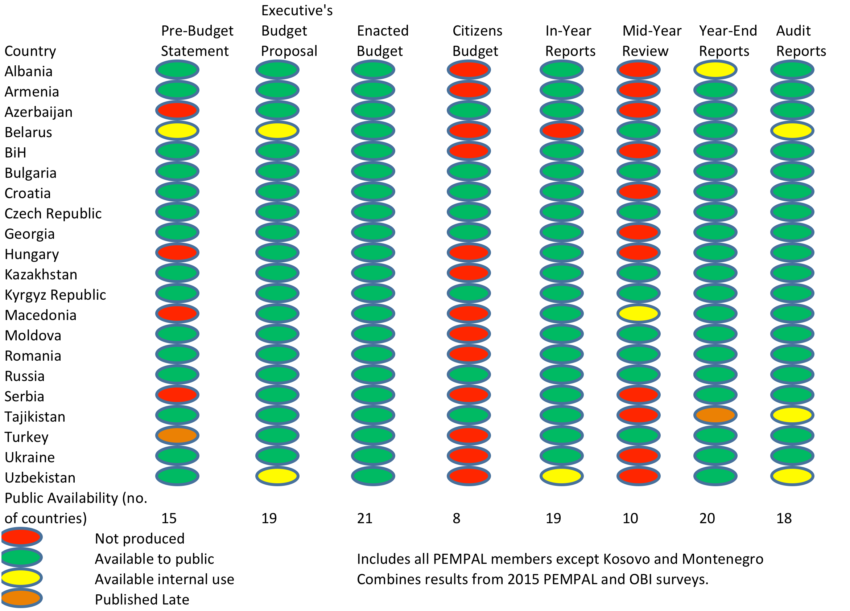
2015 Public Availability of Budget Documents

Slide 7
Knowledge Product on Citizens Budgets – Final Draft Completed
It provides options drawn from peer and international advice to address 10 challenges being experienced by working group member countries:
Challenge 1: Determining responsibility for preparation and distribution of Citizens Budgets
Challenge 2: Lack of Government resources
Challenge 3: Lack of political will
Challenge 4: Lack of motivation and incentives within central and municipal Governments
Challenge 5: Determining optimum timeline for production of Citizens Budgets
Challenge 6: Determining optimal formats for Citizens Budgets
Challenge 7: Determining optimum approach for citizen consultation
Challenge 8: Lack of budget skills and understanding by citizens and some civil servants
Challenge 9: Low public interest in the budget
Challenge 10: Lack of access to reliable media and/or communication technologies
See your materials for a copy of this Working Group Knowledge Product - please use it to progress your reforms and also tell us how you use it for our success stories!

Slide 8
10 Challenges: Peer and International Advice
Determining responsibility for preparation and distribution of Citizens Budgets
The Working Group agreed that the owner of the documents should be responsible for presenting the information in a simplified format for citizens.
The IBP advise that the Citizens Budget should be produced first and foremost by the Government:
  It possesses knowledge about insights about the budget and has an obligation to account to the broader public.
  The Government can use media and civil society groups to facilitate dissemination.
  The Government needs to decide whether it wishes to use the Citizens Budget to encourage public comment on budget issues or just to provide the document for information only.
  The IMF advise that the Government also needs to decide whether it wishes to use the Citizens Budget to encourage public comment on budget issues. ‘Basic Practice’ is providing the information only, ‘Good and Advanced Practice’ is providing citizens with a formal voice in budget deliberations (Fiscal Transparency Code: Principle 2.3.3).

Slide 9
2. Lack of Government resources
The WG discussed how to source funding for additional expenditures needed to publish and disseminate Citizens Budgets:
  Support to share costs could be sought from donors, private sector or Civil Society Organizations (CSOs) although the WG acknowledged that strong political will is required first, and outside funding carries risk of reforms not being sustainable if external funding ceases.
  The WG acknowledged that developments in information and communication technologies (ICT) have greatly lowered costs of compiling and disseminating information (also recognized in the GIFT High Level Principles on Fiscal Transparency, Participation and Accountability).
The IBP advises that the costs of a Citizens Budget can be minimized through developing a template for the document, which could be a one-off exercise.
  Once the template and structure are agreed, it should be easier to replicate each year with updated and new information.
  The Citizens Budget of the ‘Executives Budget Proposal’ (ie Draft budget) should form the basis for the Citizens Budget of the ‘Enacted Budget’ (ie Approved budget).
  The Citizens Budget can be posted on the MoF website at little cost. CSOs can be used to disseminate the document, and only limited hard copies printed where IT access is an issue.
  However, MoF should reflect on the structure, resources and capacities it will need to properly develop and disseminate a Citizens Budgets.

Slide 10
3. Lack of Political Will
The WG agreed that for those countries which lacked political will to undertake reforms, clearly demonstrating how the benefits outweigh the costs is needed.
  Significant benefits flow from strengthened trust of citizens in Government.
  Sharing International guidelines, principles and research may help.
    For example: GIFT’s High Level Principles on Fiscal Transparency was endorsed by United Nations General Assembly and established direct public participation in Government fiscal policy and budget making a right under Principle 10.
  Pressure from CSOs, academia, donors and the international community could change political motivation over time.
Encouraging membership in related international groups.
  For example as at 2017, 75 countries are members of the Open Government Partnership (OGP) which was launched in 2011 to provide an international platform for participating countries to make their Governments more open, accountable, and responsive to citizens.
    Members are required to develop OGP National Action Plans that are independently assessed.
    The following WG participants are already OGP members: Albania, Armenia, Bosnia and Herzegovina, Croatia, Moldova, Romania, Turkey and Ukraine (for BCOP: 14 members in OGP in total).
    www.opengovpartnership.org and www.opengovguide.com

Slide 11
4. Lack of motivation and incentives within central and municipal governments
The WG agreed that a legislative and regulatory framework is required to ensure compliance at different government levels.
  Methodological guidelines are a useful tool to define scope, structure, and procedures for drafting and disseminating Citizens Budgets:
    Russian Federation, Kyrgyz Republic, and Moldova have shared their guidelines.
  Croatia and Russian Federation also use published ‘open budget rankings’ of regions/municipalities to encourage benchmarking and competition.
The IBP advises that good transparency practices should be institutionalized through for example embedding them in laws, rules and procedures.
  Clear guidelines and a strong authority responsible for establishing and managing the process can be useful.
  The first GIFT High Level Principle also states changes to national legal systems are required to help guarantee the right of citizens to seek, receive and impart information on fiscal policies and ‘to establish a clear presumption in favor of the public availability of fiscal information without discrimination.’

Slide 12
5. Determining the optimum timeline for production of Citizen Budgets
The WG has concerns that international guidelines recommend producing a Citizens Budget up to four times a year although most definitions of Citizens Budgets focus on only two documents for the draft and final approved budgets.
IBP advises that four citizens versions of budget documents should be published a year, for each of the four stages of the budget process (formulation, enactment, execution and audit) - to be published at the same time the document refers to.
  This is based on ‘evolving good practice’ that citizens should be informed throughout the entire budget process (IBP’s 2015 Open Budget Survey guidelines).
  However, IBP acknowledges the focus is on Citizens Budgets for the ‘Executive Budget Proposal’ (draft Budget) and the ‘Enacted Budget’ (approved Budget), but to ensure budget literacy in the long term, will require accessible information on the ‘Year-End Report’ and ‘Audit Report’ is also provided.
  Also reflected in GIFT’s 2016 Principles of Public Participation in Fiscal Policy; OECD’s draft Toolkit on Budget Transparency; and IMF’s Fiscal Transparency Evaluation Reports

Slide 13
6. Determining optimal formats for Citizens Budgets
The WG noted that presenting too much information in a Citizens Budget remains a key challenge but examining different useful approaches has assisted.
  Different types of formats were acknowledged to be useful by the WG as long as each approach transformed technical budget documents and financial jargon into language that is accessible to ordinary people (e.g. website portal used by the Russian Federation, printed brochures used by the Kyrgyz Republic)
Other international advice and examples have been collated in the knowledge product. For example:
  GIFT 2016 Principles of Public Participation in Fiscal Policy, Principle 5 - accessibility can be facilitated by disseminating information ‘in formats and using mechanisms that are easy for all to access, understand, and to use, re-use and transform, namely in open budget formats.’
  OECD - use graphical presentations, user-friendly pictures and illustrations with key messages, graphics and graphs that put abstract numbers into perspective; and maps that highlight spatial dimension of public finances.
  IBP - no optimum content but suggestions provided in IBP’s guidelines.
  IMF – ‘advanced practice’ – publishing an accessible description of implications of the budget for different demographic groups.

Slide 14
7. Determining the optimum approach to citizen consultation (1)
IBP advises that understanding what the public wants to know is a crucial first step to ensure maximum usability of the provided information.
  Any consultations must be planned strategically and with care e.g. set objectives, who will be consulted, what is focus of consultations, formats and timing etc.
    OECD advises that realistic and relevant public participation is enabled and encouraged by a supportive legal framework that facilitates and regulates the interaction between government and citizens.
    GIFT advises that a clearly articulated framework will help manage expectations of participants and help government to understand and execute the consultation process.
  Need to consider the level of prior knowledge and the capacities of the citizens when deciding on scope and form of presentation of information.
IBP advises there is no easy answer as to whether to consult broadly or targeted although overall recommendation is to be more inclusive.
  If Government chooses not to narrow group of users down, the budget information provided would need to be quite broad to ensure that it is relevant to most users, and links to additional information and contacts provided.
IBP advises that any consultation mechanisms must be both accessible and widely used by the public (and well designed) e.g. focus groups, surveys, hotlines, meetings
  IBP notes it may be sufficient in some countries where a Citizens Budget has been consistently produced to provide contact information and feedback opportunities to improve the information.

Slide 15
7. Determining the optimum approach to citizen consultation (2)
IBP recommends consultation processes outlined in OECD’s Handbook on Information, Consultation and Public Participation in Policy-Making.
  OECD identifies three forms of interactions: firstly providing information; secondly consulting to receive feedback and thirdly providing mechanisms for citizens to be actively involved in Government decision-making.
  IBP advises that most Citizens Budgets operate under the first form. A budget literacy policy or strategy would aim to include the third form with active engagement with the budget on a regular basis.
Recent GIFT research of country practices notes ICT tools including websites and social media are useful tools to share information with citizens and to gather feedback.
  But important to report back on how feedback has been used.
  Other good practices have been included in our knowledge product.
    GIFT is also collating country case studies. Knowledge in this area is still developing and changes being made to assessment instruments e.g. revision of PEFA indicators.

Slide 16
8. Lack of budget skills and understanding by citizens and some civil servants
The WG acknowledged that one of the biggest challenges is misunderstanding of economic and technical concepts and terminology.
The WG identified the following examples to increase knowledge of citizens:
  Preparing a Citizens Budget is a key component to improving budget literacy. A glossary of budget terminology could also be included, and the document shared with other budget stakeholders such as parliamentarians.
  Conducting joint initiatives with donors and other international organizations. E.g. Joint project with World Bank and Russian Federation which aims to increase budget literacy.
  Providing training in budget terminology, concepts and processes.
    OECD advises that MoFs should actively promote an understanding of the budget process by individual citizens and non-governmental organizations.
For training of Government staff, the WG agreed that developing induction and Budget Manuals may assist. E.g. South Africa.
  For the specific skills required to develop Citizens Budgets (e.g. outreach, facilitation of large meetings of citizens), IBP advises to source them externally in the short term, if they are not available from within Government.

Slide 17
9. Low public interest in the budget
The WG agreed that when a society does not see accountability of the Government, citizens can become negative towards the Government, displaying lack of trust and apathy. Possible strategies discussed include:
Implementing Media campaigns encouraging citizens to ask where their tax dollars go to facilitate more interest.
Making changes to information portals to provide innovative ways to engage citizens eg. online games as used by Croatia and USA, and on-line brochures and booklets.
Targeting CSOs, media and schools with awareness campaigns on the importance of budget eg. Canada, UK.
10. Lack of access to reliable media and/or communication
The WG noted that some countries face this challenge at local government levels, thus different approaches to disseminating Citizens Budgets are required.
E.g. Town hall information sessions. IBP advises radio programs, and printed Citizens Budgets made available in locations such as community events, libraries, universities, local government offices. Also use line ministries to make them available in schools, health clinics and publically funded facilities.

Slide 18
Future Activities of the Working Group
 | Action Plan 2017-18 | Timeframe
Current FY
1. | Budget Literacy Conference + Back-to-Back Meeting of Working Group | May/June, Moscow
Next FY
1. | VC learning event to progress new knowledge product on public participation in the budget process and examination of 2018 Open Budget Survey results (if available) | September/October 2017
2. | Visit to a country to examine good practices in public participation approaches. | April 2018
3. | Possible joint projects with IBP and GIFT currently under discussion. | To Be Discussed
Focus of the Working Group has been on budget literacy and citizens budgets. Today we want to initiate discussions on a new topic: public participation in the budget process.

Slide 19
Scores from Public Participation Indicators
IBP’s Open Budget Survey attempted for first time in 2012 to articulate what constituted good practice in public participation in national budget systems – to measure whether the necessary conditions for structured, direct engagement between the public and Government, Legislature and Supreme Audit Institutions have been created.
  These are different indicators used for the ‘Open Budget Index’ and in 2015 were based on the results from a set of 16 questions.
The international average public participation score was 25/100 in the 2015 Open Budget Survey. 82 countries, or around 80% of those surveyed scored 40 or below on public participation (ie provide minimal opportunity for public to engage in the budget process).
PEMPAL average score was higher at 29/100 but indicating lots of opportunity for reform. Kyrgyz Republic achieved the highest score among PEMPAL countries at 52/100.
  Best in the survey: South Korea (83), Norway (75), Brazil (71)

Slide 20
0 -40 Weak participation
41-60 Limited
61-100 Adequate

Slide 21
Conclusions
Maintaining good performance in budget transparency requires ongoing focus and attention.
Good practice is still evolving in some areas ie public consultation and participation in the budget process. The ongoing work of IBP and GIFT is important here.
Survey instruments such as those conducted by International Budget Partnership has provided incentives and motivated many countries to improve performance. The results of the next Open Budget Survey are expected next year.
There is developing knowledge and norms on public participation: GIFT’s Principles on Public Participation in Fiscal Policy (approved end of 2015 and adjusted September 2016), OECD’s Toolkit on Budget Transparency (draft January 2017), OECD IMF’s 2014 Fiscal Transparency Code, and proposed changes to PEFA framework.
Agenda for today: Director of GIFT to present the Principles on Public Participation, an expert from IBP to discuss the next Open Budget Survey, and PEMPAL and international country case studies from Kyrgyz Republic and Brazil.

Slide 22

Thank you for your attention!
All Working Group event materials can be found in English, Russian and BCS at www.pempal.org and additional materials on BCOP wiki

