Slide 1
The GIFT Public Participation Principles
The Guide on Principles and Mechanisms
of Public Participation in Fiscal Policy
PEMPAL 2017 BCOP Plenary Meeting
Tools for Fiscal Management
Juan Pablo Guerrero
Bishkek, Kyrgyz Republic
April 13, 2017
#FiscalTransparency

Slide 2
Contents
1. About GIFT
2. Why Public Participation in Fiscal Policy?
3. GIFT Principles of Public Participation
4. Evidence on the Impacts of Public Participation
4. GIFT Guide on Principles and Mechanisms of Public Participation in Fiscal Policy
5. Public participation cases
2

Slide 3
The Global Initiative for Fiscal Transparency
A global network that facilitates dialogue between governments, civil society organizations, international financial and specialized institutions, private sector and other stakeholders to find and share solutions to challenges
in fiscal transparency, participation and accountability.
It works through coordination on global norms, advocacy, peer-learning and technical assistance, research, and use of IT for participation.
3

Slide 4
Members of the network - 37 in 2017
13 Governments: Secretary/Department/Office/Treasury/ Ministry of the Budget in the following countries: Brazil*, the Philippines*, USA, South Africa, Mexico, the Dominican Republic, Tunisia, El Salvador, Paraguay, Guatemala, Croatia and Uruguay
4 International Organizations: the World Bank*, IMF*, OECD and IFAC*
15 Civil Society Organizations IBP*, FUNDAR, The Institute of Public Finance of Croatia, INESC, Center on Budget and Policy Priorities, FUNDE, ICEFI, among others
4 Funders/Foundations: Hewlett, Ford, Omidyar Network, UK-DfID
Research & Technical Assistance Institutions: MITRE, Global Integrity, Open Contracting Partnership, Collaborative Africa Budget Reform Initiative
4

Slide 5
Why a new set of principles in public participation?
  Disclosure of information on its own is not sufficient for accountability
  To improve the quality in the design and implementation of public policies
  Participation is key for Sustainable Development Goal 16, and building inclusive institutions is critical to fulfill SDGs
  To complement existing governance systems
  After Access to Information as a right, Public Participation as a right
5

Slide 6
GIFT High-Level Principles on Fiscal Transparency,
Accountability and Public Participation
H-L Principle 10 establishes “Citizens and non-state actors should have the right and effective opportunities to participate directly in public debate and discussion over the design and implementation of fiscal policies.”
6

Slide 7
But, how exactly should governments engage citizens?
A starting point for GIFT was to address the gaps in norms, as well as the lack of guidance on how governments should engage the public
7

Slide 8







Accessibility
Disseminate complete fiscal information and all other relevant data, easy for all to access, understand, and to use, re-use and transform, namely in open data formats.
Openness
Provide full information on and be responsive with respect to the purpose, scope, constraints, intended outcomes, process and timelines, as well as the expected and actual results of public participation.
Inclusiveness
Proactively engage citizens and non-state actors, including excluded & vulnerable groups & individuals, & voices that are seldom heard, without discrimination & consider public inputs on an objective basis irrespective of their source.

Slide 9








Respect for self-expression
Allow articulate their interests in their own ways, and to choose means of engagement that they prefer. There may be groups that have standing to speak on behalf of others.
Timeliness
Sufficient time in the budget and policy cycles for inputs in each phase; while a range of options is still open; and, where desirable, allow for more than one round of engagement.
Depth
Provide information about key policy objectives, options, choices and trade-offs, potential impacts, and incorporate a diversity of perspectives; provide feedback on public inputs and how they have been incorporated.
Proportionality
Use a mix of engagement mechanisms proportionate to the scale and impact of the issue or policy concerned.

Slide 10






Sustainability
On-going and regular engagement to increase knowledge sharing and mutual trust over time; institutionalize public participation; feedback provided leads to revision of the fiscal policy decisions; and regularly review and evaluate experience to improve future engagement.
Complementarity
Ensure mechanisms for public participation and citizen engagement complement and increase the effectiveness of existing governance and accountability systems.
Reciprocity
All state and non-state entities should be open about their mission, the interests they seek to advance, and who they represent; respect all agreed; cooperate to achieve objectives.

Slide 11
SCOPE of PUBLIC PARTICIPATION in fiscal policy
Invited and autonomous participation
Covers all fiscal policy and budget making activities:
  The annual budget cycle (8 documents)
  Fiscal policy reviews and new policy initiatives outside the annual budget cycle (revenues, expenditures, financing, assets and liabilities)
  The design and delivery of public services
  The planning, appraisal & implementation
  of public investment projects
11

Slide 12
The Impacts of Fiscal Openness, a Review of Evidence
Working Paper produced by de Renzio (IBP) & Wehmer (LSE) for GIFT (2015)
38 papers formed the basis for this literature review: 23 investigate the effects of variables related to fiscal transparency & 14 relate to participation in budgetary decisions
Authors categorized the 38 papers into four groups of impacts:
Macro-fiscal
Allocation and service delivery
Governance
Development outcomes
12

Slide 13
Access to information and public participation: Impacts
On resource allocation & service delivery outcomes
Better resource allocation & provision of public services
Improved response to the preferences of beneficiaries of services & constituencies
Opportunity for marginalized groups to exert some influence in decisions that affect them
Greater impact of actions that affect communities in social policies: health sector, community level public works, education
Examples come from Brazil (participatory), India, Mexico, Peru, Uganda & South Africa

Slide 14
Democracy at Work: Moving beyond elections to improve well-being
B.Wampler, M. Touchton, N. Borgues, AmPolScRew. # 111, 2017
5,550 Brazilian Municipalities (2006-2013)
Demonstrates strong & positive relationship between participatory institutions & well-being over very large number of cases
Presence of participatory institutions is associated with improvements in infant mortality
Presence of innovative social policies contributes to improvements in infant mortality
Greater state capacity in the area of social provisioning also contributes to improvements in wellbeing.
Participatory institutions, social programs, and local capacity reinforce one another to improve well-being

Slide 15
Summary of findings

Slide 16
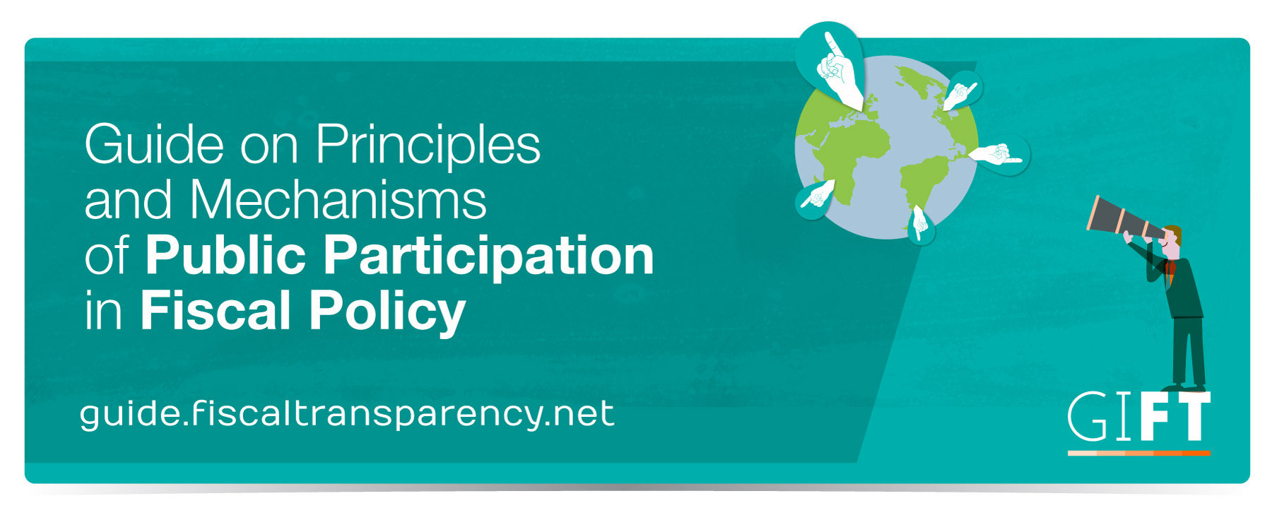

Slide 17
Objective of the Guide
To provide guidance about how to integrate public participation into fiscal policy and the associated benefits, illustrated with practical examples of mechanisms (“practices”) that show how the GIFT principles on public participation in fiscal policy can be put into practice
17

Slide 18
What will you find in this Guide?
Basic Facts (When, where, who):
  Stage in the Fiscal Policy Cycle (formulation, enactment, implementation, audit)
  Level of government (national, regional, or local)
  Lead institution (Executive Branch, Legislature, Supreme Audit Institution, or a Non-State actor)
Why: Objective of incorporating public participation
Authorizing environment: Law or regulation that provides authority for or that directs officials to engage the public. Define what the general enabling environment is
18

Slide 19
What’s in the Guide?
Who and how: the process step by step, describing how the mechanism was designed and implemented, including:
  Who participates/ selection process/how diverse were the inputs
  How are decisions made? Are they binding?
  Online/ offline- how much of the process relies on technology
  Resources invested in the implementation of the mechanism: Is it a time-limited capital project or a recurrent spending for an on-going activity?
Results and impact: How has the input generated through the participation process been used, seeking to elucidate the extent to which participation makes a difference (Cases for which there is as yet no evidence of impact can be included in the Guide, but this has to be clear and transparent)
19

Slide 20
Guide’s Contents
Lessons Learned identified by practitioners who implemented the mechanism as well as tips and the main conditions and factors associated to the success or failure of the practice
Principles of Public Participation: Which and how the mechanism aligns to the principles . When appropriate, it also offers recommendations of potential actions that would allow the mechanism to engage more principles
Country context: information to facilitate a general understanding of the surrounding factors and conditions in which the mechanism in question took place:
    Type of government
    Civic space (size of civil society, regulatory framework)
    Open Budget Survey scores – the overall budget transparency score, and the scores for public participation. Indicate whether the intervention is measured by the OBS.
    Score on TI Corruption Perceptions Index

Slide 21
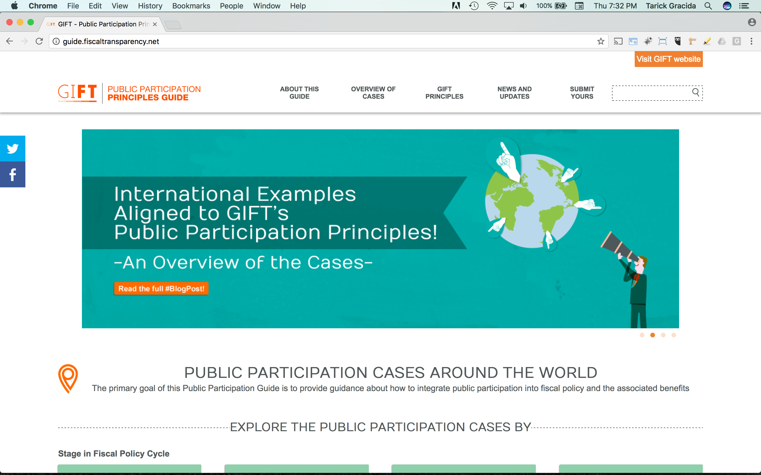
Navigation: home

Slide 22
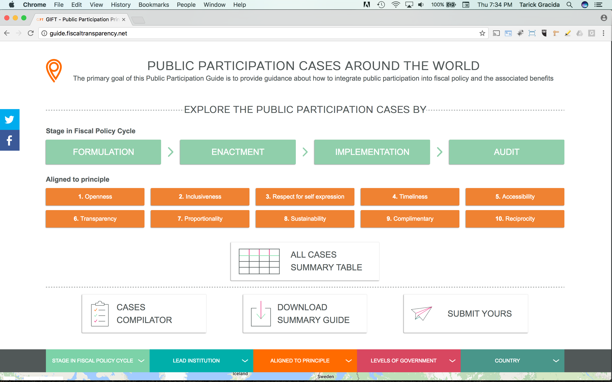
Navigation: Filter by Stage in Fiscal Policy Cycle or by Principle

Slide 23
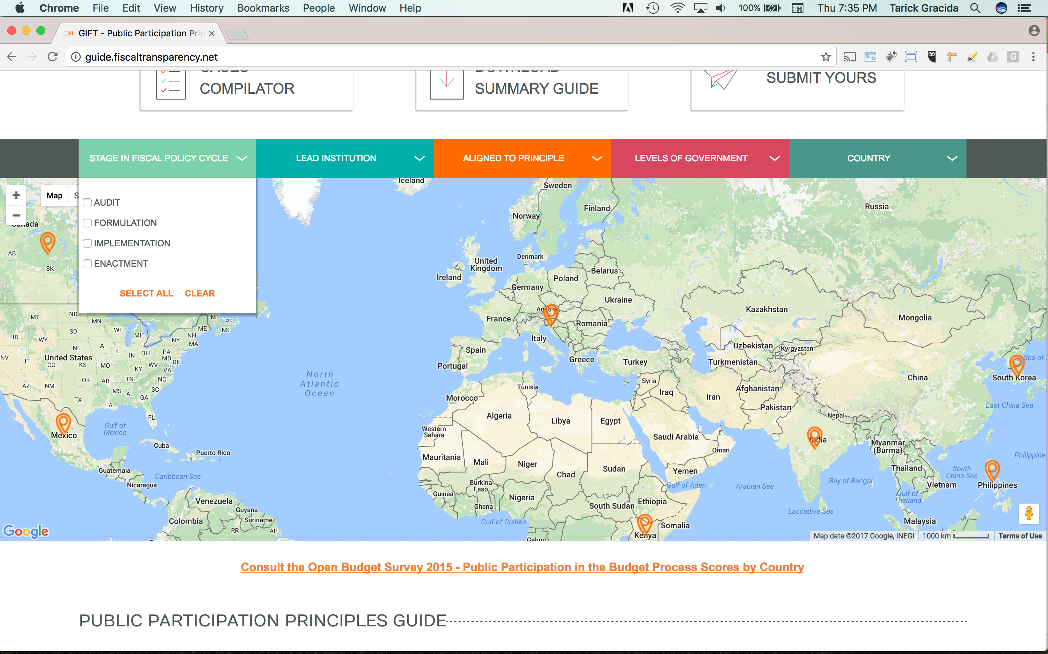
Navigation: Locate in the map & filter by stage, lead institution, principle, level of government, or country

Slide 24
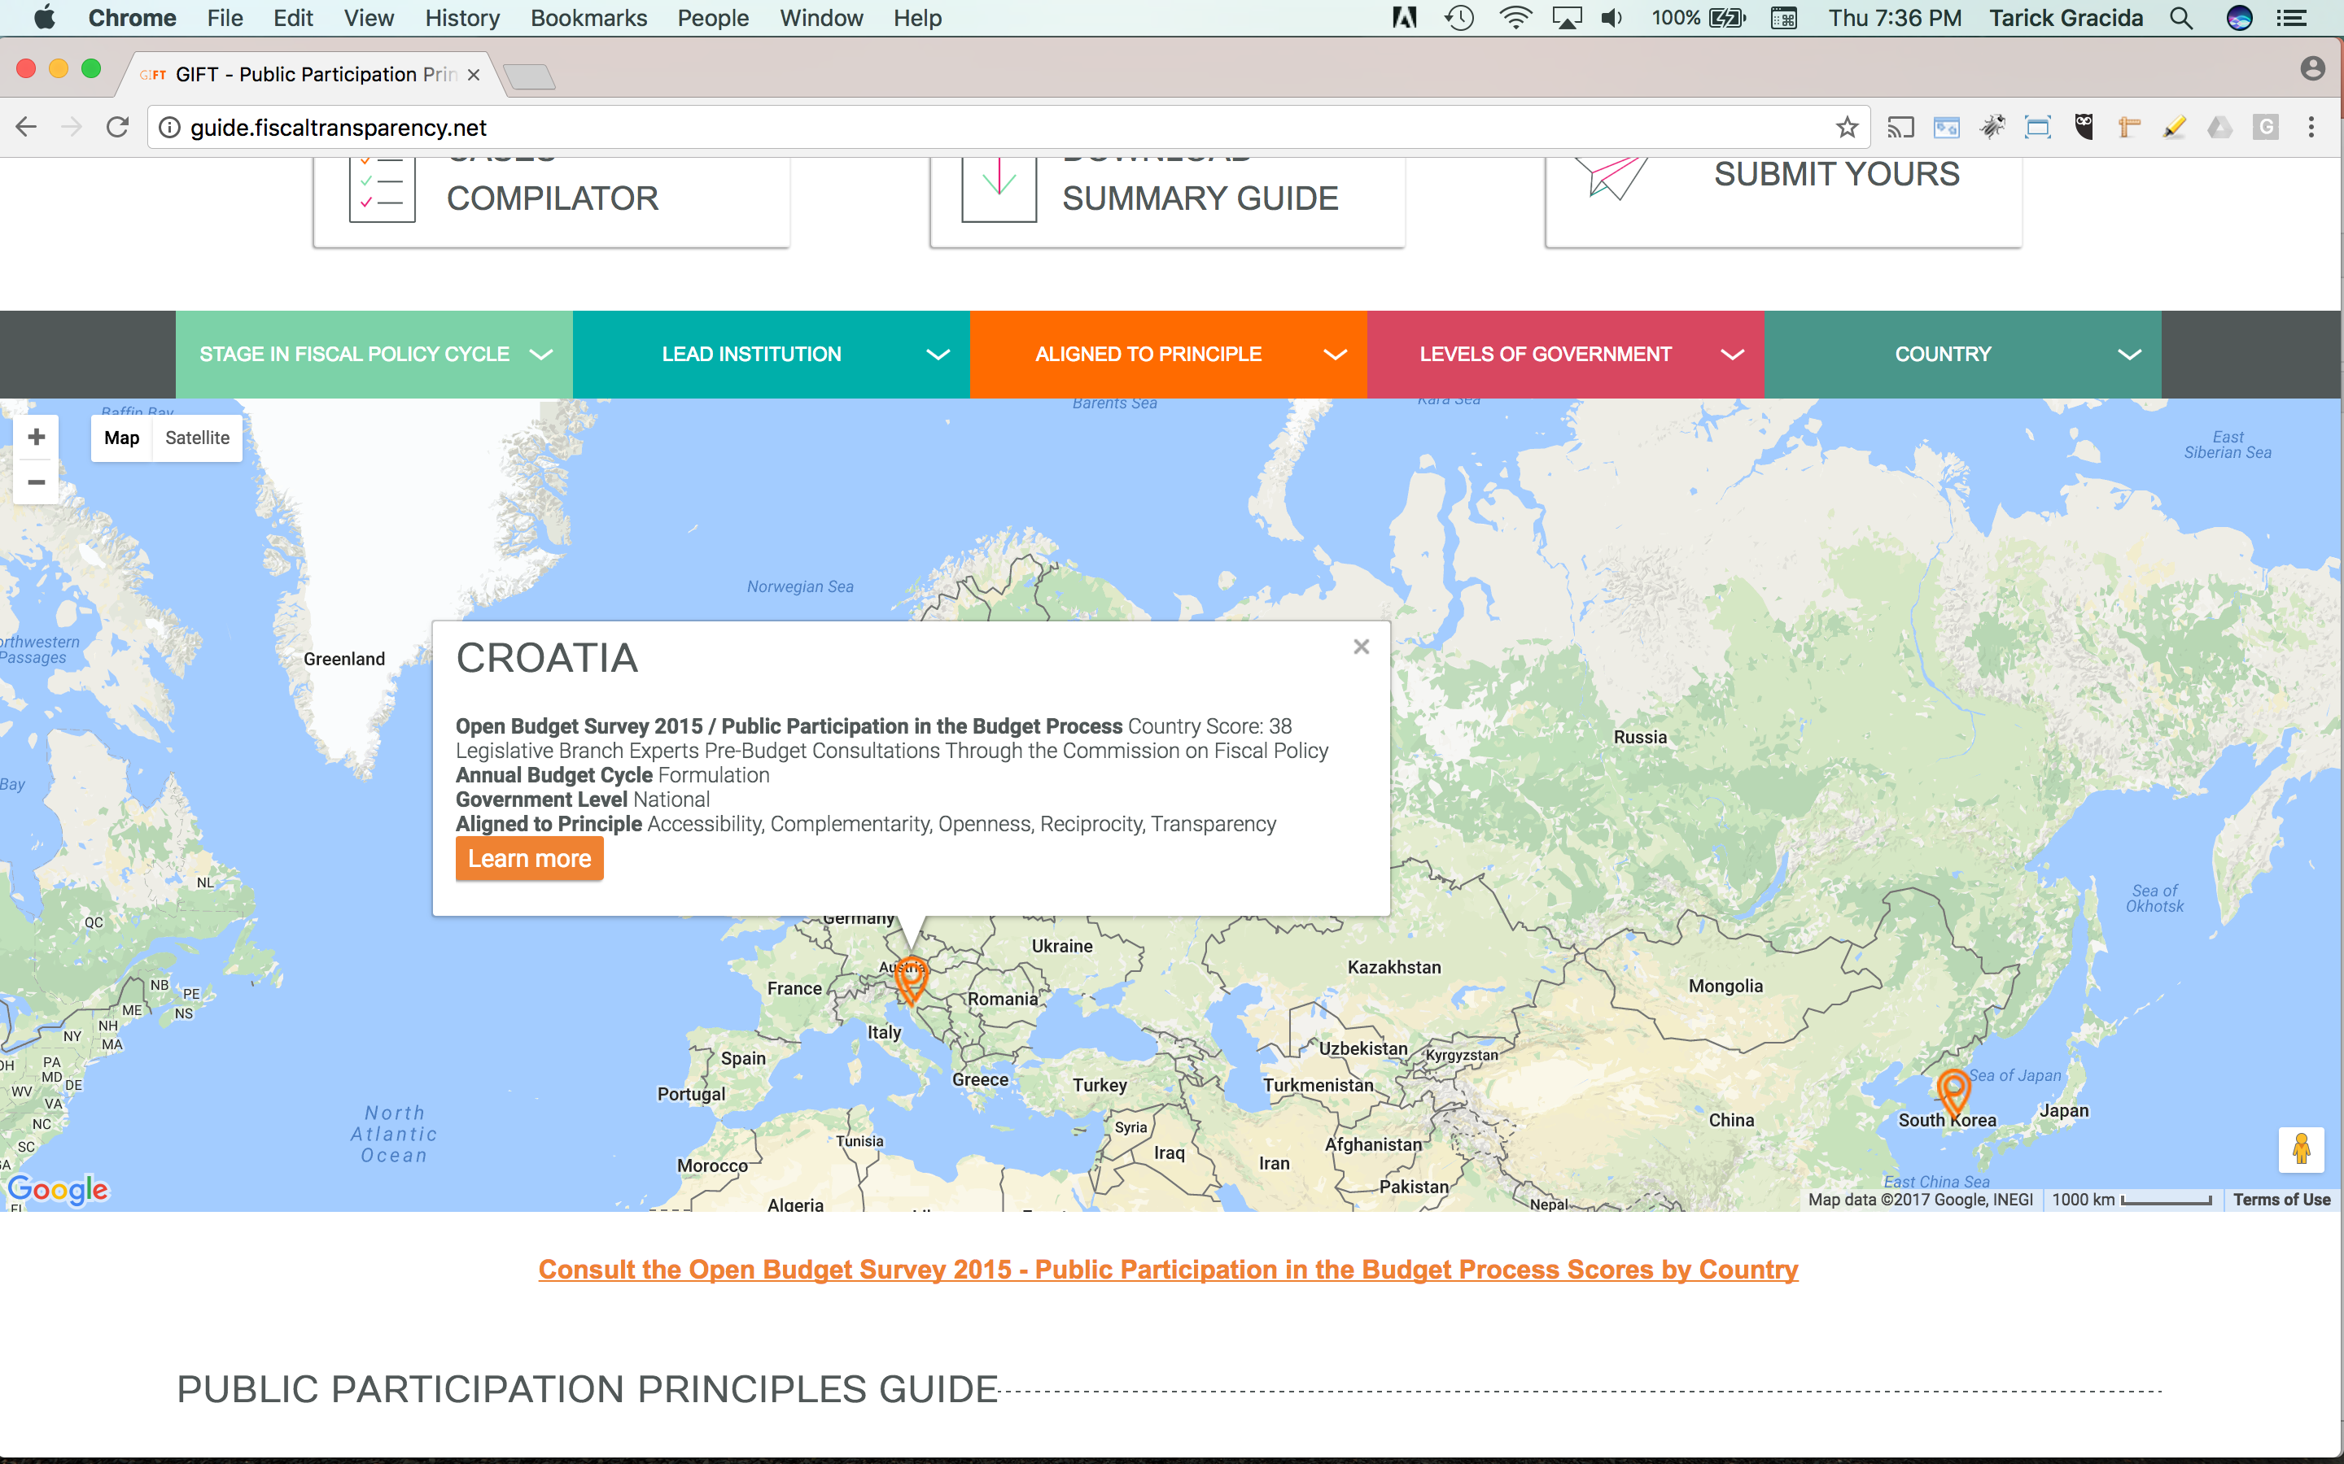

Slide 25
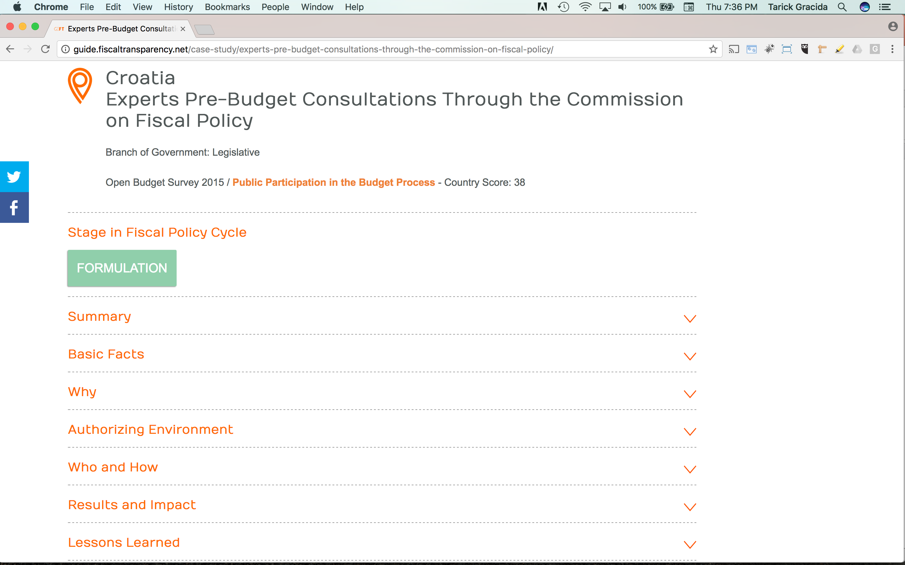

Slide 26
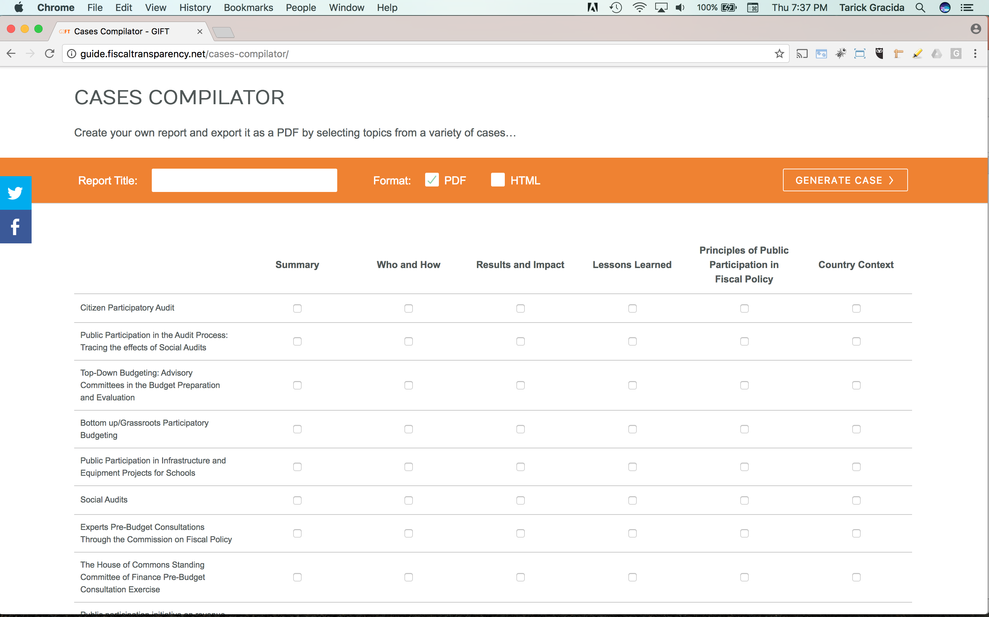
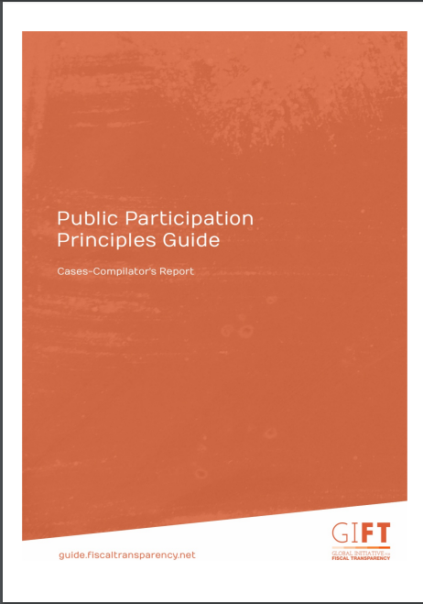
Select sections of interest, create your own report, download & print!

Slide 27
Public Participation Cases by stage of budget and policy cycle and lead institution
Stage in Budget and Policy Cycle | Lead institution
 | Executive | Legislature | Supreme Audit Institution | Non-state
Budget and policy preparation and selection | Brazil Policy Councils Philippines Bottom- Up-Budgeting Korea Advisory Committees | Canada Finance Committee Pre-Budget Consultations
Budget enactment |  | Croatia Commission on Fiscal Policy
Budget implementation | Mexico Rural School Infrastructure
Evaluation and audit | Korea Advisory Committees |  | Philippines Citizen Participatory Audit | Kenya Social Audit of Constituency Fund Social Audit in Andhra Pradesh, India
27

Slide 28
Some examples in the Guide…
28

Slide 29
Bottom Up Budgeting in the Philippines
Launched in 2012 with 515 communities and small budget
Primary objective: deliver basic social services to the poor, reduce the influence of local elites and empower the citizenry
Local poverty reduction action team (LPRAT) determines local priority projects
A general assembly is established: 50% members are from government and 50% from CSOs
The Assembly recommends projects to the LPRAT
Suggested projects are submitted for incorporation in the budget of the participating national agencies
CSOs can engage in the monitoring of the BuB projects
In 2016: BuB included 1,514 cities and municipalities and a budget 3 times bigger than in 2012
PRINCIPLES OF OPENNESS, INCLUSIVENESS, DEPTH, SUSTAINABILITY, COMPLEMENTARITY & RECIPROCITY
29

Slide 30
Education Reform Program in Mexico
Launched in 2014-2015, aiming to improve the infrastructure and equipment of the most vulnerable basic schools throughout Mexico
Parents, teachers and directors form a committee and decide how to prioritize federal funds that have been allocated for their schools
Public engagement takes place at all stages of the process, from allocation of resources, to implementation and monitoring
Interactive website allows users to monitor project status
The program has benefited over 20,138 schools and has been renewed for 2016
PRINCIPLES OF OPENNESS, RESPECT FOR SELF-EXPRESSION, TIMELINESS, ACCESSIBILITY & COMPLEMENTARITY
30

Slide 31
Expert and CSO pre-budget consultations in Croatia
Launched in 2011; it aims to consider the public’s opinion on macro-economic forecasts, budgetary priorities, and controversial projects
Vessel for public participation: Commission on Fiscal Policy, an independent body situated in Parliament
The Commission on Fiscal Policy consists of members of various institutions (Supreme Audit Institution, Institute of Economics, Institute of Public Finance, Croatian National Bank, academics) and holds public hearings with expert witnesses. On each bill that comes before the Commission, members can provide suggestions.
In 2014, the Commission issued five opinions on various budget documents.
PRINCIPLES OF OPENNESS, ACCESSIBILITY, DEPTH, RECIPROCITY & COMPLEMENTARITY
31

Slide 32
Pre-budget Consultations through the House of
Commons Standing Committee of Finance In Canada
Although established earlier, mandate for public consultations on the budget started in 1994
Provides a way for Parliament to evaluate government policy
Adds quality and legitimacy to the budget process
The Finance Committee receives witness testimony and online submissions
An annual public report is drafted, highlighting recommendations tied to the consultation Finance Committee received witness testimony from more than 100 people and groups and more than 400 online submissions
The 2014 Finance exercise
In 2014, the Committee Report contained 47 recommendations in six priority themes identified by the Committee
PRINCIPLES OF OPENNESS, RESPECT FOR SELF-EXPRESSION,DEPTH, TIMELINESS,INCLUSIVENES, COMPLEMENTARY, PROPORTIONALITY & SUSTAINABILITY
32

Slide 33
Philippines Citizen Participatory Audit
Launched in 2012, a value-for-money or performance audit conducted by the Commission on Audit (COA), with the participation of individuals selected from CSOs as members of the audit team.
Special audit teams with COA and citizen auditors are created
When citizen auditors are “deputized” as COA auditors, they:
    Are given formal roles and responsibilities and are present in all steps of the audit;
    Receive the same level of access to information and documents related to the audit as any other member of the audit team;
Joint audits brings citizens from non-government groups into the formal audit process, giving COA a chance to explore complementary and additional approaches to audit (e.g., community scorecards)
PRINCIPLES OF: OPENNESS, INCLUSIVENESS, TRANSPARENCY, SUSTAINABILITY, COMPLEMENTARITY, AND RECIPROCITY
33

Slide 34
Social Audit in Andhra Pradesh, India
Started in 2006, the Rural Development Department of Andhra Pradesh engages non-state actors to determine whether state reported expenditures reflect the actual resources spent on the ground
After verification is complete, auditors organize a village assembly where audit findings are shared; local politicians, elected members and local officials, and field assistants participate
Discussions and debates on the state of program or policy implementation are catalyzed
Presence of civil society ensures high degree of autonomy and objectivity
State government has provided full financial and operational support
Social audit is conducted by community volunteers
More than 200,000 social auditors have been trained
On average, 130-150 social audits are conducted each month across all 22 districts, with not less than 2000 people engaged in the exercise
PRINCIPLES OF OPENNESS, TRANSPARENCY, SUSTAINABILITY, INCLUSIVENESS, AND RESPECT FOR SELF-EXPRESSION
34

Slide 35
How can you contribute to the Guide?
You are welcome to nominate a new case or experience in practice where there are lessons and models to share
GIFT is considering practices that have been documented in some way; it could be a case study that is already written up, a video, interview or blog post hosted elsewhere.
The “Submit Yours” section in this site includes a methodological note that provides guidance for the development of new cases.
The Guide is a living document!

Slide 36

THANK YOU!
Engage with us
@FiscalTrans
www.fiscaltransparency.net

