Slide 1

BUDGET transparency in the Kyrgyz Republic
Ministry of Finance of the Kyrgyz Republic

Slide 2
Open Budget Index in the Kyrgyz Republic

Slide 3
Kyrgyz Republic Open Budget Index – Benchmarking (score)

Slide 4
Public Availability of Budget Documents in the Kyrgyz Republic
Document | 2008 | 2010 | 2012 | 2015
Pre-Budget Statement
Executive’s Budget Proposal
Enacted Budget
Citizens’ Budget
In-Year Reports
Mid-Year Review
End-Year Reports
Audit Reports
Not produced /produced late
Available for internal use
Published

Slide 5
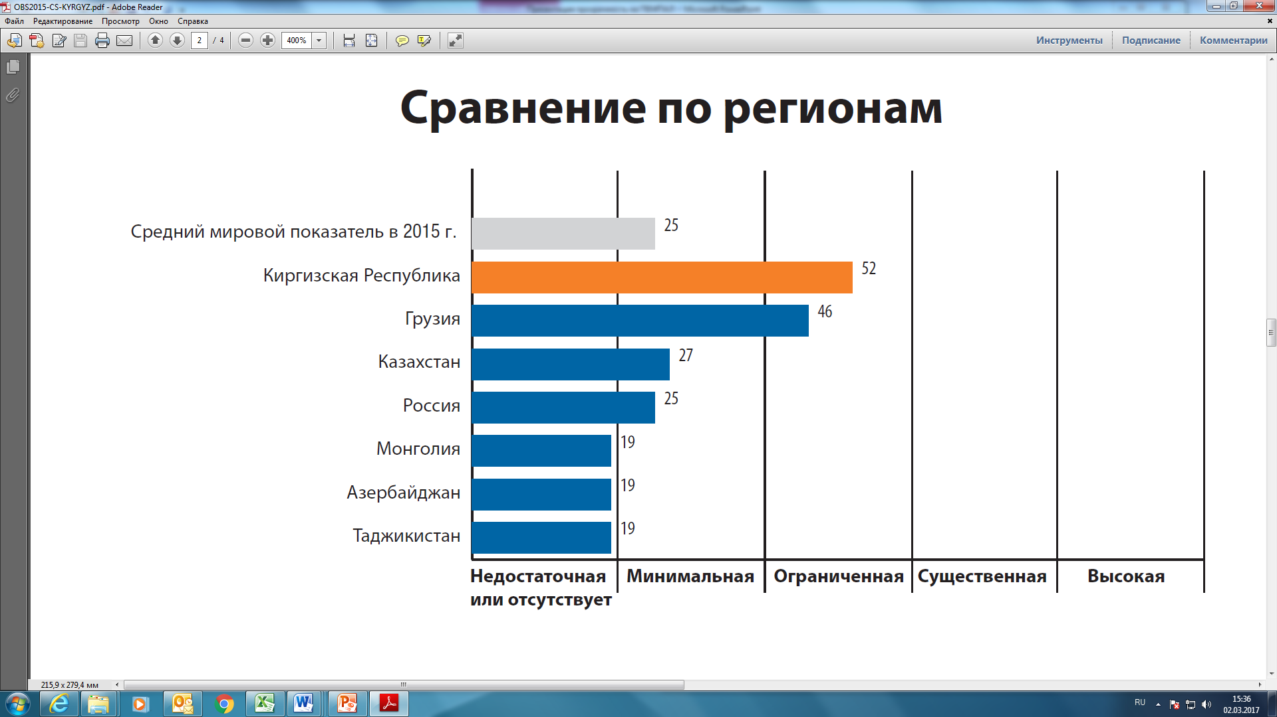
Citizen Engagement in the Budget Process – Benchmarking (score)
Average global indicator, 2015
Kyrgyz Republic
Georgia
Kazakhstan
Russia
Mongolia
Azerbaijan
Tajikistan
Insufficient or missing
Minimum
Limited
Considerable
High

Slide 6
Factors Contributing to Improved Open Budget Index
Government policy to achieve greater budget openness and transparency;
Stronger focus of civil society organizations and development partners;
The need to improve public finance management in line with best practice;
Public councils.

Slide 7
Areas of Business
Better interaction between government and civil society;
Ensuring access to budget information;
Creating an enabling environment for citizen engagement in the budget process;
Improving budget legislation;
Launching public finance information portals.

Slide 8
2012-2013 Highlights
2012
2013
Launching public hearings on the executive budget proposal prior to submission to parliament.
Publication and dissemination of the Citizens’ Budget based on the draft budget proposal and enacted budget.
Closer engagement with civil society organizations and development partners to promote budget transparency.
Initiating preparation and publication of Citizens’ Budget based on the enacted budget.
Conducting public budget hearings in parliament.
Adopting a methodology to produce Citizens’ Budget based on a list of information relevant to the public.
Adopting an information-sharing strategy and initiating regular publication of budget documents;

Slide 9
2014 -2016 Highlights
Embedding budget openness and transparency clauses in the Budget Code;
Enriching the coverage and quality of budget documents;
Publication of the preliminary budget proposal;
Conducting public hearings on the executive budget proposal in Bishkek and across the regions;
Conducting public hearings during parliamentary discussions of the budget proposal;
Enabling citizens’ real-time access to the Public Procurement website;
Design and implementation of the PFM and Public Procurement anti-corruption action plan.

Slide 10
Regulatory Framework Enabling Budget Transparency
Mandatory documents to be published on the official website of the Ministry of Finance as per the Budget Code:
Key Fiscal Policy Guidelines;
Draft budget;
Citizens’ Budget;
Enacted budget;
Semiannual budget execution review;
Audit report on budget execution;
Enacted annual budget execution report;
Monthly budget progress reports;
Program budget performance index reports.

Slide 11
Regulatory Framework Enabling Budget Transparency
Budget documents are published on official government websites in strict compliance with confidentiality and government secret protection policies.
Preliminary budget statement, draft budget, enacted budget, and Citizens’ Budget are published within 15 days after adoption/enactment.
Budget execution reports and audit reports are published within a month after enactment.

Slide 12
Regulatory Framework Enabling Budget Transparency
Local governments must conduct public hearings on draft local budgets and publish the following documents on their websites:
Draft local budget;
Enacted local budget;
Monthly local budget progress reports;
Annual report on local budget execution.

Slide 13
Enabling Legislative Environment for Citizen Engagement in the Budget Process
Public budget hearings are held to discuss the drafting and execution of the budgets within the budget framework with a view to surveying public opinion, soliciting comments, and taking decisions in the interest of the public. As per the legislation, feedback must be provided at the outcome of the hearings.
Currently, public hearings are held:
On the executive budget proposal;
During parliamentary discussions of the draft budget;
On medium-term sectoral budget spending strategies;
On selected draft regulatory acts pertaining to the budget.

Slide 14
Public Sector Public Councils
Promotion and discussion of civil initiatives relating to the work of the government agency;
Assisting public authorities in formulating and adopting quality decisions;
Enhancing public spending transparency and efficiency;
Improving public service delivery.

Slide 15
Public Finance Information Resources
Ministry of Finance official website
Public Procurement portal
Open Budget portal
Official website of the Central Treasury of the Ministry of Finance

Slide 16
Planned Measures to Improve Budget Transparency
Improve budget legislation, quality and coverage of budget information.
Enforce publication of the Citizens’ Budget across three stages of the budget process: planning, enactment, and execution.
Conduct public budget hearings across three stages of the budget process: planning, enactment, and execution, and solicit feedback.
Launch municipal Open Budget Index.
Improve budget literacy to promote public engagement in the budget process.

Slide 17
Data Sources
Data provided by the Ministry of Finance of the Kyrgyz Republic;
Results of the 2015 Open Budget Index

Slide 18
Thank you!

