Slide 1

Results of the OECD Performance Budgeting Survey:
OECD and PEMPAL Countries
PEMPAL Budget Community of Practice (BCOP)
Program and Performance budgeting Working Group
Naida Carsimamovic, BCOP Resource Team
14 April 2017

Slide 2
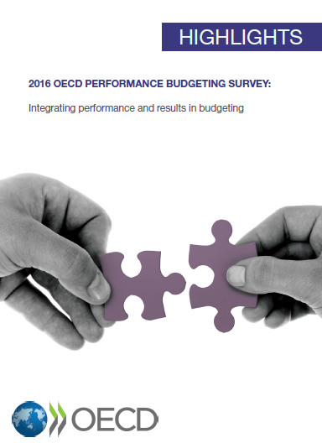
PEMPAL’S Collaboration with OECD
BCOP Working Group for Program and Performance Budgeting (WG) facilitated PEMPAL’s participation in the OECD Performance Budgeting (PB) Survey.
Participation in the Survey contributed to the WG’s objectives by:
  providing baseline data on status of program and performance budgeting reforms in PEMPAL countries
  providing opportunity for PEMPAL countries to benchmark their progress against the OECD countries
  providing information on newest trends and best practices in the developed countries

Slide 3

Data on PEMPAL Countries
13 PEMPAL countries (out of 15 WG members) filled out the survey:
  Armenia, Belarus, Bosnia and Herzegovina, Bulgaria, Croatia, Georgia, Kosovo, Kyrgyz Republic, Moldova, Russia, Serbia, Ukraine, and Uzbekistan.
  Note that the 14th WG member, Turkey, took the survey under OECD.
Survey results are based on PEMPAL countries’ own self-assessment and no data cleaning/verification was conducted.
Based on the survey response of PEMPAL countries, it is evident that there are different interpretations of the main terms (including spending reviews, evaluations, and impact), with some PEMPAL countries using less rigorous definitions than those used by OECD/World Bank.

Slide 4
Survey Findings
PART I: PERFORMANCE BUDGETING

Slide 5
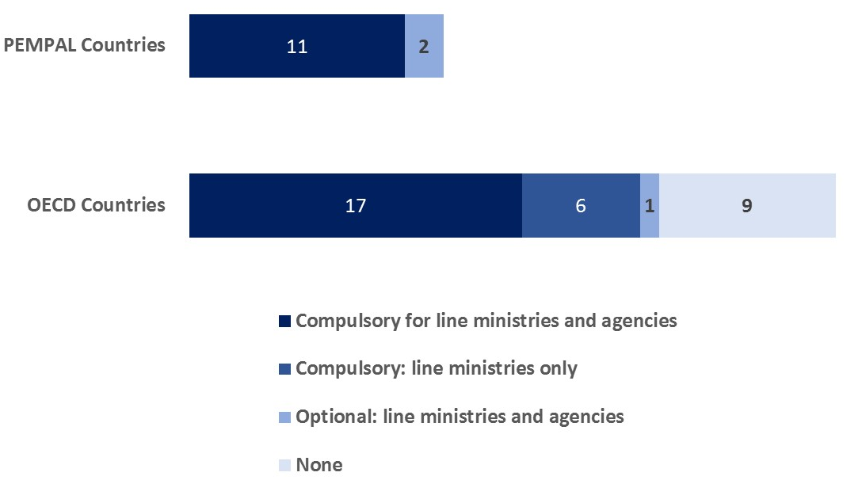
Existence of Performance Budgeting Frameworks
Performance Frameworks are a norm in both OECD and PEMPAL countries.
Coverage of frameworks is wider and more uniform in PEMPAL countries, with 11 out of 13 countries having compulsory frameworks that apply to both line ministries and agencies.

Slide 6
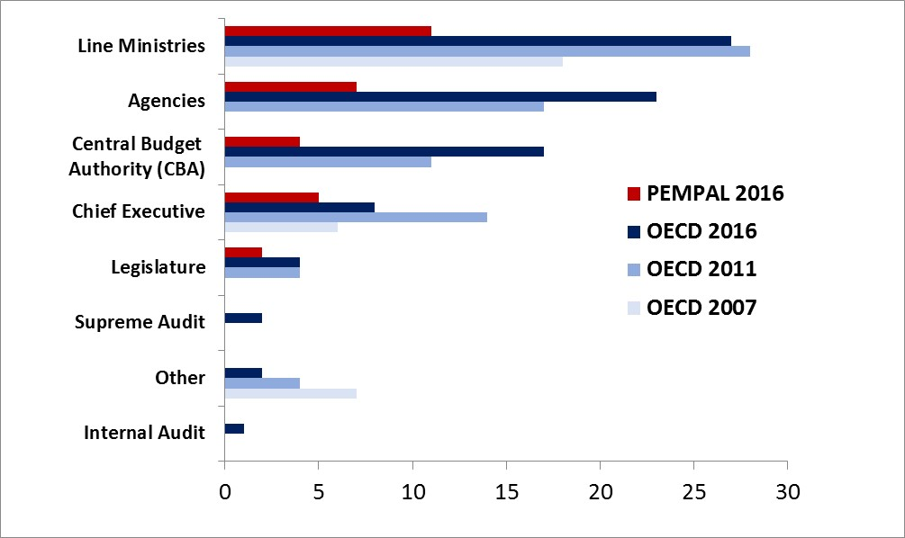
Responsibility for Setting Performance Targets
In both OECD and PEMPAL countries, targets are most frequently set by the line ministries and agencies.

Slide 7
Institutional Roles in Performance Budgeting
In both OECD and PEMPAL countries, CBAs establish the framework/guidelines, while line ministries generate performance information.
However, in OECD countries all roles are more shared between the CBA and the line ministries, while roles are more divided in PEMPAL countries.
Evaluations are a norm in OECD countries, with roles of both line ministries and the CBA, while only a few countries conduct evaluation in PEMPAL region.
Line ministries in PEMPAL countries have no role in allocating funds based on performance information, unlike in OECD countries.

Slide 8
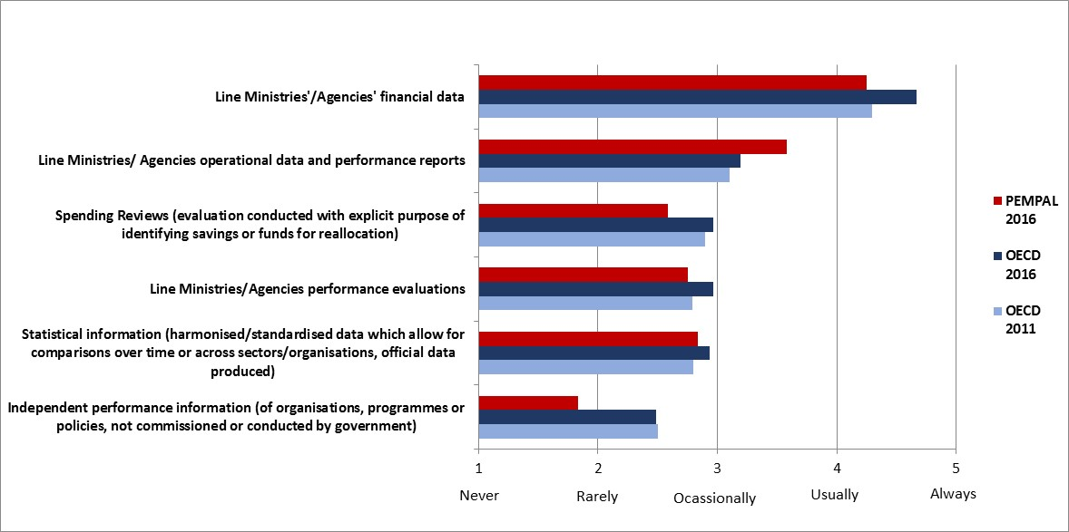
Usage of Performance Information in Budget Negotiation
There is a trend of increase of usage of performance information for budget negotiations in the OECD countries, however, the financial data remains the primary information used for negotiations in both OECD and PEMPAL countries.

Slide 9
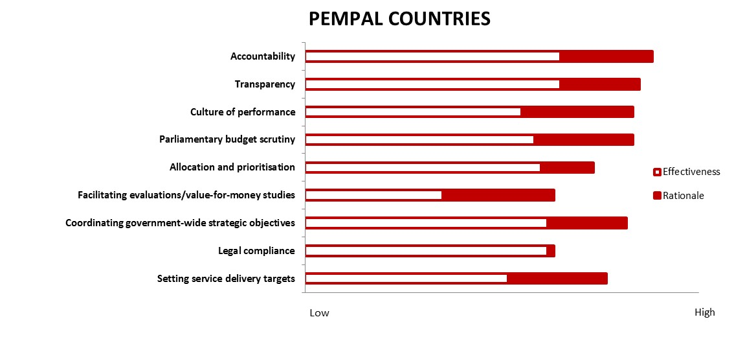
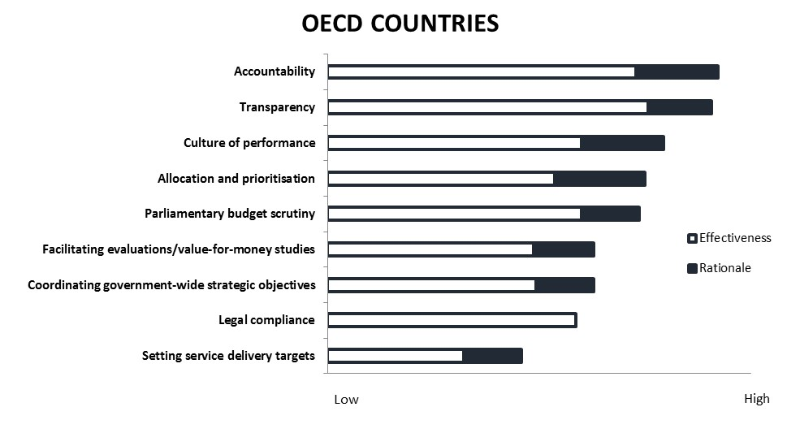
Ranking of factors behind introducing PB and effectiveness
Accountability and transparency have been the key motivation factors and key benefits.
Index calculated as
high=5, medium-high=4, medium=3, low-medium=2, low=1, N/A=0.
Depicted as sum of all countries

Slide 10
Consequences of Performance Targets Not Being Met
Management responses to poor performance are much more likely in both OECD and PEMPAL countries than budgetary consequences.

Slide 11
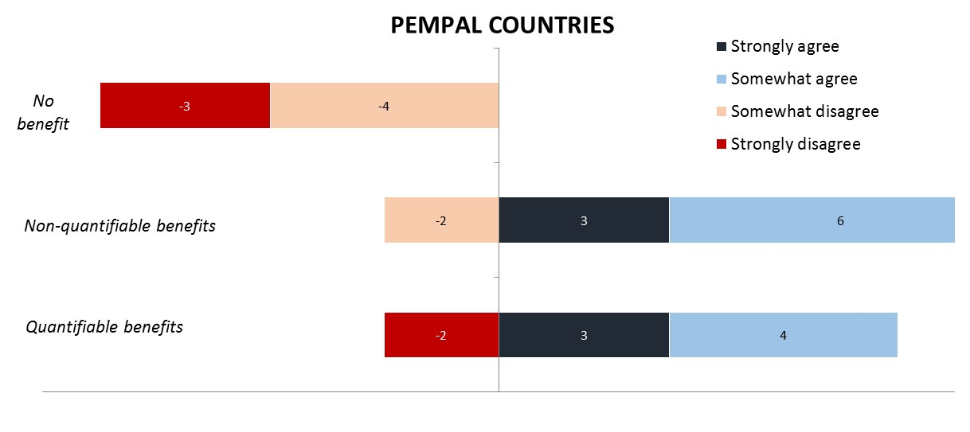
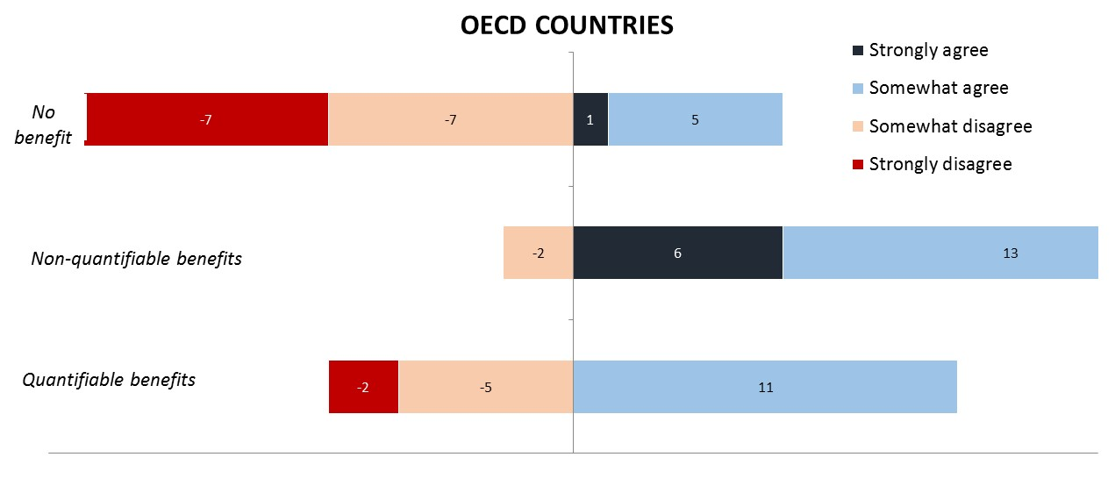
PB’s Contribution to Improved Quality of Public Finances
Countries’ perceptions on benefits of PB is very mixed in both OECD and PEMPAL countries.

Slide 12
PB Usage by Sector
Three out of the four sectors in which PB is perceived as having the highest impact on average are the same in PEMPAL and OECD countries, and so are the three out of four sectors in which PB is perceived as having the lowest impact on average.

Slide 13
Greatest Challenges to Implementation of PB
Challenges are very similar in OECD and PEMPAL countries. Notably, PEMPAL countries as their second challenge (after resources) list unclear policy/program objectives.

Slide 14
Survey Findings
PART II: SPENDING REVIEWS

Slide 15
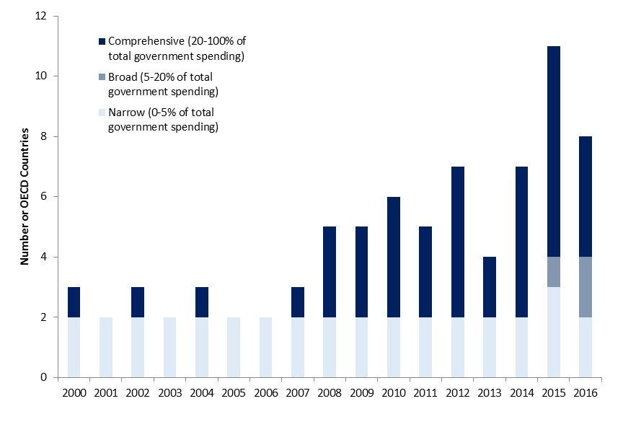
Usage of Spending Reviews
OECD countries increasingly use spending reviews.
In PEMPAL countries, Croatia, Uzbekistan, Armenia reported having conducted spending reviews, but only Croatia answered all subsequent questions on the details of spending reviews. Croatia implemented broad spending reviews in 2015.
However, all other PEMPAL countries note that spending reviews are under consideration.

Slide 16
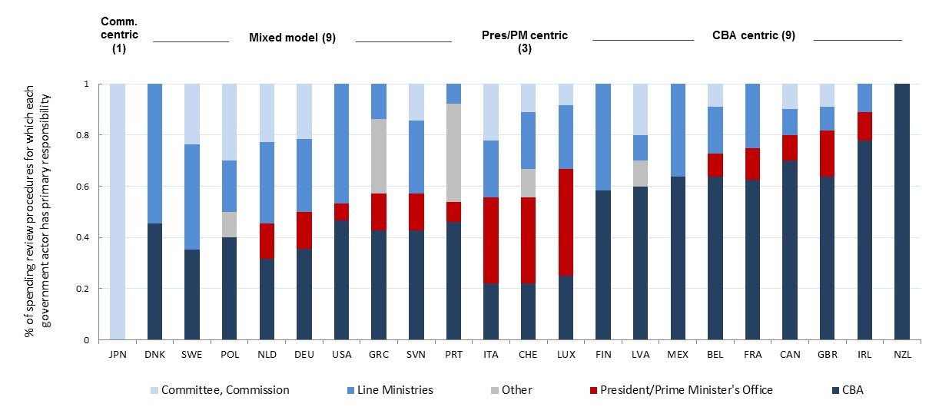
Usage of Spending Reviews
In OECD countries, the CBA tends to lead spending reviews or is co-leading it with the President/Prime Minister and/or Committee/Commissions in a mixed model approach.
Croatia also employed a mixed model approach, with the CBA and Committee/Commission having the lead role.

Slide 17
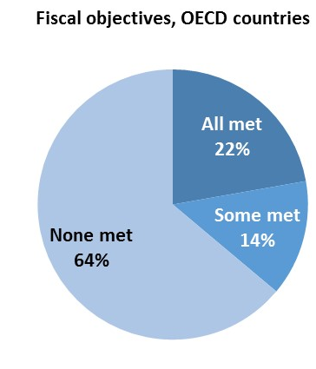
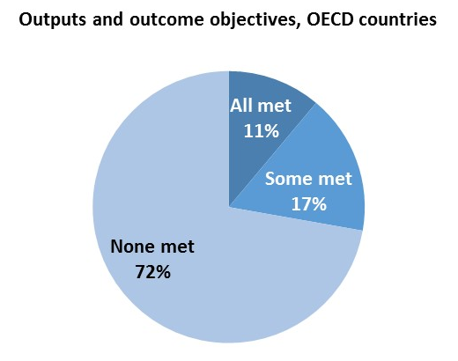
Outcomes of Spending Reviews
Spending review outcomes are unclear.
When asked to roughly estimate what percentage of spending reviewed in 2011-2014 had met the fiscal objectives and the output/outcome objectives, only one third of the OECD countries respond that all or some were met.

Slide 18
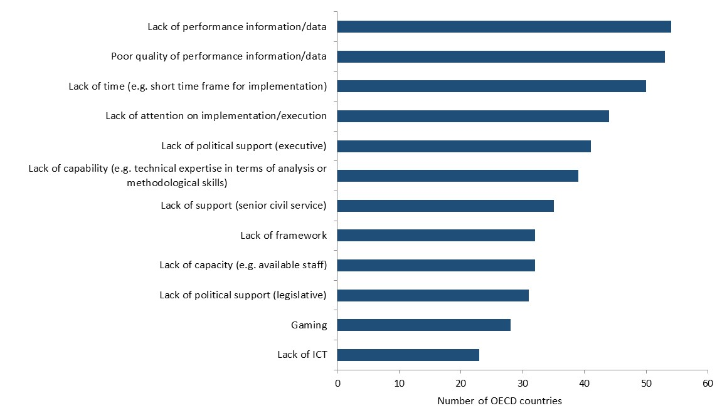
Challenges to Ensuring Implementation of
Spending Review Results
Availability and quality of performance information/data are the main obstacles listed by the OECD countries.
The three PEMPAL countries that answered this question (Croatia, Armenia, and Uzbekistan) rank poor quality of performance information as the top challenge, followed by lack of time, and lack of capacity.

Slide 19

Thank you for your attention!
All Working Group event materials can be found in English, Russian and BCS at www.pempal.org and additional materials on BCOP wiki

