Slide 1
Financial Management
Information System in Moldova
Vasile Botica,
General Budgetary Synthesis Department

Slide 2
Short history
Development started in 2009 under WB project;
Project duration – 5 years;
Main developing company – HP;
Implementation in production – starting from 2015.

Slide 3
System Components
The structure of the Financial Management Information System (FMIS) :
Budget planning system (BPS)
Apropriation managementsystem (AMS)
Business warehouse (BW)
Master data management (MDM)
Budget execution system (BES)
Reporting system (RS)

Slide 4
FMIS interrelations
MDM
BPS WIN
BES
SAP/BW
Valid budget
Executed budget
Reports
Executed budget
Limits
Budget
BPS WEB
Appropriation management
Collection of reports

Slide 5
Main system features
The system is integrated one
The system supports all business activities of budget process
The system operates on WIN and WEB platforms
Access of all users in real time (10000 users)

Slide 6
Budget planning system (component) – main functionalities - I
MTBF preparation ( I faze):
  Setting sector limits (base line, new policy initiatives, total limit)
  Disaggregation of limits by budgets: State Budget, Social Fund, Medical Insurance Budget, Local budgets (consolidated of 934 independent budgets: 899 first level+35 second level)
  State Budget limits disaggregation by CPA’s – input for next faze - annual budget preparation
  System template for working with sector limits

Slide 7
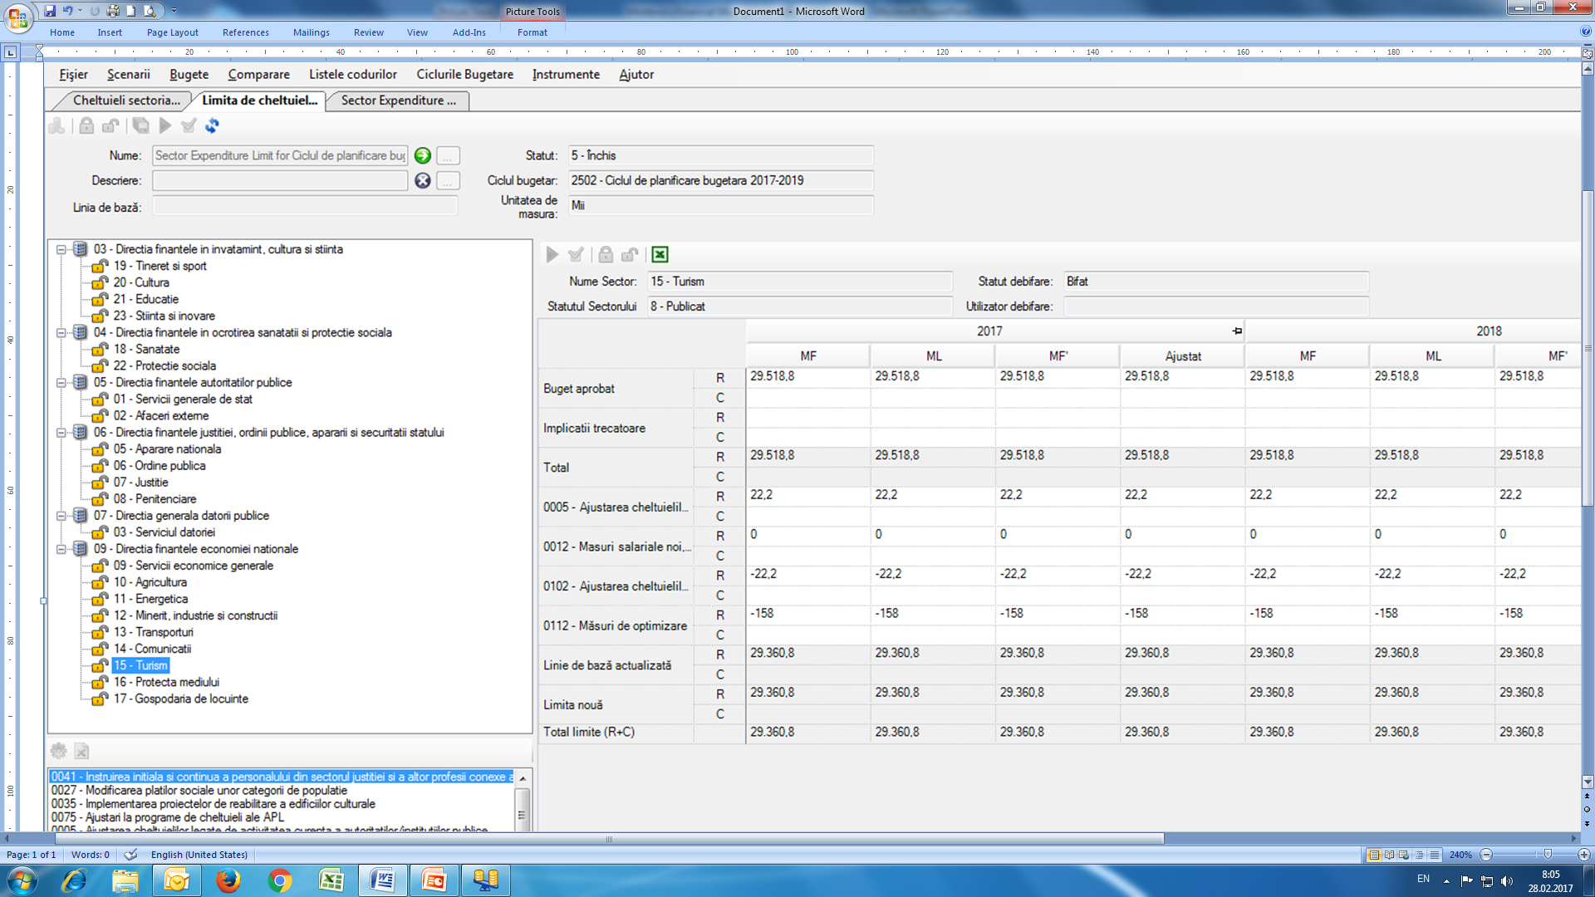

Slide 8
Budget planning system (component) – main functionalities (cont.) - II
Preparation of annual budget (second faze):
  Each CPA (direct budget user):
    Sets limits for all subordinated institutions;
    Fulfill the program description (goal; objectives; narrative description);
    Define the list of performance indicators to be used by all institutions
  Budget institutions submit budget proposal, including:
    financial part within the limit set;
    Performance part according to the list of indicators defined
  Aggregation of all budget proposals submitted by budget institutions – both: financial part and performance part

Slide 9
Budget planning system (component) – main functionalities (cont.) - III
CPA’s adjust aggregated budget proposal and submit to MoF;
MoF prepares the draft budget and presents to Government;
After Gov approval the draft budget is presented to Parliament;
Approved budget is submitted to Appropriation Management System for execution purpose
Important!
Every budget version: Budget institution proposal; CPA proposal; Mof draft; Gov draft and Approved budget is stored and saved separately.
Performance is a subject of updating as a result of changes in allocation during hole preparation process: CPA->MoF->Gov->Parl

Slide 10
Budget proposal preparation – how it works in the system
Practical demonstration from the system of working with financial and nonfinancial (performance) information
https://mfb1tp2.fmis.internal/ssofmis_wia/default.aspx

Slide 11
The lessons learned from system development and operation
Good description of business processes is a precondition for successful development of the system functionalities
There is a need for continues improvements
Communication with developing company is crucial
Before implementation allow time and resources for training
At the beginning of implementation it is important to have a strong supporting service (team)

Slide 12
QUESTIONS?

