Slide 1

Budget Transparency and Citizen Engagement in Uzbekistan: Reform Progress
Ministry of Finance
Republic of Uzbekistan

Slide 2
Budget transparency reform
Fiscal transparency evaluation
Government finance statistics
Consolidated financial reporting
Open budget portal
Citizens’ Budget
PEFA assessment
Tax reforms

Slide 3
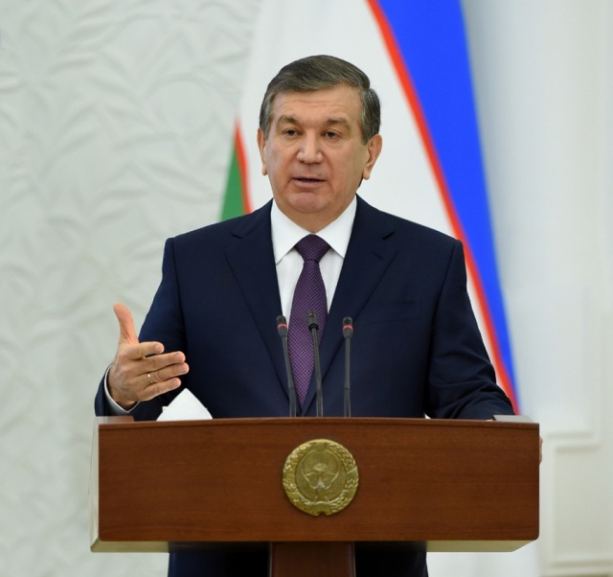
First open budget reform
In the course of economic sector reform, consistent efforts are being made to leverage new tools to make economic, financial and statistical data more accessible and to promote budget transparency.
Adopted by Decree of the President of the Republic of Uzbekistan of August 22, 2018 №ПП-3917 On Measures to Promote Budget Transparency and Citizen Engagement in the Budget Process.

Slide 4
First open budget reform
In pursuance of Presidential Decree of August 22, 2018 №ПП-3917:
- as of 2019, an arrangement is put in place enabling citizens to engage in allocation of at least 10% of additional budget resources of districts (towns) for community-driven projects;
- as of 2020, the government budget and earmarked budgets shall be adopted by law
(currently, the parameters are set by presidential decree);

Slide 5
First open budget reform
- draft government budgets and budgets of public earmarked funds, key fiscal policy guidelines and reports on execution of the government budget and budgets of earmarked funds must be publicly discussed prior to being submitted to the Legislative Chamber Oliy Majlis of the Republic of Uzbekistan;
- A Citizens’ Budget is published in parallel to the draft government budgets and budgets of public earmarked funds and budget outturn reports.

Slide 6
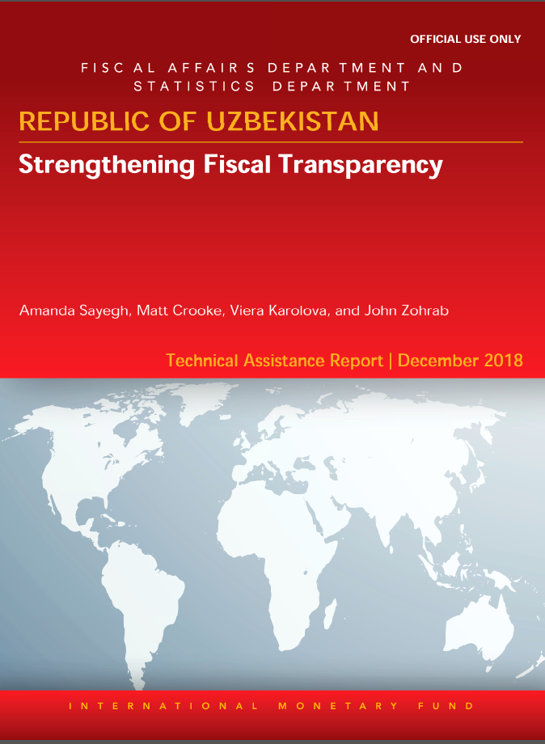
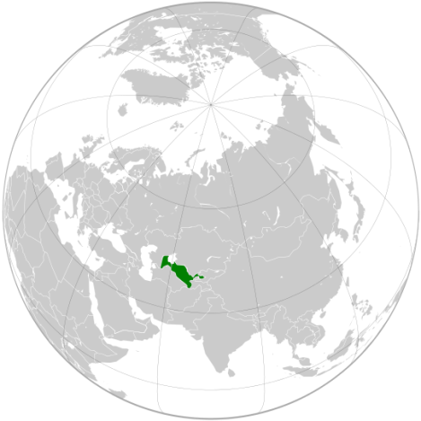
IMF fiscal transparency evaluation
In June 2018, a fiscal transparency evaluation was carried out to identify gaps and elaborate an action plan to remove them.
Following the exercise, it was concluded that Uzbekistan is in line with basic or higher standards and fits 16 out of 36 principles of the IMF Fiscal Transparency Code.
«Uzbekistan is embarking on a comprehensive PFM reform to enhance fecal transparency. It is designing broad-based reforms to increase the scope, reliability, quality and accessibility of fiscal reports”

Slide 7
PROGRESS FOLLOWING FISCAL TRANSPARENCY EVALUATION
A new division is set up in the Ministry of Finance which is tasked with improving PFM and promoting transparency.
The draft 2019 budget submitted to parliament includes the following:
medium-term revenue, expenditure forecasts, budget balance and public debt, analysis of macroeconomic risks and fiscal impact of alternative assumptions, quantitative fiscal targets;
Three state earmarked funds and one extrabudgetary fund have been abolished and their funds integrated with the government budget.

Slide 8

Consolidated financial reporting
Consolidated budget includes extrabudgetary funds and extrabudgetary resources of budget organizations;
Classification of public sector units is being finalized in accordance with the 2014 Government Finance Statistics Manual (GFSM 2014);
Extrabudgetary accounts of budget organizations and extrabudgetary funds are brought under the Treasury.

Slide 9
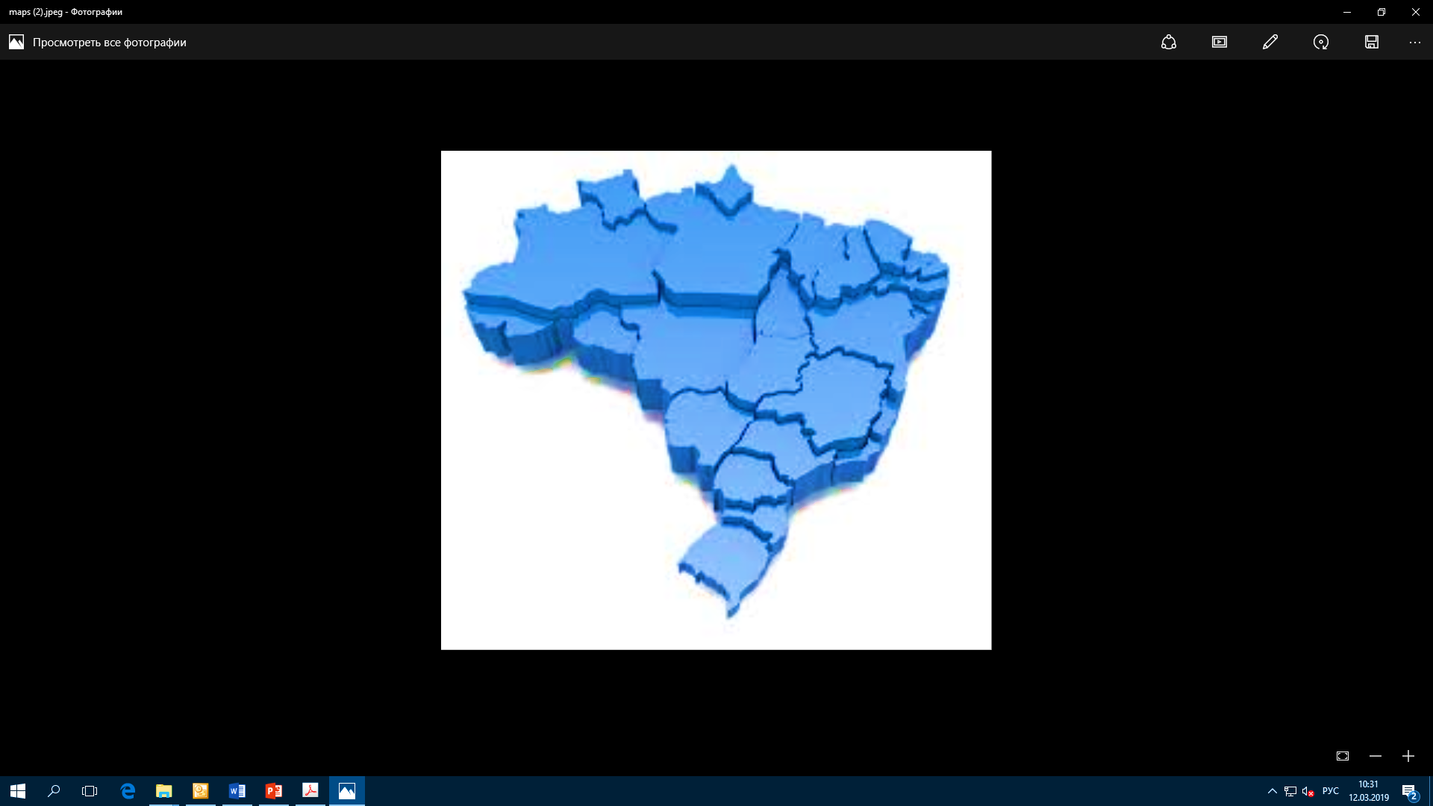
Government finance statistics
As a pilot, the government budget will be drafted and presented in compliance with IMF forms, and will subsequently adopt international standards;
Transition from an expanded General Data Dissemination Standard to the Special Data Dissemination Standard (SDDS);
Improving government statistics reports in line with GFSM 2014.

Slide 10
Enhancing fiscal transparency
The 2019 Citizens’ Budget was published together with the 2019 budget.
Publication of the opinion of the Chamber of Accounts on the draft budget and on the budget execution report.
As of 2022, Uzbekistan will participate in the Open Budget Index.

Slide 11

Open budget portal
The Ministry of Finance, in conjunction with the Ministry of Information Technologies and Communications of Uzbekistan, have launched an Open Budget portal
https://openbudget.uz/

Slide 12
Open budget portal
The Open Budget information portal implies:
Public control over targeted use of public expenditures;
Placing information on community-driven projects to be financed out of additional resources of districts (towns);
Feedback from citizens including a chance to report violations of budget legislation, and submit proposals to improve the budget process.

Slide 13
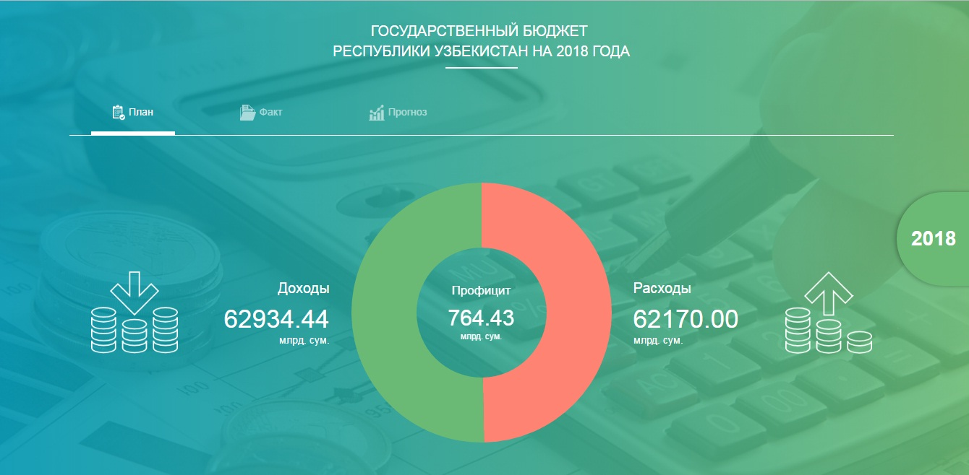
Open budget portal

Slide 14
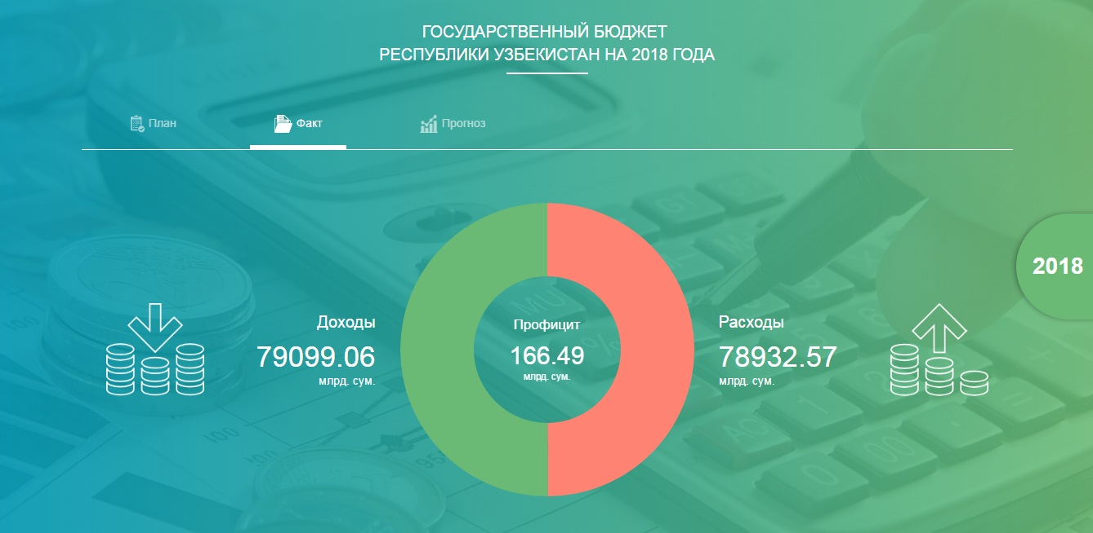
Open budget portal

Slide 15
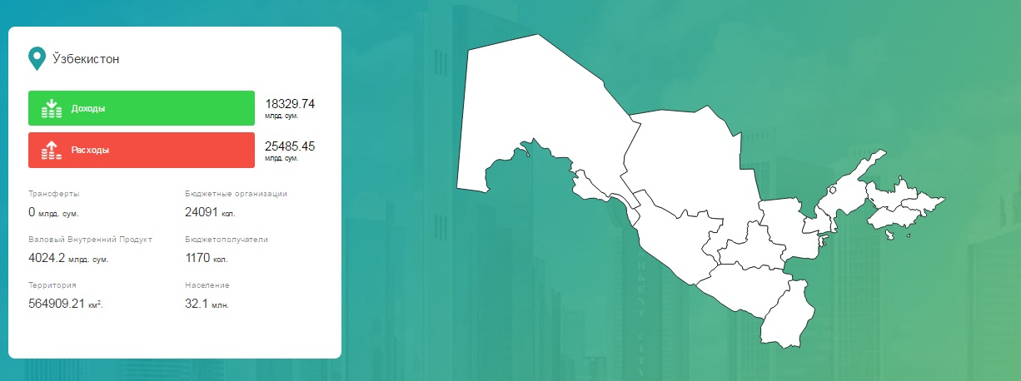
Open budget portal
Analytical Reports Available on the Portal

Slide 16
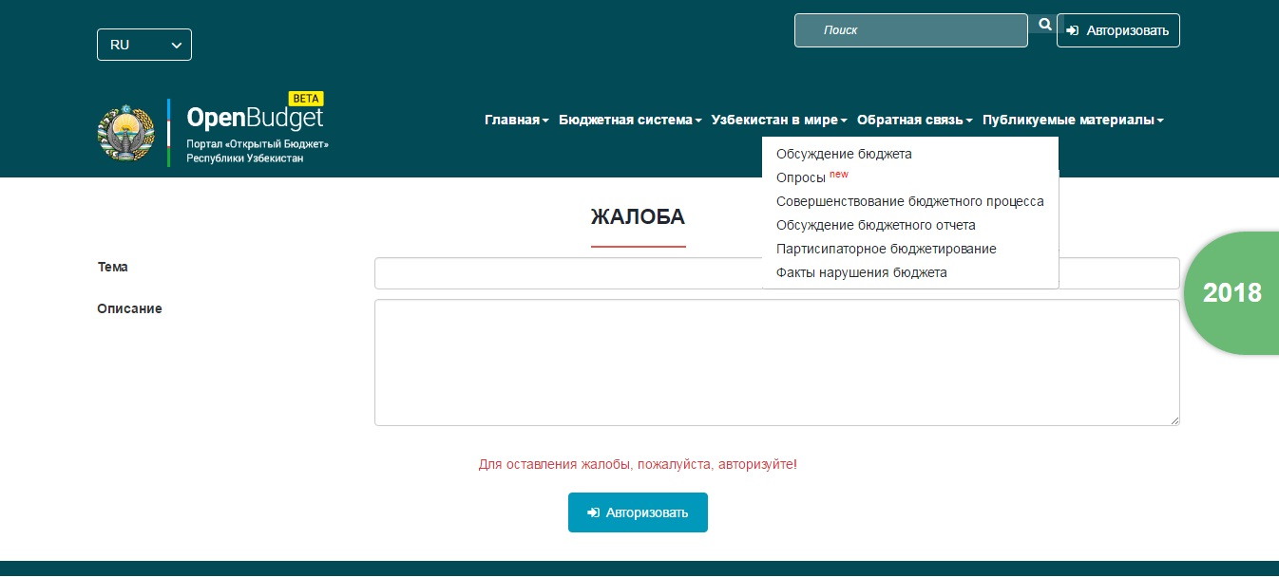
Open budget portal
Feedback

Slide 17
Citizens’ budget
Every citizen of Uzbekistan participates in generating and using the resources of the government budget.
budget generation – as a taxpayer, and budget use – as a beneficiary of public goods and services.
This is why citizens have the right to know about the sources of revenue and spending objectives of the government budget.

Slide 18


The first edition was designed on the basis of the adopted parameters of the 2018 Government Budget

Slide 19
Citizens’ budget
Citizens’ Budget is not the same as the open budget or e-budget
Fist and foremost, it is a budget made easy to understand: explained simply with minimum special terms
Open data: budget information is easily available to the public
Citizen engagement: citizens participate in the budget process (drafting, execution and reporting)

Slide 20


The next edition will follow the 2019 draft Government budget of the Republic of Uzbekistan

Slide 21
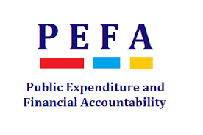
PEFA assessment
With a view to further improving budget transparency, the World Bank has carried out a PFM evaluation based on the Public Expenditure and Financial Accountability (PEFA) criteria in the Republic of Uzbekistan.

Slide 22

PEFA assessment
Assessment overview:
PEFA workshop held on September 20-21, 2018 with more than 50 representatives of government agencies;
2 field PEFA evaluation missions held. The first – from September
24 to October 5, 2018, the second – from November 26 to December 7 2018;
About 40 meetings held with 16 agencies and other stakeholders;
Report subject to an independent review by PEFA Secretariat and IMF and World Bank experts;
Final report was approved by PEFA Secretariat (PEFA Check);
The final PEFA result dissemination mission took place on March 11-15, 2019.

Slide 23

PEFA evaluation REVIEW
ACHIEVEMTNS:
a realistic budget;
scope of budget documents (a big share of core and supplementary information is provided – 7 out of 12);
effective debt management;
effective budget preparation management.
Areas of improvement:
medium-term expenditure planning
Internal and external audit (ISSAI), as well as adoption of International Public Sector Accounting Standards (IPSAS);
public procurement and investment management;
risk assessment for public asset and liability management.

Slide 24
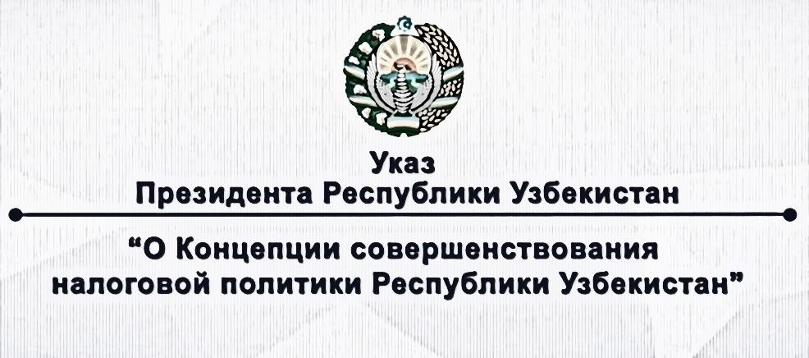
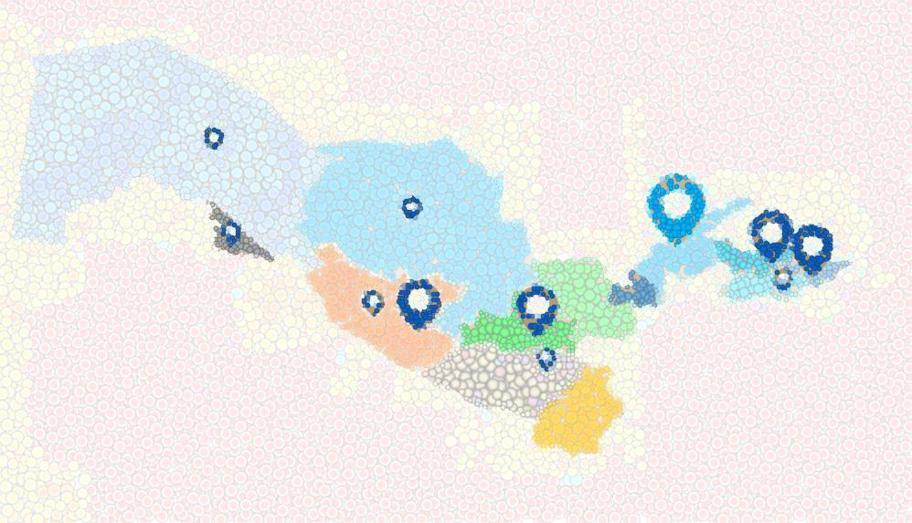
easing the tax burden on the economy;
streamlining the number of taxes through their unification;
simplification of tax legislation;
maintaining an enabling environment for foreign investors, providing support and reliable legal protection;
improving tax control forms and mechanisms.

Slide 25

Tax reforms
Tax Simplification:
the most critical reform area is to simplify the tax system and remove imbalances in tax burden imposed on economic agents subject to simplified taxation and those subject to general taxation (unification of taxes with similar tax base, revision of criteria to move to a simplified taxation regime).
Building a stronger local revenue base
raising water and land tax by 20%;
raising excise tax on certain items by 10-25%;
Personal property tax is assessed based on the cadaster value of real estate;
Enabling local governments to set land and property tax rates.

Slide 26
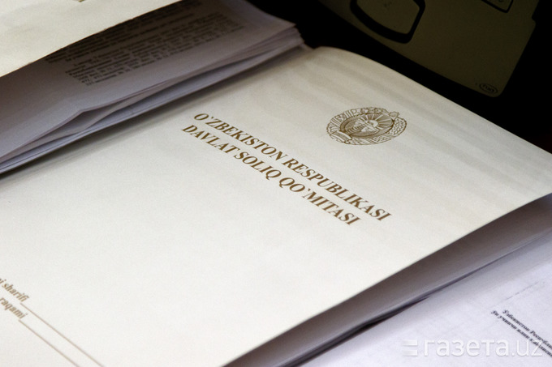
tax reforms
Easing the tax burden:
Fixed tax rates on individual entrepreneurs are lowered by 30%;
Corporate income tax for commercial banks is lowered from 22% to 20%, for other enterprises – from 14 to 12%.
Further reforms :
introducing e-invoices;
creating a uniform taxpayer database;
improving tax control;
improving tax administration.

Slide 27
Tax reforms
General government taxes – shared between republican and local budgets | 2017 | 2018 | 2019
Caproate profit tax | 7.5%+8% (social infrastructure tax) | Generate rate – 14%; commercial banks – 22% | Generate rate – 12%; commercial banks – 20%
Uniform tax payment | 5% | 5% | 4%
Personal income tax | 0% - 23% | 0% - 22.5% | 12% (direct rate)
Value added tax | 20% | 20% | 20%
Excise tax | Absolute value | Absolute value | Absolute value
Subsoil resource tax | 2.6% - 30% | 2.6% - 30% | 2.6% - 30%
Water tax | Absolute value | Absolute value | Absolute value
Fixed tax | Absolute value | Absolute value | Absolute value
Local taxes are shared between local budgets | 2017 | 2018 | 2019
Diesel fuel tax | Absolute value | Absolute value | Abolished
Corporate property tax | 5.0% | 5.0% | 2.0%
Corporate land tax | Absolute value | Absolute value | Absolute value
Uniform land tax | 0.95% | 0.95% | 0.95%
Tax and fees shared between extrabudgetary funds | 2017 | 2018 | 2019
Employees’ insurance contributions to the Pension Fund | 8% | 8% | Abolished
Mandatory contributions to earmarked funds | 1.6%+1.4%+0.5% | Uniform rate 3.2% | Abolished
Uniform social payment | 25% (15% for small businesses) | 25% (15% for small businesses) | 12% (25% for government enterprises)

Slide 28
Thank you!

