Slide 1
Georgia PEMPAL Workshop
Implementation Strategy for Georgia’s IFMIS
Analysis and Conclusions from April, 2011 Consultant Study
Eduardo Talero
February 27, 2012
Notes:
Good afternoon and thank you for inviting me to make this presentation. My name is Eduardo Talero and I was a consultant to the World Bank in April/March 2011 to make an assessment of and suggest possible implementation strategy for Georgia’s IFMIS.
In this presentation I will tell you briefly the factors that I used in the analysis, its findings, as well as the logic that led to recommending the continuation of the CDSW approach at least until a time in the future when a final decision could be made based on reliable capacity and quality management benchmarks.
This is a controversial recommendation that runs contrary to usual World Bank advice, so at the end I will contrast it against that made in Nicaragua, where circumstances were very similar and the recommendation the opposite.

Slide 2
Main Topics
Findings: Key assessment factors in Georgia
Organizational assessment of FAS
IFMIS strategy recommendations
Contrast with Nicaragua’s case
Rules of thumb for the analysis of IFMIS cases.

Slide 3
Findings: E-Governance in Georgia
GoG is advancing e-Governance in a very effective, bottom up manner with impressive results. Data Exchange Agency (DEA) is anchoring effort with interconnected government portal framework
GoG has already interconnected data hubs on people, property, land, taxpayers and businesses, a goal many countries are still struggling with.
Consequently e-service offerings are growing fast: company registration, paperless vehicle registration, an expanding intra-governmental document flow system, etc.
MOF is perhaps the biggest e-Governance player in the public sector so it has a special responsibility to coordinate with DEA in deciding on frameworks, technologies and standards. This seems to be happening informally but effectively.
Thus, MOF’s IFMIS plans reinforce, not detract, from growth of e-Governance in Georgia and viceversa.

Slide 4
Findings: Information and Communications Technology (ICT) Infrastructure
Three major data centers being formed at the ministries of Justice, Internal Affairs and Finance.
Other government agencies concentrating their operations in these data centers.
Central government fiber optic wide area network is operational.
Major strides in capacity, reliability, security and professional management of MOF data center Solid plans for standards-based quality, security management.
Plan to start disaster recovery site (DRS) in Summer 2011 is on track.

Slide 5
Findings: ICT profession & software industry
Local graduates are highly competent yet need acquiring service-oriented or event-oriented architecture (SOA or EOA) skills on the job.
Microsoft (MS)/CISCO-dominated market. Unfortunately, low level of open source software activity.
Little and negative experience in commercial, off-the-shelf software (COTS) use, both in public and private sectors
Software engineering (SE) industry not highly developed. No known quality-certified software house.
Yet there is flexible short-term SE market due to abundance of opportunities and appeal of centers of excellence, like Financial Analytical Service (FAS).
Clear space exists for government-anchored enterprise formation.

Slide 6
Findings: Stakeholder Opinions
Broad scepticism about COTS approach following vendor demonstrations.
COTS system requirements viewed as generic, not reflecting real requirements.
Consensus that real requirements are best defined through agile software development method used internally for E-Treasury, E-Budget systems
Generalized user satisfaction, including at SIs visited, with the E-Treasury and E-Budget systems.
Widespread satisfaction with FAS performance

Slide 7
Findings: Status of PFM Reform agenda
Prerequisite reforms | Status | Implications COTS vs. Custom-Developed Software (CDSW) Decision
IPSAS-compliant chart of accounts (CAO), integrated with budget classification and GFS standards (UCOA) | UCOA formulated but not being introduced yet. Modified cash basis IPSAS-compliant COA to be used. | Decision better made when pilot use of new COA provides higher certainty on system requirements.
Improved programmatic classification of the Budget | program budgeting is being piloted. Program budget classification not fully developed. | Ongoing E-budget development is best strategy to firm up system requirements
Transition plan to IPSAS-compliant accrual accounting | Gradual introduction of accrual basis IPSAS planned only after modified cash basis IPSAS. | Buying of comprehensive accrual accounting software is premature
Standardized, government-wide accounting procedures and standards | Training and documentation of modified cash basis IPSAS is still evolving. | Feedback from SIs and BOs on accounting reform would facilitate FMIS decision.
Specification of budget management and budget execution control, reporting and disclosure mechanisms. | Discovery of full control, processing, reporting and analysis requirements for formulation and execution of the budget is far from complete. | Ongoing iterative development of e-Budget and e-Treasury is best current strategy, while full user requirements are firmed up.
Notes:
This slide will not be explained in detail. Its point is that a number of reforms have not advanced sufficiently in Georgia to have certainty about their ultimate system requirements and therefore that COTS solution would be premature from this standpoint.

Slide 8
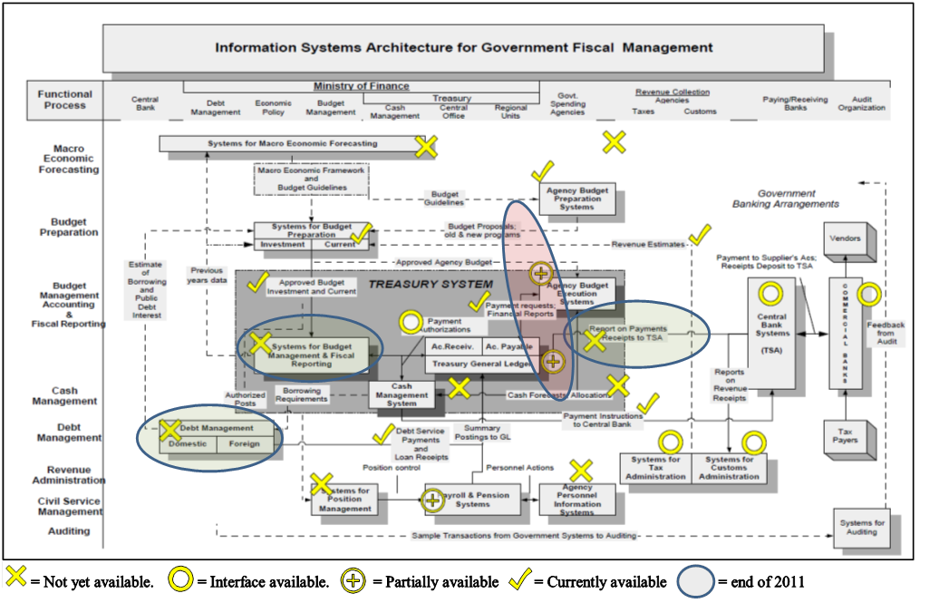
Findings: Status of FM Systems Support
A detailed assessment was made of current FAS information systems status against the well known Treasury Reference Model to identify existing, in-construction & missing modules and interfaces.
Notes:
Only the narrative at the bottom needs translating. Graph will not be explained in detail.

Slide 9
Findings: Overview of Current FM Systems
FPD
SIs, BOs
Financial Statements
Contracts
Commitments
payment requests
Asset records
Manually
FAD
Accounting Dept. (Consolidates Fin. Stmts).
TRE
BD
Budget plans, approvals, transactions
E-Treasury
Loan/grant disbursements.
DMFS
E-Budget
Appropriations
Revenues
Revenue/Customs Systems
Treasury Information System (TIS) (Legacy)
Payment orders
Central Bank Systems (Legacy)

Slide 10
Organizational Assessment of FAS
Financial Analytical Service (FAS) is a Legal Entity of Public Law created in April 2010 that provides ICT infrastructure, system development, ICT operations, ICT support and analytical services to MOF.
While wholly owned by government, FAS can manage and compensate its staff private sector style.
High performing organization rapidly developing the capacity to engineer large, complex software systems such as IFMIS.
FAS Uses iterative, agile, team-based software development methods ideally suited for discovery of real user requirements in complex systems.
Currently using latest SOA concepts and tools.

Slide 11
Organizational Assessment of FAS (2)
Staff compensation is borderline with the private sector, needs to be maintained competitive
However, appeal as a center of excellence attracts high performing, team oriented individuals. 59 staff at time of study.
Organization structure is highly functional.
Track record of client satisfaction is impressive but short. Careful work tracking tool is visible to management.
Training plan is practical and well funded, requires freeing up of staff time.
Work program for 2011 is extremely ambitious and some prioritization is indispensable.

Slide 12
Recommended IFMIS strategy
Consolidating Gains and achieving readiness
Complete Interim FMIS by building 7 interfaces and one module (see next)
Build up FAS SE and quality management capacity
Planning the implementation
Formulate IFMIS (SOA) architecture and implementation plan
Managing IFMIS program implementation.
Activate IFMIS Program structure, for decade-long operation
Retain independent technical/quality audit of FAS.
Repeat ITSM audit before proceeding
Assess FAS readiness (suggested indicator matrix)
Reassess COTS vs. CDSW software decision (suggested decision model)
Manage MOF-FAS relationship through formal MOU with (i) multi-year budgeting; (ii) SLA’s; (iii) exit milestones
Notes:
Full translation would be desirable. However, explanation will center only on the main three strategy bullets on the left. To see full text, click on left border of smart image.

Slide 13
Complete Interim FMIS by building 7 interfaces and one module
7. SI/BO Financial statements.
E-Budget
1- Appropriations
ORIS
Financial statement consolidation module (new)
2-Contracts & payment schedules.
4-Payment requests
3-Completed payments
5-Contracts & payment schedules.
E-Procurement
E-Treasury
6-Loan/grant disbursements.
DMFS

Slide 14
Position FAS for COTS/CSWD decision by mitigating present risks
Ci > Co = Net costs
COTS zone
Reduce internal risk
Ri > Ro = Net danger
Ri < Ro = Net safety
CDSW zone
* Adapted from Jaak Jurison in “Strategic Sourcing of Information Systems”, Leslie Willcoks & Mary Lacity editors, Wiley, 1998, Chapter 6
Ci < Co= Net savings

Slide 15
Is CDSW Option Feasible/Advisable? – Georgia and Nicaragua
Environmental Factor | Georgia | Nicaragua | Comments
E-Governance & ICT Infrastructure | Y/Y | Y/? | N: Persistent Infrastructure. underfunding
ICT Profession and Service Industry | Y/Y | ?/Y | N: High private sector competitiveness constantly threatens Govt. capacity .
PFM Reform Agenda | Y/Y | Y/? | N: Advanced reform agenda makes CoTS more attractive
FM systems support | ?/Y | Y/? | G: Core G/L system missing N: Highly advanced systems support
Software Development organization
Sustainability | Y/Y | N/N | N: Entirely dependent on unstable donor funding

Slide 16
Is CDSW Option Feasible/Advisable? – Georgia and Nicaragua (2)
Environmental Factor | Georgia | Nicaragua | Comments
SE capability | Y/Y | Y/Y
Staff quality and retention | Y/Y | Y/N | N: Instability will lead to staff attrition.
Technology level | Y/Y | Y/Y
Political support | Y/Y | ?/N | N: Variable track record means high risk for CDSW effort.
Management autonomy | ?/? | ?/? | Both: Rational management made difficult by firefighting demands.
 | Maybe CDSW | COTS

Slide 17
Some rules of thumb
Introducing complex PFM reforms together with complex new COTS appears attractive but is fraught with risks.
CDSW solutions may be viewed as an interim step towards full specification of IFMIS requirements.
There is a large gap b/n generic and real system requirements. Discovering the latter during COTS configuration is very expensive.
Unless Government can set up and sustain a professional SE organization for 10+ years, COTS is the right way to go.
When CDSW option is feasible, many factors must be considered to decide that it is also advisable.
THANK YOU

Slide 18
THANK YOU

