Slide 1
BCOP’s BUDGET LITERACY AND TRANSPARENCY WORKING GROUP (BLTWG): Overview of BLTWG’s Recent Work
2023 PEMPAL BCOP Annual Plenary Meeting, Ljubljana, Slovenia, March 2023
Iryna Shcherbyna, World Bank Senior Public Sector Specialist and BCOP Resource Team Coordinator

Slide 2
Presentation Overview
BLTWG’s Objectives, Membership, and Partnerships
BLTWG’s Knowledge Products
Key Additional BLTWG Topics Examined in Meetings Since 2018
Gathering Feedback for Planning Next BLTWG Activities: Group Discussion

Slide 3
I. Objectives, Membership, and Partnerships
BLTWG, established in 2015, aims to learn from international experience and provide advice to member countries on improving budget openness, including budget transparency and literacy and public participation in the budget process
The broad topic of this WG, budget openness, has been one of the two priority budgeting topics (along with program and performance budgeting) of most of BCOP members countries (based on the annual surveys of members)
Almost all of the BCOP member countries (18 out of 21) are BLTWG members
The Group has partnered and works closely with several international organizations, including the World Bank, the International Budget Partnership (IBP), and Global Initiative for Fiscal Transparency (GIFT)

Slide 4
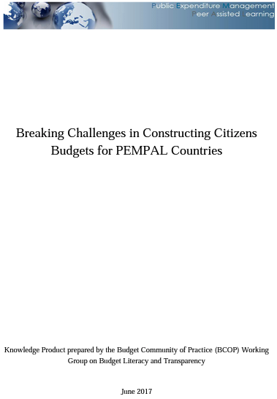
II. BLTWG’s Knowledge Products (KPs)
Breaking Challenges in Constructing Citizens' Budgets for PEMPAL Countries (2017)
At the start of the Group’s work, citizens’ budgets were not common in the PEMPAL region. Thus, the group decided to make this reform their focus and identify challenges they were currently facing, and share solutions on how to address them. KP identifies 10 challenges to developing Citizens’ Budgets in the region and lays out peer and international advice to address them.

Slide 5
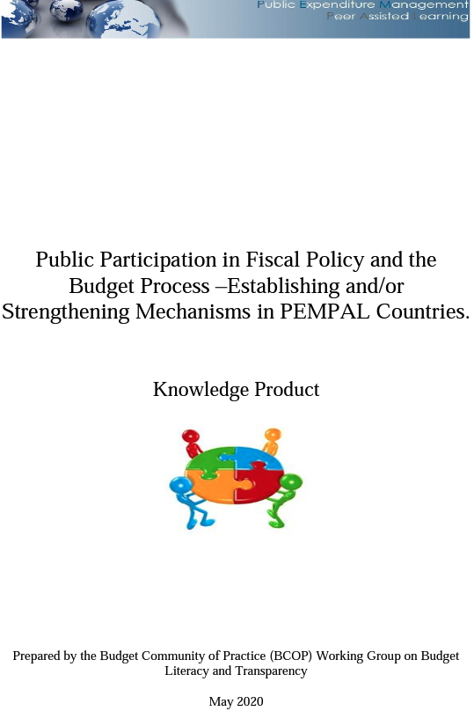
II. BLTWG’s Knowledge Products (KPs)
Public Participation in Fiscal Policy and the Budget Process – Establishing and/or Strengthening Mechanisms in PEMPAL Countries (2020)
This KP gives key concepts in public participation and a review of international frameworks and best practices. It discusses mechanisms of public participation on the demand and supply sides. A suggested road map for PEMPAL countries is included based on regional and international practices and advice.

Slide 6
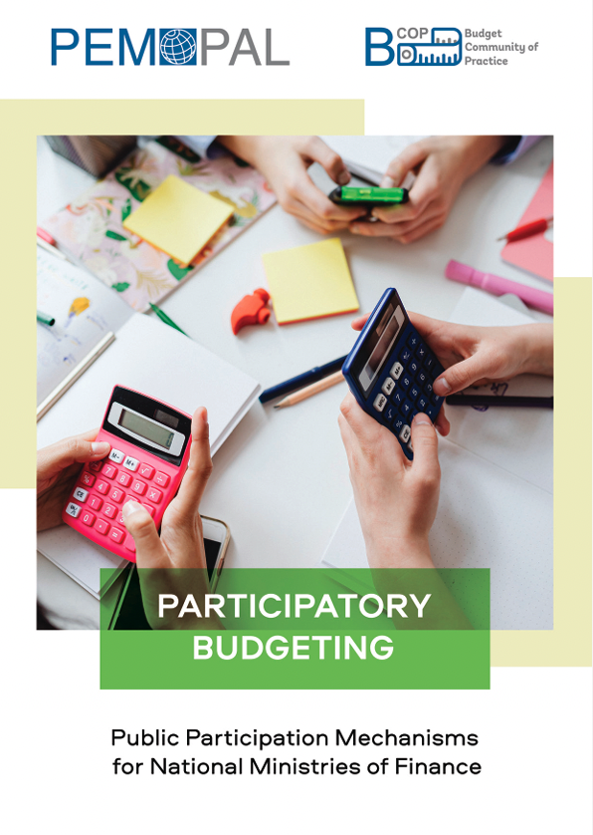
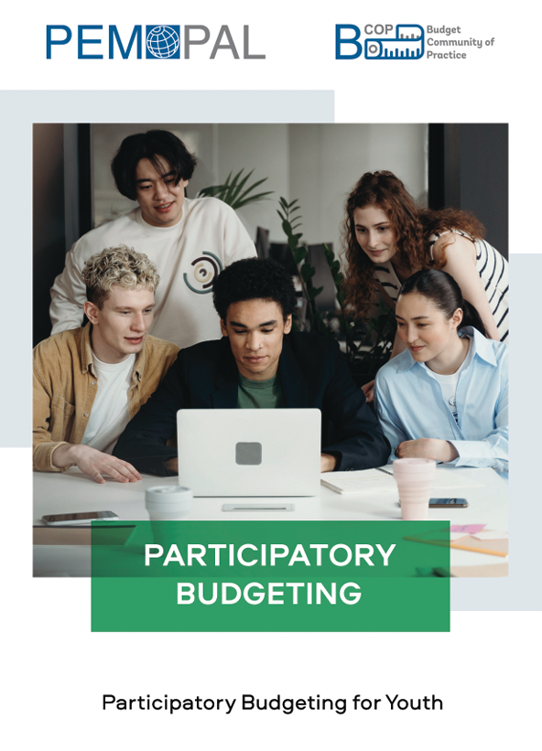
II. BLTWG’s Knowledge Products (KPs)
Participatory Budgeting: Public Participation Mechanisms for National Ministries of Finance (2021)
This KP presents recommendations on mechanisms for the national ministries of finance of PEMPAL member countries to design participatory budgeting initiatives at the national level and facilitate it at the subnational level. It also reviews participatory budgeting benefits, presents country cases and global best practices, and examines success criteria.
Participatory Budgeting for Youth (2021)
The KP describes main models, principles and impacts of youth participatory budgeting, discusses risks and their mitigations, and provides recommendations specific to initiatives aimed at this age group.

Slide 7
II. BLTWG’s Knowledge Products (KPs)
Improving Clarity and Accessibility of Budget Documentation (2022)
The KP provides good practices and recommendations for Ministries of Finances to improve budget clarity.
It draws a roadmap with 12 steps for achieving full and meaningful accessibility and understandability of budget documentation. Specific examples of good practices employed in different countries are presented throughout the knowledge product.

Slide 8
III. Key additional BLTWG Topics Examined in Meetings Since 2018
Results, findings, and recommendations based on the IBP’s Open Budget Survey (multiple iterations)
GIFT recommendations on public participation and good practice examples
Public engagement at the national level
Country cases for public participation mechanisms in Georgia, Croatia, Russia, Portugal etc.
Country cases for fiscal transparency reform and using IT in Uzbekistan and Ukraine
Trends in capturing citizens’ satisfaction, perceptions, and engagement in OECD countries, with country cases of France and Canada
Sector budget transparency in the COVID-19 response, and transparency of fiscal policy responses to the COVID-19 pandemic
Ways to increase budget understanding as seen by the journalistic community and experience of South Africa

Slide 9
IV. Gathering Feedback for Planning Next BLTWG Activities: Group Discussion
Taking into account the KPs developed so far by the BLTWG and the presentations available from the previous BCOP meetings as outlined earlier in this presentation, participants are asked to present their country’s priority reforms/topics in the broad area of budget openness in the group discussions, as inputs for the planning of the future BLTWG work
for the topic(s) you will propose in the group discussion, please provide details on what specific aspects/content/format you are interested, as well as note whether your country can contribute to BLWTG’s work and in what way
The most frequently proposed topics will be put forth to the membership to vote in an online post-plenary meeting survey and the topic(s) with the highest number of votes will be considered by the Executive Committee for examinations in events and potentially a knowledge product development

Slide 10
THANK YOU!

