Slide 1
BCOP’s PROGRAM AND PERFORMANCE BUDGET WORKING GROUP (PPBWG): Overview of PPBWG’s Recent Work
2023 PEMPAL BCOP Annual Plenary Meeting, Ljubljana, Slovenia, March 2023
Naida Carsimamovic Vukotic, BCOP Resource Team Member, World Bank

Slide 2
Presentation Overview
PPBWG’s Objectives, Membership, and Partnerships
PPBWG’s Knowledge Products
Key Additional PPBWG Topics Examined in Meetings Since 2018
Gathering Feedback for Planning Next PPBWG Activities: Group Discussion

Slide 3
I. Objectives, Membership, and Partnerships
PPBWG, established in 2016, examines trends and lessons learned and provides advice in the design and implementation of program and performance budgeting and spending reviews, with the aim to improve spending effectiveness
The broad topic of this WG, program and performance budgeting, has been one of the two priority budgeting topics (along with budget openness) of most of BCOP members countries (based on the annual surveys of members)
Almost all of the BCOP member countries (17 out of 21) are PPBWG members
The Group has partnered and works closely with the OECD and the World Bank

Slide 4
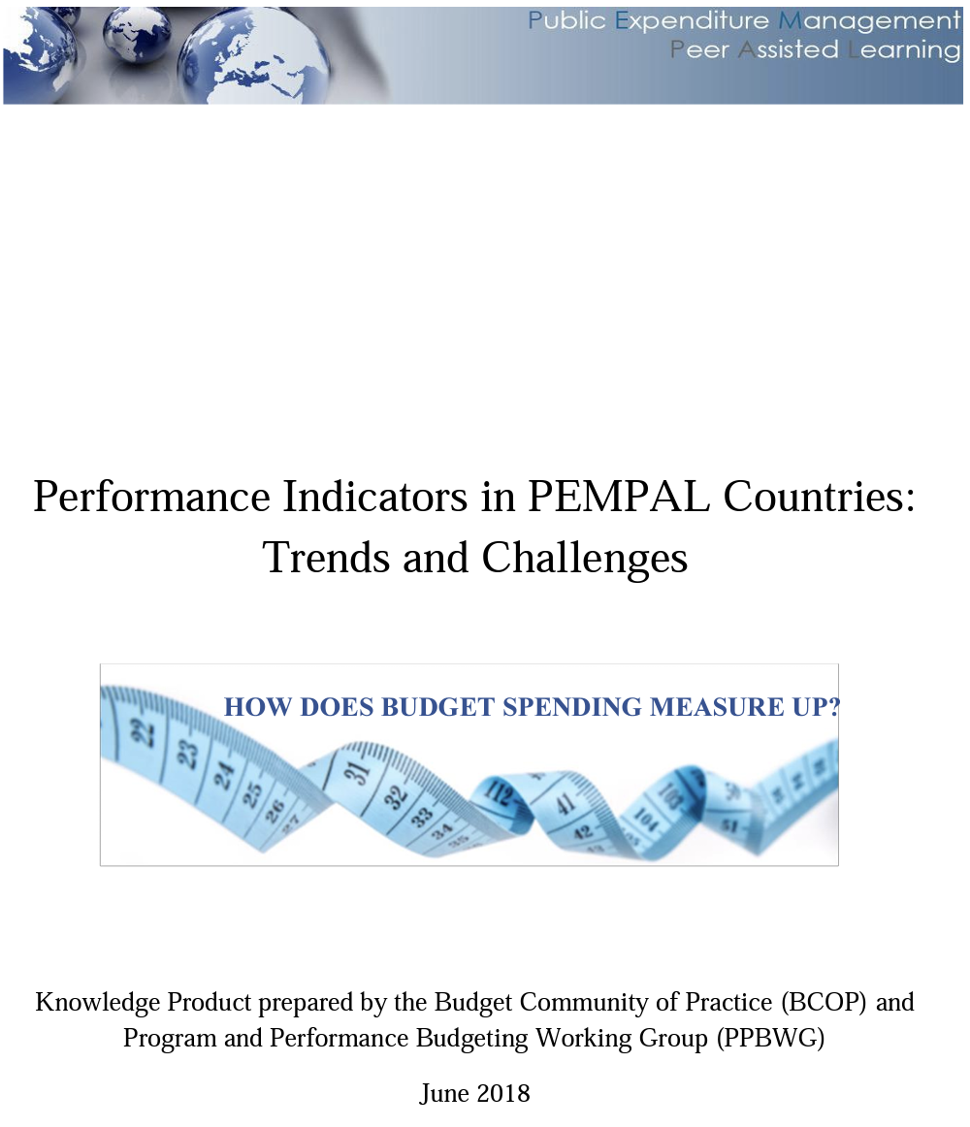
II. PPBWG’s Knowledge Products (KPs)
Performance Indicators in PEMPAL Countries: Trends and Challenges (2018)
This KP takes stock of the main characteristics of the indicators collected in budget planning processes in member countries and identifies main challenge/ weaknesses. It also gives a more detailed review of indicators in health and education.

Slide 5
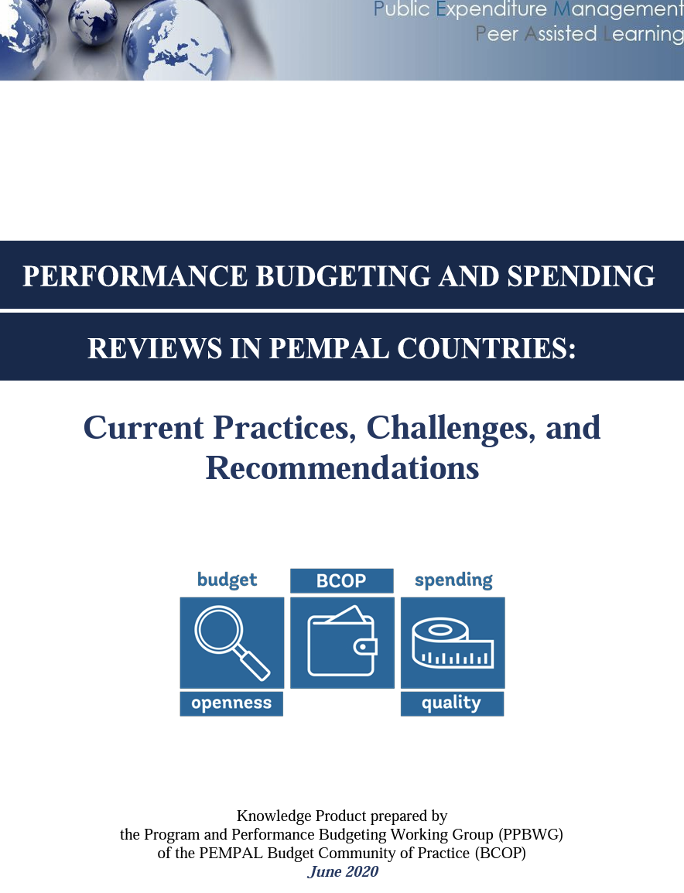
II. PPBWG’s Knowledge Products (KPs)
Performance Budgeting and Spending Reviews in PEMPAL Countries: Practices, Challenges, and Recommendations (2020)
This KP presents survey data on performance budgeting and spending reviews in PEMPAL countries, benchmarked to survey data for OECD countries. It also provides food for thought advice and options for PEMPAL countries for their performance budgeting and spending review systems.

Slide 6
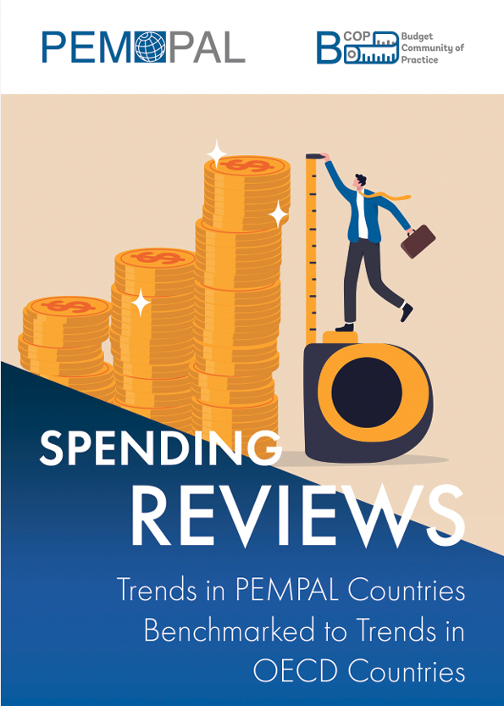
II. PPBWG’s Knowledge Products (KPs)
Conducting Rapid Spending Reviews to Identify Measures for Budget Balancing (2021)
This PPBWG publication aims to help PEMPAL countries develop concrete methodologies and tools for the implementation of rapid spending reviews as a rapid response to the Covid-19 and similar crises.
Spending Reviews: Trends in PEMPAL Countries Benchmarked to Trends in OECD Countries (2022)
This knowledge product represents a brief general stocktaking and benchmarking report. Its objective is to briefly review the current practices in spending reviews in PEMPAL countries as of 2021, benchmark to the current practices in OECD countries, and to gain a better understanding of the design, implementation, and challenges.

Slide 7
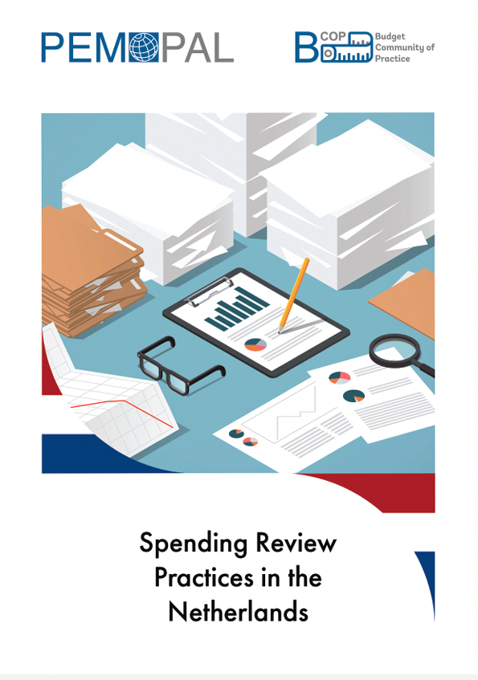
II. PPBWG’s Knowledge Products (KPs)
Spending Review Practices in the Netherlands (2022)
This knowledge product provides a step-by-step overview of the spending review process in the Netherlands. It also takes a deeper dive into one specific case – the spending review on child support schemes.

Slide 8
III. Key additional PPB Topics Examined in Meetings Since 2018
Examination of OECD advice, including Good Practices for Performance Budgeting and Draft Best Practices for Spending Review
Country cases on performance indicators in Russia and Serbia
Detailed examination of program and performance budgeting reforms in Austria
Country cases for spending reviews, including Croatia, Ireland, Italy, the Netherlands, and Poland
Reflections on how the Covid crisis impacts performance budgeting and spending review reforms

Slide 9
IV. Gathering Feedback for Planning Next PPBWG Activities: Group Discussion
Taking into account the KPs developed so far by the PPBWG and the presentations available from the previous BCOP meetings as outlined earlier in this presentation, participants are asked to present their country’s priority reforms/topics in the broad area of program and performance budgeting in the group discussions, as inputs for the planning of the future PPBWG work
for the topic(s) you will propose in the group discussion, please provide details on what specific aspects/content/format you are interested, as well as note whether your country can contribute to PPBWG’s work and in what way
The most frequently proposed topics will be put forth to the membership to vote in an online post-plenary meeting survey and the topic(s) with the highest number of votes will be considered by the Executive Committee for examinations in events and potentially a knowledge product development

Slide 10
THANK YOU!

