Slide 1
The Evolution of the Treasury Function
PEMPAL TCOP Working Group ”Evolution of Treasury Functions and Responsibilities”
Mark Silins, November 2015

Slide 2
Traditional Role of Treasury Paymaster
Payment processing - cash and cheques
Revenue collection and recording –
Maintaining public bank account(s) - the Treasury Single Account concept
Some treasuries performed a pre-audit function (and still do in some countries)
This may have been as simple as appropriation control or also involved review of whether payments represented the proper use of public money

Slide 3
Rationale for a Traditional Centralized Control Model
Budget execution is still focussed on line-item budgeting
Legislative framework prescriptive – focus on detail rather than principles, limited attention to the responsibility of managers to manage
The law may even make the Treasury accountable for payment decisions, or at least be unclear as to who is responsible
Internal controls in budget entities and the internal audit function are underdeveloped
Treasury checks that the correct codes are used and signatures are present on forms!
Who ensures that expenditure was a good use of public money?
Belief that central control is a deterrent
But without strong decentralized accountability, people find ways to get around controls
Information technology may not be integrated – no FMIS

Slide 4
Evolving Role of Treasuries
Automated accounting systems have made many of the traditional activities redundant
Electronic payments and receipts – often real time
Replacement of the pre-audit function with system-based controls in accounting systems
The traditional paymaster (processing) function largely no longer required
Provision of a modern IFMIS or central accounting system
This brings with it the need for an effective CoA supplemented with clear accounting policies
Shift from passive to active cash management
An enhanced reporting and accounting function
Greater emphasis on compliance with accounting standards and competent fiscal and statistical reporting
New understanding by government that not meeting standards impacts international competitiveness and, potentially, foreign investment

Slide 5
Devolution of Decision Making A major trend in many OECD countries in the 80’s and Beyond
Shift in decision making and accountability from the centre to budget entities – balance of authority and responsibility
Needs a strong principle-based legislative framework, which incorporates the concept of public internal financial control (PIFC)
Specific legislative requirements of the financial actors and their role in the budget execution process (PIFC-COSO¹)
Strong internal audit is important, as is a strong external review functional with parliamentary support and scrutiny
A focus on better decision making – hence the shift from just inputs to results
Ensure that the process is properly planned, that the approval is made up front, and controlled within the FMIS - each step is therefore reviewable
Thus in general, the trend has been that responsibility for controls is also devolved along with the authority, with ex-post review replacing the ex-ante checks!
¹ see www.COSO.org

Slide 6
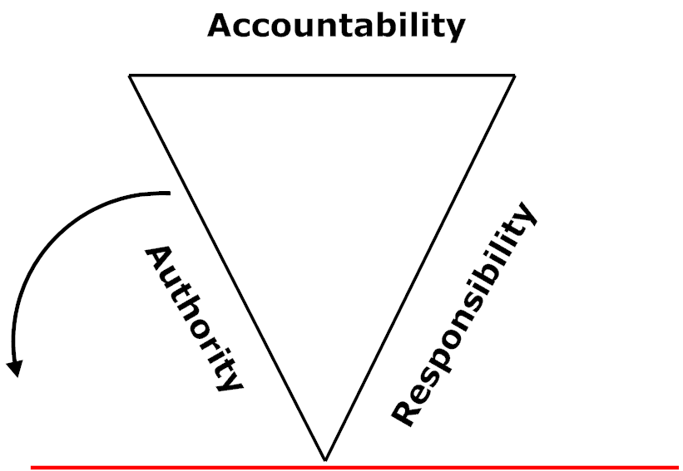
Enhancing accountability and the need to balance authority and responsibility for effective decentralisation
Diagram by Mark

Slide 7
The benefits of an FMIS for control
All steps in the process are recorded electronically
Controls in the system are more effective than manual controls:
requisition;
purchase order limited by funds control (Korean model);
goods and services receipt;
due date;
accounts payable;
payment – ideally electronic payment made through RTGS or similar payment system)
All of the above controlled through a GL and CoA and is easily auditable!
In Australia, ministry FMISs were certified as meeting certain standards which allowed the reduced checking of payments - 45(a)3(b) certificate
This is because there are now system-based controls to mitigate risks

Slide 8
Preconditions for Decentralized Controls
Increased accountability – legislative responsibility for internal control lies with the Ministry
Enforcement – accountability means carrots and sticks
Gradual shift from input control to results – ensuring managers manage and not just spend!
Strong information technology (IFMIS) predominantly shifts internal controls into the system and improves risk management capabilities

