Slide 1
BMF V/3-KH
Federal Investments
^{March 20th, 2017}

Slide 2
agenda
Federal Investments
Integration of the investments in SAP-Treasury
Bookings
Reporting

Slide 3
Integration into IT-system ‚Treasury‘
Treasury
Federal Liabilities
focus: federal financial statements
volume: ~ 100 billion EUR
responsibility: Federal Ministry of Finance
Federal Fundings
focus: payments, accounting, federal financial statements
volume: ~ 200 billion EUR
responsibility: Federal Ministry of Finance
Federal Investments
focus: accounting, federal financial statements
volume: ~ 25 billion EUR
responsibility: Federal Ministries
Debt- and Liquidity Management
focus: debt- and liquidity management
volume: ~ 650 billion EUR
responsibility: Austrian Treasury Agency

Slide 4
Federal Investments
The Republic of Austria is directly involved in around 200 shareholdings (i.e. companies, banks, universities, museums, funds)
Including indirect holdings, there are around 800 investments
Direct investments:
Joined investments (100% ownership): around 110
Associated investments (20% to 99% ownership): around 40
Other investments (up to 20% ownership): around 60
Direct investments are held by the ministries, that are functionally responsible for the shareholdings

Slide 5
investments in SAP-TR
Each investment is a business partner in SAP-TR
Several information could be integrated in the master record
Each business partner is attached to one or more company codes (rules out the authorisation for bookings and reporting)
Due to authorisation rules, the business partners are created centrally in the Ministry of Finance (on behalf of the ministries who hold the stakes)

Slide 6
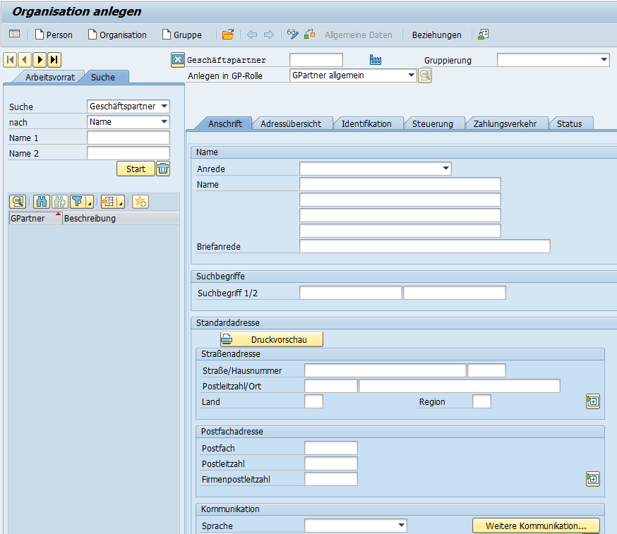
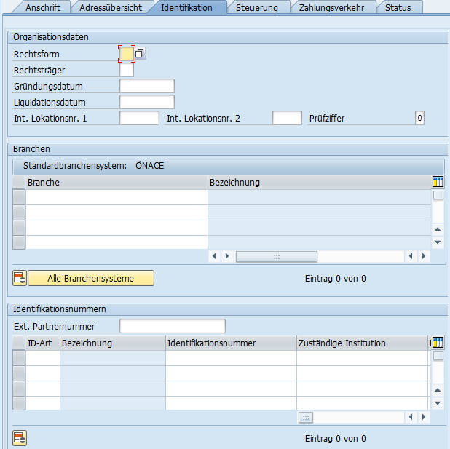
investments in SAP-TR
name of the company, address, language,…
legal form of the company, founding date, classification, company register number,…

Slide 7
bookings in SAP-TR
The following business cases are used in the Austrian asset management:
acquisition
additional purchases
capital increase
corporate actions
appreciation/depreciation in value
disposition (selling)
These business cases are booked in SAP-TR (charging of asset accounts and profit and loss accounts)
The bookings are lead over to SAP-FI via serial interface
The payment is booked directly in SAP-FI

Slide 8
bookings in SAP-TR
Moreover there are the following business cases for information and reporting (no leading over to SAP-FI):
dividends
subsidies

Slide 9
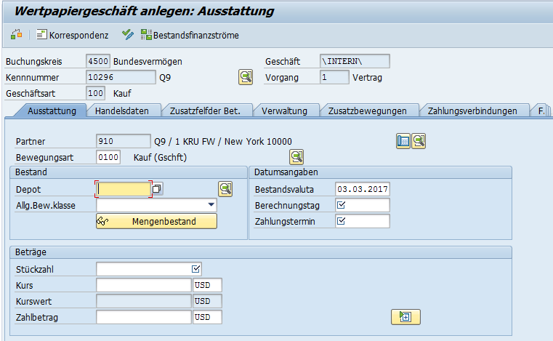
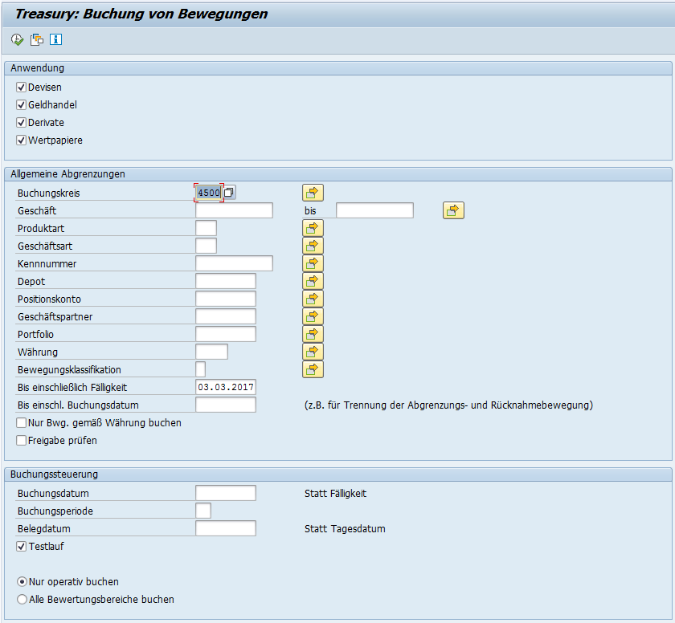
bookings in SAP-TR - acquisition
entry of the date, the number of pieces, payment amount (in euro and / or foreign currency)
execution of the booking

Slide 10
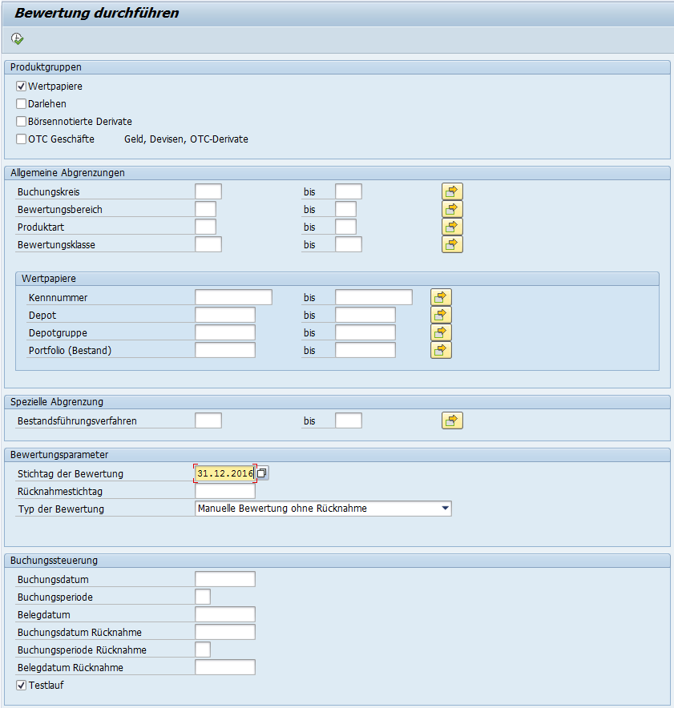
bookings in SAP-TR – appreciation/depreciation in value
date of the revaluation / company code / depot / new value in foreign currency resp. Euro
execution of the appreciation / depreciation in value

Slide 11
financial statement information
Additionally to the bookings, there is the obligation for the ministries to enter some financial statement data of the investments in SAP-TR, i.e.:
net assets
nominal capital
own capital
profit or loss on ordinary activities
number of employees (including government employees in the companies)
The information has to be entered in a z-transaction (not SAP-standard)
The information is published in the federal financial statements

Slide 12
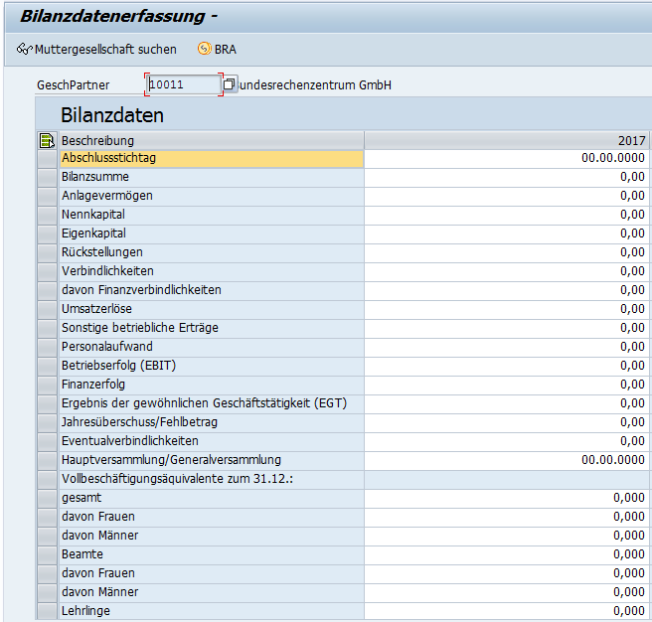
financial statements information
entry of various financial statement information and number of employees

Slide 13
reporting (SAP-TR)
For the investments the SAP-standard-reporting is used:
balances report (tpm12)
posting journal (tpm20)
cash flow (tpm13)

Slide 14
reporting (SAP-BW)
Additionally to the SAP-standard-reporting there are 2 reports in a Data Warehouse (SAP-BW)

Slide 15
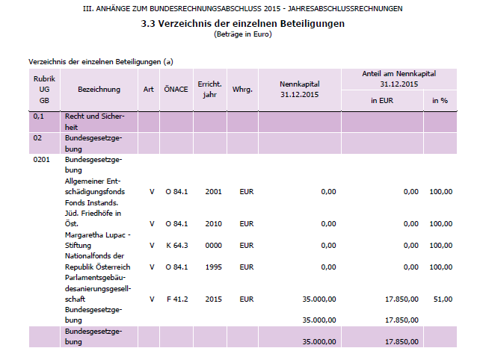
reporting – federal financial statements
For the federal financial statements, a lot of information is gathered of the data concerning investments.
In the balance sheet, there are 12 tables concerning investments
The data is edited in SAP-BW

Slide 16
Thank you very much for your attention!
Sebastian Heinrich
Ministry of Finance, Treasury System
E-Mail: sebastian.heinrich@bmf.gv.at

