Slide 1
THE FRENCH TREASURY
a francophone pattern
Benoit CHEVAUCHEZ
May 24, 2023
PEMPAL, Almaty

Slide 2
GENERAL INTRODUCTION
The “TREASURY”
FRANCOPHONE PFM FEATURES
RECENT ACHIEVEMENTS AND CHALLENGES
NEW ‘CONTROL’ APPROACHES AND METHODS
LESSONS AND CONCLUSIONS

Slide 3
FRANCE
68 million inhabitants, 550 000 km2
Centralised tradition, mitigated by “decentralisation” reforms since 1983
  13 regions
  104 departments
  35 000 communes
A heavily fiscalised country
  Tax/GDP 45%
  Spending/GDP 56%
  Debt/GDP 110%
General government= 1520 billion €
  Central government 39 %
  Local government 18 %
  Social Security 43 %

Slide 4
THE MERGER TAX COLLECTION /TREASURY IN 2008
Rational:
  Two historical vast networks of local offices :
    DGI in charge of assessing all taxes, direct and indirect; and collecting indirect taxes
    DGCP in charge of collecting direct taxes and paying all expenditures
  Hence duplications, complexities and costs
  Also, confusion for the tax payers
  Many reports, attempts and strikes, for years
Finally, a full merger decided and implemented in 2008
  The Direction Generale des Finances Publiques (DGFIP)
  A successful reform that paved the way of substantial ‘posts’ savings
A major event in the history of the French fiscal administration
  A social and cultural trauma for the ‘’Treasury” staff
  The “Treasury” has somehow lost its own identity: the word itself has disappeared

Slide 5
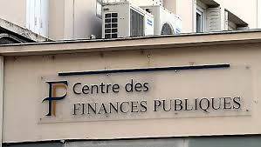


In thousands French cities and villages…”Public Finances Centers” replaced the “Public Treasury” offices

Slide 6
GENERAL INTRODUCTION
The “TREASURY”
    organization
    functions
    resources
FRANCOPHONE PFM FEATURES
RECENT ACHIEVEMENTS AND CHALLENGES
NEW ‘CONTROL’ APPROACHES AND METHODS
LESSONS AND CONCLUSIONS

Slide 7
DGFIP Organogram
DGFIP
General Directorate of Public Finances
TAX Administration
Ex DG Impots
DGI
TREASURY
ex DG public accounting
DGCP
SUPPORT services
HR, Budget, IT

Slide 8
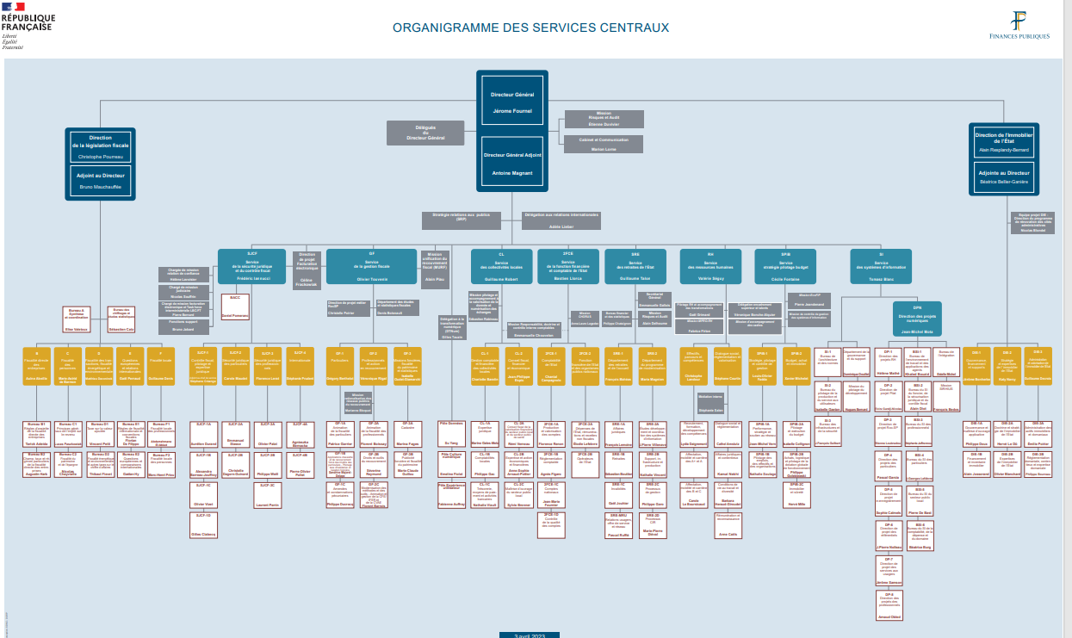


Slide 9
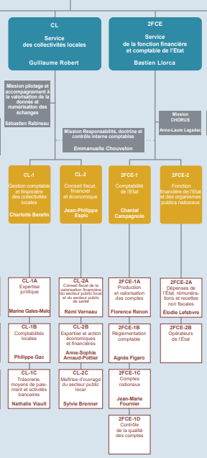
Former “Trésor Public”, now just 2 ‘Services’ of DGFIP

Slide 10
I ORGANIZATION
Within the DGFIP of the MoF
Central headquarter in Paris: two services
  Central Government Finances Service
  Local Governments Finances Service
  Both located in the “Bercy” building, hosting also the main DGFIP partners such as:
    Budget directorate
    Agence France Trésor
Local offices all over the country
  In charge of both central and local governments budget execution
  Mostly at the level of departments (104) and sub-departments levels
  but close to nothing at “Region” level, a specificity in France administration

Slide 11
II FUNCTIONS
  core historical functions
  Cash management Central and Local governments (CG and LG)
  Payment processing CG and LG
  Accounting and reporting CG and LG
  2. recently added functions
  Pension management (granting and paying) CG
  Properties’ management CG

Slide 12
II RESOURCES
Staff positions= 28000 ( + support)= 412 per million inhabitants
  Central Headquarter (Paris) 2%
  Local offices 82%, mostly at “departement” level
  Others 16%
Staff categories
  “A” university level 33%
  “B” secondary education level 41%
  “C” below 25%
Budget = 2000 Mio € (+ support)

Slide 13
IT SYSTEMS
Two main IFMIS, developed mostly internally
  Chorus (CG), developed and managed by the AIFE, a MoF internal IT agency (150 staff, 73 m€/y)
    Fully digitalized process, since 2020
  Helios (LG), developed and managed by the DGFIP IT support service (30 m€/y)
    Fully digitalized process, since 2019
Satisfying performance
  Availability rate
  No disruption
  User satisfaction
Current challenges
  Ageing systems
  Complex organization and governance
  Meagre budgets, after a period of massive IT investments… with mixed results

Slide 14
LEGAL FRAMEWORK
ORGANIC LAW 2001 (LOLF)
  A by-constitutional law defining the main fiscal and budget principles
  That introduced performance budgeting and accrual accounting, inter alia
DECREE ON “GESTION BUDGÉTAIRE ET COMPTABLE PUBLIQUE” 2012
  Dubbed the “GBCP” (Public Budget and Accounting Management) and applicable to both Central and Local governments
  Budget execution
  Spending and revenue collection process
  Accounting and reporting processes
  Cash management
Detailed “accounting rules”, both for accrual and budget accounting
“Financial Jurisdictions Code”, on accountability issues

Slide 15
GENERAL INTRODUCTION
The “TREASURY”
FRANCOPHONE PFM FEATURES for budget execution
    Role and status of the “comptable public”
    Commitment the key step of the spending process
    Separation Ordonnateur/comptable
    Centralised cash
RECENT ACHIEVEMENTS AND CHALLENGES
NEW ‘CONTROL’ APPROACHES AND METHODS
LESSONS AND CONCLUSIONS

Slide 16
I key role and specific status of the “COMPTABLE PUBLIC”
Comptable Public
  Exclusive right (monopoly) to manage public moneys
  primary role is to control and execute payments
  And to record revenue and expenditure transactions in the accounting books
  of both Central and Local budgets
  About 4000 “comptables publics”
Status
  Appointed by and reporting to MoF
  Trained in a specific PFM school, after recruitment at University level, via competitive exam
  Assigned to specified “ordonnateurs” (commitment officers)
  Pecuniary and personal responsibility (RPP)
  Submitted to the Court of Accounts, part of the judiciary
  Swearing in Court of Accounts

Slide 17
II COMMITMENT, the key step of the spending process
The commitment is the legal act – a purchase order, a contract, a decision – signed by the ordonnateur, initiating the spending process that will be terminated by a payment, provided the service or good is delivered
  In terms of sustainability, controlling the payment is too late: obligation to pay already exist
  Tracking and controlling commitment was imposed by the French Parliament at the beginning of the XXth century
  The idea was to prevent arrears and strengthen budget discipline
Operational implications
  For each budget line, there are two appropriations:
    one commitment appropriation CE, ie an authorization to commit
    one payment appropriation CP, ie an authorization to pay
    For most current expenditures CE=CP; but for most capital expenditures, CE is larger than CP
  Commitment is the responsibility of the ‘ordonnateur’ (Commitment officer) under the control of the Budget Controller
  Note the commitment is recognized in the budgetary accounting but not in the accrual accounting

Slide 18
III SEPARATION “Ordonnateur/Comptable”: a major historic principle
Applicable in Central and Local fiscal entities, for both spending and revenue
Ordonnateur (Commitment Officer)
  is appointed by and reports to the head of these entities
  he has no access to cash, with the limited exception of imprest accounts (“régies”)
Comptable Public (Public Accountant)
  is appointed by and reports to the MoF
  He has no right to interfere with the commitment
This separation is strictly defined and enforced
  e.g. the spouse of an ordonnateur cannot be comptable public (in the same entity)
Rational of this separation principle
  Ethics
  Tasks specialisation
Today challenged for several reasons
  Computerization
  Performance and productivity
  Client orientation
  Accrual accounting

Slide 19
IV CENTRALIZED CASH for central and local governments
  The CUT (Compte Unique du Trésor or TSA) is a quite old arrangement
    All public moneys, central and local, are deposited and managed in the CUT open in the Central Bank, with many subaccounts;
    Only the comptables publics are authorized to access the CUT for disbursement or collection;
    No other bank can be used, with very limited exceptions;
  Cash pooling is the general rule
    zeroing every day
  However, Social Security cash remains out of the CUT
    managed by a specific SS agency
    bank accounts at the Caisse des Depots (a Special Public Bank)
  Long disputed, the debate on the cash management of local governments seems now settled: it will remain within the CUT at the Central Bank

Slide 20
GENERAL INTRODUCTION
The “TREASURY”
FRANCOPHONE PFM FEATURES
RECENT ACHIEVEMENTS AND CHALLENGES
    Cash management
    Spending process
    Accounting
NEW ‘CONTROL’ APPROACHES AND METHODS
LESSONS AND CONCLUSIONS

Slide 21
Recent achievements and challenges
I CASH MANAGEMENT
Leading role to the debt management agency: Agence France Trésor (50 staff)
  AFT is attached to Direction General du Trésor of the Ministry of Economy
  In narrow consultation and daily cooperation with the DGFIP
  Borrowing for liquidity
  One of the largest issuer of Government bonds
Cash pooling
  in the CUT (TSA), for Central and Local cash; obligation recently extended
  Open in the Central Bank and managed by AFT
  3000 subaccounts; daily flow= 19 Billion €
  Daily sweeping; cash buffer
Cash forecasting
  Good command of seasonality; 12 months rolling cash plan
  Early warning for >1 million € transactions
Combined with strong commitment control, this is conducive to arrears full elimination
4. Issues
  Some Local governments, the largest ones, still whish to leave the CUT
  Social Security: cash is not pooled; but SS debt is managed by AFT

Slide 22
Recent achievements and challenges
II PAYEMENT PROCESS
IFMIS integration
  de facto erases the “separation ordonnateur/comptable”, that de jure still resists… so far…
  Streamlined process from commitment to payment, including control points
Better collaboration between Treasury and spending entities
  One comptable public per ministry, at central level,
    working in close collaboration with the Budget Controller
    Under the authority of a senior MoF executive
  Common invoice management centers
    Under comptable public responsibility
    With ordonnateur staff
Digitalization
  no more paper
  E-payments
  Debit cards

Slide 23
Recent achievements and challenges
III ACCOUNTING
Accrual accounting
  Introduced by the 2001 organic law (LOLF)
  Accounting standards IPSAS inspired; 19 French norms, upon advise of an independent committee
  Certification by the Cour des Comptes for the CG only, with diminishing “qualifications”
Coverage
  CG and LG, separately
  Consolidation for CG between central administration and its agencies
  Consolidation for each LG; no general LG consolidation
Delays and timeline
  Closing within 4 months
  Approval (including certification for CG) within 6 months
  Of both Financial Statements and Budget Execution reports
Reporting
  Annual fiscal statement
  Monthly and annual budget reports
  So far, limited readership and use, at both macro and micro levels

Slide 24
GENERAL PRESENTATION
The “TREASURY”
FRANCOPHONE PFM FEATURES FOR BUDGET EXECUTION
RECENT ACHIEVEMENTS AND CHALLENGES
NEW ‘CONTROL’ APPROACHES AND METHODS
    commitment control
    payment control
    accounting quality
LESSONS AND CONCLUSIONS

Slide 25
Evolution of control approaches and methods
Rational
  Multiple, cumbersome and overlapping controls on the spending process
  Computerization
  Better collaboration between different players involved in the spending process
  Development of performance budgeting and accrual accounting
New approaches
  Selectivity rather than exhaustiveness
  Ex-post rather than ex-ante
  On “system” rather than on “transactions”
  Pragmatism rather than formalism
  Confidence and collaboration rather than distrust and disputes
Evolution and changes on
  Control of commitment
  Control of payment
  Control of accounting

Slide 26
I COMMITMENT control
Initially, since the early XXth century: to prevent arrears and strengthen budget discipline
  ex-ante control of commitments by the “ordonnateur”, in Central Government entities
  by an agent of the MoF Budget directorate
  aimed at verifying i)sufficient appropriation, ii)on the right budget line
  limited coordination with payment controls (see below)
  Name : Financial Controller (FC)
Now, an evolution started in 2001 (LOLF): to promote new public management, especially performance budgeting
  more globalised control on “annual expenditure plan”
  The controller is becoming more an advisor to the ordonnateur
  Better coordination with payment controls: “BC” and “ comptable public” are under the same authority of a senior MoF representative in each line ministry
  New name: Budget Controller (BC)

Slide 27
II PAYMENT control
Historically, ex-ante, exhaustive and systematic control
On the payment stage
  On the “order to pay” issued by the “ordonnateur”
  7 control points
  On both Central and Local spending
  By the “ comptable public”, a Treasury agent
Recent development of two reforms
  “Selective” control based on risk assessment, combining transaction history and entity capacity
    Fully developed in 2012
    Large success
  “Contractual” control , following a system approach
    Later on, with a focus on the local government and with a partnership approach
    Mixed success: implies a full audit of the entity spending processes and systems

Slide 28
Impacts on accountability framework
Rational
  Relaxation of controls requires stronger accountability frameworks
  Especially, as it comes to ex-ante controls
    ex post controls implies sanctions
    monetary or not
    managerial, disciplinary or judicial
  In performance budgeting context, relaxation of controls on inputs requires controls on outputs, supported by a set of incentives
Recent developments
  for the comptable public, the antiquated RPP (Pecuniary Personal Responsibility) was suppressed in 2022
  Instead, but for both ordonnateur and comptable, a unified jurisdictional system of liability for public managers was put in place

Slide 29
III ACCOUNTING control
Context
  Accrual accounting: a specific challenge for francophone PFM system
    indeed it challenges the ordonateur/comptable separation
    In accrual environment, the key accounting event –delivery – is not directly under the control of the comptable
  Certification by the Court of Account
    From 13 “qualifications” in 2006 to 4 in 2021
A need to guarantee the accounting quality
  Accounting quality criteria defined in a specific framework (regularity, sincerity, fidelity etc…)
  Trackability and auditability, embedded in IFMIS Chorus and Helios
Modalities
  Defined in a specific 2013 regulation
  Internal accounting audit committee in each fiscal entity
  Mapping of accounting risks and related action plan
  In-year permanent auto-control and quarterly closing
  In collaboration with the Cour des Comptes

Slide 30
GENERAL INTRODUCTION
The “TREASURY”
FRANCOPHONE PFM FEATURES
RECENT ACHIEVEMENTS AND CHALLENGES
NEW ‘CONTROL’ APPROACHES AND METHODS
LESSONS AND CONCLUSIONS

Slide 31
DECENTRALIZATION/DEVOLUTION of the spending process in France during the two last decades
Decentralization/devolution
  to move spending tasks from MoF/Treasury to spending entities
  An anglophone PFM feature
Yesterday
  Everything was done by the MoF/Treasury:
    Budget execution, from commitment to payment, including cash management
    The whole accounting, from recording to reporting, for both budget reports and financial statements
  Spending entities had a limited role:
    discussing their budget
    requesting spending commitment to MoF
    recognizing the delivery
Today
  MoF
    gave up its role on commitment, keeping just a loose global control on it
    Share payment and accounting (recording) with LM
    Keep entire control of cash
  Line ministries more and more involved in spending execution, including recording

Slide 32
DECENTRALIZATION/DEVOLUTION
OF THE SPENDING PROCESS
An undisputable strategic orientation
  “Client” orientation
  Operational units are better placed to address operational issues
  Management and staff ownership and motivation
…but at certain conditions, and …
  Accountability framework:
    clear and consensual rules; mutual trust; transparency;
    incentives and sanctions
  Capacity: professional skills; training;
…with some limits and risks
  Mismanagement, including possible ethics issues
  Economies of scale; costs

Slide 33
Suggested strategic “to-do-list” for French Treasury
While solid and effective, the Treasury should address its current weaknesses
  Still rather costly despite large ‘posts’ savings
  A deep IT renovation is needed
  Culturally, still too attached to his historic legacy and identity
To continue transferring its payment tasks and experience to spending units
  Advisor rather than controller; trainer and tutor of spending units staff
  but in taking into account conditions and risks
  and in preserving central cash management and pooling
To expand its key role in terms of fiscal transparency
  To develop reporting beyond formal demands
  To improve the narrative/analytical dimensions of budget and financial reports
  To market its accounting outputs to different categories of users, micro as well as macro
To contribute to the macro fiscal policy formulation
  To put at policy makers’ disposal their deep knowledge of public spendings
  To develop spending analysis to sort out bad from good spending
  To advise Budget Directorate on allocation issues
  To invest in output measurement (indicators), beyond mere input accounting

Slide 34
CONCLUSIONS
Some tenets of the so called French ‘model’ are challenged
  the “Separation ordonnateur/comptable” is disappearing
  The central role and specific status of the “comptable public” is fading
While some others are adopted by many non Francophone countries
  Commitment is now widely recognized as the key step of the spending process
  Centralized cash pooling is a strategic objectives in most countries
Look at the others and learn from their successes as well as their failures
  Take into account your own needs and constraints
  Beware of fashion and ephemeral novelties
  Be pragmatic: aim at desirability but also at feasibility of planned changes
  Think big, advance by small steps

Slide 35
Many thanks for your attention
QUESTIONS ARE WELCOMED
benoitchevauchez@gmail.com
+33 6 6711 4442

