Slide 1
The GIFT Action Network: How we Work, How we Learn, How we Move Forward
GIFT General Stewards’ Meeting
Cascais, Portugal - October 15-17, 2018
Juan Pablo Guerrero
@jpga63
@fiscaltrans

Slide 2
Overview
The GIFT: 🎁 Goals and History
Stakeholders and the GIFT deal
Communication with stakeholders
Deliverables for stakeholders
Critical factors for a successful network
Lessons learned
2

Slide 3
The Global Initiative for Fiscal Transparency
A global action network formed in 2011 that facilitates dialogue between governments, civil society organizations, international financial and specialized institutions, private sector and other stakeholders to find and share solutions to challenges in fiscal transparency, participation and accountability:
  Global norms harmonization: High-Level Principles; Principles of Public Participation
  Peer-learning on fiscal openness (Open Government Partnership community)
  Tools & technical collaboration: open fiscal data, fiscal portals, public participation guide
  Research: case studies; impact; incentives; innovation
3

Slide 4
Fiscal Transparency (FT) + Public Participation (PP) lead to better fiscal and development outcomes
Fiscal transparency
Public disclosure of high quality fiscal data & information in budgets, forecasts, outturns etc
Public participation
Direct engagement by the public in fiscal policy design & implementation
Accountability
Public officials held effectively to account for stewardship of public resources
Improved social, economic and environmental outcomes
e.g. Improvement in SDG indicators
Improved fiscal outcomes
fairer, more efficient & effective taxation & public services, more legitimate & sustainable fiscal performance
4

Slide 5
GIFT history by looking at PP in FT International Standards
2012: GIFT High-Level Principles on FTAP & UN General Assembly
acknowledgement
12: IBP-OBS leads the way, with section on PP
2014: IMF revision of Fiscal Transparency Code
2015: OECD Principles on Budgetary Governance
15: Tax Adm Diagnostic Assessment Tool-TADAT
15: Open Contracting Partnership- OCP
15: GIFT Principles on PP and Guide on practices
2016: Revised PEFA Indicator Program
16: Extractive Industries Transparency Initiative- EITI
2017: New PP section in OBS-IBP
17: OECD Budget Transparency Toolkit
17: PEMPAL network engages systematically on topic
2018: IMF Fiscal Transparency Handbook
18: IBP/GIFT PP pilots
5

Slide 6
GIFT Stewards - The 46 Champions
Government (19)
Brazil (Budget Sec)
Intl Orgs/ Networks (9)
WBG, IMF, OECD
Funders/
Foundations (4)
Civil Society Organization (14)
IFAC, MITRE, OCP
Philippines (DBM)
16 other budget Government agencies
Mexico (SHCP)
CABRI, IPF, Global Integrity
IBP, Fundar, ILDA,
CBPP, INESC, Icefi,
ACIJ, Obs-Fiscal, Seknas
Funde, PSAM, Emerging M., NCDHR, Social Watch
Hewlett F.
Omidyar
Ford F.
DfID
6

Slide 7
Network Stakeholders
Community of Practice
Partners
Stewards
Lead Stewards
GIFT Coordination Team
7

Slide 8
The GIFT deal
What´s in it for the Lead Stewards
Coordination mechanisms for shared goals, outreach to new actors & concret outcomes (IFIs)
Work together on initiatives and projects of joint interest that they could not do separately
International Forum to lead FT and PP agendas and to share, promote and disseminte innovations (leadership, reputation)
Relationship with governments on a flexible non contractual / collaborative basis (IFIs)
8

Slide 9
GIFT
What´s in it for Stewards and Partners?
Access to experience, practice & mechanisms
Access to peer learning (challenge and encourage each other to work in a coordinated way)
Access to technical collaboration for specific tools and innovative initiatives
Support & follow up for action implementation
Practitioners dialogue: officials – civil society (suppliers of fiscal information talk to the users)
A say on FT & PP Global Standards & Norms
9

Slide 10
The 🎁 to stakeholders
Community of Practice
(CSO, networks, academia, think tanks, donors, legislators, SAI)
References to global norms and on FT & PP
Research: evidence on impact of FT & PP
Dissemination/Materials in friendly & executive formats for replication & implementation (data & FT portals, open fiscal data, budget information for citizens)
10

Slide 11
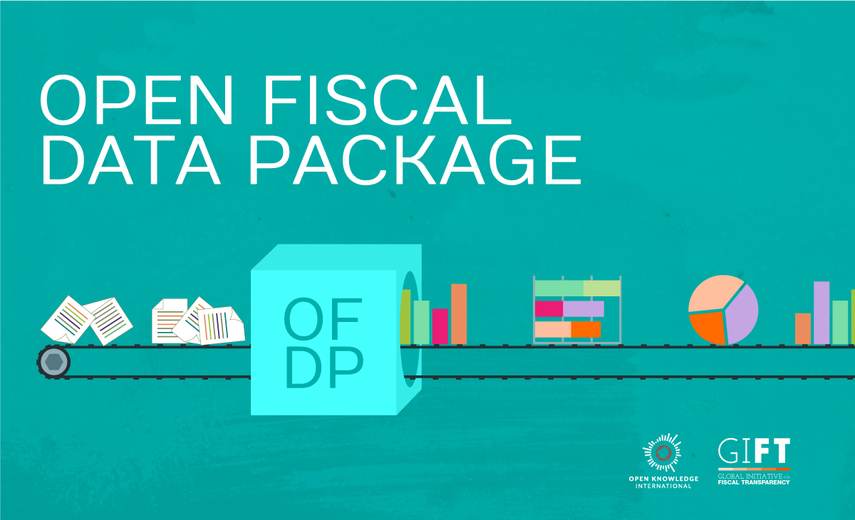
OFDP is a specification free, simple and available tool to publish
budget data in open formats with visualization
www.fiscaltransparency.net/ofdp
Notes:
OFDP is a free data specification, simple, accesible and open, for publishing budget and spending data

Slide 12
Fiscal Transparency Portals
A single entry point to make fiscal data more accessible to external parties – experts, CSOs, academics, journalists, the public
Use of technologies for information disclosure & proactive dissemination
Includes use of simple graphics, visualizations
GIFT fostered peer learning through study tours and direct collaboration between technical experts in finance ministries
Portals now in place in Brazil, Mexico, Indonesia, South Africa, Uruguay, Dominican Republic, El Salvador… and Nigeria
12

Slide 13
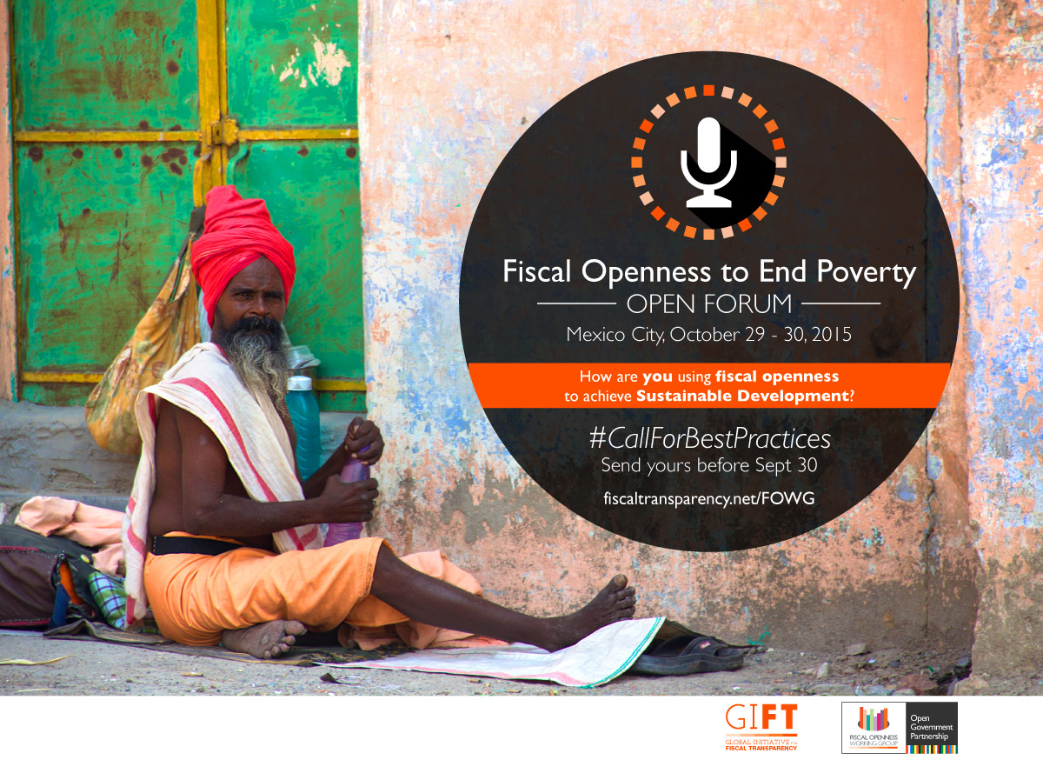

Developing a portal: GIFT emphasizes the importance of dialogue between supply/demand and consultation on content of information
13

Slide 14
2. Tipos de stakeholders
Engagement with other Network, Initiatives & Stakeholders
OGP - Open Government Partnership
PEMPAL- Public Expenditure Management Peer Assisted Learning
OECD - Senior Budget Officials
CABRI - Collaborative African Budget Reform Initiative
OLACEF – Latam SAI
Intosai - Advisory Board of the INTOSAI’s Professional Standards Committee
14

Slide 15
How we speak to each other: Stakeholders communication
Monthly Newsletter (www.fiscaltransparency.net/news/)
GIFT website (www.fiscaltransparency.net)
Social Network: Twitter, Facebook & Instagram
WhatsApp groups
Webinars
General Stewards Meeting
Specialized peer learning workshops
Technical Collaboration in field visits
15

Slide 16
Products for stakeholders
High-Level Principles on FT, Participation & Accountability
Principles on PP in Fiscal Policies
Open Fiscal Data Package
Methodology on building/redesigning FT Portals
Research on evidence of impact of FT and incentives
Case Studies on Public Participation and IT
Guide on principles and mechanisms of PP in fiscal policies
Infographics
Videos
Tutorials
16

Slide 17
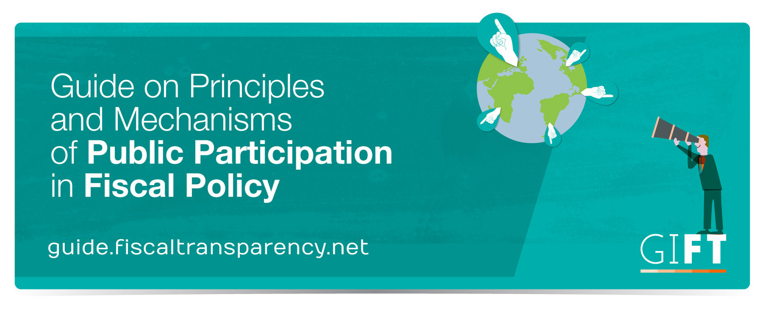
17

Slide 18
1. Critical Factors for Success
Trust, based on open dialogue among stewards and coordination team
Clarity on basic message, foundation of the way we work: sustainable improvements on FT & PP are based on dialogue between governments & CSO + stakeholder engagement
Flexibilty & adaptability: level of engagement of each member will depend on domestic context, political support, CSO engagement and political opportunities
18

Slide 19
2. Critical Factor for Success
Concrete achievements: FT portals in Uruguay, South Africa, Dominican Republic, El Salvador, Brazil, Mexico
Improvements in OBP scores + Open Data Barometer
Federal budget disclosed in open data in Mexico, linked to open contracts and extratives information
PP mechanisms in the Philippines, Mexico, Slovenia & Guatemala
Inputs adaptable to stewards needs
GIFT as broker for productive dialogues between learners and experienced
19

Slide 20
Lessons learned
Crucial to understand timing, agendas and priorities of stakeholders
Context determines products, frames, formats & means
Maintain the space as a unique forum to discuss openly and in small groups common problems, strategic issues, organizational challenges, capacity weaknesses, dialogue failures
Important value of personal relations
20

Slide 21



Stay tuned!
@fiscaltrans
@fiscaltransparency
@fiscaltransparency
www.fiscaltransparency.net

