Slide 1




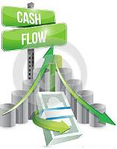


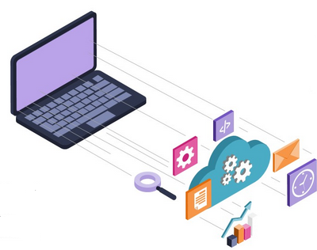

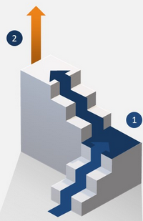
“Albanian experience of dealing with expenditures arrears” How to avoid the new arrears arising?
Treasury System
Albanian Treasury
PEMPAL TCOP
VIDEOCONFERENCE
Prepared:
Mimoza Pilkati
Director
Treasury Operations’ Department
February 27, 2020
Notes:
The accumulation of government expenditure arrears is one of the most common problems in public financial management and an important issue for Albanian Treasury System, specially to move to active cash management.
Pozita fiskale e Shqipërisë u përkeqësua pas krizës financiare botërore dhe qeveria akumuloi një shumë të konsiderueshme detyrimesh të prapambetura kundrejt sektorit privat. Deficiti i përgjithshëm fiskal shtetëror, i cili pat qenë mesatarisht 3,4 për qind në periudhën 2005-2012, u rrit ndjeshëm në 5,2 për qind të PBB-së në vitin 2013. Të ardhurat buxhetore, si përqindje e PBB-së, të cilat qenë rritur në 26,7 për qind në 2008, ranë përsëri në nivelin 23,7 për qind në 2013 për shkak të zvogëlimit të shkallës së tatimit mbi fitimin, rritjes së përjashtimeve nga TVSH-ja dhe rënies së mbledhjes së ardhurave. Borxhi publik u rrit ndjeshëm nga 55 për qind e PBB-së në 2008 në rreth 71 për qind deri në vitin 2013. Kjo qe pasojë e politikës fiskale ekspansioniste që u ndoq menjëherë përpara zgjedhjeve të vitit 2013, si edhe e shkallëve më të ulëta të rritjes ekonomike, rënies së mbledhjes së të ardhurave fiskale, rritjes së trysnive fiskale në lidhje me mungesat energjetike, si edhe stokun e akumuluar të detyrimeve të prapambetura që kishte qeveria kundrejt sektorit privat, në rreth 70,7 miliard (rreth 5,2 për qind e PBB-së në 2013).
Në vitet e fundit stabilizimi fiskal është mbështetur me politika të kujdesshme fiskale. Në vitin 2014, Shqipëria filloi një program të konsolidimit fiskal me mbështetjen e partnerëve të jashtëm, në të cilin përfshiheshin masa në të dyja anët e buxhetit—të ardhura dhe shpenzime—dhe reforma për t’u dhënë zgjidhje dobësive strukturore siç janë ato në sektorin energjetik dhe në pensione, krahas shlyerjes së detyrimeve të prapambetura kundrejt sektorit privat. Në masat për të ardhurat buxhetore përfshihej rritja e shkallës së tatimit mbi fitimin (TF), shkallëve të akcizës mbi produktet e duhanit, pijet alkoolike dhe kafenë dhe taksës së qarkullimit, si edhe puna kundër evazionit. Masat nga ana e shpenzimeve përfshijnë vendosjen e një limiti maksimal mbi fondin e pagave, disa kursime të krijuara nga ana e shpenzimeve mbi interesat dhe një ulje graduale të mbështetjes buxhetore për sektorin energjetik. Deficiti i përgjithshëm fiskal shtetëror ra në 1,8 për qind të PBB-së në 2016 (në krahasim me 4,9 për qind në 2015) në përputhje me përpjekjet për konsolidim fiskal në vend. Janë vënë re trendë të ngjashëm për qeverisjen qendrore,

Slide 2

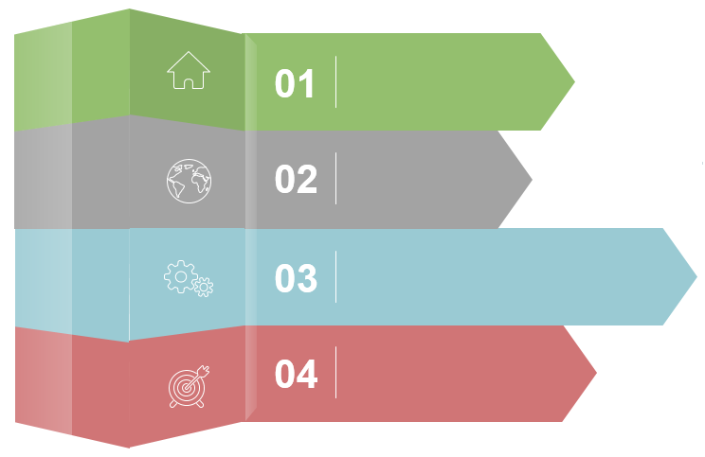
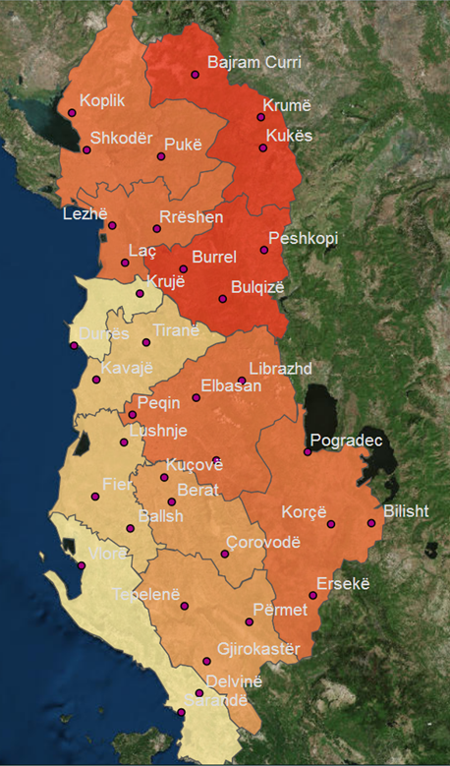

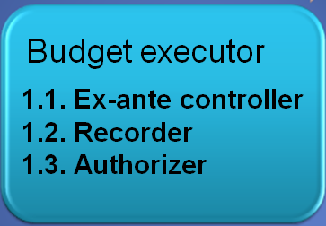
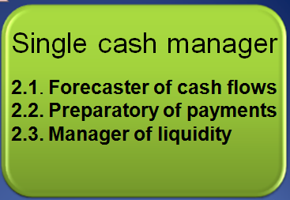


Content
Nature-Reasons
01
TREASURY
Data on expenditures arrears
02
03
Impact-Solutions
04
Initiatives to revise the approach
Notes:
This presentation defines expenditure arrears and the different types of arrears that arise. The economic impact of chronic expenditure arrears accumulation is treated. The presentation discusses the underlying causes and mechanisms for preventing and controlling the further accumulation of arrears. It concludes with some strategies for managing and clearing arrears.
Treasury was necessary because of:
market economy model,
expenditures control ,
the use of standard documents ,
information,
issuing securities and other debt instruments,
there were no system of cash management,
there were no government accounting system.
We have started with the function of budget execution:…
Then single cash manager…….
Govt’s Accountant
3.1. Data eliminator
3.2. Data consolidator
3.3. Data reconciliator

Slide 3




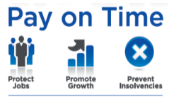
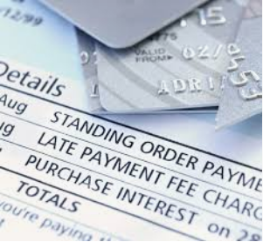
Background
Albania has clearly stated a deadline for payment in law no. 48/2014 “On late payments of trade and contractual obligations” by 60 days from the date of the invoice of economic operator, which is composed of 30 days for submission of invoice to Treasury and 30 days for processing the payment by the Treasury (the period defined may depend on the efficiency/ maturity of the payment system).
This law is based on the European Union’s (EU) Late Payments Directive (EU, 2011) which requires all public entities in EU member countries to pay their suppliers a flat-rate compensation plus interest on a daily basis at 8 points above the central bank’s rate on the amount overdue, if the payment is not done by its due date.
Money that is owed and
should have been paid earlier
-Late payment hinders growth
-See late payment as a threat to survival
-Consider dismissing staff, cannot recruit
An obligation or liability that has not received payment by its due date
Notes:
Arrearage is a legal term for the part of a debt that is overdue after missing one or more required payments.
Arrears is a financial term that refers to the status of payments in relation to their due dates. The amount of the arrears is the amount accrued from the date on which the first missed payment was due (an overdue payment).
Arrears is an accounting term for the amount of the account payable that should have been paid as of the earlier due date, an outstanding balance which can be materialized due to multiple reasons.
The value of expenditure arrears constitutes the amount of the original overdue payment, as well as any interest or financial penalties that the government might accrue (and not pay) as a result.
Commitments may arise when a formal action is taken by a government entity, for example, issuing a purchase order or signing a contract; can also be of a continuing nature that requires a series of payments often based on a legal obligation.
Në zbatim të VKM-së nr.50 datë 05.02.2014 “Për miratimin e Strategjisë për parandalimin dhe shlyerjen e detyrimeve të prapambetura e të planit të veprimit”
Ligji I kontabiliteti 03-2018 I rishikuar per detajimin e kontabilizimit te detyrimeve te prpambetura.
Liabilities are a subset of commitments and are established when one entity is obliged under specific circumstances to provide funds or resources to another party. Liabilities include outstanding debt, leases, and provisions, as well as payables for provision of goods delivered or services rendered. The liability arises when a third party satisfies the terms of the contract or similar arrangement.
Not all commitments become liabilities, for example, when the obligation to deliver goods or services is not satisfied by the supplier as specified in the agreement.
Payables (or creditors) are a subset of liabilities for which the related goods or services have been provided by a third party but not yet paid for by the recipient. A payable is created when an invoice is approved for payment and has been recorded in the general ledger or accounts payable sub-ledger as an outstanding liability awaiting payment.
Commitment is replaced by an actual expense.
Expenditure arrears are a subset of payables that have remained unpaid beyond a specified due date for payment. In cases where no due date is specified, arrears are defined as payables that have remained unpaid after a specified number of days after the date on the invoice or contract, in accordance with a law, regulation, government payment policy, or local practice.
Some countries, such as Australia, Brazil, the United Kingdom, and the United States, make it a policy to pay small and medium enterprise suppliers within fewer days than the 30 days from receipt of invoice to enable
firms, often financially constrained, to build up working capital. Some countries provide for a longer period for capital contracts to allow for an evaluation of the services provided.
Government expenditures payments’ process:
Order for goods/services placed. Commitment created, amount reserved against budget.
Goods/services delivered, invoice received.
Invoice approved for payment. Expense and payables created. Commitment is replaced by an actual expense.
Payment made by due date. Payable is reversed, and cash is reduced by the corresponding amount.
Payment not made by due date. Payable remains as a Liability in the books. Payment is in Arrears.
____________________________________
Accrual concept
Income is recognized when it is earned, not when cash is received later.
Expense is recognized when it is incurred, not when cash is paid later
Income and expenses are recorded in mercantile basis.
1.Income 2. Expense
1.1. Prepaid 2.1.Prepaid
1.1.1. Liability 2.1.1.Asset
1.1.2. Advance receipt 2.1.2.Trade advance
1.2. Accrued 2.2.Accrued
1.2.1.Asset 2.2.1.Liability
1.2.2.Trade receivable 2.2.2.Trade payable
2.2.3.Expanse payable
Debit (ADE) Credit (LER)
Assets Liability
Drawings Equity
Expenses Revenues
1.Asset 2.Liabilities
1.1.Prepaid expense 2.1.o/s expense
1.2.Accrued income 2.2.Income received in advance
Debtor (Sale) and Creditor (Purchase)
Prepaid and outstanding expense
Accrued income and Income received in advance

Slide 4







Nature – Reasons (1)
Arrears are mainly composed of:
Capital expenditures (investment) account for 45% of the total are related mainly to road constructions, water infrastructure projects and other investments;
Court decisions account for 19% of the total and are deriving mostly from former employees court decisions which are not paid due to lack of budget;
Maintenance costs that account for 4% of the total relates mainly to road maintenance;
Services expenditures account for 8% of the total and relates to various payment due from newly created and old obligations (utilities arrears such as the electricity supply account, etc.).
Other arrears account for 23% of the total (such as purchasing, social contributions, income tax, reimbursement of VAT, etc.)
In general, payments may be overdue based on:
a particular legal obligation (such as payment of social security benefits, or salaries),
a specific contractual commitment (such as payment for construction of a road),
a continuing service arrangement (such as payment for electricity supply).
Notes:
The precise point at which a government liability falls into arrears typically varies according to the type of expenditure. In particular:
• For compensation paid to individuals or transfers to households in the form of wages, salaries, social benefits, and pensions, an arrear is created as soon as the legally or contractually defined date for payment of the obligation has passed.
• For payment to commercial contractors for provision of goods, services, or fixed assets, expenditure is considered to be in arrears when: (1) the goods have been delivered, service rendered, or asset created; (2) an invoice has been received; (3) the good, service, or asset has been verified as successfully delivered; and (4) the payment due date on the invoice or the number of days after which an invoice is to be paid in accordance with a law, regulation, payment policy, or local practice has passed.
• For consumption of public utilities, such as electricity, water, and telephone, for which there are general payment procedures applicable to all consumers, an expenditure is considered in arrears once the due date for regular payment has passed.
• For mandatory transfers to statutory funds (such as social security funds) or subnational governments, an expenditure falls into arrears once the due date for payment specified in the law, regulation, or calendar of transfers has passed.
• For tax refunds owed to taxpayers, such as value added tax (VAT) rebates or income tax refunds, the obligation becomes an arrear once the refund is due and the deadline for
payment has passed.
• For payment of interest or principal on government debt or other liabilities, an expenditure falls into arrears as soon as the scheduled date for payment has passed. Arrears on amortization
of debt are not defined as expenditure arrears for financial reporting purposes, as they constitute financing transactions under international accounting and statistical standards. However, they do represent an obligation to pay and should be disclosed and included in any arrears clearance strategy.
When it comes to payroll, paid in arrears typically refers to when an employer pays an employee for work completed from a previous pay period instead of the current pay period.
when an employee receives their paycheck on payday there is some time that they have worked for the company that they ..
In a payroll sense, if several days lapse between the end of the pay period and payday then you are paying your employees "in arrears."
What is the meaning of arrears in payroll? Arrears payroll is the cadence of running the past week's payroll instead of the current week, or any kind of delayed payroll schedule.
Over ALL in arrears to electricity supply trust account
Arrears purchasing (goods, services)
Arrears works (roads)

Slide 5


Albania - Stock of Government arrears
In million LEK
Period: | Baseline 2013 | % | 2018 Year | % | 2019 Year | %
1. Arrears originated by Central Government | 7,795.5 | 100% | 6,799.0 | 100% | 6,869.8 | 100%
1.a. Court decision |  |  | 2,049.4 | 30% | 2,084.7 | 30%
1.b. Service | 995.8 | 13% | 63.3 | 1% | 66.0 | 1%
1.c. Maintenance |  |  | 710.3 | 10% | 537.8 | 8%
1.d. Investment | 5,326.8 | 68% | 2,572.2 | 38% | 2,530.4 | 37%
1.f. Other | 1,473.0 | 19% | 1,403.7 | 21% | 1,126.6 | 16%
1.g. Social insurance contribution |  |  |  |  | 390.0 | 6%
1.h. Health care insurance contribution |  |  |  |  | 43.6 | 1%
1.i. Income tax |  |  |  |  | 87.9 | 1%
1.j. Other taxes (Reimbursement of VAT is not available in AGFIS for central government) |  |  |  |  | 2.7 | 0%
2. Arrears originated by Local Government | 5,120.3 | 100% | 8,701.0 | 100% | 8,445.3 | 100%
2.a. Court decision |  |  | 983.0 | 11% | 898.7 | 11%
2.b. Service | 3.7 | 7% | 1,310.3 | 15% | 1,142.5 | 14%
2.c. Maintenance |  |  | 110.4 | 1% | 47.5 | 1%
2.d. Investment | 980.6 | 19% | 4,933.4 | 57% | 4,431.4 | 52%
2.e. VAT Reimbursement |  |  | 0.9 | 0% | - | -
2.f. Other | 4,136.1 | 81% | 1,363.1 | 16% | 1,757.2 | 21%
2.g. Social insurance contribution |  |  |  |  | 116.1 | 1%
2.h. Health care insurance contribution |  |  |  |  | 17.9 | 0%
2.i. Income tax |  |  |  |  | 32.3 | 0%
2.j. Other taxes |  |  |  |  | 1.7 | 0%
Total arrears: | 12,915.9 |  | 15,500.0 |  | 15,315.1
Total GDP | 1,350,052.5 |  | 1,647,600.0 |  | 1,752,700.0
Arrears as % of GDP | 1.0 |  | 0.9 |  | 0.9
Note: The data of Treasury for 2019 year are preliminary, the financial statements of central/local government are submitted to Treasury until in the end of March,2020
Notes:
Note: The data of Treasury for 2019 year are preliminary, the financial statements of central/local government are submitted to Treasury until in the end of March,2020

Slide 6
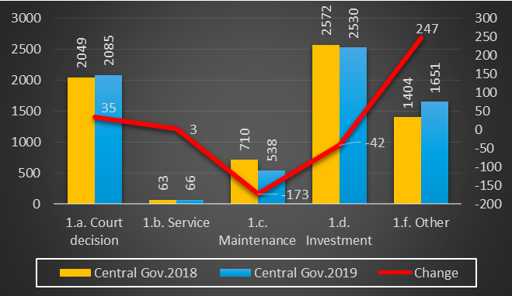
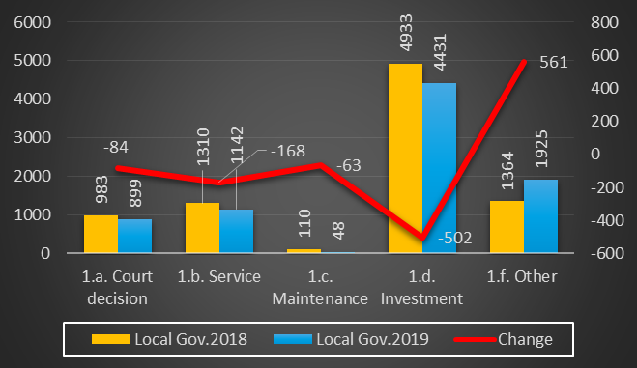
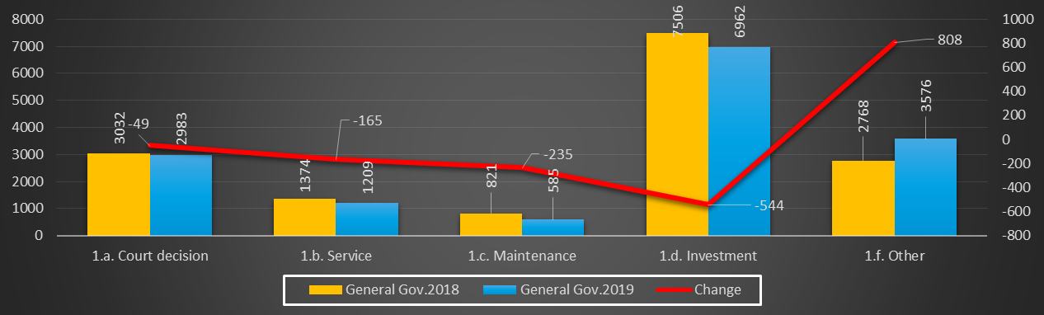
Graphs of arrears 'Changes 2018 -2019

Slide 7
Albania – Stock of expenditures payments arrears by Consolidated fiscal indicators
Nr. | E M E R T I M I | Average of actual expenditures 2008-2018 | Cumulative Stock of arrears-End of 2018 | Cumulative Stock of arrears-End of 2019 | Cumulative Amount-Over the years 2018 | Cumulative Amount-Over the years 2019 | Paid Arrears-Over the years | % of arrears/exp | Age of arrears (days)
 | TOTAL EXPENDITURE [25% of GDP (1,648 bn LEK-2018)] | 408,025 | 15,500 | 15,315 | 27,823 | 35,419 | 20,104 | 3.8 | n.a.
I. | Current Expenditures | 335,198 | 12,928 | 12,785 | 23,190 | 29,513 | 16,728 | 3.8 | n.a.
1 | Personnel expenditures | 70,770 |  | 522 |  | 534 | 12 | 0.7
 | Wages | 59,439
 | Social insurance contributions (arrears since 2019) | 9,649 | n.a. | 434 | n.a. | 440 | 6 | 4.5
 | Other tax (arrears since 2019) | 1,681 | n.a. | 88 | n.a. | 94 | 6 | 5.2
2 | Interest | 38,051
3 | Operational & Maintenance (court decision, maintenance, goods/services, other) | 36,441 | 4,227 | 3,818 | 6,165 | 6,963 | 3,145 | 10.5
4 | Subsidies | 2,191
5 | Social insurance outlays | 125,622
6 | Expenditure for owner's in value-compensation | 2,504
7 | Local budget expenditure | 34,854 | 8,701 | 8,445 | 17,025 | 22,016 | 13,571 | 24.2
8 | Other expenditures | 24,765
II. | Capital expenditures | 72,827 | 2,572 | 2,530 | 4,633 | 5,906 | 3,376 | 5.5 | n.a.
1 | Domestically financing | 45,891 | 2,572 | 2,530 | 4,633 | 5,906 | 3,376 | 5.5
2 | Foreign financed (out of TSA) | 26,936
Notes:
To have the summarized idea, I have quickly compiled this table.
I have considered the average amount of expenditures by the last 10 years, since 2009, because this is the first year that the Treasury System begin the registration of invoices by AGFIS in parallel way with manual entries by budget institutions. Before we get reporting only the total monthly amounts of expenditures and not by invoices to analised the arrears. Since September, 2010 Treasury system has implemented “live” the AGFIS-IT system of Treasury, which created the possibility to record each invoice and centrally process electronically all the payments of general government through Central Bank to commercial banks of beneficiaries’ bank accounts.
3.8% of the expenditures’ total (in absolute value of 408 billion LEK) are arrears, paid overdue (in absolute value of 15 billion LEK). Including central and local government expenditures payments.
The stock of arrears is reduced compared with 2018 year
We still have to work hard to zero out them and to take measures to avoid the rise of the new ones.

Slide 8

PEFA Pillar five: Predictability and control in budget execution: PI22 – Expenditure arrears
Albania PEFA 2017
PI-22 measures
Extent to which: there is a stock of arrears (PI-22i); a systemic problem in this regard is being addressed and brought under control (PI22-ii)
PI-22 | Expenditure arrears | C+ | Score justification
(i) | Stock of expenditure arrears | B | The stock of expenditure arrears at the end of 2016 and 2015 was less than 6% of total actual expenditures for the respective years.
(ii) | Expenditure arrears monitoring | C | The standard frequency of production of arrears monitoring reports is every four months. Annual monitoring report for 2016, including the stock and composition of expenditures arrears, was available on the MoF website at the time of the assessment.
While the stock of historic expenditure arrears was largely cleared, it was not possible to fully prevent new arrears and MOF does not have a systemic reporting approach to monitor arrears through the treasury system.

Slide 9



Nature – Reasons (2)
TDOs
Treasury Districts Offices
Phases of expenditures arrears’ managing in Albania
1
Requisition
2
Commitment
3
Expenditure
4
Payment (Centralized)
5
Reconciliation
Treasury System
Frozen medium term budget
14 Line ministries

Tirana Municipality
Frozen medium term budget
Central Government
Local Government
Invoice is matched with released commitment
Central Government
Local Government
Invoice is checked automatically with monthly cash flows forecasting
Electronic transfers files to Central Bank, then to commercial bank
1.Banking System
2.Financial reports on multiyear commitments data by 3+1 year
Bank of Albania
Reference: slide 29-39
Currently the managing is done through:
AGFIS by above scheme (Albanian Government Financial Information System) (References to slides no. 26)
TDOs authorize manually procurement requests against the medium term budget, detailed by projects/
products code (requisition phase). Every day, the Agency of Public Procurement confirms by e-mail with TDOs all procurement orders submitted by spending units, before allowing them to begin the tendering.
Monthly Financial Reports on unpaid amounts of multiyear commitments (References to slides no. 28)
(last column of report calculated by previous column data on each year commitments, expenditures,
payments) by spending units (central + local government).
Notes:
The news for Albania Treasury System compare with the presentation submitted in Hungary’s Plenary Meeting-working group discussions is that “Every day, Agency of Public Procurement confirm by e-mail with
TDOs all procurements order submitted by spending units, before allow them to begin the tendering.” So I will not comment more in detail this slide.
Arrears’ managing by treasury system
1/3. Approval medium term central budget is detailed annually by line ministries/central institutions; functional classifications; economic classification by three digits level (chart of accounts level in 7-digits); also controlled on three digits level.
2. The consolidated fiscal indicators data of general government (central/local government & special funds) by economic classification are breakdown in monthly basis. After adjustments, these targets serve as a monthly limit (ceilings) for cash flows forecasting of three aggregated items: salaries, capital expenditures and others of each spending unit.
2.4. Spending units revise their allocations:
Themselves between ….
With approval of line ministry as a subordinated unit for …..
With approval of Ministry of Finance and Economy for ….
With approval of Council of Minister for ….
With approval of Parliament …
2.5. The controls on over spending units allocations are done automatically through the AGFIS, which rejects their invoices without annual budget plan.
2.6. Approval medium term central budget for each spending unit is recorded in AGFIS by General Directorate of Budget (GDB) under the Ministry of Finance and Economy. Also treasury districts offices (TDOs) get from GDB the protocol paper for checking the consistency with AGFIS data.

Slide 10
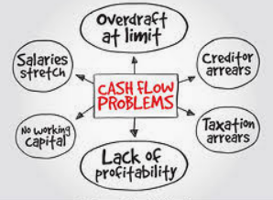

Nature – Reasons (3)
Before the PFM Strategy’s approval persistent expenditure arrears was typically a symptom of underlying weaknesses in PFM system and inadequate legal frameworks.
Problems with the financial management information system (FMIS)/lack of interfaces with related IT systems.
Unrealistic budgets programming (optimistic revenues/under provisioning for compulsory expenditure items/uncertain time and unknown value of budget support).
Weak commitment controls (which manage the initial incurrence of obligations, rather than the subsequent cash payments, to avoid the accumulation of unaffordable liabilities and unpaid bills). Commitments was not registered/ controlled within available expenditure ceilings/cash limits (started after 2017 year).
No active cash management, no produce rolling forecasts, government was not able to access financial markets, arrears re-emerge, acute government liquidity shortages in financial crises and risk in elections year.
Notes:
Causes of Expenditure Arrears
The temporary accumulation of government expenditure arrears is sometimes the result of acute government liquidity shortages that accompany serious economic or financial crises. Once the immediate shock of the crisis has passed, revenues recover, and the government is able to access financial markets, arrears tend to be paid down quickly and often do not re-emerge.
Persistent expenditure arrears are typically a symptom of underlying weaknesses in a country’s PFM system. Expenditure arrears can be the result of failures at any or all stages of the PFM cycle, including inadequate legal frameworks, unrealistic budgeting, weak or cumbersome expenditure controls, inefficient cash management, lack of or problems with a financial management information system (FMIS), or gaps in fiscal reporting. The most effective approach to dealing with expenditure arrears, therefore, depends on their underlying causes and usually requires concerted action in a number of PFM areas. As described in Table 1, the expenditure process can be thought of as comprising four stylized stages: budget formulation, expenditure commitment, expenditure liquidation or verification, and payment. Weaknesses, errors, or delays at any stage can result in the accumulation of expenditure arrears.
Another reason that expenditure arrears can accumulate is that governments are not aware of them. As shown in Figure 3, a survey of 121 low- and middle-income countries found that 38 percent were unable to generate reliable data on the stock of unpaid bills from the past two years. Only 12 percent of countries regularly generate reliable data on the stock and vintage of arrears. The reason for the lack of awareness of arrears can be due to weaknesses in the fiscal reporting system. First, some accounting systems are unable to determine liabilities or the sub-set of liabilities that are beyond the due date: for example, the date of the invoice or
the date the invoice is payable is not registered systematically in the FMIS or general ledger. Second, in many countries, particularly those operating cash-based budgeting and accounting systems, there is no requirement to report arrears, or if a requirement exists, reporting is at the year-end only. Finally, the government reporting entity is often restricted to the central government budget, while arrears may be building up in extra-budgetary funds, autonomous agencies, subnational governments, and state-owned enterprises.
While inadequate monitoring and reporting of arrears can complicate prevention and management, their underlying cause is usually one or more weaknesses in the PFM process. The most common causes include:
• Formulation of unrealistic budgets. Unrealistic budgets can be the result of overly optimistic macroeconomic or revenue projections and/or under-provisioning for compulsory expenditure items. On the revenue side, uncertainty regarding the scale and timing of external budget support can pose a particular problem for developing countries. This uncertainty can be also an issue in resource-rich countries significantly dependent on revenues from natural resources (for example, oil and minerals), where volatility of international prices of the commodities can complicate budgetary projections. On the expenditure side, deliberate under-budgeting for infrastructure, entitlements, subsidies to state-owned enterprises or essential items (for example, utilities, pharmaceuticals, maintenance, or food for hospitals, prisons, and schools) is sometimes used as a tactic by ministries and agencies to get initial authorization for a broader range of expenditure than the ones that can ultimately be afforded.
• Lack of commitment controls. Controlling commitments is essential for controlling expenditure and preventing arrears (Radev and Khemani, 2009). Commitment controls manage the initial incurrence of obligations, rather than the subsequent cash payments, to avoid the accumulation of unaffordable liabilities and unpaid bills. Commitment controls based on expenditure ceilings or cash limits reconcile the availability of cash resources with commitments, thereby ensuring that spending units are able to enter into contracts or other obligations only if sufficient unencumbered balances are available, or are likely to be available, at the time of payment. Empirical evidence shows a strong relationship between the accumulation of arrears and the lack of proper commitment controls. Table 2 shows the relationship between PEFA indicators related to arrears and commitment controls. Countries with strong commitment controls tend to have lower stocks of arrears and countries with poor commitment control have a higher tendency to accumulate significant expenditure arrears.
• Poor cash management. Even where expenditure commitments are registered and controlled within available expenditure ceilings or cash limits, arrears can accumulate if sufficient liquidity is not available to pay invoices when they fall due. Commitment limits therefore need to be linked to projected cash inflows and appropriate mechanisms set up within the ministry of finance to collect forecast data from budget agencies, aggregate the data, and produce rolling forecasts to guide expenditure commitment ceilings (Lienert, 2009). The government banking arrangement should be unified in a treasury single account (Pattanayak and Fainboim, 2011) to enable the ministry of finance or treasury to track government cash flows in and out of these bank accounts and pool liquidity. The treasury, as the chief financial agent of the government, should manage the government’s cash and debt positions to ensure that sufficient funds are available to meet payment obligations, idle cash is efficiently invested, and debt is optimally issued.
• Delays in processing of payments. Even where commitments are controlled and liquidity is available to make payments, arrears can arise due to administrative delays in the processing of expenditure transactions. Excessive documentation requirements, cumbersome ex ante audits, or lack of manpower or automation can slow the processing of invoices and making of payments. Delays occur at various stages and are sometimes associated with rent-seeking, lack of resources, weak capacity, and inefficient procedures.
• Deliberate deferral of payments. In countries that account and report fiscal data on a cash basis, governments may be tempted to deliberately delay payments as a means of reporting a higher cash balance in the short term, notably at the end of the fiscal year (Irwin 2012). This is a particular risk in election years, when the incumbent government may pass on to the next administration a large balance of outstanding payments without correspondent resources to finance them.
• Inadequate sanctions. Expenditure controls can be undermined by ineffective sanctions, or an unwillingness to enforce them, against officials or institutions who fail to comply with the law. This noncompliance may include the following: entering into commitments above expenditure ceilings or budget limits; failure to register commitments; fraud or collusion with suppliers; or failure to prepare and publish budget execution reports and financial reports. The legal framework should clearly specify financial management responsibilities and sanctions for noncompliance both at personal and institutional levels. Sanctions can be administrative (dismissal or suspension), criminal (imprisonment or prohibition from running in elections), financial (fines), or organizational (reduce the financial flexibility of the entity or suspend or reduce appropriations).

Slide 11


Nature – Reasons (4)
Gaps in fiscal reporting (or mistakes/errors in its compilation, for example, by restructuring of line ministries not updated the codes of formulas, etc.); mismatches in the timing of receipts and payments. No accrual basis of accounting for expenditures transactions (government may be tempted to deliberately delay payments as a means of reporting a higher cash balance in the short term, notably at the end of the fiscal year; inherit to next year a large balance of outstanding payments without correspondent resources to finance them).
‘Delays in any stage of expenditures process (no verification, changes in meantime by normative act during the year).
Unable to generate reliable data on the stock of unpaid bills and to monitor the days of delay for overdue payments for the general government units, no consolidated reporting of extra-budgetary/SOEs funds (beneficiaries of subsidies/transfers from central government).
No training for recent developments; no qualified bottom-up forecasts of cash flows; no timely information.
Ineffective/fruitless sanctions and discipline against responsible officials who do not respect the legislation (for example, fraud or collusion with suppliers, especially for advanced works of the construction).
Notes:
Causes of Expenditure Arrears
The temporary accumulation of government expenditure arrears is sometimes the result of acute government liquidity shortages that accompany serious economic or financial crises. Once the immediate shock of the crisis has passed, revenues recover, and the government is able to access financial markets, arrears tend to be paid down quickly and often do not re-emerge.
Persistent expenditure arrears are typically a symptom of underlying weaknesses in a country’s PFM system. Expenditure arrears can be the result of failures at any or all stages of the PFM cycle, including inadequate legal frameworks, unrealistic budgeting, weak or cumbersome expenditure controls, inefficient cash management, lack of or problems with a financial management information system (FMIS), or gaps in fiscal reporting. The most effective approach to dealing with expenditure arrears, therefore, depends on their underlying causes and usually requires concerted action in a number of PFM areas. As described in Table 1, the expenditure process can be thought of as comprising four stylized stages: budget formulation, expenditure commitment, expenditure liquidation or verification, and payment. Weaknesses, errors, or delays at any stage can result in the accumulation of expenditure arrears.
Another reason that expenditure arrears can accumulate is that governments are not aware of them. As shown in Figure 3, a survey of 121 low- and middle-income countries found that 38 percent were unable to generate reliable data on the stock of unpaid bills from the past two years. Only 12 percent of countries regularly generate reliable data on the stock and vintage of arrears. The reason for the lack of awareness of arrears can be due to weaknesses in the fiscal reporting system. First, some accounting systems are unable to determine liabilities or the sub-set of liabilities that are beyond the due date: for example, the date of the invoice or
the date the invoice is payable is not registered systematically in the FMIS or general ledger. Second, in many countries, particularly those operating cash-based budgeting and accounting systems, there is no requirement to report arrears, or if a requirement exists, reporting is at the year-end only. Finally, the government reporting entity is often restricted to the central government budget, while arrears may be building up in extra-budgetary funds, autonomous agencies, subnational governments, and state-owned enterprises.
While inadequate monitoring and reporting of arrears can complicate prevention and management, their underlying cause is usually one or more weaknesses in the PFM process. The most common causes include:
• Formulation of unrealistic budgets. Unrealistic budgets can be the result of overly optimistic macroeconomic or revenue projections and/or under-provisioning for compulsory expenditure items. On the revenue side, uncertainty regarding the scale and timing of external budget support can pose a particular problem for developing countries. This uncertainty can be also an issue in resource-rich countries significantly dependent on revenues from natural resources (for example, oil and minerals), where volatility of international prices of the commodities can complicate budgetary projections. On the expenditure side, deliberate under-budgeting for infrastructure, entitlements, subsidies to state-owned enterprises or essential items (for example, utilities, pharmaceuticals, maintenance, or food for hospitals, prisons, and schools) is sometimes used as a tactic by ministries and agencies to get initial authorization for a broader range of expenditure than the ones that can ultimately be afforded.
• Lack of commitment controls. Controlling commitments is essential for controlling expenditure and preventing arrears (Radev and Khemani, 2009). Commitment controls manage the initial incurrence of obligations, rather than the subsequent cash payments, to avoid the accumulation of unaffordable liabilities and unpaid bills. Commitment controls based on expenditure ceilings or cash limits reconcile the availability of cash resources with commitments, thereby ensuring that spending units are able to enter into contracts or other obligations only if sufficient unencumbered balances are available, or are likely to be available, at the time of payment. Empirical evidence shows a strong relationship between the accumulation of arrears and the lack of proper commitment controls. Table 2 shows the relationship between PEFA indicators related to arrears and commitment controls. Countries with strong commitment controls tend to have lower stocks of arrears and countries with poor commitment control have a higher tendency to accumulate significant expenditure arrears.
• Poor cash management. Even where expenditure commitments are registered and controlled within available expenditure ceilings or cash limits, arrears can accumulate if sufficient liquidity is not available to pay invoices when they fall due. Commitment limits therefore need to be linked to projected cash inflows and appropriate mechanisms set up within the ministry of finance to collect forecast data from budget agencies, aggregate the data, and produce rolling forecasts to guide expenditure commitment ceilings (Lienert, 2009). The government banking arrangement should be unified in a treasury single account (Pattanayak and Fainboim, 2011) to enable the ministry of finance or treasury to track government cash flows in and out of these bank accounts and pool liquidity. The treasury, as the chief financial agent of the government, should manage the government’s cash and debt positions to ensure that sufficient funds are available to meet payment obligations, idle cash is efficiently invested, and debt is optimally issued.
• Delays in processing of payments. Even where commitments are controlled and liquidity is available to make payments, arrears can arise due to administrative delays in the processing of expenditure transactions. Excessive documentation requirements, cumbersome ex ante audits, or lack of manpower or automation can slow the processing of invoices and making of payments. Delays occur at various stages and are sometimes associated with rent-seeking, lack of resources, weak capacity, and inefficient procedures.
• Deliberate deferral of payments. In countries that account and report fiscal data on a cash basis, governments may be tempted to deliberately delay payments as a means of reporting a higher cash balance in the short term, notably at the end of the fiscal year (Irwin 2012). This is a particular risk in election years, when the incumbent government may pass on to the next administration a large balance of outstanding payments without correspondent resources to finance them.
• Inadequate sanctions. Expenditure controls can be undermined by ineffective sanctions, or an unwillingness to enforce them, against officials or institutions who fail to comply with the law. This noncompliance may include the following: entering into commitments above expenditure ceilings or budget limits; failure to register commitments; fraud or collusion with suppliers; or failure to prepare and publish budget execution reports and financial reports. The legal framework should clearly specify financial management responsibilities and sanctions for noncompliance both at personal and institutional levels. Sanctions can be administrative (dismissal or suspension), criminal (imprisonment or prohibition from running in elections), financial (fines), or organizational (reduce the financial flexibility of the entity or suspend or reduce appropriations).

Slide 12




Impact/Solutions (1)
A large flow of arrears may disguise the true size of the government deficit, significantly reduce the impact of fiscal policy on aggregate demand, and potentially undermine macroeconomic stability.
If businesses are dependent on government contracts, payment arrears can cease or delay activity as a result of payment delays or impose difficulties in accessing credit from commercial banks, resulting in a reduced pace of economic activity and increased unemployment.
Government suppliers try to mitigate the risks and opportunity cost of delayed payments by adjusting their initial prices upward. This reduces the efficiency of government expenditure and contributes to economy-wide inflation.
Suppliers may require that government pay for goods and services in advance, that quantities supplied be limited, or that delivery of further supplies or services be made dependent on the payment of outstanding amounts. The delivery of public services may be halted entirely, if suppliers cease supplying essential services (such as electricity, water, medicine, or fuel) or stop or delay the construction of investment projects.
Illiquid suppliers may try to bridge the delay in payments by borrowing from banks, adding pressure to credit markets, and driving up interest rates. These pressures, in turn, may induce the central bank to relax monetary policy, further driving up the domestic price level.
As government suppliers suffer from liquidity shortages, lower profits, reduced employment, and falling confidence in government, they may be inclined to reduce or withhold payment of taxes and social security contributions until, in turn, they receive payments due to them from government.
Notes:
Impact of Chronic Arrears Accumulation.
The accumulation of expenditure arrears by governments can have a serious negative effect on the domestic economy.
A large flow of arrears may disguise the true size of the government deficit, significantly reduce the impact of fiscal policy on aggregate demand, and potentially undermine macroeconomic stability. The economic consequences of persistent arrears accumulation by governments can include the following:
• Reduced economic growth. Arrears imply a liquidity problem in the economy which can have a detrimental impact on aggregate demand. If businesses are dependent on government
contracts, payment arrears can cease or delay activity as a result of payment delays or impose difficulties in accessing credit from commercial banks, resulting in a reduced pace of economic activity and increased unemployment.
• Increased cost of service provision. Government suppliers try to mitigate the risks and opportunity cost of delayed payments by adjusting their initial prices upward. This reduces the efficiency of government expenditure and contributes to economy-wide inflation.
• Reduced or interrupted public service delivery. As the cost of supplies rise, governments with limited resources may be forced to reduce the amount of supplies purchased and/or the volume of service provided. Suppliers themselves may require that government pay for goods and services in advance, that quantities supplied be limited, or that delivery of further supplies or services be made dependent on the payment of outstanding amounts. The delivery of public services may be halted entirely if suppliers cease supplying essential services (such as electricity, water, medicine, or fuel) or stop or delay the construction of investment projects.
• Increased rent-seeking. Chronic payment delays also increase the incentives for rent seeking and collusion between government and suppliers, as the latter seek to accelerate payment or circumvent expenditure control procedures.
• Increased interest rates. Illiquid suppliers may try to bridge the delay in payments by borrowing from banks, adding pressure to credit markets, and driving up interest rates. These pressures, in turn, may induce the central bank to relax monetary policy, further driving up the domestic price level.
• Reduced confidence in fiscal policy. Significant expenditure arrears can disguise the true size of the government’s liabilities by as much as 20 percent of GDP.
• Second-round fiscal costs. As government suppliers suffer from liquidity shortages, lower profits, reduced employment, and falling confidence in government, they may be inclined to reduce or withhold payment of taxes and social security contributions until, in turn, they receive payments due to them from government.

Slide 13

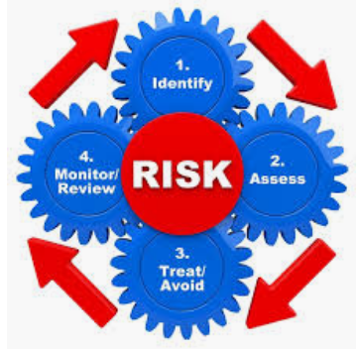



Impact/Solutions (2)
In Albania the first step in preventing arrears was the establishing of the database (IT system) and understand the underlying causes.
Then the legal framework/related regulations defined payment terms (when a payment is in arrears); reporting; controls at the budget authorization, commitment, payment stages; the sanctions, etc.(for example: within 5 days the signed contract should be registered in AGFIS)
Strengthening of the realism of the budget programmers; annual budgets are reflecting gradually spending requirements; contingencies reserves; outstanding commitments of multi-year investment projects was tried to be included in the budget/outer-year forecasts (3+1) consideration of the medium-term fiscal capacity to finance them; a timetable was communicated for the stocktaking exercise.
Comprehensive, timely, and reliable information about their size, composition, and vintage; calculating of deficit by the invoices received and verified.
The special Committee has prioritized the arrears clearance; enable the systematic monitoring /warnings of liabilities as an integral part of the regular monthly fiscal report and was disclosed in the annual financial statements.
It is preventing public entities from initiating expenditure without available budget/cash providing assurance to potential suppliers that they are participating in a bidding process for which budgetary funds have already been secured.
Reliable cash forecasting will be ensured that liquidity is available to meet payment obligations as they arise.
Select the proper time of borrowing to local market (considering bankruptcy), auction calendar.
Operating of TSA with an adequate cash buffer to make payments as they arise.
Developing of reporting capacity which will aim at consolidated fiscal reporting for the entire general government, including extra-budgetary units/SOEs.
Notes:
Solution:
Monitorimi i detyrimeve të prapambetura në shpenzimet buxhetore
Ky dimension vlerëson se sa identifikohen dhe monitorohen detyrimet e prapambetura në shpenzime. Ai shikon se cilat aspekte të detyrimeve të prapambetura monitorohen dhe sa shpesh dhe sa shpejt nxirret informacion.
Duke pasur parasysh stokun e konsiderueshëm të detyrimeve të prapambetura të akumuluar në të shkuarën e afërt, Shqipëria përgatiti një strategji për parandalimin dhe shlyerjen e detyrimeve të prapambetura e cila u miratua në vitin 2014 si pjesë e programit me FMN-në. Kjo strategji përfshinte ngritjen e një mekanizmi të posaçëm për të monitoruar detyrimet e prapambetura në shpenzimet publike, ku përfshihet një sistem vetëraportimi nga njësitë e vartësisë i ngritur në çdo ministri të linjës, të cilave u kërkohet t’i paraqesin MF-së informacione të konsoliduara për sektorët e tyre përkatës. Në bazë të informacioneve të paraqitura nga ministritë e linjës, duhen përgatitur raporte monitorimi të konsoliduara çdo katër muaj, të cilët duhen publikuar në faqen në internet të MF-së brenda një muaji pas përfundimit të periudhës përkatëse. Ky mekanizëm vijon të ketë rëndësi për monitorimin e stokut të mëparshëm të detyrimeve të prapambetura dhe të detyrimeve të reja të prapambetura të lidhura me kontratat e mëparshme shumëvjeçare, që janë lidhur përpara vitit 2016. Raportet përfshijnë të dhëna të zbërthyera sipas ministrisë, institucionit / njësisë shpenzuese në varësi të ministrisë dhe vitit / periudhës kur ka lindur. Raporti vjetor i monitorimit për vitin 2016 gjendej në faqen në internet të MF-së në momentin e vlerësimit.
Pas ndryshimeve legjislative, funksionaliteti i sistemi informatik të thesarit SIQF u zgjerua në vitin 2016, në mënyrë që ky sistem të regjistrojë tani edhe informacione për angazhimet në momentin e regjistrimit të kontratave të nënshkruara, përfshirë angazhimet shumëvjeçare për kontratat që shtrihen në disa vite fiskale. Sistemi mbulon informacion edhe për faturat për kontratat përkatëse, përfshirë edhe informacionin për afatin e pagesës. Pra sistemi i thesarit përmban informacion të saktë për detyrimet e prapambetura që kanë lindur prej vitit 2016, përfshirë edhe të dhëna në nivel të njësisë shpenzuese, kontratës dhe datës se kur ka lindur detyrimi i prapambetur, të dhëna që mund të nxirren në çdo moment. Por nuk ka një kërkesë / format specifik për monitorimin e detyrimeve të prapambetura përmes sistemit të thesarit dhe nuk nxirren raporte të rregullta.Në bazë të analizës dhe dëshmive mbështetëse, rezultati i vlerësimit për këtë dimension është C
Ky dimension vlerëson se sa MF, apo një subjekt tjetër i ngjashëm, arrin të identifikojë dhe konsolidojë tepricat e likuiditetit si bazë informacioni mbi të cilën bën çlirimin e fondeve. Përdorimi i një llogarie unike thesari, apo i llogarive që janë të centralizuara në një bankë të vetme, zakonisht në bankën qendrore, ndihmon në konsolidimin e llogarive bankare. Llogaria unike e thesarit është një llogari bankare ose një tërësi llogarish të lidhura nëpërmjet të cilave qeveria kryen veprimet e arkëtimeve dhe pagesave. Kontrolli dhe raportimi për veprimet e veçanta duhet të arrihet nëpërmjet sistemit kontabël, që i jep mundësi Thesarit të veçojë menaxhimin e likuiditetit nga kontrolli mbi veprimet e veçanta. Arritja e konsolidimit të rregullt të llogarive të shumta bankare që nuk mbahen në nivel qendror në përgjithësi kërkon kryerjen e kleringut elektronik dhe marrjen e masave organizuese për pagesat me bankat ku mban llogaritë qeveria.
Në Shqipëri, një pjesë e konsiderueshme e tepricave të likuiditetit ndodhen në llogarinë unike të thesarit e cila është në Bankën e Shqipërisë dhe administrohet nga Drejtoria e Thesarit e MF-së. Konsolidimi i fondeve në llogarinë unike të thesarit bëhet çdo ditë. Mbahen nëntë llogari në Bankën e Shqipërisë, por veçmas nga llogaria unike e thesarit, përfshirë katër llogari të fondeve të veçanta të administruara nga MF, tri llogari të administruara nga fondi i sigurimeve shëndetësore dhe dy llogari të fondit të sigurimeve shoqërore. Gjithashtu, trembëdhjetë llogari të fondeve të ndryshme buxhetore, ekstra-buxhetore dhe speciale mbahen pranë bankave të nivelit të dytë (përfshirë disa llogari të administruara nga MF). Edhe llogaritë e projekteve të financuara nga donatorë mbahen kryesisht në banka të nivelit të dytë. Tepricat e të gjitha llogarive të lartpërmendura mbahen veçmas në bankat përkatëse, nuk transferohen apo nuk centralizohen në asnjë moment dhe në shumicën e rasteve nuk mund të përdoren njësoj si fondet e mbajtura në llogarinë unike të thesarit. Raportet për gjendjen e llogarive jashtë llogarisë unike të thesarit merren çdo muaj, por shumica e tepricave jashtë llogarisë unike të thesarit nuk konsolidohen. Siç e tregojnë të dhënat më poshtë, madhësia e tepricave të mbajtura jashtë llogarisë unike të thesarit është më e madhe se teprica e kësaj llogarie.

Slide 14
Albania Public Finance Management Strategy 2019-2022
Key interventions and Outcomes
Table 2.4:
Key interventions/components | Lead | Outcomes
4.1.Expanding the use of AGFIS | DBP | XI)Efficient budget execution (through use of IT support). XII)Arrears are minimized. XIII)Costs of borrowing is reduced and cash is available when needed. XIV)Increasing the efficiency and transparency of procurement system.
4.2.Multi-annual commitment controls and accounts payable | DM and General Secretary
4.3.Debt and cash management | GDPDCFA
4.4.Public Procurement | PPA
4.5.Management of external funds | GDPDCFA
4.6.Strengthening the State Aid role | GDEDE
Abbreviations:
DBP-Department of Business Processing under General Directorate of Treasury
DM-Respective Directors Management
GDPDCFA-General Directorate of Public Debt and Coordination of Foreign Aid
PPA-Public Procurement Agency
GDEDE-General Directorate of Economic Development and Employment
Notes:
Specific Objective 4: Efficient execution of the budget
Overall objective
To ensure efficient and effective use of the approved budget resources.
Overview
This Specific Objective focusses on the execution of the budget in the most efficient way: making sure that the Budget, as approved by Parliament, is implemented as planned: that cash is available at the right time to make payments in order to avoid arrears, and provide a sufficient level of liquidity. The focus is therefore: (i) expenditure control, ensuring that payments do not exceed budget and that arrears do not recur; (ii) cash and debt management, ensuring that cash is available to make payments at the right time and lowest possible cost to ensure a prudent degree of risk; (III) continuing to bring the procurement system in line with the EU acquis, and improve its transparency and efficiency; and (Iv) improve the Human Resources Management Information System (HRMIS)/Payroll system and Treasury interface for fully centralised payroll calculations and electronic payments.
Progress since 2014
AGFIS is the key system-based tool for controlling and monitoring revenues and expenditures and the government plans to roll-out the system to Bis. The system sits at the heart of effective budget execution. Currently, 15 budget institutions are enrolled onto AGFIS, representing around 74 percent of total spending, against the original plan in 2014 to roll out to up to 50 BIs by 2018. However, there has been no further roll out of the system to BIs since 2016. This has impacted both control of spending and arrears and the automation of payroll controls though the HRMIS. The payroll management system currently covers over 50 percent of salaries, a significant increase from a baseline of 0.5 percent in 2014, but is still incomplete requiring manual checking and reconciliation of data. The Strategy envisaged a system for the management of external funds, External Aid Management Information System (EAMIS). While system design is finalised, the migration/entering of data is in process.
A Medium-Term Debt Management Strategy (MTDMS) is in place and debt sustainability analysis is regularly undertaken.
In 2018, a “Market Maker Program” was piloted that would encompass more securities and would involve a wider set of rights and obligations aimed to have benchmark securities in order to start developing the secondary market activity. A Cash and Debt Management Committee to enhance the operational framework and coordination of debt management was established. The accuracy of cash forecasts and procedures for liquidity cash management at the General Directorate Treasury (GDT) still requires strengthening. The 2017 PEFA also reported that balances on the bank accounts outside Treasury Single Account (TSA) exceed the TSA balance. Progress has been made to align the Public Procurement Law (PPL) with the Acquis (new EU directives), and legal and regulatory measures were undertaken to enhance the independence of the Public Procurement Commission (PPC). Also, a new PPC, became operational on 16 July 2018, but further work is needed during the next phase for the commission to become effective.
Lessons learned and priorities for 2019-2022
Many of the Components’ actions have been completed as planned, or are on track for completion. The complexity and long-term focus of some of the actions resulted in delays. Progress in some Components was delayed due to government restructuring, for example the roll-out of the HRMIS and AGFIS and activities under the Public Procurement Component. In functional areas, such as debt management where specialist skills are essential, hiring and retaining appropriately skilled staff has been a challenge, despite training programmes designed to mitigate this. From several years, the debt directory structure has suffered frequent structural changes and lack of staff at all levels, therefore, the decision making process has been negatively impacted
Over the next phase, the government will continue to expand the use of AGFIS, and monitoring of commitments and accounts payable through the system. Automatic controls were introduced into AGFIS to limit the BIs from being able to over-commit budgets, so as to avoid the emergence of new arrears. However, new arrears are still emerging because the controls introduced are not operational and there is no Unit in charge at MOFE to signal whether three-year ceilings have been entered into AGFIS. Integrating automated payroll within AGFIS remains an outstanding output and efforts will continue. Particular focus will be placed on reforming cash and debt management in line with IMF and World Bank recommendations.
Strengthening the Procurement Law in line with the Acquis is also a priority, as well as making the appeals procedure more transparency and efficient through the PPC. Work will continue in strengthening compliance with entering the required data in EAMIS and using this system as the prime source of information for all donors’ funds.
Specific reform areas are outlined in Table 2.4 below.
^{Albania PEFA, 2017}

Slide 15
(References to slides no. 18-22)

Slide 16
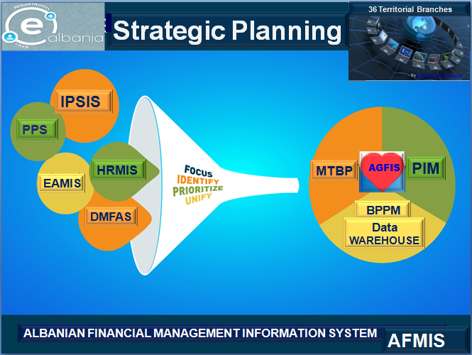






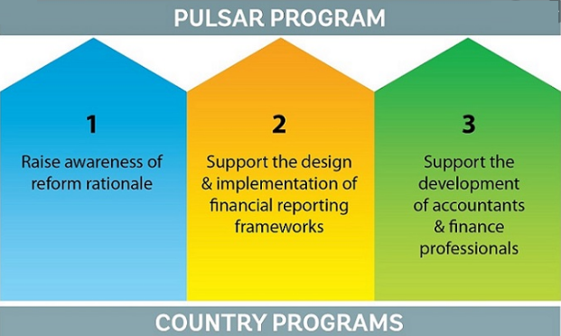
Initiatives to revise the approach
The automations strength the disipline
The link between AGFIS and Public Procurement System is not yet in place. It is the component of AFMIS project financed from the World Bank. Currently the communication is done manually between TDOs and Agency of Public Procurement.
The one-day delay after the order of the daily cash limit is the result of the programing time. Since January 2017, we have created the posibility to record invoices against annual budget plans and, after being accounted for in the General Ledger, the invoice will be checked against the monthly cash flows forecasting. We have separated these controls to avoid the rise of arrears.
Abbreviations:
BI-Budget Institutions
TDOs-Treasury Districts Offices
IT-Information Technology
PULSAR-Public Sector Accounting and Reporting
Achieving an active cash management by enhancing bottom-up cash flows forecasts (for the first time on December, 2019 BI presented all invoices to TDOs which accounted in separated item of chart of account: 4865100) and using advance IT tools (macro-excel and then data warehouse) with technical
assistance from the World Bank Treasury. (References to slides no.40-41)
Moving on to accrual basis of accounting by PULSAR project.
(References to slides no. 23-25)
Notes:
Sistemi kryesor informatik që shfrytëzohet nga Ministria e Financave tani për tani është sistemi informatik i thesarit (zyrtarisht I quajtur sistemi informatik financiar i Qeverisë, SIQF10). Funksionet e automatizuara nëpërmjet këtij sistemi përfshijnë zbatimin e buxhetit, menaxhimin e angazhimeve, menaxhimin e likuiditetit, kontabilitetin dhe raportimin. Vënë në zbatim në 2010, ky sistem është përdorur fillimisht nga Drejtoria e Përgjithshme e Thesarit, degët e thesarit dhe Drejtoria e Përgjithshme Buxhetit. Por u pa se ky sistem do të ishte edhe më efektiv nëse edhe njësive shpenzuese u jepeshin të drejta në të. Testimi pilot i dhënies së të drejtave të drejtpërdrejta në këtë sistem ka nxjerrë në pah kufizime teknike dhe financiare madhore mbi zbatimin e tij (për shkak të nevojave për të bërë ndryshime në softuer dhe të kostove të larta të licencimit). Më pas u vendos të krijohej një portal në rrjet për t›u dhënë njësive shpenzuese të drejta (pa pagesë ose me kosto të ulët) në atë funksionalitet të sistemit që nevojitet në nivelin e tyre. Aktualisht, MF po zhvillon në bazë të SIFQ-së, zgjidhje TIK për një sistem informatik të integruar të menaxhimit financiar (SIIMF) dhe dy module të ndërlidhura të sistemit informatik që do të administrohen nga Kryeministria (Kryeministria do të administrojë modulin e planifikimit të integruar, SISPI, dhe modulin e asistencës së jashtme, EAMIS
The Public Sector Accounting and Reporting Program (PULSAR) is a new initiative, launched in Vienna on 11 December 2017, to increase transparency, accountability, and better management of public resources in Albania, Armenia, Azerbaijan, Belarus, Bosnia and Herzegovina, Croatia, Georgia, Kosovo, FYR Macedonia, Moldova, Montenegro, Serbia, and Ukraine through the enhancement of public sector accounting (PSA) and financial reporting frameworks. PULSAR is financed by the Governments of Austria and Switzerland and is implemented by the World Bank.

Slide 17




Thank you for your attention!
-What are other words for be in arrears to?
-Owe, be in debt to, be indebt to, be under an obligation to, owing, owed, be in debt
Any questions?
You can find me at mimoza.peco@financa.gov.al
Notes:
That’s it. I hope this helps.

Slide 18
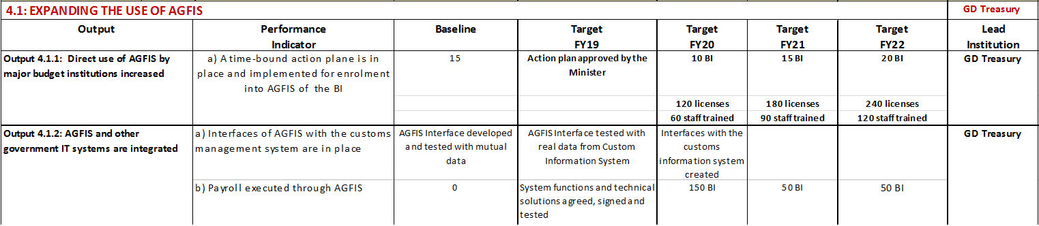
Abbreviations: FY-Fiscal year; AGFIS-Albanian Government Financial Information System; BI-Budget Institutions; GDTreasury-General Directorate of Treasury

Slide 19
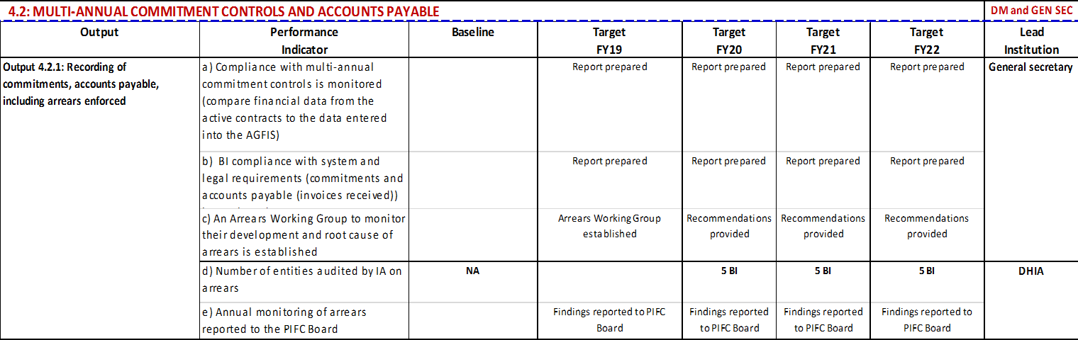
Abbreviations: FY-Fiscal year; PIFC-Public Internal Financial Control; DHIA-Department of Harmonization of Internal Control

Slide 20
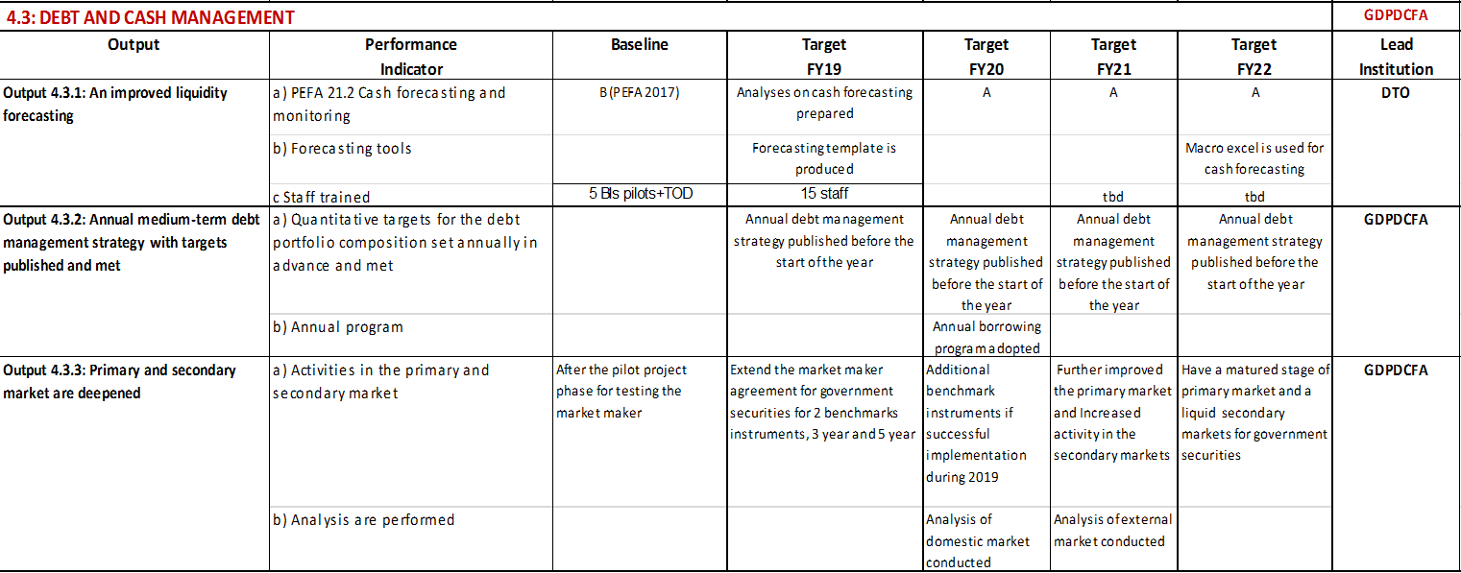
Abbreviations: FY-Fiscal year; PEFA-Public Expenditure & Financial Accountability; DTO-Department of Treasury Operations; GDPDCFA-General Directorate of Public Debt and Coordination of Foreign Aid

Slide 21
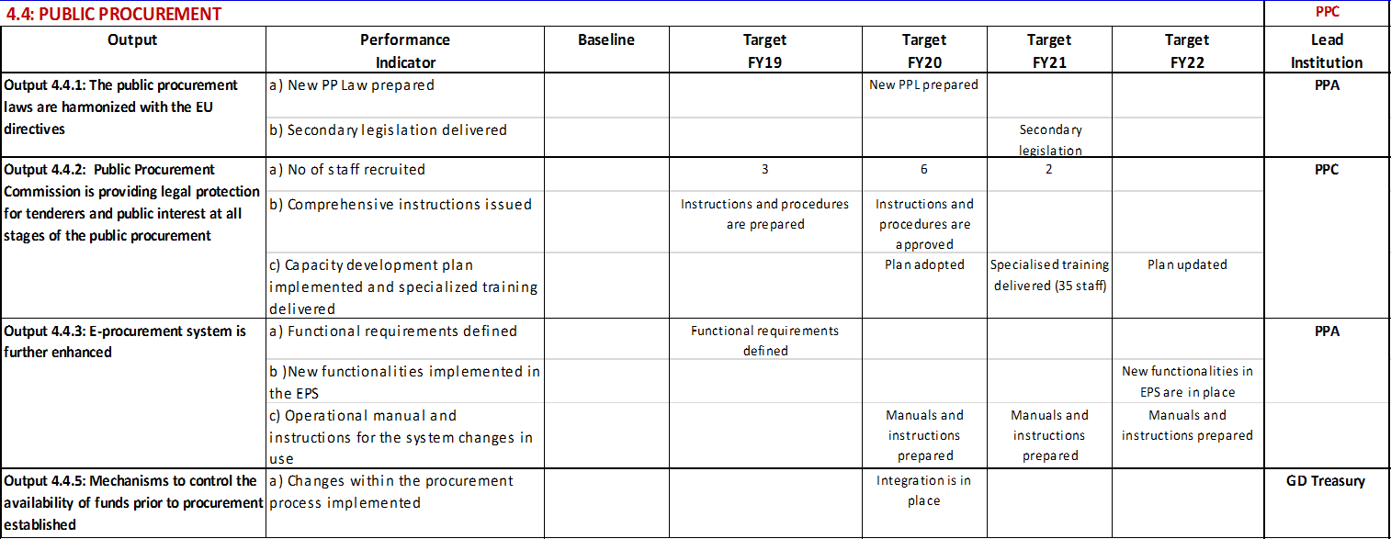
Abbreviations: FY-Fiscal year; PPA-Public Procurement Agency; PPC-Public Procurement Commission; GDTreasury-General Directorate of Treasury

Slide 22
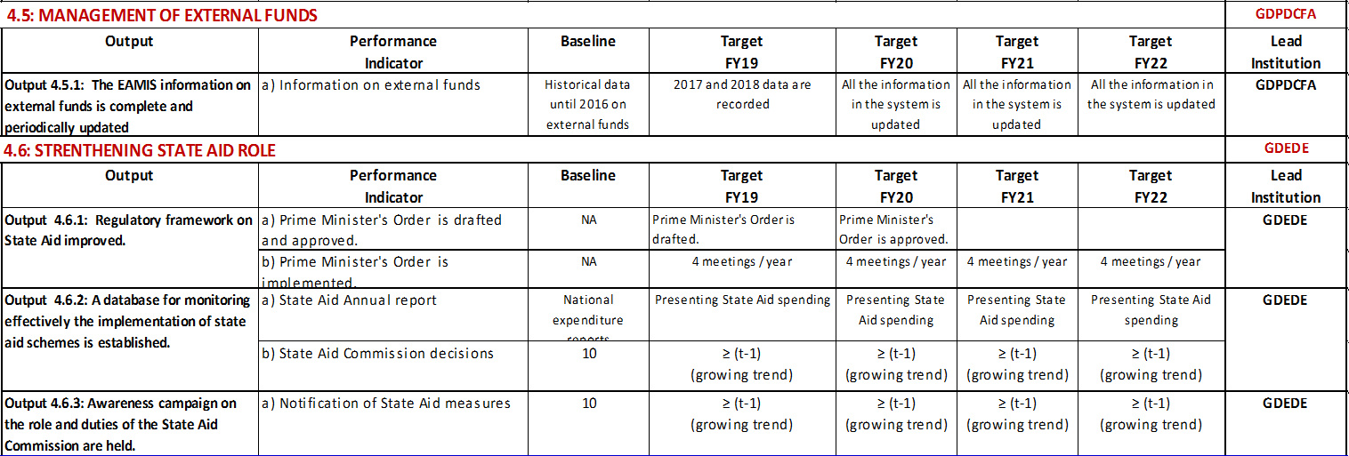
Abbreviations: FY-Fiscal year; GDPDCFA-General Directorate of Public Debt and Coordination of Foreign Aid; GDEDE-General Directorate of Economic Development and Employment;

Slide 23

Abbreviations:
INSTAT-Institution of Statistics
DTO-Department of Treasury Operations
MOU-Memorandum of Understanding
GFS-Government of Financial Statistics; BOA-Central Bank

Slide 24

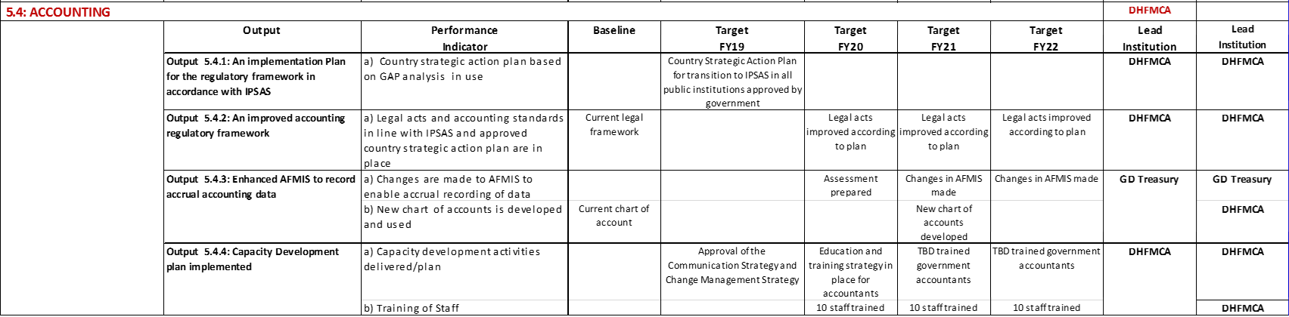

Slide 25


Slide 26
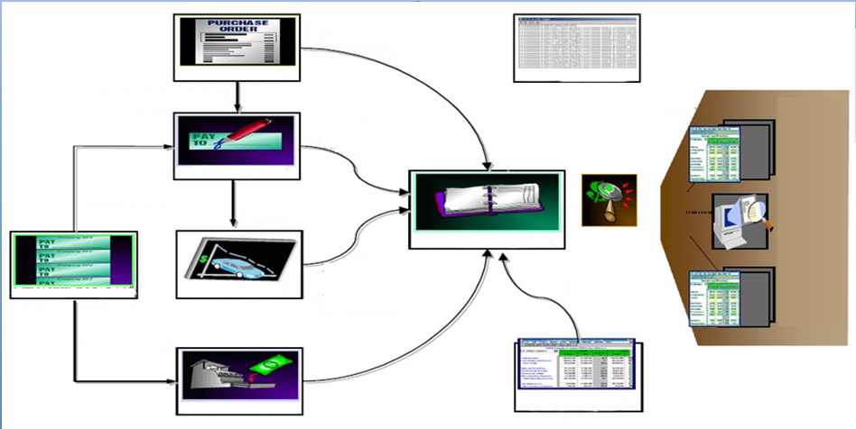
1. AGFIS - Albanian Government Financial Information System’s modules
1.Banking System daily data (interface)
2.Tax System daily data (interface)
3.Customs System monthly data (manually)
4.Social Insurance System monthly data (manually)
5.Obligatory Fund of Health Care System ( ‘’ ‘’ ‘’ )
6.Foreign Financing Project Implementation Units’
monthly data (manually)
7.Assets/.Inventory Journals’ annual data
(manually in 13th period)
Requisition (15 Institutions)
Commitments (All Institutions) (contracts/purchase order)
Purchases
Outside Systems
Invoice matched with released commitment
Expenditures/Payments
Financial Reports
Payables
Banking Reconciliation
Automatic assets additions
Journals Inquiry
General Ledger
Revisions
Assets’ capitalization/transfers/ depreciation/destructions
(used daily only by 6 institutions)
Financial Statements (Balance sheets) Inquiry
Cash Management
Fix Assets
Approval Budget, Revisions, Releases
Banking Reconciliation
Non Tax Revenues
Budget
Receivables
Notes:
AGFIS is the key system-based tool for controlling and monitoring revenues and expenditures and the government plans to roll-out the system to Bis. The system sits at the heart of effective budget execution. Currently, 15 budget institutions are enrolled onto AGFIS, representing around 74 percent of total spending, against the original plan in 2014 to roll out to up to 50 BIs by 2018. However, there has been no further roll out of the system to BIs since 2016. This has impacted both control of spending and arrears and the automation of payroll controls though the HRMIS. The payroll management system currently covers over 50 percent of salaries, a significant increase from a baseline of 0.5 percent in 2014, but is still incomplete requiring manual checking and reconciliation of data. The Strategy envisaged a system for the management of external funds, External Aid Management Information System (EAMIS). While system design is finalised, the migration/entering of data is in process.

Slide 27
Treasury Operations’ Department
TSA Manag.
Division
Experts
(1+4)
36 TDO’s
Liquidity Manag.Division
Experts
(1+3)
36 TDO’s
Financial Reporting Division
Experts
(1+4)
36 TDO’s

Slide 28
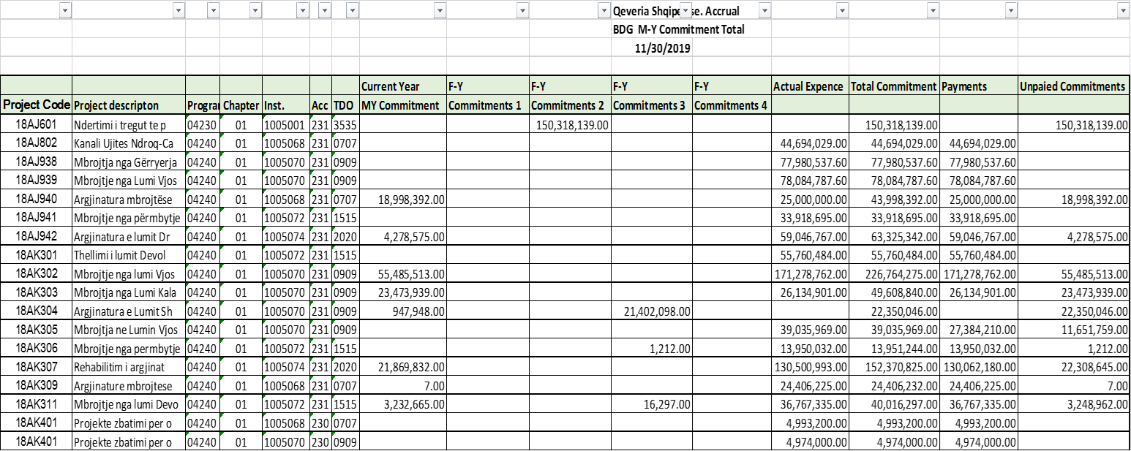
Monthly Financial Reports on unpaid amounts of multiyear commitments
Published in the link:
http://www.financa.gov.al/ecuria-e-investimit-te-projekteve-2/

Slide 29
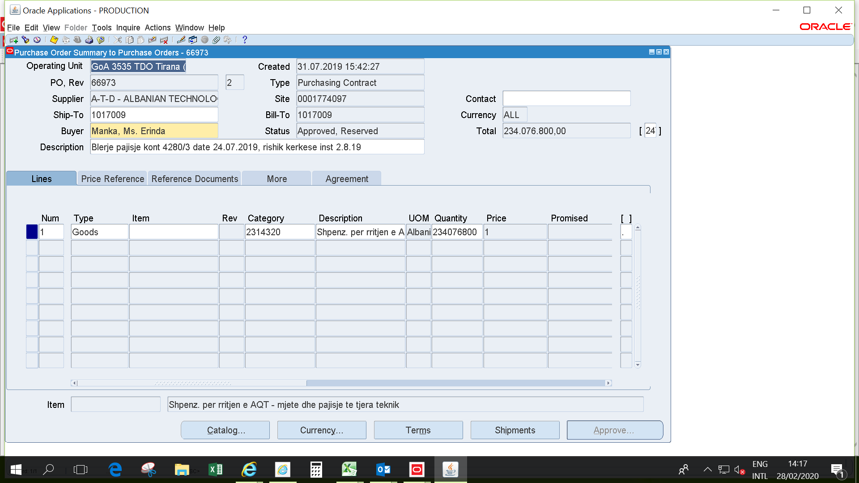
I - The commitments registration in AGFIS for spending unit offline with AGFIS (continuing)
(They carry out their transaction through Treasury District Offices-TDOs)
The screen below is the head of contract for investment project (economic account 231 by chart of accounts):

Slide 30
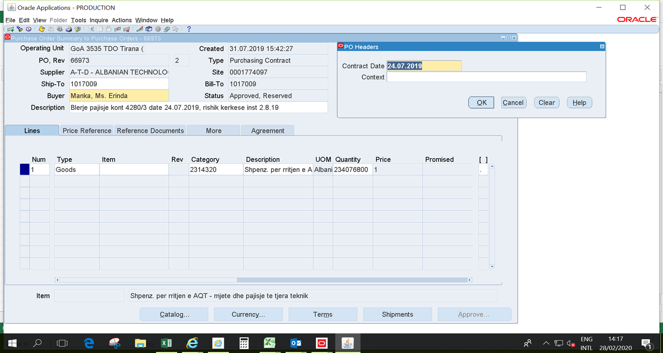
I - The commitments registration in AGFIS for spending unit offline with AGFIS (continuing)
(They carry out their transaction through Treasury District Offices-TDOs)
2. The screen below is the same with the screen 1, but display the description of the field in red quadrant, sideways the “Total”, which represents the date of original contract [we can compare the date of creation (record in AGFIS) on 31.07.2019 with the date of contract on 24.07.2019, it results that spending unit has submitted to Treasury within 5 working days (27-28.07.2019 are weekend)]:

Slide 31
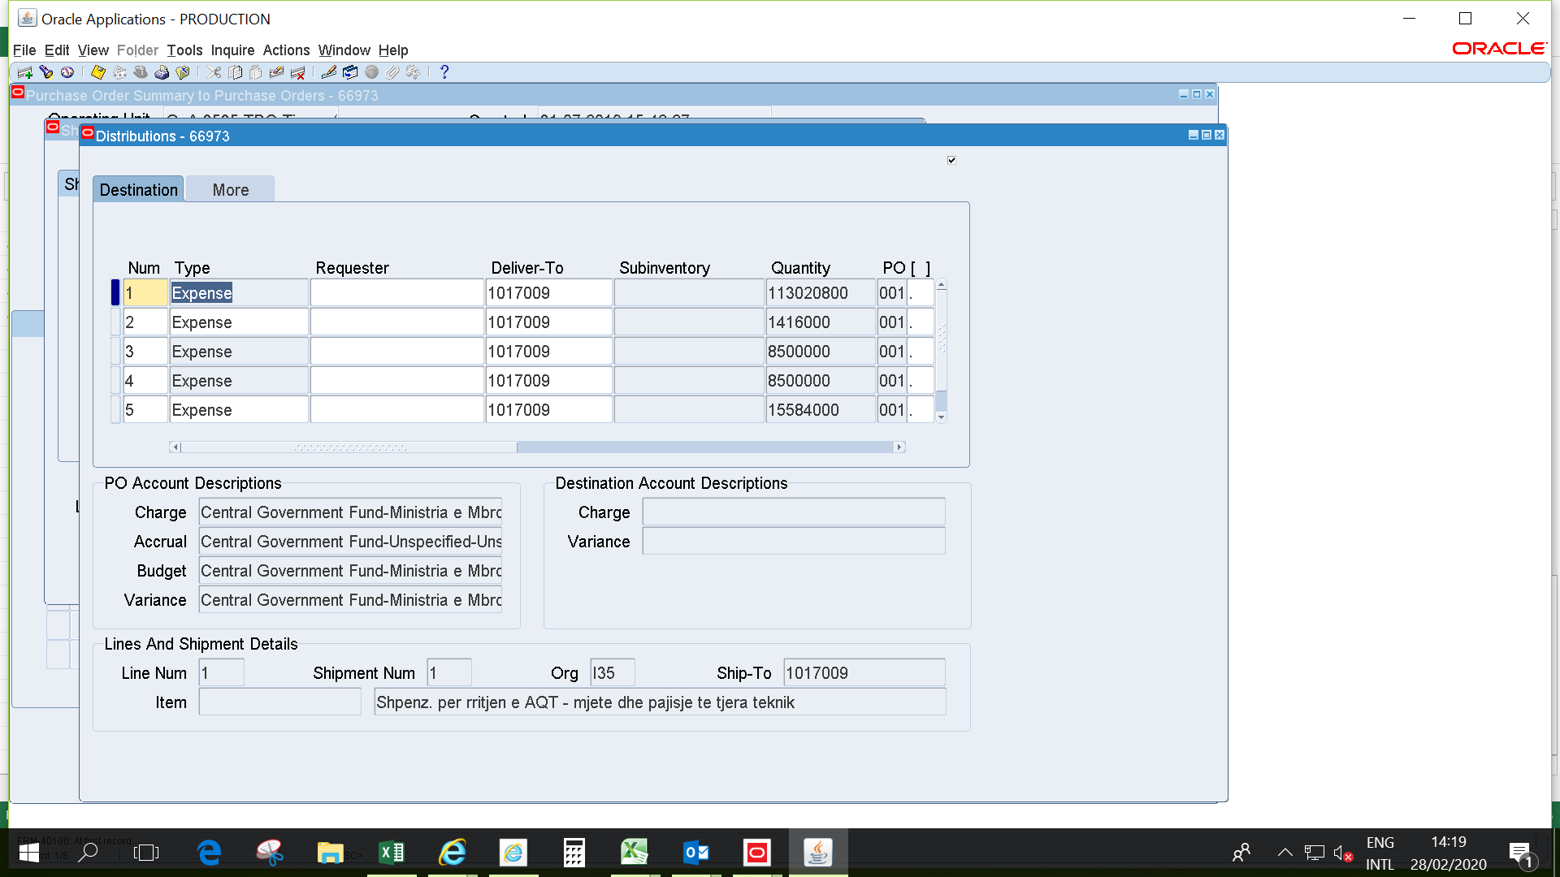
I - The commitments registration in AGFIS for spending unit offline with AGFIS (continuing)
(They carry out their transaction through Treasury District Offices-TDOs)
3. The screen below appears when is clicked on button “Shipments” in the end of the screen 2 (right side) and presents the invoiced amount of the contract (schedule of payments). The distribution window consists in two screens (you can understand by the position of horizontal lift, which is on the left side and then in the right side):

Slide 32
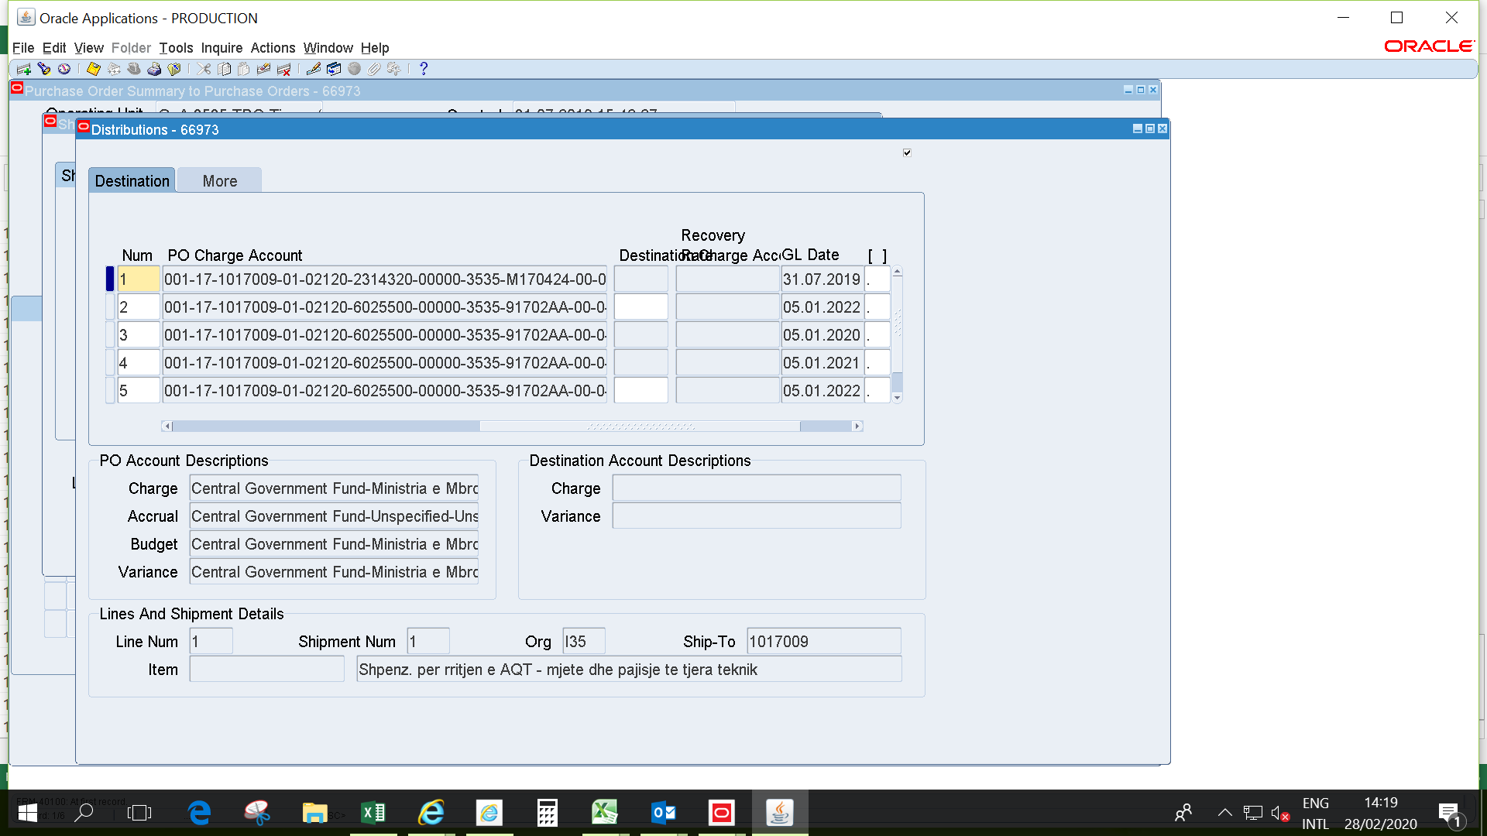
I - The commitments registration in AGFIS for spending unit offline with AGFIS (continuing)
(They carry out their transaction through Treasury District Offices-TDOs)
3.1. The screen below is continuing part of the screen 3 (you can see the position of horizontal lift on the right side):

Slide 33
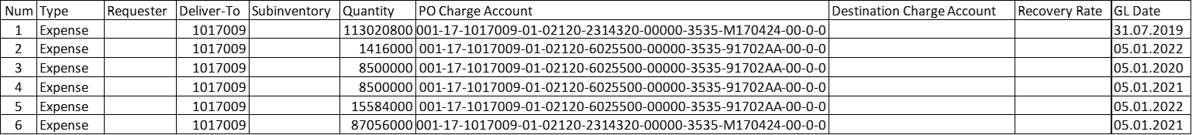
I - The commitments registration in AGFIS for spending unit offline with AGFIS (continuing)
(They carry out their transaction through Treasury District Offices-TDOs)
A summarized table on the data of two screens in slides 31-32:

Slide 34
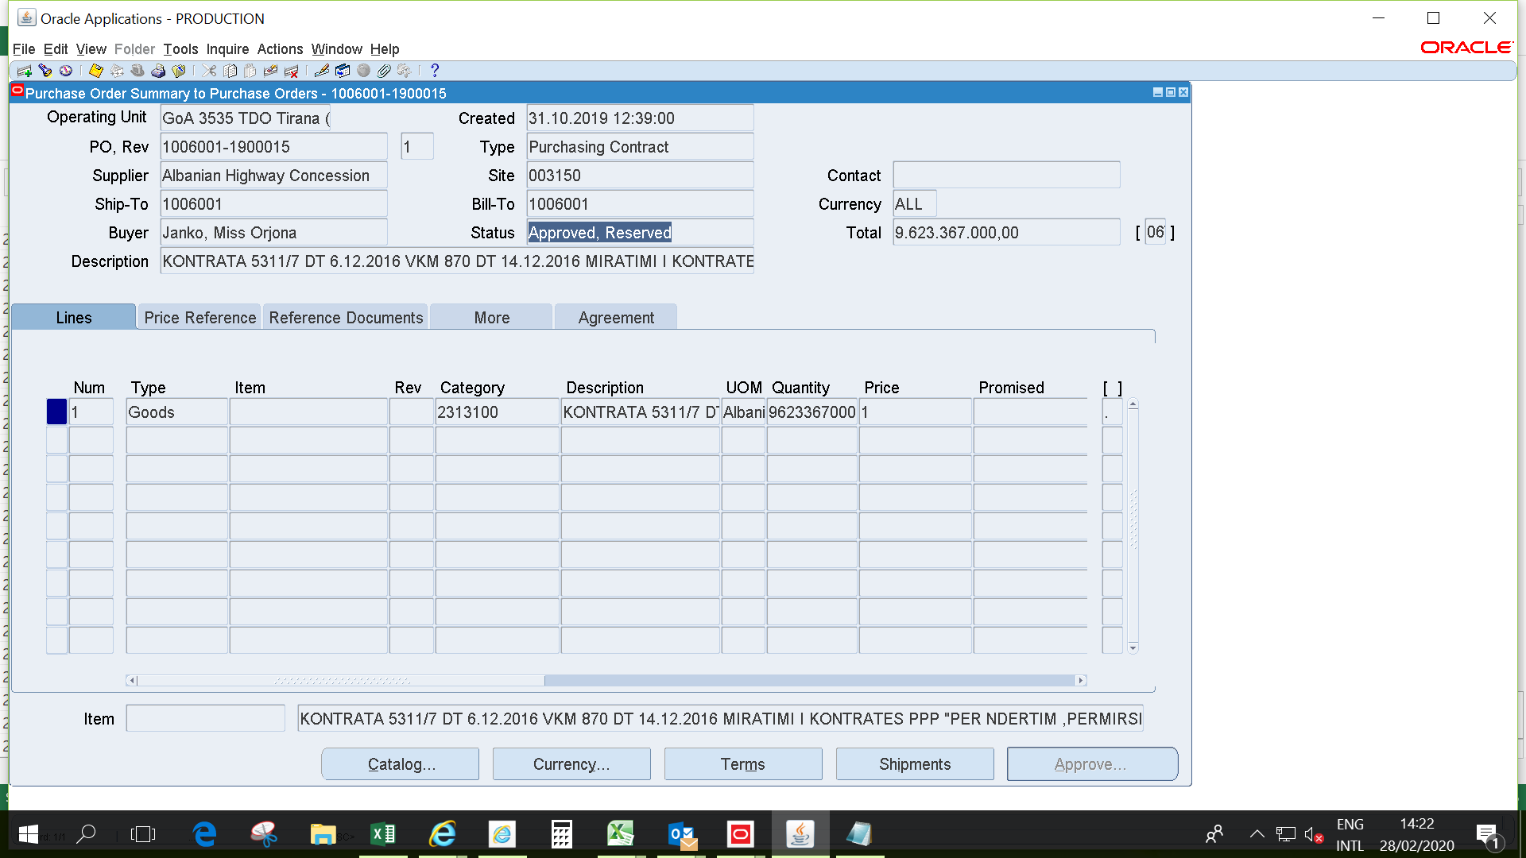
II-The commitments registration in AGFIS for spending unit online with AGFIS (continuing)
(They carry out their transaction by themselves, user of AGFIS)
1. The screen below is the head of contract for investment project (economic account 231 by chart of accounts) of PPPs (Public Private Partnership):

Slide 35
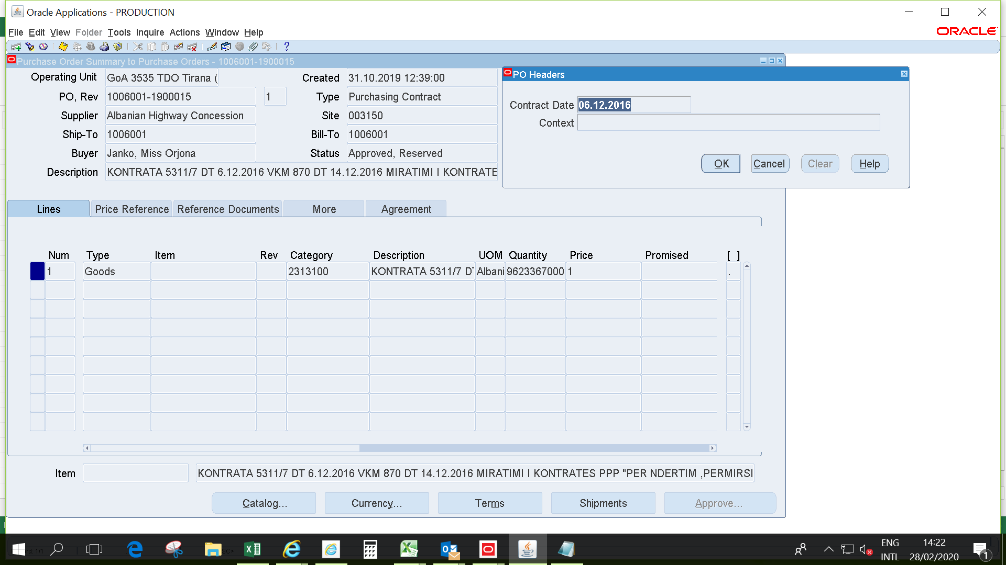
II-The commitments registration in AGFIS for spending unit online with AGFIS (continuing)
(They carry out their transaction by themselves, user of AGFIS)
2. The screen below is the same with the screen 1, but display the description of the field in red quadrant, sideways the “Total”, which represents the date of original contract [we can compare the date of creation (record in AGFIS) on 31.07.2019 with the date of contract on 06.12.2016, depending by agreement terms of PPPs on budget financing]:

Slide 36
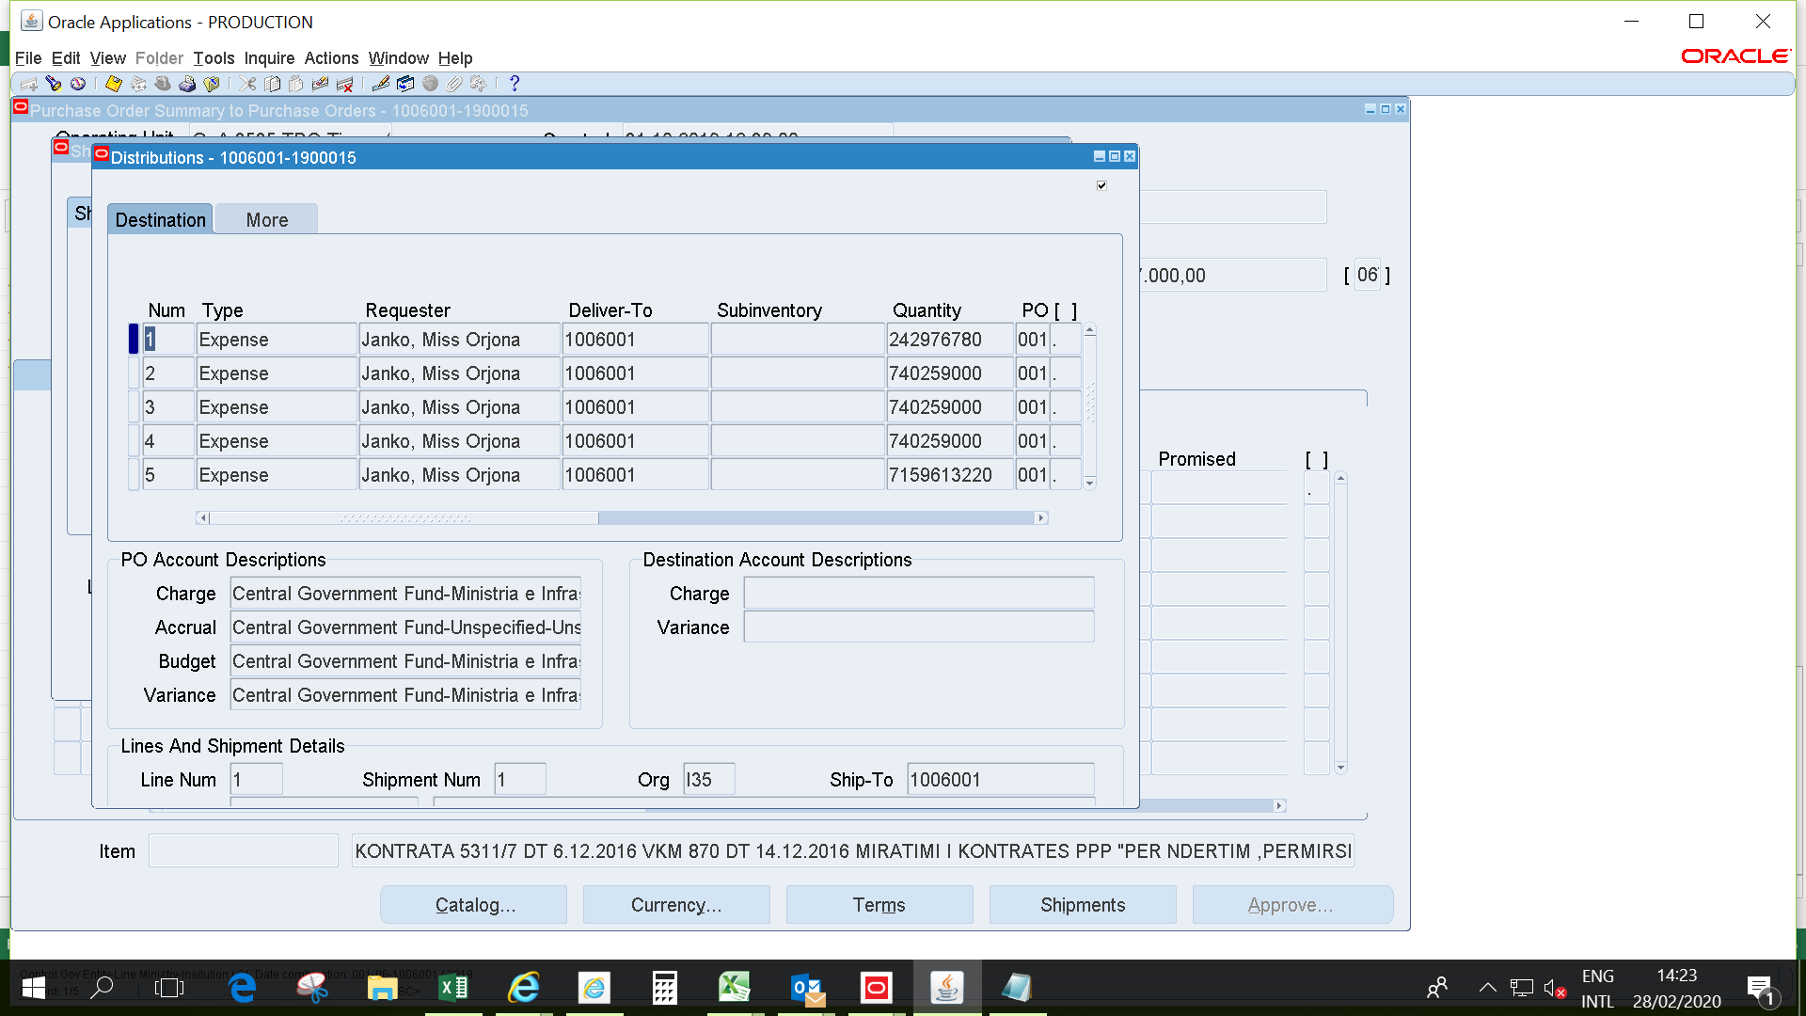
II-The commitments registration in AGFIS for spending unit online with AGFIS (continuing)
(They carry out their transaction by themselves, user of AGFIS)
3. The screen below appears when is clicked on button “Shipments” in the end of the screen 2 (right side) and presents the invoiced amount of the contract (schedule of payments). The distribution window consists in two screens (you can understand by the position of horizontal lift, which is on the left side and then in the right side):

Slide 37
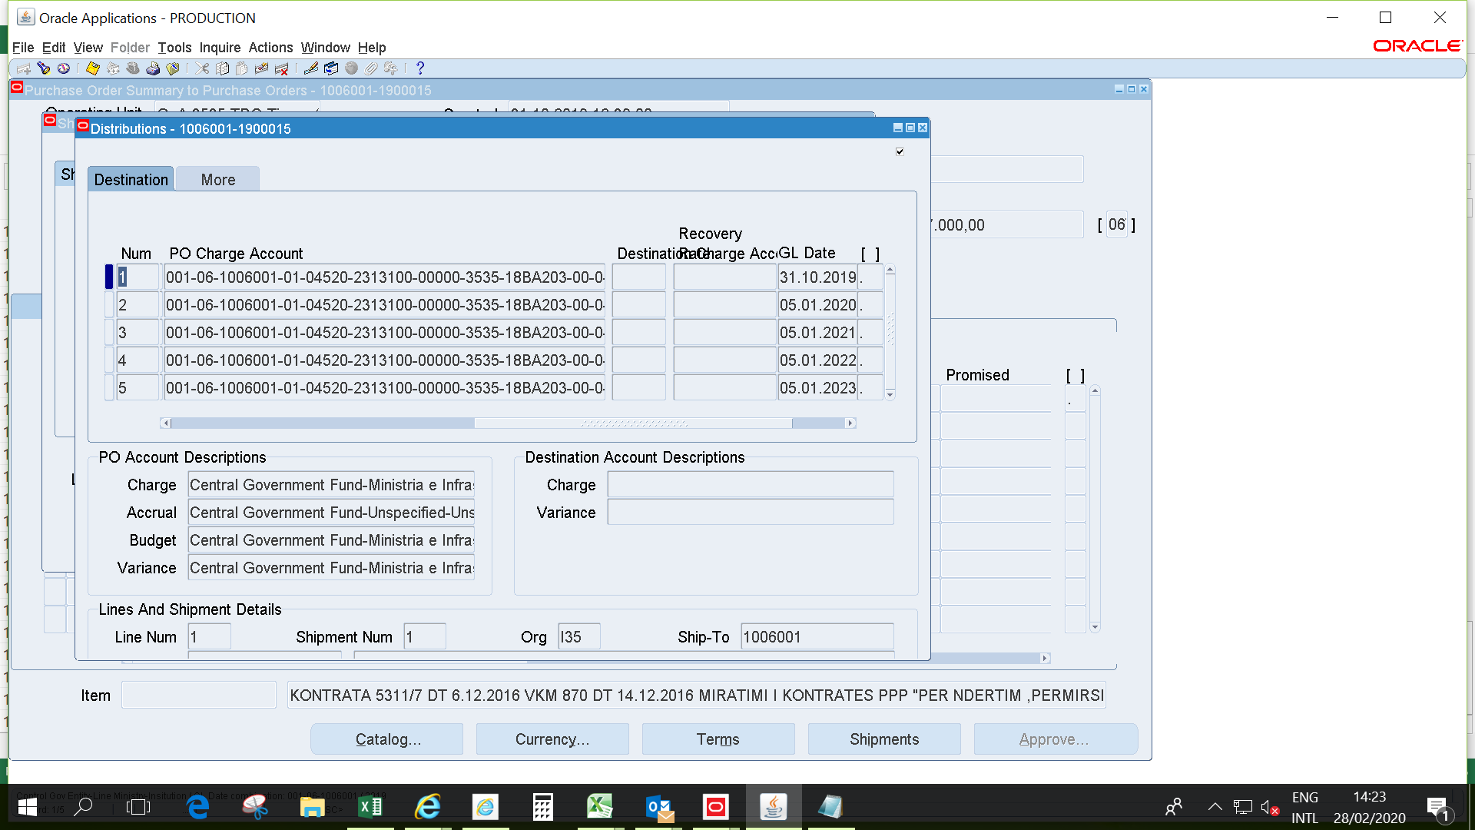
II-The commitments registration in AGFIS for spending unit online with AGFIS (continuing)
(They carry out their transaction by themselves, user of AGFIS)
  3.1. The screen below is continuing part of the screen 3 (you can see the position of horizontal lift on the right side)

Slide 38
II-The commitments registration in AGFIS for spending unit online with AGFIS (continuing)
(They carry out their transaction by themselves, user of AGFIS)
A summarized table on the data of two screens in slides 36-37:

Slide 39
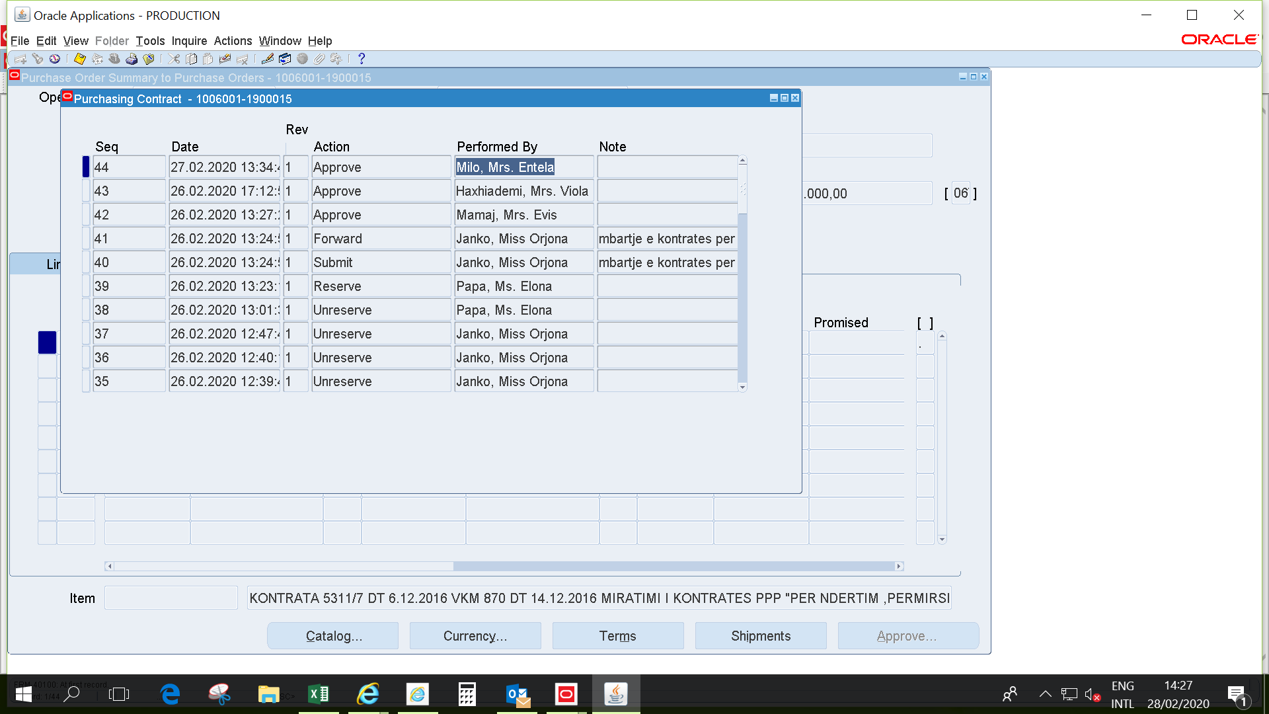
II-The commitments registration in AGFIS for spending unit online with AGFIS (continuing)
(They carry out their transaction by themselves, user of AGFIS)
4. Also Treasury monitor the hierarchy of approval of the contract from responsible officer of spending units online with AGFIS, the last approval (the highlighted first row) is the treasury approval:

Slide 40
Format of IT report on multiyear commitment by signed schedule
Use for cash flows forecasting
Table 1
The information of the last column of table 1 “General Ledger Date” is considered for the cash flows forecasting:

Slide 41
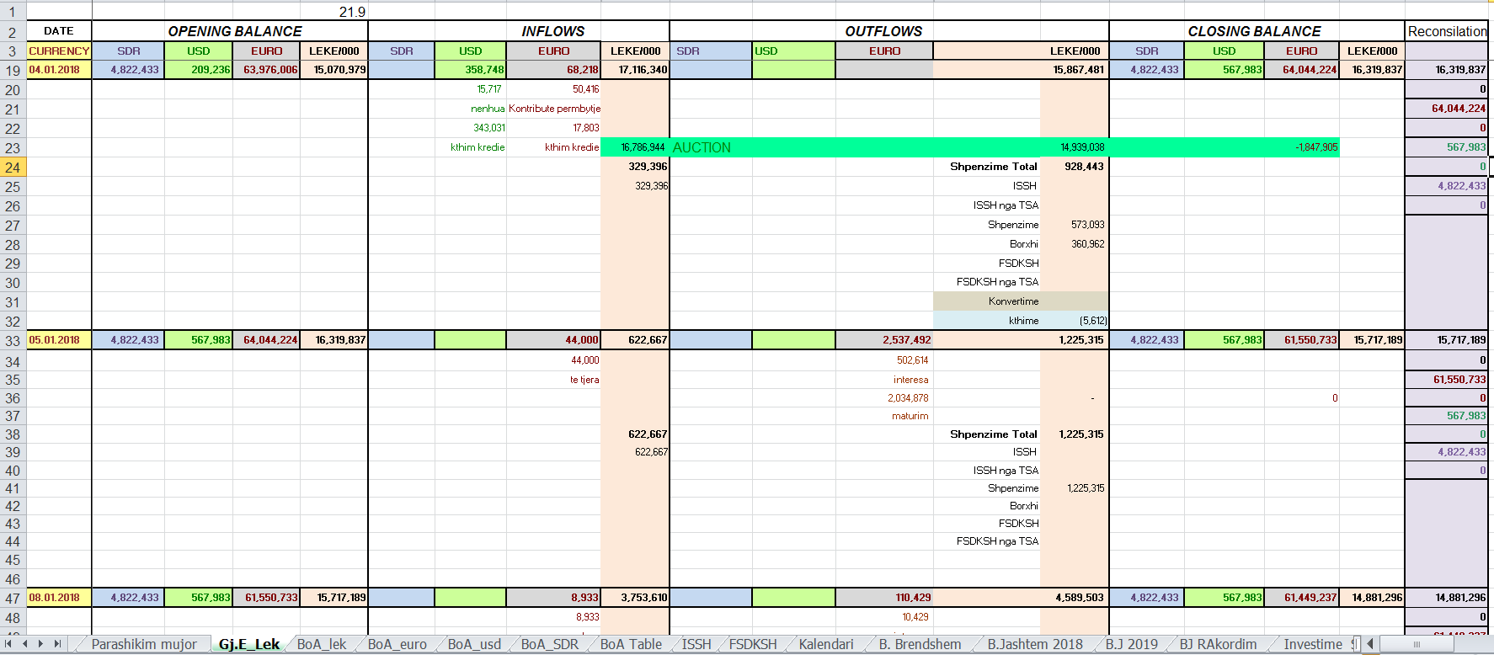
Format of IT report on multiyear commitment by signed schedule (continuing)
Use for cash flows forecasting
Table 2-The format of daily cash flows forecasting:
The amount of the “Shpenzime” item of the outflows of the Table 2 on one day of the month must be higher than the total amount of the commitments’ schedule (invoiced amount) for the respective day of the contract of Table 1.

