Slide 1
Hungarian State Treasury
Forecast preparing solution

Slide 2
Treasury Single Account
TSA was set up, when the Treasury was established (1996)
HUF account, kept by the National Bank of Hungary. The money circulation of the budget is executed through this account, incomes are arriving to this account, and expenditures are paid from here
TSA covers (subaccounts of the TSA):
accounts of central budget institutions and chapters;
social security funds and extra-budgetary funds;
accounts linked to centrally managed appropriations;
finance related accounts;
accounts of regional development councils;
accounts of county governments and their offices;
accounts of public foundations;
accounts of non-profit companies (majority state influence);
accounts of other organizations defined in the law on public finances.

Slide 3
Structure of the tsa subaccounts

Slide 4
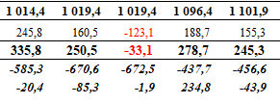
Forecasting the balance of the Treasury Single Account
The Hungarian State Treasury prepares forecasts on the liquidity position of the central subsystem of public finances.
Daily breakdown
Current month + two months ahead
Government Debt Management Agency
National Bank of Hungary
Ministry of Finance

Slide 5
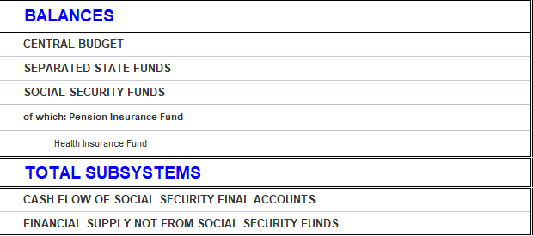
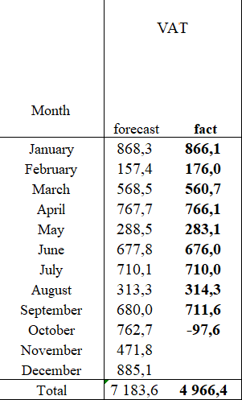
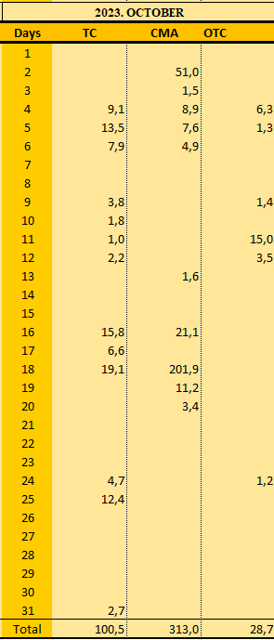
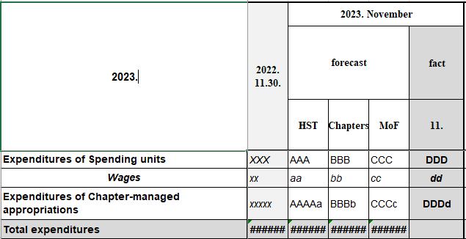
Forecasting the balance of the Treasury Single Account – Resources
Quick/daily report on the budgetary position of the central subsystem
Analytical sheet on the revenues and expenditures
Forecast on revenues and expenditures of spending units and chapter-managed appropriations
Forecast on revenues and expenditures of Social Security Funds and Extra Budgetary Funds
Data provision on the expected (large amount) expenditures
Debt management outlook and issuance calendar from the Debt Management Agency
Expenditures related to the European Agricultural Guarantee Fund (on paper)

Slide 6
Resource data - Quick/daily report on the budgetary position of the central subsystem
Based on the circulation of the accounts managed by the Treasury.
Every account is assigned to a line of the daily report.
Main lines - Revenues (Budgetary items)
Payments of economic organizations (Corporate tax, Special tax on financial organizations, Advertising tax, Game tax, Mining royalty…)
Taxes related to consumption (Value added tax, Registration tax, Insurance tax…)
Payments of households (Income tax, Tax payments, Fee payments…)
Revenues of spending units and chapter-managed appropriations
Revenues from both subsystems of public finances
State property-related revenues
Interests
Revenues from the European Union
Other revenues
Revenues of Extra Budgetary Funds
Revenues of Social Security Funds

Slide 7
Resource data - Quick/daily report on the budgetary position of the central subsystem
Main lines - Expenditures (Budgetary items)
Individual and normative subsidies
Public service broadcasting fund support
Social policy fees
Housing support
Family support and social fund
Expenditures of spending units and chapter-managed appropriations
Supports for both subsystems of public finances
Expenditures of programs related to the European Union
Interest payments
Reserves
Extraordinary expenses
Contribution to the budget of the European Union
Other expenditures
Expenditures of Extra Budgetary Funds
Expenditures of Social Security Funds

Slide 8
Resource data - Quick/daily report on the budgetary position of the central subsystem
Main lines - Items to be financed (Financial items)
Central budget deficit or surplus
Advance loan payments for local governments
Advances to the European Agricultural Guarantee Fund
Technical accounts for wages from the preceding year
Debt payment
Main lines - Financing items (Financial items)
Own financing items
Government securities
Loans

Slide 9
Structure of the Forecast table
Balance of central budget
Financing need
Own financing items
Government Debt Management Agency operations
Financing source together (2+3)
= Balance
Calculated balance of TSA

Slide 10
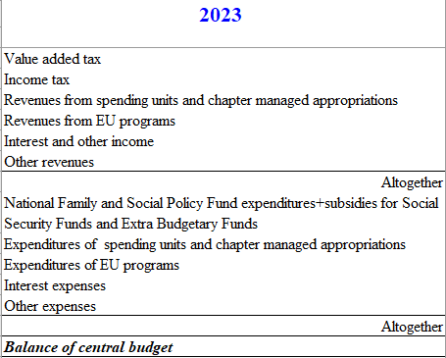
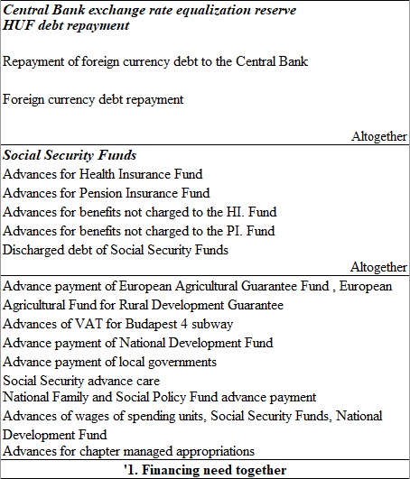
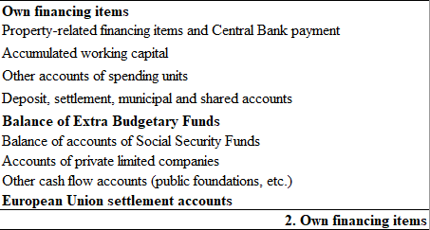
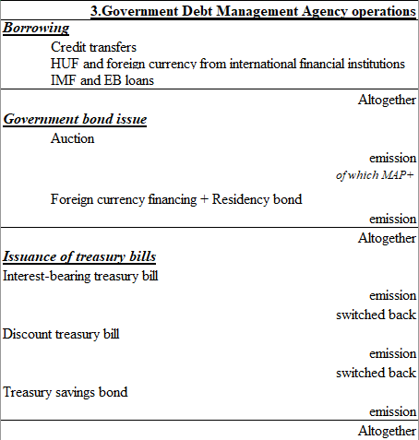
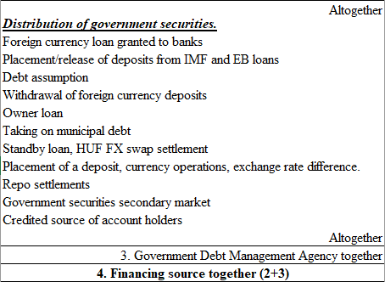
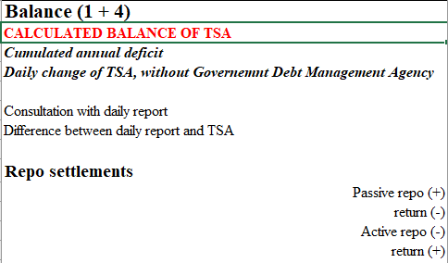
Structure of the Forecast table

Slide 11
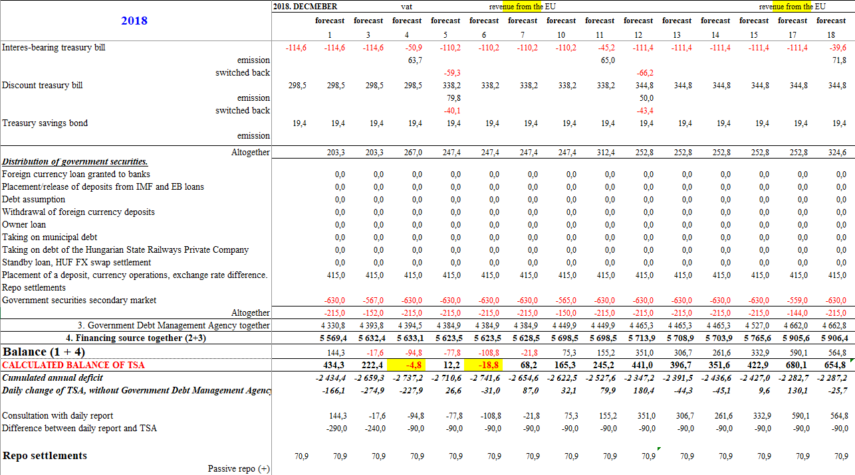
interaction between the treasury and the Government debt management agency
Forecast report 2018.11.07.

Slide 12
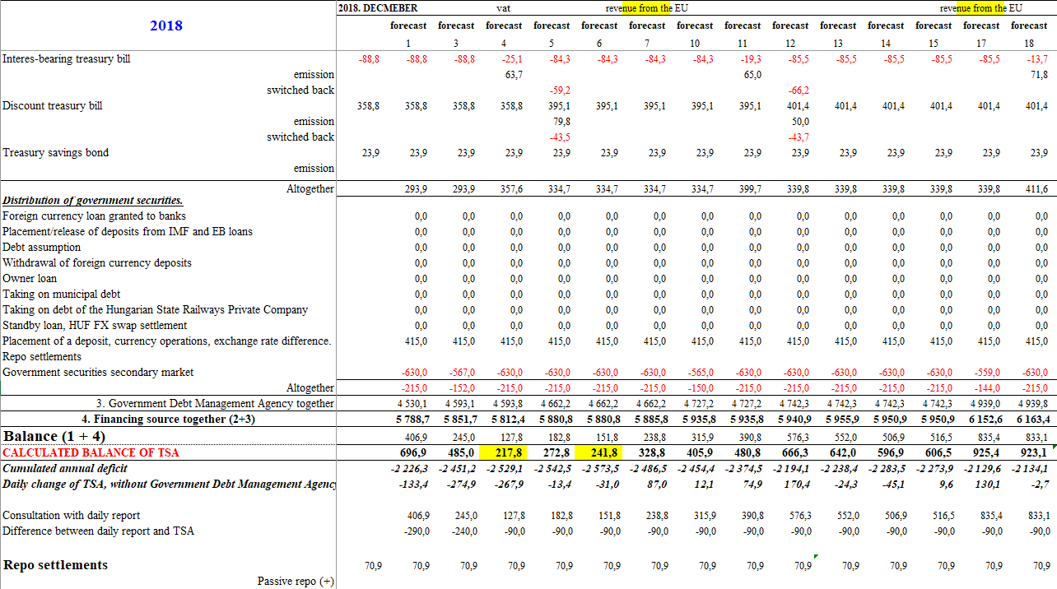
interaction between the treasury and the government debt management agency
Forecast report 2018.11.26.

Slide 13
Thank you for your attention!

