Slide 1

Hungarian State Treasury
Foundations of an integrated Financial management information system

Slide 2

Hungarian State TreAsury (HST)
HST was founded on the 1st of January 1996 as the organization responsible for budget execution.
During the implementation process of the budget, HST is responsible, among others, for
  appropriation management,
  account management,
  clearing off accounts,
  cash-, deficit- and state debt management (in cooperation with the Debt Management Agency),
  data supply.
HST provides some budgetary, executive, control and financing functions concerning payments from the funds of the European Union. It performs tasks related to the financial relationship between the central budget and local governments. HST carries out payroll calculations in the public sector.
HST became a highly centralized organization recently after the absorption of payment functions of several entities including the Office of Agriculture and Rural Development and the Directorate of National Pension Funds.

Slide 3
Former PFM systems
Developed by HST
  T20XX – internal banking system
  TSH – appropriation management system
Developed by Hungarian vendors
  KGR-K11 – information (institutional budgets, elementary budgets, interim reports, annual reports) gathering system
  OTR – monitoring system for budgetary subsidies
  KIRA – central payroll calculation system for the whole public sector
  Treasury dream – general ledger for centrally managed appropriations
  Bookkeeping system – institutional bookkeeping system
  ASP – Data warehouse and financial management system for local governments
  KTÖRZS – register of public institutions

Slide 4
Former PFM network
payroll
EKR
subsidies
EMIR
FAIR
KTÖRZS
KIRA
purchases
OTR
Spending units
Manual process
Electra (offline frontend)
Treasury accounting and reporting
T20XX
Book
keeping
KGR-K11
Analitical data
Treasury dream
General ledger
Manual process
Synthetic data
eADAT
TSH
Centrally managed appropriations
Manual
process
Manual process
ASP
EFER
ÖNKADÓ
Debt mgt
Tax Office
Spending units

Slide 5
Scheduling of the project elements
Preparatory phase
Public purchasing processes
Detailed Design
The DWH started functioning and received data from old and new systems simultaneously
The Budget Module, the Integrated Accounting Application, and the Institutional Accounting system went live
The New Banking System managed the accounts outside the Treasury Circle since
The New Banking System took over the accounts of the Treasury Circle
Detailed information on commitments
Public Finance Portal
2016
2018-2019 Q1
2019 Q2
2020 - 2021
01.01.2022
01.05.2021
01.01.2022
01.01.2023
2023 Q2
01.06.2021

Slide 6
Two projects: 1) ifmis + DWh, 2) Internal banking System
KM
KÖR
INKA
Budget Management Module
Institutional Accounting System
Central Accounting System
Detailed breakdown of statutory appropriations
Management of mid-year changes in appropriations
Reporting, amending and checking commitments and receivables
Fulfillment of expenses, receipt of incomes
Financing, opening budget resources
Management of factual and expected data on budget implementation
Supports the accounting of institutional appropriations
General ledger accounting
Management of appropriations
Support for framework management
Cash management
Management of supplier and customer accounts
Asset and inventory records
Management of commitment and receivables
VAT analytics
Supports the general ledger accounting tasks of centrally managed appropriations
High degree of automation in the general ledger of appropriations and fulfilments based on transactions performed in KM
Uniform electronic management of data submitted by different external and internal data providers
DWH reporting tools

Slide 7
Two projects: 1) ifmis + DWh, 2) Internal banking System
Implementation of a multi-currency account management system (SZR)
A new type of informative account statement
Customer FrontEnd with online access available on the Internet - with two-factor authentication
Introduction of (new) bank standard services (e.g. instant payment, receiving)
Group transfers in IG2
Integrated operation - MDM, KM, DWH
Further developments

Slide 8
Change management – internal banking system
Accounts migrated to the New Banking System on 01.05.2021. and 01.06.2021.
Accounts migrated to the New Banking System on 01.01.2022.

Slide 9
Monthly turnover numbers
Payment transactions of the Treasury take place exclusively in SZR
  The distribution of turnover to settlement channels was as follows:
Turnover in February 2023 | IG1 |  | IG2 |  | Instant |  | Total
 | Transactions | Million HUF | Transactions | Million HUF | Transactions | Million HUF | Transactions | Million HUF
Outgoing | 4 283 932 | 713 462 | 1 537 950 | 2 371 727 | 16 970 | 8 307 | 5 838 852 | 3 093 496
Incoming | 36 918 | 16 258 | 901 924 | 1 784 964 | 1 704 143 | 348 280 | 2 642 985 | 2 149 501
Treasury's turnover in February 2023 was the 2nd largest in the ranking of Interbank Clearing System by turnover value, with a share of 14.6%.

Slide 10
current PFM systems
Developed by International vendors (SAP)
  KM – Budget Management Module
  INKA – Central Accounting System
  MDM – Master Data Management
  DWH – Data Warehouse
  ESB – internal data traveler
Developed by Hungarian Vendors
  SZR – internal banking system
  KÖR – bookkeeping system for spending units
  KKSZB – external data traveler

Slide 11
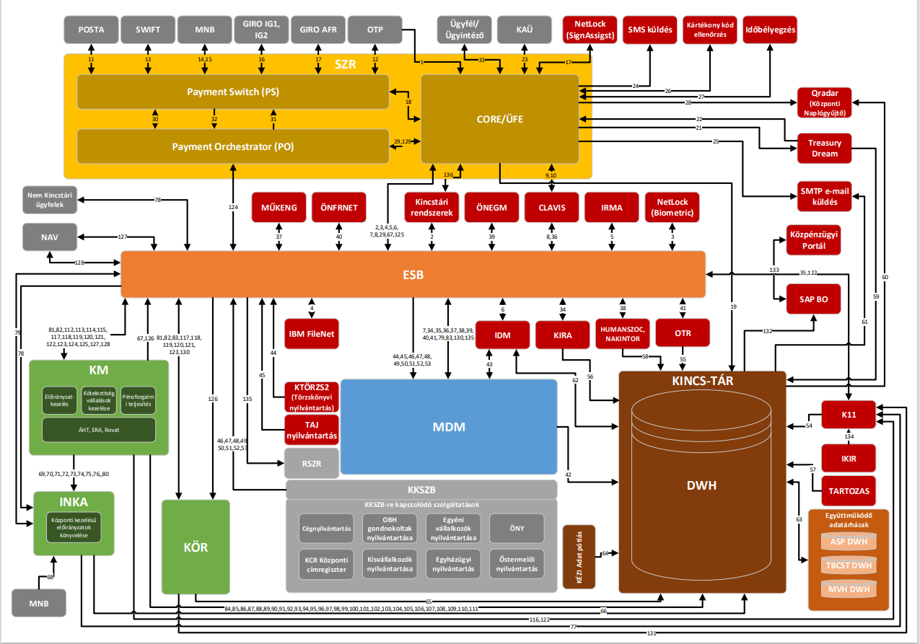
Current PFM Network

Slide 12












New way of providing information services
The data warehouse automatically processes and stores the data historically in a form optimized for analysis
Hungarian State Treasury
Ministry of Finance
Debt Management Agency
State Audit Office
Ministry of the Interior
Budget Council
Central Statistics Office
National Bank of Hungary
Ministries
Treasury’s BI portal
IFMIS systems and other source systems
IFMIS data warehouse
Dashboards
Reports
Citizens
NGOs
Businesses
The data to be loaded is automatically sorted and generated from the source systems
Public Finance Portal

Slide 13
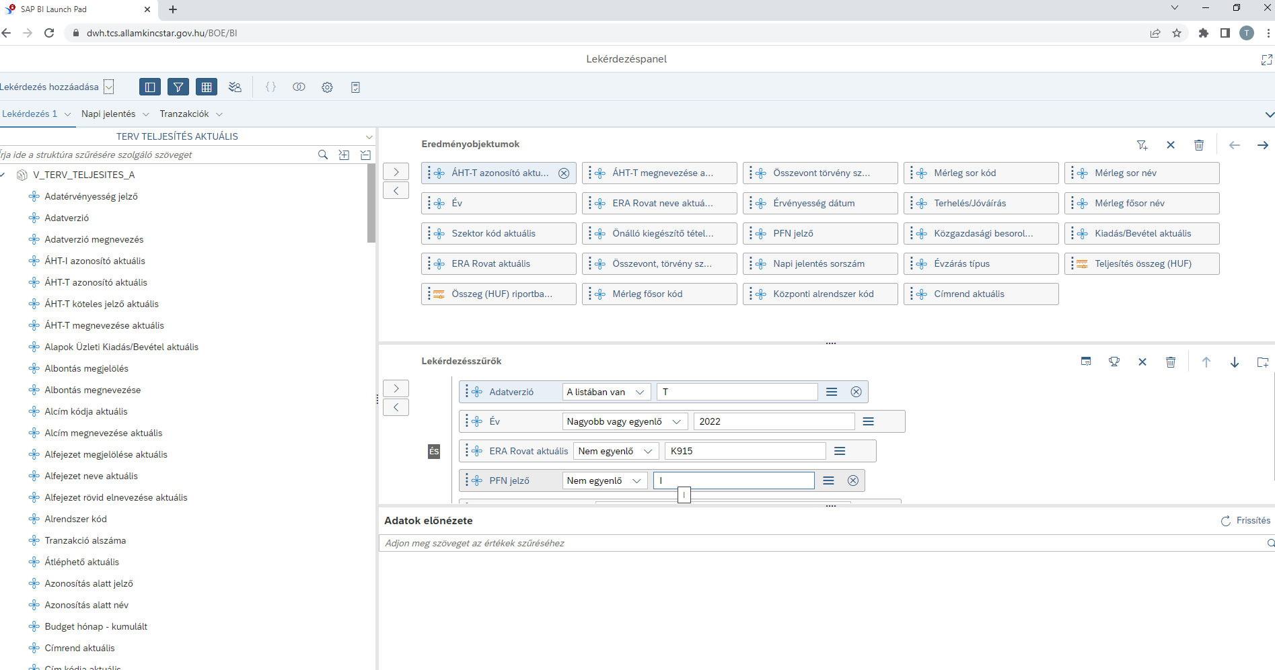
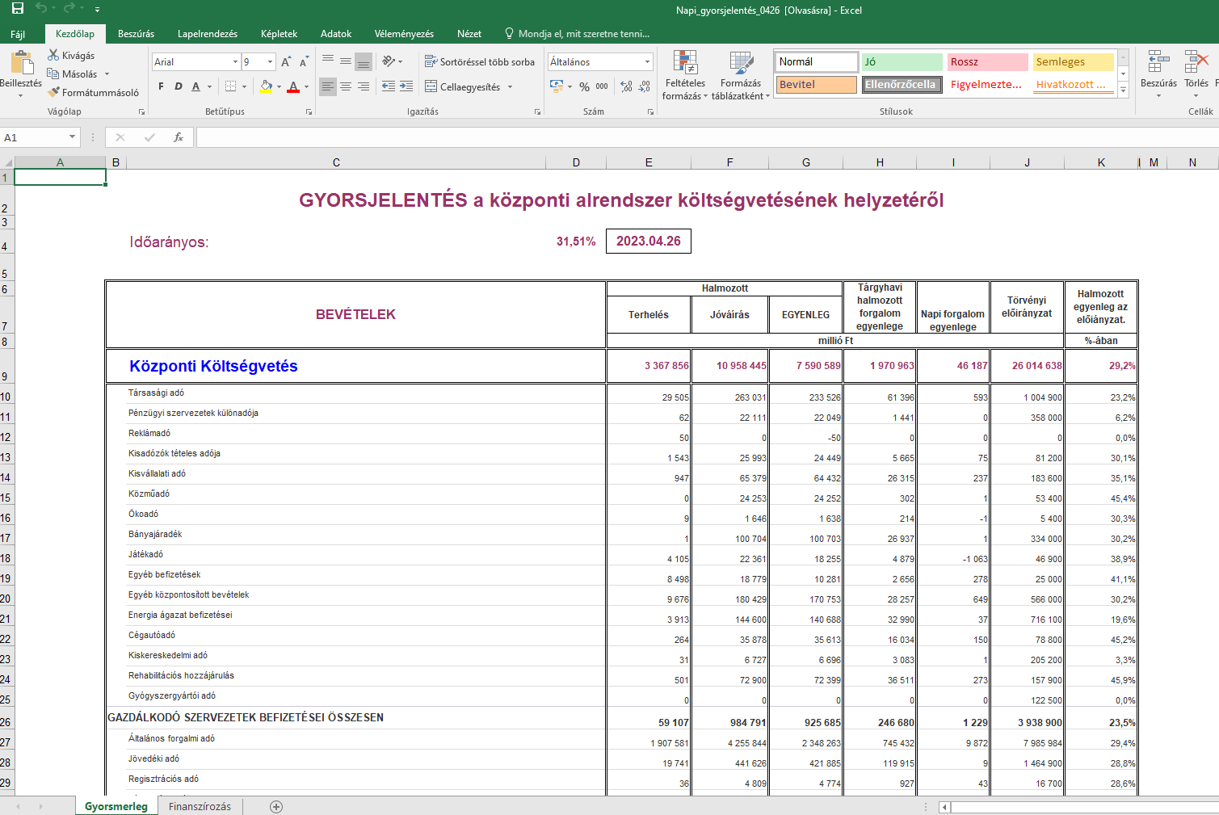
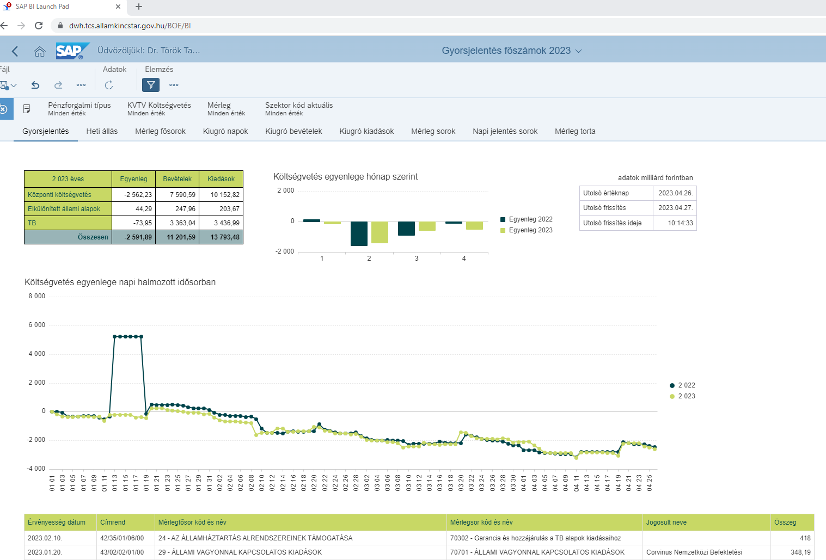
New ways of reporting

Slide 14
Lessons learned
Based on user experience, with time and financial requirements in mind.
 | Developed by HST | LDSW | COTS
Supply | + | + / - | -
Maintenance | + | + / - | -
Development | + | + / - | -
Reporting | - | + / - | +
Flexibility | - | + / - | +
 | T20XX | OTR | KM
 | TSH | KGR-K11 | INKA
 |  | KÖR | DWH
 |  | SZR | ESB
 |  | KKSZB | MDM
 |  | KIRA

Slide 15
Further development goals
New system connections to monitor the settlement of budgetary subsidies
Standard accreditation process for bookkeeping systems
Developing automated reporting tools
Connection with other Treasury data warehouses
Detailed information on commitments
Involving budgetary planning processes in the new functioning method

Slide 16
Thank you for your attention!

