Slide 1
Certification and Mentoring system for Internal Auditors in Estonia
Evelin Pungas
Financial Control Department
Internal Control Coordination Unit (CHU)
17.-20.04 2012, Sofia

Slide 2
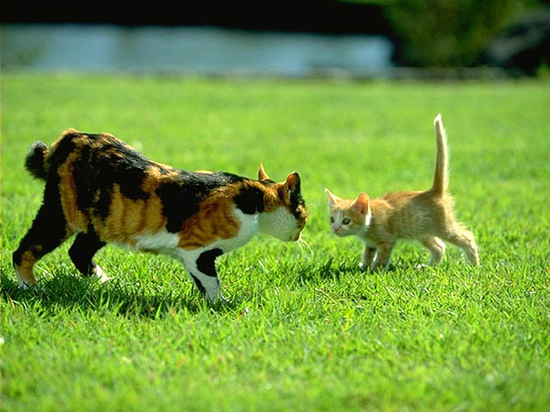
Who is an Internal Auditor?
Or someone very cooperative?
Or not so cooperative
Some kind of a watchdog?

Slide 3
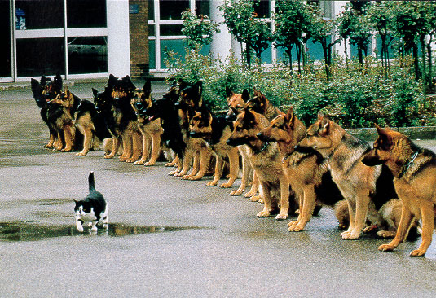
Internal Auditors should be respected
He or she is a professional!

Slide 4
So the main question is - how to improve the quality of internal auditing?
… by following the internationally accepted approach.
But you cannot reach the quality overnight!

Slide 5
We need qualified professionals
Professionalism means
  adherence to the Standards
  compliance with the Code of Ethics
  competency, evidenced by certificates
  ongoing professional development
  maintaining a “Quality Assurance and Improvement Program.”

Slide 6
Auditors activities act establishes
requirements for public sector auditors, who are obliged to:
  follow the Standards (Mandatory Guidance is put into force with decree of Minister of Finance);
  act in compliance with the Code of Ethics;
  enhance his/her competences through continuous professional development.

Slide 7
Certification system
Internal auditors
Continuous
Professional
Education
reporting
Certification system for
public sector auditors
Qualification
maintenance
Examination system
Public Sector Entity’s
Internal auditor

Slide 8
Auditors activities act also defines
the requirements for examinees as follows:
  at least a bachelor’s degree or higher (university) education or equivalent educational qualification;
  2 years work experience
  These requirements shall be deemed to be fulfilled in case of a person has at least five years operated in a profession
  pay the examination fee
  pass the exams

Slide 9



There are three main players
in training/practice process:
        trainee
        trainer, instructor
        training organiser

Slide 10
Training program
Trainee with his/her instructor has to draw up the training program.
Training program has to be signed by both and submitted to the Ministry of Finance.

Slide 11
Training program must include at least:
the name, personal code and contact information of the trainee;
date of the first day and the duration of the training/practice;
name of the training organiser (entity or person);
name of the trainer/instructor, his/her qualification and contact information;
action plan with schedule showing how and when knowledge, skills and competence necessary for internal auditor’s professional practice will be obtained.

Slide 12
Training report
At the end of training/practice period trainee has to draw up a report, that must include at least:
  name, personal identification code and contact information of the trainee;
  date of the first day and the duration of the training/practice;
  name of the training organiser (entity or person)
  name of the trainer/instructor, his/her qualification and contact information;
  actual training/practice period;
  description of tasks and assignments trainee was fulfilling during the training period, also showing the time spent on these assignments;
  trainer’s opinion.

Slide 13
Training program
Training report has to be signed by trainee and trainer
and
when trainee applies for the certification exam, the training/practice report has to be attached to the application.

Slide 14
Examination scheme
For public sector entity’s internal auditors there is a professional qualification sublevel consisting of two parts:
  Exam on Estonian Public Law
  CGAP test
The candidates who pass the exams will obtain the professional qualification sublevel on public sector entity’s internal auditor.

Slide 15
Thank You!

