Slide 1
Internal audit
Community of practice
Strategic Action Plan
FY2016-2017

Slide 2
Our Mission
IA COP offers support to its member countries
in establishing modern and effective Internal Audit system that
meets international standards and best practices and
is a key for good governance and accountability in the public sector
Our Core Values
Professionalism, dedication to reforms, commitment to sharing knowledge
and experience with the community (as professional family of peers),
trust, unity and respect to diversity of 23 member countries.
IACOP Motto
unityINdiversity

Slide 3
IACOP Balanced Scorecard
Internal Processes
To maintain and develop a
volunteer network of internal audit professionals through ‘peer’ learning,
knowledge management
with range of activities
Customer
To serve our
governments
Financial
Accomplish donors’ needs and make best value for money of PEMPAL with the help of Secretariat
Learning and Growth
Develop the volunteering, Executive Committee leadership, self sustainability
of IA COP Working Groups, coordination with Steering Committee and other COPs

Slide 4
IACOP Objectives
Addressing priorities of member countries and helping them to solve challenges in IACOP functional area.
Providing quality resources and sustainable network services to members, which are in line with relevant IA best practices and international standards. Promoting dedicated, sustainable and professional membership having a voice and influence and supported by appropriate leadership and communication technologies.
Ensuring financially sustainable network of IA professionals, supported by development partners and member countries’ in-kind and financial contributions, and via other sources of income (e.g. selling knowledge products, participation in IACOP events, etc.)
Raising awareness of high government and political levels regarding the benefits and value of IACOP impact on reforms.

Slide 5
Strategic Priorities for 2015-2017
Priority themes for the FY 2016-2017:
FMC implementation with emphasize on accountability and transparency (new working group)
Relationship of Internal Audit with Financial Inspection and External Audit (RIFIX continuing working group)
Practical implementation of audit cycle, different type and models of audits, including IT solutions (new working group)
Central harmonization units’ challenges at the different reform’s stages
Promotion of IACOP, including the existing knowledge products and experience gained in ongoing and previous working groups: T&C, CPD, RA, QA, Body of knowledge
The format of events proposed:
Plenary, working group, thematic meetings, ex com members and leaders’ meeting, study visit
Promotion activities, including distribution and of existing knowledge products (participation at national and international conference)
IACOP peers’ advisory missions and reverse study visit (types of thematic meeting)
Videoconferences, webinars (specifically for thematic meetings)

Slide 6
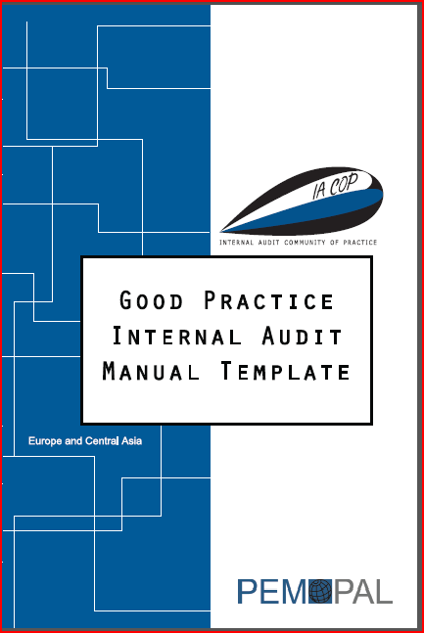
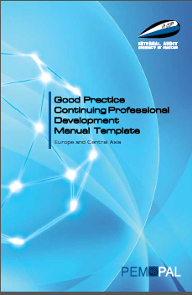
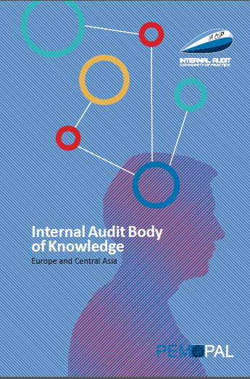
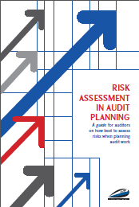
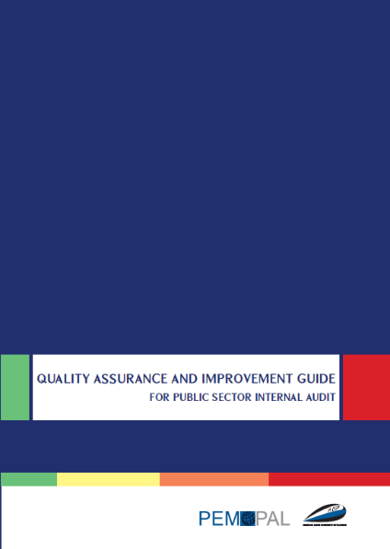
IACOP Good Practice Products
Good Practice IA Manual Template (completed and published)
Good Practice CPD Manual Template (completed and published)
Internal Audit Body of Knowledge (completed and published)
Risk Assessment in Audit Planning (completed and published)
Concept Note on RIFIX (Relationship of Internal Audit with Financial Inspection and External Audit) (to be completed in October 2015)
Quality Assurance Guide (to be completed in October 2015)
Communiqués and 100+ other knowledge products
Concept note on RIFIX

Slide 7
Thank you

