Slide 1
Value Detectives

Slide 2
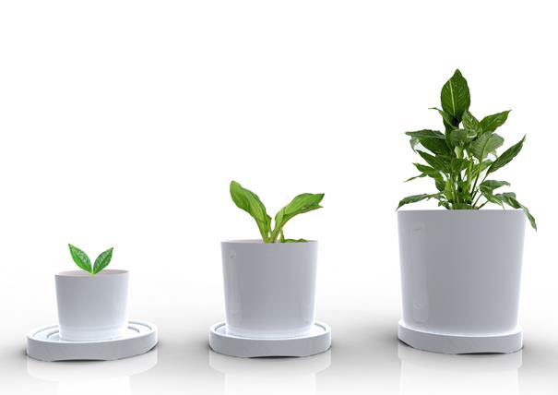
Value Detectives
Explore created values
Collect evidence of impact
Record evidence in attractive way

Slide 3
How we do this?
Delegation of the responsibility to two ExCom members:
1) Before and during the events:
Prepare TOR with clear tasks
Invite volunteers to collect information
Allocate time in the agenda
2) Once in 3-4 years: conduct country survey to assess the Impact

Slide 4
Our Value Detectives collect
Information (via face to face interviews, or surveys)
Stories
Communication (e.g. e-mails)
that demonstrate the value of IACOP activities for the member countries.

Slide 5
Key questions
What value do members gain from participating in the activities?
What value is being generated by the knowledge products?
How do people use the knowledge products, how their work as a reform leader in the area of Internal Audit is improved?
How has the application of knowledge and other products contibuted to PFM reforms in member countries?

Slide 6
How we detect the created value and the IACOP impact?
PEMPAL documents /expceerienIm
PEMPAL meetings/documents /experience
Country
Outputs
Impacts
PEMPAL documents /expceerienIm
PEMPAL documents /expceerienIm
The member returns home and does something with this insight, knowledge product, or connection
A member participates in IACOP activity that generates interest, ....
..This participation creates an insight, a knowledge product, or a new relationship
...which leads to an improvement in PFM or PIC practices
Immediate value
Potential value
Aplied value
Realised value

Slide 7
http://pempaltc.wikispaces.com/37th+IACOP+meeting+-+Plenary –RESULTS – value detectives
Country | PEMPAL documents / experience | Outputs | Impacts
Moldova | Quality Assessment Guide | There was developed the Draft Regulation on EQA | 5 internal audit units assessed in 2017
Albania | Manual for Continuing Professional Development | Discuss and share experience with others countries | Have to prepare the IA Continuous Program training in public sector
Bulgaria | Discussion and presentations QA and RIFIX, Document for EAA (External Audit Assessment) | Cooperation Agreement MOF- SAI –FI (upgraded methodology) Useful questions from the questionnaire | Improvements of the IA and FMC system
Kyrgyz Republic | Internal Audit Manual Template Risk Assessment Guide Quality Assessment Guide Experience from peers: legislation, methodology from PEMPAL member states | Draft internal audit manual Draft risk assessment guide Draft of quality assurance program | It influenced the development of internal audit function in the country and also the effectiveness of public institutions
The Russian Federation | Quality Assessment Guide RIFIX concept paper Risk Assessment in Audit Planning | Approach to be used, indexes Collaboration and relationship between IA and FI Partially used | Could be implemented and used Is used in regulating the relationship, using the results of audits Decided to be used by internal audit units

Slide 8
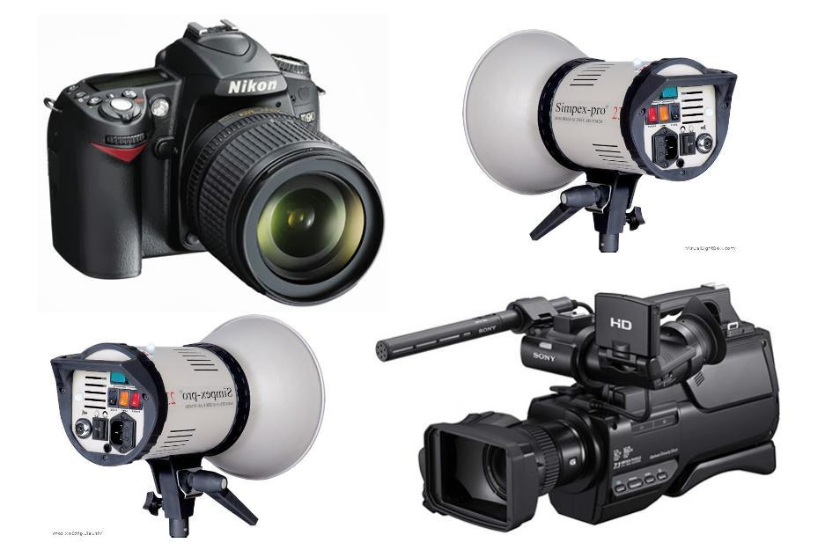
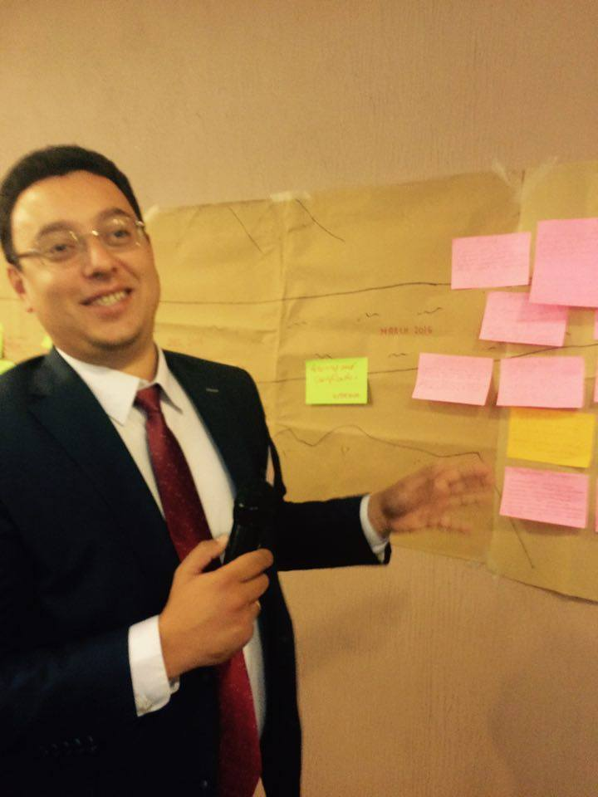
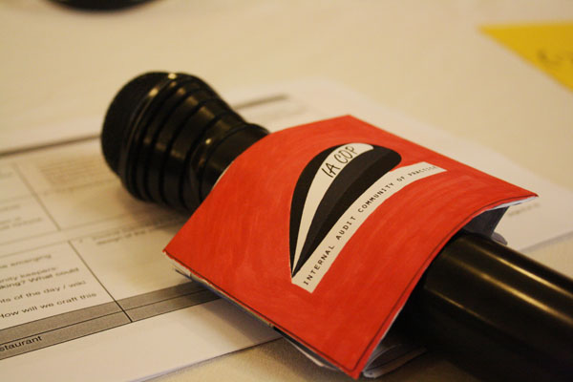
How we do it?

Slide 9
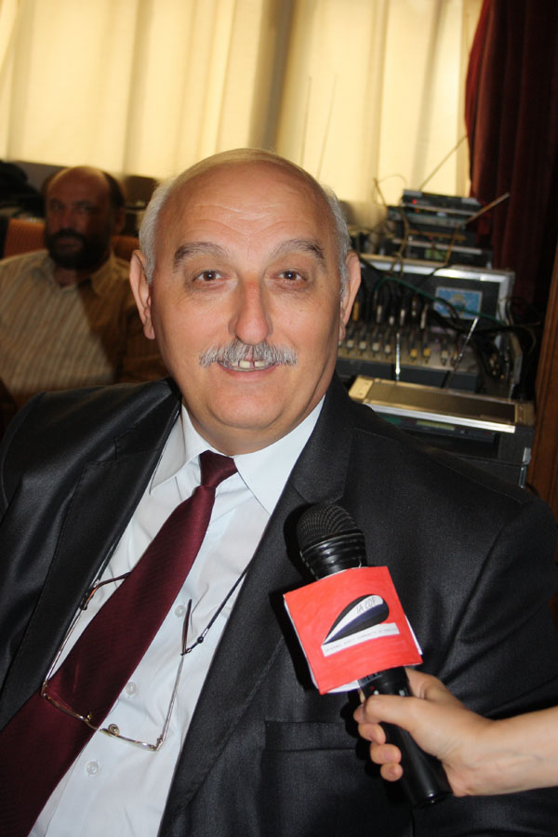
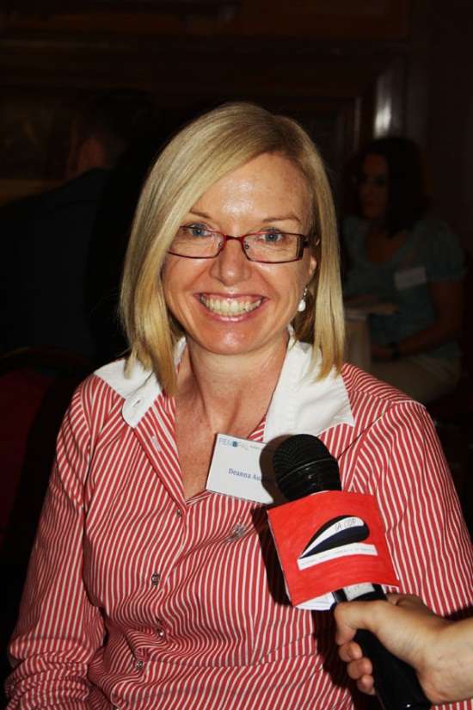
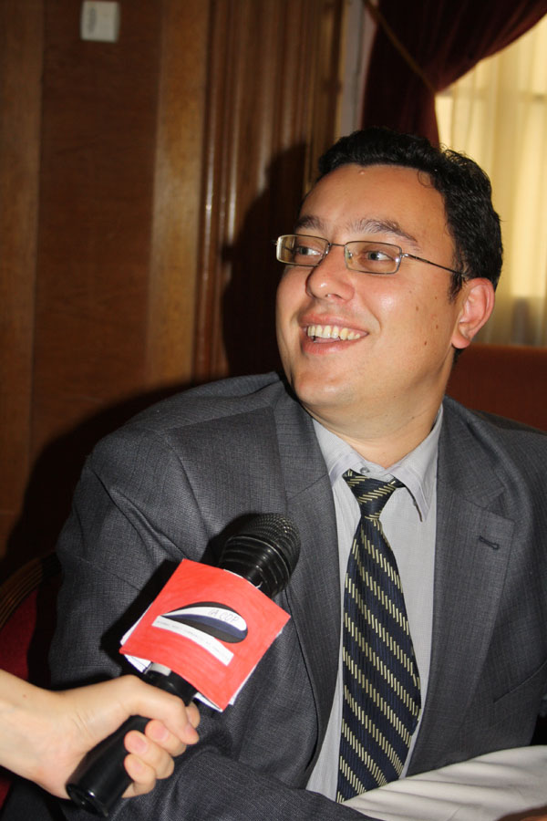
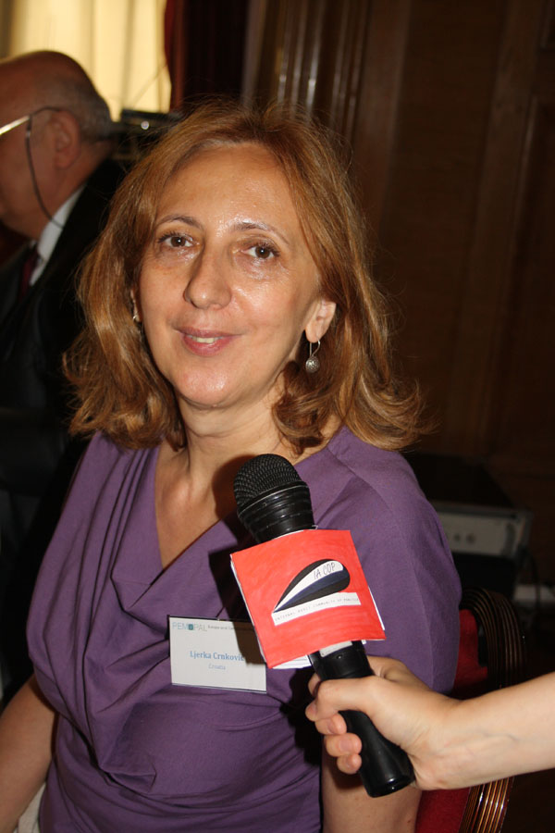
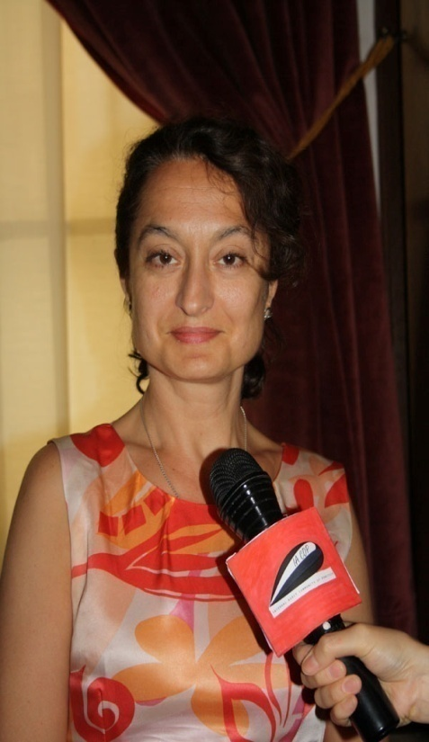
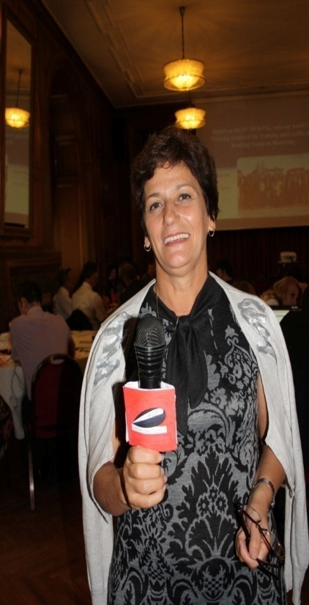
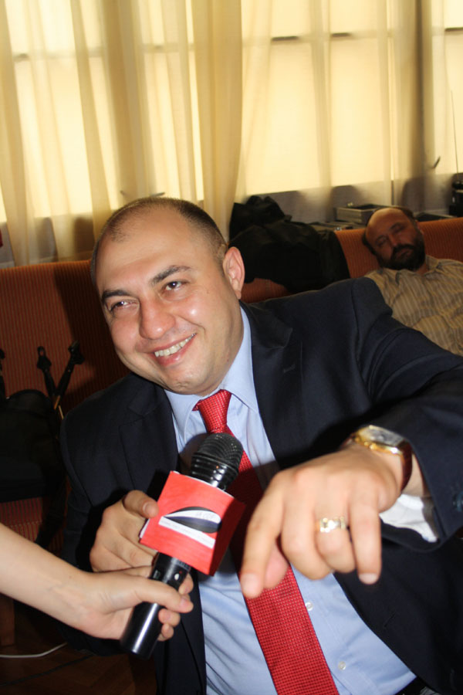

Slide 10
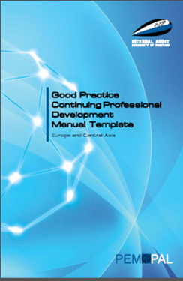
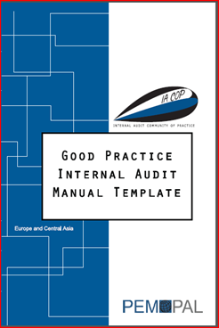
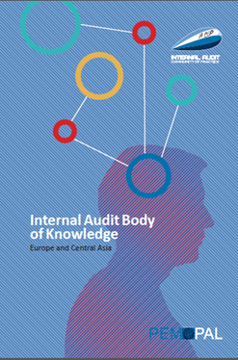
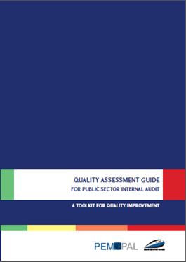
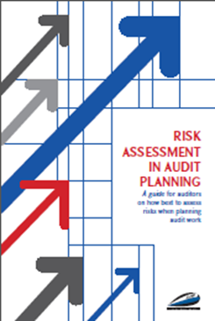
An example of IACOP value created
RIFIX
Concept Note

Slide 11
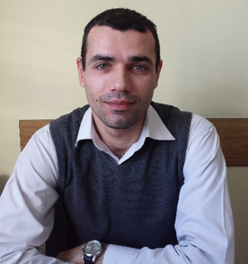
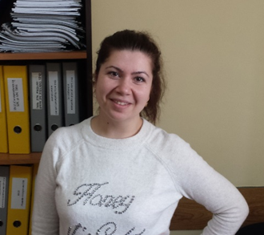
The "new born" Quality Assessment Guide is a valuable document for Moldova’s CHU, and useful at the respective moment. The QA Guide offers all the necessary steps to be carried by CHU in performing external assessment. The guide is so practical that can be easily adapted to national context.
We would like to say that getting acquainted and communicating with the colleagues from other countries at PEM PAL events influenced considerably our professional development, common understanding of modern tendencies of public internal financial control evolution.

Slide 12
Georgian Internal Audit
Manual is drafted based on the
IACOP template
√ We learned here the definition and methodology of internal audit
√ We used Bulgarian experience as a basis of our law of internal audit
√ Training & Certification system in Tajikistan was implemented following IACOP template. - Umed Sharapov

Slide 13
You are welcomed to come back and we’ll show more IACOP values created! Come

