Slide 1

Managing Risks Under COVID-19
Fiscal Affairs
June 1, 2021
Jason Harris
Fiscal Affairs Department
Lake Mansfield, Great Barrington MA, United States

Slide 2
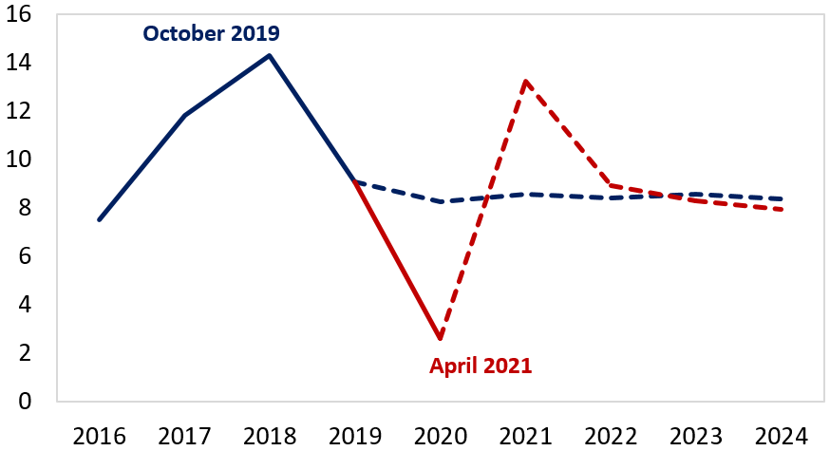
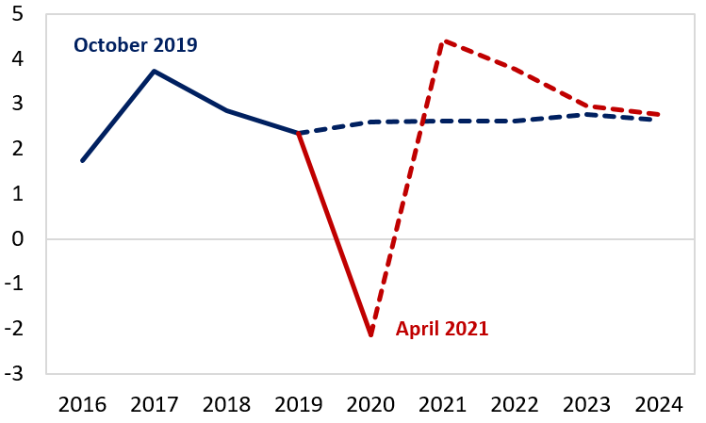
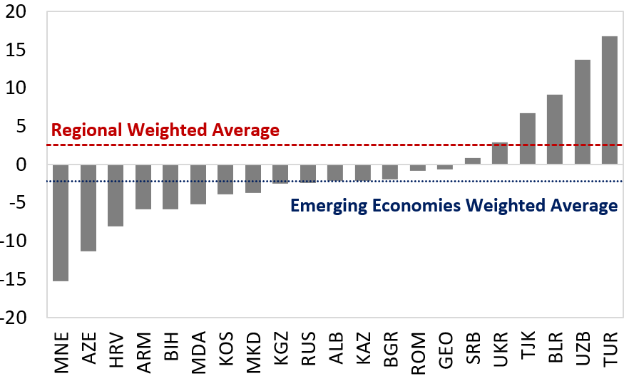
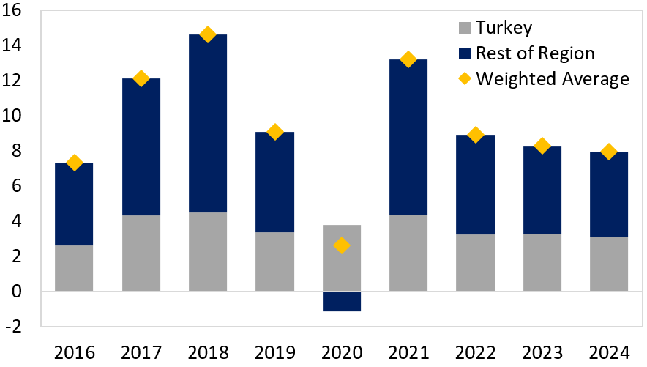
Central Asia and Eastern Europe experienced significant economic volatility last year
Regional Nominal GDP Growth
(Weighted Average, Percent of GDP)
Regional Real GDP Growth
(Weighted Average, Percent of GDP)
Source: World Economic Outlook and IMF Staff estimates.
Source: World Economic Outlook and IMF Staff estimates.
2020 Nominal GDP Growth
Contributions to Regional Nominal GDP Growth
(Weighted Average, Percent of GDP)
Source: World Economic Outlook and IMF Staff estimates.

Slide 3
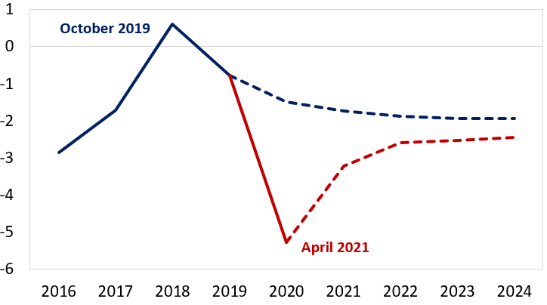
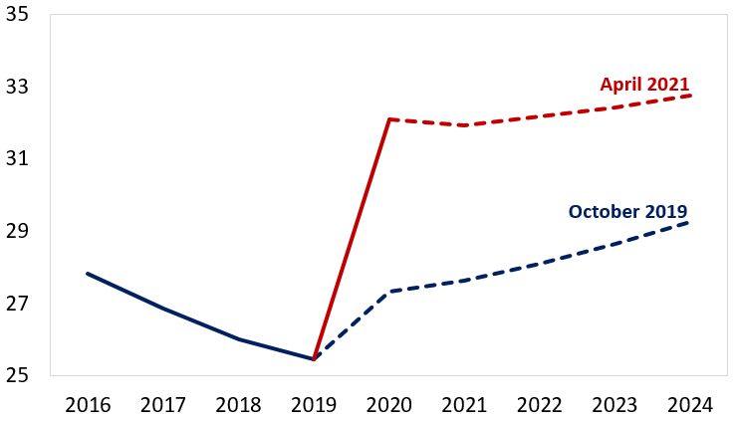
Resulting in a deterioration of public finances and a build up of new debt issuance
Regional Net Lending (Borrowing)
(Weighted Average, Percent of GDP)
Regional General Government Debt
(Weighted Average, Percent of GDP)
Source: World Economic Outlook and IMF Staff estimates.
Note: Solid line represents outturns; dashed lines represent WEO forecasts for each respective vintage.
Source: World Economic Outlook and IMF Staff estimates.
Note: Solid line represents outturns; dashed lines represent WEO forecasts for each respective vintage.

Slide 4
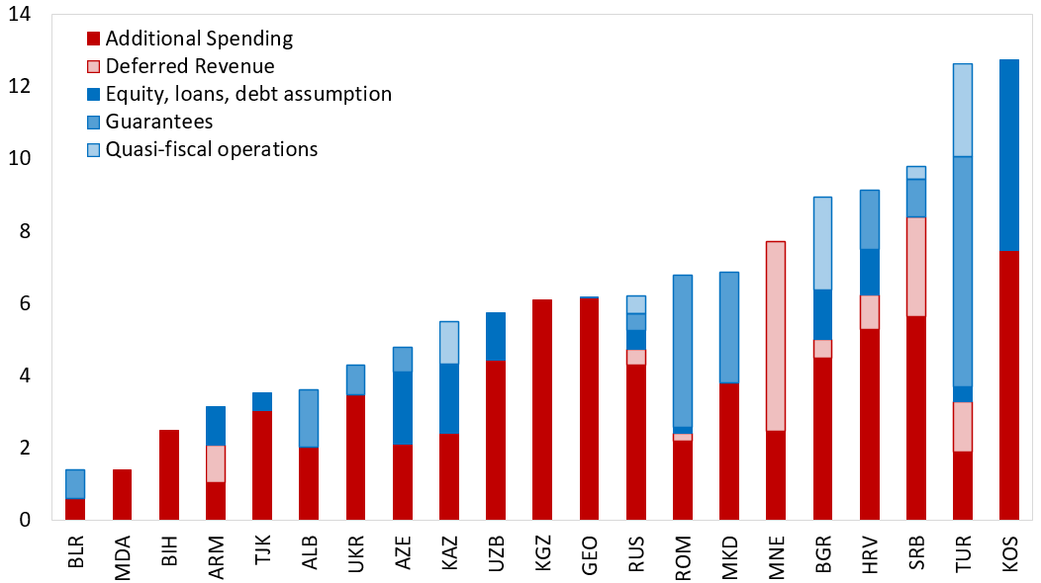
Governments enacted stimulus packages to combat the economic fallout from the pandemic
Though the size and types of interventions vary substantially across countries, governments must better understand these fiscal exposures and debt vulnerabilities.
Additional Spending: Risk bonuses for the medical and social assistance staff; Emergency spending on health programs, purchases of medical and protective equipment; wage subsidies, unemployment benefits.
Deferred Revenue: Tax deferrals (i) for SMEs and most affected companies on most taxes (Russia); (ii) for the self-employed, farmers, tailors, grocers, lawyers (Turkey)
Contingent liabilities: A state guarantee scheme for bank loans to SMEs (N.Macedonia, Albania, Serbia)
Below-the-line measures: Subsidized lending to help SMEs (Kazakhstan); Government equity injections and new loans to SOEs to repay debt and finance additional investment (Uzbekistan).
Sources: Database of Country Fiscal Measures in Response to the COVID-19 Pandemic; and IMF staff estimates.
Note: Estimates as of March 17, 2021.

Slide 5





IMF supports countries to better assess and manage debt vulnerabilities and fiscal risks
In addition to strengthening public debt management and debt sustainability analysis, the IMF is developing and expanding its fiscal risk toolkit
PFRAM
PPP Fiscal Risk
Assessment Module
FRA
Fiscal Risk
Assessment
Better understand risk exposures
C-ST
COVID-19
Stress Test
PSBS
Public Sector
Balance Sheet
Improve management of fiscal risks
FST
Fiscal Stress Test
Fiscal Risk
Toolkit
SOE
Health Check Tool
More transparent reporting of risks
L&G*
Loans & Guarantees
Assessment
More resilient public finances

Slide 6
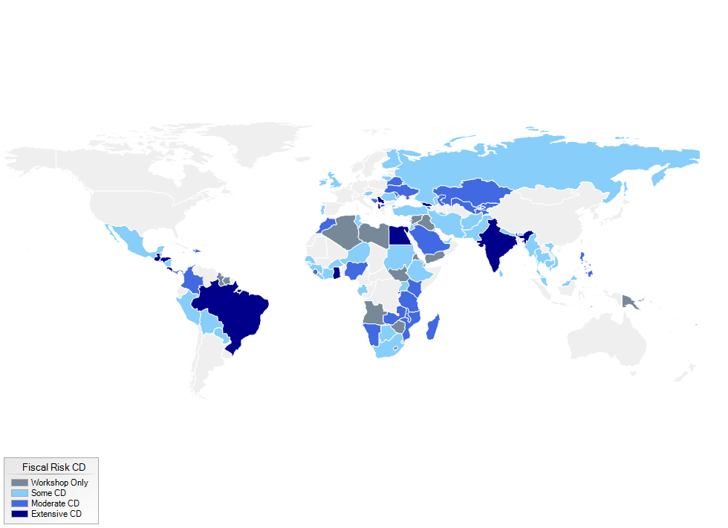
IMF Capacity Development has supported many countries across a wide range of topics
  Capacity Development has focused on helping countries strengthen:
  Legal and regulatory frameworks
  Fiscal rules related to debt
  Information systems
  Monitoring and reporting of arrears
  Controls over contingent liabilities, including the design and management of a Credit Guarantee Scheme
  Central oversight of SOE and PPPs
  Quantification of fiscal risks
  Disclosure in fiscal risk statements and financial statements

Slide 7
Operational risks and business continuity plans
  Operational risks and business disruptions - major concern for Treasuries and other institutions, with transactional function.
  Business disruptions to governments’ cash and debt management operations can have spill-over effects on the delivery of government services and on the functioning of financial markets.
  To ensure operational resilience under business disruptions, Treasuries should have Business Continuity Plan which:
    Is focused on “high-impact” risks and on the critical functions and activities of the treasury.
    Assists in preventing, preparing for, responding to, managing, and recovering from the impacts of an incident or disruptive event.
    On urgent basis, simple measures undertaken can make a big difference.
Internal Processes
Human Resources
Operational Risks to Treasuries
External Events
  Public information on this topic is very limited as it exposes vulnerabilities. A few country examples are Uganda, Portugal, USA, Brazil, Korea, Turkey.

Slide 8
Thank you!

