Slide 1



Implementing Accrual Method of Accounting
LEPL Financial-Analytical Service, Ministry of Finance
March, 2018
Guram Shvangiradze
Senior analyst, Research and system analysis Department

Slide 2

eBudget
eTreasury (Implementing Accrued Method of Accounting)
Implementing Accrual Method of Accounting
This is ongoing reform aiming accounting transition from cash based method to accrual based method. We are in the middle of reform, as we have already completed expenditures part and moving towards implementing receivables.
During reform implementation we changed spending process trough adding some new stages, logic and features.

Slide 3

eBudget
eTreasury (Implementing Accrual Method of Accounting)
Primary Document
System Invoice
Budget Assignation
Agreement
Payment Order
Commitment

Slide 4
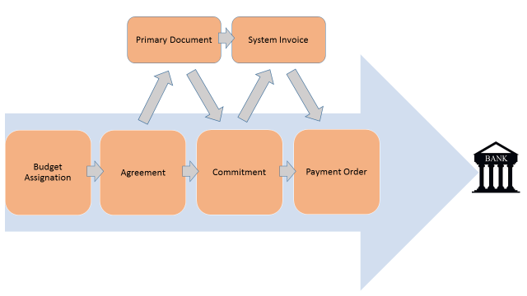
eBudget
eTreasury (Implementing Accrual Method of Accounting)
eTressury
Revenue Service
eBudget
Procurement Agency

Slide 5
eBudget
eTreasury (Implementing Accrual Method of Accounting)
Created
Sent To Supervisor
Sent To Middle Office
Sending To Treasury Back Office
Approving By The State Treasury
Sending To Bank
Created
Sent To Supervisor
Accrued
Completed
Primary Accruals Transactions
Withholding Transactions
Cash Flow Transactions
Other Transactions
Opening Balances
Treasury Day Closing
Opening Balances Module
Independent Adjustment Module
General Ledger

Slide 6
eBudget
eTreasury (Implementing Accrual Method of Accounting)
Accounting Module Consists of:
Accounting code classification
Operational classification
System operation rules
Opening balance form
Independent adjustment submodule
Relational forms for payroll and invoice operations
General Ledger (analytical view)
General Ledger (alternative analytical view)
Reporting

Slide 7
eBudget
eTreasury (Implementing Accrual Method of Accounting)
Accounting Dimensions
Each accounting transaction has its own attributes (for example Budget Classification, CPV Code, Primary Document Number, Organizational Code, etc.)
Attributes are transformed into dimensions in the data warehouse (CUBE), where aggregated information is stored. This enables us to reach pre-calculated and pre-grouped data fast and without disturbing operational tables.
Attributes can be used in filtering analytical view of the GL, thus providing vast advantages in analysis of accounting transactions.

Slide 9
eBudget
eTreasury (Implementing Accrual Method of Accounting)
Live Demonstration
Thank you for your attention, fill free to ask questions.

