Slide 1
“European Commission - Internal Control Response in the Context of the Pandemic” PEMPAL Internal Audit Community of Practice (IACOP) Brussels, 25th February 2021

Slide 2
Council
European Parliament
European Commission
(College of Commissioners 28)
DG X
DG Y
DG …
DG
Budget
Service
X
Service
Y
Internal
Audit Serv.
European Court of Auditors
33 Directorates-General
11 Services
Budget of 150 billion EUR
Member States
Contractors / Beneficiaries
Third Countries

Slide 3
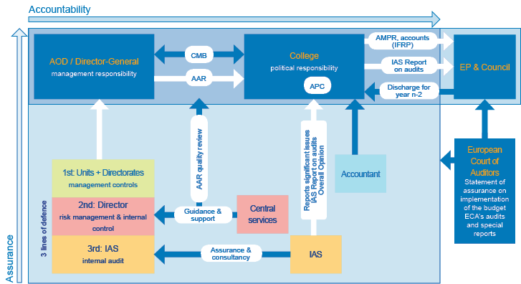

Slide 4
EC Internal Control Framework
Components | Principles
Control Environment | 1. Demonstrates commitment to integrity and ethical values 2. Exercises oversight responsibility 3. Establishes structure, authority and responsibility 4. Demonstrates commitment to competence 5. Enforces accountability
Risk Assessment | 6. Specifies suitable objectives 7. Identifies and analyses risk 8. Assesses fraud risk 9. Identifies and analyses significant change
Control Activities | 10. Selects and develops control activities 11. Selects and develops general control over technology 12. Deploys through policies and procedures
Information and Communication | 13. Uses relevant information 14. Communicates internally 15. Communicates externally
Monitoring Activities | 16. Conducts ongoing and/or separate assessments 17. Assesses and communicates deficiencies

Slide 5
Internal Control Monitoring Cycle
Ongoing monitoring
(Supervision, meetings, scoreboards, KPIs, IT tools, …)
Ongoing monitoring
(Supervision, meetings, scoreboards, KPIs, IT tools, …)
Strengths Deficiencies
Strengths / Deficiencies
Actions
Actions
Annual assessment
(Stocktaking and reporting)
Annual assessment
(Stocktaking and reporting)
Exceptions & non-compliance events
Audit findings
OLAF reports
Other sources

Slide 6
COVID and the Internal Control Components
Components
Control Environment
Risk Assessment
Control Activities
Information and Communication
Monitoring Activities
Control Environment
Staff capacity (availability and wellbeing)
Response:
Internal redeployment
Improve teleworking arrangements
Medical protocol
Business Continuity Plan (including list of critical staff)
Vademecum for managers

Slide 7
II. Risk Assessment
Components
Control Environment
Risk Assessment
Control Activities
Information and Communication
Monitoring Activities
Ad hoc Risk Assessment on COVID in July 2020 in terms of compliance and performance
Specific consideration on COVID issues in the annual Risk Exercise in December 2020
Special consideration to risk of fraud linked to the abuse of the emergency situation which increases the risk of conflicts of interest and corruption.

Slide 8
III. Control Activities
Components
Control Environment
Risk Assessment
Control Activities
Information and Communication
Monitoring Activities
Delays in the Implementation of policies and programmes
Response: Flexible contracting and payment procedures. Extension of deadlines for ongoing award procedures.
Delays of ex-ante and ex-post controls
Response: Simplified financial procedures,
Remote audits and additional guidance for the audit authorities in MSs, candidate countries and third countries
Emergency Support Instrument for COVID-19
Recovery and Resilience Facility

Slide 9
IV. Information & Communication
Components
Control Environment
Risk Assessment
Control Activities
Information and Communication
Monitoring Activities
Comprehensive internal and external communication actions
Specific website on Covid-19 in the intracomm (News & helpdesk) and internet (Coronavirus response)
Specific information and communication activities at DG level
Vademecum for managers

Slide 10
V. Monitoring Activities
Components
Control Environment
Risk Assessment
Control Activities
Information and Communication
Monitoring Activities
Covid-19 - Corporate cross-cutting critical risk
Central Services are providing oversight and support, including through the corporate governance bodies.
Services are invited to remain vigilant on Covid-related risks and monitor them in real time

Slide 11
Emergency Support Instrument for COVID-19
Helps Member States respond to the coronavirus pandemic:
Advance purchase agreements with vaccine producers (Coronavirus vaccines strategy)
Secure Treatments
Testing: Rapid antigen test and Strength Testing capacity
Transport of essential goods, medical and patients
Essential health related products
Training of professionals in intensive care skills
Linking national contact tracing apps
Budget of €2.7 billion.

Slide 12
Recovery and Resilience Facility (1/2)
Provide large scale financial support to public investments and reforms to accelerate the recovery and make Member States’ economies more resilient
Financed by the European Union Recovery Instrument (EURI)
GRANTS
312.5 billion EUR (2018 prices)
LOANS
360 billion EUR
(2018 prices)

Slide 13
Recovery and Resilience Facility (2/2)
Focus on six pillars:
1.
Green transition
2.
Digital transformation
3.
Smart, sustainable and inclusive growth
4.
Social and territorial cohesion
5.
Health and economic, social and institutional resilience
6.
Education and skills for the next generation

Slide 14
Basic info on approval of plans & payments
Recovery and Resilience Facility
Grants
Loans
2018 prices: 312.5 billion EUR
Submit RRP as a rule by 30 April
Investments and reforms up to 2026, deadlines for commitments
70% of max allocation available in 2021-2022; remainder until 2023
Pre-financing of up to 13% available in 2021
2018 prices: 360 billion EUR
Request until 31 December 2023
Justified by higher financial needs linked to additional reforms and investments
Loans are capped – not to exceed 6.8% of 2019 GNI
The cap can be increased in exceptional circumstances
Approval of the plans by means of Council implementing decision
Payment request (role of Economic and Financial Committee, comitology)

Slide 15
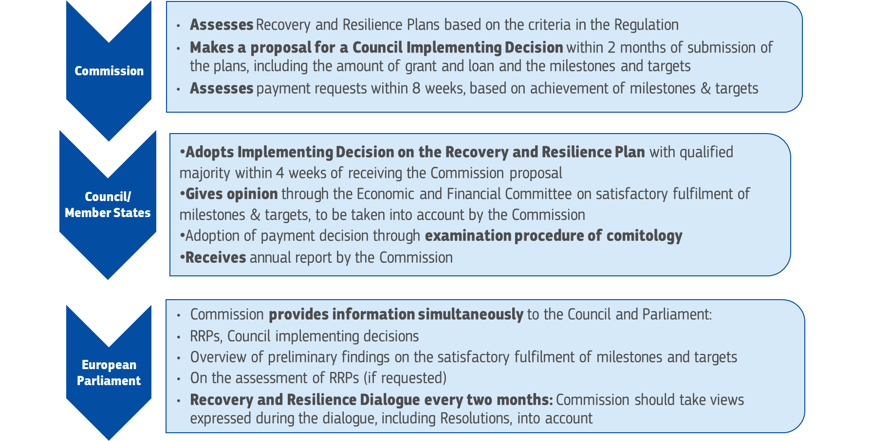
Governance

Slide 16
Questions?
Thank you for
your attention!

