Slide 1

Technology, Safety, Performance
4th of June, 2019
Public Institution
„Center of Informational Technology in Finance”

Slide 2


Content:
P.I. „Center of Informational Technology in Finance”
1
Stages of creating the Center
2
Organizational Structure
3
Fields of Competence
4
Services, users
5
Aims and priorities for development

Slide 3
Stages of creating the Center
P.I. „Center of Informational Technology in Finance”
6th of February 2018 | Government Decision 125 of February 6, 2018 on the establishment of the Public Institution “Center of Informational Technology in Finance“
2nd of April 2018 | 1st stage- The State Enterprise «Fintehinform» was reorganized into the Public Institution “Center of Information Technology in Finance”, the founder of which is the Ministry of Finance.
1st of August 2018 | 2nd stage- State Enterprises «Fiscservinform» and «Vamservinform» have been reorganized by merging into the Public Institution “Center of Information Technology in Finance”. The rights and responsibilities of the legal entities involved were fully transferred to the emerged legal entity.

Slide 4
Organizational Structure of the Center
P.I. „Center of Informational Technology in Finance”
Board of Directors
Director
11 Subdivisions
(directions and sections)
Deputy director
(field of informational technologies)
Deputy director
(field of public services)
D1
D2
D3
29 Divisions
(departments, general directions, sections)
25 Divisions
(departments, general directions, sections)
D4
D5
And others
D1
D2
D3
D1
D2
D3
D4
D5
And others
D4
D5
And others
Established units - 513

Slide 5
Center’s Fields of Competence
S.I. „Center of Informational Technology in Finance”
Administration, development, maintenance and operation of the informational systems in the areas of public finance, government procurement, as well as tax and customs areas;
implementation of information technologies, both within the Ministry of Finance, the administrative bodies under its jurisdiction, as well as outside of it;
providing institutional assistance, including in the field of accounting in the public sector and in the process of continuous development of professional potential of employees working in the fields of public finance, public procurement, tax and customs;
administration and maintenance of ITC infrastructure and other infrastructures related to the activities carried out, both in the Ministry of Finance and in its administrative bodies;
providing representation at customs and temporary storage;
other areas, related to the competence of the Center of its normative acts, including the acts of its founder.

Slide 6



Services provided by the center
P.I. „Center of Informational Technology in Finance”
Customs
Public finance
Taxation
Control, development, maintenance and provision of the functionality of the informational systems in the field of public finances, state procurement, and as well as tax and customs areas l
Administration and maintenance of the ITC infrastructure of the Ministry of Finance, Taxation and Customs service.
Training specialists within the field of customs
Training specialists within the field of public finances
Training specialists and taxpayers operating in the electronic tax services
Ensuring representation at customs and temporary storage (cargo weighting services, brokerage, temporary storage)
Development and implementation of the accounting information system in the public sector (1C)
Processing and Archiving fiscal documents
Call Center - of the tax services
Providing institutional assistance in the field of accounting in the public sector
Connection to the electronic services of the Tax Service and the Center of the electronic signatures registration

Slide 7





IT service users
P.I. „Center of Informational Technology in Finance”
P.I. „Center of Informational Technology in Finance”
Ministry of Finance
Customs Service
Tax Service
Legal entities
Physical entities
Users: +300
Users: +2000
Users: +1600
Users: 58000
Users: 93000

Slide 8
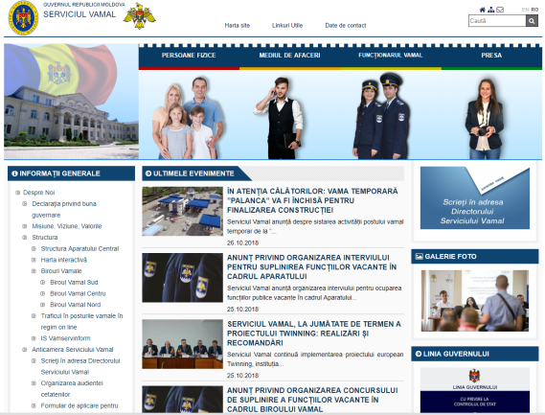
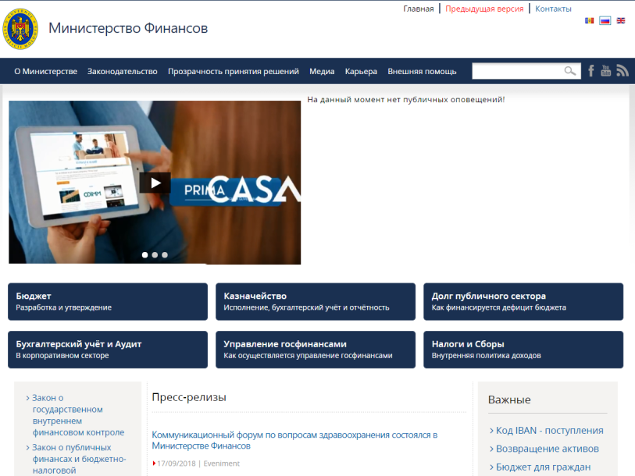



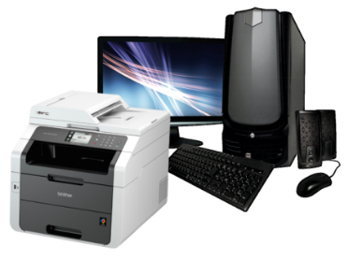

Maintenance and administration of informational systems
P.I. „Center of Informational Technology in Finance”
www.customs.gov.md
www.mf.gov.md
www.sfs.md
22 Informational systems
17 Informational systems
52 Informational systems
+1600 users
+10944 users
+ 150 000 users
60 functioning local networks
2000 equipment
2 functioning local networks
600 equipment
44 functioning local networks
2000 equipment

Slide 9
Aims and priorities for development
P.I. „Center of Informational Technology in Finance”
Ensuring suitable conditions for the highly qualified IT specialists (higher wages, training and team consolidation);
Implementation of new projects of national importance;
Implementation of international quality standards (ISO:9001, ISO:27000 ISO/TEC:20000);
Increase of informational security levels;
Unification of used technologies for the development and administration of IS;
Expand the range of information services for the public sector;
Establishing networks and ways of cooperation with foreign companies

Slide 10
P.I. „Center of Informational Technology in Finance”
THANK YOU FOR YOUR ATTENTION!
elena.saharnean@ctif.gov.md

