Slide 1

Public Investment Management: Trends and Challenges in PEMPAL Countries
This Photo by Unknown Author is licensed under CC BY-NC-SA
Iryna Shcherbyna
Senior Public Sector Specialist, World Bank - Governance

Slide 2

CONTEXT
Introduction: Why effective PIM is needed?
Investments in PEMPAL countries: What are the key trends and challenges?
Effectiveness and efficiency of PIM: How can an efficient public investment system be achieved?

Slide 3
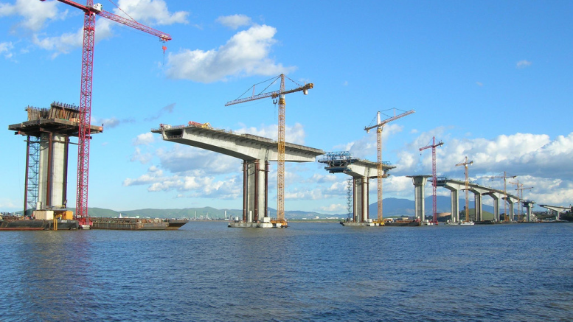
Part 1: INTRODUCTION: THE THEORY AND PRACTICE OF PUBLIC INVESTMENT Management

Slide 4
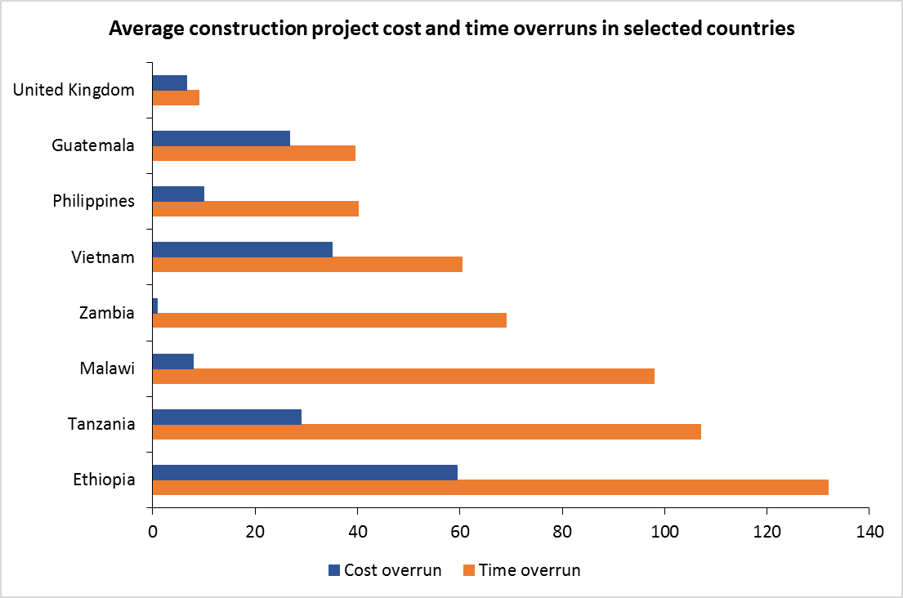
an advanced modern economy can better ensure value for money by minimizing the cost and time overruns more effectively than the typical developing country.
Source: The Construction Sector Transparency Initiative (CoST) 2011.
CoST is a multistakeholder attempt to assess the impact of greater transparency in implementation of public sector construction projects on the value for money derived from such projects.

Slide 5
The argument to increase public investment spending is often weakened by evidence of its low efficiency in a number of dimensions, including the following:
Political influence in project selection, often leading to wasteful “white elephant” projects with little economic or social value;
Delays in design and completion of projects;
Corrupt procurement practices;
Cost overruns;
Incomplete projects;
Poor quality of completed infrastructure; and
Failure to effectively operate and maintain assets.

Slide 6
The lack of good PIM capacity leads to myriad forms of resource waste.
Flyvbjerg* (2009) reviewed data from 258 transport projects in 20 countries across five continents and found that 90 percent of the projects experienced significant cost overruns. The average real-cost overrun for rail projects was about 45 percent; for bridges and tunnels, 34 percent; and for road projects, a little over 20 percent.
* Bent Flyvbjerg is a Danish economic geographer. He is the most cited scholar in the world in megaproject planning and management, and among the most cited in social science methodology.

Slide 7
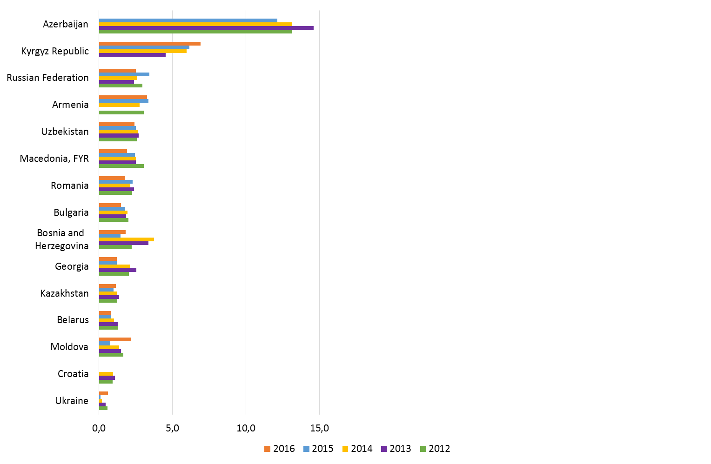
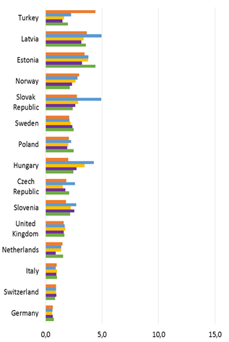
THE POWER OF INVESTMENT POLICY IS BASICALLY SIMILAR ACROSS COUNTRIES…
Net investment in nonfinancial assets (% of GDP)
in PEMPAL countries
in EU area countries
Source: WB World Development Indicators

Slide 8
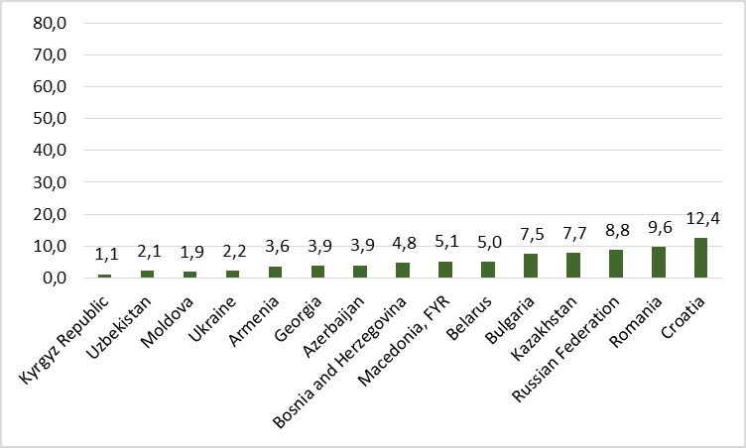
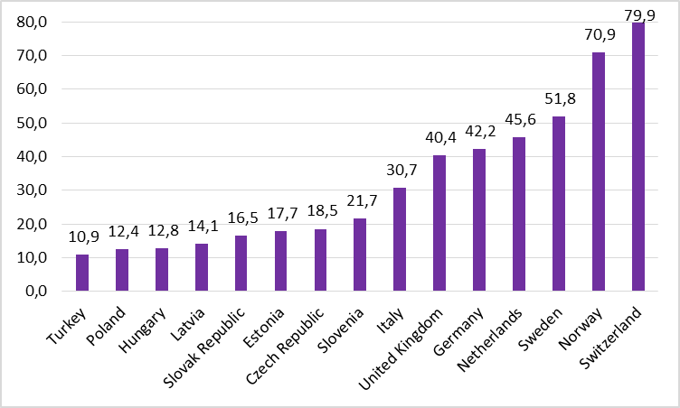
…BUT THE POWER to produce GDP IS DIFFERENT ACROSS COUNTRIES.
GDP per capita (thousands of dollars) in 2016
in PEMPAL countries
in EU area countries
Source: WB World Development Indicators

Slide 9
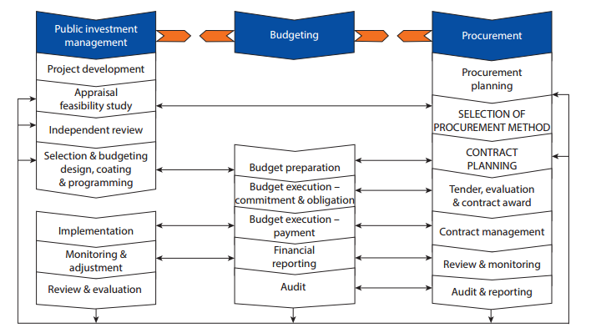
IF Well managed, each of following stages and linkages could lower costs and speed up project implementation.
PIM system linkages
Public investment management
Budgeting
Procurement
Project development
Procurement planning
Appraisal feasibility study
SELECTION OF PROCUREMENT METHOD
Independent review
Selection & budgeting design, coating & programming
CONTRACTING PLANNING
Budget preparation
Budget execution – commitment & obligation
Tender, evaluation & contract award
Implementation
Budget execution – payment
Contract management
Monitoring & adjustment
Financial reporting
Review & monitoring
Review & evaluation
Audit
Audit & reporting
Source: The Power of Public Investment Management, WB 2014.

Slide 10
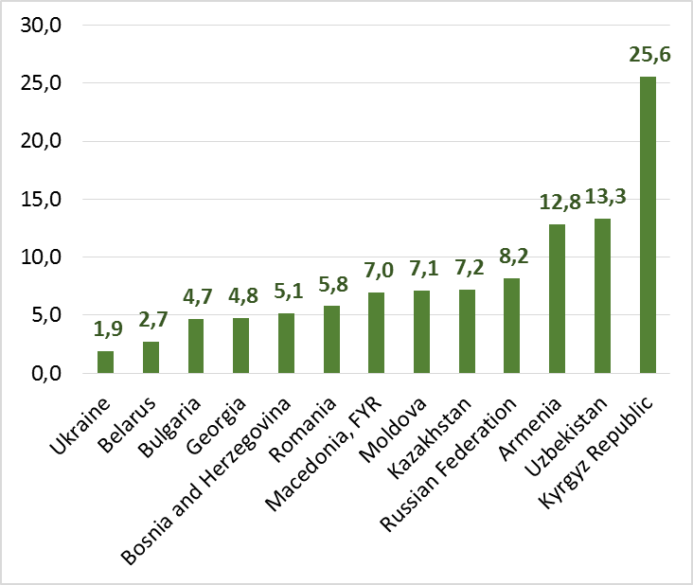
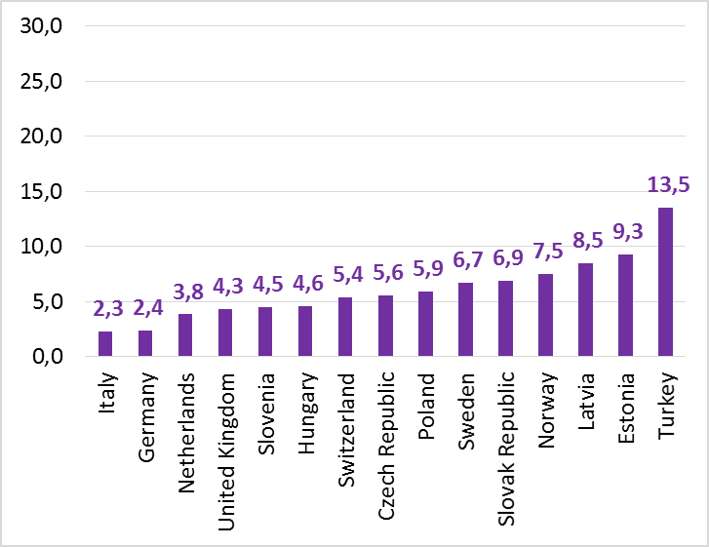
Development countries with the good PIM invest effectively less part of all expenses
Share of net investment in nonfinancial assets in expense (%) in 2016
in PEMPAL countries (average 8,2%)
in EU area countries (average 6,1%)
Source: WB World Development Indicators

Slide 11
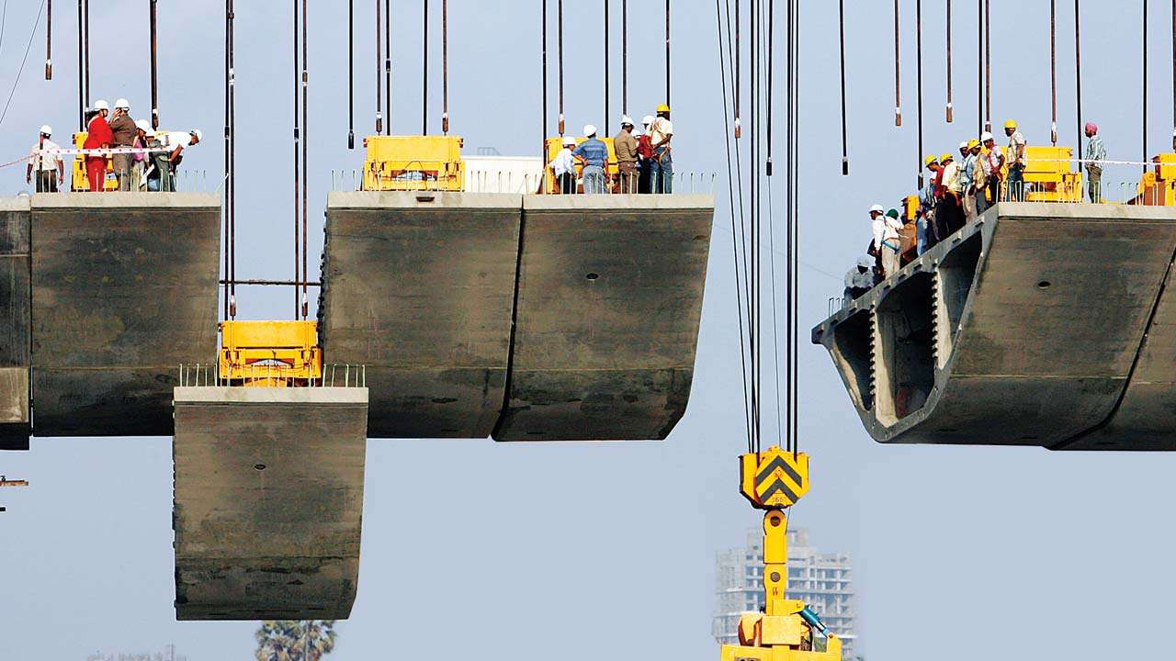
Part 2: PUBLIC INVESTMENTS IN PEMPAL COUNTRIES

Slide 12
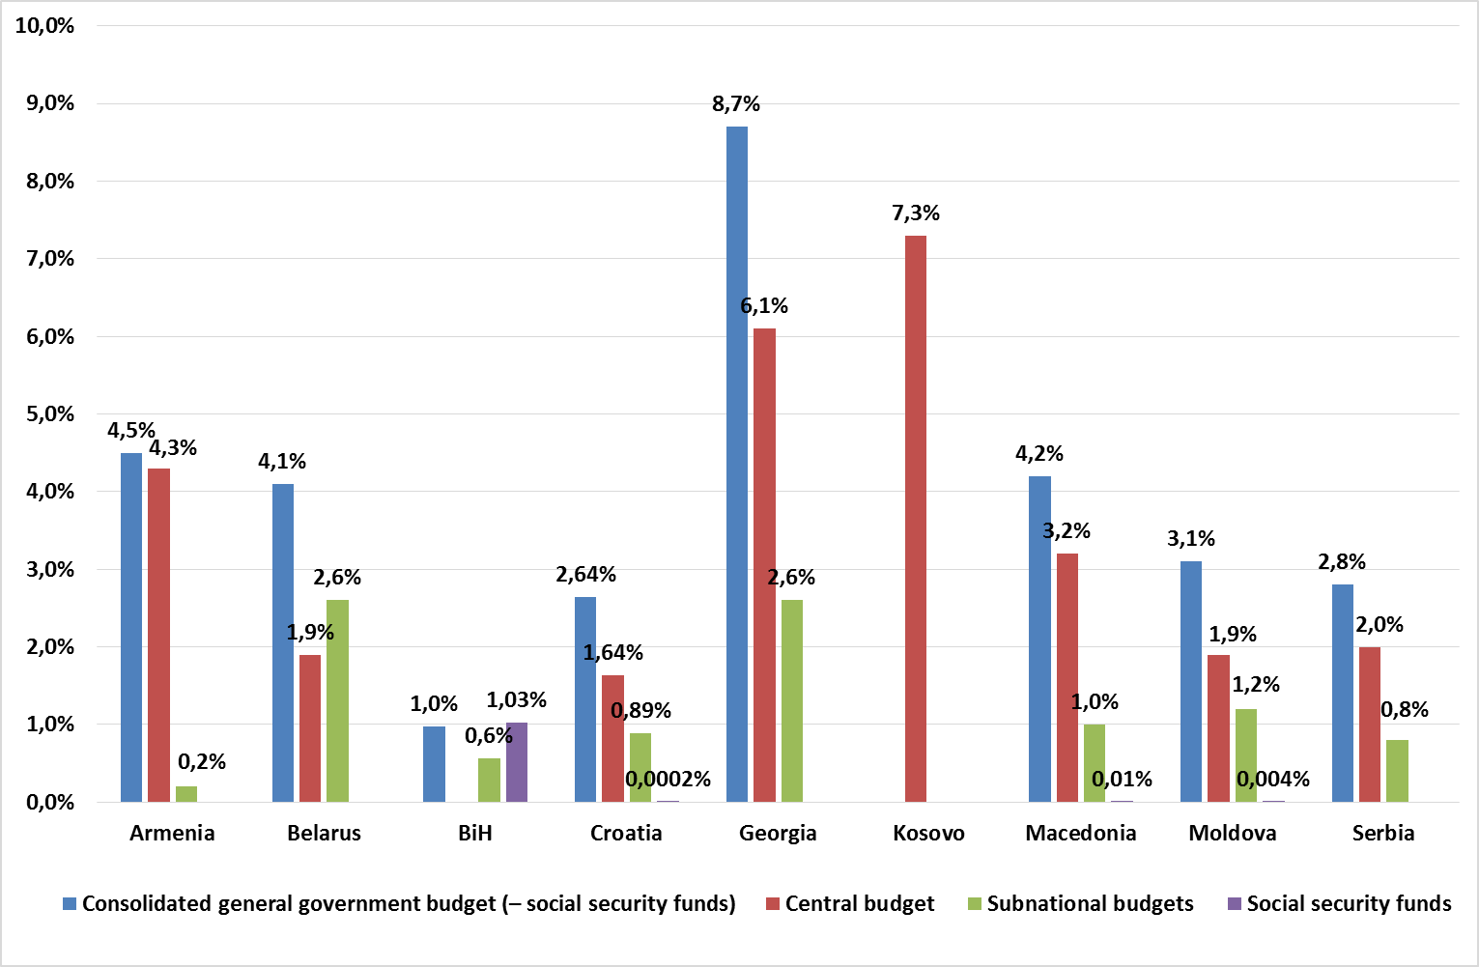
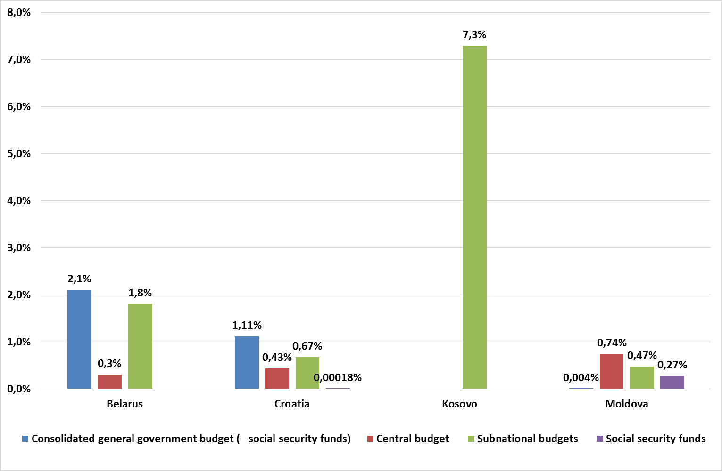
CAPITAL EXPENDITURES VERSUS PUBLIC INVESTMENTS
The share of total capital expenditures in GDP in 2017 (%)
The share of total public investments in GDP in 2017 (%)
Notes:
Here we see the importance of the availability of the clear mandatory request to reflect the national development goals in subnational investment plans. But what if the picture reflects the issue of the definition?

Slide 13
For all participants, The definition is important step to establish common rules.
Is there terminology in the existing legislation which separately identified capital expenditures and public investments?
Which type of budget classifications reflects capital expenditures and public investments?
Country | Terminology in the existing legislation for |  | Type of budget classifications reflects capital expenditures and public investments
 | Capital expenditures | Public investments | Economic | Program
Armenia | No | No | no answer
Belarus | Yes | No | x | Partially
Bosna i Hercegovina | Yes | Yes | x | x
Croatia | Yes | Yes | x | x
Georgia | Yes | No | x | x
Kazakhstan | Yes | Yes | x | x
Kosovo | No | No | x | x
Macedonia | No | No | x | Partially
Moldova | Yes | Yes | x | x
Montenegro | Yes | Yes | x | x
Russia | Yes | No | x | -
Serbia | No | No | x | x

Slide 14
PIM Legal Framework
Which law has a primary role for public investment management?
Country | Organic Law on Public finances | Organic Law on investments | There is no legislation | Other
Armenia | x
Belarus | x | x |  | x
BiH |  |  |  | x
Croatia | x | x |  | x
Georgia | x |  |  | x
Kazakhstan | x
Kosovo | x
Macedonia |  |  |  | x
Moldova | x
Montenegro | x
Russia |  |  |  | x
Serbia |  |  | x
Total | 8 | 2 | 1 | 6
Decrees of the President of the Republic of Belarus that approve the government investment program
There is no single legislation which regulates public investment management, but there are separate laws that regulates different areas of public investments (roads, railways, etc)
Federal Law of February 25, 1999 No. 39-FZ "On Investment Activity in the Russian Federation Pursued in the Form of Capital Investments"
Notes:
PIM is effective if a law that regulates the general provisions of the budget process also has a primary role for PIM

Slide 15
Institutional Framework
Ministry/agency is responsible for the decision-making in following areas:
 | Review and analyzing of public investment project proposals | Assessment of possible fiscal risks | Assessment of the potential contribution of investments to development | Selection of projects for financing | Regular monitoring of project implementation | Regular monitoring of public investment project implementation | Evaluation of completed projects | Maintaining a unified data about all public investment projects
Ministry of Finance | BIH, GEO, KOSOVO, MDA, MNE, SRB | BIH, GEO, KOSOVO, MDA, MNE, SRB | BIH, KOSOVO | GEO, KAZ, KOSOVO, MDA | BLR, BIH, KAZ, KOSOVO | KAZ, KOSOVO |  | BIH, GEO, KOSOVO
Ministry of Economy (or Planning) | BLR, KAZ, RUS | BLR, KAZ, RUS | BLR, KAZ, RUS | BLR, RUS | RUS | BLR, RUS | BLR, RUS | BLR, KAZ, RUS
Ministry/State Agency of Regional Development
Line ministries | ARM | ARM, MCD | ARM, GEO, KAZ, MCD, MDA, MNE, SRB | ARM | ARM, GEO, MDA, MNE, SRB | ARM, GEO, MCD, MDA | ARM, GEO, KOSOVO, MCD, MDA, MNE, SRB
Accounting Chamber (State Audit Institution) |  |  |  |  |  |  | KAZ
Other | HRV, MCD | HRV | HRV | BIH, HRV, GEO, MCD, MNE, SRB | HRV, MCD | BIH, HRV, MNE, SRB | BIH, HRV | HRV, MDA, MNE, SRB

Slide 16
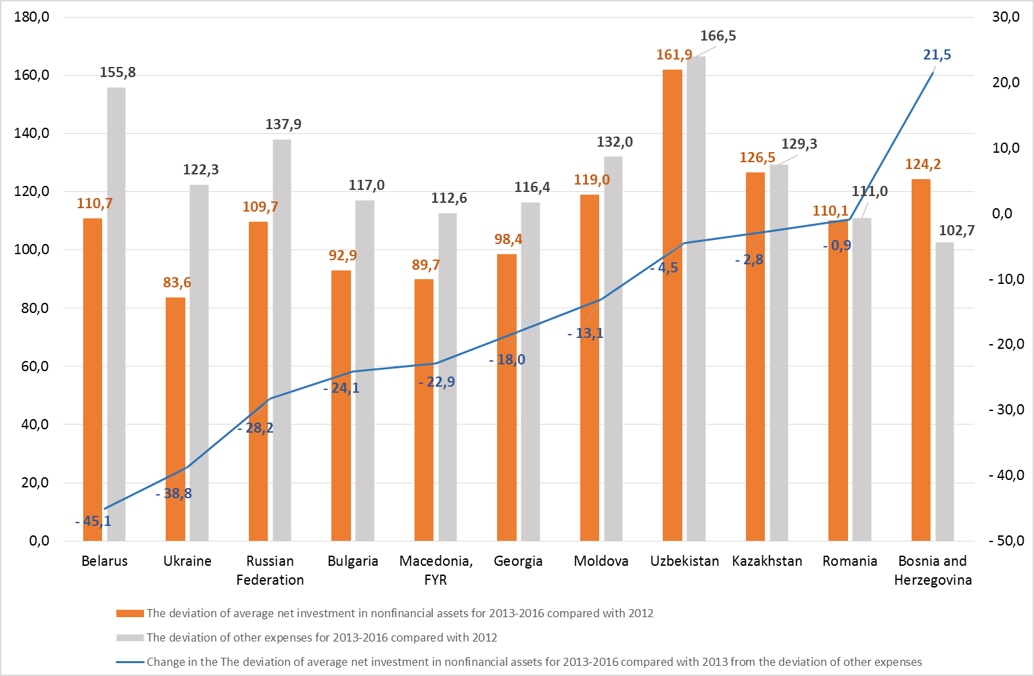
In general, investment changed insignificantly over 2012-2016, while other expenses increased more.
The deviation of average net investment in nonfinancial assets and other expenses for 2013-2016 compared to 2012 (%)
Source: WB World Development Indicators

Slide 17
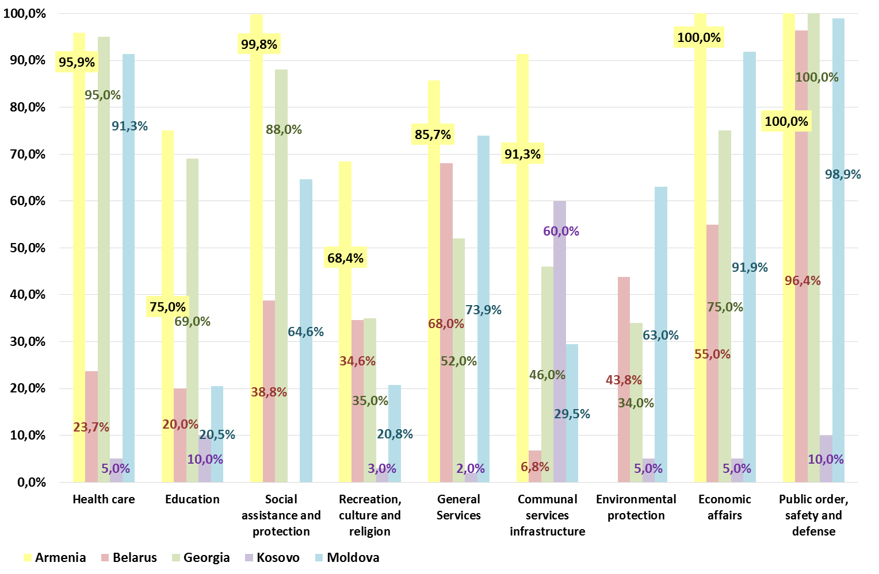
The average structure of Central budget capital expenditures in the consolidated general government budget (%) in 2015 – 2017
Notes:
each country has own approach to divide capital expenditures between sectors

Slide 18
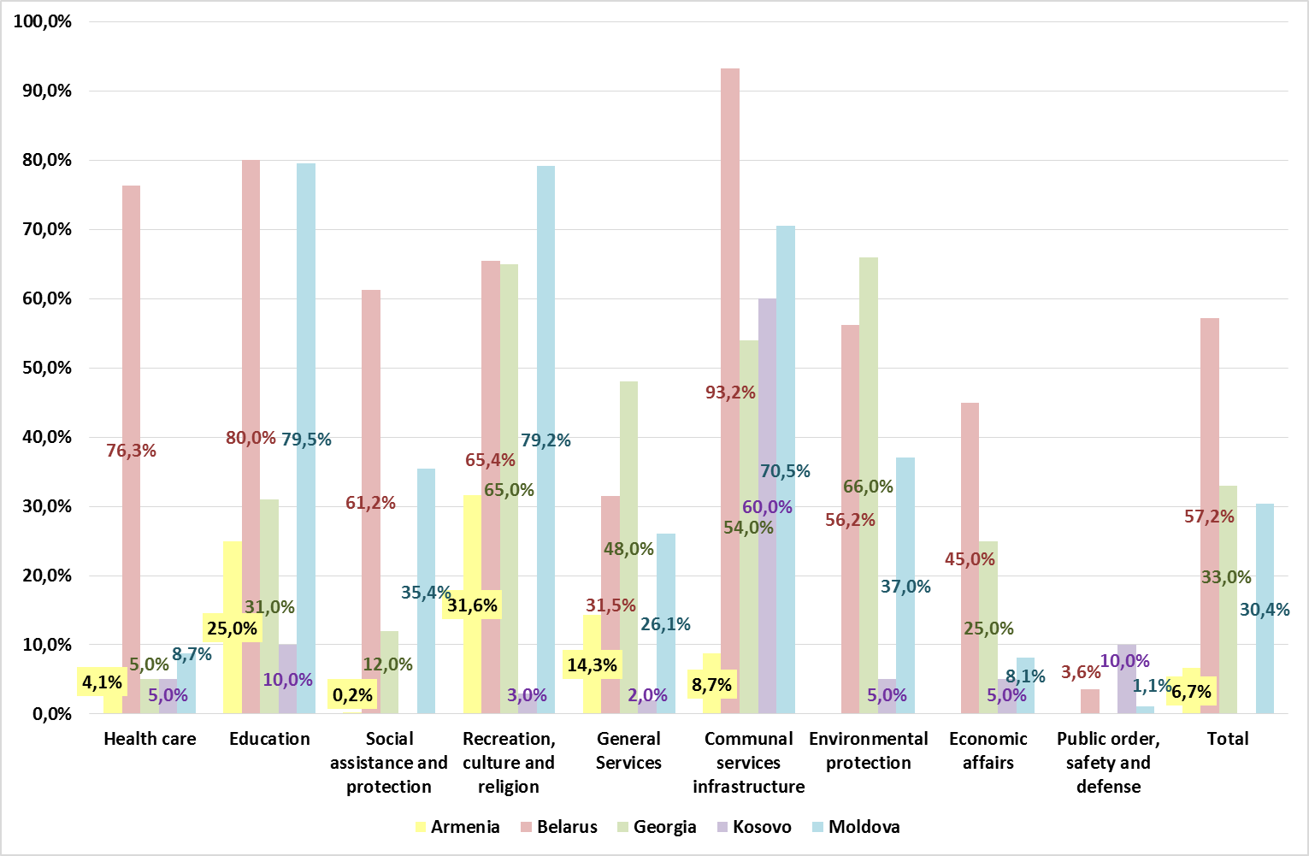
approaches to divide capital expenditures between budget levels are different.
The average structure of subnational budgets capital expenditures in the consolidated general government budget (%) in 2015 – 2017

Slide 19
The Sustainable Investment Strategy is key to the effective public investments within limited Funds.
Country | A clear and authoritative statement of public investment priorities at national and regional levels? |  | A clear mandatory request to reflect the national development goals in subnational (regional) investment plans?
 | Yes/No | Yes. Please explain: | Yes/No | Yes. Please explain:
Armenia | No |  | No
Belarus | Yes | Provision of quality and affordable housing in the course of implementing the Government Program “Housing Construction” for 2016-2020 | No
BiH | No |  | No
Bulgaria | Yes | Medium-term budget forecast | Yes | The regional development plans contain goals which are reflected in subnational investment plans.
Croatia | No |  | Yes | Plan documents of the regional development policy include the Regional Development Strategy of the Republic of Croatia, the county development strategy, i.e. the development strategy of the City of Zagreb and the urban development strategy
Georgia | Yes | Government Strategy clearly defines Infrastructure as key priority for the Government | Yes | Government Program Priorities are used as umbrella for any strategy and plan
Kazakhstan | Yes | Government programs, national-level sectoral programs. Subnational-level territorial development programs | Yes | Goals of the Kazakhstan Development Strategy are aligned with government programs objectives. The programs goals must be cascaded down
Kosovo | Yes | Yes, government priority | Yes | Yes, government priority
Macedonia | No |  | No
Moldova | No |  | No
Montenegro | Yes | A Priority List of Projects has been defined. | Yes | Projects are eligible to compete if they are in accordance with the Development Plan adopted by the Government and/or the Assembly
Russia | Yes | Action Plan on accelerating the growth rate of investments in fixed assets and increasing their share in GDP to 25% | No
Serbia | No |  | Yes | Strategic relevance is one of the basic criteria for selecting capital projects.
Notes:
Availability of a clear and authoritative statement of public investment priorities at national and regional levels and a clear mandatory request to reflect the national development goals in subnational (regional) investment plan

Slide 20
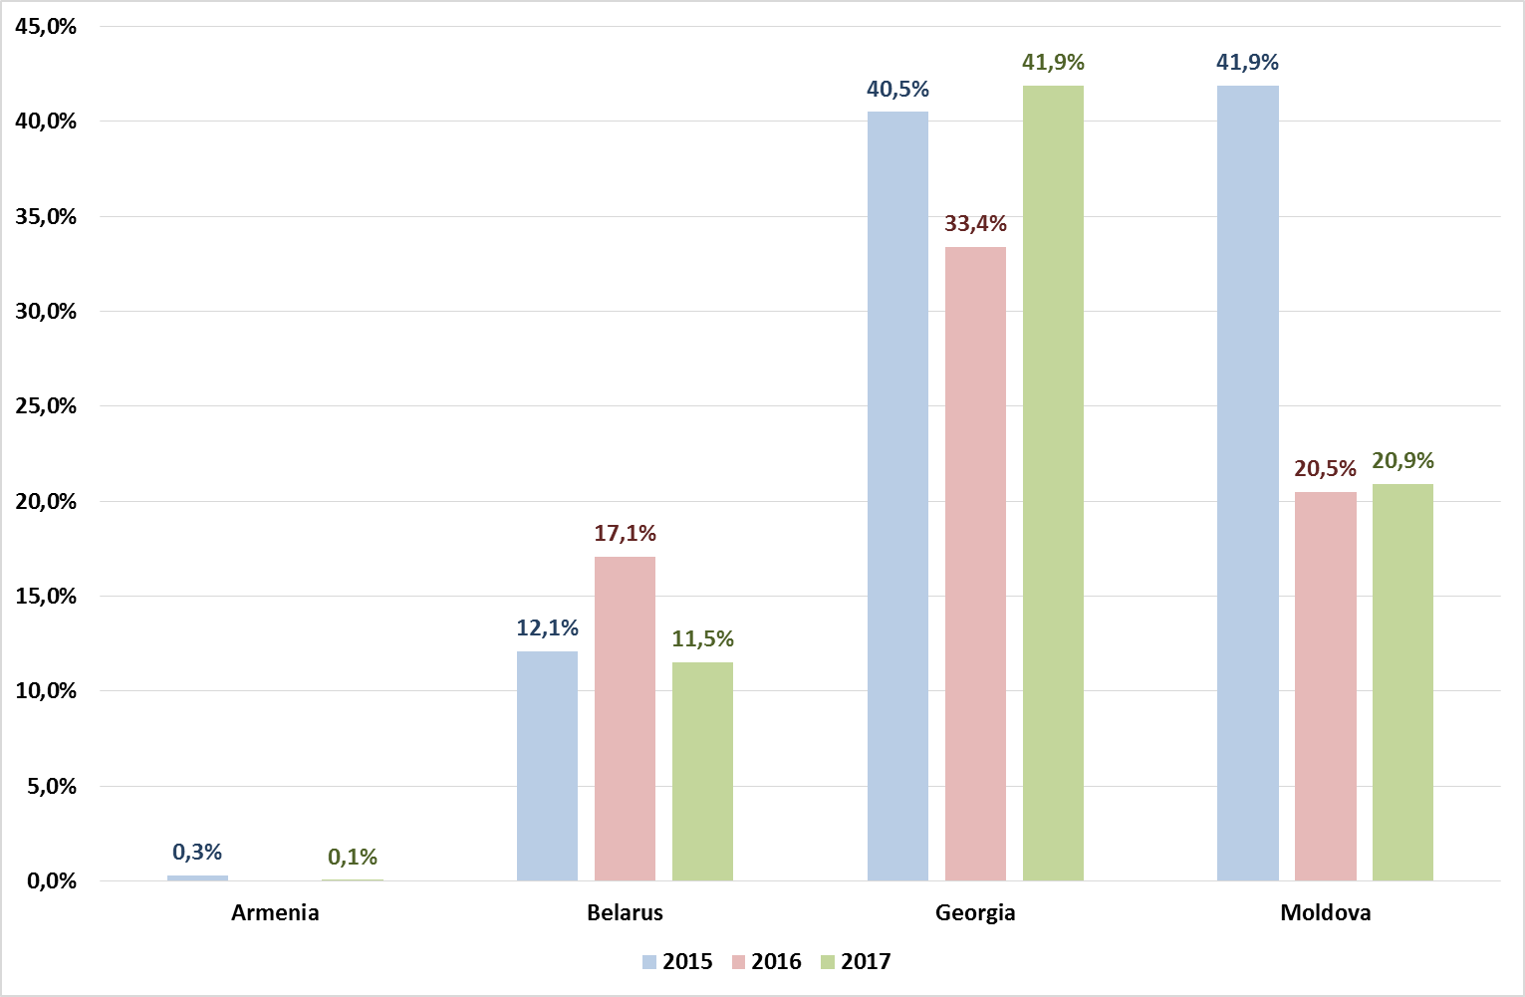
clear RULES are needed To regulate inter-budgetary capital transfers.
Is there a formula-based approach or clearly and legally established criteria to calculate capital inter-budgetary transfers?
Share of inter-budgetary capital transfers in total capital expenditures of subnational budgets in 2015-2017
Armenia | No
Belarus | No
BiH | No
Croatia | No
Georgia | Yes
Kazakhstan | Yes
Kosovo | No
Macedonia | No
Moldova | No
Montenegro | No
Russia | No
Serbia | No

Slide 21
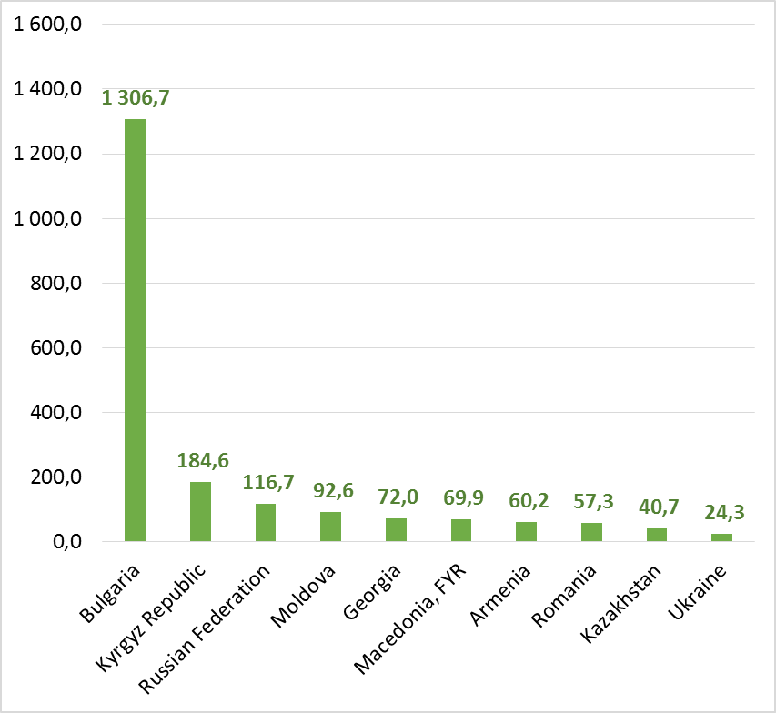
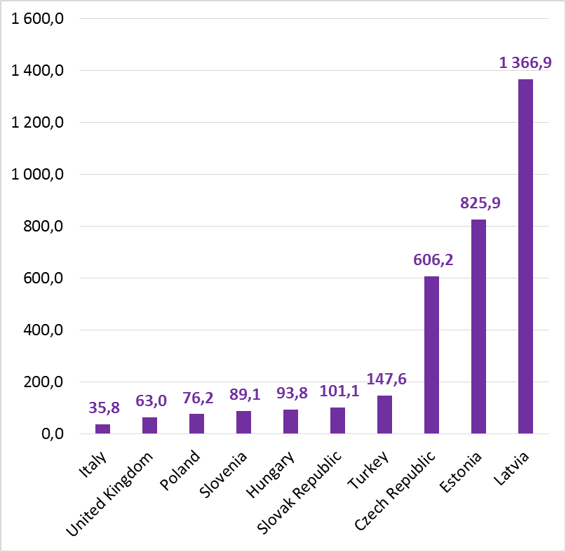
efficiently using resources for public investment is imperative.
Ratio of net investment in nonfinancial assets to net borrowing (%) in 2016
in PEMPAL countries (average 202,5%)
in EU area countries (average 340,5%)
Source: WB World Development Indicators

Slide 22
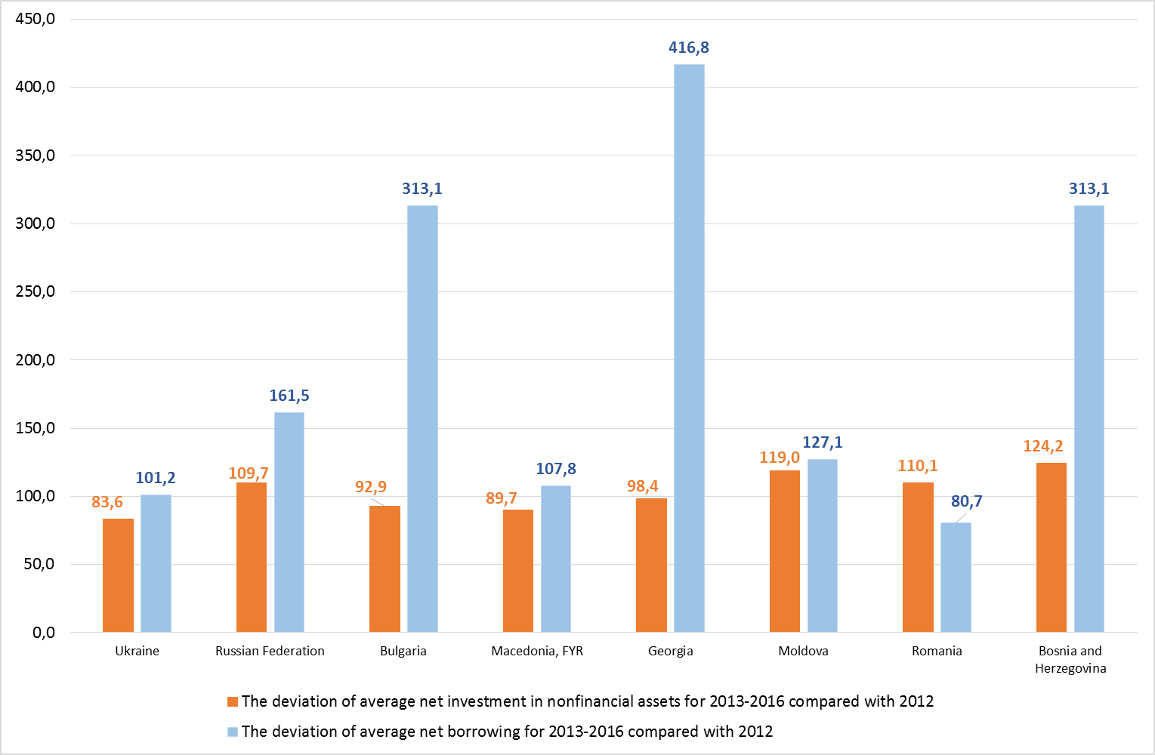
deviation of average net borrowing for 2013-2016 compared with 2012 VS. the deviation of average net investment in nonfinancial assets for 2013-2016 compared with 2012 (%)
Source: WB World Development Indicators
Notes:
The growth rate of investment exceeded the growth rate of the net borrowing in only one of eight countries with a deficit

Slide 23
Public Investment will be improved through the Improved Transparency.
The budgetary information regarding public investments that is available publicly to stakeholders at all levels of government in a timely and user-friendly format
Country | Yes/No
Belarus | Yes | On a quarterly basis the Ministry of Finance publishes budget execution information on its website; information on budget capital expenditures can be found there as well.
BiH | No
Croatia | Yes | Investments are planned in a special section of the budget, and the budget is published in the Official Gazette and online.
Georgia | Yes | Capital Budget Annex of the State budget is a publicly available document; Investment projects of local governments are public as part of the budget; All the investment projects implemented by the Municipalities through capital transfers of central government is decided by Government decrees and they are public.
Kazakhstan | Yes | Articles 153-154 of the Budget Code. Article 67-1 “Citizens’ Budget” of the Budget Code
Kosovo | Yes | Budget low with tables are published every year in the web of MoF
Macedonia | No
Moldova | Yes | The IT system is in place and every budget authority/institution have access to the needed information, according to its role in the budget process. More than, there is a reporting system in place and every budget beneficiary has to present implementation reports according to the time frame set. The list of capital investments projects is an annex to the annual budget law
Montenegro | No
Russia | No
Serbia | Yes | Information in the Budget Act

Slide 24
The key challenges in planning and executing capital expenditures, including public investments
Key challenges | Belarus | Bosnia and Hercegovina | Georgia | Kazakhstan | Kosovo | Macedonia | Moldova | Montenegro | Russia | Serbia
Related to selection criteria, evaluation, preparation, and prioritization of capital projects | * | * |  |  |  | * |  |  |  | *
IT support |  | * | * |  |  | * |  | *
Methodology support | * | * | * |  |  | * |  | *
Lack of clear definition of the Public investments (capital investments, capital expenditures) |  | * |  |  |  |  | *
Capacity of institutions |  |  | *
Achieving direct and ultimate outcomes vis-a-vis budget resources allocated to quasi-public sector entities |  |  |  | *
Weak planning for the budget execution, key point procurement procedures |  |  |  |  | *
Complex administrative procedures |  |  |  |  |  |  |  |  | *
Institutionalization |  |  |  |  |  |  | *
Ad-hoc decisions of investment projects makes it a very time consuming exercise |  |  | *
Need for full scale training for large number of stakeholders |  |  | *
Notes:
Methodology for each phase of pim and it support the main challenges

Slide 25

SOME Key decisions TO BE TAKEN FOR GOOD pim
Interagency coordination processes;
No (reduce) the political considerations on the promoting projects;
Annual and medium term budget management capacity and consistency of the PIM with the budget process; and
Acquisition and resettlement issues, environmental safeguards, and complex procurement challenges.

Slide 26
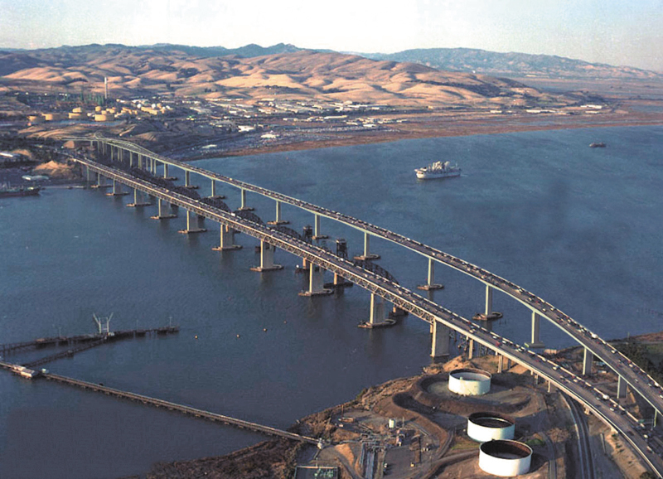
Part 3: Strengthening the efficiency of capital spending and PUBLIC INVESTMENT Management
This Photo by Unknown Author is licensed under CC BY-SA

Slide 27
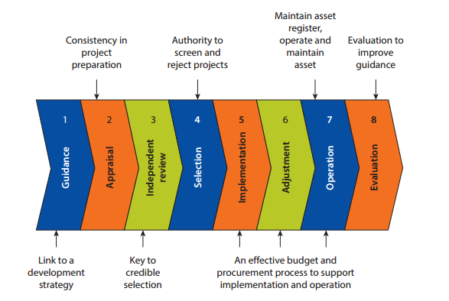
“must-have” Features for an efficient public investment system
Key features of a public investment management system
Maintain asset register, operate and maintain asset
Consistency in project preparation
Authority to screen and reject projects
Evaluation to improve guidance
1
4
7
Guidance
Appraisal
Independent review
Selection
Adjustment
Operation
Evaluation
Implementation
Link to a development strategy
Key to credible selection
An affective budget and procurement process to support implementation and operation
Source: The Power of Public Investment Management, WB 2014.

Slide 28

Key features (1)
Guidance
Projects or programs are subject to (a) actionable strategic guidance and (b) adoption of first-level screening of all project proposals relative to this guidance.
The emphasis should be on basic elements of formal project appraisal, including whether:
the need for a project is well justified;
the project’s objectives are clearly specified;
broad alternative options to meet the project’s objectives are identified and comparatively examined;
the most promising option is subject to detailed analysis;
project costs are fully and accurately estimated; and
project benefits are assessed qualitatively as likely to justify the costs.
Independent review
An independent peer review checks any subjective, self-serving bias in the evaluation.

Slide 29
Key features (2)
Selection
The process of appraising and selecting public investment projects is linked appropriately to the budget cycle.
Implementation
Projects are scrutinized for implementation realism and then implemented with regard to efficiency.
Adjustment
Project implementation review has enough flexibility to allow for necessary adjustments due to changes in project circumstances that would either change the disbursement profile or require project termination.
Operation
Process for ensuring that a facility is ready for service delivery should be in place, and asset registers are maintained and asset values recorded.
Evaluation
Basic completion review and ex-post evaluation of completed projects are conducted.

Slide 30
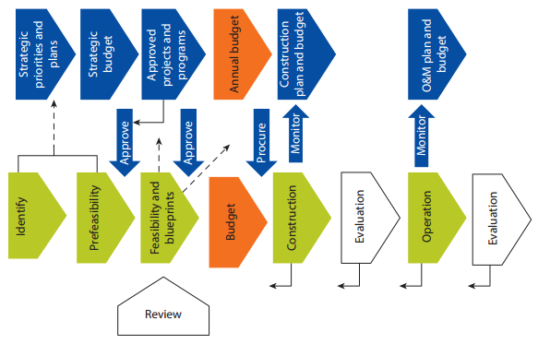
interdependencies, overlaps, Feedbacks, and synergies of Budget and project cycles
Interdependencies, overlaps, feedbacks, and synergies of budget and project cycles
Strategic priorities and plans
Strategic budget
Approved projects and programs
Construction plan and budget
O&M plan and budget
Annual budget
Approve
Approve
Procure
Monitor
Monitor
Identify
Prefeasibility
Feasibility and blueprints
Construction
Evaluation
Operation
Evaluation
Budget
Review
Note: O&M = operation and maintenance.
Source: The Power of Public Investment Management, WB 2014.

Slide 31
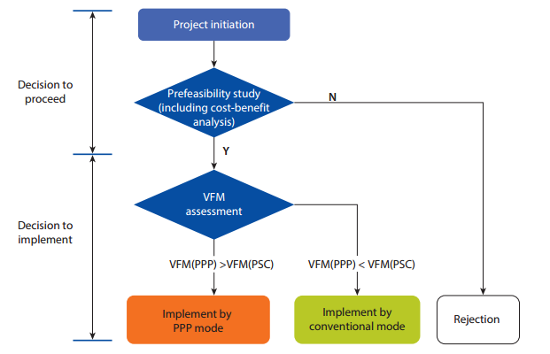
assessment whether the PPP might achieve better Value For Money
Standard example of a unified framework for project appraisal
Project initiation
Decision to proceed
Prefeasibility study (including cost-benefit analysis)
N
Y
VFM assessment
Decision to implement
VFM(PPP)
VFM(PSC)
VFM(PPP)
VFM(PSC)
Implement by PPP mode
Implement by conventional mode
Rejection
Note: PPP = public-private partnership; PSC = public sector comparator; VFM = value for money.
Source: The Power of Public Investment Management, WB 2014.

Slide 32
PUBLIC INVESTMENT MANAGEMENT ASSESMENT FRAMEWORK (PIMA)
PFM OUT-TURNS: Credibility of the Budget (assessment of the capital expenditures).
KEY CROSS-CUTTING ISSUES: Comprehensiveness and Transparency (assessment of the classification, comprehensiveness of information included in budget documentation, PIM-related inter-governmental fiscal relations, management of fiscal risks and public access to key information).
C. BUDGET CYCLE
  C(i) Policy-Based Budgeting (assessment of the investment guidance, project development, and preliminary screening; formal project appraisal; independent review of appraisal; orderliness and participation in the annual budget process; multi-year perspective in fiscal policy and management; project selection and budgeting).
Notes:
WORLD BANK PIM PERFORMANCE INDICATORS assess following issues (1)

Slide 33
PIMA (2)
C. BUDGET CYCLE
  C(ii) Predictability and Control in Budget Execution (assessment of the project Implementation; predictability in the availability of funds for commitment of expenditures; value for money in procurement; effectiveness of internal controls and internal audit of capital project expenditure; project adjustment; facility operation).
  C(iii) Accounting, Recording, and Reporting (assessment of the basic completion review and evaluation; budget reporting and financial statements).
  C(iv) External scrutiny and audit (scope, nature and follow-up of external audit; legislative scrutiny of capital spending in the annual budget law and of external audit reports on capital spending).

Slide 34
The activities on PIMA have to comprise of:
2. Conducting a review of capital budgeting processes.
3. Conducting a review of related processes that affect public investment project performance countrywide as well as in specific agencies.
4. Establishing a baseline assessment for the country.
1. An initial high level workshop to re-invigorate reform and policy dialogue on public investment management with key players.
To launch the assessment on what the most critical constraints to efficient PIM are, and build consensus around what needs to be done.
Analysis of the process that an investment project has to follow through its lifecycle from the identification to completion and benchmarking this process against good practice.

Slide 35
Thank you
Questions?
Please refer to:
Iryna Shcherbyna (WB, Governance)
ishcherbyna@worldbank.org

