Slide 1

A Framework for the Governance of Infrastructure
- Getting Infrastructure Right -
Jungmin Park, OECD Budgeting & Public Expenditures Division
2019 Annual BCOP Meeting
19 March 2019, Tashkent, Uzbekistan

Slide 2
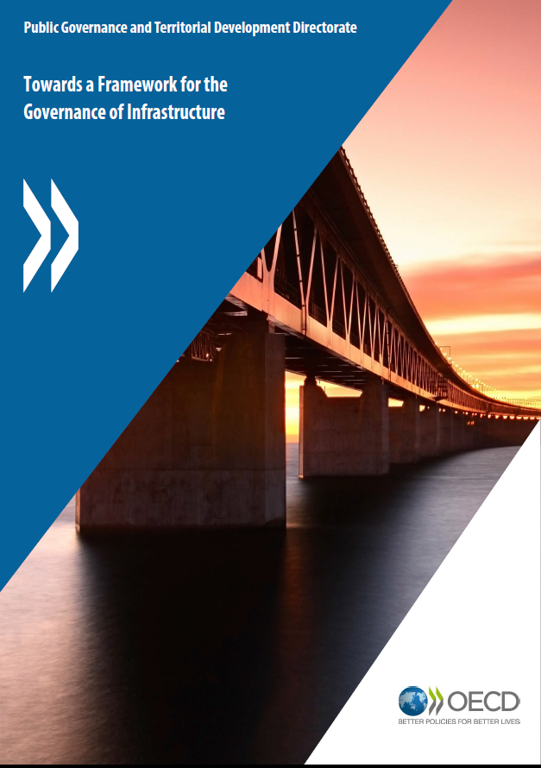
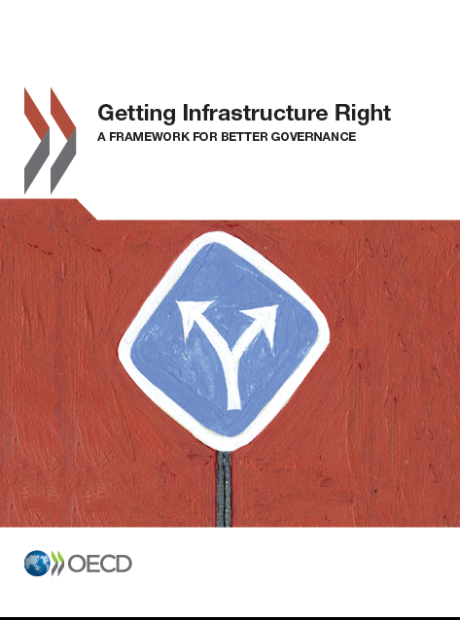


Infrastructure Governance at the OECD
Network of Senior Infrastructure Officials
OECD (2012), Public Governance of Public Private Partnerships
OECD(2017)
Getting Infrastructure Right: A Framework for Better Governance
OECD (2015),
Towards a Framework for the Governance of Infrastructure

Slide 3
Good governance for good infrastructure
Good governance is necessary for planning, selecting and delivering the right infrastructure, on time, and on budget
  Infrastructure governance: processes, tools, norms of interaction, decision-making processes and monitoring
Objective: making the right projects happen, in a way that is cost effective, affordable and trusted by investors, users and citizens.

Slide 4
A framework for infrastructure governance
10 dimensions or “success factors”
A normative approach supported by:
  Key questions for decision makers
  Benchmark indicators to identify enabling factors
Countries use the framework to assess the adequacy of their infrastructure management systems.

Slide 5
10 dimensions of good infrastructure governance that addresses current challenges
Develop a strategic vision for infrastructure
  A means to go beyond silos
  Requires a to balance of multiple objectives
Manage threats to integrity
  Adequate conflict of interest policies
  System of internal controls and reporting mechanisms
Choose how to deliver infrastructure
  Most efficient delivery mode
  Ensure value-for-money and affordability

Slide 6
10 dimensions of good infrastructure governance that addresses current challenges
Ensure good regulatory design
  Reduce uncertainty from the "rules of the game“
  Create confidence
Integrate a consultation process
  Identify and meet users’ needs
  Enhance the legitimacy amongst the stakeholders
Co-ordinate infrastructure policy across levels of government
  Reduce gaps, overlaps, or contradictions
  Alignment of strategic priorities
  Economies of scale

Slide 7
10 dimensions of good infrastructure governance that addresses current challenges
Guard affordability and value for money
  Ensure affordability for the public and the users
Generate, analyse and disclose useful data
  Evaluation, transparency and accountability
Make sure the asset performs throughout its life
    Maintaining value for money through the performance of the asset
Public infrastructure needs to be resilient
  Socio-economic and environmental impacts
  Functional dependencies of critical infrastructure

Slide 8
Challenges and Good Practices in oecd countries

Slide 9
Governance challenges
The governance challenges are strategic and specific.
The following slides show varied practices across OECD countries.
Strategic challenges | Specific challenges
The period it takes to develop and sustain an enabling environment conducive to delivering and maintaining quality infrastructure Adapting the enabling environment to respond to changes in the risk landscape Understanding the interconnected impact of good governance throughout the investment process. | Political motivations behind investment decisions The absence of a long-term strategic plan Robust co-ordination across levels of government Ensuring value for money A lack of data, analysis and evaluation to inform decisions Limited focus on the performance of an investment through its lifecycle

Slide 10
Political priorities are often behind infrastructure investment decisions
Determinants for project funding
Source: OECD (2016), OECD Survey of Infrastructure Governance

Slide 11
Integrated long-term strategic infrastructure plans are missing in many countries
Around half of the surveyed countries have an integrated strategic infrastructure plan, but many countries still rely only on sector-based plans
Countries with a LT strategic infrastructure plan | Countries with only sector-based infrastructure plans
Australia | Belgium
Austria | Chile
Hungary | Czech Republic
Italy | Estonia
Japan | France
Mexico | Germany
New Zealand | Ireland
Republic of Korea | Norway
Spain | Slovenia
Sweden | Switzerland
Turkey
United Kingdom
South Africa
Note: Total respondents: 24. Other forms of strategic planning include medium term (6-7 years), sector and regional plans.
Source: OECD (2016), OECD Survey of Infrastructure Governance

Slide 12
Robust coordination mechanisms across levels of government are lacking
Do national PPP units or Infrastructure Units in central government strengthen the capacities of sub-national governments (municipalities, regions, states) to design and run infrastructure projects?
Yes | No
Australia* | Austria
France* | Chile
Germany* | Denmark
Italy* | Estonia
Republic of Korea* | Finland
Spain* | Hungary
United Kingdom* | Japan
Czech Republic | Luxembourg
Ireland | New Zealand
Turkey | Norway
 | Slovenia
Non-OECD | Sweden
Philippines | Switzerland
South Africa | Mexico
Note: Total respondents: 23; * Without mandate.
Source: OECD (2016), OECD Survey of Infrastructure Governance

Slide 13
Ensuring absolute value for money from infrastructure projects is not always formalised
Is there a formal process/legal requirement for ensuring value for money from infrastructure projects?
Yes in all cases | In all cases above a certain value | On an ad hoc basis | Only PPP Projects | No
Australia | Hungary | Czech Republic | France | Austria
Germany | Ireland | Denmark | Mexico | Chile
Italy | Japan | Finland |  | Estonia
United Kingdom | New Zealand | Switzerland |  | Luxembourg
 | Norway | Belgium |  | Slovenia
 | Republic of Korea |  |  | Spain
 | Turkey |  |  | Sweden
 | Non-OECD
 | South Africa
 | Philippines
Source: OECD (2016), OECD Survey of Infrastructure Governance

Slide 14
The lack of data impedes accurate analysis and evaluation of projects
Is there a central, systematic collection of information on the financial and non-financial performance of infrastructure?
Who collects information on financial and non-financial performance of infrastructure?
Yes | No
Australia | Austria
Finland | Belgium
Japan | Chile
Mexico | Czech Republic
New Zealand | Denmark
Korea | Estonia
Spain | France
 | Germany
 | Ireland
 | Italy
 | Luxembourg
 | Norway
 | Slovenia
 | Sweden
 | Turkey
 | Switzerland
 | United Kingdom
 | Hungary
Non-OECD | Non-OECD
Philippines | South Africa
Source: OECD (2016), OECD Survey of Infrastructure Governance

Slide 15
Performance throughout the life of an asset requires more attention
Is there a policy ensuring that the relevant line ministry or agency conducts performance assessment of each project?
Yes | No
Czech Republic | Australia
Finland | Austria
Germany | Belgium
Ireland | Chile
Italy | Denmark
Japan | Estonia
Mexico | France
New Zealand | Luxembourg
Korea | Norway
Spain | Slovenia
Turkey | Sweden
United Kingdom | Switzerland
Non-OECD | Hungary
Philippines
South Africa
Note: Total respondents: 25
Source: OECD (2016), OECD Survey of Infrastructure Governance

Slide 16
Thank you
Jungmin Park Budgeting and Public Expenditures Public Governance Directorate, OECD. jungmin.PARK@oecd.org

Slide 17
References
OECD (forthcoming), Framework of Infrastructure Governance – State of Play
OECD (2016), Integrity Framework for Public Investment
OECD (2015) Recommendation of the Council on Public Procurement
OECD (2015) Recommendation of the Council on Budgetary governance
OECD (2015) High-Level Principles for Integrity, Transparency & Effective Control of Major Events & Related Large Infrastructure
OECD (2015), Toward a Framework of Infrastructure Governance
OECD (2014) Recommendation of the Council on Digital Government Strategies
OECD (2014) Recommendation of the Council on Effective Public Investment Across Levels of Government
OECD (2014), The Governance of Regulators, OECD Best-Practice Principles for Regulatory Policy
OECD (2014) Recommendation of the Council on the Governance of Critical Risks
OECD (2013) G20/OECD High-level principles of long term investment financing by Institutional Investors
OECD (2012) Recommendation of the Council for the Public Governance of Public-Private Partnerships
OECD (2012) Recommendation of the Council on Regulatory Policy and Governance
OECD (2010) Guiding Principles on Open and Inclusive Policy making
OECD (2010) Recommendation of the Council on Principles for Transparency and Integrity in Lobbying
OECD (2007) Recommendation of the Council on Principles for Private Participation in Infrastructure
OECD (2003) Recommendation of the Council on OECD Guidelines for Managing Conflict of Interest in the Public Service

