Slide 1
Trends and best practice of spending review in OECD
Jungmin Park, OECD Budgeting & Public Expenditures Division
2019 Annual BCOP Meeting
20 March 2019, Tashkent, Uzbekistan

Slide 2
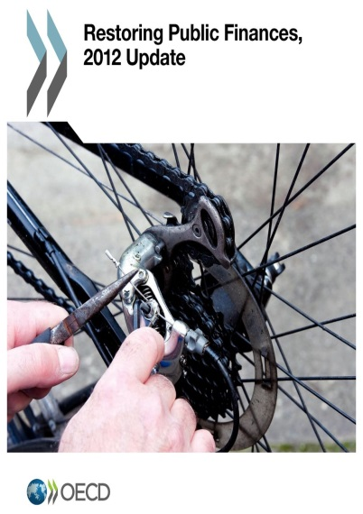
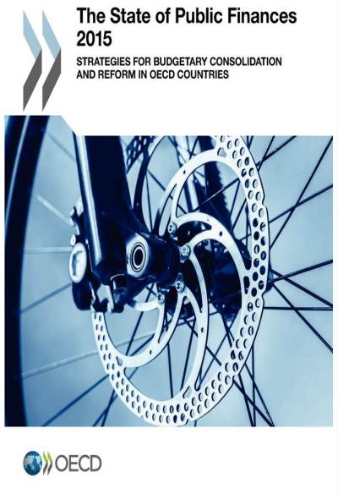
OECD Budgeting Flagship Publication
“A single flagship publication for SBO”
What is the “state of the art” in modern budgeting?
What are the key challenges that countries face?

Slide 3
OECD Budgetary Principles
Budgeting within fiscal objectives
Alignment with medium-term strategic plans & priorities
Perfor-mance, evaluation & VfM
Quality, integrity & indepen-dent audit
Transparencyopenness & accessibility
Participative, inclusive & realistic debate
Fiscal risks & Sustaina-bility
Capital budgeting framework
Compre-hensive budget account-ing
Effective budget execution
Performance, Evaluation & VFM

Slide 4
2018 OECD Performance Budgeting Survey
5th OECD Performance Budgeting Survey
Coverage:
45 questions on
Performance Budgeting
Spending Review
Evaluation
Respondents mainly from Central Budget Authorities(CBAs)
Response rate: 33 countries (out of 35)
all 2018 data in this presentation is coming from the
2018 OECD Performance Budgeting Survey

Slide 5
Why spending reviews?

Slide 6
Continued increase in number of countries conducting spending reviews
Adoption of spending reviews (2011-2018)

Slide 7
SR information is becoming more important and is more likely to be used during budget negotiations

Slide 8
Main Objectives of Spending Review
From Short-term budget cuts to a more medium-term view on efficiency and an improved programme impact

Slide 9
Key results has been the reallocation of spending to match government priorities
Main results of Spending Reviews over the past 10 years (2018)

Slide 10
Which challenges and approaches in spending review?

Slide 11
Main challenges for the implemetation of spending review

Slide 12
The approach to spending review
Selective Spending Review
Focus on a pre-agreed set of topics (programmes, processes, agencies)
Topics chosen on discretionary or cyclical basis
Useful for improving efficiency and effectiveness of spend
Integration into budget cycle:
Informs annual resource allocation decisions
Examples:
Canadian Strategic Review (2008,2009,2010)
Danish Special Studies
Dutch Interdepartmental Policy Reviews Reviews
Comprehensive
Spending Review
Open review process focusing on most important savings options
Suitable for quick fiscal consolidation or change in policy direction (e.g. start of new government)
Resource intensive and conducted when required (e.g. to set MTEF*)
Integration into budget cycle:
Helps in setting MTEF / annual budget targets
Informs annual resource allocation decisions
Examples:
UK 2010 CSR (Comprehensive Spending Review)
Canadian Strategic & Operating Review (2011)
* MTEF : Medium Term Expenditure Framework

Slide 13
Prevalence of different types of Spending Review
Expenditure Coverage of spending review in the past 10 years (2018)

Slide 14
Best examples of Spending Reviews
Canada
Focused on thematic areas of spending, such as support for innovation, and the management of fixed assets.
Covered spending across all of government and applied the result for assessing spending
The UK
In 2017, introduced the concept of a “Public Value Framework”
Assessing the likelihood of value being maximised in any given area of spend
Improving the process through which inputs are turned into outcomes.
Sound planning, citizen engagement, changing cultures and behaviors within government

Slide 15
Concluding observations
More and more countries are conducting Spending Reviews
but these follow different methodologies given different policy & fiscal objectives and national & political context
Focus is moving away from short-term budget cuts to:
a medium-term view on efficiency
improved programme impact
alignment of spending with government priorities
Many challenges remain
quality and availability of performance information
determining a process that provides timely and relevant results for budget decisions
Success features include:
Linkage to MTEF and/or annual budget targets
Guidance on policy & fiscal objectives and assessment criteria
Common agreement among key stakeholders on rules, process, objectives
Apolitical analysis, even if the final decision process is political

Slide 16
Thank you
Jungmin Park Budgeting and Public Expenditures Public Governance Directorate, OECD. jungmin.PARK@oecd.org

