Slide 1

THE TREASURY COMMITTEE OF THE MINISTRY OF FINANCE
OF THE REPUBLIC OF KAZAKHSTAN
PEMPAL:
Information Technologies
in Treasury Operations
АLMATY, May 2023 г.

Slide 2
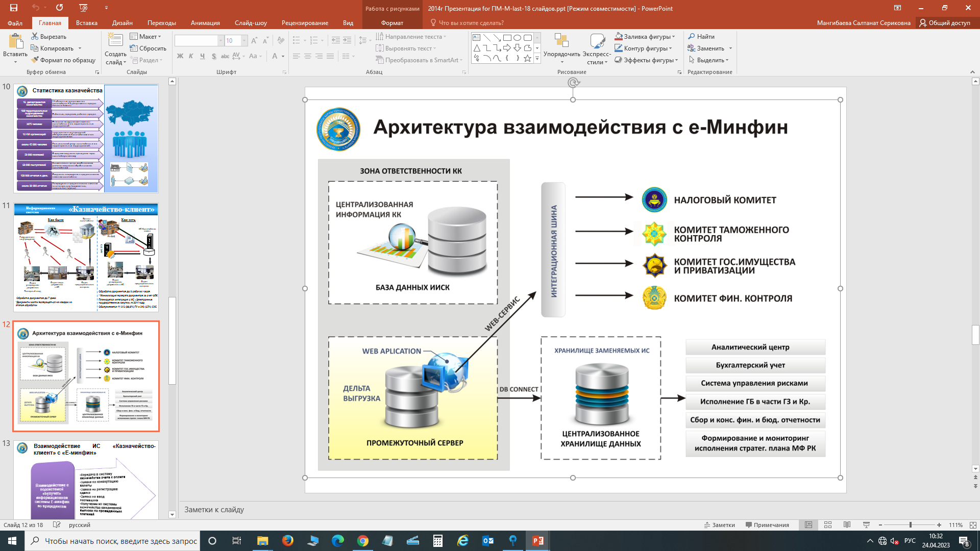
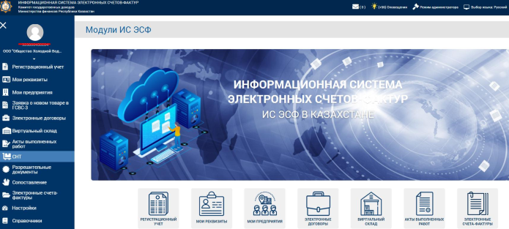
The Treasury Information System
Evolution of the Treasury System in Kazakhstan
Stage I
1996-2002
Stage II
2001-2007
Stage III 2007-2008
Stage IV
2009-2014
Stage V
2015 –
BASK-M automated system
Decentralized budget execution system
Settlement and cash services of government budgets
Integrated Treasury Information System
Centralized system
Automation of all functions
Implementation of new technologies
Compliance with international standards
System security
Migration to upgraded version of Oracle
Introduction of new tools
Human factor minimization
System integrity
Elimination of corruption risks
National language supported
E-workflow development
Automation of receipt and processing of financial documents
Online document signing
Online access to financial reports
Elimination of corruption risks
Digital transformation
Expanding integrations
Process optimization
ICT upgrade
Functional extension
Creating new services
Баск- М
Oracle R8
Oracle R12
E-Workflow

Slide 3
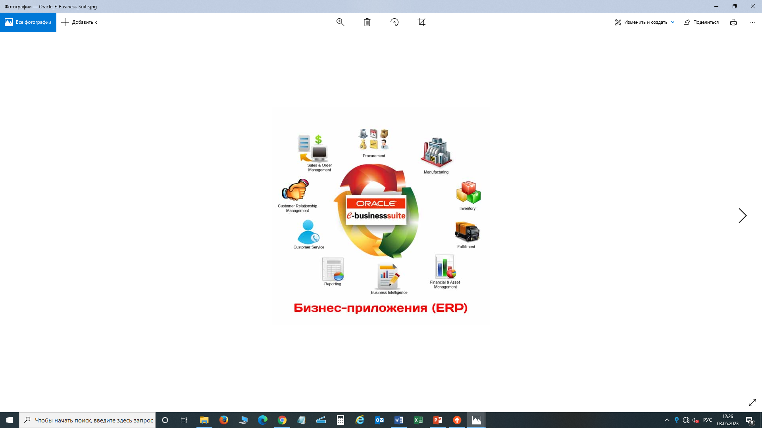
The Treasury Information System
Functional Architecture of the System
Fiscal Revenues Management module
Crediting, allocation and accounting of the state budget revenues
General Ledger module (in national currency and FX)
budget management
accounting of all transactions
Commitments Management module
Registration and recording of civil transactions of state organizations
Cash Management module
Daily closure of the operational day and generation of TSA analysis
Payments Management module
(in national currency and FX)
Making and recording of payments by government organizations
Banking System Interface
Receipt and sending of electronic payment messages through the Kazakhstan Interbank Settlement Center of the National Bank

Slide 4
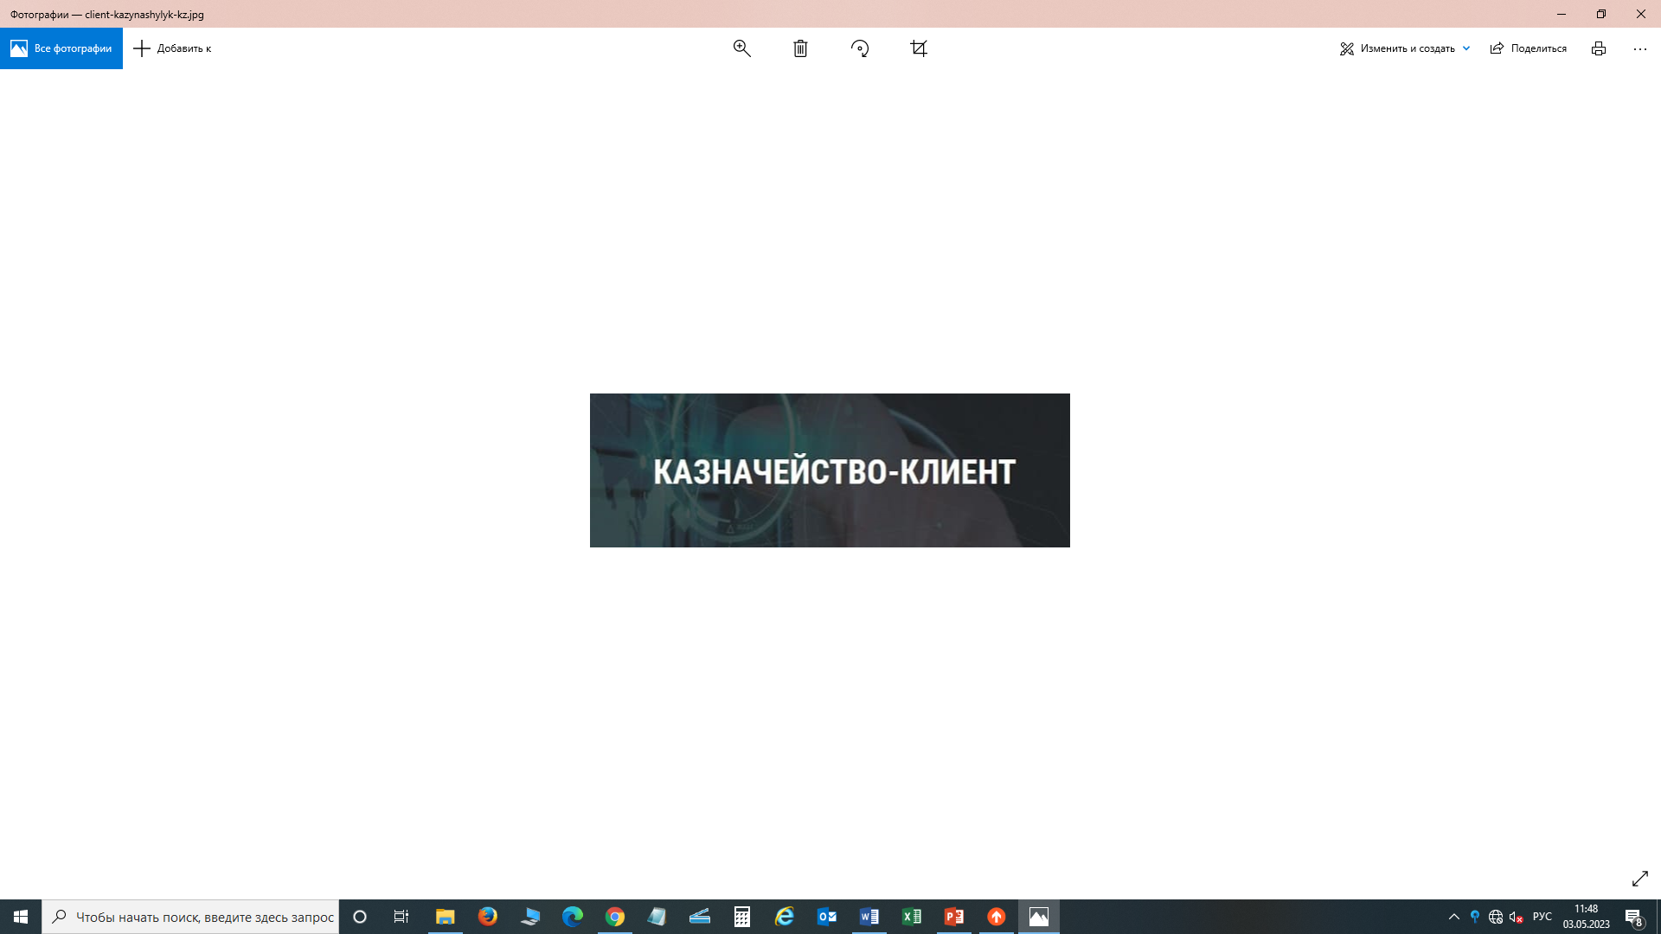
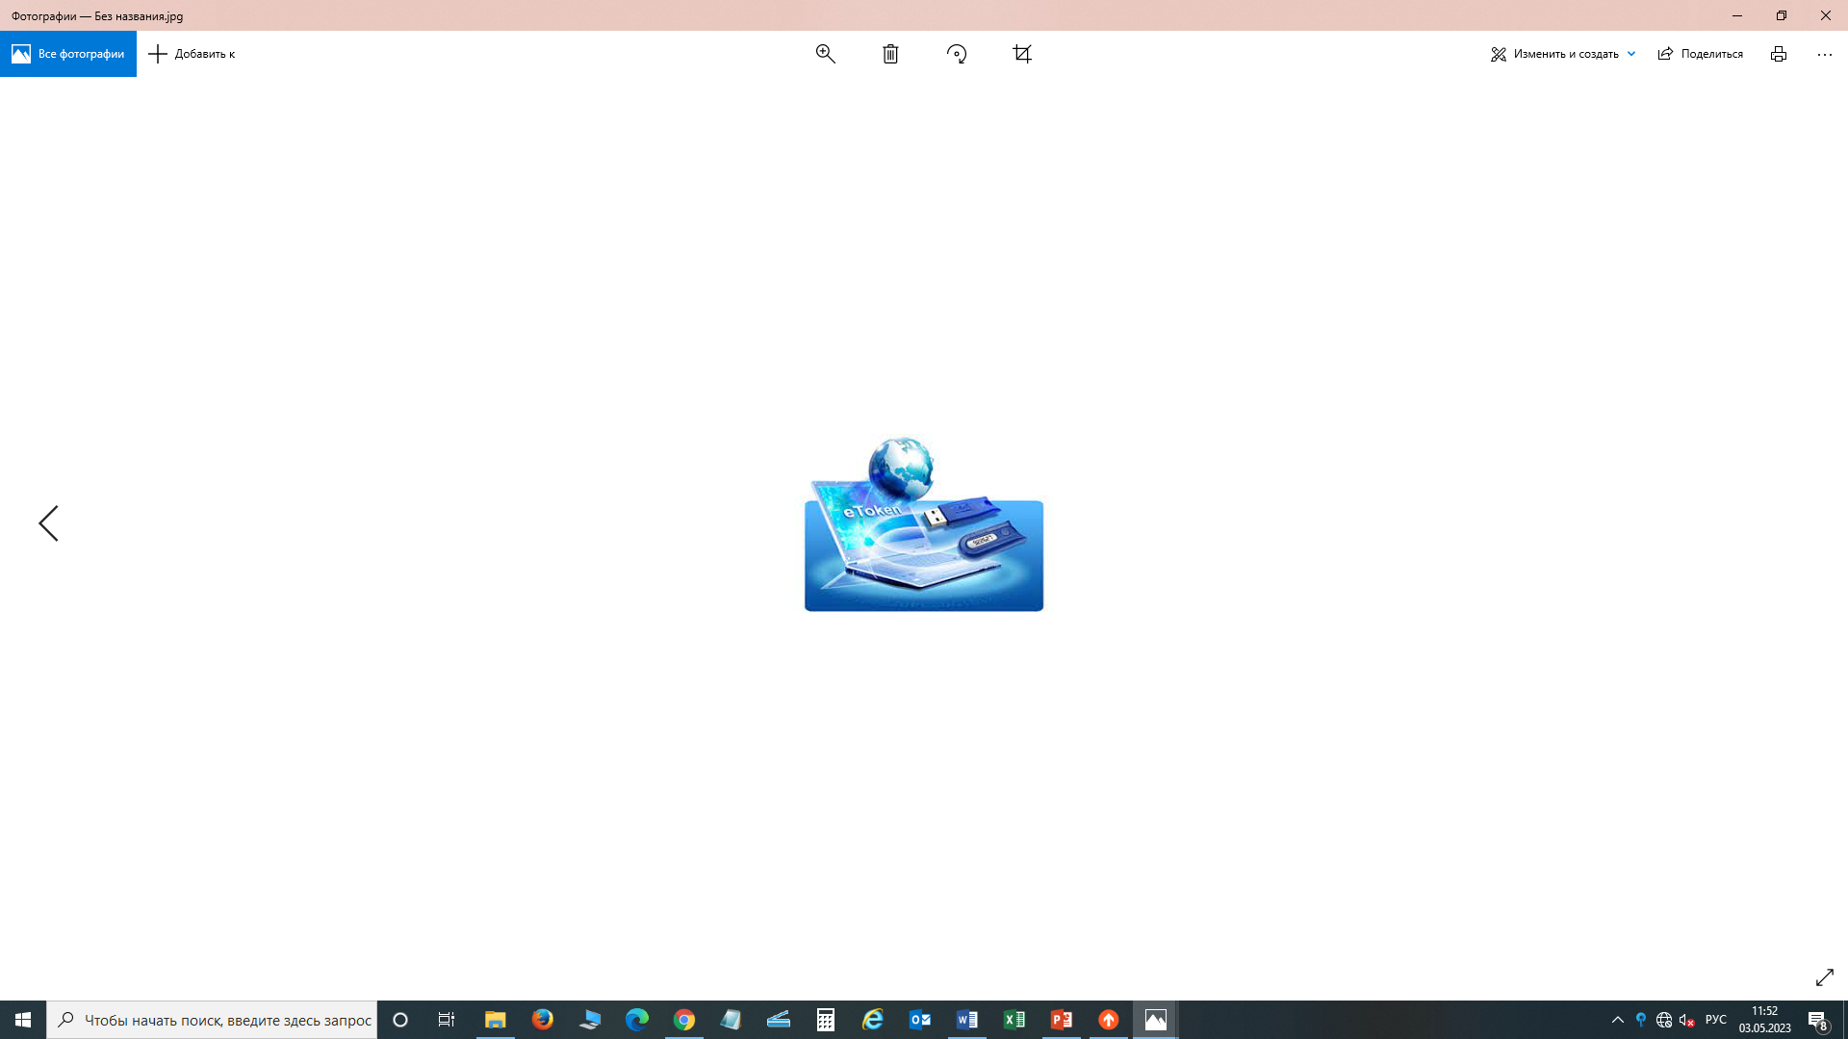













The Treasury Information System
Introduction of E-workflow with Government Organizations
Before
Now
FINANCIAL DOCUMENTS
Paper-based workflow
E-workflow, online
FINANCIAL DOCUMENTS PROCESSING TIME
3 days
up to 6 hours
INFORMATION SYSTEMS
ITIS
State Planning IS
E-Procurement AIS
e-Invoices IS
Centralized Current Accounts IS
e-MINFIN. IAIS
OUTCOMES
integrations
Costs
Administrative costs savings for government entities (paper – more than 100 m tenge p.a., transport and time – up to 400 km in some regions);
No direct contact with government agencies, reduced administrative barriers and minimization of the "human factor" in the execution of the state budget;
Increased security of document transmission;
Transactions transparency.
Transport
Paper
Fuel
Money
Paper archives
Business processes:
Posting financing plans and references
Posting a civil law transaction registration request
Posting transactions in foreign currencies
Posting accounts payable
Issuing payment orders, including refunds and offsets
Posting a supplier entry request
Reporting

Slide 5
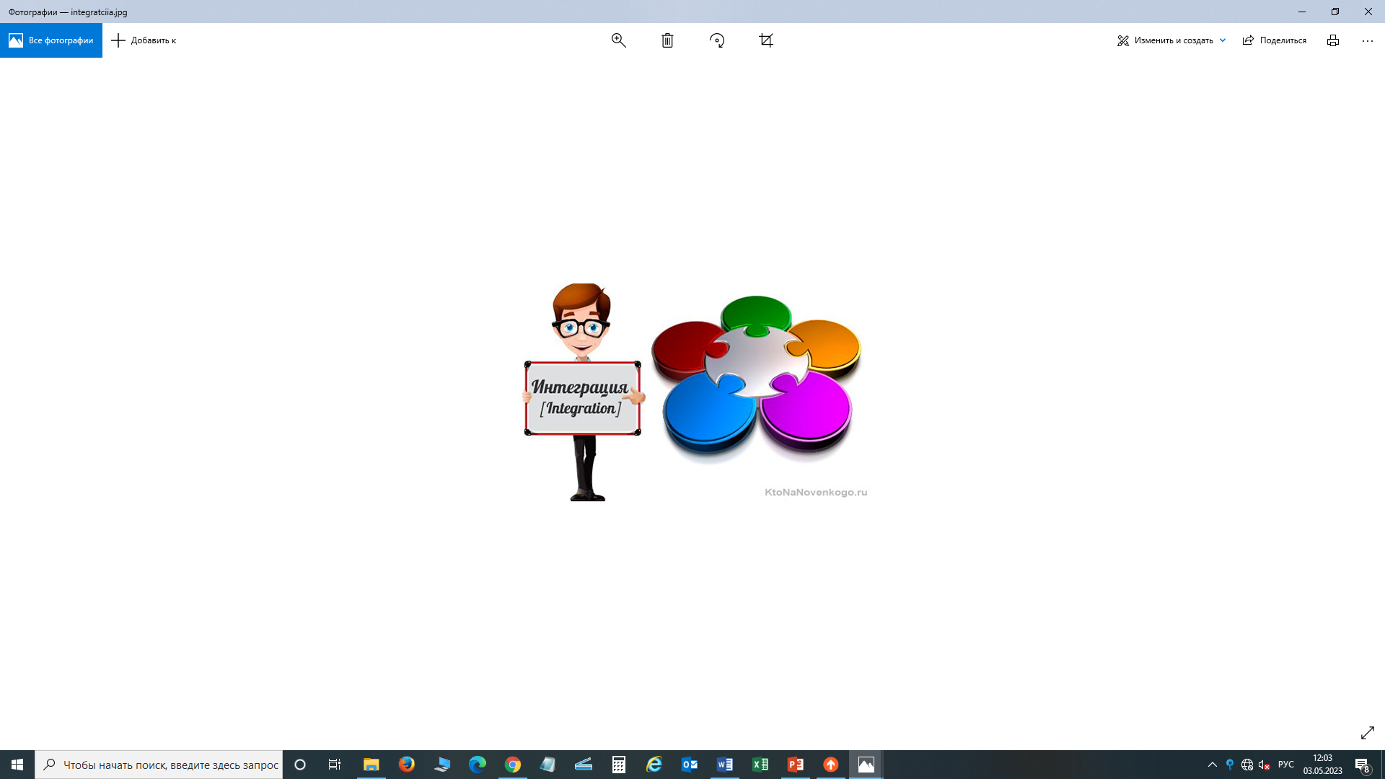




The Treasury Information System
Integrations – Digital Transformation
“State Planning” IS
(since 2024)
Financing plans re. revenues, commitments and payments
“National Certification Authority” IS
Online-check of digital signature for authenticity
The Treasury Information System
“e-Public Procurement” AIS
E-contracts data
e-MINFIN IAIS
State budget execution data re. revenues, expenditures, regulatory reference data
IS “E-Invoices”
E-Invoices
“Centralized Uniform Current Accounts” IS
Payment orders for refunds and offsets between revenue codes

Slide 6

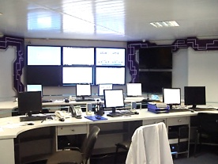

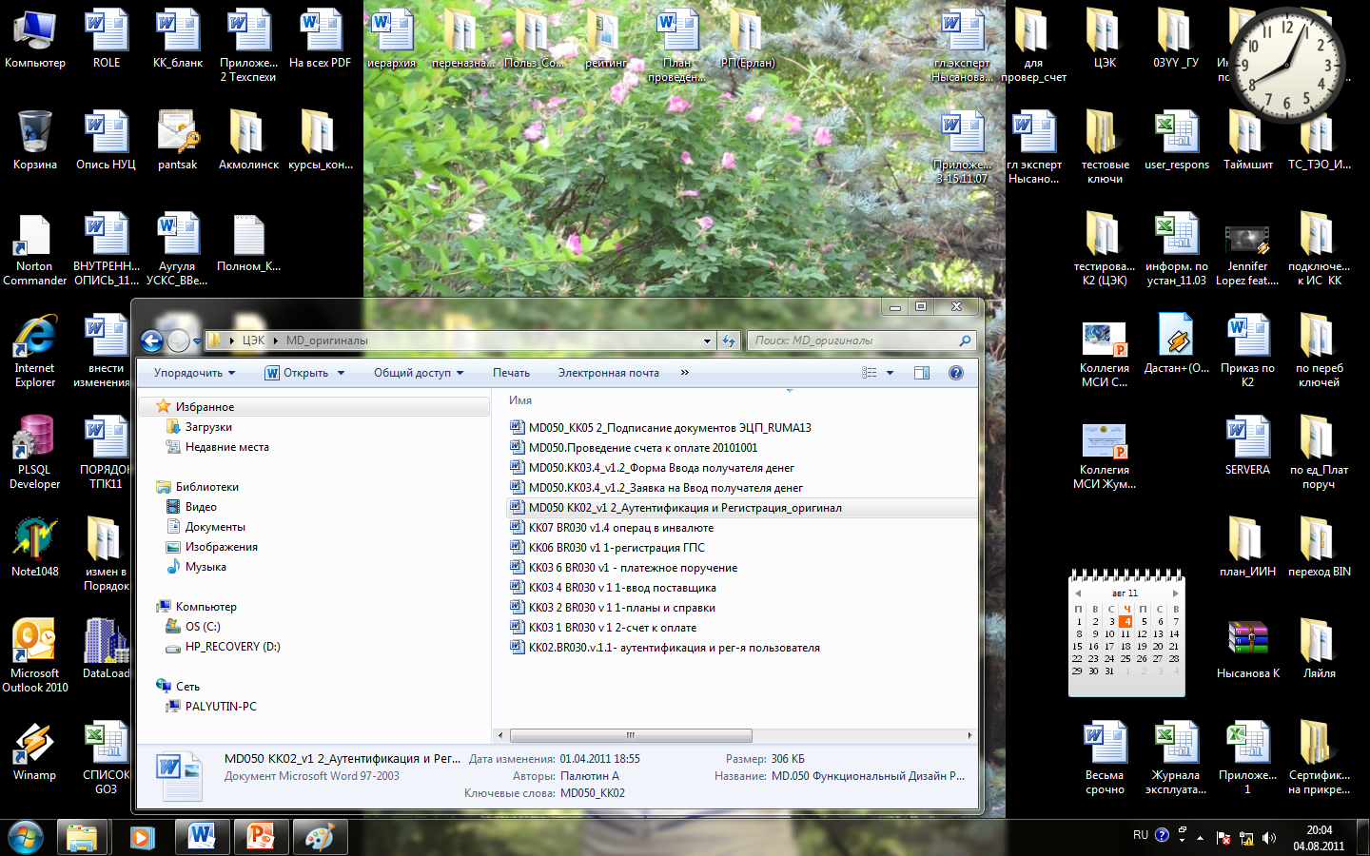




2023 PEMNA Treasury CoP Bangkok – Making the Treasury More Efficient and Accountable to Enhance Service Delivery
2.
The Treasury Information System
IS of the Treasury Committee – State Planning IS
Past
Fragmented GO systems
GO
Business process “Plans and references”
IS of MoF
“General Ledger” module
1С-accounting, Parus,
SP IS (plans)
Vision
“General Ledger” module
GO
SPS 2024
EXPECTED OUTCOMES
  Faster processing
  Human factor minimization
  Better quality of documents provided
Электронный счет-фактура

Slide 7
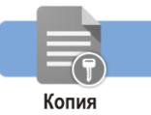



2023 PEMNA Treasury CoP Bangkok – Making the Treasury More Efficient and Accountable to Enhance Service Delivery
2.
The Treasury Information System
IS of the Treasury Committee – e-Public Procurement IS
e-Invoices IS
Before
Civil Law Transaction Registration Request
business process
GО
Commitments Management module
Paper-based contracts, invoices
Treasury – Client
Account Payable business process
Payments Management module
Now
GO
Civil Law Transaction Registration Request
business process
Commitments Management module
E-contract
EP IS
II IS
Payments Management module
Treasury - Client
Account Payable business process
E-invoice
OUTCOMES
  Elimination of scanned copies (archive)
  Faster processing
  Amounts control
  Human factor minimization
  Better quality of documents provided

Slide 8


The Treasury Information System
PAYMENT ORDERS FROM STATE REVENUES BODIES
ЭЛКТРОННЫЙ
ДОГОВОР
The Treasury Committee IS – Centralized Uniform Current Accounts IS
Before
After
SIGNING SOURCE DOCUMENTS
Hard copy
IN CUCA IS
ATTACHED IN TC IS
Scanned copies
E-copies
Электронный
SIGNING IN TC IS
e-signature
e-signature
CHECKING IN TC IS
Business process “Posting Payment Order for Refund”
Business process “Posting Payment Order for Refund”
OUTcOMES
  Elimination of scanned copies (archive)
  Faster processing
  Human factor minimization
  Better quality of documents provided
Business process “Posting Payment Order for Offset”
Business process
“Posting Payment
Order for Offset”»

Slide 9

2023 PEMNA Treasury CoP Bangkok – Making the Treasury More Efficient and Accountable to Enhance Service Delivery
2.
The Treasury Information System
Organizations served: 2008 - 11,000,
2022 - 15,000.
Financial documents: 2008 – 6.7 M
2022 – 14 M.
  Optimization and Re-Engineering
Past
Four-Eyes Invoice Processing
Spending Unit
Treasurer 1
Treasurer 2
submits invoice
reviews invoice
reviews invoice
Kazakhstan Interbank
Settlement Center
of the National Bank
Now
One-click processing
Spending Unit
Treasurer
payment
submits invoice
reviews invoice
OUTCOMES
  Faster payments
  Human factor minimization

Slide 10
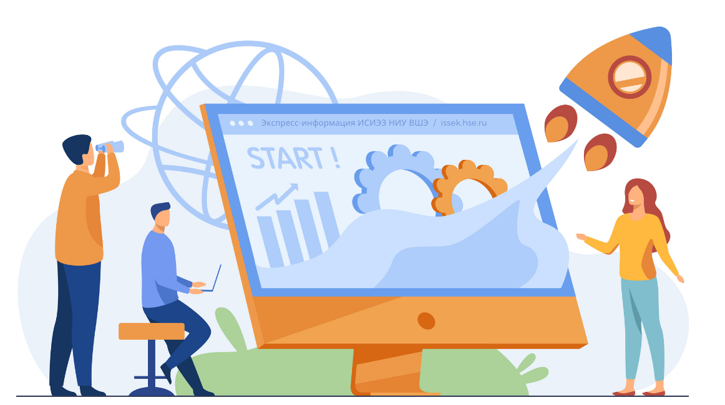





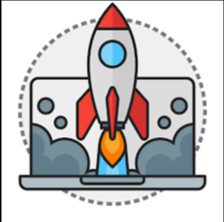
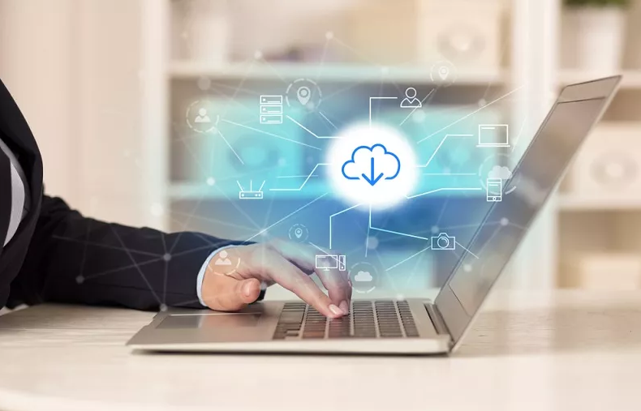

The Treasury Information System
Перспективная ИСУГФ
01
IS Development Prospects
Now
Obsolete servers
Сервер от 2012 года
Lower performance
End-month load and failures
Development and integrations constraints
Vision
Server capacity upgrade
Higher performance
Continuity in operation
Introduction of new tools and services

Slide 11


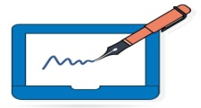


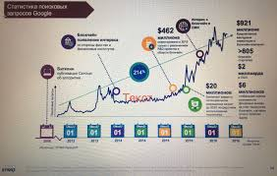
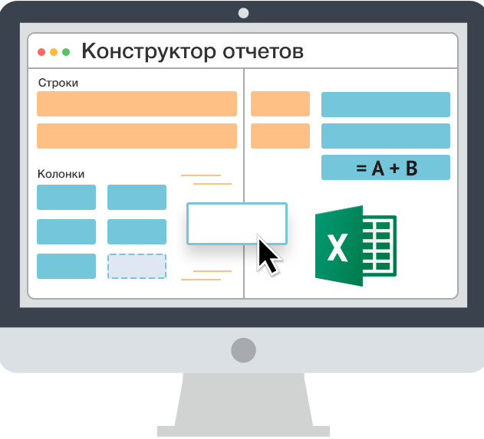
The Treasury Information System
IS Development Prospects
  Data Management
Risk Management System
During national and local budgets execution
During arrangement and conduct of centralized public procurement
Analytical reporting (Dashboard)
Report Builder
Computable values
Flexible filter configuration
Access customization
Viewing in the mobile app
  Expected Outcomes:
  Risk reduction in all areas
  Information for decision making
  Better state budget execution

Slide 12
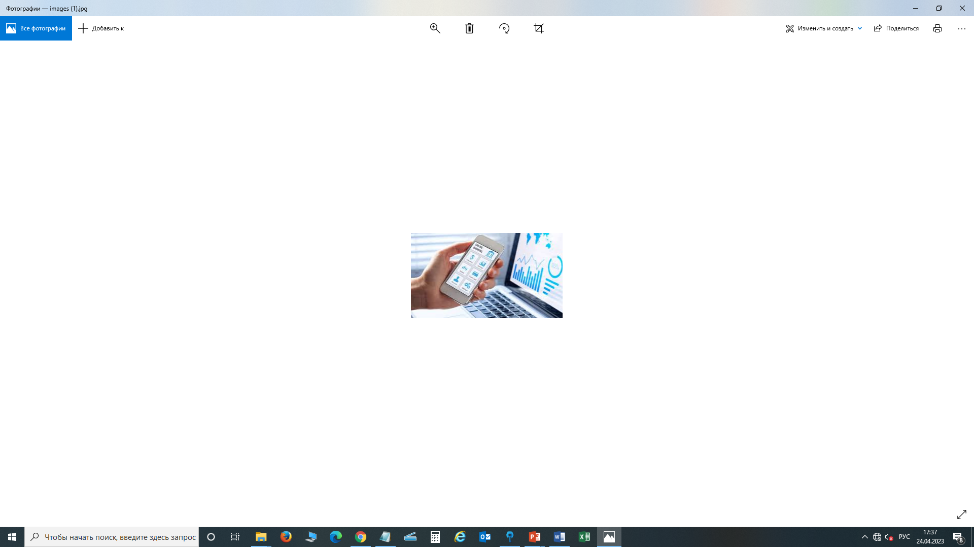

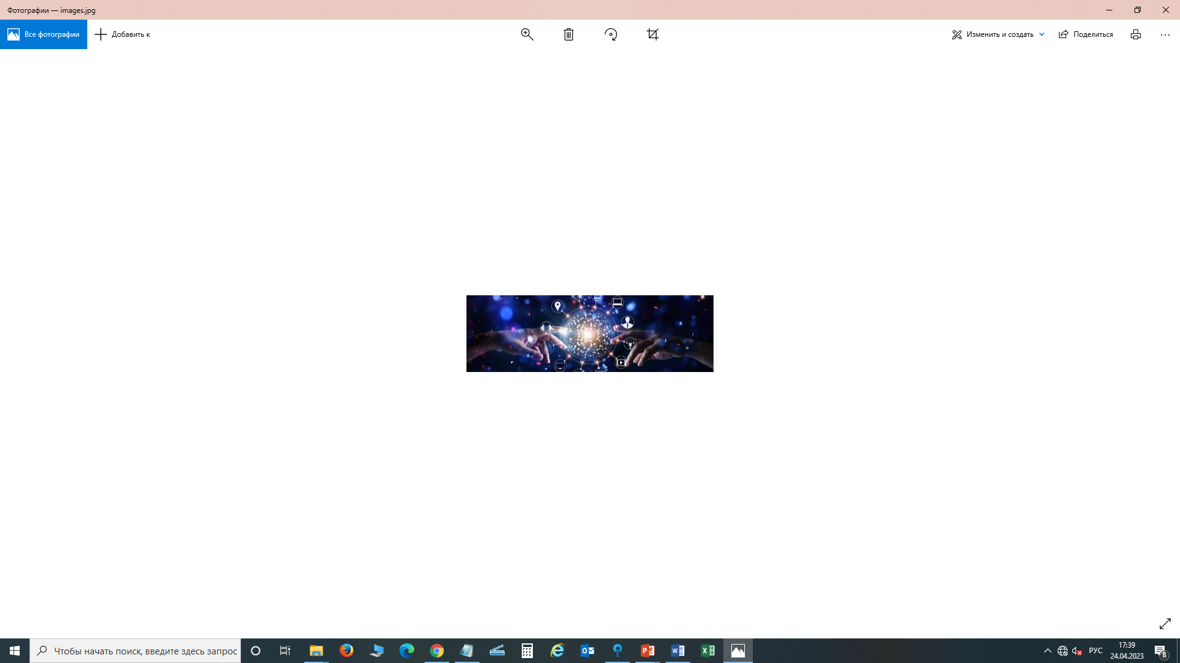

The Treasury Information System
Designing Mobile Service and Mobile Banking
Now
Future
E-Workflow
Е-qazyna
SMS
Local control:
Budget keeping
Contracts registration
Making payments
Reports generation
Mobile control:
Faster payments system (auto payment of taxes)
Viewing registered contracts
Viewing of balances
Reports generation
Advice and support
  Expected outcomes:
  Real-time monitoring and budget management

Slide 13

API
СЕРВИСЫ
THANK YOU!

