Slide 1
Treasury Committee of the
Ministry of Finance of the
Republic of Kazakhstan
Комитет казначейства Министерства финансов Республики Казахстан
PEMPAL Meeting,
May 22-26, 2023
Experience of the Treasure Committee in execution of the state budget: Roles and responsibilities of the Treasury, and main achievements
Presenter: Aliya Baigenzhina
Deputy Chair, Treasury Committee, Ministry of Finance of the Republic of Kazakhstan
Almaty, 2023

Slide 2
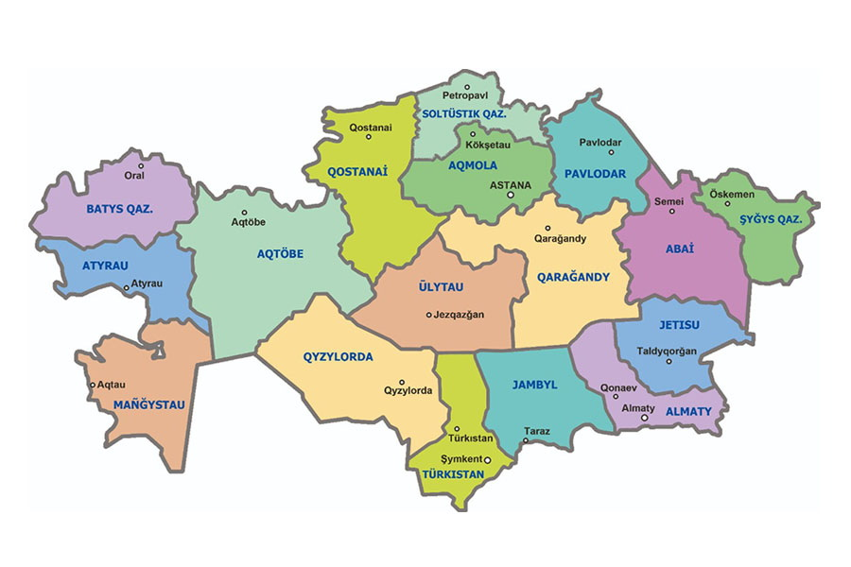
Treasury Committee and Regional Offices
Treasury Dept – North Kazakhstan Region
13 district/city Treasury Offices
Treasury Dept – Kostanai Region
19 district/city Treasury Offices
At a glance
Central Committee:
23 divisions;
186 employees
Reginal Offices:
20 departments in regions and cities;
189 district and city-level offices;
over 2460 employees in regional and local offices.
Treasury Dept – West Kazakhstan Region
12 district/city Treasury Offices
Treasury Dept – Pavlodar Region
12 district/city Treasury Offices
Treasury Dept – East Kazakhstan Region
8 district/city Treasury Offices
Treasury Dept – Akmola Region
18 district/city Treasury Offices
Treasury Dept –Astana
Treasury Dept – Aktobe Region
12 district/city Treasury Offices
Treasury Dept – Abai Region
10 district/city Treasury Offices
Treasury Dept – Ulytau Region
4 district/city Treasury Offices
Treasury Dept – Karaganda Region
12 district/city Treasury Offices
Treasury Dept –Atyrau Region
7 district/city Treasury Offices
Treasury Dept – Zhetysu Region
9 district/city Treasury Offices
Treasury Dept – Jambyl Region
10 district/city Treasury Offices
Treasury Dept – Almaty Region
9 district/city Treasury Offices
Treasury Dept – Kyzylorda Region
8 district/city Treasury Offices
Treasury Dept – Mangistau Region
6 district/city Treasury Offices
Treasury Dept – Turkestan Region
17 district/city Treasury Offices
Treasury Dept –
Almaty
Treasury Dept – Shymkent

Slide 3
History of Treasury in Kazakhstan
2010
Mechanism for distribution of import duties among budgets of the Eurasian Economic Union member-states
2011
Information System Treasury-Client is piloted
2009
Integration with the National Certification Center
Services to quasi-fiscal sector entities
Integration with information system for the acceptance and processing of e-invoices
2012
2008
Creation and implementation of Information System Treasury-Client
2014
A special account for external loans is opened at treasury
2005
Reorganization of ROs into Treasury Departments under Treasury Committee in the Ministry of Finance;
Medal and certificate The Computer World Honor
Integration with information system “Centralized Unified Customer Accounts” and Automated Integrated Information System “E-Public Procurement”
2016
2003
Transition to the new software ORACLE
Treasury support to public procurement in construction projects
Registration of PPP contracts
2017
2001
Implementation of mechanism for crediting and distribution of cash revenues to the National Fund
2018
Implementation of the 4th tier of budget
Public procurement legislation developed
Registration of civil transactions in treasury commenced
Centralized public procurement
Chief Treasury Office established
Regional Treasury Offices are established at payment processing centers of the National Bank
2000
2019
1994
Opening of Cash Control Accounts for operators of financial and/or non-financial support under state programs
1999
Treasury Committee under the Ministry of Finance
2022
1995
Reorganization into Treasury Department under MoF
1998
Unique Budget Classifier implemented
2022
Tendering based on rating and scoring system
Treasury Single Account at the National Bank
Devolution of functions from the Budget Bank to Treasury
Opening of Cash Control Account for Education Infrastructure Support Fund and Cash Control Account Directorate
1996
1997
2023
Treasury Single Account

Slide 4
Key roles of Treasury
Execution of the republican budget and supporting execution of local budgets, National Fund and Indemnification Fund
Development and approval of general plan for liability financing, general plan for revenues and payments from the republican budget
Distribution of revenues among republican and local budgets, National Fund, Indemnification Fund and EAEU budgets
Improvement of treasury information systems, reliable functioning and information security of treasury information systems
Accounting
Consolidation of financial reporting
Review and clearing of requests made by Budget Program Administrators for withdrawal from the accounts of external government loans, tied grants and development of consolidated reporting
Coordination of subregional offices
Registration and accounting of government liabilities under public-private partnership and concession projects
Management of public finance, budget monitoring, liquidity management
Organize and conduct centralized public procurement of goods, works and services specified by the competent authority
Other roles envisaged by legislation of Kazakhstan

Slide 5
Budget execution process
Implement financing plans
Adjust financing plans
Distribution of receipts between budget tiers, cash control accounts of the National Fund, Indemnification Fund and EAEU
8 budget execution processes 23 sub-processes
Amend financing plans
Develop and maintain financing plans
Suspend transactions with unused balance under a budget program (sub-program)
Refund of excessively (incorrectly) paid amounts
Integrated Information System of Treasury (IIST):
The system automates business processes of the Treasury Committee and ROs.
The purpose of IIST is to ensure effective management, by Government and local governments, of public finance, assets and liabilities which includes effective control of state budget execution on all levels.
Execution of collection orders
Credit revenues to the composite account
Registration of liabilities
Maintain catalogue of providers
Reconciliation of accounts
Reporting
Registration of liabilities
Budget execution on revenue side
Reports
Control of liabilities
Information System “Treasury-Client”:
This is a system of electronic documentation flow of IIST with public institutions, administrators of budget programs, competent authorities.
The objective of “Treasury-Client” is to improve effective interaction of Treasury with Client by enabling a modern, integrated and high-value information environment.
Compliance
Execution of payments
Review of invoices and transfer orders for compliance with budget legislation
Departmental control
Registration of transactions paid from internal resources of public institutions
Execution (decline) of payments
Plans of cash receipts and spending from sale (of goods, works and services) слуг)
FX transactions
Conversion
FX transfers
Re-conversion
Accounting and control of cash

Slide 6
Treasury services of the state budget
Four tiers of budgets serviced by the Treasury
Institutions and entities
Quantity of processed documents in 2022
In ‘000
1.9
1 084.7
12 052.9
Invoices of public institutions and payment orders of quasi-fiscal sector entities, public procurement
(85.1%)
585.5
445.2
External loans (0.01%)
Set-off of excessively paid amounts (3.0%)
Republican
1
15 901
entities
Request for civil transactions
(4.1%)
Regions and cities
20
# of budgets
2569
Public institutions
Financing plans
(7.7%)
Local self-governments
2345
14 464
State-owned entities
451
Districts
203
Entities involved into public procurement
964
Operators of financial and non-financial support
22
Processing of all payment documents in local and foreign currency in due time, reconversion of revenues to the National Fund in foreign currency, repayment of external government debt, transfers of pensions, benefits and social contributions to the State Center of Pension Payments, as well as liabilities under EAEU
In total, 14.2 million
financial documents were processed

Slide 7
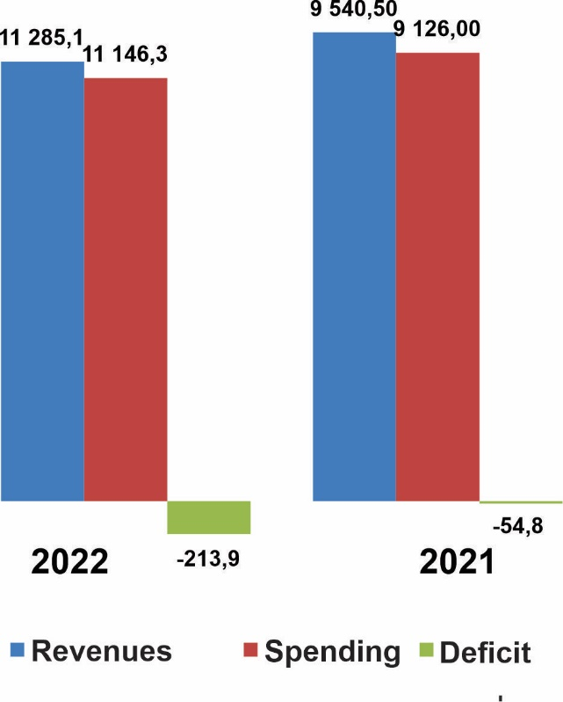
Execution of republican and local budgets
(Billion KZT)
Republican budget
Local budgets
Budgets of local self-governments
7

Slide 8
Key objectives of budget execution on revenue side
Crediting to the Treasury Single Account according to the received electronic payment documents;
Distribution of receipts between the republican budget, local budgets, National Fund, Indemnification Fund, Education Infrastructure Support Fund, budgets of Eurasian Economic Union member-states based on revenue distribution rates in accordance with the Table of Revenue Distribution, decisions of respective representative bodies, Eurasian Economic Union Treaty followed by crediting to the respective cash control accounts;
Refund/set-off of excessively paid amounts;
Preparation and submission of reporting to the MoF, competent authorities in Kazakhstan, as well as competent authorities of EAEU member-states and EEC;
Transfer from cash control account of the National Fund to the Government accounts at the National Bank and from cash control account of EAEU member-states to the accounts of national/central banks of the Eurasian Economic Union at the National Bank of Kazakhstan.
8

Slide 9
Cash management
Guaranteed and special-purpose transfers
from the National Fund of Kazakhstan
State Revenues Committee,
Department of Tax and Customs Legislation
provide information about expected revenues
Data from the general plan of revenues
and financing of payments; expenditures in the respective period in the past and expected spending in the forecasted year
Forecast of the republican budget execution
Ministry of Labor and Social Security, “Government-2-Citizens” Corporation approach with requests for payment of pensions and benefits
Cash deficit (surplus)
Budget surpluses
Data on borrowings and debt repayment

Slide 10
Sources to finance republican budget spending

Slide 11
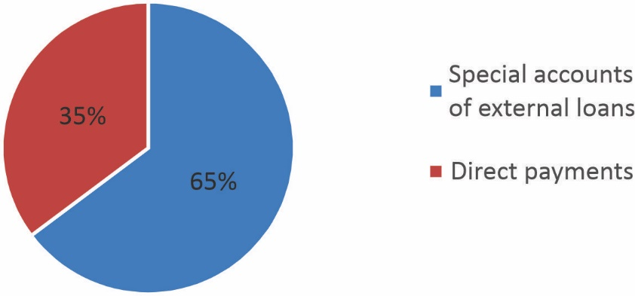
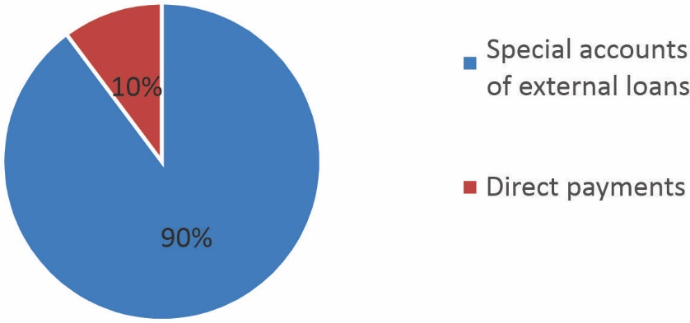
Treasury procedures for disbursement of external government loans
In Kazakhstan, two types of payments are used for the drawdown of government external loans:
PAYMENTS FROM SPECIAL ACCOUNTS – borrower’s accounts which may be used for replenishment only for the project implementation and payment of authorized project expenditures;
DIRECT PAYMENTS – transfer from the loan account directly to provider of goods (works, services)).
THE USE OF GOVERNMENT EXTERNAL LOANS IN 2022 (in %)
PAYMENTS FROM SPECIAL ACCOUNTS vs. DIRECT PAYMENTS IN 2022 (in %)
For reference:
765 payments in 2022, which include:
Payments from special accounts – 687;
Direct payments - 78.
The average amount of payment from the special account is US$145,900;
Direct payments – US$ 699,800.

Slide 12
Evolution of procedures related to registration of PPP and concession contracts in Treasury
7 July 2006 №167
31 October 2015 № 379-V ZRK
- Concession Law implemented
- Public Private Partnership Law implemented
10 June 2017
December 2018
2018
March 2019
2020
Keeping records of registered PPP contracts in E-MinFin (integrated automated information system)
Development and implementation of e-registration of PPP contracts
Piloting of automated registration of PPP contracts (2 regions: Astana and East Kazakhstan Region)
Completion of pilot stage and roll-out of e-registration in other regions
Treasury Committee started registration of PPP contracts

Slide 13
PPP and concession projects on the level of local budgets
(with and without government liabilities)

Slide 14
Consolidated financial reporting of the government sector
Accrual-based financial reporting of the public institutions is used since 1 January 2013
Financial reporting is prepared in accordance with IFRS:
Financial institutions since 1 January 2003
Joint-stock companies from non-financial sector since 1 January 2005
Other entities from non-government sector since 1 January 2006
Public institutions since 1 January 2013
Government’s annual report on execution of the republican budget includes:
Report on execution of the republican budget (cash method)
Analytical report on execution of the republican budget
Aide Memoire
Annual consolidated financial statement on execution of the republican budget (accrual method)
2019 – consolidated financial reporting is prepared for the republican budget, local budgets and state budget
Consolidated balance sheet report
Consolidated profit and loss statement
Consolidated cash flow statement
Consolidated statement of changes in net assets/capital
Aide Memoire
Since 2020, in accordance with the State Audit Law, the consolidated financial reporting on execution of the republican budget is subject to audit by Supreme Auditor
In 2020, development of forward-looking financial reporting based on consolidated financial reporting was initiated

Slide 15
Improvement of the reporting system
Past achievements
2010-2013 – methodology is prepared to shift to accrual-based reporting
2012-2013 – information system is developed to collect and prepare reporting
2013 – financial reporting of public institutions shifted to accrual basis
2013-2014 – budget reporting has been made more efficient
2013-2018 – assets and liabilities unaccounted by cash method were recovered
2014-2018 – development of methodology and implementation of revenues-side accounting
2019 – consolidated financial reporting is prepared for the republican budget, local budgets and state budget
2020 – audit of consolidated financial reporting is conducted, and audit recommendations fulfilled
2018-2020 – budget autonomy is implemented down to the level of villages or townships
2020 – development of forward-looking consolidated financial reporting was initiated
2022 – analytical report is prepared about fiscal risks and long-term sustainability of public finance
2022 – Public Finance Management Concept Note until 2030 is developed which includes, inter alia, gradual transition to consolidated financial statement of the country
PROGRESS IN THE REFORM OF ACCOUNTING AND REPORTING IN THE GOVERNMENT SECTOR IN THE REPUBLIC OF KAZAKHSTAN

Slide 16
Improvement of reporting system
Future plans
Activities envisaged by the Public Finance Management Concept Note until 2030:
2023 – development of forward-looking consolidated financial statement of local budgets
2023 – 2025 – implementation of the Unified Information System of Accounting in public institutions
2024 - 2025 – development and implementation of the Unified Chart of Accounts
2027-2028 – inclusion of the consolidated financial statements of quasi-fiscal sector entities
2023-2028 – improvement of the state internal financial control
PROGRESS IN THE REFORM OF ACCOUNTING AND REPORTING IN THE GOVERNMENT SECTOR IN THE REPUBLIC OF KAZAKHSTAN

Slide 17
Public procurement
Public Procurement Committee under MoF is established in June 2014.
Treasury Committee is reorganized on January 15, 2020, by merging with Public Procurement Committee under MoF.
Improvement of public procurement
Creation of the Committee as the Single Public Procurement Authority in order to :
1. Rating and scoring system (since July 01, 2022)
- No human interference in selecting the winning bidder;
- Automated selection of provider.
Reduce corruption proneness in selecting winning bidders
Continue improvement of efficiency and transparency of public procurement system
Avoid risks of emerging latent monopoly of corporates where the state holds a stake in public procurement
2. E-shop (since January 01, 2022)
- No direct sourcing for minor procurement;
- Transparent selection of provider;
- Savings resulting from competition.
3. Centralized public procurement – framework agreements (since July 01, 2022)
- Centralized procurement via Single Tendering Authority for public procurement;
- Budget savings due to larger lots;
- Procurement of goods and services based on uniform technical specification.
4. Tendering based on life-cycle cost (since January 01, 2023)
- Provider selected based on life-cycle cost of goods.
5. Prevention of sham companies (since July 01, 2019)
- Financial sustainability as a qualification requirement.
6. Reduced direct sourcing (ongoing)
- Revised grounds to allow direct sourcing.
7. Prioritization of competitive bidding (since January 01, 2022)
- Direct sources in exceptional instances.
17

Slide 18
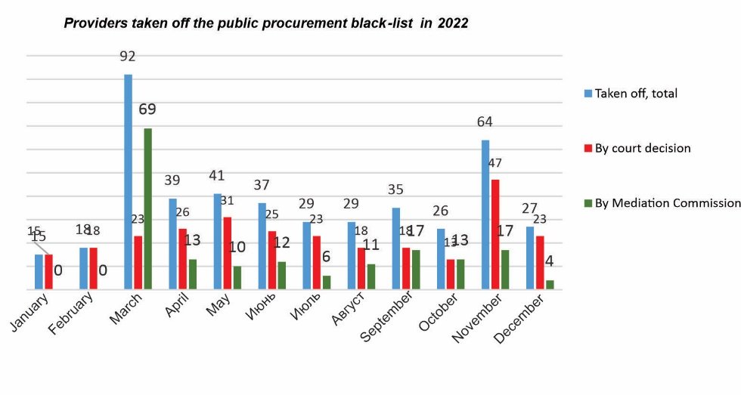
Performance of the Single Public Procurement Authority
E-depository
4 727 public procurement tenders were completed in 2022, for the total amount 356 642.3 million KZT (savings - 5 925.4 million KZT, or 1.7 %).
млн. тенге ),
32 000 evidences and documents received to verify experience of potential suppliers
32,800 evidences and documents reviewed
2022
2021
23,800 verified
2020
4 727
procurements
356.6 million KZT
(1.7%)
2 153
procurements
160.1 million KZT
(3.7%)
4 148
procurements
206.9 million KZT
(2.6%)
7,000 declined
Public procurement registers
Requests considered for the inclusion into provider black-list
19 584
Requests satisfied
13 532
18

Slide 19
Objectives of the Treasury in accordance with the Public Finance Management Concept Note
1. Make amendments to the Budget Code to regulate improvement of Treasury performance
2. Extend the instruments for cash management
3. Increase the number of users of Treasury Information System
4. Improve financial compliance
5. Make treasury information systems uniform
6. Implement discipline – “Treasury execution of the state budget”

Slide 20
1. Make amendments to the Budget Code
Current wording of the Budget Code
Proposed wording of the Budget Code
Section 4. Budget Execution
Based on Section 4. Budget Execution a new section is added : “Treasury budget execution”
Chapter 15. General provisions about budget execution
Chapter 16. Process of budget execution
Chapter 17. Accounts for the cash execution of budget
Chapter 18. Budget execution
Chapter 19. Budget adjustment
Chapter 20. Budget sequestration and correction
Chapter 21. Budget monitoring and performance evaluation
Article 1. Competence of the authority responsible for treasury budget execution
Chapter 1-1. Accounts for the cash execution of budget
Chapter 2-1. Treasury budget execution
Rationale:
Clear definition of roles and responsibilities of Treasury in the process of budget execution
Further development of treasury system based on OECD standards (completeness and quality of budget projections, fiscal plans and budget execution based on detailed analysis should be promoted; budget documents and data should be open, transparent and accessible)
Make procedures of interaction between treasury and budget process actors more specific
Since the establishment of the unified centralized system of state treasury in 1994 and until now, the functions and powers of the Treasury were not regulated in legislation of Kazakhstan.
Development of treasury system makes it possible to accelerate transfer of cash to recipients of public funds, ensure sufficient cash by making budget process transparent and open.
20

Slide 21
2. Develop cash management instruments
Current situation
Prospects
Revenues
Treasury Single Account
Projected cash flow at TSA (deposit auction NB)
National Bank
Treasury
Revenues to the republican budget
Local budget | TSA
Higher interest rate Depositing budget surplus at the National Bank | Higher interest rate on budget surplus Interest on daily account balance at TSA
Interest on daily account balance at TSA (0.25%)
Revenues to the respective budget
Cover cash deficit by attracting:
Budget surplus from Cash Control Accounts of local budgets
Cash from Cash Control Accounts of quasi-fiscal sector entities
Depositing surplus to the National Bank (0.25%)
The Concept Note initiated development and maintenance of large cash surplus at the accounts of the Treasury Committee to provide more flexibility in raising funds during adverse market conditions
It is necessary to make amendments to legislation: Budget Code; Budget Execution and Cash Banking Rules; some matters related to the Unified Budget Classification; Auction Rules conducted by the National Bank in the framework of fiscal policy; some matters related to deposit taking by the National Bank
21

Slide 22
3. Increase the number of users of Treasury Information System
Current situation
Prospects
473 quasi-fiscal sector entities serviced
growth 13 times
6421 quasi-fiscal sector entities to be potentially serviced
Tasks covered by IIST since 2012
5948 expected increase of SOEs using the IS
Transition of IIST to the new version of DB and software (Migration) | 2014
Dissemination of Treasury-Client information system | 2014
Treasury-Client information system is integrated with IS e-public procurement and IS e-invoices | 2014
Interface of IIST and IS Treasury-Client in the Kazakh language | 2015
Business process “Foreign Loans and Co-financing” | 2016
Obligatory Health and Social Insurance | 2017
Treasury support to public procurement in construction | 2017
4th tier budget of local self-governments | 2018, 2020
Workload on IIST since 2017
100 %
(on month end and year end)
Ministry of Digital Development will include servers for Treasury-Client IS as part of procurement of the new Data Center. Server capacities will be distributed before the end of the year (on co-location terms)
Recent update of hard/software in 2014
22

Slide 23
4. Improve financial compliance
Strengthening of ex-ante control
Use of Risk Management System (RMS)
State budget, National Fund
Make internal control more efficient in Treasury
Financial documents
Risk events which are not regulated by the budget legislation
Use of RMS
Interaction with the Committee of State Internal Audit
Pursuant to the task of the President in 2020 : “Ensure elements of lean and responsible budget policy”
Decrease financial violations
Minimize cash deficiencies
Timely financing of liabilities of public institutions
Timely repayment of state debt
Reliable accounting and financial reporting
Considering this initiative, it is necessary to make amendments to the budget legislation, and ensure interaction with the state internal audit on financial documents according to the risk-based approach
23

Slide 24
5. Make information systems uniform
Integrated Information System of Treasury (IIST)
One database will be shared by two systems (no technical interventions are needed for data pooling)
Operational since 2002
Services provided to 20 departments and 189 district-level treasury offices
Over 2000 internal users (Treasury staff)
8 modules are used
Each year, over 13 million financial documents are processed
Information System «Qazyna»
The following amendments will be needed:
Budget Execution and Cash Banking Rules approved by Order of MoF of December 04, 2014 №540
List of essential ICT infrastructure approved by Resolution of the Government of August 09, 2018 №489-dsp.
List of ICT infrastructure of “E-government” approved by Order of Ministry of Investments and Development of January 28, 2016 №107.
Regulations for interaction with other authorities in IT environment.
Adjustment in the balance-sheet of MoF.
Information System Treasury-Client
Operational since 2014
Services provided to ca. 15,000 entities (public institutions, quasi-fiscal sector entities and public procurement accounts, financial and non-financial operators)
Over 51,000 external users
14 business processes are used
24

Slide 25
Thank you !

