Slide 1
Treasury Committee of the Ministry of Finance of the Republic of Kazakhstan
Liquidity Management
Vienna, 2023

Slide 2
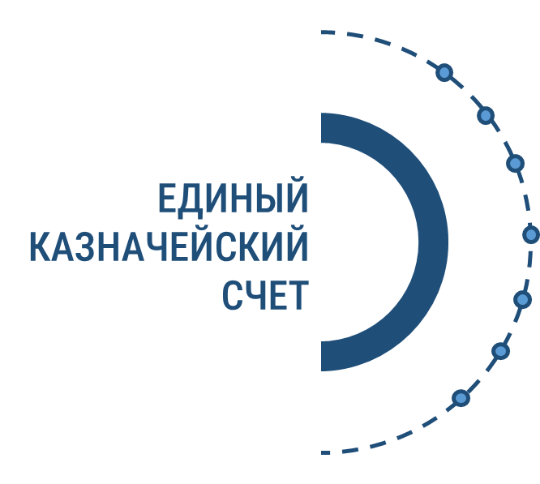
Cash balance on STA as of 01/11/2023
STRUCTURE OF A SINGLE TREASURY ACCOUNT
1
REPUBLICAN BUDGET
Single
Treasury Account
2
LOCAL BUDGET
3
QUASI-PUBLIC SECTOR ENTITIES
4
SOCIAL HEALTH INSURANCE FUND
5
SUBJECTS OF PUBLIC PROCUREMENT
6
OTHERS
STA 2022-2023 at the beginning of the month, billion tenge
1329,7
billion tenge the average STA in 2022
1060,1 (44,5 %) 2,2 b $
494,8 (20,7%) 1,0 b $
2112,9
billion tenge the average STA in 20223
275,3 (11,5%) 0,5 b $
15,5 (0,65%) 0,03 b $
535,0 (22,4%) 1,1 b $

Slide 3
CASH FLOW FORECASTING
State revenue committee, Department of a tax and customs legislation give information about expected budget receipts
Guaranteed and targeted transfers from the National Fund of the Republic of Kazakhstan
Data of the consolidated income plan and financing of payments, the dynamics of expenses of the same period of previous years and expected expenses for the forecast year
Deficit (surplus)
cash
FORECAST OF THE EXPECTED EXECUTION OF THE REPUBLICAN BUDGET
Incoming balances budget funds for the cash control account
Ministry of Labour and Social Protection of Population of the RK, NJSC “Government for Citizens” provides the need for the payment of pensions and benefits
Data on borrowing and debt repayment

Slide 4
SOURCES OF FINANCING OF REPUBLICAN BUDGET EXPENDITURES
29 070
billions of tenge
25 069
billions of tenge

Slide 5
PLANNED TOOLS FOR LIQUIDITY MANAGEMENT ON THE SINGLE TREASURY ACCOUNT
OFFERS
DEPOSITS
IN THE NB RK
second-tier banks
Increasing the interest rate to 6%
Placement of temporarily free money on deposits of second-tier banks
ORGANIZATIONS,
IMPLEMENTING
SPECIFIC SPECIESBANKING
OPERATIONS
Single
Treasury Account
MONEY
FROM THE BALANCES
OF Cash Control
Accounts ON THE Single
Treasury Account
Placing temporarily free money on deposits of the National Postal Operator
Calculation of rewards on the balance of money on Single Treasury Account from 0.25% to 1%
Raising money from the balances of cash control accounts on the Single Treasury Account in the Republican Budget to cover the cash deficiency (1-2 days)
Current legal acts: Concept of public finance management of the Republic of Kazakhstan; budget code of the Republic of Kazakhstan; rules for budget execution and cash services; some issues of the unified budget classification of the Republic of Kazakhstan;
At the development stage: Procedure for placement in second-tier banks, organizations of temporarily free budget money; agreement between the agency for regulation and development of the financial market and the Ministry of Finance of the Republic of Kazakhstan; general agreement between the Ministry of Finance of the Republic of Kazakhstan, the National Bank of the Republic of Kazakhstan and second-tier banks, organizations

Slide 6
GOALS AND TASKS AT THE STAGES OF IMPLEMENTATION OF PLACEMENT OF TEMPORARILY FREE BUDGET MONEY ON DEPOSITS OF SECOND-TIER BANKS, ORGANIZATIONS
Ministry of Finance of the RK
State Treasury of the MF RK
National Bank of the RK
STB, Organizations
Consideration of applications from the State Treasury of the Ministry of Finance of the Republic of Kazakhstan for the placement of temporarily free budget money on deposits of Second-Tier Banks and Organizations.
Approval and consideration in the Law of the Republic of Kazakhstan of a consolidated revenue and financing plan for payments under Budget Classification Code 201604 “For deposits of the Government of Kazakhstan and for transactions with financial instruments in Second-Tier Banks and organizations”
Approval and consideration by the ZRK of a consolidated plan for receipts and financing of payments for expenses for commissions for transferring funds to Second-Tier Banks, Organizations
Liquidity forecast for the Single Treasury Account
Determining the volume of temporarily free budget money for the STA and the terms of placement
Coordination of the submission of applications with the Ministry of Finance for the placement of temporarily free budget money on deposits of Second-Tier Banks and organizations.
Sending a letter to the Agency for Regulation and Development of the Financial Market for compliance with the STB criteria
Study of the notification from the Agency for Regulation and Development of the Financial Market on STBs that meet the established requirements and identification of STBs, participants of the competition
Placement of an advertisement on the WEB website of the Ministry of Finance of the Republic of Kazakhstan on the placement of temporarily free budget money from the Unified Tax System into deposits, indicating the volume, placement period and initial rate
Notification of the National Bank of the Republic of Kazakhstan
Determination of the winner, conclusion of a general agreement between the State Treasury, the National Bank of the Republic of Kazakhstan, Second-Tier Banks, organizations for placement of deposits
Submitting a transaction passport for placing a deposit in the Second-Tier Bank or organization to the National Bank of the Republic of Kazakhstan
Transfer of money by payment order to a Second Tier Bank
If necessary, has the right to early withdrawal of the deposit
Notification of Second Tier Banks, Organizations on the placement of temporarily free budget money from the Unified Treasury Account into deposits, indicating the volume, placement period and initial rate
Application for participation in the competitive selection for the placement of temporarily free budget money, indicating the volume, term and rate in the State Treasury Placement of money on deposit
Monthly transfer of rewards from placing money on deposit into the income of the Republican Budget to BСС 201604
After the end of the deposit period, returns the entire deposit amount to the State Treasury, accrued as a reward to the income of the Republican Budget
In case of early withdrawal of the deposit, the entire amount is returned

Slide 7
Questions
What difficulties did you encounter when introducing and implementing a liquidity management mechanism?
Methods for creating an effective liquidity management system mechanisms for placing temporarily free budget money with the Single Treasury Account
Does the central bank accrue rewards on the balance of money on the STA? If yes, what percentage?
How is insurance of deposits and money placed in various financial instruments carried out?
What risks may arise and what measures are being taken to avoid these risks?
What future prospects do you see for the development of liquidity management and the placement of temporarily free budget money in various financial instruments?
Do you have automated liquidity management, including the use of artificial intelligence?

