Slide 1



KFIS-PEMPAL Treasury COP
Update on experience with dBrain⁺
25th May 2023

Slide 2
Ⅰ.
KFIS-PEMPAL Treasury COP
Update on experience
with dBrain⁺ system
Background and necessity
Ⅱ.
Construction project
Ⅲ.
Key Features of dBrain⁺
CONTENTS
Ⅳ.
Analysis and evaluation
Ⅴ.
Implication

Slide 3
Ⅰ.
Background and necessity
01
01
01
History
dBrain was a critical information infrastructure of Korea
3rd generation FMIS built with locally developed software (LDSW) since 2007
On-site management processing in thirteen financial business areas to improve financial business efficiency (budget, revenue, expenditure, debt, performance, settlement, etc.)
Accrual basis and double-entry accounting system(2009), UN Public Administration Award(2013), Open Fiscal Data System (www.openfiscal.go.kr)(2015), ISO20000 certification(2017)
The average daily average of KRW 13.3 trillion in national fund transfers and KRW 6.5 trillion in receipts as of 2022, 24 hours a day, 365 days a year (18,000 average daily users)
1’st Generation
2’nd Generation
3’rd Generation
4’th Generation
Budget System
FIMSYs ^{⑴}
dBrain
KFIS
Official Launch
dBrain⁺
Next Generation
SALIMI
NaFIS ^{⑵}
  1999
  2000
  January 2007
  July 1,2016
  January 2022
Outsourced to private IT corporations supervised by Ministry
Of Economy and Finance(e.g. Samsung SDS, LG CNS)
Managed by public organization(KFIS)
  (1) FIMSYs : Fiscal Information Management System
  (2) NaFIS : National Fiscal Information System
- 3 -

Slide 4

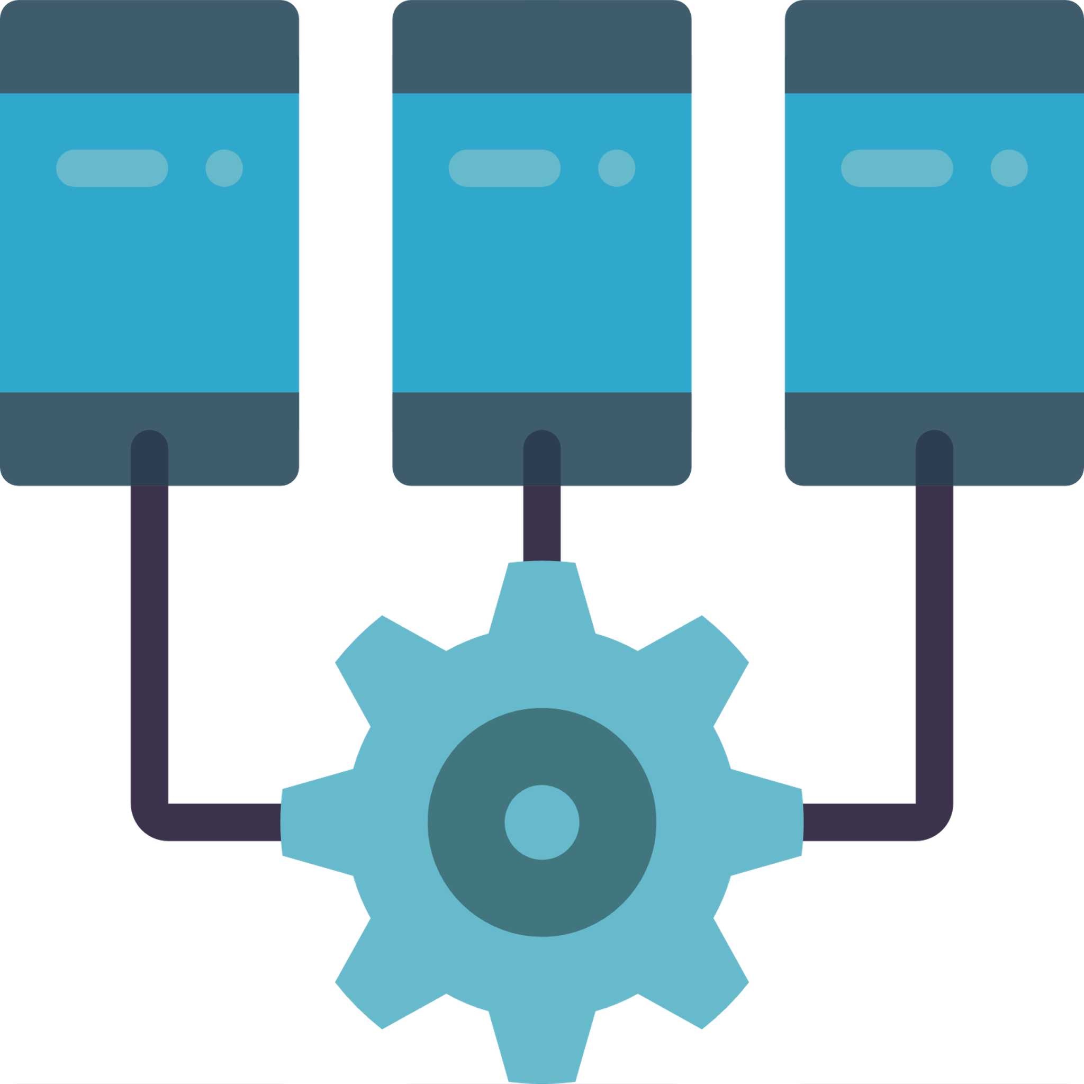






Ⅰ.
Background and necessity
01
02
Necessity
14 years passed since operation of dBrain
Technology obsolescence, difficulties in improving the services of dBrain
Causing user inconvenience and continuous complaints
Small screen size
Multi-task not supported
Hard to install
Fixed in 14-inch screen
: only few information can be viewed
Cannot open multi
windows
: not suitable for multi-tasks
Active-X needed
: to install in PC
Low performance
Enquiry limitation
Latest ICT
Slows down
when look up a large
amount of information
Only available during operating hours in weekdays
Unable to apply latest ICT such as
Big Data and AI
- 4 -

Slide 5


Ⅰ.
Background and necessity
01
03
Timetable
From December 2019 to March 2022 (27 months)
Grand Open of the next generation dBrain in Jan. 2022
ISMP*
( Nov.2017~Apr.2018)
Start of development and construction in Sep. 2019
Partial opening
in May 2021
Grand open in Jan. 2022
2020 |  |  |  |  |  |  |  |  |  |  |  | 2021 |  |  |  |  |  |  |  |  |  |  |  | 2022
1 | 2 | 3 | 4 | 5 | 6 | 7 | 8 | 9 | 10 | 11 | 12 | 1 | 2 | 3 | 4 | 5 | 6 | 7 | 8 | 9 | 10 | 11 | 12 | 1 | 2 | 3
Grand open
Request
definition
Analysis and design
Construct and unit testing
Integrated test
User test
Stabilization
Partial opening
Open and operate budget compilation support system
*Information System Master Plan
- 5 -

Slide 6
Ⅱ.
Construction project
01
Construction process: Preparation phase
Business Process Reengineering and Establishment of the Target Model of the Next-generation System (BPR/ISP) in 2013
Implementation of the Preliminary Feasibility Study in 2015
Establishment of the Korea Fiscal Information Service(KFIS) in 2016
Establishment of the Information System Master Plan (ISMP) in 2018
Installation of the Government project organization in 2019
Selection of the Construction Contractor in 2019
dBrain⁺
Government
Project Organization
Advisory
Committee
Total Planning Division
System Establishment Division
Fiscal Information Disclosure Division
Fiscal Data
Institution Team
- 6 -

Slide 7
Ⅱ.
Construction project
01
Construction process: Development phase
Carried out for most of the entire dBrain⁺ project period for 24 months
Definition and Analysis of User Requirements : Analyzed dBrain through interviews with practitioners operating dBrain and utilizing the dBrain education and training system, Utilized the dBrain portal (online survey) to collect dBrain⁺ requirements
System Design : Held intensive workshops of the design phase, formed a dBrain⁺ user council
Integration Tests : performed the integration tests by field experts and dBrain operators, shared the daily progress of integrated tests every day and resolved issues by developer-operator councils
Government Project Organization
KFIS
dBrain⁺
Government
Project Organization
PMO
User Group
Advisory Committee
Private IT companies Project Organization
Project Management Office
Project Management
Team
Common System
Project/ Budget
Revenue/ Expenditure/Fund
Settlement
Asset
Portal
Infrastructure Technology Team
- 7 -

Slide 8
Ⅱ.
Construction project
01
Construction process: Implementation phase
‘Pre-opening of the budgeting system' for the fiscal year 2022 budget in the first stage and the 'full opening' in the second stage
Data Transfer : planning and data backup, data transfer, and data verification
User Education : produced dBrain⁺ user manuals for each financial business, conducted through online videos because of COVID-19
Operator Training : conducted to strengthen operational capabilities for new technologies applied to dBrain⁺
Power User Tests : Selected representative users for each function of financial work from central government departments
Expansion of the User Support Center : increased the number of dBrain⁺ counseling centers from 34 to 60 in preparation for an explosion in user inquiries after the full launch
Full Opening, Parallel Operation : dBrain⁺ processed the financial business for the 2022 fiscal year and dBrain processed the settlement for the 2021 fiscal year.
- 8 -

Slide 9

Ⅲ.
Key Features of dBrain⁺
Feature#1.
01
Reconstruction of 13 unit tasks & new construction of 11 unit tasks
Task expansion from 13 to 24
Project management : liability amount, bond, contributions, loan, private investment, income outside of tax (6 new items)
Statistics : government debt, GFS, debt statistics, finance estimation, finance management expansion (5 new items)
  Project
  Management
Establishing basis for sub-project management
Establishment of attribute classification management base
Securing time series between projects
  Statistics
Revenue
National asset
Perfor
-mance
EIS
Budget
Fund
Procure
ment
OLAP
Finance estimation
Expendi
ture
Debt
EBPP
/EFT
Goods management
Settlement
GFS
Expanding network
among Local/
education/
public institution
Function modularization
Debt statistics
Government
debt
Bond management
Loan execution management
Non-tax
revenue
Finance management expansion
Liability amount management
contributions execution management
Private investment project
- 9 -

Slide 10
Ⅲ.
Key Features of dBrain⁺
Feature#2.
Data-based policy decision supporting system
dBrain
dBrain⁺
Data-based policy decision support
Focusing on dealing with financial tasks,
Financial information confine to dBrain
poor analysis and utilization
Central finance (next generation
budget and accounting)
Support financial
decision making
General
accounts
Next generation
dBrain
Special
accounts
Finance
Financial data connection
Financial information
statistics/estimation
Lack of multi-dimensional analysis,
various visualized analysis
Local finance
(e-Hojo)
Educational finance (EduFine)
Macro data connection
Budgeting support
Bank of Korea
OECD
IMF
Lack of connection and
utilization of data
Economic, social, administrative
data connection
Financial information
disclosure
National
Statistical Office
Each
Department
- 10 -

Slide 11
Ⅳ.
Analysis and evaluation
Q1. Did the dBrain⁺ meet the initial expectations after a year of operation?
1
Supports data-based financial management through the implementation of information systems across all the areas of fiscal tasks
– Developed additional functions in fiscal tasks such as liability amount management, private investment, loan, contributions, etc.
2
Enhances the system performance, the obsolete customer support centers, and user inconveniences
– Improved speed, bigger screen, multi-windows that allow multitasking, adoption of AI chatbot, etc.
3
Reduces the inter-system influences and increases flexibility
– Minimized inter-system influences through modularization
– Installation per unit module (budget, asset, execution, settlement), multi-lingual support
- 11 -

Slide 12
Q1. Did the dBrain⁺ meet the initial expectations after a
year of operation?
Challenge
Solution
Achievement and Takeaway
01
Interviews with the department managers (20 times)
Workshops for finalizing the design output (4 times)
Core tests with power users
(2 times, 6 weeks total)
Used the collected data as a basis for fiscal policymaking
Reinforced the time series data management function by digitizing the handwriting tasks
Difficulties in
defining the
process of the
new fiscal tasks
02
Supporting mobile, multi-tasking
Adoption of chatbots for task support (2,934 types)
Adoption of mobile ID card
Improved user satisfaction with the system
Enhanced user convenience and work efficiency
Request for the
improvement of
the user work
environment
03
Utilize the solutions for analyzing influence and complexities
Analyze influence by analyzing the task-related regulations and guidelines
Apply multi-lingual terms for defining the fiscal terms
Facilitated the operation by reducing the inter-module interference
Enhanced the portability for development by making the system lightweight
Difficulties
in analyzing the
inter-system
connections for
modularization
- 12 -

Slide 13
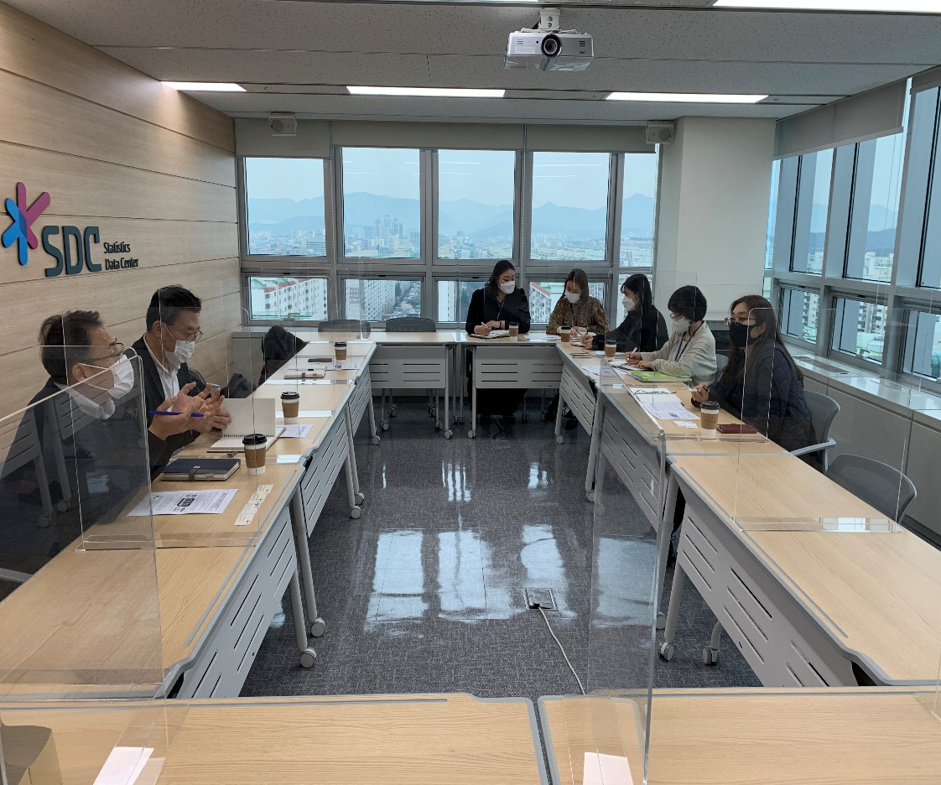
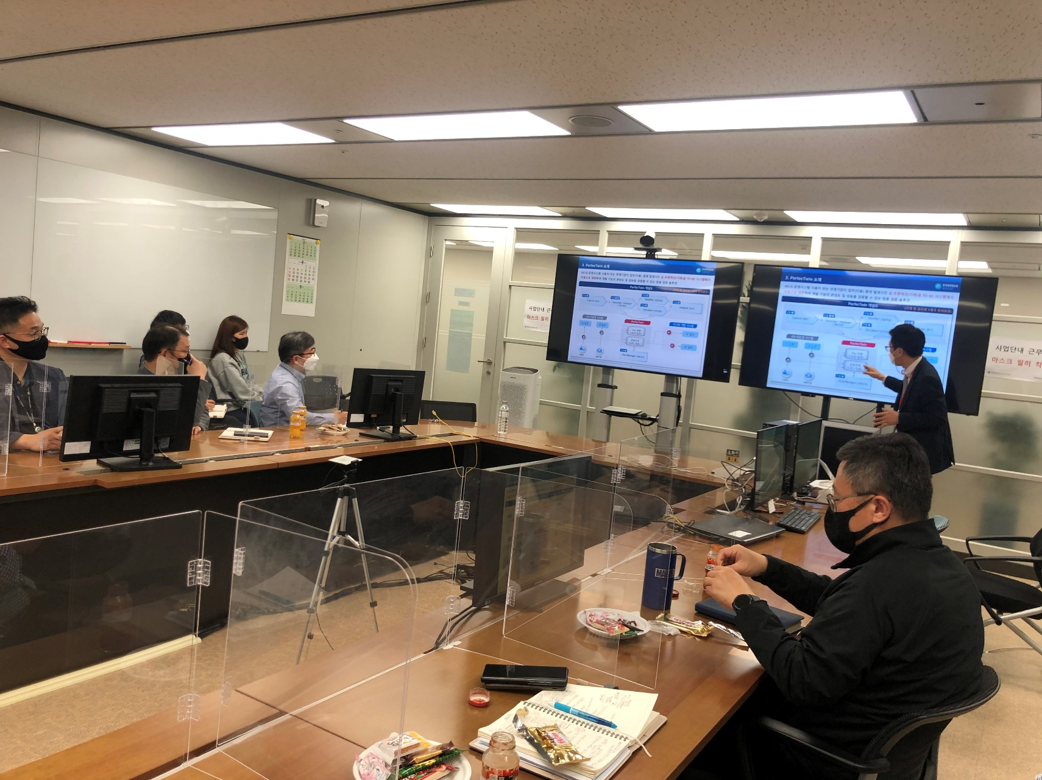
Appendix 1. User input
Interviews
Workshops
- 13 -

Slide 14
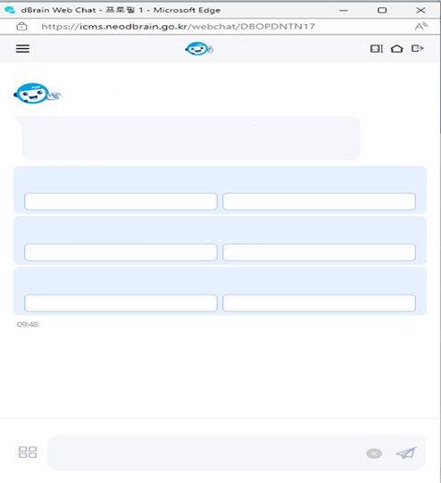
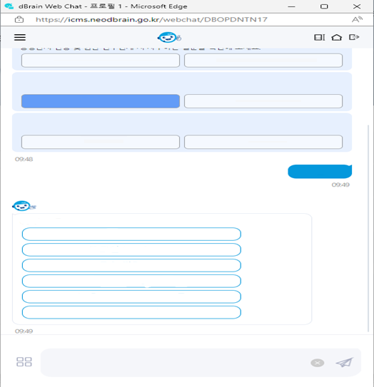
Appendix 2. The Use of Chatbot
MyD
MyD
Hello! I am ‘MyD’, a counseling chatbot
I'm here to help you use the Budget Accounting System (dBrain⁺) conveniently.
Organization and Administrative Agency Change FAQ
Authority Application and Take Over FAQ
Is it your first time using dBrain⁺?
You can ask questions about how to use dBrain+ system, as well as questions frequently asked by new users.
The billing date for government purchase card occurs once a month [July 22nd]
For inquiries related to government purchase cards and expenditures, please refer to the [Expenditure FAQ] below.
Login FAQ
Settings FAQ
Do you have any questions about expenditure and procurement tasks related to dBrain⁺?
Please check which questions about expenditure and procurement tasks related to dBrain⁺ are frequently asked.
Have you started a new task due to a personnel transfer?
Please check the frequently asked questions during administrative office changes and authority take overs.
Expenditure FAQ
Procurement FAQ
Organization and Administrative Agency Change FAQ
Authority Application and Take Over FAQ
Login FAQ
Is it your first time using dBrain+?
You can ask questions about how to use dBrain+ system, as well as questions frequently asked by new users.
Login FAQ
Settings FAQ
Do you have any questions about expenditure and procurement tasks related to dBrain+?
Please check which questions about expenditure and procurement tasks related to dBrain+ are frequently asked.
dBrain⁺ Login FAQ
Expenditure FAQ
Procurement FAQ
User registration
Change Login ID
Long-term inactivity
Certificate error during Login
Login certificate validity error
Create new certificate
Enter your inquiry here
Enter your inquiry here
- 14 -

Slide 15
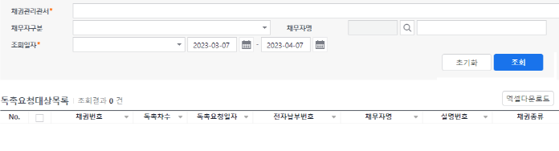
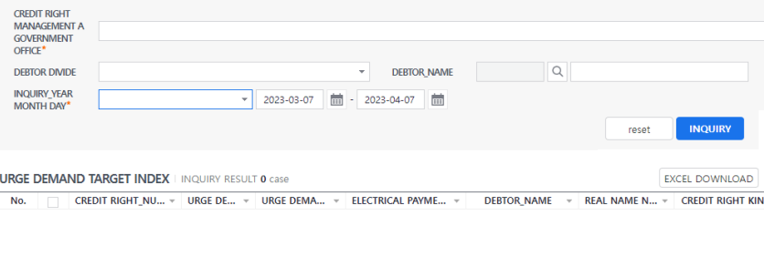
Appendix 3. Multi-lingual support
Multi-lingual support (Korean)
Multi-lingual support (English)
- 15 -

Slide 16
Appendix 4. Modularization
Modularization to each fiscal business unit
Setting options for export
Fund
Management
National Asset
Management
Accounting
Settlement
…
Multi-lingual
function
Date
Format
Master Code
Data
Revenue
Bond
Expenditure
Debt
Project
Management
Budget
Management
Country
Setting
Currency
Exchange rate
E-government Standard Framework
HTML5
- 16 -

Slide 17
Ⅳ.
Analysis and evaluation
Q2. How did we implement the real-time connections on dBrain⁺, and what were the challenges and the takeaways?
1
Expanding the data connection and achieving “integrated financial management” through automatic computation by the system
– (the government) connecting the settlement information to compute the consolidated central government balance such as ’86,’01 GFS, etc.
– (the public) active sharing of the beneficiary information (government subsidies, loans, contributions, etc.) personalized to the public and the open data about public-targeted fiscal businesses (private investment information, etc.)
2
Expanding the connections from 48 organizations & 83 systems to 77 organizations & 136 systems
– (financial data) 265 types of fiscal data, including the current budget, asset, settlement, etc.
– (external data) active collection of external information (administrative+economic+social+public)
– (historical data) converting the budget and settlement data accrued since the establishment into time series data
[The Procedure of Expanding the Connections of Integrated Financial Information]
Check the current data in our
possession
(including open, closed data)
Mapping our own data
to the data from connected
organizations
(sorting out the overlapping
data, etc.)
Consult with the relevant
organizations
(expansion of the data, method
of connections, method of data provision, etc.)
Prepare legal and institutional
basis for
information provision
01
02
03
04
- 17 -

Slide 18
Q2. How did we implement the real-time connections on
dBrain⁺, and what were the challenges and the takeaways?
Challenge
Solution
Achievement and Takeaway
01
Revision of the enforcement decree of the National Finance Act (December 21, 2021)
e.g., amendment of the law for connecting to sensitive
information (connecting to the verification of the
social security number in the Ministry of Public
Administration and Security)
Synchronizing the national property information
e.g., connecting to the property registration
information of the Supreme Court
Provided expanded nationwide integration of financial data
Increased work efficiency by eliminating duplicate tasks
e.g., verification of the social security
number, property ownership
information
Request legal
basis
for information provision
02
Selecting the essential statistics required between the municipal and educational finance systems
Defining the common standards for computing statistics
The system’s automatic computation of Government Finance Statistics (GFS)
Formed an archive of statistics dataset
Defining the
appropriate
connection target,difficulties in
negotiation
Enhance its usefulness by providing various statistical functions
e.g., time-series statistics, performance
information
Provide information highly relevant to the people’s living
e.g., personalized information about
benefits such as subsidies, loans, etc.
03
Increased user views (25%)
Improved credibility in finance policy due to the expansion of data opened to the public
The public’s
request for
a wider
variety of
open data
- 18 -

Slide 19
Appendix 6. Open Fiscal Data
Types of Performance Indices for Open Fiscal Data
ㅇㄹㅇㄹㅇㄹㅇㄻㄴㄹ
Created infographics for 105 main performance indices of 45 central administrative offices
and made it public through the Open Fiscal Data website
<Examples of Key Performance Indicator by Major Areas>
Area | Ministry | Key Performance Indicator | Indicator Overview | 2023 Goal [2026 Goal]
Economy | Ministry of Finance | Government’s budget balance (ratio between GDP) based on the original budget. | Government's net financial deficit from the integrated budget balance, excluding the social security fund balance. | △ Less than 3.0% [△ Less than 3.0%]
 | Ministry of Science and ICT | Technical strategy ratio of global accomplishment | Fields in Korea that have achieved a national technical strategy level of over 90% compared to leading countries. | 25.0% [33.3%]
 | Ministry of SMEs and Startups | Number of new Corporate Startups | Number of Corporate Startups annually | 124,519 [128,292]
Society | The Ministry of Health and Welfare | Relative poverty rate (downward index) | The ratio among all households whose income falls below 50% of the median income | 14.1% [13.2%]
 | The Ministry of Employment and Labor | Fatality rate per accident (downward index) | The fatality rate from occupational accidents per 10,000 workers | 0.377‱ [0.29‱]
 | The Ministry of Culture, Sports and Tourism | Total number of domestic travel | Index of tourism industry measurement through the development of tourism contents and the development of local tourism. | 4.1 billion days [4.7 billion days]
General Administration | Korean National Police Agency | Number of four major crimes per 100,000 population (downward index) | Index showing the number of four major crimes (murder, robbery, rape, and assault) per 100,000 population annually | 387.9 cases [368.4 cases]
 | The Ministry of Patriots and Veterans Affairs | Improvement plan in cultural awareness of veterans | Expecting the awareness of veterans' affairs to be improved after experiencing policies for veterans' benefits. | 68.5 score [74.8 score]
- 19 -

Slide 20
Appendix 7. Open Fiscal Data
Search Engine for Beneficiary Information
To minimize the inconvenience arising from having to search the fiscal business information by every website, we connected gosims.go.kr (e-Naradoum), gov.kr (Government 24), NTIS, and 23 funding institutions to provide personalized information about beneficiaries
Search Engine for Beneficiary Information
Life cycle
Add search conditions
Infants
(0~5years old)
Childrens
(6~12years old)
Teenagers
(13~18years old)
Youths
(19~29years old)
Middle-aged adults
(30~49years old)
Matured adults
(50~64years old)
Eldery
(65~years old)
Age - neutral
Corporate name
Insurance
Select gender
female
Select location
seoul
Select field
All
Reset
Re-search
List of personalized benefit information (total 12 items)
[Support for Accidental Injury Insurance Premiums (10,000 Won Happiness Insurance)] Source: Government 24
Support for the insurance registration fee of public interest accident insurance (Manwon's Happiness Insurance) for basic livelihood recipients and the lower middle class.
Compensation of KRW 20 million in case of accidental death, payment of hospitalization allowance and surgical allowance for personal injury.
[Discount on Postal Real Expense Medical Insurance Premium for Medical Aid Beneficiaries] Source: Government 24
Discount on medical insurance premiums for recipients of medical assistance at post offices.
- 20 -

Slide 21
Ⅳ.
Analysis and evaluation
Q3. What are the achievements and the current status of using AI for
policy management and the prediction of national treasury balance?
1
Policy Management
Data-based monitoring of policy indices
e.g., managing and monitoring about 8000 major economic∙social indices such as job openings, population, and public welfare
Real-time policy management of major indices
e.g., population structure as well as the change in its composition, the current state of job openings and local job openings, managing external variability
2
Estimation of National Treasury Balance
Attempt to estimate the national treasury balance of a total of 7 monthly taxable items, including the total tax revenue and 6 major types of tax revenue (income tax, corporate tax, value-added tax, individual consumption tax, traffic/energy/environment tax, liquor tax)
e.g., presents 7 monthly prediction model that reflects the characteristics of each item in the monthly and quarterly data
Aim to increase the prediction accuracy of the national treasury balance and to support the planning of capital financing
- 21 -

Slide 22
Q3. What are the achievements and the current status of using AI for
policy management and the prediction of national treasury balance?
Challenge
Solution
Achievement and Takeaway
Analysis of performance indices through interviews with the actual staff of each department
e.g., 61 departments, about 3000 performance
indices (program unit)
e.g., (the Ministry of Environment) greenhouse
gas emissions (MOEF) GNI per person
Benchmarking (Statistics Korea, the Bank of Korea, etc.)
e.g., the current state of data connections,
data provision and application
01
Supported data-based policymaking
e.g., employment policymaking
customized to each district by
monitoring their unemployment
allowance through the job
dashboard
Difficulties in
defining the
indices
for policy
diagnostics
Abnormal pattern of the data due to COVID-19
e.g., use the correction index called
prediction error percentage of
annual aggregate
Algorithms that predict the moderate level of national treasury balance
e.g., 4 major algorithms, utilizing 24
external environment indices
02
Used as a reference at work
Need to continuously secure the data and improve the model’s accuracy and precision
Difficulties in
building
appropriate
model
- 22 -

Slide 23
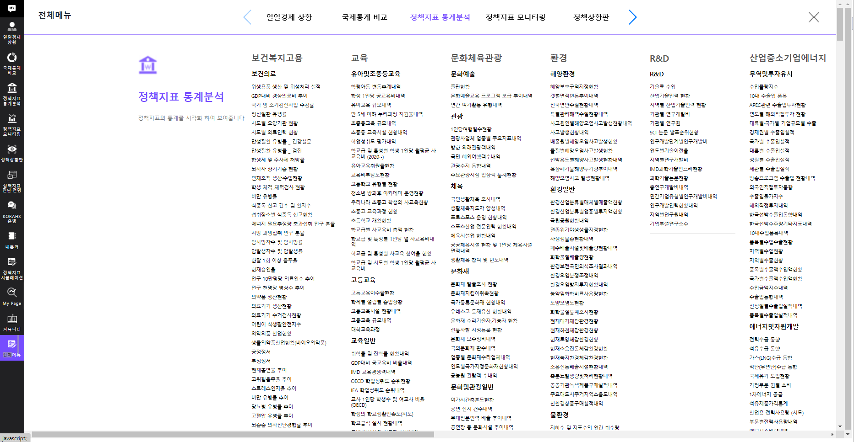
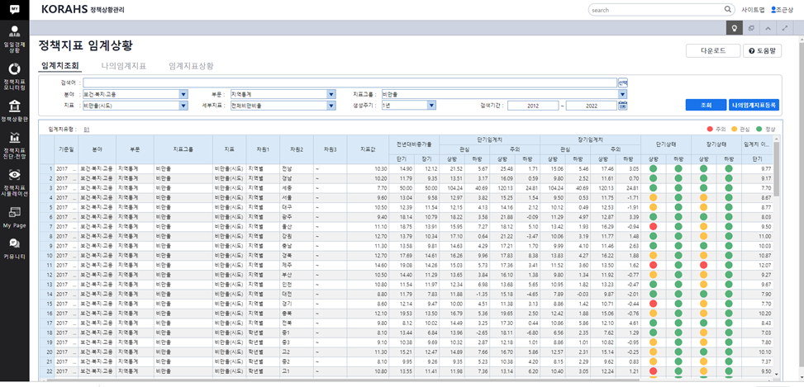
Appendix 8. Korea Risk Assessment and Horizon
Scanning
KORAHS Indices
KORAHS Thresholds
Healthcare
National Cancer Early Screening Inspection Rate
Infants and Elementary and Secondary Education
Public education expenses per student
Tourism
Travel days per person
Marine environment
Status details of Marine pollution accident
R&D
R&D expenses by institution
Trade and Investment
Top 10 Import and Export Items
- 23 -

Slide 24
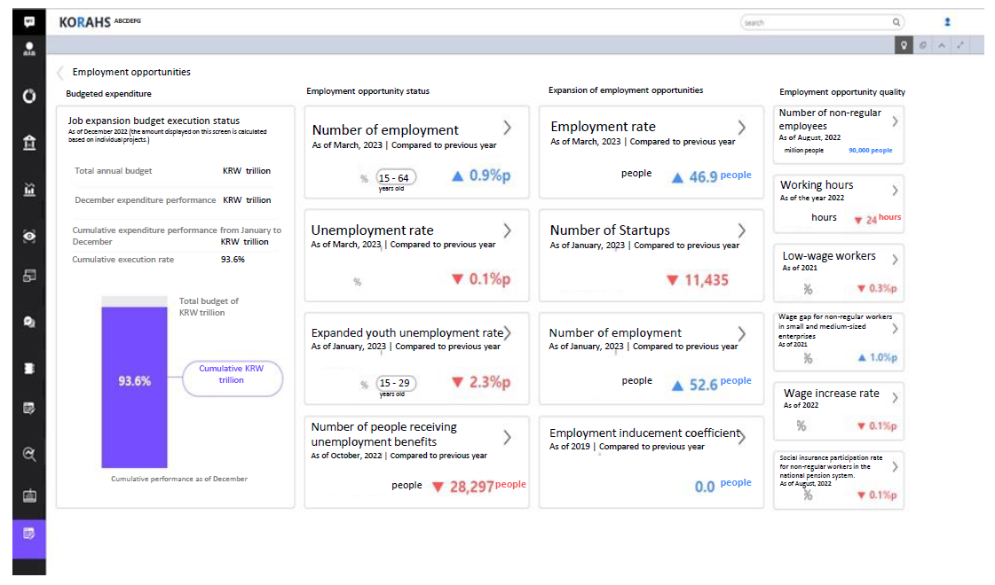
Appendix 9. Korea Risk Assessment and Horizon
Scanning
KORAHS Job Dashboard
- 24 -

Slide 25
Ⅴ.
Implication
05
03
Implication
Make thorough preliminary arrangements for the construction project
- long-term reform process such as improving the financial system,
- reengineering the financial business process
- reorganizing the financial-related legal system
- establishing a master plan to develop the FMIS.
The financial management information system construction project should be served
- project-dedicated organization composed of public officials before the start of the project
- financial information system users join from the beginning of the project.
- it is vital to have an environment in which they can operate the FMIS independently since
they should ensure a system continuity plan
- 25 -

Slide 26
KFIS-PEMPAL Treasury COP
Update on experience with dBrain⁺ system
Q&A
- 26 -

Slide 27
KFIS-PEMPAL Treasury COP
Update on experience with dBrain⁺ system
Thank You

