Slide 1
Treasury Single Account - TSA Case of Republic of Kosovo
Vienna, November 2023

Slide 2
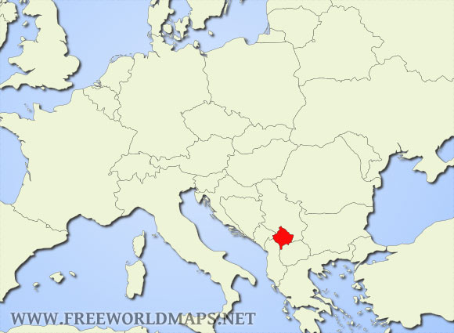

Slide 3
Kosovo Fact Sheet
GDP as of October 2023 - EUR 9.8 billion
Inflation as of September 2023 – 4.2%
Official currency – EURO
Estimated population 1.74 million
Of which 58% is below 30 years old
Unemployment rate in the end of 2022 - 11.8%

Slide 4
Treasury Single Account
Types of fund in the TSA beside main fund of the central government budget
Grants offered from the donors
Own Source Fund of the Central Level
Own Source Fund of the Local Level
Development Trust Fund
Dedicated Revenues
Funds from the Loans

Slide 5
Legislative Framework
All transactions involving funds within the Kosovo Consolidated Fund shall be conducted through the TSA.
Primary legislation
The Law on Public Financial Management and Accountability (LPFMA) regulates the TSA
According to Article 18 of the LPFMA all accounts and sub-accounts (established for each municipality) shall be part of the TSA as well as all payments and expenditures of public money shall be made through the TSA.
Secondary Legislation
The Regulation on Public Fund Expenditure regulates the purpose of receiving, handling and spending of public funds.
Notes:
The process of spending of Public Funds is managed by the KFMIS through five steps: Allocation, Commitment, Obligation, Processing of Expenditure and Certification of Payment.

Slide 6
Authority of Establishing and Managing TSA funds
The General Director of the Treasury have the authority to establish and maintain such accounts and sub-accounts for funds within the Kosovo Consolidated Fund as he/she may deem reasonably necessary to implement the provisions of the present law.
The General Director of the Treasury shall establish the accounts and sub-accounts constituting the TSA at the Central Bank.
The relationship between the CBK and the Treasury shall be elaborated in an inter-agency agreement that sets forth the CBK’s responsibilities in connection with its administration of the TSA and the management of the KCF.

Slide 7
Pros and Cons of the TSA
Pros
Improved Accountability and Transparency
Reduced Fiscal Risks
Enhanced Cash Management
Effective Monetary Policy
Reduction of Idle Funds
Simplified Bank Operations

Slide 8
Pros and Cons of the TSA
Cons
Operational Challenges
Impact on Commercial Banks
Political Resistance
Disruption to Cash Flow
Risk of Overcentralization
Potential for Misuse

Slide 9
THANK YOU FOR YOUR ATTENTION!

